Slide 1
Drug Availability Reporting and Expectations (iDare)
Melanie Singh

Slide 2
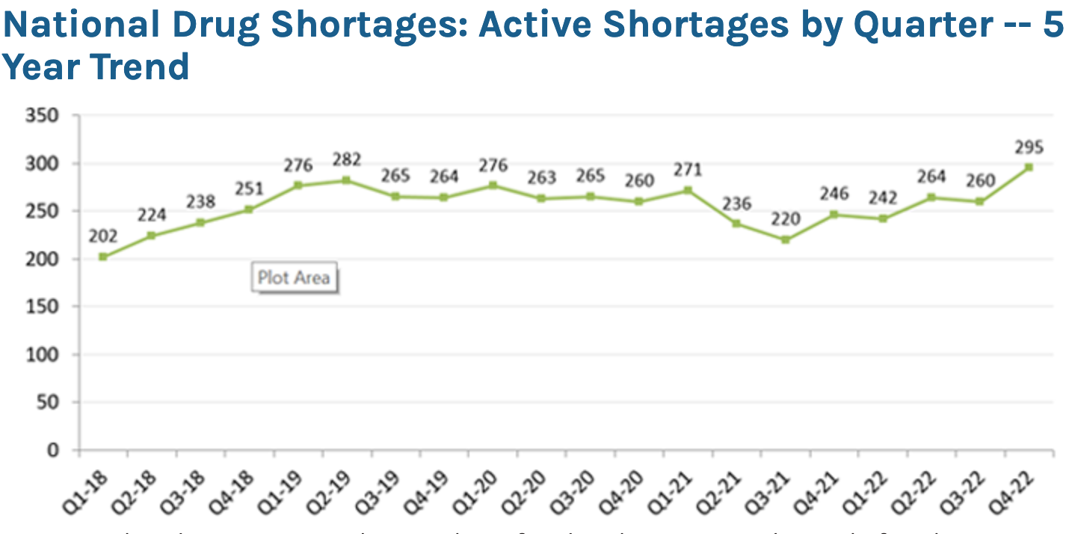
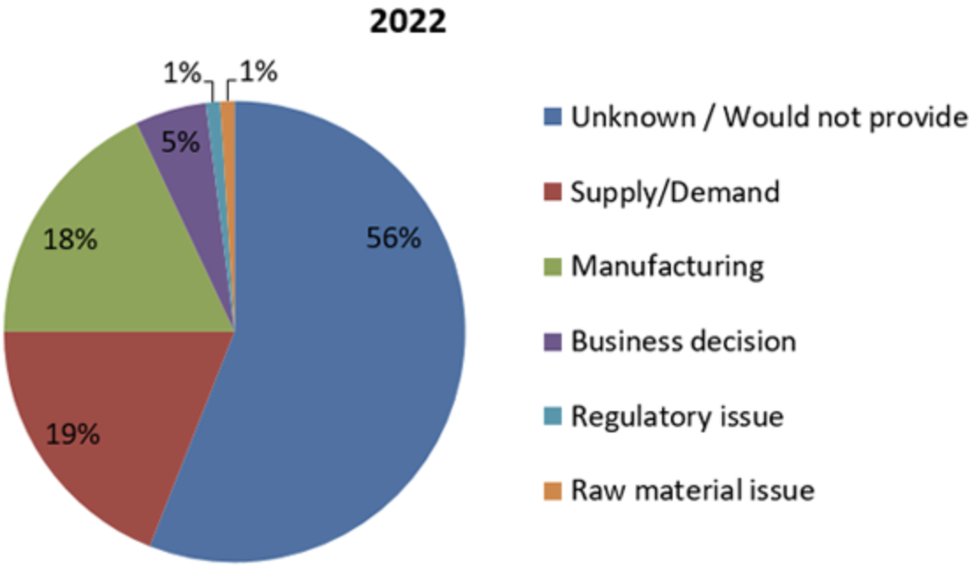
Problem
2022 ended with 295 active drug shortages
Although measures to mitigate drug shortages exist, no tools exist to accurately predict drug shortages
AI can be used to evaluate trends and predict drug shortages for implementation of protective measures
Reasons for Shortages
“Drug Shortages Statistics.” ASHP, https://www.ashp.org/drug-shortages/shortage-resources/drug-shortages-statistics?loginreturnUrl=SSOCheckOnly.

Slide 3
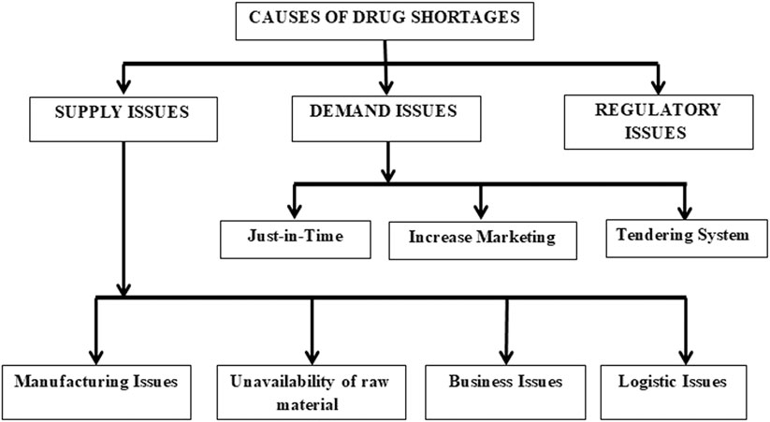
Role of Drug Supply Chain
Shukar, Sundus, et al. “Drug Shortage: Causes, Impact, and Mitigation Strategies.” Frontiers in Pharmacology, vol. 12, 2021, https://doi.org/10.3389/fphar.2021.693426.

Slide 4
Data Accessible to FDA from Drug Supply Chain
Inventory/Production Data and Supply Interruptions
Sales/Market Data
Inventory/Supply Interruptions and Purchase/Sale Records
Drug Shortages Strategic Plan 2013 - Food and Drug Administration. https://www.fda.gov/media/86907/download.

Slide 5
FDA 2022 Focus Areas of Regulatory Science
Strategic Initiative 1: Public Health Preparedness and Response
Medical Countermeasures and Preparedness for Emerging Infectious Diseases
Quality of Compounded Drugs
Strategic Initiative 3: Unleashing the Power of Data
Artificial Intelligence
Use of Real-World Evidence to Support Medical Product Development and Regulatory Decision-Making
2022 Advancing Regulatory Science at FDA. https://www.fda.gov/media/161381/download.

Slide 6
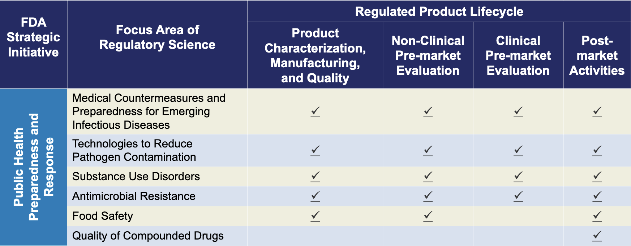
FDA 2022 Cross Cutting Topics: Lifecycle of FDA-Regulated Products
2022 Advancing Regulatory Science at FDA. https://www.fda.gov/media/161381/download.

Slide 7
Use AI to Analyze a Multitude of Data from Diverse Disciplines
Epidemiological factors
Business Decisions
Factors that Affect Drug Shortages
Open-source databases available through organizations such as the CDC and WHO
Stocks, quarterly reports, and drug price
Supply and Demand
Required and voluntary submitted records to FDA

Slide 8
Use of AI to Predict Drugs Shortages
Epidemiological factors
Business Decisions
Factors that Affect Drug Shortages
Establish trends to predict prevalence of ailments
Predict volatility of drugs based on established trends
Supply and Demand
Predict ability of wholesalers and suppliers to meet expected pharmaceutical demand

Slide 9
Translating to Practice
Develop a method to weigh the intensity of diverse factors which drive drug shortages
Investigate cause to determine solution for minimize disruption
Establish a ranking system to determine drugs susceptible to shortages

