Slide 1
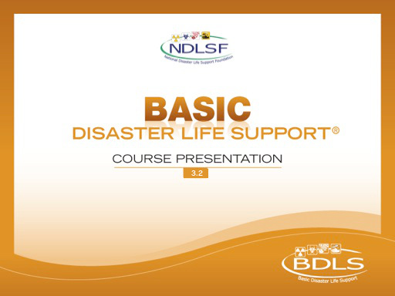

Slide 2

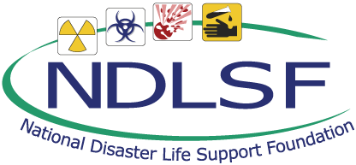
Session 1 – Lesson Two
Natural Disasters

Slide 3
Learning Objectives
Provide prevention and mitigation strategies for common natural disasters
Identify the types of illnesses and injuries commonly seen in natural disasters
Discuss actions to take to protect health, safety, and security of responders and affected populations in natural disasters
Describe clinical management guidance for injuries and illnesses seen in common natural disasters
Notes:
Lesson Two, Natural Disasters, and its corresponding text chapter, describe the event specific clinical aspects of situational awareness, health workforce protection, casualty management, healthcare infrastructure, public health, incident management and after action reporting, reinforcing critical steps through utilization of PRE-DISASTER™ and DISASTER Paradigms™.

Slide 4
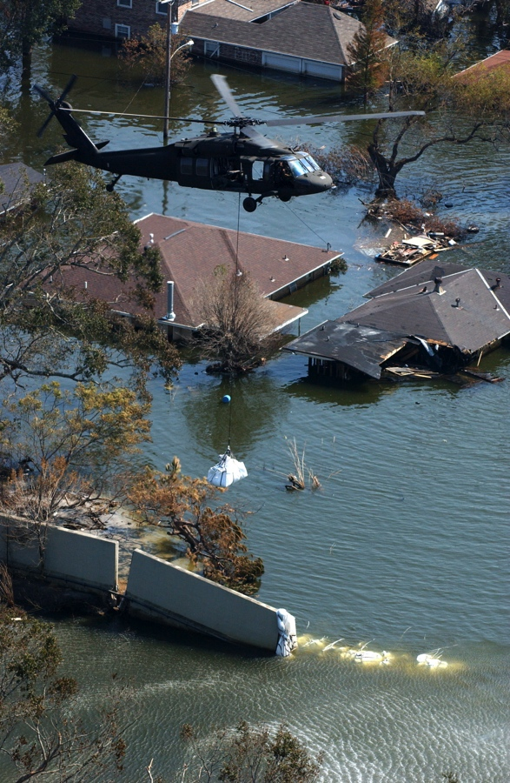
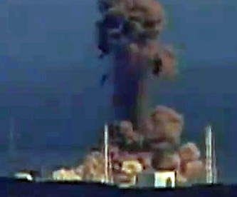
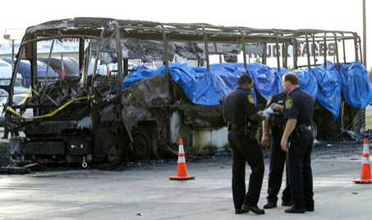
Natural Disasters
Important to use an all-hazards approach
Multiple scenes are common
Multiple disasters may occur
Human systems failures often occur
Jocelyn Augustino/FEMA
Associated Press
Notes:
It is important to use an all-hazards approach. Natural disasters often are complicated scenes involving many hazards and scenarios including structural collapse, chemical spills, fire, explosion, and infectious and communicable disease risks. To be truly “ready” for a natural disaster demands an all-hazards preparedness approach.
Multiple disasters may occur (ie, aftershocks following an earthquake, or subsequent tornadoes in the same area, flooding following hurricane or excessive rainfall, etc, as well as human systems failures)
After a natural disaster, additional disasters from human system failures often occur, such as in the following examples:
Levee failure: widespread flooding (Hurricane Katrina, 2005)
Industrial damage: contamination, fire, explosion, etc (Japan tsunami 2011 with the Fukushima Daini nuclear power plant catastrophe)
Evacuation: vehicle/aircraft accidents (Hurricane Rita, 2005, commercial bus fire outside of Dallas during the evacuation process, killing more than 20 people)
IMAGES --
Top Left: New Orleans, LA, September 9, 2005: A Blackhawk helicopter loads sand bags into areas where the levee has broken and is flooding neighborhoods throughout the area as a result of Hurricane Katrina. Jocelyn Augustino/FEMA.
Bottom Left: Bus explosion and fire that killed more than 20 people near Dallas during Hurricane Rita in September 2005 during the transportation of nursing home residents from Houston. From an MSNBC article from the Associated Press, September 24, 2005; photo by Matt Slocum.
Right: Explosions occurring at Fukushima nuclear power plant, Japan, 2011. http://static.guim.co.uk/sys-images/Guardian/Pix/pictures/2011/3/14/1300106679419/Explosion-at-Japans-Fukus-007.jpg.

Slide 5
Natural disasters require:
Workforce preparedness
Situational awareness
Surge capacity readiness
Casualty management preparedness
Notes:
Workforce preparedness is a mainstay:
Appropriate personal protective equipment use: injury, contamination, and communicable disease risk
Immunization status up to date
Training and exercises
Situational awareness:
Early detection and warning notifications
Early post-event information: Early on, information from the scene or “field” is limited in accuracy and fraught with communication challenges. This is very important as prompt decision making regarding resource utilization, rescue/evacuation, and innate health care infrastructure needs are significantly affected.
Critical: Timely location of the acutely injured and ill, as well as identification of at-risk populations, is challenging
Surge capacity readiness:
Operational health facility expansion
Alternate care facilities (ACFs) may become the mainstay of local health care delivery until local health and medical infrastructure is reestablished and able to meet the demands
Sustained altered medical and health care delivery is a challenge for the health and medical workforce
Casualty management preparedness:
Resource management: Health and medical resources allocation and utilization should anticipate the types and boluses of casualties
Injury and illness timelines: When, what types, and how many of injured and ill casualties will be arriving? “Waves” or boluses of patient types should be anticipated. [Note: this last bullet item leads into the next slide, which is a table of injury and illness timelines following a natural disaster.]

Slide 6
Injury and Illness Timelines
Time After Event | Injury and Disease Process | Examples
Immediate (< 48 hours) | Acute trauma Acute medical | Multisystem injuries, burns, orthopedics, lacerations Environmental events, drowning, inhalation, electrocution, CAD/MI
Ongoing (days) | Trauma Medical Chronic diseases | Wound management, orthopedic and burn care Environmental, dehydration, cold/heat, contamination Asthma, HTN, diabetes, CHF, COPD, dialysis, psychiatric
Sustained (weeks) | Acute medical Chronic diseases Mental and behavioral | Communicable diseases Ongoing difficult access to care, supplies, medications Stress, anxiety, depression, substance abuse, pre-existing
Notes:
This table is a general example of injury and illness timelines after a natural disaster. Times are but rough estimates to demonstrate that natural disaster preparedness demands a locally based immediately available response to the acute trauma and acute medical casualties. The emphasis is clearly on the importance of local preparedness early in disaster response, eg, requesting a disaster medical team that will not arrive and be functional in the first 48 hours will have little impact on meeting the acute trauma or acute medical needs.
The needs change as the timeline continues, as after the initial days; eg, trauma and wound management needs will be changing from laceration repair to contaminated or infected wounds, while acute medical demands will change to increased casualties from environmental exposures (ie, dehydration, hypothermia, etc) and exhaustion, as well as the likely surge of now acutely decompensating chronic illnesses.
Important point: All natural disasters, ongoing or sustained, will likely experience a surge in chronic disease and mental/behavioral casualties occurring a few days to week after the event. The importance of planning and logistics for such additional surge or bolus of casualties must be anticipated.

Slide 7

Natural Disaster Typology
Earthquakes and tsunamis
Floods
Heat emergencies
Hurricanes, cyclones, and typhoons
Tornadoes
Volcanic eruptions
Wildfires
Winter storms
NASA
Notes:
The eight items listed here represent many of the possible “natural” disasters. This is the categorization order used in Chapter 10 of the BDLS 3.0 Course Manual. There are other ways to organize, as well as other “natural” events (ie, climate change regional or seasonal impact, or a more apocalyptic event such as meteor or asteroid impacts [see image description below regarding a recent newsworthy near-earth object]).
The remainder of this presentation on natural disasters is purposed to identify areas of prevention, mitigation, and the likely injuries and illnesses that are important to casualty management, by using the associated typology as an outline.
IMAGE -- This full view of the giant asteroid Vesta was taken by NASA's Dawn spacecraft, as part of a rotation characterization sequence on July 24, 2011, at a distance of 3200 miles (5200 km). A rotation characterization sequence helps the scientists and engineers by giving an initial overview of the character of the surface as Vesta rotated underneath the spacecraft. This view of Vesta shows impact craters of various sizes and grooves parallel to the equator. The resolution of this image is about 500 meters per pixel. NASA.

Slide 8
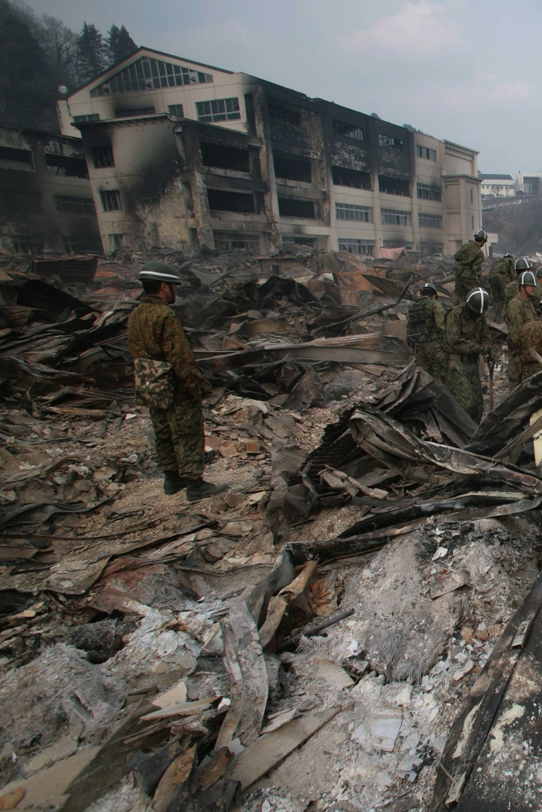
Earthquakes and Tsunamis
Common, with over 500,000 tectonic movements annually
Few are powerful and potentially devastating
Tsunami: oceanic or sea floor earthquake displaces mass of water creating large waves
Toshiharu Kato/Japanese Red Cross
Notes:
Richter scale and the moment magnitude scale (MMS) range from 0 to 10 and are logarithmic. An increase of one “point” on either scale represents both a 10-fold increase in the shaking amplitude associated with the earthquake and an increase in energy release of 31.6 times.
Tsunamis may occur when seismographs detect earthquakes that occur in the ocean or on coastal areas.
In 2009, there were 91 earthquakes that affected large populations and had magnitudes greater than 5.9 on the Richter scale. Of these, 28 generated tsunamis.
The 2010 Haiti earthquake measured 7.0 on the Richter scale but is estimated to have caused more than 200,000 deaths.
The 2011 Japan earthquake with an estimated magnitude of 9.0 on the Richter scale and the associated tsunami caused more than 12,000 deaths, with as many or more people still unaccounted for or displaced.
IMAGE -- The 2011 tsunami wiped away the gas station, causing a fire that burned down the whole town. Toshiharu Kato/Japanese Red Cross.

Slide 9
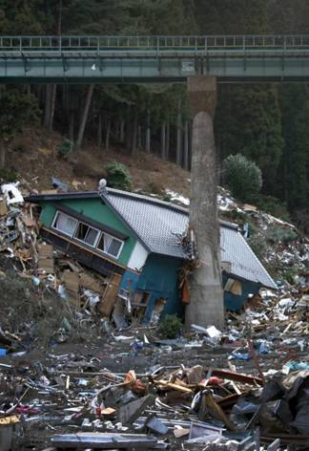
Earthquakes and Tsunamis
Prevention and Mitigation
Limited ability to provide advance warning
Building codes and guidelines important
At-risk population preparedness vital
Japanese Red Cross
Notes:
There is limited ability to provide advance warning, as the identification of an impending, significant earthquake is an inexact science. The likelihood of damaging aftershocks (earthquakes that occur in the same or nearby geographic location) should always be anticipated.
Building codes and guidelines are important, and considerations include both building/construction science and laws/regulations:
Ductility — the ability of a structure to deform to a significant degree before failing — is crucial in earthquake disaster-prone areas.
Updating building codes and improving land use and engineering legislation remains the most viable way to mitigate the impact of earthquakes.
At-risk population preparedness is vital:
• Responders: ensure PPE and immunizations up to date
• Populations that are technology/medical device dependent or have special needs at increased risk, including:
People with preexisting conditions, physical limitations, and disabilities may be at a higher risk for injury because of inability to flee collapsing structures or inability to flee or take adequate shelter.
People who are bed-bound, on dialysis, or on ventilators may not have the ability to self-evacuate.
Data from the 1995 earthquake in Nishinomiya, Japan, and the 1999 earthquake in Taiwan suggest that serious injury is most common among the very young and the elderly.
IMAGE -- This picture, taken in Iwate Prefecture, illustrates the extreme damage done to infrastructure by the tsunami waves. Japanese Red Cross.

Slide 10
Earthquakes and Tsunamis
Casualty Management
Injuries and Illness | Clinical Care
Structural collapse, resulting in complex traumatic injuries Tsunami, submersion injuries | Wound management Hemorrhage control Fracture management IV fluid therapy Pain control measures Specialty trauma care
Notes:
Structural collapse leading to traumatic wounds and injuries, such as:
Lacerations, fractures, sprains, and contusions
Complex multisystem trauma, including the following, should be anticipated after earthquakes:
Crush injuries (one of the most common types of injury after an earthquake)
Compartment syndrome
Crush syndrome (condition caused by crushed tissue and release of intracellular molecules and electrolyte, and associated reperfusion)
Traumatic asphyxiation
Head and spinal trauma
Chest and abdominal blunt and penetrating injuries
Drowning and submersion injuries if tsunami occurs
Wound, bleeding, and fracture management are mainstays of earthquake casualty management.
IV fluid therapy is important and it should start immediately if crush injuries are suspected, even beginning before rescue if it is possible to establish IV access.
Pain control measures are important.
The need for specialty trauma access is likely and reinforces the importance of available trauma centers.

Slide 11
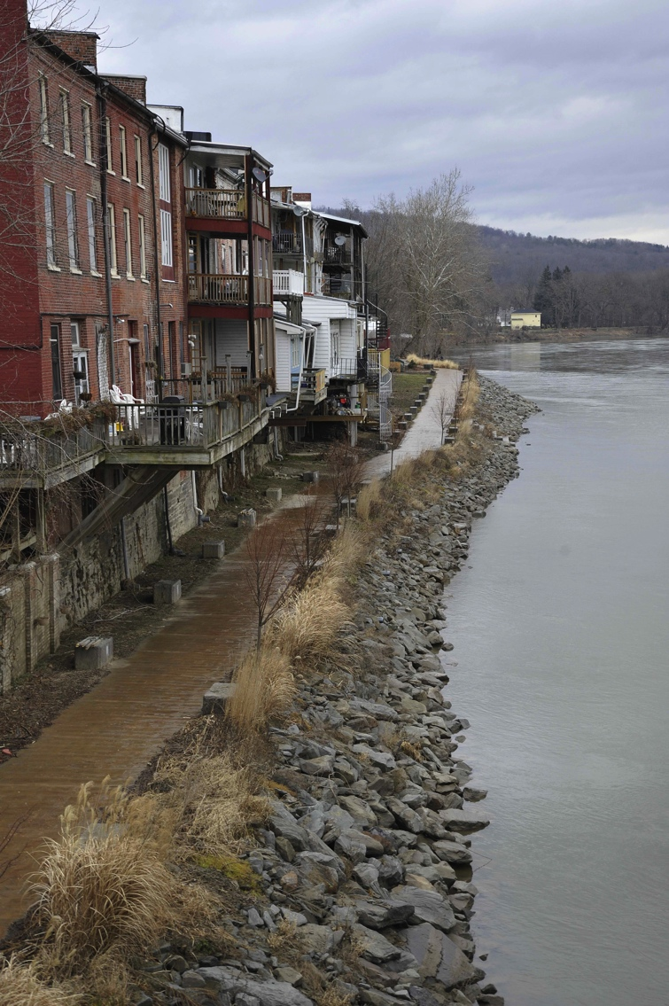
Floods
Most common disaster worldwide
Occurs in 90% of all US disasters
Accounts for numerous weather-related US deaths
Hans Pennink/FEMA
Notes:
There are many types of flooding:
Regional floods occur when winter or spring rains couple with melting snow and fill water basins too quickly with too much water
Flash floods can occur within a few minutes or hours of excessive rainfall, a dam or levee failure, or a sudden release of water held by an ice jam
Ice-jam floods occur when rivers partially or totally freeze and jammed ice acts as a dam that causes water to back up upstream
Dam and levee-failure floods are usually due to excessive water buildup behind a levee or dam
Debris and landslide floods are generally caused by the accumulation of debris, mud, rocks, logs or other large objects that converge in a channel or narrowed area and form a temporary dam that prevents the normal flow of water
Sea-level rise floods are directly tied to a rise in sea level. Sea-level rise is generally caused by a variety of factors including storm-related activities such as hurricanes, typhoons, tsunamis, or the timing of tides.
IMAGE -- Owego, NY, February 1, 2012: Front Street business shop and apartment units along the Susquehanna River during the recovery effort. FEMA plays a vital role in supporting state, tribal, and local governments as they respond to the impacts of Hurricane Irene. Hans Pennink/FEMA.

Slide 12
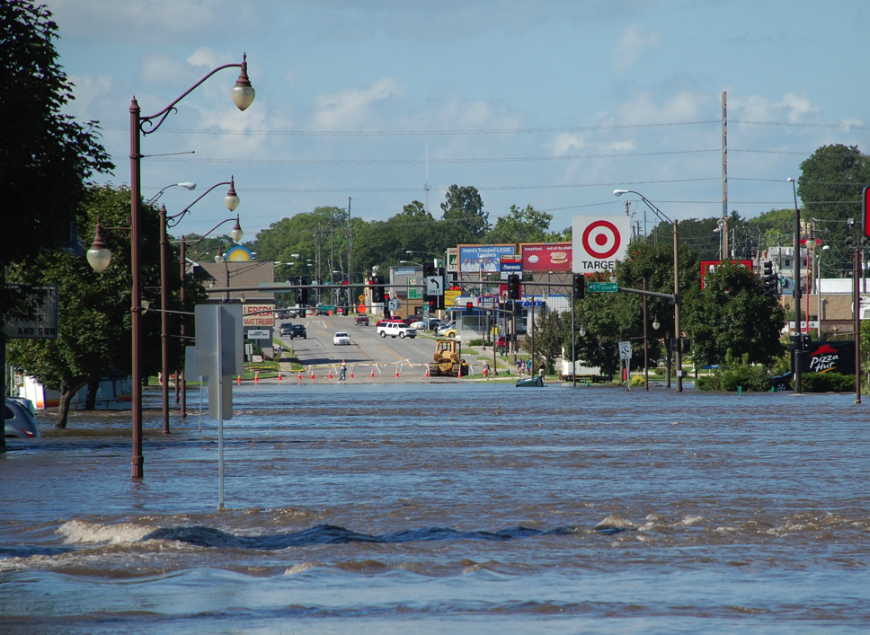
Floods
Prevention and Mitigation
Identify vulnerable locations and populations
Building and road construction methods
Educate communities in flood-prone areas
Jace Anderson/FEMA
Notes:
Identify vulnerable locations and populations:
Personal/family disaster plan and adequate supplies, medications, etc
Ensure clean water, safe food access and storage, and basic sanitation methods
All flooding results in debris, floating or sometimes swiftly moving, as well as dark flood waters hiding unseen obstacles or holes; all contribute to likelihood of traumatic injuries and submersion injury risk.
Building and road construction methods:
Elevate building foundations in flood-prone areas
Seal basements and foundation walls
Educate communities in flood-prone areas:
Proper evacuation methods
Proper potable water, food safety and sanitation
Flash flooding effects of rising water levels:
6 inches: bottom of cars, may stall engine if water enters exhaust system
1 foot: vehicles will float, steering limited or ineffective
2 feet: carry away even trucks and SUVs
Warning terminology developed by the National Weather Service is as follows:
Flood watch: a flood is possible
Flash flood watch: flash flooding is possible; be prepared to move to higher ground
Flood warning: flooding is occurring or will occur soon
Flash flood warning: a flash flood is occurring; move to higher ground immediately
IMAGE -- Ames, IA, August 11, 2010: Squaw Creek overflows its banks and inundates area businesses. Hundreds of residents were evacuated from their homes and were forced to boil their drinking water. Jace Anderson/FEMA; http://www.fema.gov/photolibrary/photo_details.do?id=44990.

Slide 13
Floods
Casualty Management
Injuries and Illness | Clinical Care
Submersion injuries Traumatic injuries Environmental exposure illnesses and injuries | Near-drowning Traumatic wounds Heat/cold injuries IV fluid therapy Pain, vomiting, and diarrhea control Antibiotic selection
Notes:
Casualty management after floods may include:
Submersion injuries
Traumatic injuries
Prolonged environmental exposure resulting in:
Hypothermia
Hyperthermia
Dehydration
Complex wound infections:
Waterborne illness are transmitted through water that is contaminated by sewage, human waste, or industrial waste. Examples include typhoid fever, cholera, leptospirosis, hepatitis A
Vector-borne illnesses are transmitted by living organisms such as mosquitoes or rodents, which may be prevalent after the initial flooding event when there are resultant pools of standing water. Examples include malaria, dengue hemorrhagic fever, yellow fever, and West Nile fever.
Mold exposure is also prevalent after flood waters have receded. Mold can develop in 24 to 48 hours after water exposure.

Slide 14
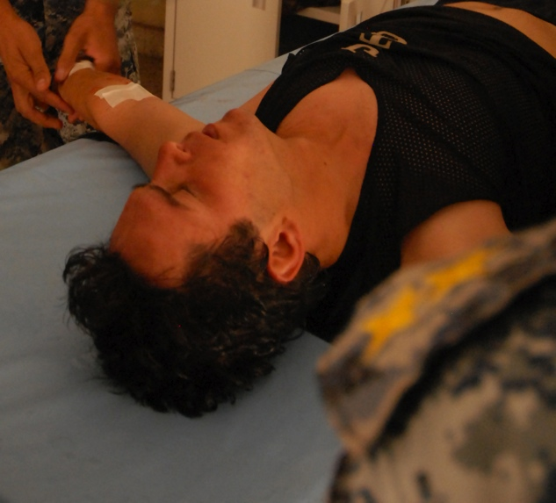
Heat Emergencies
Leading weather-related cause of death in US
Air temperature greatest factor affecting onset of heat-related illness
Hydration status, degree of work-stress effort, and underlying health status important
Children and the elderly are especially vulnerable
Greg Pierot/U.S. Navy
Notes:
Heat emergencies are the leading weather related cause of death in the US. (seenws.noah.gov)
The heat index is a measure of how hot it really feels when relative humidity is factored with the actual air temperature. The most important factor is simply how high the air temperature is.
Who will be affected by the heat is influenced by hydration status, degree of work-stress effort, and underlying health status. Children and the elderly are especially vulnerable.
IMAGE -- June 10, 2008: Medics of the 2-7-2 Iraqi National Police Battalion treat a man who collapsed from a possible heat stroke while on his post in Maydiyah, Iraq, June 10, 2008. Mass Communication Specialist 2nd Class Greg Pierot/US Navy.

Slide 15
Heat Emergencies
Prevention and Mitigation
Identify and inform at-risk populations:
Hydration
Shelter
Exposure
Notes:
Identify and inform at-risk populations, which may include the following:
Workforce
People at extremes of age (very young and very old)
Those with chronic diseases
People with cognitive, functional, and sensory limitations
Those living or working in poorly ventilated buildings, homes, apartments, or any place lacking air conditioning
Those lacking access to shade or shelter site access, the homeless, outdoor workers, etc.
Hydration: Adequate proper fluid intake
Shelter: cool, air-conditioned sheltering
Exposure: Proper work-rest cycles and clothing
National Weather Service issues heat alert when heat index is elevated or during extreme sustained air temperatures (ie, an alert is called if temperatures reach between 105 F and 110 F for 2 consecutive days)
Basic precautions against heat-related illness include the following:
Wear light-colored and lightweight clothing
Plan to stay inside during hottest hours of the day
Ensure adequate fluid intake
Avoid alcohol intake

Slide 16
Heat Emergencies
Casualty Management
Injuries and Illness | Clinical Care
Heat illness progresses from mild to life-threatening As core temperature rises, onset of compensatory mechanisms failing Early sign and symptom recognition is key | Remove from hot environment Cooling measures Provide hydration
Notes:
Types of heat illness and injury include the following:
Heat cramps are when the body’s muscles experience pain and cramping, usually due to dehydration
Heat edema occurs when there is swelling of hands and feet due to vasodilation
Heat syncope occurs when dilation of the body’s venous system leads to pooling of blood, usually in lower extremities, due to gravity; this results in a fainting episode, leading to temporary loss of consciousness and postural tone
Heat exhaustion is a core temperature less than 104 °F with dizziness, fatigue, and normal mentation
Heat stroke is the failure of compensatory mechanisms and can be fatal. It is associated with a core temperature equal to or above 104.9 °F, abnormal mental status, and tachycardia
Treatment includes active cooling, ice packs to groin/axilla, removal from hot environment, and hydration either oral or IV fluids.
Recognize life-threatening signs of heat illness such as:
Abnormal mental status
Core temperature > 104 °F
Persistent tachycardia

Slide 17
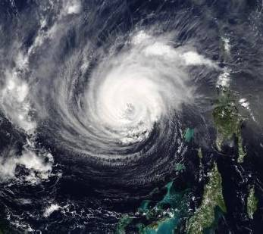
Hurricanes
Large, rotating core that produces heavy rainfall, strong winds, and storm surge coastal flooding
Names all describe similar events, based on location:
Hurricane: Atlantic, Eastern Pacific Oceans
Typhoon: Western Pacific Ocean
Cyclone: Indian Ocean
NOAA
Notes:
There have been many large and destructive hurricanes in US history. A notable recent example is Hurricane Katrina in 2005, impacting our Gulf Coast states. The most lethal hurricane in US history, a category 4 storm that occurred in 1900, killed between 6000 and 12,000 people in Galveston, Texas. Most of these deaths were caused by storm surge and may have been preventable today through the use of hurricane warning systems.
The tremendous physical size of some hurricanes should be noted, such as Hurricane Ike in 2008, which was more than 200 miles in diameter!
Strong winds, heavy rainfall, and the surge of coastal waters are all mechanisms of destruction attributable to hurricanes.
The terms hurricane, typhoon, and cyclone are sometimes used interchangeably to describe the same type of event in a different location; for example, the definition of a cyclone per the National Weather Service is an atmospheric closed circulation rotating counterclockwise in the Northern Hemisphere and clockwise in the Southern Hemisphere.
IMAGE -- Location: Atlantic Ocean, Hurricane Isabel. NOAA; www.fema.gov/photolibrary.

Slide 18
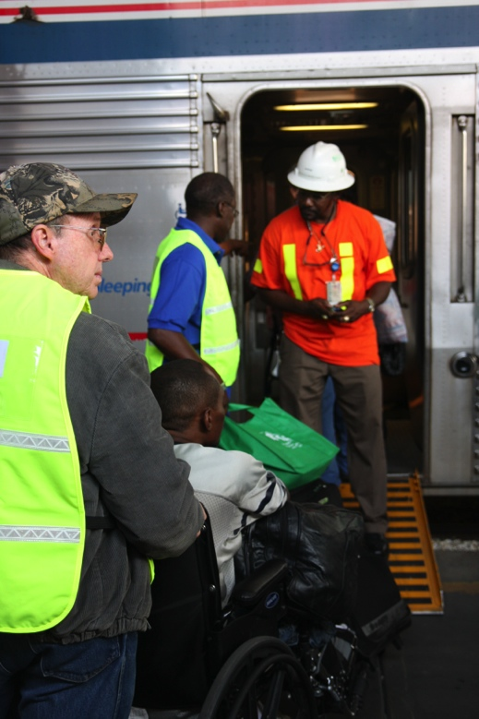
Hurricanes
Prevention and Mitigation
National Weather Service (NWS) predictions, tracking, and warning systems important
At-risk populations heed warnings
Evacuation methods/route access
Ensure timely access to potable water, safe sheltering, food, sanitation, and health care
Jacinta Quesada/FEMA
Notes:
Modern technology allows for prediction of hurricane landfall with increasing accuracy. However, hurricanes are notorious for making directional and strength changes even after well-planned modeling and predictions have been established. This leads to time-dependent difficult decisions regarding sheltering in place vs evacuation; for example, a change in direction within the 24 hours before landfall may be too late to begin a wide-based evacuation of an area.
Communities can mitigate these effects somewhat by:
Proper planning: clear evacuation routes
Evacuation drills, including use of warning sirens and shelters
Mapping of floodplains and flood-prone areas
Preventing contamination of water supplies
IMAGE -- New Orleans, LA, August 30, 2008: The first evacuees with medical and special needs are helped boarding Amtrak and State of Connecticut trains at the New Orleans Union Passenger Terminal (NOUPT) in downtown New Orleans. Jacinta Quesada/FEMA.

Slide 19
Hurricanes
Casualty Management
Injuries and Illness | Clinical Care
Wind and water surge leading to traumatic and submersion injuries Environmental exposure resulting in injury and illness | Submersion injuries Traumatic wounds Fracture management Heat/cold injuries IV fluid therapy Pain control measures
Notes:
Casualty management is primarily the result of wind force and water surge leading to traumatic wounds and submersion injuries:
Most common include lacerations, contusions, fractures, and skin/wound infections
Prolonged environmental exposure resulting in:
Hypothermia
Hyperthermia
Dehydration
Complex wound infections
Waterborne illnesses
Vector-borne illness
Skin rashes
Environmental toxins from spilled containers and substances
The establishment of the “Katrina Clinics” at the Houston Astrodome and the Dallas Convention Center Medical Unit after Hurricane Katrina is an example of large medical sheltering operations undertaken in US history. In the Houston Astrodome more than 25,000 evacuees were sheltered and more than 15,000 clinical patient encounters occurred. The Dallas Convention Center Medical Unit provided 10,367 emergent or urgent care visits.

Slide 20
Hurricanes
Casualty Management
(may occur in other incidents that effect infrastructure)
Other considerations
Children
  Risk of separation from families / guardians
    Family member tracking and reunification programs
  Risk of accidental poisoning
    Hydrocarbon and bleach poisonings
Elderly and institutionalized
  Evacuation of facility or home may be delayed
  Exacerbation of chronic illnesses is likely
Notes:
Experience from Hurricane Katrina in 2005 led to numerous instances of separation of children from their families. It is vital that tracking systems be implemented as early as possible to facilitate family reunification. Establishment of family support and information centers staffed by trained social service workers may be very helpful in achieving early reunification.
Experience from Hurricane Andrew in 1992 demonstrated numerous instances of hydrocarbon and bleach poisoning of children as these substances are commonly used to boil or decontaminate drinking water before ingestion. Such poisonings should be anticipated whenever the local supply of potable water becomes disrupted for an extended length of time.
Institutionalized patients pose numerous challenges to emergency providers. Evacuation is typically difficult and prolonged, while just-in-time inventories of foodstuffs and medications at an isolated facility may become rapidly depleted. As a result, chronic illnesses may be left untreated, causing significant, sometimes rapid, deterioration in the health of the patient.

Slide 21
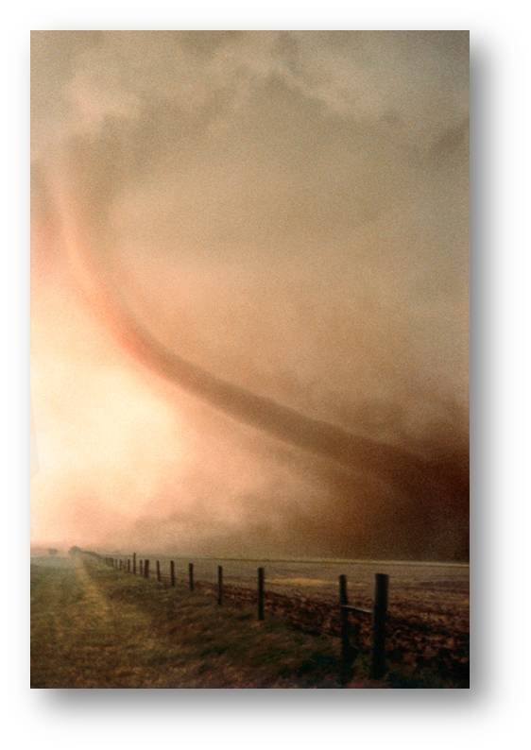
Tornadoes
Rapidly rotating funnel-shaped column of air
Extends from thunderstorm to the ground
Wind speed correlates best to destructive power
Notes:
Tornadoes are a common occurrence throughout the US. The historically referenced “tornado alley” that runs vertically in the Midwest seems to be an expanding area and is currently being redefined. Tornadoes are not only common in event occurrence, but often common in that many occur at nearly the same time, some staggering in numbers and related destruction, as shown in these recent examples:
On April 28, 2011, the NWS estimated 150 tornadoes tore across six southern states, resulting in more than 290 deaths and likely more than 1700 injuries.
On May 22, 2011, another series of tornadoes hit the Midwest, the largest of which struck the town of Joplin, Missouri. The tornado caused more deaths and an estimated $3 billion in damage.
During the weekend of April 14 and 15, 2012, an estimated 100+ tornadoes occurred throughout much of the Midwest, resulting in widespread destruction but very fortunately only a few deaths, largely due to the mostly rural, sparsely populated locations impacted.

Slide 22
Tornadoes
Prevention and Mitigation
National Weather Service (NWS) tracking/warning systems important
At-risk populations must seek immediate safe shelter
=
Survival
Warning + Shelter
Notes:
The mainstays of both prevention and mitigation related to tornadoes is appropriate warning followed by immediate safe sheltering.
Most tornadoes are preceded by severe thunderstorm warnings or watches, and the presence of such conditions should be a concern for possible tornadoes even before official warnings are issued.
Warning systems are most effective in preventing injuries if activated at least 20 minutes before the tornado strike.
Tornado watch means that a tornado is possible: remain alert for storms.
Tornado warning means that a tornado has been sighted or seen on weather radar: take shelter immediately.
The National Weather Service (NWS), in addition to tracking and warning of threatening conditions, assesses probable strength based primarily on anticipated wind speeds. Tables and detailed descriptions of these can be reviewed in the BDLS 3.0 Course Manual (pp 10-28) as well as at the National Weather Service and related websites.
NOAA Weather Radio (NWR) is a nationwide network of radio stations broadcasting continuous weather information directly from the nearest National Weather Service. More information can be found at www.nws.noaa.gov/nwr/.

Slide 23
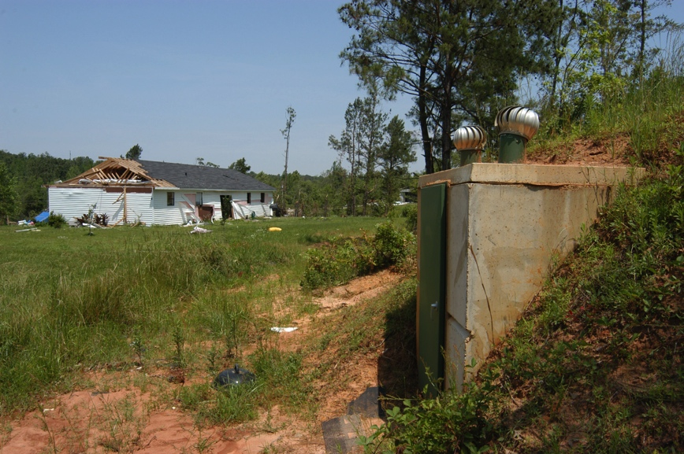
Tornadoes
Prevention and Mitigation
Permanent structure
Lowest level or basement
Interior walls
Avoid windows
Avoid vehicles and motor homes
Mark Wolfe/FEMA
Notes:
The mainstays for tornado prevention and mitigation are a timely appropriate warning followed by immediate safe shelter access, as noted on the previous slide.
This list of items outlines key aspects in safe and proper sheltering from an impending tornado strike.
IMAGE -- Jackson, TN, May 28, 2003: A shelter built with funds from a Small Business Administration loan after the 1999 tornadoes stood strong as homes were destroyed in a community near Jackson, Tennessee. Mark Wolfe/FEMA.

Slide 24
Tornadoes
Casualty Management
Injuries and Illness | Clinical Care
Tremendous wind and flying debris causes traumatic injuries Complex injuries from burns, electrocution, and blast injuries | Traumatic wounds Fracture management IV fluid therapy Pain control measures Specialty trauma care
Notes:
Tornadoes produce tremendous forceful winds and flying debris, causing traumatic injuries.
In addition to the multitude of traumatic injuries, complex multisystem injuries should be expected, such as:
Burns from ensuing fires
Electrocution from downed power lines
Blast injuries from exploding natural gas leaks

Slide 25
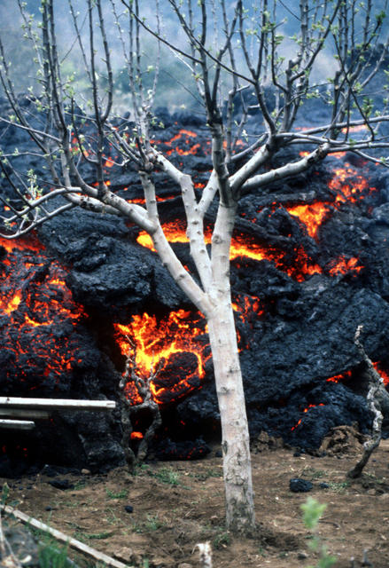
Volcanoes
Catastrophic explosion with searing heat, large volumes of incinerating hot gases, molten rock (lava), and toxic chemicals released
Release of tremendous ash quantities causing darkness for days
U.S. Navy
Notes:
Volcanoes are located throughout the world, including the US.
More that one-half of the most active are located in a near-circular region of the Pacific Ocean known as the “Ring of Fire.”
Pyroclastic flows and mudslides are the most common direct cause of death associated with volcanic eruption. Pyroclastic flows are mixtures of gas, ash, pumice, and rocks, and cause injury and death from intense heat and asphyxiation. Mudslides and debris flows, known as lahars, are swift moving, hot, and deadly! In 1908, between 28,000 and 30,000 people were killed within minutes after the eruption of Mount Pelee, in Martinique, because of effects of pyroclastic flows.
The release of ash is one of the most significant hazards of volcanic eruptions. Mount Saint Helens, Washington, erupted violently in 1980, leading to the death of 60 people mostly from asphyxiation from ash exposure.
IMAGE -- Lava advances through an orchard after an eruption of Mount Etna. US Navy and Marine Corps personnel are in the area in an attempt to stem the volcano's flow and minimize destruction to the town of Zafferana Etnea as part of Operation Hot Rock. The military personnel are using 8000-pound concrete blocks in an effort to divert the flow of lava away from the town. U.S. Navy.

Slide 26
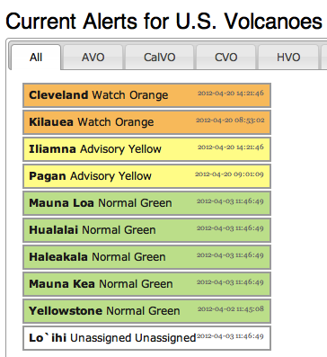
Volcanoes
Prevention and Mitigation
Warning systems by US Geological Survey (USGS)
At-risk population is growing
Early evacuation, shelter access, water, food, and sanitation
Long-term agricultural and environmental contamination
Notes:
Warning systems vary worldwide. The USGS system in the United States is a four-tiered color-coded alert denoting watch and warning condition status.
The growth of populations near and around volcanoes is a significant concern in regard to the safety and preparation of a now-larger threatened population.
Evacuation planning and early mobilization is key, as once eruption is occurring, escape becomes unrealistic with pyroclastic flow and lahars potentially reaching a speed greater than 60 mph.
Darkness and large quantity of ash will complicate evacuation and response efforts alike. The darkness from ash can last for many days; depending on the quantity, it could even last for weeks. The ability to receive supplies may be hampered by the large amount of ash fall. Air filters in motor vehicles, electrical generators, and other critical machinery may quickly become clogged and inoperable. Building rooftops may be at high risk of collapse due to weight of accumulated ash.
The eruption of the Eyjafjallajokull Volcano in Iceland in 2010 caused air flights to and from the European continent be suspended because of ash clouds damaging aircraft engines.
Long-term agricultural and environmental contamination may occur. For example, sulfur dioxide mixed with steam results in acid rain, contaminating agricultural lands and water.
Plan for large-scale population displacement and sheltering for an extended period.
Disrupted communications are to be expected in the impacted area and areas with ash-filled sky.
IMAGE -- This graphic demonstrates a report of current alerts for US volcanoes that are regularly monitored. The US Geological Survey website (http://volcanoes.usgs.gov/activity/status.php) provides detailed descriptions of monitoring levels, sites, and informational bulletins.

Slide 27
Volcanoes
Casualty Management
Injuries and Illness | Clinical Care
Direct cause of death is pyroclastic flow and mudslides Traumatic injuries Respiratory symptoms from smoke/ash inhalation Eye injury from ash | Traumatic wounds Fracture management Respiratory support IV fluid therapy Pain control measures Specialty trauma care Eye irrigation
Notes:
The most common direct causes of death are pyroclastic flows and mudslides.
Asphyxiation and inhalation injuries are common causes of death and significant illness related to ash exposure.

Slide 28
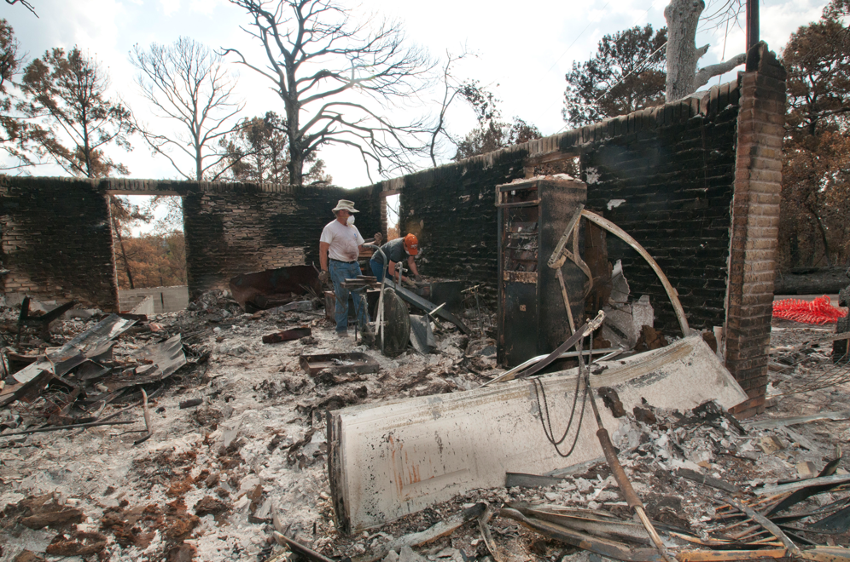
Wildfires
Human causes are most common
Common cause of home and property destruction
High workforce mortality and morbidity
Patsy Lynch/FEMA
Notes:
Humans are the most common cause of wildfires. Wildfires often result from faulty machinery, discarded cigarettes, improperly maintained/extinguished campfires, or intentional fire starting.
Natural causes can result in wildfires and may be from a variety of sources such as lighting strikes, volcanic activity, and coal steam fire.
During the 2009 wildfire fire season, there were 78,792 individual fires in the United States. These consumed more than 5.9 million acres of land and cost billions of dollars.
IMAGE -- Bastrop, TX, September 17, 2011: Residents shift through the remains of their home after a fire swept through the area in Bastrop, Texas. Patsy Lynch/FEMA;
http://www.fema.gov/photolibrary/photo_details.do?id=51840.

Slide 29
Wildfires
Prevention and Mitigation
Prevention
Proper handling and storage of flammable materials and fuel
Detection
Early identification
Suppression
Forest service wild land firefighting teams
Notes:
Prevention:
Proper handling and storage of flammable materials and fuel
Controlled burns
Fire breaks around houses
Development of personal fire plans, home disaster kits, and proper evacuation plan
Detection:
Early identification leading to rapid extinguishing, as well as threatening condition analysis such as fire danger rating systems
Fire mapping programs
Satellite reconnaissance
Suppression
Forest service, such as the wild land firefighting teams
Exposure to wildfires may result in long-term respiratory illnesses and require monitoring of affected workforce and population to prevent or mitigate long-term consequences

Slide 30
Wildfires
Casualty Management
Injuries and Illness | Clinical Care
Burn injuries Smoke inhalation Work-stress heat-related illness Extremity trauma Animal and insect bites | Remove from hot environment Burn care Respiratory support Cooling measures Provide hydration
Notes:
Thermal injuries and management should be well known to the clinical provider managing casualties from a wildfire. In addition to the obvious skin surface injuries, superheated air causing facial burns, nasal hair singing, facial edema, stridor, and respiratory distress; as well as smoke inhalation and asphyxia, are but some of the complex etiologies and injuries likely after wildfire exposure.
Respiratory support consists of giving the patient oxygen either via nasal canula or face mask, as well as treatment of stridor and bronchospasm if present. Endotracheal intubation is considered if the possibility of airway swelling or compromise is present or an impending risk.
Additional injuries may result from fleeing or injured animals, insect bites and stings, explosions from stored materials in burning structures or natural gas lines, and electrocution from downed/melted wiring and lines, as well as various extremity trauma mechanisms from lacerations, contusions, fractures, sprains, etc.

Slide 31
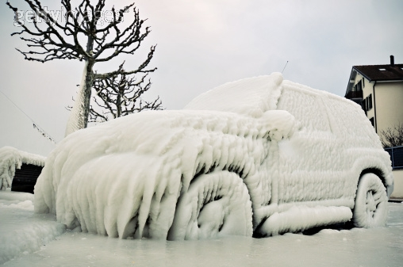
Winter Storms
Dangerous and damaging accumulations of snow, ice, or sleet
Life-threatening below- freezing temperatures
Aaron Skolnik/FEMA
Notes:
Winter storms include blizzards, heavy snowfall, and extreme cold. Detailed typology can be found on pp 10-30 of the BDLS 3.0 Course Manual.
Freezing rain/drizzle or sleet: dangerous, and damaging accumulations of ice or sleet
Frost or freeze warning: temperatures critical for crops and sensitive plants
Ice storms: freezing rain accumulation
IMAGE -- Germantown, MD, January 26, 2011: A truck under 8+ inches of heavy, wet snow that fell across the Washington, DC area. Aaron Skolnik/FEMA.

Slide 32

Winter Storms
Prevention and Mitigation
Prediction is imprecise
Preventable hazards
  CO poisoning
  House fires
At-risk population preparedness key
Notes:
Prediction of blizzards and other winter storms is imprecise. Satellites track blizzards, but their future paths are predicted on the basis of computer modeling. According to the National Weather Service, these models have the ability to correctly predict the path of the storm about 85% of the time.
Unintentional carbon monoxide (CO) poisoning may occur indoors or in vehicles. Carbon monoxide poisoning may occur when motor vehicle exhaust systems are obstructed with snow; when kerosene or propane heaters and gasoline-powered generators are used indoors; and when charcoal briquettes are used to cook food.
Structure fires also may result from faulty or careless use of space heaters and from faulty damaged electrical wiring.
At-risk population preparedness is key:
Residents should winterize homes, obtain proper clothing
They should have sufficient heating fuel and a supply of food and water on hand
The homeless are at higher risk for injury or death because of inadequate sheltering and lack of heat and water
Technology- and medical device-dependent people and those with functional and cognitive limitations are at increased risk

Slide 33
Winter Storms
Casualty Management
Injuries and Illness | Clinical Care
Frostbite Hypothermia Cardiac events CO poisoning Burn injuries | Remove from cold Replace wet clothing Appropriate re-warming Provide warm liquids Other injuries/illnesses
Notes:
Frostbite is the freezing of the body tissue. It may be temporary or become permanent if rewarming is not accomplished.
Hypothermia is when the body’s core temperatures drop below 96 °F. Extreme cold is not required for hypothermia to occur:
It can occur even in a warm environment if an individual is exposed to a cold situation, independent of ambient air temperatures, as in the case of US Navy divers
Signs of hypothermia may include uncontrollable shivering, disorientation, memory loss, slurred speech, etc.
Management includes removing the individual from the cold, removing wet clothing, rewarming the body, and providing warm (not hot) liquids if the person is able to drink (alcohol and sedatives should be avoided)

Slide 34
Lesson Summary
Natural disasters require an all-hazards approach
Providing timely health and medical services requires preparedness
Reviewing natural disaster typologies aids in prevention, mitigation, and casualty management
Notes:
Natural disasters are likely to involve multiple scenes, and multiple disasters may occur from additional natural typologies as well as human systems failures.
Workforce readiness, situational awareness, surge capacity/capabilities, and an understanding of the likely casualties and the estimated timelines involved are all important parts of natural disaster preparedness.

Slide 35
Questions?

