Slide 2
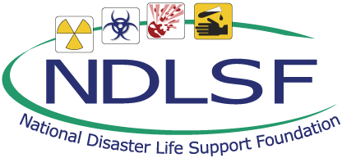
Session 3 – Lesson Six
Explosive, Traumatic, Nuclear, and Radiologic Disasters
BDLS 3.0 Course Manual
Chapters 6 & 7

Slide 3
Learning Objectives
Discuss background and epidemiology of explosions and traumatic disasters, including three primary types of explosions
Describe the four blast-related mechanisms of injury
Identify important hazard-specific considerations involved in response to explosion disasters
Discuss clinical decision making relevant to explosions and traumatic disasters
Identify individuals who may be at increased health risk in an explosion or other traumatic disaster
Notes:
Discuss background and epidemiology of explosions and traumatic disasters, including three primary types of explosions.
Describe the four blast-related mechanisms of injury.
Identify important hazard-specific considerations involved in response to explosions disasters.
Discuss clinical decision making relevant to explosions and traumatic disasters.
Identify individuals who may be at increased health risk in an explosion or other traumatic disasters.

Slide 4
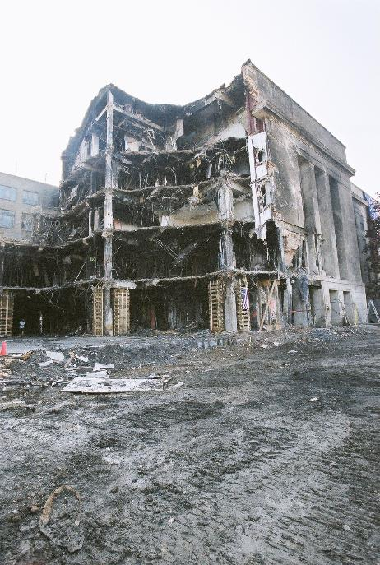
Background
Explosions and traumatic disasters occur throughout the world
Explosive devices account for about 75% of terror events worldwide
Number of criminal bombings in United States doubled in last decade
Jocelyn Augustino/FEMA
Notes:
Explosions may be attributed to terrorism, conflict-based disasters, industrial mishaps, transportation incidents, and structural collapse, among other causes. The more widespread use of bombs and improvised explosive devices (IEDs) contributes to the numbers of explosions.
Despite widespread concern over biological and chemical attacks, conventional explosive devices are by far the most commonly used terrorist weapons, accounting for about 75% of all terror events worldwide; firearms are responsible for most of the rest.
The majority of bombing threats have been thwarted in the United States, but despite this, the number of criminal bombings in the United States has doubled in the last decade.
IMAGE -- Arlington, VA, September 21, 2001: The exterior of one side of the Pentagon crash site is shown. Photo by Jocelyn Augustino/ FEMA News Photo

Slide 5
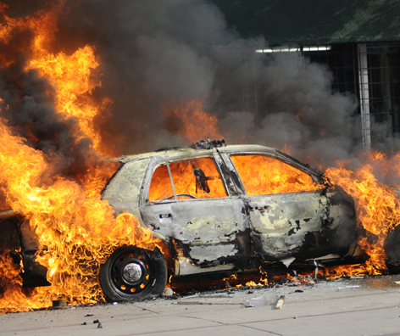
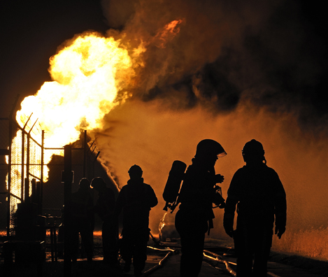
Types of Explosions
Thinkstock
Notes:
The most powerful type of explosion is nuclear. The explosive power from the alteration of atomic and subatomic structures is catastrophic in its destructive impact, with the force to destroy urban centers.
Mechanical explosions are the result of a physical process, rather than a nuclear or chemical reaction. A boiling liquid expanding vapor explosion (BLEVE) is an example of a mechanical explosion. When an enclosed vessel or container holding a liquid under pressure is exposed to heat sufficient to raise the temperature of the contained liquid above its boiling point, a BLEVE can occur.
Chemical explosions are the most common type of explosions. They result from the rapid chemical conversion of a solid or liquid explosive material into a rapidly expanding gas, with an ensuing energy release. Explosives are arbitrarily considered “high energy” or “low energy,” depending on whether the speed of the explosion exceeds the speed of sound.
IMAGES -- ©2012 Thinkstock.

Slide 6
Mechanism of Blast Injury
Primary
Overpressure of blast wave (ear, lung, intestines)
Tertiary
Blunt injuries from blast wind (forceful impact)
Quaternary
All other blast injuries (burns, psychological trauma)
Secondary
Penetrating injuries from blast wind (flying debris)
Notes:
Primary blast injury is caused by the blast wave. It is essentially a form of barotrauma that is unique to explosions and that causes damage to air-filled organs:
Blast ear: tympanic membrane rupture and middle ear damage
Blast lung: pulmonary barotrauma
Blast belly: abdominal hemorrhage and perforation
Blast eye: globe rupture
Blast brain: traumatic brain injury without physical signs of head injury
Secondary blast injury is caused by shrapnel (ie, fragmentation of the explosive device container and its contents) or secondary elements from the surrounding environment (ie, the powerful blowing of objects in the area of the explosion whose inertia is overcome by the force of the blast).
Tertiary blast injuries occur when the individual is propelled through the air (body displacement) by the blast wind or when a structure collapses with resultant casualties.
Quaternary blast injuries are described as additional injuries beyond primary, secondary, and tertiary injuries:
Burn injuries (flash, partial, and full thickness)
Toxidromes from chemical exposures
Inhalation injury
Respiratory distress from asthma or chronic obstructive pulmonary disease (COPD)
Acute coronary syndrome (ACS) or acute myocardial infarction (AMI)
Hypertensive emergencies
Psychosocial and behavioral emergencies
Some add an additional term Quinary Blast Injury which is the addition of adulterants to a blast such as a dirty bomb or the addition of infected biologic material to the bomb.

Slide 7
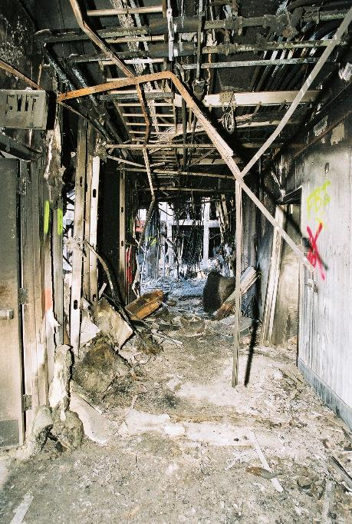
Situational Awareness Detection, Safety, Security, and Hazard Assessment
Beware intentional “targeting” of first responders
Observe site safety
Assess hazards
Downed power lines?
Debris?
Fire?
Hazardous materials?
Smoke or toxic inhalations?
Structural?
Secondary
Jocelyn Augustino/FEMA
Notes:
The likelihood of intentional “targeting” of the emergency response community and health facilities (ie, “secondary devices”) must be considered during any explosion or traumatic disaster occurrence until appropriate law enforcement agencies have eliminated such threats.
Site safety: The threat of additional detonations or further collapse is of particular concern. This is demonstrated starkly by the fact that most of the fatalities among rescue personnel on September 11, 2001, occurred when the World Trade Center towers collapsed.
Assessing hazards:
Are there downed power lines?
Is there debris and trauma at the scene?
Do you see fire and people with burns?
Are blood and body fluids apparent on the scene?
Do you see any hazardous materials?
Is there smoke or toxic inhalants?
Do you see a structural collapse or a structure that looks like it could collapse?
Are there any reports of possible secondary devices on the scene?
Is there the possibility of exposure to chemical/biological/radioactive material?
IMAGE -- Arlington, VA, September 21, 2001: Debris is shown inside the Pentagon. Jocelyn Augustino/FEMA.

Slide 8
Casualty Management Begins with performing Life Saving Interventions during the triage process
Control major hemorrhage
Open airway
Needle chest decompression
Autoinject antidotes
Notes:
Clinical decision making in explosion-based casualties always begins with performing basic lifesaving interventions as we learned in mass casualty triage.

Slide 9
Casualty Management
Initial care and decision making should follow established clinical guidelines
Ongoing care follows specific clinical decision making related to mechanism of injury and injury patterns
Consider early intubation for patients with inhalation injury
Administer fluid judiciously in combined blast lung and burn
Notes:
Initial care of blast trauma follows currently accepted treatment guidelines such as established in Pre-hospital Trauma Life Support®, Advanced Trauma Life Support®, and Advanced Burn Life Support training programs and materials.
Ongoing care follows specific clinical decision making, and may include one or more of these blunt, penetrating, blast and burn related topics:
Pulmonary blast injury
• Gastrointestinal blast injury
• Arterial gas embolism
• Auditory blast injury
• Traumatic asphyxiation
• Ocular blast injury
• Traumatic amputation
• Flash burns
• Crush injury/syndrome
• Penetrating injuries
• Compartment syndrome
• Blunt ballistic injuries
For example, patients with blast burn injury, consider early intubation if there is any evidence of respiratory distress, since airway swelling may occur rapidly following exposure to superheated gases. For patients with combined blast lung and blast burn injury, administer fluid judiciously, since too much fluid may compromise oxygenation, while too little fluid may compromise perfusion.
Some of these topics are reviewed in the following series of slides.
9

Slide 10
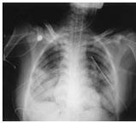
Clinical Decision Making Pulmonary Blast Injury (“Blast Lung”)
Explosions tear alveolar walls
Hemorrhage, barotrauma, AV fistulae
Signs and symptoms
Respiratory distress
X-ray findings
Treatment
Airway and oxygen
Mechanical ventilation challenges
Avoid excessive positive ventilation
CDC
Notes:
The enormous pressure differentials generated in explosions tear the delicate alveolar walls and disrupt alveolar capillary interface, leading to multifocal hemorrhage, hemothorax, pneumothorax, traumatic emphysema, or alveolovenous fistulae.
Signs and symptoms of pulmonary PBI may include difficulty completing sentences in one breath, rapid shallow respirations, poor chest wall expansion, hemoptysis, decreased breath sounds, or wheezes.
Chest radiograph may reveal:
“Butterfly” pattern of hilar-based, fluffy infiltrate
Pneumothorax
Pulmonary contusion
Treatment of pulmonary PBI focuses on correcting the effects of barotrauma and supporting gas exchange:
Oxygenation
Decompression of pneumothorax
Positive-pressure ventilation
If mechanical ventilation is unavoidable, use protocols that include:
Low tidal volumes
Permissive hypercapnia
Pressure-controlled modes keeping airway pressures at less than 35 cm H₂O
IMAGE -- Photo courtesy of CDC.

Slide 11
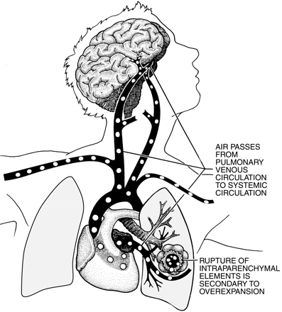
Clinical Decision Making Arterial Gas Embolism
Air embolizes directly between bronchial tree and disrupted pulmonary vasculature
Manifestation
Rapid decompensation
“Sudden death”
Management
Positioning
100% Oxygen
Physiology, 2002
Notes:
Air emboli result from direct communication between the bronchial tree and disrupted pulmonary vasculature. Air may enter the pulmonary venous system as a result of a positive pressure gradient caused by low venous pressure (as in hypovolemia), increased airway pressure (as in positive-pressure ventilation or tension pneumothorax), or both.
Arterial gas embolism often manifests as rapid decompensation immediately following intubation and positive-pressure ventilation. Such a collapse is usually unresponsive to resuscitation. While vascular obstruction from air bubbles may occur anywhere, the most catastrophic are those in the coronary or cerebral circulation.
Management of suspected air embolism begins with:
Simultaneous placement in the left lateral decubitus and Trendelenburg positions, to sequester air bubbles in the tips of the right and left ventricles
Administration of supplemental 100% oxygen, which promotes absorption of arterial bubbles
Keeping airway pressure as low as possible, less than intravascular pressure
Selective intubation of the uninjured lung if injury is unilateral
IMAGE --Physiology . 2002;17(2):77-81.

Slide 12
Clinical Decision Making Traumatic Asphyxiation
Mechanism of Injury
Compression of chest that impedes venous return to heart
Signs and symptoms
HEENT: Facial edema or cyanosis, subconjunctival hemorrhages
Chest: Respiratory distress, chest wall ecchymosis
Skin: Petechiae of head, neck, and chest
Treatment
Rapid extrication - The most important survival factor!
Evaluate for other life-threatening injuries
Supportive care
Notes:
Traumatic asphyxia occurs when the chest is suddenly and markedly compressed by a heavy object to such a degree that both respirations and venous return to the heart are impeded. The sharp increase in thoracic and superior vena cava pressure and the lack of valves in the vessels result in retrograde flow of blood and transmission of pressure from the right heart into the great veins of the head and neck.
Although individuals with traumatic asphyxiation often present quite dramatically, the condition itself is usually relatively benign and self-limiting in those who survive the initial asphyxial insult. Signs and symptoms may include respiratory distress, chest wall ecchymoses, facial edema or cyanosis, subconjunctival and retinal hemorrhages, and pinpoint petechiae of the head, neck, and chest.
Rapid extrication and release from compression is the single most important factor in improved survival. Treatment should focus on aggressive support of the respiratory and neurologic systems. Control of the airway and ventilatory support are paramount.

Slide 13
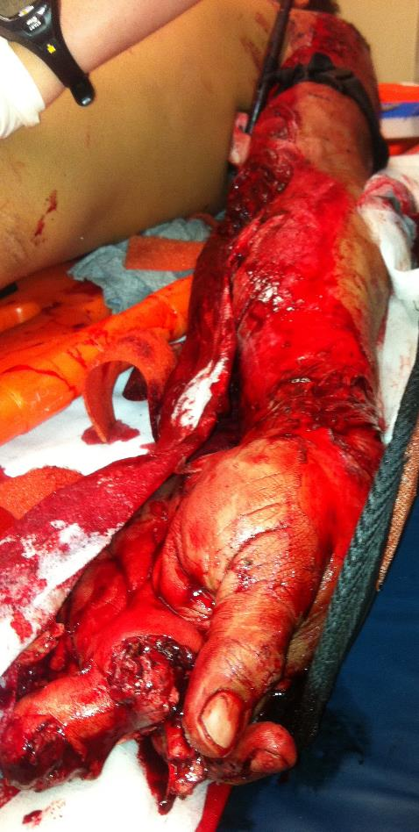
Clinical Decision Making Traumatic Amputation
Control hemorrhage
Tourniquet should be first line treatment for life threatening extremity hemorrhage
Richard Schwartz
Notes:
For traumatic amputation or severe mangling of an upper or lower extremity in domestic civilian practice, tourniquet use is indicated, based on extrapolation from military medical experience with commercially manufactured tourniquets such as the Combat Application Tourniquet.
IMAGE – Mangled Extremity Richard Schwartz MD.

Slide 14
Clinical Decision Making Crush Injury and Crush Syndrome
Crush injury - Compression of large mass of skeletal muscle
Ongoing compression - Tissue ischemia and rhabdomyolysis, with toxins released from cellular breakdown
Crush syndrome - Systemic complication of rhabdomyolysis and ischemic reperfusion injury
Life threatening - Hyperkalemia, hypovolemia, etc, leading to cardiac dysrhythmias and profound shock
Notes:
Compression of a large mass of skeletal muscle for as short a time as 20 minutes impedes tissue perfusion and leads to tissue ischemia and rhabdomyolysis.
Crush syndrome is an ischemia reperfusion injury and refers to the systemic complications of traumatic rhabdomyolysis. When an entrapped individual is extricated and blood flow into the damaged tissue is restored, toxins are released, leading to the various metabolic derangements characteristic of reperfusion injury. Severe hyperkalemia may also occur due to massive muscle breakdown (75% of body potassium is stored in skeletal muscle), potentially leading to cardiac dysrhythmia and cardiac arrest.
Sodium, Calcium, Water Shift Into Damaged Muscle Cells
Potassium, Phosphate, Lactate, Myoglobin Shift Out of Cells
Acute renal failure and disseminated intravascular coagulation (DIC) are late complications of crush injury, and both are associated with high rates of morbidity and mortality.
Prevention of crush syndrome by early and aggressive management of crush injury is the key to effective treatment. The principles of management of crush injury include urgent volume expansion, recognition and treatment of major metabolic derangements, prevention of acute renal failure due to rhabdomyolysis, and management of established acute renal failure.

Slide 15
Clinical Decision Making Compartment Syndrome
Compartment syndrome is complication of crush injury
Signs include severe pain, erythema, blistering, swelling, and diminished pulses
Treatment
Fasciotomies, controversial in the field setting
Transport to a facility that is capable of providing this care
Tissue edema
Increased pressure
Decreased blood flow
Notes:
The development of compartment syndrome is a complication of crush injury. Tissue edema inside of the confining fibrous sheath of a muscle compartment can cause an increase in pressure within the compartment, resulting in decreased blood flow and additional injury to the nerves and muscles within the compartment.
Erythema at the wound margins and blistering of the adjacent skin may also occur. As the compartment syndrome evolves, the individual may become hypotensive or show symptoms of shock. Marked tenderness, bruising, and swelling can be seen. Distal pulses may or may not be present.
Field fasciotomies are controversial; the risk of bleeding and infection must be weighed against the potential benefit. However, they should be performed as soon as possible by a qualified first receiver on arrival at a definitive care facility.

Slide 16
Clinical Decision Making Gastrointestinal Blast Injury (“Blast Belly”)
Intestinal (usually colon) injury from stretching and ischemia resulting in bowel wall weakening, leading over time to bowel rupture
Intra-abdominal trauma to liver, spleen, etc, from blunt or penetrating associated trauma following explosion
Signs and symptoms
Nausea and vomiting, Abdominal pain, Diarrhea
Notes:
Gas-containing abdominal organs are injured in a similar manner and at similar overpressures as the lung.
However, primary blast injuries to the abdomen or “blast belly” may be overshadowed by the more immediately life-threatening manifestations of blast lung. Gastrointestinal injuries are even more common than pulmonary injuries in immersion or enclosed-space blasts.
A gastrointestinal blast injury tends to affect the colon and spare the small bowel, owing to the greater amount of gas in the former.
Damage may range from edema to hemorrhage to frank rupture. Colonic rupture, although possible acutely, is generally occult and delayed.
Signs and symptoms are nonspecific and include abdominal pain, nausea, vomiting, diarrhea, tenesmus, decreased bowel sounds, rebound tenderness, guarding, and rectal bleeding.

Slide 17
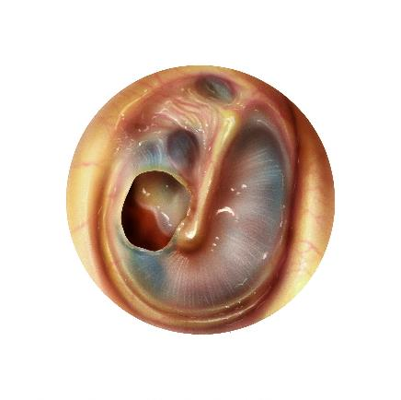
Clinical Decision Making Auditory Blast Injury (“Blast Ear”)
Blast-related damage to inner ear
Acute hearing loss
May be unable to hear verbal instructions (complicates triage)
Ear pain, vertigo, tinnitus
Avoid irrigation and consider antibiotics
May be associated with other blast injuries
Notes:
A blast injury to the auditory system occurs at much lower overpressures than pulmonary or gastrointestinal injuries.
It is not predictive of underlying pulmonary or gastrointestinal blast injury.
Tympanic membrane rupture can cause an acute sensorineural hearing loss that can be quite incapacitating in the moments following an explosion, often leading those affected to ignore oral instructions or even secondary explosions because of acute hearing loss.
Other common symptoms of auditory PBI include vertigo, tinnitus, and otalgia.
Initial treatment involves avoiding probing or irrigation of the canal. If the ear canal is full of debris, then a course of antibiotic drops is recommended.
IMAGE -- Custom Medical Stock Photo.

Slide 18
Clinical Decision Making Ocular Blast Injury (“Blast Eye”)
Vulnerable to secondary and tertiary blast injuries
Symptoms – foreign body sensation, pain and visual loss
Injuries – may be serious, globe rupture, penetrating FB
Referral to ophthalmologist
Notes:
Eyes of blast casualties are most vulnerable to secondary and tertiary blast injuries, with up to 28% of these casualties experiencing serious injuries.
Symptoms include eye pain or irritation, foreign body sensation, altered vision, periorbital swelling, and contusions.
Some of these injuries include lid lacerations, hyphemas, retinitis, orbital fractures, and ruptured globe.
Referral to an ophthalmologist is mandatory.
IMAGE --Disaster Medicine and Public Health Preparedness. June 2010. 4(2): p155.

Slide 19
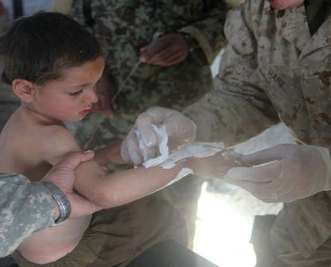
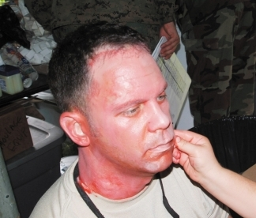
Clinical Decision Making Flash Burns
Short-lived intense heat of blast
Wounds tend to be superficial
Confined to exposed areas of body
Face and hands most common
Managed as other burns are
Lance Cpl Joseph M. Peterson
Uniformed Services University
Notes:
In the absence of secondary fires, such burns usually only affect the individuals closest to the blast, tend to be superficial, and are confined to exposed areas of the body such as the face and hands.
Deeper or more extensive burns may occur if the clothes ignite.
Burns from explosions or traumatic disasters should be managed as other burns are, with fluid resuscitation, debridement, and antimicrobial prophylaxis.
IMAGES --
Upper: Boy getting a burn bandaged. US Marine Corps/Lance Cpl Joseph M. Peterson.
Lower: September 11, 2008 : A moulage (make-up) artist applies make up to a first-year medical student to give the appearance of a flash burn. First-year students act as patients for the fourth-year students during Operation Bushmaster. Photo Courtesy of Uniformed Services University.

Slide 20
Clinical Decision Making Penetrating Ballistic, Stab, or Impaling Injuries
”Low velocity” or “high velocity”
Injuries depend on tissue involved
Entrance and exit wounds
Extensively contaminated
Adequate debridement
Tetanus prophylaxis and broad-spectrum antibiotics
Notes:
Projectiles are customarily described as either low velocity or high velocity, with the arbitrary cutoff equal to the speed of sound:
High-velocity weapons of war tend to produce exponentially greater tissue destruction and cavitation than the low-velocity weapons typically used by civilians
The nature of the wound depends on the specific biological properties of the tissue involved and the physical characteristics of the projectile
The missile’s path can be estimated from the locations of the entrance and exit wounds or the position at which the projectile came to rest within the body
Penetrating ballistic wounds are generally extensively contaminated and adequate debridement is mandatory. All penetrating wounds to the chest or abdomen should be adequately explored. Tetanus prophylaxis and broad-spectrum antibiotics should be given. Consider delayed primary closure with these wounds
The clinical injury depends on the size, shape, depth of penetration, and force with which the weapon strikes the body, and which part of the body is struck:
Impaled objects should not be removed in the field, but should be stabilized manually or with bulky dressings
Penetrating chest wounds require careful observation for the development of tension pneumothorax, open pneumothorax, massive hemothorax, and cardiac tamponade
Abdominal wounds require careful observation for the development of hemodynamic instability or peritoneal irritation
Penetrating soft-tissue wounds require little field management other than controlling hemorrhage and covering the wound to avoid further contamination

Slide 21
Clinical Decision Making Blunt Ballistic Injuries
Rubber bullets, beanbag shotgun shells, etc
Standard bullets impacting a protective vest
Heart, liver, spleen, lung, and spinal cord are vulnerable
Injuries may occur beneath benign-appearing skin lesions
Close observation due to possibility of delayed on-set of symptoms
Notes:
Blunt trauma resulting from ballistic weapons may occur from the use of nonlethal weapons that result in blunt ballistic injuries including weapons that project rubber bullets, beanbag shotgun shells, etc. Blunt ballistic injuries may also occur from an intended penetrating projectile such as a standard bullet impacting a protective vest (“bulletproof” vest).
Nonpenetrating, severe injuries may occur. Heart, liver, spleen, lung, and spinal cord are vulnerable. Injuries may occur beneath benign appearing skin lesions. The possibility of a delayed presentation warrants close observation.

Slide 22
Casualty Management Pediatric Blast Trauma Considerations
When compared with other types of pediatric trauma:
Head injuries are more common
Injuries are likely more severe and consume more resources compared to adults
Provide care in pediatric specialty hospitals if possible
Comprehensive pediatric specialty care
Pediatric intensive care unit
Notes:
With respect to children, the priorities of care in pediatric blast trauma are no different from those in adults. However, as with other types of pediatric trauma, the application of these priorities to children may require slight modification, owing to their anatomic and physiologic differences from adults. That said, data from the Israeli Trauma Registry indicate that, with respect to other types of pediatric trauma, head injuries are more common in blast injury, older children and adolescents predominate, while blast injuries are three times more severe than other injuries, requiring more intensive care and rehabilitation days. Treatment in pediatric specialty hospitals is known to provide better outcomes owing to the availability of comprehensive pediatric specialty care, including pediatric intensive care.
22

Slide 23
Session 3 – Lesson Six
Nuclear and Radiologic Disasters
BDLS 3.0 Course Manual
Chapter 7

Slide 24
Learning Objectives
Discuss difference between nuclear and radiologic disasters with respect to magnitude and health outcomes
Define basic radiation terms, types, and units of measure important to health personnel
Describe rationale for time, distance, and shielding in radiation protection
Identify early clinical signs and symptoms suggestive of radiation exposure
Discuss general considerations for clinical management of radiation casualties
Notes:
The lesson learning objectives include:
Discuss difference between nuclear and radiologic disasters with respect to magnitude and health outcomes
Define basic radiation terms, types, and units of measure important to health personnel
Describe rationale for time, distance, and shielding in radiation protection
Identify early clinical signs and symptoms suggestive of significant radiation exposure
Discuss general considerations for clinical management of radiation casualties

Slide 25
Learning Objectives
Summarize the clinical features and treatment of acute radiation sickness and cutaneous radiation syndrome
Discuss decorporation techniques and countermeasures for the management of internal contamination with radioactive materials
Discuss the purpose of emergency public health response actions during a nuclear or radiologic disaster, including risk communication, care of populations with access or functional needs, and population exposure monitoring
Notes:
The lesson learning objectives include:
Summarize the clinical features and treatment of acute radiation sickness and cutaneous radiation syndrome
Discuss decorporation techniques and countermeasures for the management of internal contamination with radioactive materials
Discuss the purpose of emergency public health response actions during a nuclear or radiologic disaster, including risk communication, care of populations with access or functional needs, and population exposure monitoring

Slide 26
Background
Radiologic and nuclear events represent unique challenge
Local and state community preparedness to respond may result in saving of tens of thousands of lives
Nuclear and radiologic events often confused:
Nuclear event involves nuclear detonation and accompanying massive explosion
Radiologic event involve release of radioactive materials to populated areas (with or without explosion)
Notes:
As the threat of the use of weapons of mass destruction on civilian populations continues to increase, clinical and public health providers and their supporting infrastructures are facing considerable preparedness challenges from the resulting mass casualties.
According to the federal interagency document “Planning Guidance for Response to a Nuclear Detonation,” “Local and state community preparedness to respond to a nuclear detonation could result in life-saving on the order of tens of thousands of lives.”
Nuclear and radiologic events are often confused with each other, but the two are vastly different in the magnitude and severity of health outcomes. Basically, nuclear events involve very large numbers of deaths and severe injuries, while radiologic events can be expected to have a much smaller or even no impact on morbidity and mortality in an affected population.

Slide 27
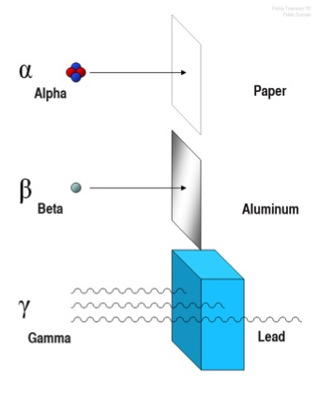
Radiation Basics
Alpha (α) particles
Beta (β) particles
Gamma (γ) radiation
Notes:
Alpha (α) particles have a very short range and are easy to shield against (even by a single sheet of paper). Alpha particles cannot penetrate the outer layers of skin and are not an external hazard. Radioactive materials that emit them are an internal hazard if ingested or inhaled.
Beta (β) particles have a longer range and are harder to shield against. Aluminum foil or glass will stop most beta particles. They can penetrate the outer layers of skin and are both an external and an internal hazard. Beta radiation travels only a short distance in tissue, depending on its energy, and can be a significant source of dose to the skin.
Gamma (γ) radiation has a very long range and is very difficult to shield against. Unlike alpha or beta particles, gamma rays are electromagnetic energy waves similar to x-rays. Concrete, lead, or steel is needed to shield against sources of gamma rays. Gamma radiation can penetrate through the whole body. It is an external and an internal hazard. High-energy gamma radiation can penetrate deeply into tissue. Most radioactive materials with current commercial applications emit high-energy gamma rays.
IMAGE -- Public Domain art from Tungsten.

Slide 28
Characteristics of Injuries after Nuclear and Radiologic Disasters
Blast injuries
Thermal burns
Radiation toxicity
Electromagnetic pulse
Notes:
Trauma injuries:
As occurs with conventional explosion blasts, a nuclear blast would cause pressure change (albeit far exceeding that of a conventional blast in both peak intensity and duration) that would decrease in intensity with greater distance from the blast. It would also cover a much larger area.
Thermal burns:
A daunting spectrum of thermal burn injuries will be incurred from a nuclear blast as a result of the heat and electromagnetic radiation released by the explosion. Thermal burn injuries (flash burns), which would occur immediately after the detonation (resulting in both fatalities and survivors), should be distinguished from flame burns and also cutaneous radiation burns, which will not appear until hours and days after the event.
Radiation toxicity:
Both immediate and delayed radiation exposure occur after nuclear detonations. Gamma irradiation is released by the detonation, as well as from fission products resulting from the blast.
Electromagnetic pulse:
Detonation of a nuclear weapon above the atmosphere can generate a significant radiofrequency flash of 30 000 to 100 000 kV/m intensity with a rise time of less than 10 nanoseconds. This flash, called electromagnetic pulse, can disable or destroy medical equipment, communications equipment, computer-controlled vehicles, and power control systems.

Slide 29
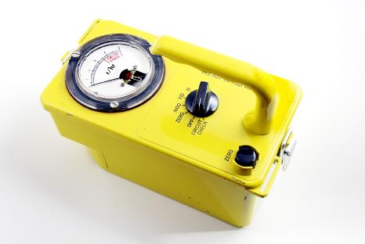
Situational Awareness and Detection
Scene assessment
High index of suspicion
Visible clues on vehicles or containers
Use detection equipment to
Detect radiation field present
Identify radioactive isotopes present
Radiation detection technology
Field detection devices (meters)
Airborne particulate detectors
Isotope identifiers
Thinkstock
Notes:
After an explosion, first responders may not be aware they are entering an area in which radioactive material has been dispersed. A high index of suspicion, backed by appropriate radiation survey equipment, will enable them to detect the presence of radiation.
Visible clues such as markings on vehicles or containerscan hint at the possibility of radioactive contamination.
Two major elements of scene assessment are required:
Detection of the radiation field present
Identification of the radioactive isotopes present
The types of detection to be used are grouped generally into these categories:
Field detection devices (meters): A Geiger counter (which detects beta radiation and gamma radiation) or a scintillation detector (which detects gamma radiation only) is useful for scene management and can affect response personnel management
Isotope identifiers: An isotope identifier is a specific label that identifies the source of a particular isotope (ie, Cesium 137 has many isotopes that originated from different sources.
Airborne particulate detectors: If an alpha detector is available, it should be brought to the scene as soon as possible. Airborne alpha radiation can be extremely dangerous to response personnel and the affected population because of the potential for high specific activity and significant internal doses from ingestion of alpha-emitting isotopes.
IMAGE -- ©2012 Thinkstock.

Slide 30
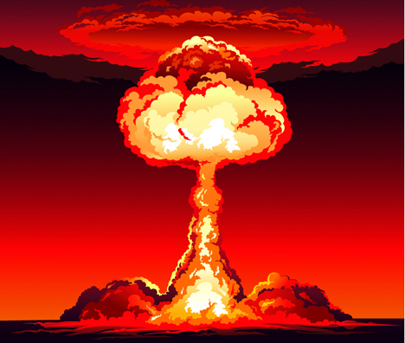
Hazard Assessment
Nuclear detonation
Prompt radiation
Activation products
Fallout (fission) products
Radiation dispersal device
No activation products
Lethal radius from blast far exceeds that from radiation
Radiation from contamination
Thinkstock
Notes:
In a nuclear detonation, first responders need to be aware of two types of hazards:
Nuclear detonation:
Prompt radiation:
As this occurs only within the first few seconds of device disassembly, it will not be a risk for first responders
Activation products (materials made radioactive by the neutron flux from the weapon):
Activation products are present near ground zero and are created almost immediately after detonation
Fallout (fission) products (ie, what uranium or plutonium atoms “split” or fission into):
Fallout is formed from fission products, as well as from activation products created in the nonfuel materials in the device that are vaporized, then cool, condense, agglomerate, and also coat nonradioactive particles in the cloud. They fall from the cloud, hence the name fallout.
Radiation dispersal device:
No activation products
As a rule, the lethal radius from the blast far exceeds that from the radiation, so uninjured persons will generally have relatively little radiation exposure
Radiation from contamination, both of the environment and deposited on an individual’s clothing and body, can affect first responders
IMAGE -- ©2012 Thinkstock.

Slide 31
Incident Management Challenges
Evacuate vs shelter in place
Radiation field determination
Logistical support services
Personnel shortages
Information sharing
Media cooperation
DHS
Notes:
Nuclear and radiologic disasters will present challenges to the incident management system.
Early situational awareness regarding the radiation field, for example, is important in determining risk communication (information sharing, media cooperation for examples) AND guidance for such issues as evacuate vs. shelter-in-place instructions. Incident management will be challenged by available support, including personnel.
IMAGE -- The NIMS cover pictured on this slide is from https://www.fema.gov/pdf/emergency/nims/NIMS_core.pdf, published December 2008, accessed June 11, 2012.

Slide 32
Workforce Preparedness
Scene safety and security
Outer and inner perimeter
Personal protective equipment (PPE)
Typical barrier PPE, Bunker gear
Respiratory protection
Radiation exposure monitoring
Radiation exposure limits responders
Casualty decontamination
Contaminated persons unlikely to present radiation hazard
Not necessary to decontaminate before treatment
Notes:
Determining the radiation field present should be viewed as an emergent action to ensure that emergency responders, including medical personnel, are aware of the steps needed to manage the radiation risk.
The tendency for workers to enter a hazardous environment regardless of personal risk must be addressed. First responders must be aware of the radiation hazards in their areas of operation. Two perimeters, or control zones, are recommended to facilitate casualty care:
An outer perimeter of 0.1 mSv/h (10 mrem/h) where casualties should be decontaminated, if medical conditions permit, and then transported as indicated. First responders and other personnel coming inside the outer perimeter must have monitoring devices (film badges, preferably “pagers”).
An inner perimeter of 0.1 Sv/h (10 rem/h). Responders should not go beyond this perimeter except to perform time-sensitive, mission-critical activities such as lifesaving. No one should go beyond this point without the explicit permission of the incident commander, and then only for short intervals to save lives. Time spent inside this area must be strictly monitored. The decision dose is 0.5 Sv (50 rem).
The incident commander must assess benefit, in terms of lives potentially saved vs increased risk to first responders.
In a radiation incident, typical barrier PPE may not be effective, because many isotopes produce gamma radiation capable of penetrating most clothing and protective equipment.
In general, firefighters are protected from beta radiation by the heavy nature of “bunker gear” or “turnout gear” (boots, trousers and coat, gloves, hood, mask).
The most significant component of any PPE is respiratory protection. An N95 mask or better is optimal. Keeping radioactive materials out of the body is paramount.
Close monitoring of radiation levels received by responders between the perimeters and inside the inner perimeter is mandatory.
Radiation exposure limits for responders:
All personnel: 50 mSv (5 rem)
Protecting major property: 100 mSv (10 rem)
Lifesaving/protecting large populations: 250 mSv (25 rem)
Lifesaving/protecting large populations: >250 mSv (>25 rem); only on a volunteer basis to persons fully aware of the risks involved
The medical provider should understand that contaminated persons are unlikely to present a radiation hazard to the personnel. It is not necessary or advised to delay emergent treatment to decontaminate the casualty.

Slide 33
Casualty Management
Mass casualty triage
Providing emergency care
Decontamination
Evacuation
Notes:
The goal of triage is to evaluate and sort individuals by immediacy of treatment needed to do the greatest good for the most people.
The first responder team needs to sort, assess, perform lifesaving interventions, and then treat or transport the casualty. Risks to health care providers from contaminated patients, while greater than zero, are very low.
Decontamination can often be done simultaneously with treatment if the situation permits, but if sequencing of lifesaving care is necessary, decontamination comes last.
The injured public and many of those who are contaminated will require evacuation to a suitable medical treatment or decontamination facility. It is not necessary to decontaminate before evacuation if it delays transport for lifesaving treatment or if remaining in the area poses a ongoing risk from radiation.

Slide 34
Clinical Management of Radiation Casualties Basic Concepts and Principles
Sign/Symptom | Mild 1-2 Sv (100-200 rem) | Moderate 2-4 Sv (200-400 rem) | Severe 4-6 Sv (400-600 rem) | Very Severe >6 Sv (>600 rem)
Emesis | <35% | 35%-72% | 72%-95% | ∙100%
Emesis (time to onset) | ≥2 h | 1-2 h | <1 hour | <30 minutes
Survival (Chernobyl data) | 41/41 | 49/50 | 15/22 | 1/21
Absolute lymphocyte count 24 hours after exposure (% normal) | 78%-100% | 60%-78% | 50%-60% | <50%
Notes:
After a nuclear or radiologic disaster, there is a good possibility that casualties will arrive at health care facilities unaware that they have been exposed to radiation or that they may be contaminated.
The first symptoms of significant radiation exposure are generally nausea, vomiting, fatigue, and lassitude; these are rather “soft” symptoms that present with other illnesses as well as acute radiation sickness.
The best laboratory test to determine level of exposure is the complete blood cell count (CBC) with differential. Lymphocytes are the most sensitive tissue in the body to radiation exposure, and a serial drop can tell roughly how high a dose was received.
Table from BDLS v 3.0 Course Manual, Table 7-2.

Slide 35
Basic Concepts and Principles
Trauma care
ATLS®
Contaminated materials
Therapeutic Interventions
Stopping further exposure
Find other treatable conditions
Altered Care Environment
Ratio of medical providers to patients
Modified care standards
Diagnostic Testing
Radioactive isotopes
External radiation
Notes:
Adherence to routine advanced trauma life support is the mainstay of care delivery. If contaminated material (eg, radioactive isotopes) is removed during treatment, the surgical staff will require medical physics support and radiation monitoring. Fragments should be handed off to the radiation safety officer or designate for disposition.
As the treatment for these radioactive isotopes is different (chelating agents for plutonium, alkalinization of urine with sodium bicarbonate for uranium), it is important to discern via bioassays of urine and stool which, if either, of these isotopes may have been inhaled.
For external radiation exposure, the critical parameter is dose received. Leukopenia, particularly lymphopenia, in serial CBCs is probably the quickest and easiest way to diagnose significant radiation exposure.
In any toxic exposure, the first step in therapeutic intervention generally includes stopping further exposure to the toxin. This is true in radiation exposure as well. For external whole-body irradiation, this means removing the patient from the area of radiation exposure and removing external contamination.
Ensure that there is not some other treatable condition causing this patient’s symptoms.
Therapy for ARS and cutaneous radiation syndrome will be covered later.
Altered care environment (ACE) refers to the concept of treating large numbers of casualties outside of a traditional setting because of limitations in existing traditional health care facility capacity.
The most striking difficulty will be with mass casualty burn care, as the ratio of medical personnel to patients will be so adverse relative to standard care.

Slide 36
Management of Acute Radiation Sickness
Cardiovascular/CNS
Supportive care
Gastrointestinal
Treatment of emesis and diarrhea
Hematopoietic
Infection control
Cytokine therapy
Stem cell transplants
Antiemetics
Fluid and electrolyte therapy
Notes:
ARS is now regarded as a multisystem disorder, with radiation damage occurring to all systems at all doses sufficient to induce ARS.
The three subsyndromes of ARS are as follows:
Hematopoietic, generally occurring at 1 to 6 Sv (100–600 rem)
Gastrointestinal, from 6 to 20 Sv (600–2000 rem)
Cardiovascular/CNS, occurring above 20 Sv (2000 rem)
Treatment of emesis and diarrhea is antiemetics and fluid and electrolyte therapy. Consider the use of antidiarrheals and probiotics. Symptoms usually improve 24 to 48 hours after onset.
Infection control consists of reverse isolation precautions for persons receiving 3 Sv (300 rem) or more, and gut decontamination with quinolones. Neutropenia or signs of infection should prompt aggressive expansion in antimicrobial coverage.
Hematopoietic colony-stimulating factors (CSFs), which are cytokines, have received Food and Drug Administration (FDA) approval for management of medical treatment-induced neutropenia. Though they have not yet been formally approved for management of radiation-induced aplasia, these cytokines are in the Strategic National Stockpile (SNS), and their off-label use should be considered in casualties with significant radiation exposure.
Recommendations for cytokine administration are based, for mass casualty scenarios, on doses of 3 to 7 Sv (300-700 rem) in otherwise healthy persons.
While stem-cell transplantations have been used with success in patients with certain hematologic malignant conditions, the success of this treatment for radiation casualties is much less impressive. There is no convincing evidence that allogeneic stem-cell transplants would have much of a role in radiation mass casualty events

Slide 37
Cutaneous Radiation Syndrome (CRS)
Seen in highly irradiated casualties
Patients often present with acute radiation sickness
CRS worsens prognosis
Conservative vs surgical treatment
Anti-inflammatories and antimicrobials
Surgical debridement and grafting
Notes:
CRS is a critical feature of highly irradiated casualties, often associated with expectant patients.
Generally, when there is significant whole-body radiation, there is significant local radiation injury, primarily CRS.
During the triage process, including the ongoing patient sorting at medical treatment facilities, clinicians must be aware that CRS will lower the prognosis for survival in casualties with ARS and other major injuries.
The two main approaches to managing CRS are conservative and surgical treatment.
For relatively intact skin, appropriate treatment is corticosteroid ointments, topical antibiotics with dressings if blistering is present, and other emollients.
If severe pain or necrosis or ulceration without signs of regeneration is present, conservative and surgical debridement and grafting can be performed.

Slide 38
Management of Internal Radioisotope Contamination
Isotope determination
Organ scanning
Nose sampling
Bioassays
Decorporation techniques and countermeasures
Lavage
Blocking deposition
Elimination
Notes:
Whenever internal contamination is suspected, it is important to rapidly detect and identify the isotope(s) involved:
Thyroid scanning is useful in determining whether the thyroid has taken up a significant amount of one or more radioactive iodine isotopes
Sampling of the nose can detect isotopes that have been inhaled
Bioassays of the urine and stool will detect isotopes that are excreted; 24-hour urine and fecal collections are important in monitoring the remaining body burden if appropriate
Decorporation techniques and countermeasures take a variety of forms:
Lavage, or rinsing out a cavity (nose, nasopharynx, stomach, and even lungs) prevents uptake of isotopes that have entered the body (removal of radioactive fragments, such as from an RDD, would also fall in this category.
Deposition can be blocked with stable iodine for the thyroid or strontium for bone
Elimination of uranium can be increased by alkalinizing the urine. Hydrating the patient can increase the excretion rate of water-soluble isotopes. Accelerating the passage of certain ingested materials by enemas, laxatives, or cathartics will also reduce the time available for uptake.
Elimination of Plutonium by use of DTPA (DIETHYLENETRIAMINEPENTAACETATE)
Cesium use Prussian Blue

Slide 39
Public Health Implications of Nuclear and Radiologic Disasters
Crisis and emergency risk communication
Mental and behavioral health considerations
People with functional, access, or other special needs
Age-related vulnerabilities, both children and elders
Risk to pregnant women and fetuses
Notes:
Effective risk communication is essential to ensure that the public receives appropriate instructions to protect its health and safety Explicit explanations must be made in as simple terms as possible, avoiding complex technical arguments, for any recommendations regarding public activity in a radiologic incident.
In addition to the loss of medical care, among the anticipated outcomes for the general public will be fear of invisible agents and contagion, magical thinking about radiation, anger at perceived inadequacies by government entities, scapegoating, paranoia, social isolation, demoralization, and loss of faith in social institutions.
Special need considerations should include not only children, aged parents, and those requiring special home care, but also medical staff and all other responders and their families. If responders cannot assure the safety of their families, they will be ineffective.
With advancing age, the capacity to repair injuries and fight infection decreases. The treatment protocols for radiation only and combined injury are the same, but their likelihood of success decreases. The elderly are at lower risk of development of a radiation-induced cancer due to long latency.
One of the most misunderstood issues in radiation-contaminated environments is the relative risk to pregnant women and prenatally exposed infants.
A limited number of birth defects were reported in Hiroshima and Nagasaki atomic bomb survivors, but none was found from the Chernobyl incident. However, the risk of “beta” skin burns is higher in infants and small children owing to their thinner skin; the risk of late thyroid cancer is also higher in infants and children, owing to exposure to beta-emitting radioiodides from fallout, their uptake and concentration in the thyroid gland, and the shorter distances the emitted beta particles need to follow to damage the smaller pediatric thyroid gland. Public health officials will advise the community if prophylactic potassium iodide should be taken by exposed individuals in age-appropriate doses. There is some evidence that leukemias occur with greater frequency in children exposed to ionizing radiation.
The rate of radiogenic cancers does increase after fetal exposure to high doses of radiation.

Slide 40
Lesson Summary: Explosive, Traumatic, Nuclear, and Radiologic Disasters
Understanding the four basic blast-related injury mechanisms guides specific treatment
Situational awareness of the blast-related hazards is important for all response personnel
Initial care follows accepted guidelines
Clinical decision making must identify and address blast-related findings associated with increased risk
Notes:
The management of casualties following a blast incident requires an understanding of the basic mechanisms of blast injury, including primary, secondary, tertiary, and quaternary injury. Understanding the likely hazards encountered in blast incidents is key, noting that additional explosive devices may be present. Initial care follows PHTLS®/ATLS®/ABLS guidelines. The blast-related casualty must be thoroughly assessed for the unique mechanisms previously reviewed to guide further management.

Slide 41
Lesson Summary: Nuclear and Radiologic Disasters
Radiation provokes special fear
Clinicians will play role vital in radiation emergency
Health threat to response personnel is low
Basic clinically relevant knowledge is key
Notes:
Radiation provokes a special fear, but, with appropriate understanding and preparation, effective clinical care can be provided to exposed people.
In the event of a terrorist attack or other radiation disaster, clinicians will play vital roles as responders and as sources of accurate information for affected individuals and communities.
The health threat to response personnel is low and can be minimized by using universal safety precautions (mask, gown, gloves).
A basic clinically relevant knowledge of the unique terms, principles, mechanisms of injury, and common units of measure associated with ionizing radiation is a base on which to build understanding that facilitates workforce protection, as well as clinical decision making that fosters good casualty management.

Slide 42
Questions?

