Slide 2
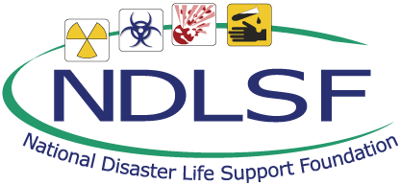
Session 4 – Lesson Seven
Public Health and Population Health in Disasters

Slide 3
Learning Objectives
Discuss emergency public health response actions that can be implemented in a disaster
Discuss health issues that need to be addressed in all-hazards disaster preparedness and response planning
Explain the rationale for a function- and access-based definition to address all individuals who may be more vulnerable to adverse health effects in a disaster or public health emergency
Notes:
Discuss emergency public health response actions that can be implemented in a disaster.
Explain the rationale for a function- and access-based definition to address all individuals who may be more vulnerable to adverse health effects in a disaster or public health emergency.
Describe pediatric vulnerabilities and challenges that need to be addressed in all-hazards disaster preparedness and response planning.

Slide 4
Learning Objectives
Describe pediatric vulnerabilities and challenges that need to be addressed in all-hazards disaster preparedness and response planning
Discuss the potential impact of disasters on individuals with chronic illnesses
Discuss mental and behavioral health consequences for children and adults affected by a disaster or public health emergency
Notes:
Discuss women’s health issues that need to be addressed in all-hazards disaster preparedness and response planning.
Discuss the potential impact of disasters on individuals with chronic illnesses.
Discuss mental and behavioral health consequences for children and adults affected by a disaster or public health emergency.

Slide 5
Definition of a Public Health System
A complex network of individuals and organizations that, when working together, can represent what we as a society do collectively to ensure the conditions in which people can be healthy.
Institute of Medicine (IOM), 1988
Notes:
The IOM definition of the public health system can be found and reviewed on pp 2-3 of the BDLS 3.0 Course Manual.

Slide 6
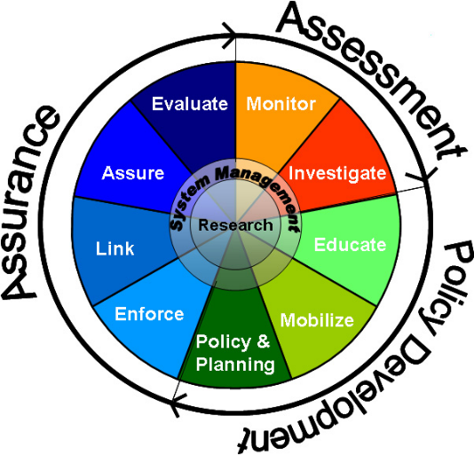
Public Health System Basics
Function:
Protect populations against injury, disease, environmental and occupational hazards
Workforce:
Diverse skill sets, backgrounds, and experience
Notes:
The role of the public health system is to protect the nation against injury, disease, and a myriad of environmental and occupational hazards. The distinct difference between emergency care and public health is that public health focuses its efforts on the population as a whole. The public health workforce is made of up of a wide variety of skill sets, educational backgrounds, and experience – from specially trained nurses to epidemiologists to postdoctoral researchers to lab technicians and social workers.
IMAGE -- http://www.health.gov/phfunctions/public.htm.

Slide 7
Large-Scale Disasters and Public Health Emergencies
Damage to public health infrastructure
Health service disruption
Population resource disruption
Widespread population displacement
Critical: Integration of public health and emergency care system
Notes:
A large-scale disaster or a public health emergency may disrupt and impact important components of a community, including damage to the public health infrastructure, widespread displacement of the population affected, disruption of normal health and medical services, and destroying or disrupting access to key resources.
It is critical that during times of a large-scale disaster or public health emergency that the public health system and the emergency care system be integrated and working collaboratively.

Slide 8
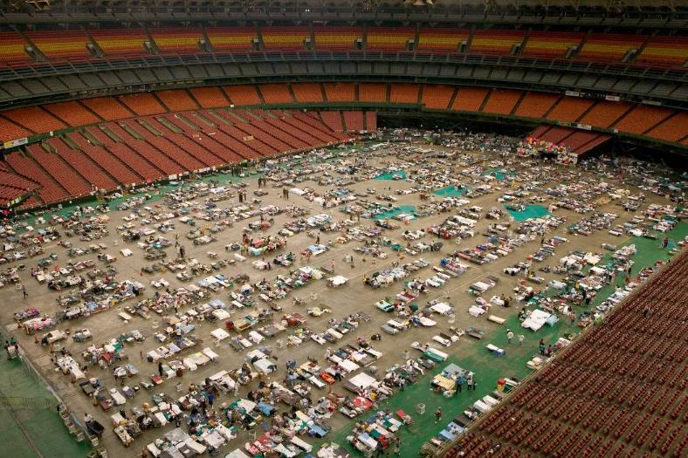
Shift in Perspective
Jocelyn Augustino/FEMA
Andrea Booher/FEMA
Population
Individual
Notes:
The scope and scale of disasters may significantly exceed resources available for individual care. Large-scale disasters can readily become public health emergencies. These are defined broadly as any event that significantly threatens the health or safety of the public.
It is important at this stage for every disaster responder to have an understanding of public health and how we transition our thinking from treating an individual to taking care of an entire population, in order to provide the greatest good for the greatest number of people. This is in contrast to the traditional medical model of a physician having an independent relationship with each patient and providing all the care the patient needs regardless of effects on availability of these resources to others.
For example, a physician must make the difficult transition from a physician-patient relationship to a physician-population relationship.
IMAGES -- Left: Jocelyn Augustino/FEMA; right: Andrea Booher/FEMA.

Slide 9
Public Health Functions in Disaster
Promote health and hygiene, prevent epidemics and spread of disease | Provide supply of food, clean water, sanitation supplies
Conduct mass vaccination/prophylaxis | Implement environmental controls
Enhance epidemiologic surveillance | Ensure provision of health services
Inform professionals about health issues and emerging diseases | Enforce laws and regulations relating to health and disease
Implement and enforce isolation and quarantines | Provide emergency risk communication
Assist with community evacuation and sheltering operations | Manage incidents related to public health issues/epidemics
Collect health data and report to community, responders, and providers | Develop new policies and plans to aid in preparedness for next disaster
Notes:
This is a partial list of the functions of public health during a disaster. We will not cover all of these in this lecture, nor read through all of them right now. However, it is important that you get a sense of the essential role that public health plays in preparedness, response, and recovery of disasters. Shortly, we will highlight a few of the key functions of which every disaster responder should be aware.

Slide 10
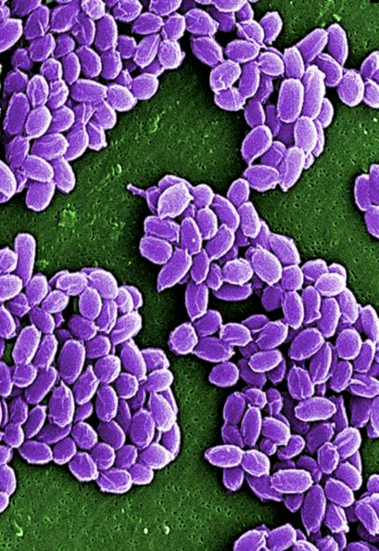
Epidemiologic Surveillance
Ongoing assessment of community health
Identify new health concerns/issues (look for patterns, oddities)
Track and document potential exposures
Laura Rose/CDC
Notes:
Public health surveillance and epidemiologic investigation are directed to the systematic, ongoing assessment of the health of a community. In some cases, an epidemiologist may suspect an outbreak by noticing unusual patterns or clusters of a disease in routine surveillance data.
Public health surveillance systems identify new health concerns, manage public information, and measure the effectiveness of ongoing interventions.
In a disaster or public health emergency, health assessment and monitoring programs increase dramatically.
IMAGE -- Under a high magnification of 12,483x, this scanning electron micrograph (SEM) depicted spores from the Sterne strain of Bacillus anthracis bacteria. Laura Rose/CDC.

Slide 11
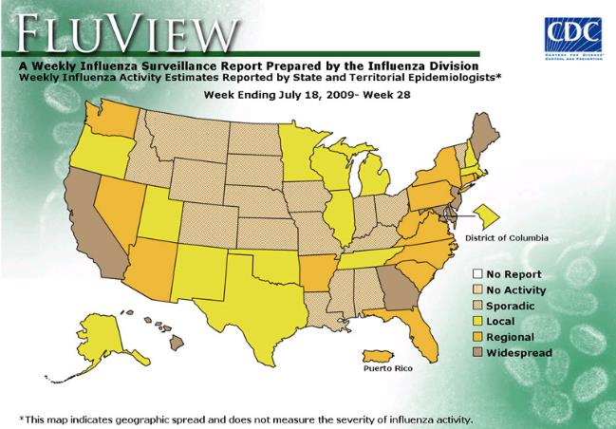
Epidemiologic Investigation
Comprehensive and multidisciplinary
Investigative work
In outbreaks
Map spread of disease
Mechanism of spread
Identify the “index case”
Morbidity and mortality
CDC
Notes:
After surveillance identifies a problem, an investigation begins. These are comprehensive and involve a multidisciplinary team, including experts in clinical medicine, epidemiology, infection control, environmental health, microbiology, behavioral science, biostatistics, and health education.
Interviews provide epidemiologists with crucial data needed to map the spread of an outbreak (ie, source of the outbreak, mode of transmission). Through interviews and detective work, epidemiologists may identify the source of the outbreak, the first patient with the disease (the “index case”), mechanism of spread and possible control, morbidity, and mortality.
IMAGE -- CDC.

Slide 12
Rapid Needs Assessment
Determine nature and scale of disaster
Extent of population’s immediate needs
Stability of health care infrastructure
Impact on essential human services
Notes:
It is important to complete a rapid needs assessment to determine the nature and scale of the disaster. Identifying the extent of the population’s immediate needs as well as the status of the health care infrastructure are vital. This will greatly assist in determining the impact on essential human services.

Slide 13
Emergency Public Health Powers
Decrease exposure and spread of contagious disease
Public health interventions: quarantine and isolation
Individual rights vs. common welfare
Notes:
In a major disaster or public health emergency, states have authority to exert reasonable control over citizens to directly secure and promote the welfare of the state and its people.
They must balance individual rights and freedoms with the common welfare.
Classically, there were two major ways that public health may exert power over individual freedom: quarantine and isolation. The goal of these is to decrease exposure and spread of contagious diseases.

Slide 14
Incident Management Emergency Support Functions
ESF-6: Mass Care, Emergency Assistance, Housing, and Human Services
FEMA, American Red Cross, and Public Health
ESF-8: Public Health and Medical Services
Public Health traditional lead agency of ESF-8
During certain events Public Health takes incident command leadership roles
Biological disasters
Notes:
With disasters involving infectious disease outbreaks or other public health emergencies, public health agencies that usually oversee ESF-8 may actually take an overall leadership role in the incident command structure:
ESF-8 – Public Health and Medical Services: Public health; medical, mental health services; and mass fatality management
ESF-6 – Mass Care, Emergency Assistance, Housing, and Human Services: Mass care; emergency assistance; disaster housing, and human services

Slide 15
ESF-6: Mass Care Services Public Health Supporting Role
Assessing health and medical needs of populations
Provision of emergency medical care
Surveillance in sheltering facilities
Norman Lenburg/FEMA
Immediate needs: Food, water, shelter, and sanitation
Notes:
2.6.10 Public health plays a supporting role in the provision of services to the affected masses. The primary agency that helps coordinate mass care and sheltering in the United States is the American Red Cross.
However, public health may play several roles in this area, such as disease surveillance and core public health functions. This involves providing sheltering of displaced persons, distribution of clean water and food, provision of emergency first aid, and distribution of emergency relief items. In addition, they may be involved in assessing the needs of those with functional and access needs, vulnerable patients, and those with chronic medical conditions, and in many cases providing the services needed.
IMAGE -- East Hartford, CT, November 3, 2011: Providing drinking water and ready-to-eat meals to residents recovering from the effects of a severe October storm that dumped snow in many parts of the state, downing trees and utility lines. FEMA is providing emergency protective measures including direct federal assistance. Norman Lenburg/FEMA.

Slide 16
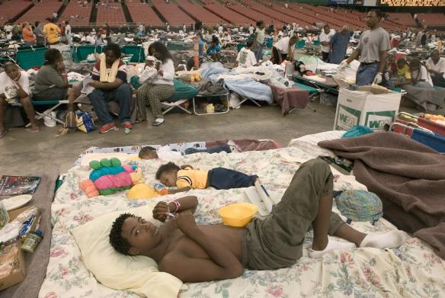
ESF-8: Public Health and Medical Services Role in Sheltering Populations
Disease outbreaks
GI and respiratory
Injury safety
Interpersonal violence
At-risk
Worsening of chronic and mental illnesses
Andrea Booher/FEMA
Crowding + limited resources = high-stress environment
Notes:
Sheltering is an essential element of disaster response and recovery, a role largely assumed by public health agencies. Shelters are not without their own pitfalls, however.
The combination of crowding, limited resources, and a high-stress environment leads to many problems in shelters, most notably outbreaks of diseases (especially GI and respiratory illnesses), interpersonal violence, and worsening of chronic and mental illnesses.
IMAGE -- Houston, TX, September 5, 2005: Thomas John and baby brothers are among the 18,000 Hurricane Katrina survivors housed in the Red Cross shelter at the Astrodome and Reliant center after evacuating New Orleans. FEMA photo/Andrea Booher.

Slide 17
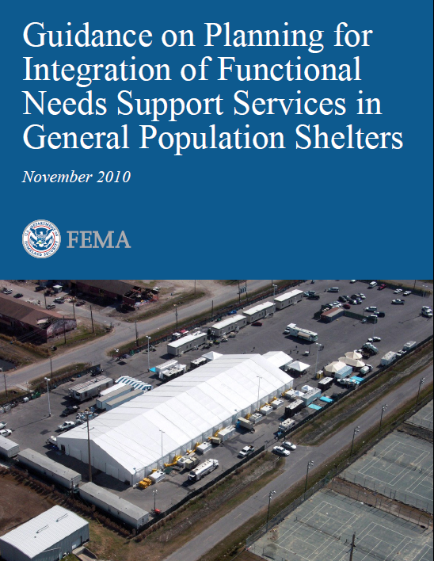
Sheltering Guidelines
General population shelters
Guidelines for sheltering children and adults with functional support needs
Functional Needs Support Services - “FNSS”
Services enabling individuals to maintain independence!
FEMA
Notes:
Assist emergency managers and shelter planners in understanding the requirements related to sheltering children and adults with functional support needs in general-population shelters.
IMAGE -- FEMA.

Slide 18
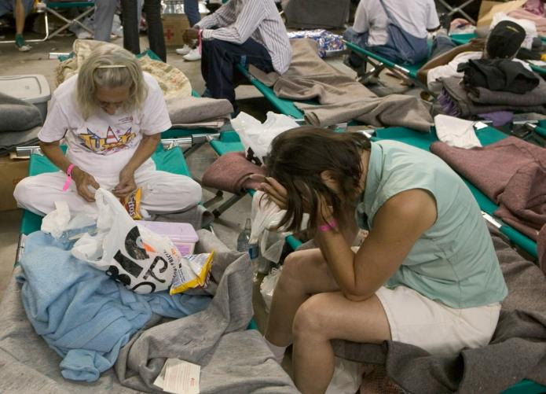
Health in Disasters
Lodging and shelter
Sanitation, hygiene, and pharmaceutical supplies
Health testing including pregnancy management
Protection from physical and sexual assault
Psychological impact
Andrea Booher/FEMA
Notes:
Lodging and shelter: Sleeping and bathing facilities with adequate privacy are needed. Women should feel comfortable bathing, breastfeeding, and caring for their families.
Pharmaceuticals: people will need access to medications that may have been lost in the disaster including birth control pills/supplies
Sanitation: adequate sanitation is critical to good health
Hygiene supplies: Disasters do not stop menstrual cycles. Appropriate supplies must be available.
Pregnancy management: Pregnant women have many special needs, from obstetric care to special diets and medications. They may experience increased levels of stress due to concern over their unborn child. Safety and security: increased risk of physical and mental abuse, as well as sexual assault.
IMAGE -- Houston, TX, September 2, 2005: Hurricane Katrina survivors sheltered in the Red Cross shelter at the Astrodome reflect on their losses. Andrea Booher/FEMA.

Slide 19
Vulnerable Populations
Disasters disproportionately affect certain populations:
Infants and children
Pregnant women
Elderly
Those with chronic disease
Those with functional and access needs
Chris Ragazzo/FEMA
Notes:
Now we will transition from public health to population health. An important concept to remember is that disasters do not affect all people equally. There are certain groups of people that are more vulnerable to the effects of a disaster. The major groups are infants and children, the elderly, women, those with chronic diseases (including mental health issues), and people with functional or access needs.
It is essential to plan for the needs of these populations, as they each have different needs when it comes to post-disaster medical care, support services, and sheltering.
IMAGE -- Biloxi, MS, June 29, 2011: Photographer/videographer Howard Greenblatt (FEMA) conducts an interview with disabled person Cindy Singletary about her experiences during Katrina. FEMA works with local organizations to understand the special needs of the disabled community during a disaster. Chris Ragazzo/FEMA.

Slide 20
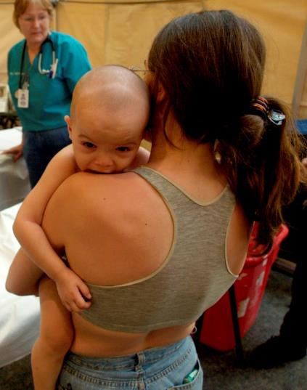
Children in Disasters
Disasters do not discriminate by age
Communities need plans for the care of children in disasters
Emergency managers and responders must be educated in needs of children
Michael Reiger/FEMA
Notes:
Disasters do not discriminate by age. Children and infants are uniquely vulnerable to the effects of disasters because of multiple factors, from anatomic to physiologic to developmental.
At the present time, few communities have plans in place to respond to the special needs of pediatric casualties of a disaster.
Every disaster responder must have a working knowledge of the care and support of pediatric patients, even if the care provider only takes care of adults in his or her usual job.
IMAGE -- New Orleans, LA, September 7, 2005: A mother and her three children receive medical care at the New Orleans airport where FEMA's D-MATs have set up operations. Michael Rieger/FEMA.

Slide 21
Children in Disasters Pediatric Vulnerabilities
Unique Characteristics
Anatomic
Physiologic
Developmental
Behavioral
Familial
George Armstrong/FEMA
Notes:
Pediatric patients have unique anatomic, physiologic, developmental, behavioral, and familial vulnerabilities that make them prone to effects of disasters. Examples of these are below.
Children are more vulnerable to toxic exposures, especially with exposure to agents heavier than air, such as sarin or chlorine:
Agents accumulate close to the ground where children live
High body surface area increases the area of skin for absorption of toxins
Rapidly developing brain and nervous system are more easily damaged
Higher respiratory rate (minute ventilation) results in increased intake of gases
Children are more susceptible to trauma and burns:
Poor understanding of the situation and instructions from adults, along with poorer coordination, make children more likely to get injured
Their more flexible skeletal system enables them to have serious internal injuries with minimal external damage
Children have low tolerance to blood loss and shock, and they compensate well, so evidence of early shock may be missed by providers
Children have a higher risk of infection:
They have immature immune systems, especially younger children who do not have all of the vaccinations
They are not aware of the importance of sanitation and hand washing
Children are very prone to hypothermia (as well as heat illnesses):
They have thin skin and limited subcutaneous tissue
They have greater body surface area
They lack knowledge and behavioral traits to get out of the environment, change clothes, and ask for help
IMAGE --Orlando, FL, August 25, 2004: Kathy Taylor, National Disaster Medical System nurse practitioner, provides medical attention to a child at the Osceola Disaster Recovery Center. George Armstrong/FEMA.

Slide 22
Children in Disasters Pediatric Care
Communicate as if your own child
Provide clinical and emotional support
Remember special drug doses, equipment
If able, include parents
Andrea Booher/FEMA
Notes:
For a variety of reasons, many providers are uncomfortable taking care of children, especially in the very stressful environment following a disaster. If all else fails, communicate and interact with the child as if he or she were your own child. Speak to and ask questions of children who are verbal.
If parents are available, include them in all aspects of evaluation and treatment. Parents will likely be afraid and possibly feel guilty or angry. They can be an asset in calming the child, encouraging participation in care, and giving background on the child’s health issues and medications.
When dealing with pediatrics, you must simultaneously provide clinical care as well as emotional and mental support.
Pediatric patients require specific doses of medications, and special sets of supplies and equipment for proper care. Many references are available to help with dosing. Planning should include stocks of supplies for mass pediatric casualties.
IMAGE -- Houston, TX, September 10, 2005: Vicki LaTour comforts lost child Antoine Edwards at the Houston Astrodome. Antoine’s family was evacuated from New Orleans because of Hurricane Katrina. Andrea Booher/FEMA.

Slide 23
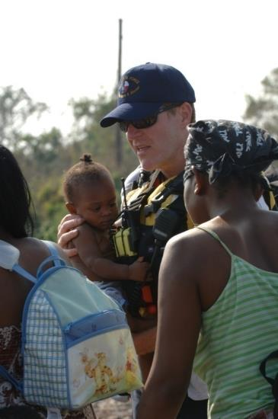
Children in Disasters Other Pediatric Considerations
Sheltering requires planning
Special food, diapers, sleeping furniture
Prone to exploitation and violence
Must keep families together
Reunification is a high priority
Medical care, decontamination, shelters
Limited pediatric health access
Specialty care and ICU beds
Monitor pregnant women to ensure health of fetus
Jocelyn Augustino/FEMA
Notes:
It is essential to keep families together if at all possible. If children are separated from their families, reuniting them is a high priority.
Sheltering children and their families requires significant forethought and planning. Children of various ages have various and special needs. Consider that infants and toddlers will require special food, diapers, and wipes. Some will not be able to safely sleep in cots and will require cribs or bassinets. Children are particularly vulnerable to violence and exploitation in the crowded environment of the shelters as well.
Nationwide, there is limited access to pediatric health care, especially specialty care and critical care units. How many pediatric ICU beds are available? To where will you transfer your sickest children? Where are the pediatric burn centers?
IMAGE -- New Orleans, LA, August 31, 2005: FEMA USAR member assists residents displaced by Hurricane Katrina. New Orleans is being evacuated following Hurricane Katrina and rising flood waters. Jocelyn Augustino/FEMA.

Slide 24
People with Chronic Illnesses
80% of adults over 65 have at least one
Disaster planning is focused on acute issues
Disasters disrupt:
Pharmacies, dialysis
Oxygen supplies, electricity
Medical infrastructure
Liz Roll/FEMA
Notes:
Traditionally disaster planning has focused on acute disaster-related illnesses and injuries and has largely not considered the needs of casualties with pre-existing conditions. This is very short-sighted, as the vast majority of older adults have one or multiple chronic medical conditions, many of which demand the close care of a physician, multiple medications, or special equipment to manage.
Disasters disrupt the basic infrastructure of health maintenance for many patients with chronic illnesses, including pharmacies, dialysis centers, oxygen supplies, refrigeration, electric wheelchairs, wheelchair ramps, and many more.
IMAGE -- New Orleans, LA, September 3, 2005: This man, an evacuee from New Orleans after Hurricane Katrina, waits to be seen by a DMAT team member at the airport. New Orleans is being evacuated because of flooding caused by Hurricane Katrina. Liz Roll/FEMA.

Slide 25
People with Chronic Illnesses
Exacerbation of illness due to effects of disaster
Loss of functional and life-sustaining equipment, medications, medical records
Loss of access to usual health care
Jocelyn Augustino/FEMA
Notes:
Patients with chronic illnesses can be dramatically affected by disasters. The emotional, physical, psychosocial, and environmental effects of the disaster itself can exacerbate chronic diseases.
Patients can lose equipment that is mandatory for their everyday functioning, such as wheelchairs, canes, walkers, and special foods, as well as life-sustaining equipment – oxygen, dialysis supplies, central lines, feeding tubes, ventilators.
Patients often present without any of their innumerable daily medications that are required for the maintenance of their often tenuous health. Medical records are often destroyed, and patients and their families may be unable to provide complete histories.
IMAGE -- Boynton Beach, FL, October 29, 2005: A FEMA Disaster Medical Assistance Team member returns a wheelchair at the JFK Medical Center. The DMAT is set up in the entryway of the hospital to assist in seeing the increase flow of patients due to Hurricane Wilma. Jocelyn Augustino/FEMA.

Slide 26
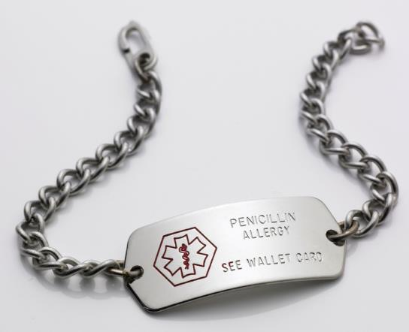
People with Chronic Illnesses Considerations
Individuals should prepare:
Medical alert
Identification
Current list of medications
Allergies
History
Where will patients get dialysis, chemotherapy, tube feeds, ventilators, bariatric beds?
How to evacuate?
Thinkstock
Notes:
There are many issues relating to patients with chronic illnesses that must go into disaster planning. Preparedness should include education of these people to have current lists of medications, allergies, and medical history. Each should obtain or be provided medical alert bracelets or identification. If possible, additional commonly needed durable medical equipment, medications, and supplies are beneficial.
Ask yourself: where will patients obtain life-sustaining medical supplies, equipment, and services such as dialysis, chemotherapy, radiation, tube feedings, ventilators, specialty beds?
How will these patients be evacuated? Where will they go? How will you transport their special equipment?
IMAGE -- ©2012 Thinkstock.

Slide 27
People with Functional or Access Needs
Assistance with:
Maintaining independence
Communication
Transportation
Supervision
Medical care
Robert Kaufmann/FEMA
Notes:
Populations with functional or access needs require special assistance with maintaining independence, communication, transportation, supervision, or medical care.
These populations each have very different needs. It is important to assess your own community to understand the needs therein. Then you can appropriately plan for the myriad of issues that will come up in a disaster.
Special planning is needed for evacuation, sheltering, durable medical equipment, medical devices, medications, transportation, and more.
Professionals trained to take care of these populations within your community not only should be involved in the planning process, but also must be utilized in the care and supervision of care after the disaster.
IMAGE -- Baton Rouge, LA, January 21, 2006: This local resident writes suggestions on a sticky note at the Louisiana Recovery Planning Day Open House in Baton Rouge to give input identifying recovery issues unique to her community and parish affected by Hurricanes Katrina and Rita. Feedback forms and notes placed on maps and charts, as well as one-on-one discussions with planning team members, are methods used to gather information during this planning event. Robert Kaufmann/FEMA.

Slide 28
Mental Health Effects
Everyone involved will have own response to event
Loss of appetite
Fear
Difficulty concentrating
Anger
Worry
Helplessness
Confusion
Fatigue
Sleepiness
Reaction of Children = Own Response + Parents’ Reaction
Notes:
Everyone involved in a disaster will have his or her own response to the event, whether that is psychiatric, psychosocial, or behavioral. Responders, too, are affected. This is normal.
Responses can vary, but some symptoms include fear, worry, anger, helplessness, confusion, anger, fatigue, loss of appetite, sleeplessness, and many more.

Slide 29
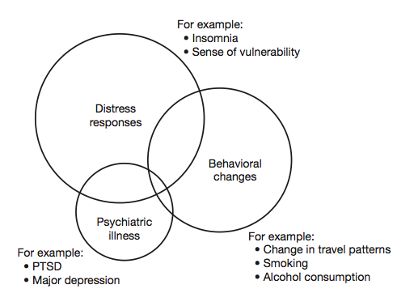
Stress and Psychological Trauma
Psychological Consequences of Disasters and Other Mass Trauma Events
Notes:
Disasters can induce a range of normal responses, including a sense of apprehension, worry, edginess, and difficulty concentrating on anything other than the source of the threat; rational and irrational attempts to remove, or escape from, the threat; and altruistic behaviors intended to ameliorate the situation. In general, an abnormal response that impairs daily life may occur when symptoms are greater in duration or intensity, when symptoms result in avoidance of certain situations or objects, and if certain patterns of symptoms occur and persist.
IMAGE -- BDLS Course Manual v3.0, pp. 3-27. Chicago: American Medical Association, 2012.

Slide 30
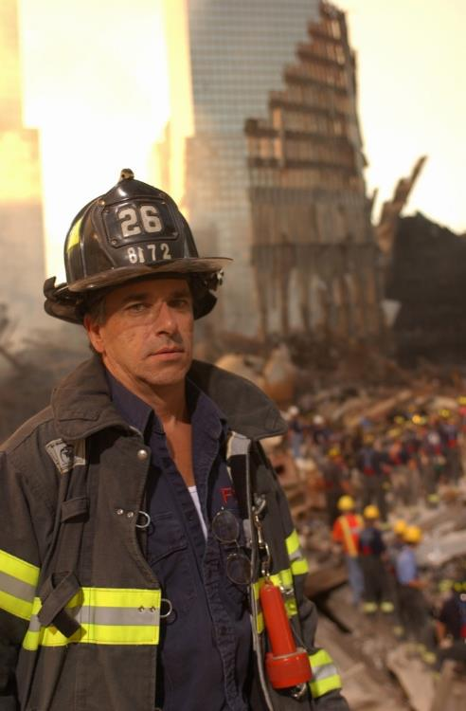
Responder Mental Health Effects
Susceptible to same psychological traumas
Should be monitored closely by team and trained mental health providers
Realistic training and education can help
Andrea Booher/FEMA
Notes:
Emergency responders are susceptible to the same psychological reactions and trauma as everyone else. Responders should be closely monitored for dissociative symptoms of acute stress disorders as well as for impairment of functioning.
Formal critical incident stress debriefing (CISD) is no longer recommended, since research has failed to demonstrate any consistent benefit and indicates that it may in fact be psychologically harmful to some. Debriefing and sharing stories is still a helpful adjunct to help manage post-disaster psychological responses.
Realistic training and education prior to events can be helpful in building up individual and team resilience to traumatic events and disasters.
IMAGE -- New York, NY, September 16, 2001: Members of the New York Fire Department continue search for survivors among the wreckage. Andrea Booher/FEMA.

Slide 31
Question 1 Large-scale disaster and public health emergencies require health professionals to shift their perspective from individual provider relationships to ________ health.
Global
Population
Workforce
Personal
All of the above
Notes:
Question 1:
Large-scale disaster and public health emergencies require health professionals to shift their perspective from individual provider relationships to ________ health.

Slide 32
Question 2 Which of the following is a function of public health during a disaster?
Implement isolation and quarantine
Conduct mass vaccination and prophylaxis
Promote health and hygiene in shelter operations
Provide emergency risk communication
All of the above
Notes:
Question 2:
Which of the following is a function of public health during a disaster?

Slide 33
Question 3 Disasters disproportionately affect certain vulnerable populations, including all of the following except _______?
Infants and children
Elderly
Truck Drivers
Pregnant Women
Those with chronic illnesses
Notes:
Question 3:
Disasters disproportionately affect certain vulnerable populations, including all of the following except _______?

Slide 34
Lesson Summary
Disasters require us to change our focus from needs of individual to those of population as a whole
Integration of public health and emergency care is essential to response and recovery
Certain groups in our communities are especially vulnerable to the effects of disasters and require special planning
Notes:
Disasters require us to change our focus from the needs of the individual to those of the population as a whole.
Integration of public health and emergency care is essential to response and recovery.
Certain groups in our communities are especially vulnerable to the effects of disasters and require special planning.

Slide 35
Questions?

