Slide 1
Notes:
Transition slide.

Slide 2
Session 4 – Lesson Eight A Biologic Disasters
Applied Learning Exercise
Notes:
Transition slide.

Slide 3
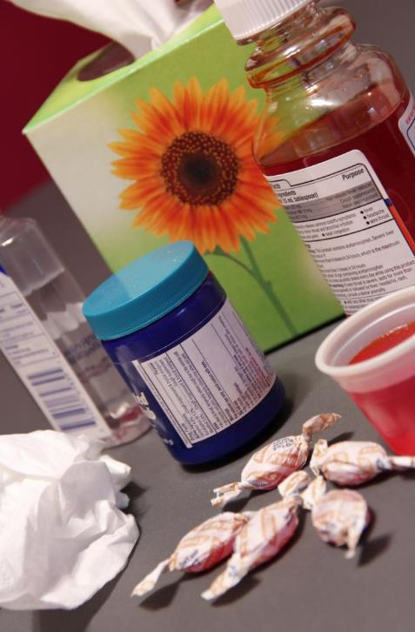
Biologic Disasters Scenario
Late fall – as flu season starts
Flu-like illnesses
More patients
Sicker
Negative flu swabs
Bad pneumonias
Debora Cartagena/CDC
Notes:
The cases occur all during one week in the late fall, right around the time when the influenza season is just starting up. Many early cases are misdiagnosed as the seasonal flu, and patients are mistakenly sent home.
IMAGE -- A still life composed of a number of cold remedies, including cold syrup at right, throat lozenges in the center foreground, a blue bottle of mentholated salve in the center, and a bottle of cooling emollient in the left background. A box of facial tissues can also be seen in the background, and a crumpled tissue has its place in the foreground. Debora Cartagena/CDC.

Slide 4
Biologic Disasters Scenario – Status Report
Many patients dying unexpectedly
Emergency departments full of sick and worried well
Occurring in multiple major cities
Notes:
It is only when several people in short succession die in one hospital that some astute health care providers recognize that something is very wrong.
This is a very different flu. Patients present in droves, often multiple people from the same household. They have sudden onset of fever, chills, muscle aches, headache, and cough. The flu swabs are mostly negative, and in some patients severe pneumonias are seen on their x-rays. Emergency departments everywhere are overwhelmed with very sick patients and even more people who are terrified of the slightest sniffle. The hospital beds are nearly full, and the ICU is running out of ventilators.
You learn from the media that the same scene is playing out in several major cities across the country.

Slide 5
Biologic Disasters Scenario – CDC Epidemiologic Reports
Similar unusual flu illness earlier this year in Australia and then Asia
Cases now spreading in North America and Europe
Christopher Mardorf/FEMA
Notes:
The illness is spreading, too, with cases cropping in the suburbs and small towns.
Days later, facts start to emerge that a similar illness had occurred a few months earlier in Australia and then in Asia. The disease multiplied rapidly. A nationwide pandemic has become a global crisis, as unbounded airline travel has allowed cases to pop up in major hubs of Europe and North America.
IMAGE -- Ewing, N.J., September 5, 2011: FEMA leadership coordinates its statewide response to requests for assistance from New Jersey disaster survivors as a result of the extensive wind and flooding damage inflicted by Hurricane Irene on August 28, 2011. FEMA's response team uses a map to identify "hot spots" of flooding activity as they work in a temporary office at New Jersey State Police Headquarters and the state's Emergency Operations Center (EOC) in Ewing where FEMA has set up an "Incident Command System" (ICS) while a Joint Field Office (JFO) is being prepared in Neptune by a FEMA Logistics team. Photo by Christopher Mardorf/FEMA.

Slide 6
Biologic Disasters Scenario – SITREP
Cases multiplying
Infections showing up on other continents
Town running out of staff, supplies, and space to put patients
Notes:
In your own medium-sized city, public health, public safety, EMS, and hospitals alike are scrambling to control the infection and take care of the ill. Staff are staying away from work for fear of getting sick; supplies of gloves, gowns, and masks are nearly exhausted; hospital beds are overflowing with patients; and the stock of appropriate antibiotics and respiratory treatments is dangerously low.

Slide 7
P | lanning and Preparation
R | esilience
E | ducation and Training
D | etection
I | ncident Management
S | afety and Security
A | Ssess Hazards
S | upport
T | riage and Treatment
E | vacuation
R | ecovery
Are my needs > resources?
Putting the PRE-DISASTER Paradigm™ into practice!
Notes:
The applied learning exercise (ALE) is a facilitated discussion to provide an example applying the PRE-DISASTER Paradigm™ to practice. Each chapter in the BDLS 3.0 Course Manual has a “Discussion Points” section at the end. These “Discussion Points” will be a useful reference during the ALEs.
As was explained in the first presentation, “Disaster Basics,” the PRE-DISASTER Paradigm™ is a useful tool to both learn and organize your approach to many of the key areas and topics relevant to being a prepared disaster health and medical personnel. Clearly, having excellent health and medical skills are essential to helping meet the needs of the casualties and impacted communities after a disaster; however, it is equally important that each health and medical provider be properly skilled in the basic tenets and practices of a disaster in order to be an effective asset to the situation.
Always be asking yourself with each step or area considered, am I in a needs > resources situation? If so, prioritize the action items and information sharing required to solve and address it.

Slide 8
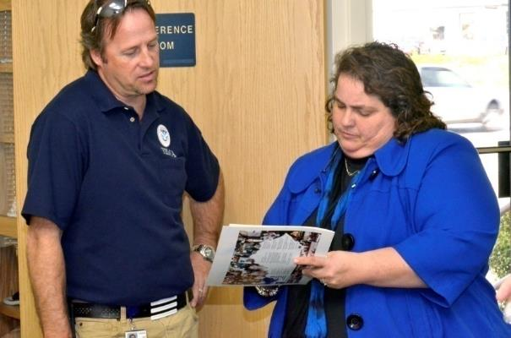
PRE-DISASTER Paradigm™ Planning and Practice
What issues must you consider when planning for a biologic event?
How do you drill a biologic disaster or bioterrorism scenario?
Tim Tyson/FEMA
Notes:
Communities must anticipate public heath emergencies, including epidemics and pandemics or bioterrorism attacks, and plan accordingly. Communities must exercise the plans to ensure all stakeholders are prepared and on the same page. Issues include the following: identifying likely agents, epidemiologic investigation, control mechanisms, ensuring proper vaccination and treatment of community and responders as needed, training all responders on proper personal hygiene and PPE, etc. There are many ways to test the plans for a public health emergency or bioterror event, from tabletop exercises to full-scale drills involving hospitals, public health, public safety, and community stakeholders.
IMAGE -- Frankfort, KY, April 3, 2012: Michael Houston, FEMA Disability Integration Specialist, and Virginia Moore, Executive Director of the Kentucky Commission on the Deaf and Hard of Hearing, discuss ways FEMA and the Commonwealth can best meet the needs of disaster survivors with access and functional needs. FEMA collaborates with its state and government partners to integrate access and functional needs in disaster planning before, during, and after a disaster. Tim Tyson/FEMA.

Slide 9
PRE-DISASTER Paradigm™ Resilience
How would you emotionally and mentally prepare your population and responders for the effects of a pandemic?
Notes:
This involves many layers including education of responders and populace about the threats, how to prepare, and what to expect in the event of a disaster. Preparation includes training for evacuation, sheltering in place, and personal hygiene.
Risk communication as the event unfolds is essential to resilience. The population must be well informed of what is happening, what will happen, and what they can do to protect themselves and their families.

Slide 10
PRE-DISASTER Paradigm™ Education and Training
List the education and training responders and providers should have in anticipation of a biologic disaster, whether public health emergency or terrorism event.
Notes:
Education and training relevant to a biologic disaster include many areas: proper infection control and epidemiologic investigation; role of law enforcement; PPE; vaccination; prophylaxis; treatment; isolation and quarantine; understanding of vulnerabilities of special populations; care of children and elderly; awareness of specific biologic agents; individual medical skills; personal hygiene; interface between health care, public safety, and public health; and individual role in a disaster response.

Slide 11
The DISASTER Paradigm™ Detection
How will you figure out that a biologic event is occurring?
What will you do next?
Who do you call?
What surveillance mechanisms need to be in place to detect and confirm an infectious disease outbreak?
Notes:
It is important to maintain a healthy index of suspicion at all times. Initial detection of a public health emergency including emerging infection, pandemics, and epidemics in addition to a potential BT agent may occur days and weeks after initial exposure. Health professionals should know how to alert proper authorities about actual or perceived biologic emergencies.
PH surveillance includes monitoring of routine data reported by area hospitals (number of patients, diagnoses), patterns in laboratory test ordering and results, pharmacy prescriptions, types of people affected (elderly, young, healthy, chronically ill, institutional, etc), death rates, and detection of sentinel events. Outbreaks in other communities should be monitored.

Slide 12
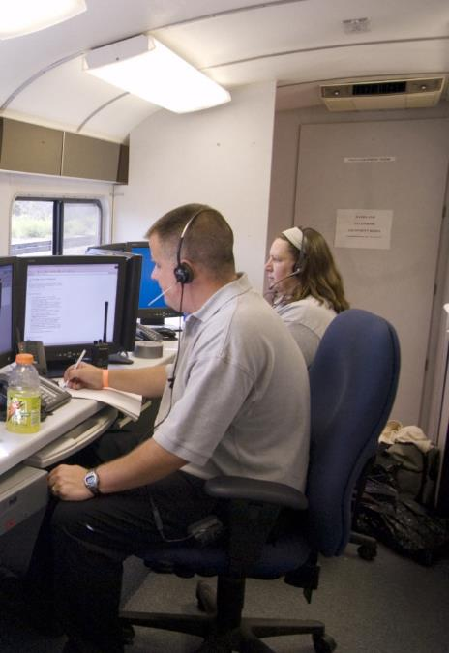
The DISASTER Paradigm™ Incident Management
Who is the incident commander?
Who is in charge of getting key information out to the public, and feedback to hospitals and responders?
Patsy Lynch/FEMA
Notes:
Who is in charge? Or will there be joint command? In a disease outbreak or public health emergency, the public health agency may act as incident commander or be a major part of the command structure. In the case of bioterrorism, federal agencies will likely be involved and assume command of the situation.
How much information do you put out to the public so that they are aware of the situation and know what to expect, but do not panic? Emergency risk communication must be planned in advance. All agencies and stakeholders that communicate to the public must do so with one voice, using the same message.
IMAGE -- La Crosse, WI, August 25, 2007: An incident command center monitors local activity. FEMA is working with state and local officials to help with recovery efforts. Patsy Lynch/FEMA.

Slide 13
The DISASTER Paradigm™ Safety and Security
How do you stop the spread of the disease?
How will providers and responders protect themselves?
Will health care providers show up?
Notes:
Personal protective equipment and hygiene are the cornerstones of infection control. Responders must be vigilant about wearing appropriate PPE and about good hand washing. These alone will eliminate the vast majority of infections and stop disease spread. Gloves, mask, gown, and eye protection will protect the responder from most infectious diseases.
It is very important not to become complacent with PPE and hand hygiene. It must be done 100% of the time. This becomes particularly difficult when supplies of appropriate PPE (such as N95 masks) become low.
Hand washing will prevent the spread of biologic agents from person to person in many cases. Although not completely effective, it is inexpensive, readily available, and reasonably effective. Similarly, appropriate hygiene and sanitation will generally decrease the spread of the agent from contaminated areas and decrease potential vectors such as rodents from proliferating.
Some diseases will require respiratory protection and negative-pressure rooms. In order to provide good infection control and worker protection, one must know the method of spread of the entity. In the absence of that knowledge one must protect against all methods, airborne, contact, etc.

Slide 14
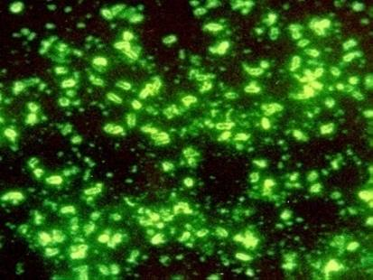
The DISASTER Paradigm™ Assess Hazards
What is the disease?
How contagious is it?
How many people are affected?
Mortality and morbidity?
Methods of spread?
Any populations particularly vulnerable?
How effective are control methods, prophylaxis, treatment?
CDC
Notes:
There are no specific answers, but things to consider that greatly affect the way that you prepare and respond to the outbreak.
Consider issues such as infectivity, mortality and morbidity, methods of spread, available control methods, and availability and effectiveness of prophylaxis and treatment.
IMAGE --Yersinia pestis immunofluorescence (http://www.cdc.gov/ncidod/dvbid/plague/ifa.htm).

Slide 15
The DISASTER Paradigm™ Support
How will you handle the influx of patients?
Where will they go?
How will you care for them?
Where will you get equipment, supplies, manpower?
Patsy Lynch/FEMA
Notes:
What will you do with a surge of patients? Where will they go? How will you take care of them? From where will you obtain more supplies of linens, masks, gloves? Do you have agreements with suppliers for reliable resupply in case of an epidemic? What happens if an entire hospital in the region is quarantined?
IMAGE -- Beaumont, TX, August 31, 2008: Ambulances line up for assignments in Beaumont, Texas. These units transport patients with special medical needs out the area in advance of Hurricane Gustav's landfall. Patsy Lynch/FEMA.

Slide 16
The DISASTER Paradigm™ Triage and Treatment
What is the goal of triage in this case?
How do you allocate scarce lifesaving equipment and medications?
Who gets ventilators, and for how long?
Vaccines, antivirals, antibiotics?
What happens when you run low on N95s?
Notes:
The goal of triage in an infectious disease outbreak is both to triage scarce resources and to prevent secondary spread. Who is most vulnerable? Who is least likely to get sick? How do we do the most good for the most people?
Triage in this scenario involves not only determining who the sickest patients are, but also triaging who will receive your limited lifesaving equipment and medications. With many more patients in respiratory failure than you have ventilators, how will you decide which patients get put on a ventilator, and for how long? Your community has antivirals and vaccines for only about half of the population; who should get them?

Slide 17
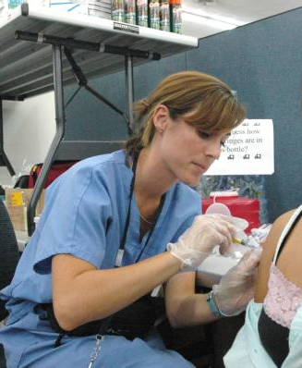
The DISASTER Paradigm™ Triage and Treatment
How will you ensure compliance with vaccine and medication regimens?
How do you accomplish mass vaccination and/or prophylaxis?
Do you treat the ill, responders, vulnerable populations?
Mark Wolfe/FEMA
Notes:
Do you prophylactically treat or vaccinate your vulnerable populations? How about your potential responders? Do you save all of your medications for the ill?
How will you ensure compliance with complicated treatment regimens? Can you force people to take medications?
Can you mass vaccinate the population in time to make a difference? With smallpox, you have 3 days after exposure to vaccinate people. Can that be accomplished in your community?
IMAGE -- Biloxi, MS, September 20, 2005: Registered nurse Stephanie Lynn administers an inoculation to Rebecca Sanford at the FEMA Area Field Office (AFO) in Biloxi. Relief workers must be careful with serious diseases in disaster areas. Mark Wolfe/FEMA.

Slide 18
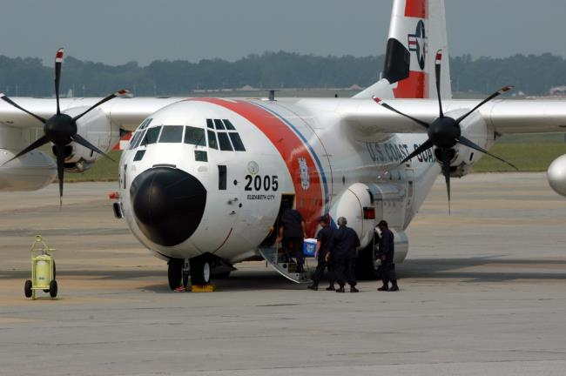
The DISASTER Paradigm™ Evacuation
Do you need to evacuate?
Partial, total?
Who? To where? How?
Should you ban travel?
How do you prevent self-evacuation?
Are they infected?
Mark Wolfe/FEMA
Notes:
Do you need to evacuate in the case of an infectious disease outbreak? Will members of the community take it upon themselves to leave the area when a disease breaks out? How can you ensure that those self-evacuating are not infected already and will take the disease with them to another community?
It is unlikely evacuation will be required in a BT or emerging pandemic. However, specific shelter-in-place may be recommended by local public health departments. It is very difficult to ensure that the unknown infected public does not leave town on their own, only to spread the disease to other communities. Public health likely will not recommend evacuation for this reason, but may suggest or require sheltering in place and social distancing measures (stay inside your home; do not go to areas with large crowds of people; cancel sporting events, concerts, church). Quarantine or isolation may also be implemented, which may be considered a type of evacuation to a fixed location.
IMAGE -- Marietta, GA, August 16, 2007: FEMA Federal Incident Response Support Team (FIRST) boards a US Coast Guard C130J cargo plane at Dobbins Air Reserve Base in preparation for flying to Puerto Rico to respond to impacts from Hurricane Dean. The FIRST Team leads FEMA's initial response to disasters. Mark Wolfe/FEMA.

Slide 19
The DISASTER Paradigm™ Recovery
When does recovery begin?
How can you help heal the mental and physical scars of a biologic disaster?
When do you start scaling back mass care and alternate care sites?
Notes:
What lessons did you learn during this disaster that can help prevent or mitigate a future event?

Slide 20
Biologic Disasters After-Action Review
Situational awareness - requires high index of suspicion, surveillance mechanisms, and clinical acumen
Risk communication - essential inform public, responders with one voice, accurate and timely
Allocation of scarce lifesaving or sustaining resources - must be anticipated and plans must provide guidance
Workforce protection - paramount to keeping functional health and medical services delivery
Notes:
After-action review:
Situational awareness--requires high index of suspicion, surveillance mechanisms, and clinical acumen
Risk communication--essential inform public, responders with one voice, accurate and timely
Allocation of scarce lifesaving or sustaining resources--must be anticipated and plans must provide guidance
Workforce protection--paramount to keeping functional health and medical services delivery

Slide 21
Questions?
Notes:
Allow time at the conclusion of the lesson for participant questions.

