Slide 1
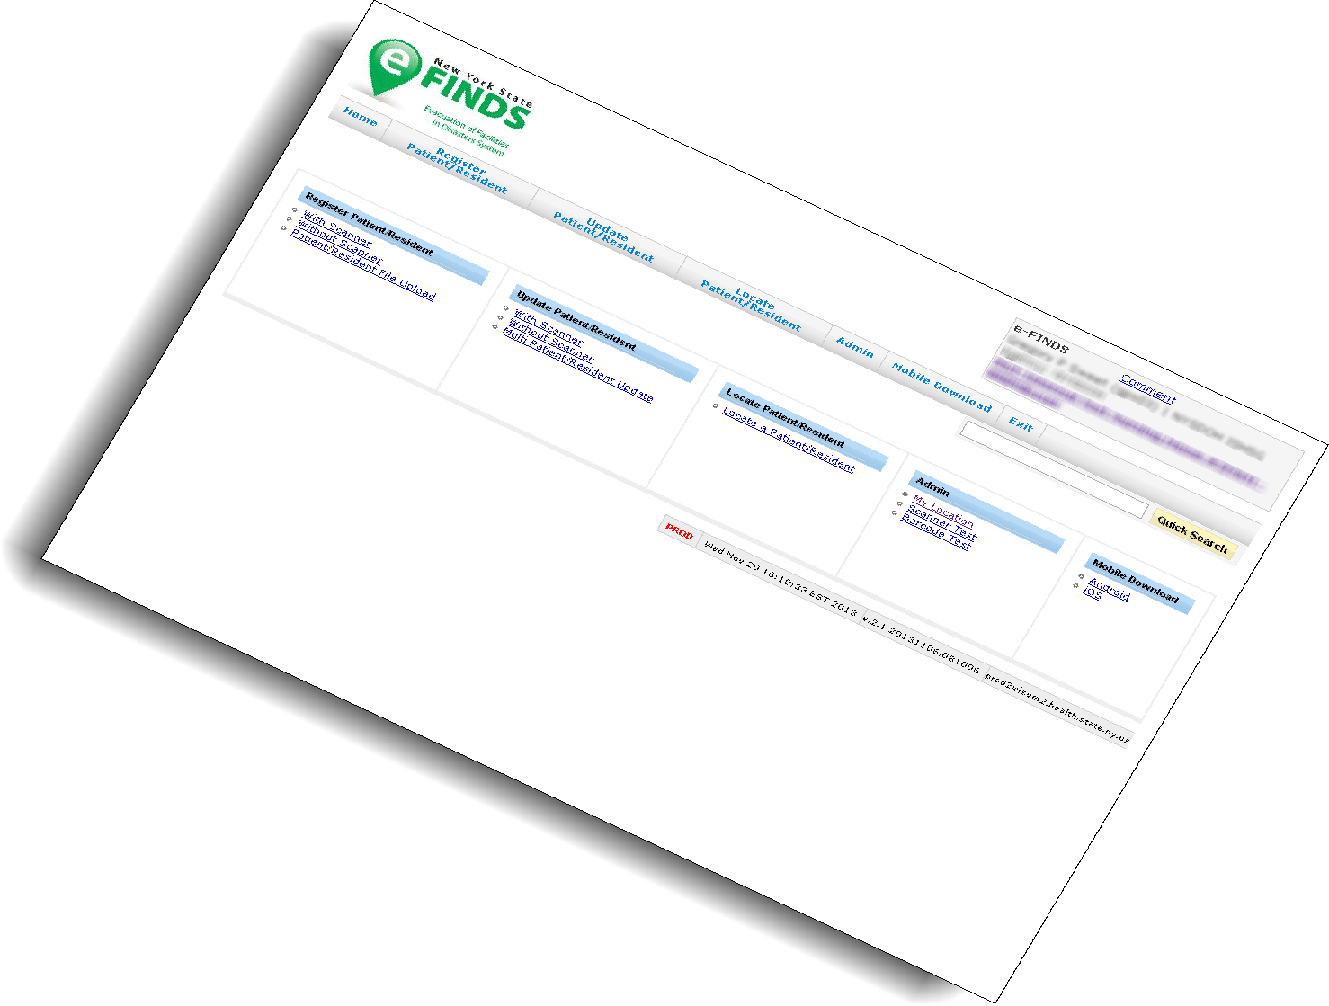
{Instructor Name}
{Title & Contact}

Slide 2
Notes:
2
Say: Good {insert time of day} everyone! Thank you. Let me begin with a quick introduction of myself. My name is {insert name and credentials}
First, we do not want anyone to leave today’s session with any unanswered questions about the e-FINDS application. We will spend about 45 minutes with the demonstration of the new tool, so please feel free to raise you hand or interrupt me if you have a question or comment.
Transition: I also want to provide you with some contact information for technical and non-technical eFINDS questions

Slide 3
Technical Questions
For example:
I do not see my facility listed in eFINDS.
I cannot log into the HCS.
I cannot find or open eFINDS.
Contact the Health Commerce System Trainers
Usually available Monday—Friday 8:30 a.m. to 4:30 p.m.
518-473-1809 option 2
hcsoutreach@health.state.ny.us
Notes:
Say: The Health Commerce System trainers are the team responsible for providing technical assistance with eFINDS, so if you find that you are having a technical issue with eFINDS or the Health Commerce System in general you should contact the Health Commerce System Trainers at the number or email listed on the screen. These numbers are provided for you in your participant guide on page 5 of the guide.
Transition: Sometime however you will have questions that are non-technical and lean more towards operations and regulatory concerns. Those questions should be address to the NYSDOH Office of Health Systems Management Liaison to Public Health Emergency Preparedness

Slide 4
Non-technical Questions
For example:
What about the ED?
Regulatory issues.
Contact the
OHSM Liaison to Public Health Emergency Preparedness
Debra L. Sottolano, PhD, MBA
Division of Standards and Surveillance
NYS Department of Health
518-402-1004
dls20@health.state.ny.us
Notes:
Dr. Debra Sottolano, whose contact information is also provided on page five of your guide.
Transition, so today I am going to show you how, but if you have questions about when or why your will need to contact Dr. Sottolano.

Slide 5
Agenda
Introduction to e-FINDS
What is eFINDS
What an evacuating facility can and is expected to do
What a receiving facility can and is expected to do
Accessing eFINDS
What material you should have received from NYSDOH (and what to do if you do not have it or did not get it).
Break
Notes:
Say: We will begin with what an evacuating facility can accomplish, that is, register a patient/resident with a scanner, without a scanner. Remember, that an evacuating facility may only have time to place wristbands on the people being relocated. So only if time allows, would the patient/resident information be entered and/or updated.
To demonstrate the complete process, I will also show you what a receiving facility will do.
I will also point out the menu differences of an e-FINDS Data Reporter and an e-FINDS Reporting Administrator, like how the Administrator can view what barcodes have been already assigned, and how to generate and save an e-FINDS spreadsheet that someone can complete and then the Data Reporter or Admin can upload.
Transition: Our goal is to have you leave today’s presentation feeling like a skilled operator of this new application. Let’s begin.

Slide 6
Agenda
Practical work
Evacuate a single patient or resident
Receive a single patient or resident
Search eFINDS for a patient or resident
Register multiple patients or residents through the web page (admins only)
Release a batch of patients or residents from the evac. facility.
Check in a batch of patients or residents at the receiving facility.
Create a fillable spreadsheet (admins only), fill it in and upload.
Create a paper log.
Notes:
Say: We will begin with what an evacuating facility can accomplish, that is, register a patient/resident with a scanner, without a scanner. Remember, that an evacuating facility may only have time to place wristbands on the people being relocated. So only if time allows, would the patient/resident information be entered and/or updated.
To demonstrate the complete process, I will also show you what a receiving facility will do.
I will also point out the menu differences of an e-FINDS Data Reporter and an e-FINDS Reporting Administrator, like how the Administrator can view what barcodes have been already assigned, and how to generate and save an e-FINDS spreadsheet that someone can complete and then the Data Reporter or Admin can upload.
Transition: Our goal is to have you leave today’s presentation feeling like a skilled operator of this new application. Let’s begin.

Slide 7
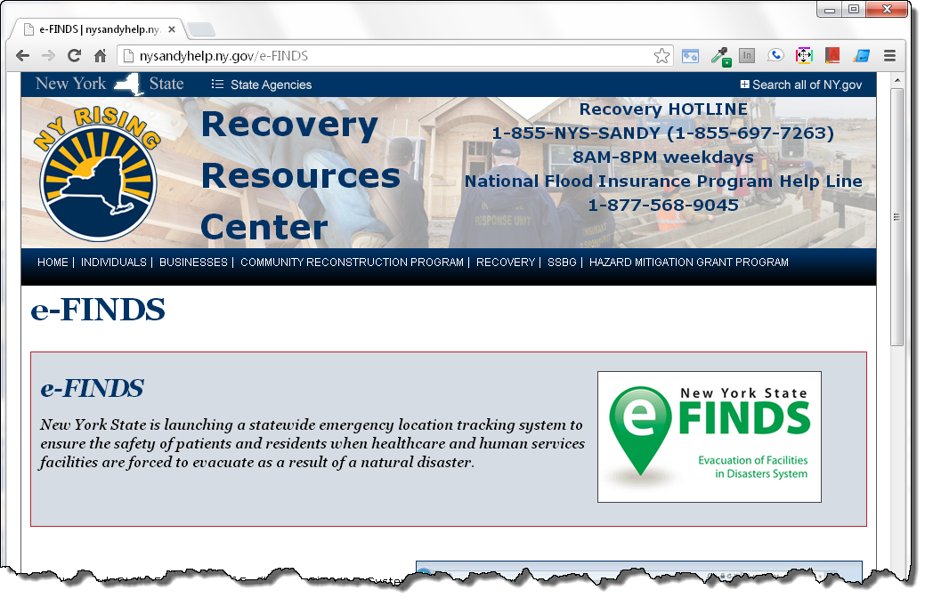
e-FINDS
Notes:
Say: So what is e-FINDS?
Secure, real time & easy to use
common platform for sharing patient and resident location information
It Promotes data accuracy and saves Time
Allowing collaboration between facilities.
Used for incidents, events or practice exercises
This is the Governor’s initiative from lessons learned after Hurricane Sandy. Essentially, it is to be used for patient and resident location information, when facilities need to relocate their patients or residents. The application is time saving, especially for the evacuating facilities. At the very minimum, the evacuating facilities will only need place the barcoded wristbands on their patient/residents and send them to a safe location. The receiving locations can scan wristbands, and update the location information when they arrive.
The system captures minimal amounts of data, can accommodate multiple updates and allow facilities to track their patient’s and resident’s movement to other facilities, including temporary shelters. More importantly, where ever the patient/resident resides, the system has hard coded the original location, that is, the location they will return to.
This is our first version, and we modeled it after the Department of Defense Joint Patient Tracking Application used to track the global location information of seriously wounded service members. Keep in mind that eFINDS merely tracks patients and in no way is meant to be an electronic medical record.
Transition: eFINDS is a commerce based-application and relies on Communications Directory role assignments to access the system. There are three roles that provide access, one for State DOH employees, and two for healthcare facility employees. Let’s look at the state’s role first.

Slide 8
e-FINDS Roles
Data Reporter | Reporting Administrator
Register patient/resident Update patient/resident Information Upload patient/resident file | Same as facility user Generate the paper log file Generate patient/resident barcodes spreadsheet Register multiple patients/residents without pre-printed barcode wristbands via the website
Notes:
Say: There are two facility permission assignment: the e-FINDS Data Reporter and the e-FINDS Reporting Administrator role. Now because these roles are a mouth full to say every time, please remember that during this presentation, I will sometime refer to the e-FINDS Data Reporter as just a Data Reporter I am not referring to the HERDS data reporter, and the same goes for the e-FINDS Administrator role; not the facility’s Administrator.
The e-FINDS Data Reporter can register patients/residents in the system with or without a scanner, one at a time or multiples by using the e-FINDS spreadsheet provided by the e-FINDS Admin. They can also update with or without a scanner, one at a time or more than one.
Say: The functions that the e-FINDS Reporting Administrator role can accomplish, that the user role cannot, is to generate a PDF of used and unused barcodes, generate a spreadsheet that can be populated with patient/resident information and uploaded by the e-FINDS Data Reporter. The Admin also has the ability to register multiple patient/residents, at a time, without scanning the barcodes. Because the Admin can do everything that a data reporter can, you only need to be added to the admin role; both roles are not needed. Also, a facility can have more than one person assigned to either role.
Transition: Let’s go out to the Health Commerce System, and walk through some practice scenarios. For demonstration purposes, we will act as both an evacuating and receiving facility during concurrent events. The training scenarios are outlined in the participant guide, so please follow along.
***Demonstration Begins - Please refer to the Participant Guide for Scenarios***

Slide 9
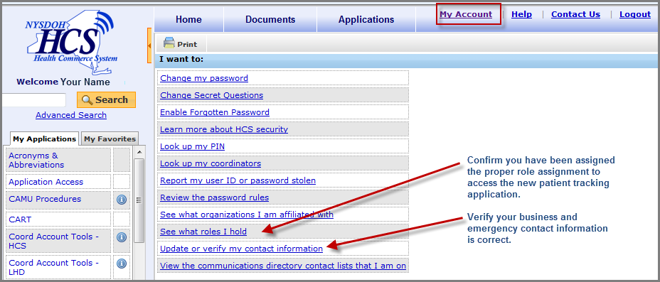
Your HCS Person Record
Notes:
Say: Because e-FINDS is a role based application, once you are added to an e-FINDS role, the application will appear in your My Applications list in the left side panel. If you do not see the e-FINDS or e-FINDS Demo, then try closing your internet browser completely and log back in. If need e-FINDS can also be access from the main list of applications.
Action: Point to the My Applications list, and then Applications from the top menu bar.
Say: To verify your role assignment, go to the My Account link and click See what roles I hold. If you are not in an e-FINDS and would like to be, then click on the Look up my coordinators. They are the ones who will add you to the role.
Action: Point to the My Account link on the menu bar.
Say: How many people on the call today have looked at, updated or verified their contact information on commerce in the last three months?
Now, I will assume that you are participating in this training because you are either a facility administrator or in some kind of preparedness role. To be sure that you receive communications from your county health department or the state, please make sure your business and emergency contact information is correct. To do so, click on the Update or verify my contact information. I recommend that everyone does this after the presentation, and I will show you how I updated mine.
Action: Point to Update or verify my contact information.

Slide 10
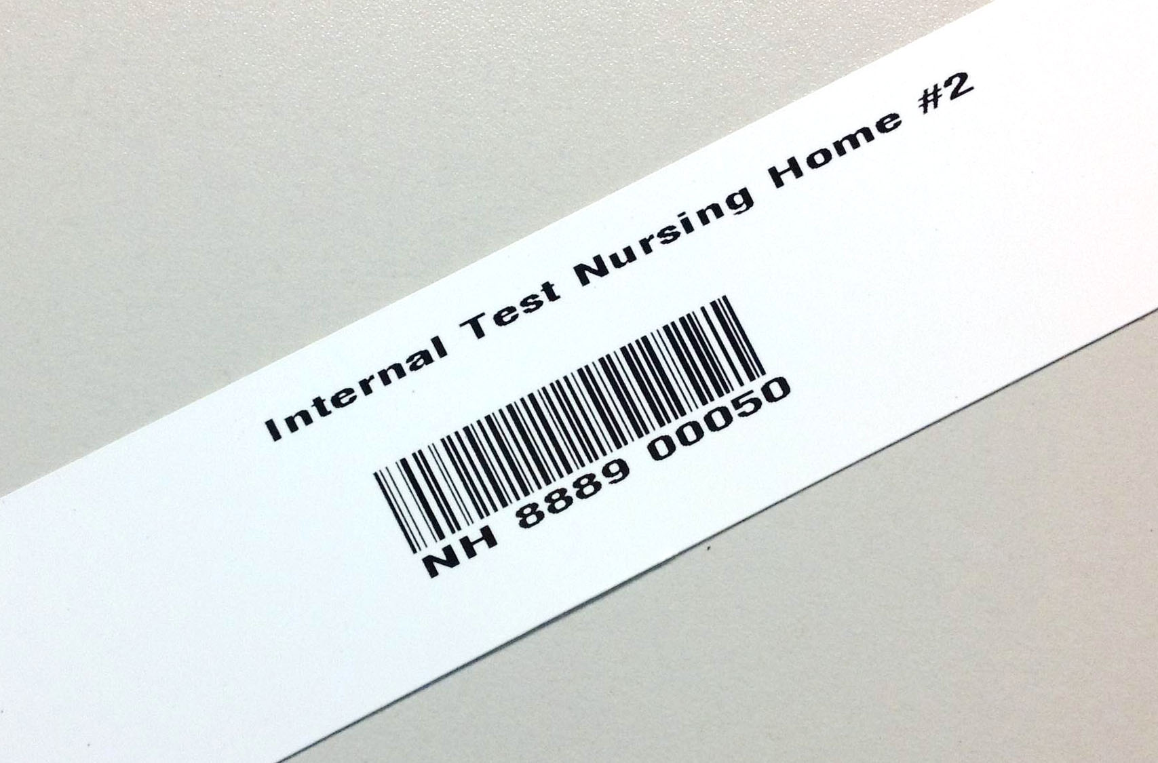
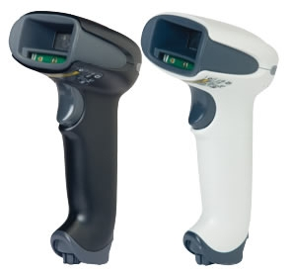
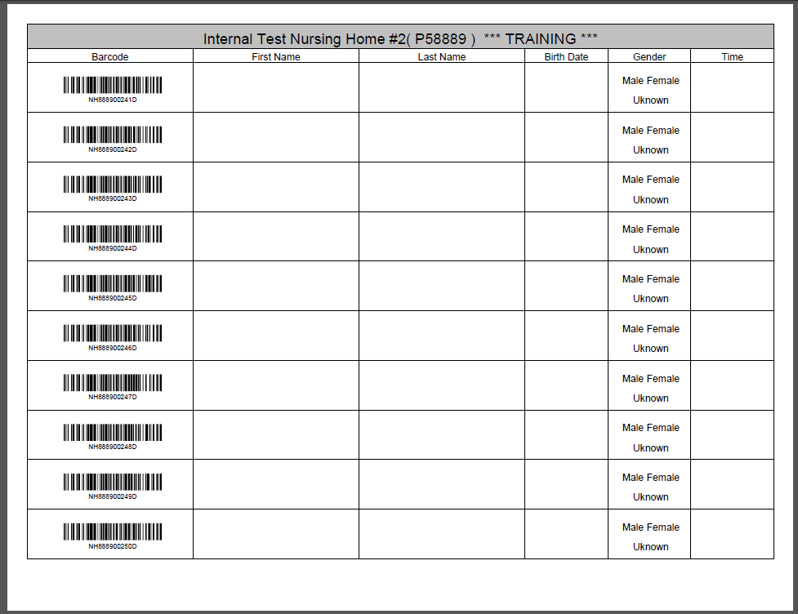
So what’s in the box?
Notes:
Say: Each facility will receive a number of wristbands, based on the licensed bed, and the corresponding log sheets. The barcodes provided will have a special sequence number used solely for your facility to allow for better patient and resident relocation management. Each wristband will contain the facility name, a scannable barcode, and the barcode number. If needed, you can even write on them.
The number of wristbands you receive is based on the number of licensed beds your facility has, not on any current census.
The barcodes on the wristband have a prefix that corresponds to the type of facility
HO for hospital
NH for nursing home
ACF for adult care facility
Facilities will also be receiving a small set of training bands. You will clearly know that they are for training, because they are marked for training in two places, and the barcode number ends in a D for demo. Training wristbands can only be used in the e-FINDS Demo application and the production bands are only recognized in the production e-FINDS. The bands cannot be used in the wrong application by mistake.
State health has been working on printing the facility wristbands, printing the barcode logs that will accompany the wristbands, testing the hand-held scanners, and shipping to the MARO region facilities. The goal is to have the nursing homes in Southern NY (Sullivan Co down to Suffolk) completed by end of the month (July). Of course, this is a goal; not a promise.
Each facility is also receiving one bar code scanner select to work with the e-FINDS application. The budget only provides for one scanner per facility, Greater New York Health Association members can take advantage of a bulk purchase GNYHA has set up if you wish to purchase more scanners.
I will show you what the paper logs look like, but they too contain our facility name, and a space for a patient/resident’s first name, last name, date of birth and gender. These logs can be used if a facility has no power or not internet.
Transition: OK so let’s get to it and actually see this e-FINDS application in action

Slide 11
— Fin —
Commerce Trainers
518-473-1809 or hinweb@health.state.ny.us
Account Issue
CAMU 1-866-529-1890
Notes:
Thank you for participating in this training. Feel free to contact the Commerce Trainers with your technical questions. I always find it easier to just pick up the phone if you have questions, so I advise you to contact us anytime. If we cannot answer your questions, then we are most likely able to direct you to the program area that can.
Again we would like to thank your for your time. Have a good day.
Commerce Trainers:518-473-1809 or hinweb@health.state.ny.us
Debra L. Sottolano, PhD, MBA
OHSM Liaison to Public Health Emergency Preparedness
Division of Standards and Surveillance
NYS Department of Health
875 Central Avenue
Albany, NY 12206-1388
(P) 518/402-1004, (F)518/402-1010
Email: dls20@health.state.ny.us

