Slide 1
Animal Decontamination
Chemical Events and Natural Disasters
Notes:
June 2014
During some animal health emergencies, animals may be exposed to toxic materials in the environment. Efforts to decontaminate animals may be necessary to prevent adverse health effects. This Just-In-Time training presentation will discuss animal decontamination procedures and considerations in the event of a chemical event or natural disaster.

Slide 2
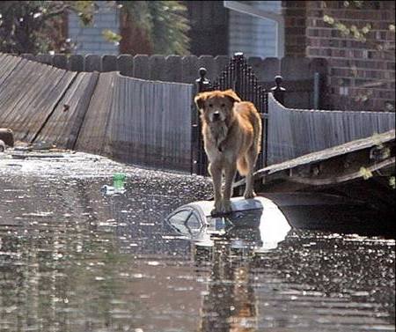
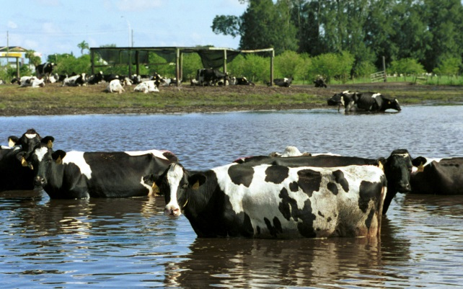
Risks
Natural disasters
Floods, hurricanes, tornadoes, earthquakes
Agricultural or industrial
Chemical spill
Gas leak
Terrorism/criminal event
Chemical toxins
Microbial pathogens
Notes:
The exposure of animals to toxic contaminants present in the environment can occur during emergency situations. Following natural disasters, such as floods, hurricanes, tornadoes, or earthquakes, animals may be exposed to a variety of household or agricultural chemicals, petroleum products, heavy metals (e.g., lead), or harmful pathogens from disrupted manure pits or septic tanks. Situations involving agricultural or industrial accidents may result in exposures to chemical spills or gas leaks. Terrorism or criminal events may involve chemical toxins or microbial pathogens that can cause subsequent harm. Decontamination efforts for exposed animals may be needed for any of these situations.
[Photo: (Top) A dog surrounded by contaminated floodwaters following Hurricane Katrina. Source: Garry Goemann, VMAT 5; (Bottom) Cattle in floodwaters. Source: Federal Emergency Management Photo Library #314.]

Slide 3
Goals of Decontamination
Neutralize/remove harmful materials
Confine to specified area
Limit exposure time
Limit tissue damage and absorption
Prevent systemic poisoning
Prevent secondary contamination to responders and other animals
Notes:
Decontamination involves the process of neutralizing and removing harmful materials that animals (or people) have been exposed to during or after a chemical or natural disaster situation. Primary goals for decontamination are to confine the hazardous substances to a specified area, and limit exposure time for animals and people to reduce absorption, tissue damage or systemic poisoning. It also serves to minimize the further spread and distribution of contaminants through the movement of animals (or people).

Slide 4
Contaminants of Concern
Solids
Fecal materials from manure pits or septic tanks containing pathogenic microorganisms
Mold spores
Liquids
Gasoline, diesel fuel, motor oil, solvents, kerosene, propane
Insecticides, herbicides, fungicides, rodenticides
Soaps, detergents, disinfectants, household cleaners
Heavy metals: Arsenic, lead
Antifreeze
Particulates
Dust, smoke, debris in air
Fiberglass and asbestos fibers
Toxic gases
Confined manure pits or tanks
Methane, hydrogen sulfide, carbon dioxide, ammonia
Anhydrous ammonia, chlorine
Toxic fumes from burning products
Chemical reactions
Ammonia + hypochlorite (bleach) = chlorine gas
Pipeline breakage
Gasoline/diesel exhaust
Welding/cutting torch fumes
Notes:
This slide shows the wide variety of potential contaminants that may be present following a particular animal health emergency. Hazardous substances may be in the form of solids, liquids, particulates, or gases; many are also flammable, reactive with water, or toxic. It is very important to know the specific toxicant or contaminants involved. This will not only determine the level of risk and specific decontamination measures needed, but also any short-term or long-term impacts that may weigh on the decontamination decision. Additionally, food animal exposure to certain chemicals (e.g., organochlorine, heavy metals, radioactive substances) raises concerns regarding the risk of residues in animal by-products (e.g., meat, milk, eggs) that may prevent affected animals from the human food chain. The loss of economic value of the animal may cause the owner to choose euthanasia over decontamination.

Slide 5
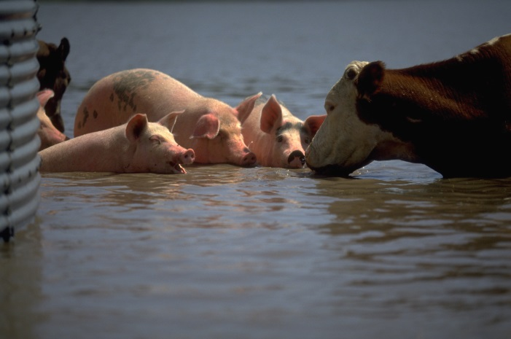
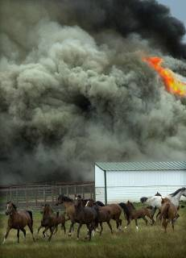
Exposure
Contact with skin
Ingestion
Eating, drinking
Licking fur or contaminated surface
Inhalation
Ocular (eyes)
Fumes, dust, particulates, splashing liquid
Indirect cross contamination
Notes:
Animals can be exposed to contaminants in a number of ways. Most exposures will involve direct contact with the material and subsequent absorption through the skin or mucous membranes. The hair coat of animals may be somewhat protective, but can be more difficult to decontaminate. Non-haired portions of the skin, such as the footpads or nose, or any damaged or inflamed skin present, are at a higher risk of absorbing a contaminating agent. Animals can also ingest toxic substances by eating contaminated food sources, drinking contaminated water, licking contaminated surfaces or from grooming or licking their own bodies. Gas, vapor, or aerosol contaminants can also be inhaled, resulting in exposure and absorption by the respiratory tract. This route is most likely to cause severe intoxication. Fumes, dust, particulates or splashed liquids can enter the animal’s eyes, causing pain, irritation and possibly irreversible damage. Indirect exposures (or cross contamination) can occur when hazardous substance on the feet, skin, or hair coat contaminate objects, people or other animals with which they come in contact.
[Photo: (Top) Cow and pigs immersed in flood waters. Source: Andrea Booher/FEMA Photo Library #3336. (Bottom) Horses escaping from a wildfire.]

Slide 6
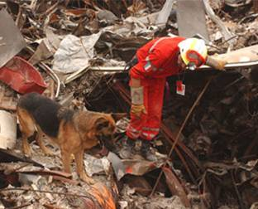
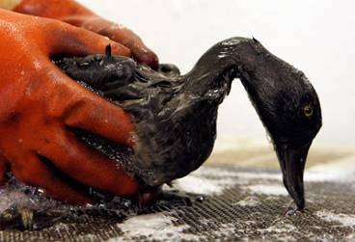
Animals Affected
Pets
Service animals
Working dogs
Livestock, horses, poultry
Captive and concentrated animal populations
Wildlife
Notes:
A wide variety of animal species may require decontamination, including companion animal species – such as dogs, cats, rabbits, or pet birds – service animals, livestock – such as cattle, sheep, goats – horses and poultry. Working dogs are at high risk of becoming contaminated during the course of their duties. Captive or concentrated animal populations can also be affected by animal health emergencies. These include settings such as biomedical research facilities, zoos, sanctuaries, wildlife parks, commercial breeding operations, pet retailers, kennels and stables. Any number of wildlife species in the area may be exposed. Many of these animals will have high emotional, financial, and cultural value.
[Photo: (Left) Search and rescue dog and handler. Source: FEMA; (Right) Oily bird from the Deepwater Horizon Gulf oil spill. Source: BP America]

Slide 7
Affects To Animals
Similar to humans
Immediate (acute) damage
Skin irritation, redness
Chemical burns, hair loss
Respiratory distress
Systemic shock, death
Chronic injury
Respiratory damage, scarring
Carcinogenesis
Notes:
Animals exposed to contaminants can be affected in the same manner as humans. Contaminants may cause immediate or acute damage to the skin, respiratory tract, eyes or the entire body. Depending on exposure and contamination levels, animals may have skin irritation and redness, chemical burns and hair loss, or respiratory distress. Systemic shock or even death are also possible. Some contaminants may cause long term or delayed damage. Contaminants can also be carcinogenic.

Slide 8
Considerations
Human safety
Animal welfare and health
Response needs
Personnel and resources required
Personnel safety
Specific toxic substance
Number and variety of species
Time constraints
Notes:
The decision to decontaminate animals is driven by several considerations. Decontamination efforts should only be performed when it is possible to minimize the risk of injury for both the affected animals and responders performing decontamination procedures. During decontamination procedures, human safety is always a primary goal and the most important consideration, followed by the welfare of affected animals.
Decontamination procedures will require a number of personnel to perform the task. In some situations, trained handlers may be needed to escort the animals through the decontamination stations. The availability of adequate veterinary resources for triage, stabilization, decontamination and supportive care will also be an important consideration.
Decontamination decisions will also be driven by the known or suspected agent(s) involved. If a highly toxic chemical or zoonotic disease is involved, the risk to human health may be too great to proceed with an animal decontamination operation. Additionally, situations involving a large numbers of animals may place time constraints in treating all animals before health impacts occur.

Slide 9
Environmental Issues
Large volumes of wastewater
Contaminated objects
Leashes, collars, halters, hair
Legal or jurisdictional issues/regulations
Consult with officials before and after regarding appropriate disposal measures
Weather conditions
Fans, shade, shelter to avoid overheating
Dryer, heater, shelter to avoid hypothermia
Notes:
Environmental concerns need to be taken into consideration. Extremely large volumes of contaminated waste water will be generated when washing and rinsing animals. Appropriate drainage is needed to prevent further exposure of animals by drinking or prolonged contact with contaminated wastewater.
The containment and proper disposal of the wastewater as well as any contaminated objects (collars, leashes, halters, hair, feces) following decontamination procedures will be need to be addressed to avoid any environmental issues.
Any legal or jurisdictional issues should be understood; consult with environmental officials before decontamination procedures begin and after completed.
Weather conditions are also an important consideration. Dry, windy conditions may further aerosolized particles, dust or chemicals. Prevent overheating in hot conditions by providing protection against the sun.
Rainy conditions can pool and concentrate contaminants. Cold conditions will require measures to prevent hypothermia.

Slide 10
Decontamination Setup
Notes:
Decontamination procedures needed for animals is determined on a case-by-case basis. Alterations may be necessary based on the contaminant involved and available resources. Effective planning and preparation is needed for the smooth operation of any animal decontamination procedure.

Slide 11
Site Control Zones
All areas should be clearly demarked
Monitor access
Prevent unauthorized access
Contain contaminant
Hot Zone – contains hazard
Warm Zone – decontamination area
3 stations
Cold Zone – medical treatment, kennel area, quarters
Soric S, Belanger MP, Wittnich C. A method for decontamination of animals involved in floodwater disasters. JAVMA 2008 Feb 1; 232(3):364-370.
Notes:
As with any hazardous situation, the establishment of site control zones is essential. Control zones aid in preventing unauthorized access to the hazard, containing the contaminant or agent, and providing functional boundaries for responders. Site control zones should be immediately designated and enforced at the start of the response.
Traditionally, three control zones are created at a hazardous site – the hot zone, the warm zone and the cold zone.
The hot zone is the area where the actual hazard is located.
The warm zone is located between the hot and cold zones. It is the area where animals (or people) will be brought for decontamination. The warm zone consists of three stations which will be described on subsequent slides.
The cold zone is the area free from any contamination.
All zones should be clearly demarcated. The entry and exit to the zones should be well monitored to prevent tracking of contaminants. Natural obstacles or man-made barriers may be used, as well as temporary materials, such as snow fences or barrier tape.

Slide 12
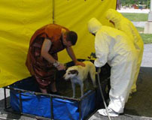
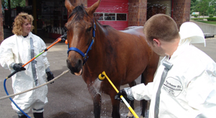
Site Setup
Location
Upwind and uphill
Close but safe distance from incident
Flat, level area
Ample size
Water supply
Runoff containment
Avoid environmental impact
Notes:
Animal decontamination sites should be located at a safe and reasonable distance from the incident, yet close enough to allow easy access from the hot zone. The area should be located upwind and uphill from the hot zone. Decontamination setup should be on reasonably flat and level ground. Ensure sufficient size for the safe handling of the animals. The decontamination site will require a clean, potable water supply of sufficient quantity as well as a means for containing runoff generated during the decontamination procedure. If the stations are set up indoors, adequate ventilation and air flow will be necessary.
[Photos: Animal decontamination stations. Source: (Top) International Association of Fire Chiefs at www.iafc.org; (Bottom) Nature’s Way Animal Rescue and Rehabilitation at www.nwart.org]

Slide 13
Decontamination procedure
Notes:
The decontamination procedure involves leading contaminated animals through a series of sequential stages to dilute and remove contaminants or toxins. When decontamination procedures are needed, owners may be reluctant to part with their animals; running animal decontamination stations parallel to human decontamination stations can help to alleviate owner anxiety. Service animals should not be separated from their owner due to severe distress caused in an already stressful situation.

Slide 14
Warm Zone: Station 1
Medical assessment
Emergency decontamination
Photograph and record information
Owner, if available
Location found
Remove and discard contaminated items (e.g., collars, halters)
Place clean restraining device
Notes:
As previously mentioned, the warm zone is the area where animals (or people) will be brought for decontamination. As animals enter Station 1 of the warm zone, they should be assessed for any emergency health issues, such as injury, dehydration or shock.
For animals requiring medical stabilization or life-saving intervention, full decontamination may need to be delayed and a preliminary rinse may be all that is possible initially until the animal can be stabilized. Thorough decontamination measures will be needed following triage treatment. Euthanasia should be considered for animals too severely affected to withstand the stress of decontamination.
Animals that are stable, should proceed through the warm zone stations and the decontamination process.
Photograph the animals with its current identification (collar, halter, etc.). Gather and record any animal (and owner) information, including the location found; this information can help to reunite the animal with its owner, and may provide information on the type and level of contaminant exposure.
Remove and discard any contaminated objects, such as leashes, collars or halters on the animal; these items may trap contaminants against skin or hair coat of the animal. Place a clean restraining device (e.g., nylon lead) on the animal to lead them through the decontamination stations.

Slide 15
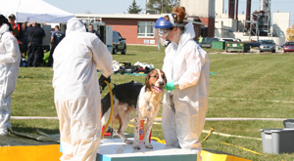
Station 1, continued
Preliminary rinse
Some contaminants may be reactive (and more dangerous) when mixed with water
Move to Station 2
Notes:
A preliminary rinse (or gross decontamination) should be done. Flushing or flooding contaminated skin with water can remove or dilute many toxic agents. It also allows the washing stages to be much more effective. However, be aware that some contaminants may be reactive (and more dangerous) when mixed with water. The possible contaminants you are dealing with should always be identified before any decontamination procedure.
For toxicants or contaminants that are reactive with water, physical removal by brushing or combing may possible; however, knowledge of the contaminant is necessary, as these actions can further aerosolize and increase inhalation exposure for responders. Additionally, some dusts or powders may clump when wet making them more difficult to remove. The use of vacuums may be possible for animals that will tolerate it or wiping with dry or slightly damp towels may be helpful.
[Photo: (Top) Decontamination of a llama. Source: International Association of Fire Chiefs at www.iafc.org; (Bottom) Decontamination of a dog. Source: Nature’s Way Animal Rescue Team at nwart.org]

Slide 16
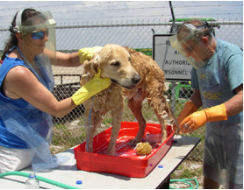
Warm Zone: Station 2
Flush animal’s eyes
Saline solution
Not eye ointment
Wash-Rinse
Mild liquid detergent
Lukewarm water
Wipe head area with moist towelette/gauze
Careful attention to skin folds and creases
Provide non-slip surface
Notes:
Station 2 involves washing and rinsing the animal to remove organic matter and contaminants.
Before washing, flush the animal’s eyes with saline solution to remove any dust or debris, and dilute any chemical contaminants. Eye ointments should not be used until there is confirmation there is no contamination or ocular damage (e.g., corneal ulcers). Petroleum based ointments can absorb chemical agents and worsen the damage.
It is most helpful to have two areas available – one for the washing process, the other for rinsing. Wash basins, kiddie swimming pools or shower areas can be used (based on the size of the animal) and may help with wastewater containment.
Animals should be lead into wash basins or shower areas of appropriate size for the animal. It is best to have at least two personnel – one handler and one washer. Be sure nonslip surfaces are provided to ensure secure footing for animals. Rubber mats or indoor-outdoor carpeting can be placed to over grates to protect toes, nails, or hooves from getting caught and to prevent slipping.
Wash the animal using a mild, liquid detergent (e.g., Dawn®, Palmolive®). Household dish soaps can help remove oils in which some toxins may be dissolved; these products are also readily available, economical, and minimally irritating or drying. Use low pressure, lukewarm water when possible. Gently scrub the detergent solution into the hair of the animal with a soft bristle brush or gloved fingers. Avoid harsh or abrasive scrubbing as this may drive material deeper into tissues. Pay special attention to skin folds and creases, as well as the feet (or hooves of large animals) where contaminants may become trapped.
Clean areas of the head, especially around the eyes, nose and mouth with non-alcoholic moist towelettes (e.g., baby wipes) or gauze pads. Thick, bulky or sticky substances may require additional effort such as mechanics soap, mineral oil, or scraping with a wooden stick (e.g., a tongue depressor or popsicle stick) to remove the material by physical means. Long or matted hair may need to be shaved or trimmed.
[Photo: Responders washing a dog. Source: Florida Search and Rescue Team at www.flsart.org]

Slide 17
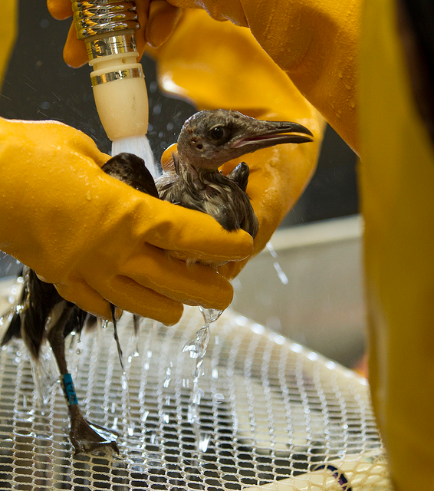
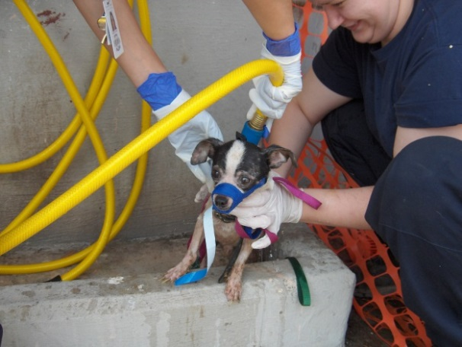
Station 2, continued
Rinse thoroughly
Repeat process as necessary
3 times for maximum benefit
Animal temperament
Muzzle or other restraint
Head gate or chute for large animals
Chemical sedation on limited basis
Notes:
After washing, lead the animal to the rinse basin or shower. Rinse the animal thoroughly with clean water to remove all residue and detergent. Repeat the wash/rinse process as necessary; three times for maximum benefit. For companion animals, a tarp may be laid on the ground between the wash and rinse basins to catch water dripping from the animal when transferring between the two locations. Larger animals may be startled and reluctant to walk over tarps. Larger animals, especially those generally kept outdoors, may also be hesitant to enter doorways, low-roofed structures such as tents, or enclosed areas. Properly discard dirty water from the wash and rinse bins before the next animal arrives.
Depending on the temperament of the animal, muzzles or restraint measures may be needed. For larger species (i.e., livestock), the animal may need to be placed in a head gate or chute. Chemical sedation may be needed to calm nervous or aggressive animals, and reduce the risk of injury, however, this method should only be used on a limited basis, and should not be used with severely injured or debilitated animals.
[Photo: (Top) Bird being rinsed after decontamination. Source: BP America; (Bottom) A muzzled dog during decontamination. Source: Heather Case – DMAT/CFSPH]

Slide 18
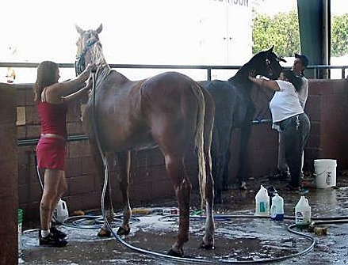
Warm Zone: Station 3
Kill microbial contaminants
Use antimicrobial solution
Minimum contact time
Set up like Station 2
Wash basin/shower
Rinse station
Re-examine
Contaminant found – Re-decontamination
No residual contaminant – Cold Zone
Notes:
The third station of the decontamination procedure is for an antimicrobial washing of the animal to kill any microbial contaminants remaining after the initial wash. The set up is similar to station 2, with two basins or showers, one for washing and one for rinsing. The difference is that an antimicrobial solution is used in place of the detergent. As with station 2, the size of the basins or showers should be able to accommodate the animal and a minimum of two personnel, one for handling the animal and one for washing should be available.
Antimicrobial products can be deactivated by organic material, thereby making the initial wash-rinse step at Station 2 very important. Additionally, it is important to allow the antimicrobial solution to remain for the recommended contact time to adequately kill the microorganisms. Rinse thoroughly. Repeat the process if necessary.
Once the animal has been decontaminated and rinsed, it is carefully re-examined for any residual contaminants, and if found, must be returned for additional decontamination.
[Photo: Rinsing horses. Source: Thomas Ratke/CFSPH Iowa State University]

Slide 19
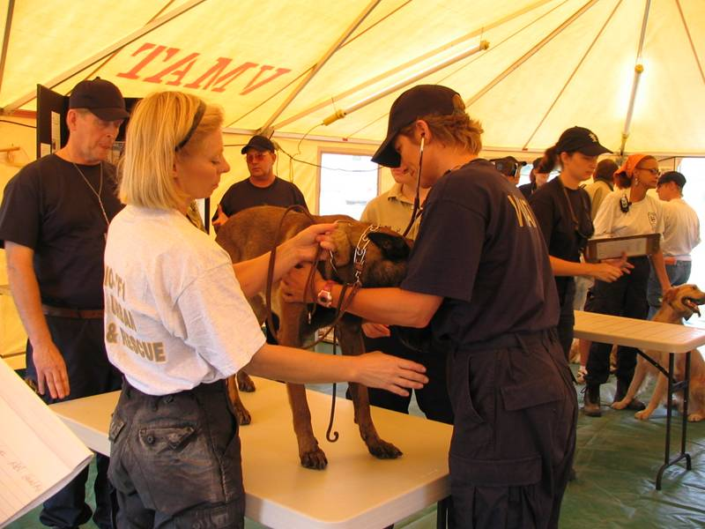
Cold Zone
Re-examine for residual decontamination
If found, repeat decontamination procedure
If decontamination was adequate
Move to cold zone
Triage room for veterinary care
Notes:
If decontamination was successful and the animal passes visual inspection, it should be transferred to a handler in the cold zone to be dried. Animals need to be dried well to avoid thermoregulatory issues; in cold temperatures, a warm dryer should be used to avoid hypothermia. The animal is then taken to the triage room for assessment and examination for injuries or health issues by the veterinary care team.
Animals can then be moved to safe housing; they should be protected from excessive winds, or drafts, especially in cold weather. They should be monitored for any changes in health status, including signs of hypothermia or hyperthermia. Ill animals may require veterinary care and support.
[Photo: Veterinary assessment of a dog after a natural disaster situation. source: Garry Goemann-VMAT-5]

Slide 20
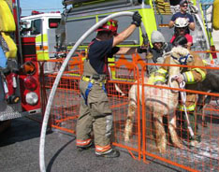
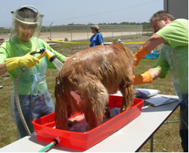
Responders
HAZMAT training
Personal Protective Equipment
Eye protection, gloves, waterproof clothing, respirator
Animal handlers
Not animal owner
Except for working dogs
Notes:
Responders assisting with animal decontamination procedures should have appropriate hazardous materials training; consulting and collaborating with trained HAZMAT personnel, such as local hazardous materials response teams or fire departments can also be helpful.
Personnel at all stations should have appropriate PPE for the level of hazard. This should include eye protection, gloves, and Tyvek or waterproof suit/coveralls; in some cases respirators may be needed. These items work to create a barrier against the hazardous contaminant and the responder.
Responders knowledgeable about proper animal handling and restraint should be used. Animal owners should not decontaminate their own animals. Exceptions are made for working dogs – as these animals are sometimes not safely separated from their handlers. Additionally, search and rescue and other detection dog handlers may also be HAZMAT trained.
[Photo: (Top) Decontamination of a llama. Source: International Association of Fire Chiefs at www.iafc.org; (Bottom) Decontamination of a dog. Source: Florida Small Animal Response Team at www.flsart.org]

Slide 21
Responder Safety
Injury from animals
Bites, scratches, crushing, kicks
Contaminant exposure
Heavy lifting
Back injuries, muscle strain
Biological hazards
Zoonoses
PPE safety issues
Slip, trips and falls
Notes:
There are several safety issues responders need to remain aware of during the decontamination procedure. Any interaction with animals can lead to injury, including bites, scratches, kicks, or crushing incidents. Implement proper restraint and handling procedures for the animal when necessary to avoid a hazardous situation. Animals should also be handled to prevent contamination of emergency personnel. Limit direct contact and prolonged exposure to contaminants to minimize potential for health impacts. Slips, trips and falls may occur when uneven or wet surfaces are present. Musculoskeletal injuries may occur following heavy, frequent or awkward lifting procedures. If a zoonotic disease (a pathogen of animals transmissible to humans) is involved, there can also be a potential threat to you or other responders. Personal protective equipment can limit your range of motion and vision predisposing to falls as well as loss of agility and dexterity.

Slide 22
Resources
National Alliance of State Animal and Agricultural Emergency Programs (NASAAEP). Animal Decontamination Best Practices. 2012. http://www.learn.cfsph.iastate.edu/dr/node/157.
Soric S, Belanger MP, Wittnich C. A method for decontamination of animals involved in floodwater disasters. J Am Vet Med Assoc. 2008 Feb 1; 232(3):364-70.
VMAT Decontamination Standard Operating Procedure. http://pennvetwdc.org/wp-content/uploads/2012/02/ VMAT_DECON_SOP_APRIL2004.pdf
FEMA Animals In Disasters – Technological Hazards at http://www.training.fema.gov/emiweb/downloads/is10_a-6.pdf
FEMA Canine Decontamination http://www.k9team.org/files/articles/Canine%20Decontamination%20Guide.pdf
Notes:
Additional information on animal decontamination set-up and procedures can be found in these resources.

Slide 23
Resources
Murphy L, Slessman D, Mauck B. Decontamination of Large Animals. In Technical Large Animal Emergency Rescue, Gimenez R, Gimenez T, May KA, editors. 2008. Wiley-Blackwell, Ames. ISBN#978-0-813801998-3.
Murphy L. Basic Veterinary Decontamination. In: Veterinary Disaster Response. Wingfield WE, Palmer SB, editors. 2009. Wiley-Blackwell: Ames. ISBN#978-0-8138-1014-0.
Murphy L. Responding to Mass Exposures. In Small Animal Toxicology, 3rd edition. Peterson ME, Talcott PA, editors. 2013. Elsevier Saunders: St Louis. ISBN#978-1-4557-0717-1.
Soric S, Belanger MP, Wittnich C. A method for decontamination of animals involved in floodwater disasters. J Am Vet Med Assoc. 2008 Feb 1; 232(3):364-70.
Notes:
Several textbook chapters on animal decontamination are also available.

Slide 24
Acknowledgments
Development of this presentation was by the Center for Food Security and Public Health at Iowa State University through funding from the Multi-State Partnership for Security in Agriculture
Authors: Melissa Lang, BS; Glenda Dvorak, DVM, MPH, DACVPM
Notes:
Information provided in this presentation was developed by the Center for Food Security and Public Health at Iowa State University College of Veterinary Medicine, through funding from the Multi-State Partnership for Security in Agriculture.

