Slide 1
Model for mammalian-cell NMD: Pioneer round of translation¹, the splicing-dependent mark (EJC)², and the 50-55-nt rule³
EJC
UPF2
UPF3 or 3X
Exon-Exon
Junction
Initiation of pioneer round of translation
CBP80
80S
PABPC1
PABPN1
^{m7}Gppp
AAAAAAAAAAAAAAAAAA(A)_{n}
CBP20
~20-24 nt
Norm Ter
AUG
PTC
~50-55 nt
SURF
SMG1
UPF2
Step 1:
SURF complex formation at a PTC
UPF1
UPF3 or 3X
CBP80
eRF3/eRF1
PABPC1
PABPN1
^{m7}Gppp
AAAAAAAAAAAAAAAAAA(A)_{n}
CBP20
AUG
PTC
Norm Ter
SMG1
UPF1
UPF2
Step 2:
SMG1-UPF1 bind to a PTC-distal EJC
UPF3 or 3X
CBP80
PABPC1
PABPN1
^{m7}Gppp
AAAAAAAAAAAAAAAAAA(A)_{n}
CBP20
AUG
PTC
Norm Ter
P
SMG1
UPF1
UPF2
UPF3 or 3X
PABPC1
PABPN1
SMG1 phosphorylates UPF1
CBP80
^{m7}Gppp
AAAAAAAAAAAAAAAAAA(A)_{n}
CBP20
AUG
PTC
Norm Ter
¹ Ishigaki, Li, Serin, Maquat (2001) Cell. 106:607-17
² Le Hir, Moore, Maquat (2000) Genes Dev. 14:1098-108
³ Nagy and Maquat (1998) TIBS 23:198-9
Translational repression
mRNA decay
Notes:
1

Slide 2
p-UPF1 represses translation initiation on an NMD target
P
SMG1
5
UPF1
UPF2
1
UPF3 or 3X
Phosphorylation
of UPF1 by SMG-1
CBP80
1A
eIF3
PABPC1
PABPN1
2
1A
AAAAAAAAAA(A)_{n}
2
^{m7}Gppp
2
40S
40S
CBP20
AUG
PTC
Norm Ter
P
SMG1
Phospho-UPF1
binds eIF3 of
preinitiation complex
UPF1
UPF2
1
5
UPF3 or 3X
CBP80
1A
eIF3
PABPC1
PABPN1
2
1A
AAAAAAAAAA(A)_{n}
2
^{m7}Gppp
2
40S
40S
CBP20
AUG
PTC
Norm Ter
Translational repression
60S
Translational repression
P
UPF2
Block of 60S
ribosomal subunit
joining to form
80S ribosome
1
5
UPF1
UPF3 or 3X
CBP80
1A
eIF3
PABPC1
PABPN1
2
1A
AAAAAAAAAA(A)_{n}
2
^{m7}Gppp
2
40S
40S
CBP20
AUG
PTC
Norm Ter
Recruitment of mRNA decay factors
CBP80
UPF2
5
P
UPF3 or 3X
PABPC1
PABPN1
1
UPF1
mRNA decay
^{m7}Gppp
1A
eIF3
A
A
A
2
1A
A
2
2
40S
40S
A
A
A
CBP20
Isken, Kim, Hosoda, Mayeur, Hershey
and Maquat (2008) UPF1 phosphorylation
triggers translational repression during
NMD. Cell. 133:314-327
AUG
PTC
Norm Ter
Notes:
2

Slide 3
Model for CBP80-promoted NMD: The interaction of CBP80 with UPF1 promotes NMD at (minimally) two steps
EJC
UPF2
Exon-Exon
Junction
80S
UPF3 or 3X
Initiation of pioneer round of translation: CBP80 and UPF1 transiently or weakly interact
CBP80
PABPC1
PABPN1
^{m7}Gppp
AAAAAAAAAAAAAAAAAA(A)_{n}
UPF1
CBP20
~20-24 nt
AUG
PTC
Norm Ter
SMG1
Step 1:
CBP80-UPF1 promotes SMG1-UPF1 binding to eRF1-eRF3 to augment SURF complex formation
pppG^{7m}
CBP20
CBP80
SURF
+
SMG1
UPF2
UPF1
UPF3 or 3X
eRF3/eRF1
PABPC1
PABPN1
AAAAAAAAAAAAAAAAAA(A)_{n}
AUG
PTC
Norm Ter
+
Step 2:
CBP80-UPF1 promotes SMG1-UPF1 binding to a PTC-distal EJC
pppG^{7m}
CBP80
SMG1
CBP20
UPF1
UPF2
UPF3 or 3X
PABPN1
PABPC1
AAAAAAAAAAAAAAAAAA(A)_{n}
AUG
PTC
Norm Ter
P
SMG1
UPF1
UPF2
UPF3 or 3X
PABPC1
PABPN1
SMG1 phosphorylates UPF1
CBP80
^{m7}Gppp
AAAAAAAAAAAAAAAAAA(A)_{n}
CBP20
AUG
PTC
Norm Ter
Hwang, Sato, Tang, Matsuda and Maquat (2010)
UPF1 association with the cap-binding protein,
CBP80, promotes nonsense-mediated mRNA decay
at two distinct steps. Mol Cell. 39: 396-409
Translational repression
mRNA decay

Slide 4
Decay steps of NMD
Kurosaki, Miyoshi, Myers, Maquat (2018)
NMD-degradome sequencing reveals ribosome-bound
intermediates with 3'-end nontemplated nucleotide
heterogeneity. Nat Struct Mol Biol. Epub ahead of print.

Slide 5
Genetic screens of haploid mammalian cells for new RNA decay factors

Slide 6
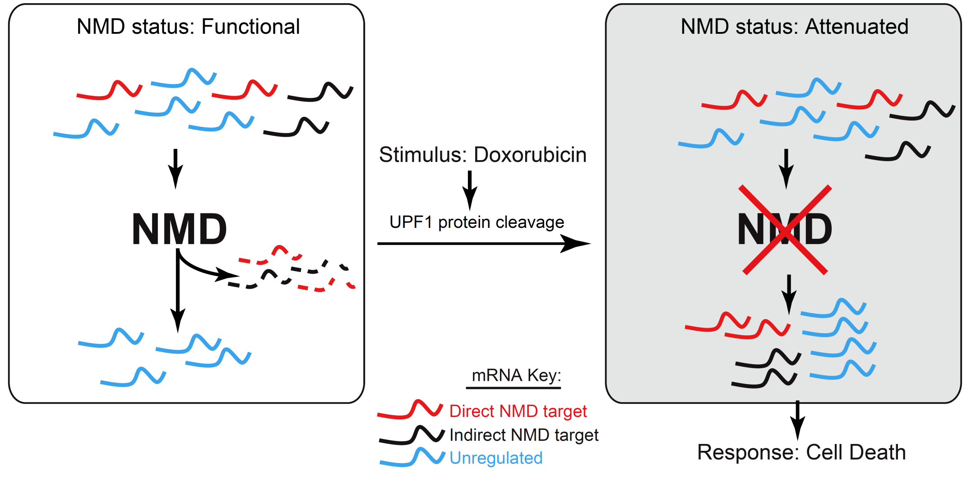
NMD is a molecular valve enabling cellular responses
Popp and Maquat (2015) Attenuation of nonsense-mediated mRNA decay
facilitates the response to chemotherapeutics. Nat Commun. 6:6632

Slide 7
Generation of iPSCs using FXS patient cells for metabolic and transcriptomic analyses
(A,B) Monitoring the reprogramming of Fragile X Syndrome (FXS) patient fibroblasts to iPSCs using a cocktail of Oct4, Sox2, Klf4, and c-Myc mRNAs and Lin-28 miRNA (Stemgent) over a two-week period. FXS iPSCs exhibit pluripotent stem cell colony morphology and express pluripotency markers TRA-1-60 and SSEA4.

Slide 8
Model for how intermolecular base-pairing triggers SMD
C
N
Alu
*
ulA
*SBS and sbs = STAU-binding site;
½ = one complementary strand
Gong and Maquat (2011) lncRNAs transactivate STAU1-mediated mRNA decay by duplexing with 3'UTRs via Alu elements. Nature 470: 284-8
Notes:
8

Slide 9
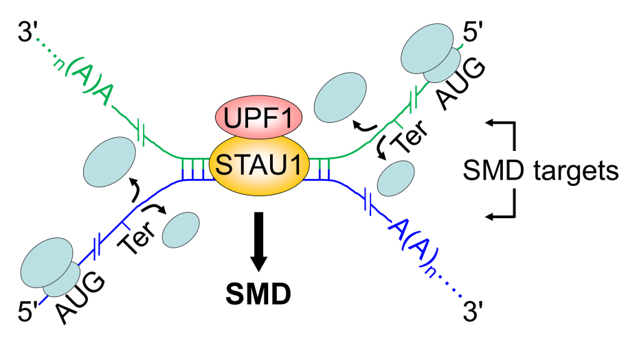
A new mechanism by which human mRNAs directly crosstalk
Gong, Tang and Maquat (2013)
mRNA-mRNA duplexes that auto-elicit STAU1-mediated mRNA decay.
Nat Struct Mol Biol. 20: 2114-2120

Slide 10
Staufen binding 3'UTR IRAlus complements nuclear retention, obviating PKR-mediated translational shutdown
Alu
3'UTR IRAlus mRNA
(A)n
Alu
Paraspeckle
(A)n
p54^{nrb}
STAU1
hNEAT1
p54^{nrb}
STAU1
(A)n
Nucleus
Cytoplasm
STAU1
(A)n
PKR
STAU1
Translational Repression
PKR
STAU1
Active Translation
STAU1
(A)n
STAU1
(A)n
Elbarbary, Li, Tian, Maquat (2013) STAU1 binding 3' UTR IRAlus complements nuclear retention to protect nuclear retention to protect cells from PKR-mediated translational shutdown. Genes Dev. 27:1495-1510

Slide 11
Competition between Staufen-mediated mRNA decay (SMD)¹⁻⁴ and NMD
AUG
Ter
EJC
Cap
A(n)
UPF3X
NMD
Gong, Kim, Woeller, Tang, Maquat
(2009) SMD and NMD are competitive pathways that contribute to myogenesis. Genes Dev. 23:54-66
UPF2
Competition
CH
UPF1
Staufen
AUG
Ter
SMD
Cap
A(n)
Since UPF2 and Staufen compete for binding to UPF1
SBS
(Staufen-binding site)
¹ Kim, Furic, Desgroseillers, Maquat (2005) Mammalian Staufen1 recruits Upf1 to specific mRNA 3'UTRs so as to elicit mRNA decay. Cell. 120:195-208
² Kim, Furic, Parisien, Major, DesGroseillers, Maquat (2007) Staufen1 regulates diverse classes of mammalian transcripts. EMBO J. 26:2670-2681
³ Gong and Maquat (2011) lncRNAs transactivate STAU1-mediated mRNA decay by duplexing with 3' UTRs via Alu elements. Nature. 470:284-288
⁴ Gong, Tang, Maquat (2013) mRNA-mRNA duplexes that autoelicit Staufen1-mediated mRNA decay.
Nat Struct Mol Biol. 20:1214-1220

Slide 12
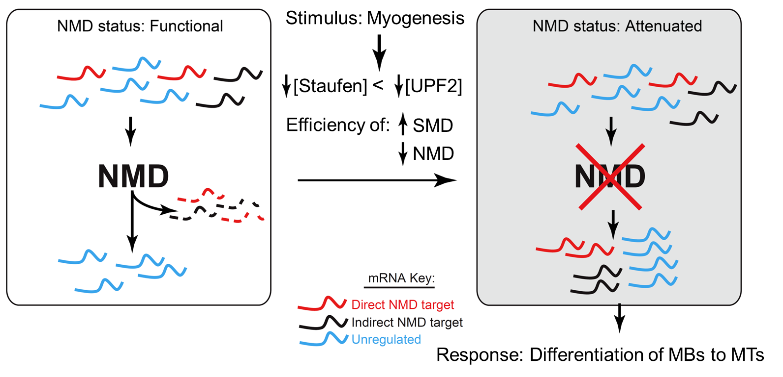
NMD is a molecular valve enabling cellular responses
During myogenesis, SMD targets, including PAX3 mRNA, which maintains MBs in an undifferentiated state, are degraded and lost from polysomes, whereas NMD targets, including myogenin mRNA, which promotes myogenesis, are not degraded and are translated.
Gong , Kim, Woeller, Tang, Maquat (2009) SMD and NMD
are competitive pathways that contribute to myogenesis:
effects on PAX3 and myogenin mRNAs. Genes Dev. 23:54-66

Slide 13
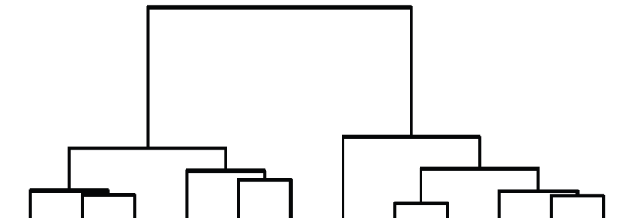
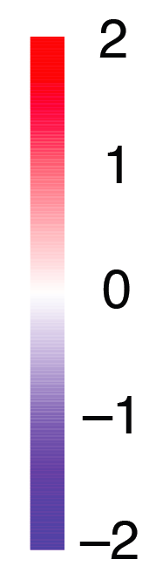
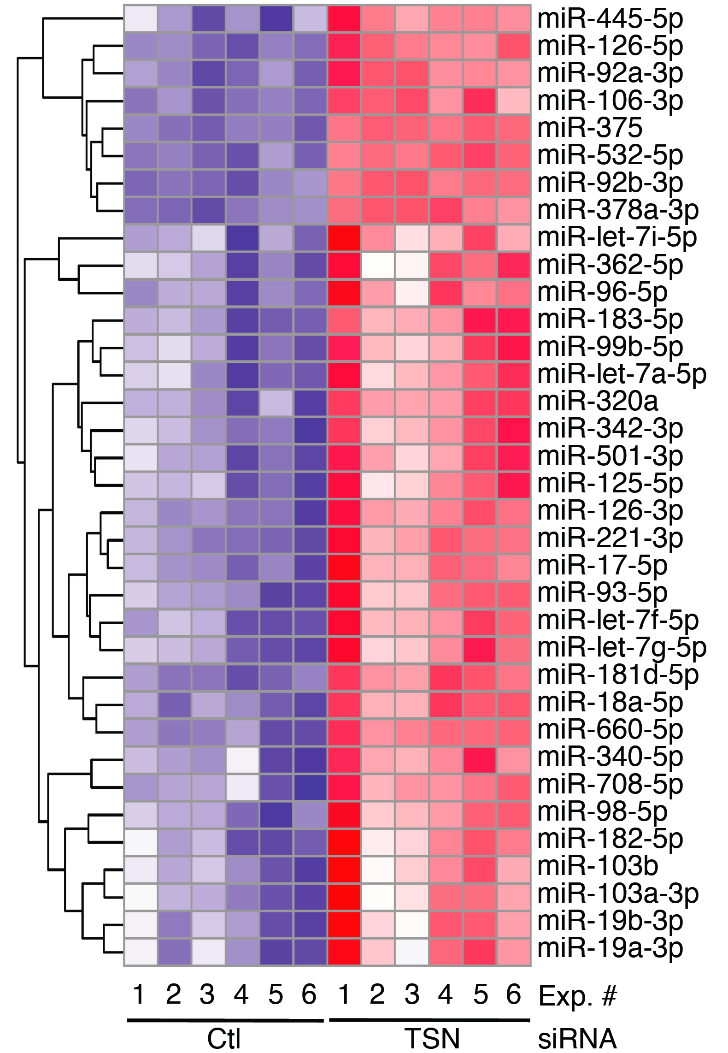
TumiD: Tudor-SN-mediated miRNA decay
Candidate
TumiD Targets
Conclusion:
By miR-seq,~28% of HEK
293-cell miRNAs are
Candidate TumiD targets.
Note, however, that
the miR-seq data
underestimate the number
of TumiD targets since
TSN KD was limited to
≤ 4 days.
Elbarbary, Miyoshi, Myers, Du,
Ashton, Tian, Maquat (2017)
Tudor-SN-mediated endonucleolytic decay of human cell microRNAs promotes G₁/S phase transition.
Science. 356:859-862
Ctl
TSN
siRNA
Notes:
Fig. 2A, B

Slide 14
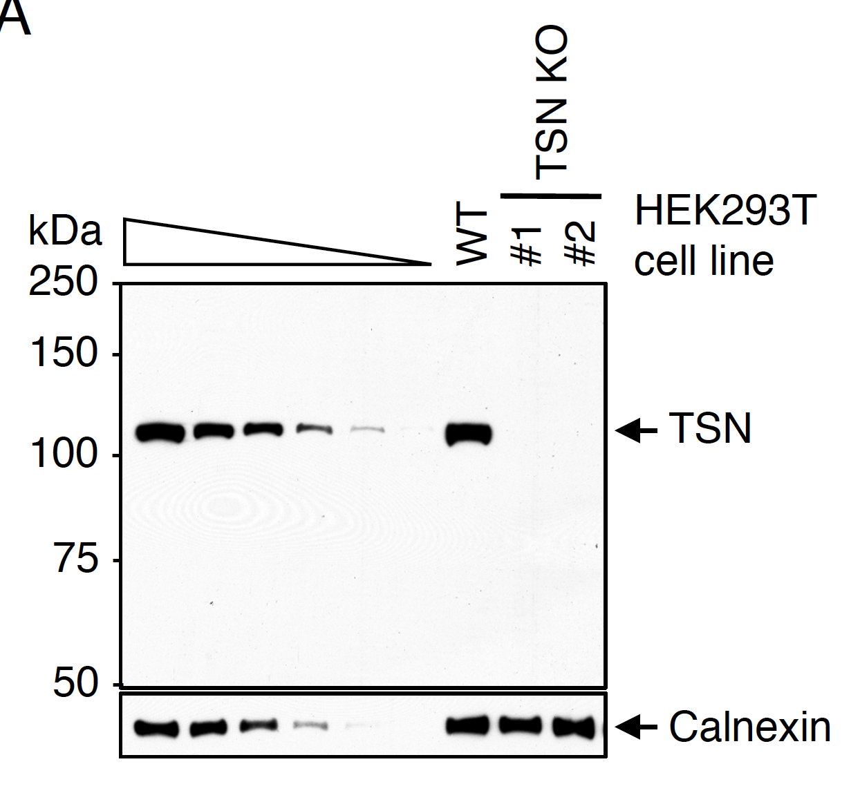
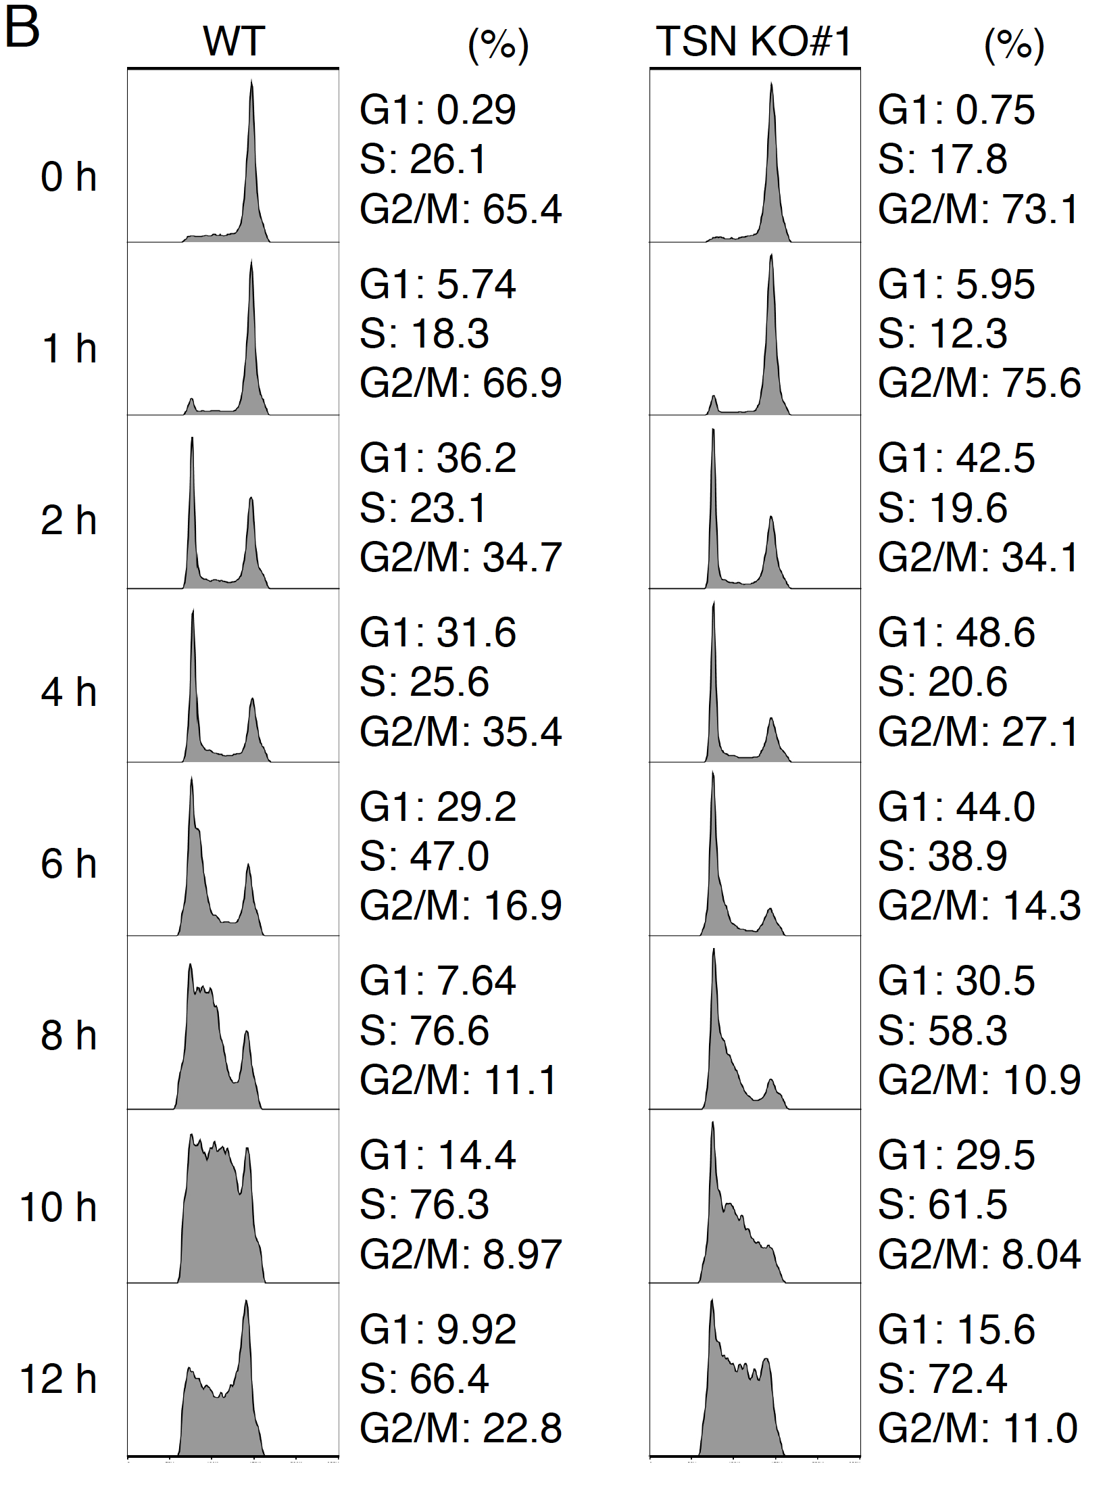
TSN-KO cells show a delay in G1-to-S phase progression
CRISPR/Cas9-mediated deletion of TSN
Elbarbary, Miyoshi, Myers, Du,
Ashton, Tian, Maquat (2017)
Tudor-SN-mediated endonucleolytic decay of human cell microRNAs promotes G₁/S phase transition.
Science. 356:859-862
Cells were synchronized in G2/M
using nocodazole
Notes:
Fig. 4A, B

Slide 15
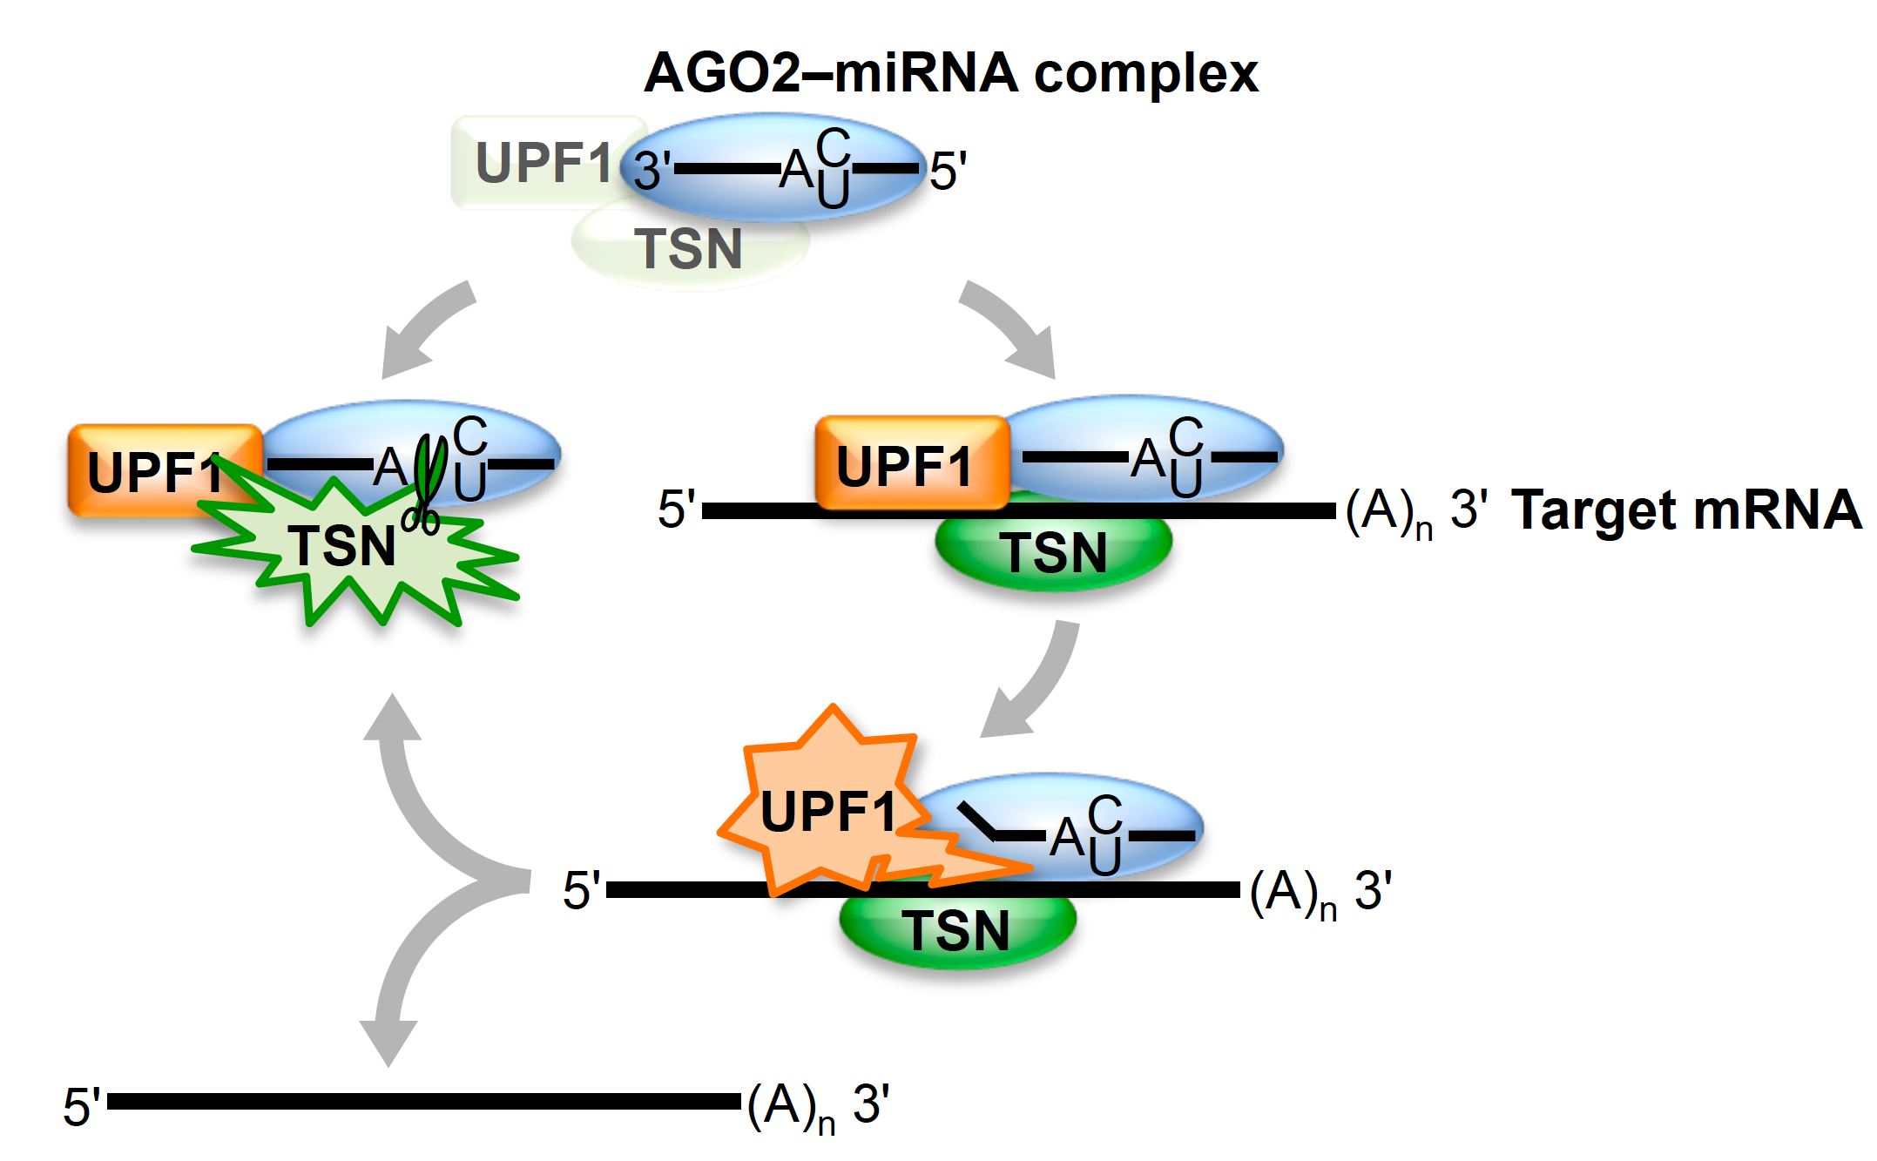
Model for TumiD, in which the complex of TSN–UPF1 might be a core component of RISC or recruited to RISC
Elbarbary, Miyoshi, Hedaya, Myers, Maquat (2017)
UPF1 helicase promotes TSN-mediated miRNA decay.
Genes Dev. 31: 1483-1493

Slide 16
Solving the structure of the interface between the transcriptional coactivator PGC-1β and the
CBP80−CBP20 cap-binding complex (CBC)
Crystal structure of PGC-1β−CBC−m⁷GpppA. The box encompasses the PGC-1β−CBP80 interface (enlarged, left). CBP80, green; CBP20, blue; m⁷GpppA, black; and PGC-1β peptide, golden-brown, which includes the nine (FDSLLKEAQ) amino acids at residues 1011-1019 that comprise the CBP80-binding motif (CBM). CBP80 and PGC-1β interacting residues are detailed and labeled.
Cho, Rambout, Gleghorn, Nguyen, Phipp, Miyoshi, Myers, Kataoka, Fasan, Maquat (2018)
Transcriptional PGC-1α coactivator contains a novel CBP80-binding motif that
orchestrates efficient target gene expression. Genes Dev. 32: 555-567

Slide 17
Model for PGC-1α-promoted transcriptional activation
PGC-1α
CBC
CBC
PGC-1α
RNAPII
RNAPII
TF
TF
Myogenesis
Myoblasts
Myotubes
Cho, Rambout, Gleghorn, Nguyen, Phipp, Miyoshi, Myers, Kataoka, Fasan, Maquat
(2018) Transcriptional PGC-1α coactivator contains a novel CBP80-binding motif
that orchestrates efficient target gene expression. Genes Dev. 32: 555-567

Slide 18
Establishment of a PGC-1α mutant mouse to investigate the physiological roles of the direct interaction of PGC-1α with the CBC
CRISPR-Cas9 editing of the Ppargc1a gene in the mouse genome to mutate the four CBP80-binding residues of the CBP80-binding motif (CBM) of PGC-1α to alanines.

