Slide 1
University of Rochester
Animal Resource (AR)
Bar-coding Cages
AR starting using barcodes for tracking census in December of 2005

Slide 2
Why bar-coding?
Provide timely census data
Provide accurate census data
Track room capacity

Slide 3
Each cage card/bar code is specific to the following information
PI name
Protocol Number
Account Number
Species
Location

Slide 4
New Cages
Animal Purchases
Weaned cages
Separated cages
Transfer from one UCAR # to another UCAR#

Slide 5
Creating a new cage in the room
(separating or weaning)
Two options
Order preprinted cage cards via our website or a paper form in the AR office.
Use a Temporary Card which are provided in the animal rooms. This will generate a permanent cage card from our office.

Slide 6
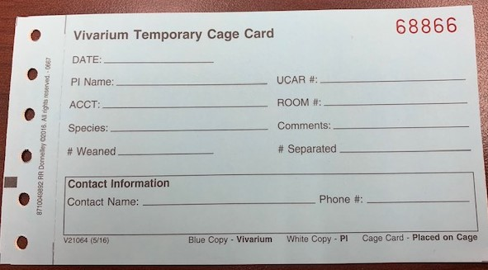
Creating a new cage in the room
(separating or weaning)
Use a temporary cage card (available in the room)
Complete the card, place the blue copy in a depository box, keep the white copy for yourself and place the card on the cage
The Animal Resource will generate a cage card with a bar code for you the next business day. This new card will placed on the cage within 3 business days.
Per diem charges will start the day the temporary cage card is put on the cage

Slide 7
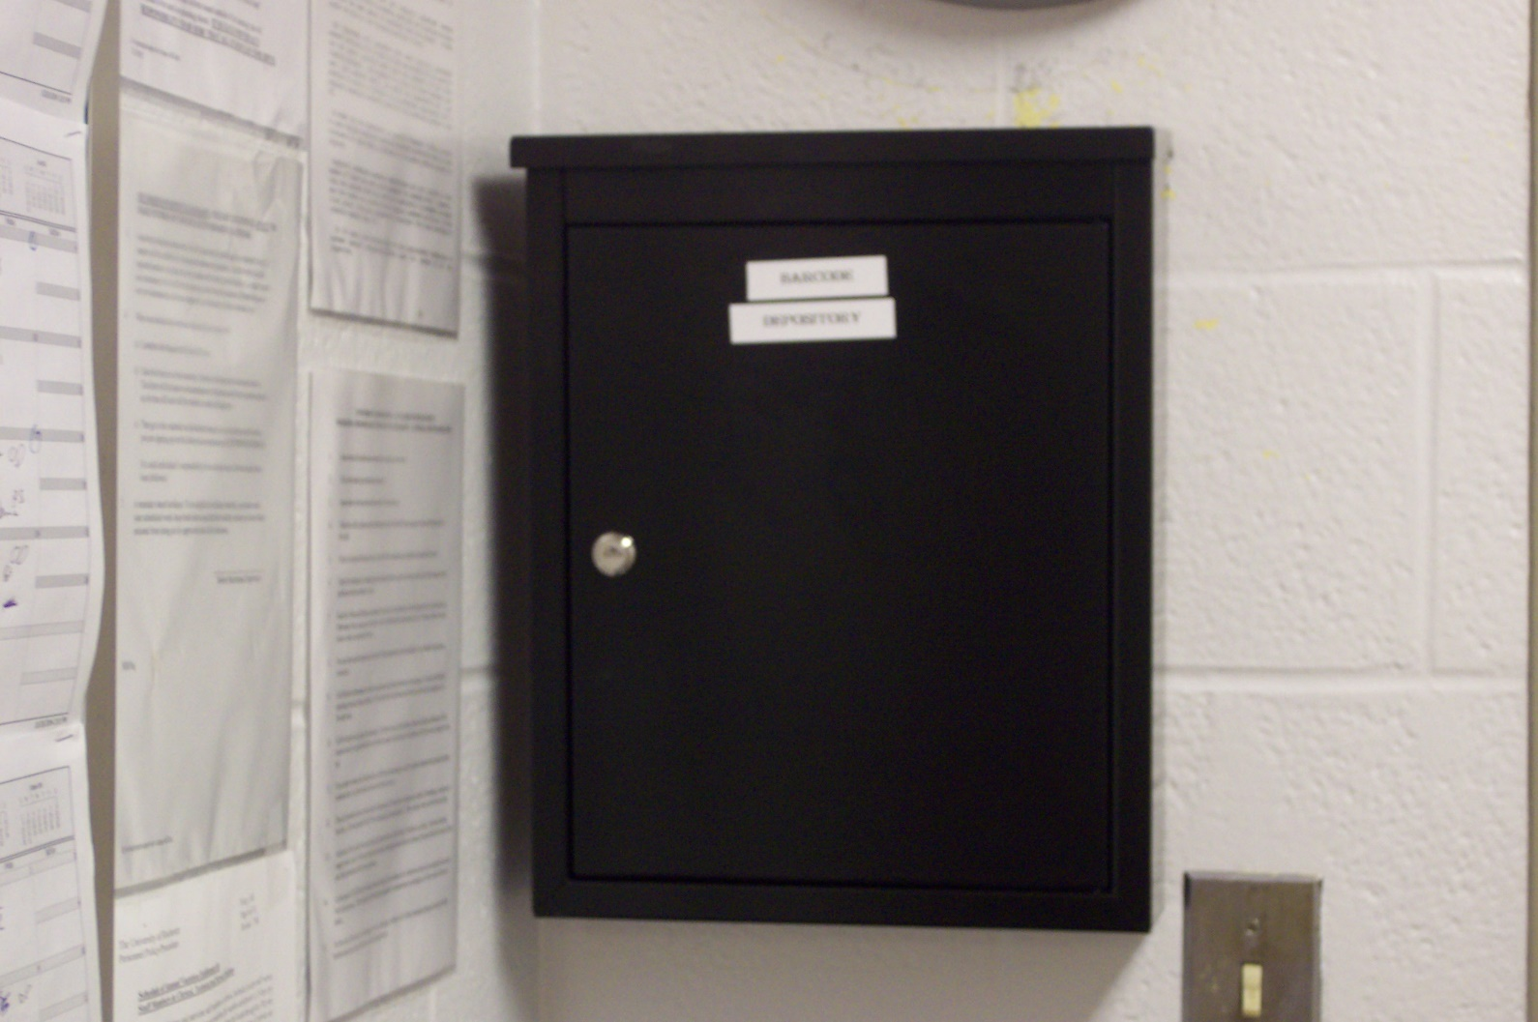
DEPOSITORY BOX

Slide 8
Location of Depository Stations
1st Floor 6900 hallway
2nd Floor 6900 hallway
3rd Floor 6900 hallway
4th Floor 6900 hallway
6th Floor 6900 hallway
B8600 hallway 2 stations (near B8670 and B8657)
Outside of B6516
Outside of B6922
MRB Every Suite
Annex 1st floor hallway and 3rd floor hallway

Slide 9
The most important things to remember
Tell us when you activate a cage and deactivate a cage.
Activations and Deactivations can be done electronically via our website
Paper form supplied in the animal rooms
Using the perforated slips on the cage cards

Slide 10
Deactivate
Elimination of Cages
Euthanasia
Shipping to Other Institutions
Transfers
A cage does not need to be deactivated when going to and from your lab

Slide 11
Deactivate – Top Slip
Fold and detach the top perforation part of the cage card and complete the deactivation date field.
Place the slip in a depository box located closest to the animal room.
The ARO will collect all the deactivation slips from the depositories.
Per diem charges for the corresponding cage will end on the date written on the slip.

Slide 12
DEPOSITORY BOX

Slide 13
Location of Depository Stations
1st Floor 6900 hallway
2nd Floor 6900 hallway
3rd Floor 6900 hallway
4th Floor 6900 hallway
6th Floor 6900 hallway
B8600 hallway 2 stations (near B8670 and B8657)
Outside of B6516
Outside of B6922
MRB Every Suite
Annex 1st floor hallway and 3rd floor hallway

Slide 14
Transfers
Transfers from one PI to another PI
OR
From one UCAR # to another UCAR #
Complete an AR Transfer via our website
All transfers require new cage cards
AR Office will generate them

Slide 15
Electronic Scanning of Animal Inventory
AR personnel will scan the cages in animal rooms weekly.
The scan provides a physical inventory to compare against the database. If any discrepancies exist, they are reconciled based on the scan date

Slide 16
Most Important Things
Activate and Deactive cages immediately.
Any questions contact the AR Office
        5-2651

