Slide 1
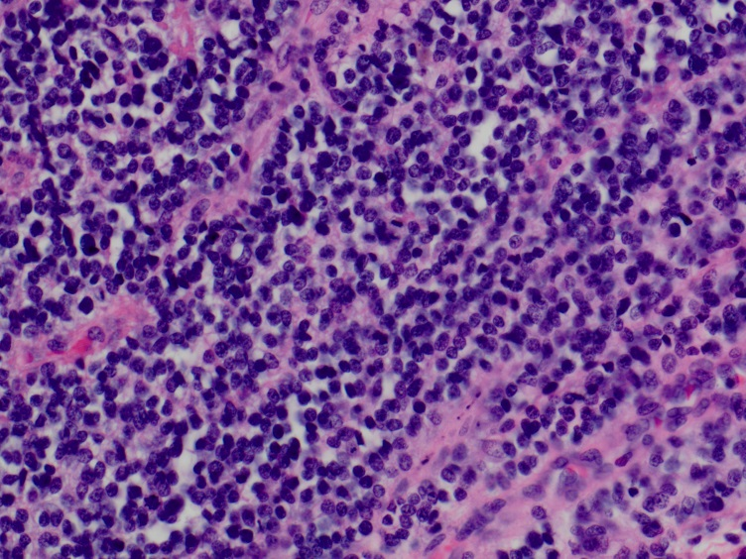
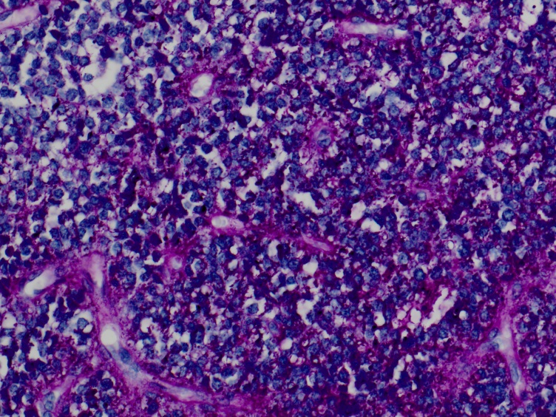
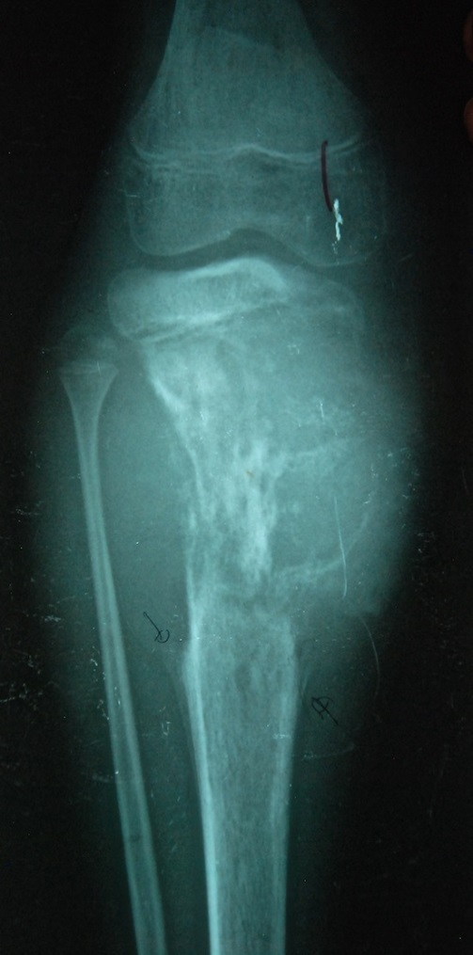
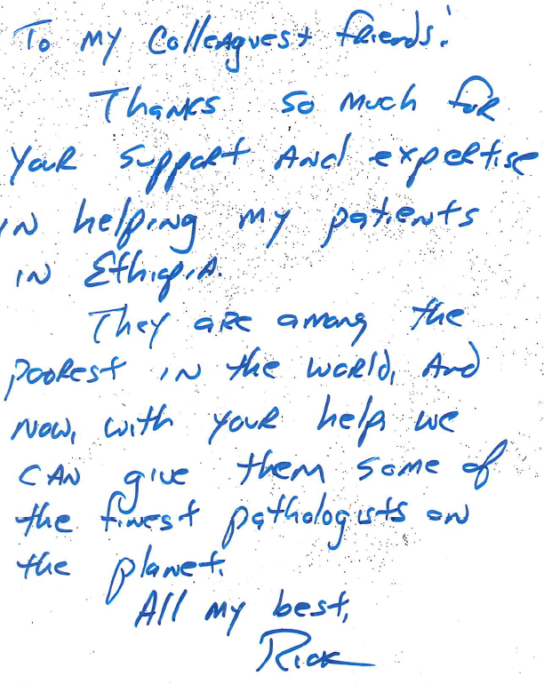
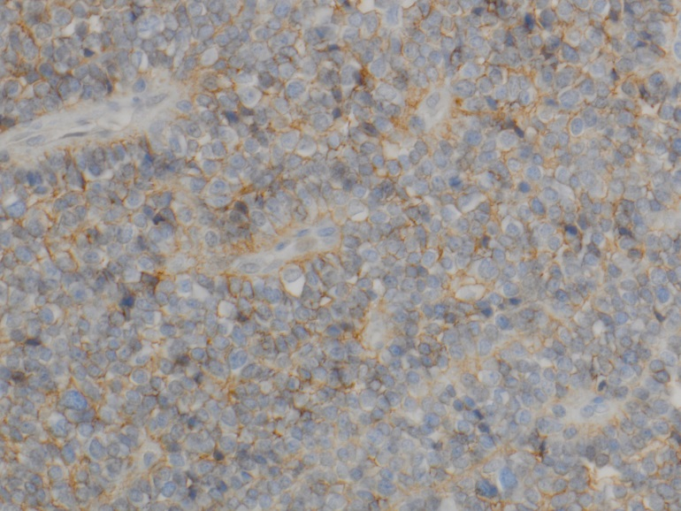
The Department of Pathology and Laboratory Medicine GOES GLOBAL
A 13-year-old male presented to Clinic with a complaint of pain and swelling of his left knee for several months (Figure A). Here’s his story…
Hematoxylin and eosin stained sections for the tumor (Figure C) showed a malignant undifferentiated small round cell tumor with areas of necrosis
Rick Hodes is an American doctor who has lived and worked in Ethiopia for over 20 years. He is the Medical Director of Ethiopia for the American Jewish Joint Distribution Committee (JDC), a 95-year-old non-governmental organization.
X-Ray showed an ill-defined, destructive lesion of his proximal tibia with permeative or “moth-eaten” destruction of the bone with a soft tissue mass (Figure B)
Figure C
Currently, he is the senior consultant at a Catholic mission helping the sick and destitute with heart disease (rheumatic and congenital), spine disease (TB and scoliosis), and cancer. He has also worked with refugees in Rwanda, Zaire, Tanzania, Somalia, and Albania.
Figure A
Further studies showed that the cytoplasm of the tumor cells contained glycogen granules (Figure D, PAS stain)
The Department of Pathology receives biopsies and reviews cases from Dr. Hodes that will be read by several of our subspecialty Anatomic Pathologists, including Surgical Pathologists, Neuropathologists, and Hematopathologists. Our pathologists give their diagnosis to Dr. Hodes, so he may provide the right treatment to the patient.
Figure D
Also showed membrane expression of CD99 (Figure E, lHC stain)
352 Ethiopian spine patients have had operations in Ghana through July, 2014. If this surgery had been done in the USA, it would have cost $50 million dollars! Our costs in Ghana are significantly less than 10% of that.
Figure B
Figure E
“These findings are diagnostic of Ewing’s sarcoma of bone. Ewing’s sarcoma is an aggressive primary bone tumor affecting mainly adolescents and young adults. If left untreated this is almost universally fatal. In the modern era of cancer therapy, these tumors are responsive to aggressive treatments (surgery, chemotherapy and radiation) and there is an excellent chance of cure and long term survival for more than half of such patients!” Dr. David Hicks, MD
“We are so grateful and happy with our new life”-Post-Op spine patients

