Slide 1
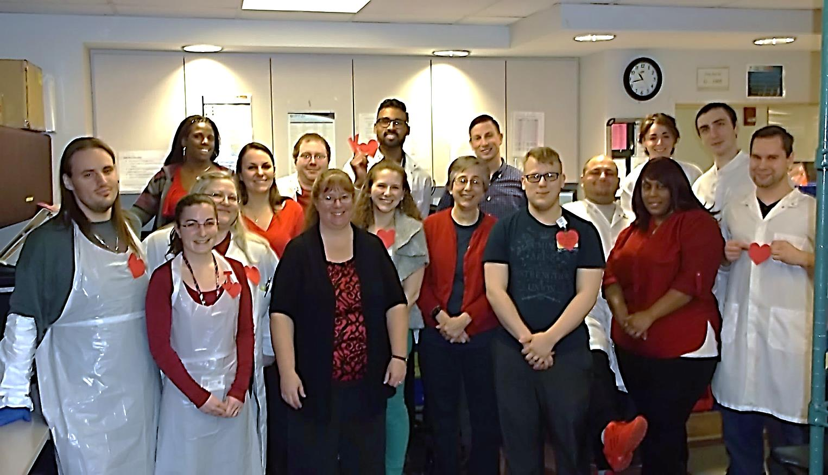
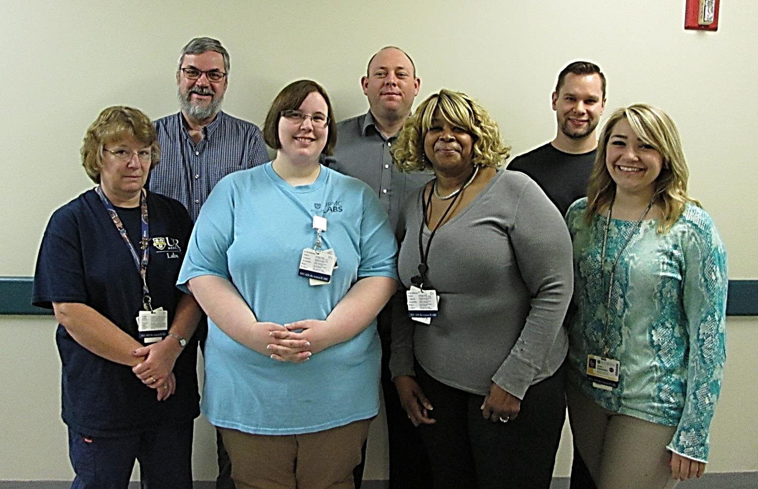
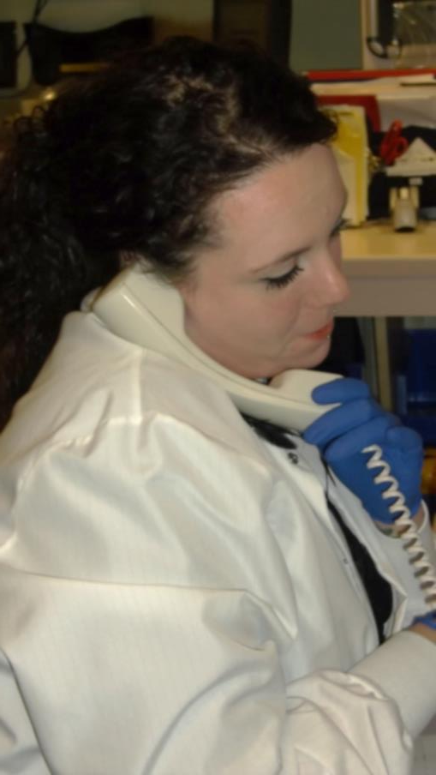

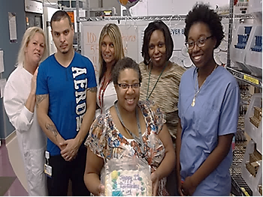
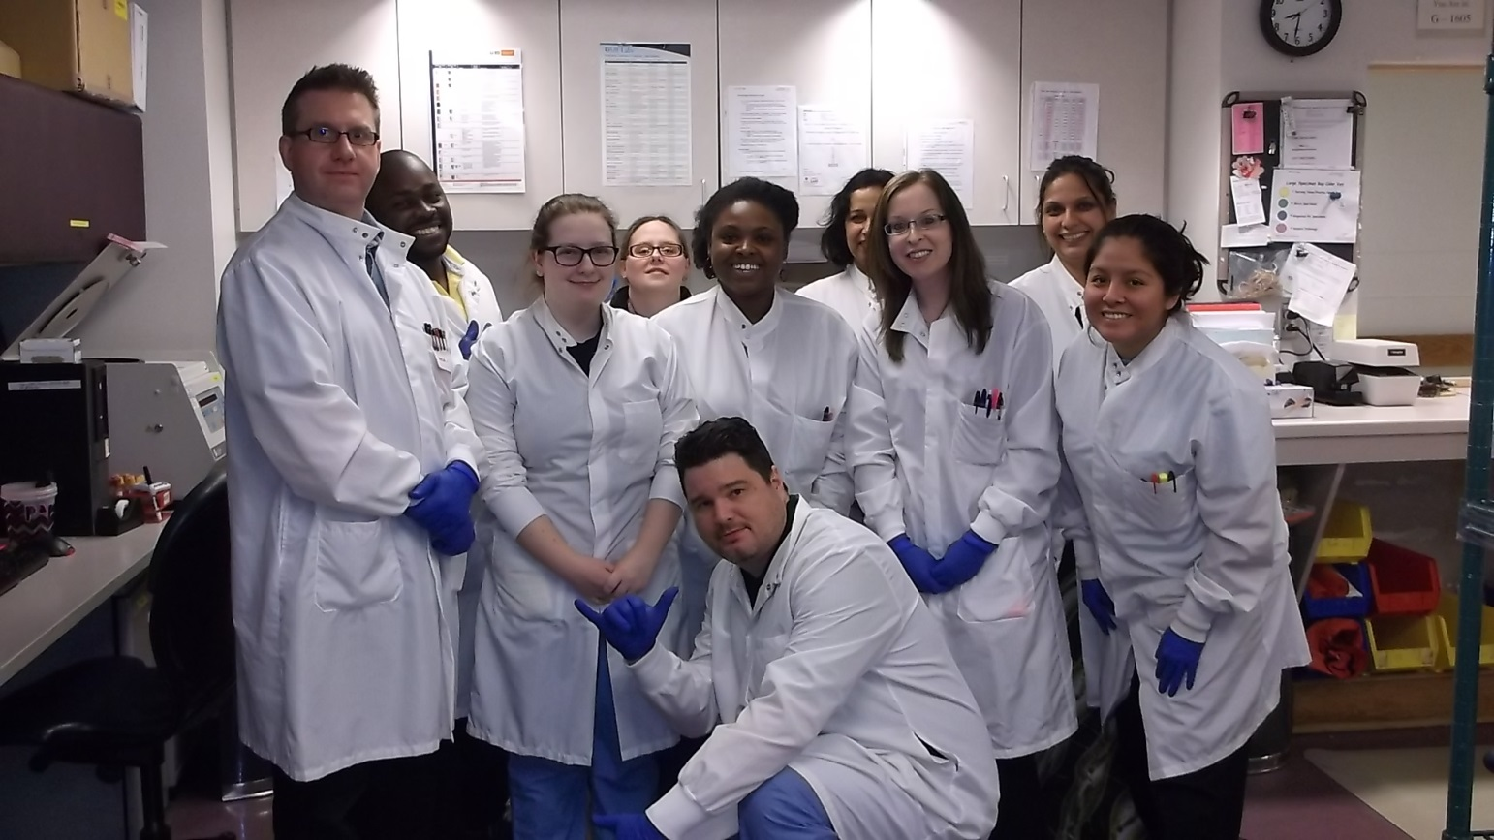
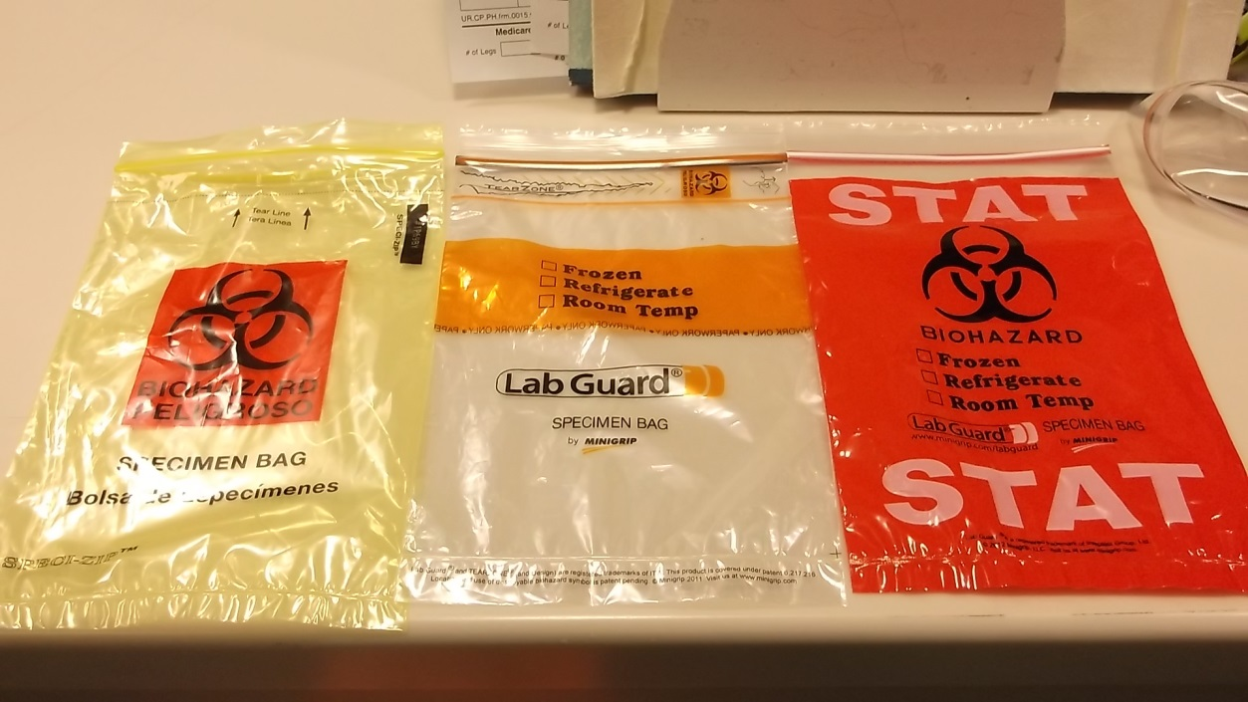

Department of Pathology and Laboratory Medicine
Who is Specimen Management?
Specimen Management (SMS) is a patient-oriented department responsible for accurate pre-analytical preparation of specimen. We provide all departments with samples ready for testing and emphasize quality assurance while ensuring quick turnaround times.
-We are a department made up of over 94 Clinical lab support techs working around the clock to deliver specimen to the appropriate testing locations.
-We process over 10,000 specimen per day, including urine samples, blood, body fluids and stool.
Which clinical labs do we support?
Chemistry
Hematology
Urinalysis
Flow Cytometry
Molecular Diagnostics
Tissue Typing
Blood Bank
Toxicology
Microbiology
ARUP Laboratories
MAYO Lab
Rochester General
Cytogenetics
Coagulation Lab
Ridgeland Road
Protein lab
MSAFP Lab
And over 53 other external labs!
Strong Memorial Hospital SMS
Visit Registration: Register patient visits using FLOWCAST
Log: Log all tests in SOFTLAB following requisition
Receive: Receive specimen from inpatient units, 18 outpatient draw sites, 30+ nursing homes, home-draws, and affiliated and reference labs.
Organize: sort specimen by priority, stability, specimen type, and testing locations.
Process: processing samples utilizing automation, or manual process if indicated.
QA: Ensuring that all specimens delivered for analysis meet high quality standards. Training to ensure that all employees work to minimize human error.
Specimen Integrity: Maintaining specimen to ensure quality and validity test results, including temperature control, processing limitations, stability over time.
Tracking: Pursuing accountability for all of our patients by tracking the locations and status of all specimen that come through the lab.
Study Processing: preparing submitted clinical and research studies for analysis.
Exception Handling: Problem resolution, including specimen integrity, unknown providers, unclear tests and unsuitable samples. Working with providers to provide medicine of the highest order.
Ridgeland Road SMS
Who we are?
A subset of the Specimen Management Section located at RR lab
What we do?
Receive specimens from 17 outpatient Patient Service Center’s, including Pluta Cancer Center
Process an average of 2,000 orders daily
Reference Lab/ Send-Outs:
Who we are?
A specialized section of SMS who process and sends outsourced testing to external laboratories
What we do?
Process, manifest, transmit, and package specimens for shipment to other labs including ARUP, Mayo, and over 53 others
Facilitator for the Laboratory Diagnostic Committee to research requests for off-formulary testing
Research and process 135 off-formulary and restricted test requests monthly
Enter, report, and mail results for non-interfaced, off-formulary tests, and non-ERecord providers
Daily Quality Assurance of all NYS Newborn Screens and random QA audits
Check for NYS approval for all send-out testing and obtain permits for non-NYS approved testing
Send 4200 Specimens to ARUP monthly
SPECIMEN MANAGEMENT
"KEEPING THE BEAT"
SMS Workload 2015 | Tests Prepared | Blood tubes Processed
SMS SMH | 7,470,262 | 1,743,984
SMS Ridgeland | 1,989,604 | 469,512
Ref Lab | 50,412 | NA

