Slide 1
Bicycle Safety
Hand Signals and Road Rules for School Age Bicyclists
By Amy Sterling
Ashley-Marie DiVincenzo
Laura Kolb
Megan Puls

Slide 2
Need:
To decrease bicycle injuries in school age
children by increasing road safety knowledge
for bicycle riding.
The National Highway Traffic Safety Administration (NHTSA) states that due to children less than 10 years of age not being mature enough to make the decisions necessary to ride safely in the street they are better off riding on the sidewalk. However, New York state law and jurisdiction does not allow sidewalk bicycling. To be in accordance with the law, children need to be taught bicycle safety on the roadway. This will decrease the growing number of injuries and fatalities associated with motor vehicle/bicycle accidents.

Slide 3
Goals and SMART Objectives
Education regarding bicycle safety in accordance with current safety laws on roadways.
This will be measured by a pre and post test given to the recipients of the education, with the education being visual, demonstrated and hands on.
Children ages 6-12
Goal of 50% improvement in correct answers on the post test vs. pretest.
This goal is expected to be met at the conclusion of the 1 hour course.

Slide 4
There are many health and environmental benefits to bicycling, however, severe injuries and fatalities are also associated.
Healthy People 2020 goals for injury prevention include reducing pedalcyclists deaths on public roads and increasing the number of states that require bicycle helmet use. This matches up nicely with our goals.
Our target age group 6-12 year olds - school age children
Statistics
- accidents #1 cause of death in this age group
- in Monroe County in 2005, 216 (3.7%) of total accidents were bicycle related
- in New York State in 2010, 4,820 (1.9%) of total accidents were bicycle related
- also in 2010, 2,523 (41.2%) of bicycle accidents did not have helmets on, 18 deaths
- again in 2010, 841 (13.7%) of bicycle accidents were wearing helmets, 4 deaths
- 4,082 (2.2%) of children ages 5-9 were injured or killed in 2010
- 4,218 (2.2%) of children ages 10-13 were injured or killed in 2010
- in New York State in 2012, 1,726 (29.2%) of total accidents were bicycle related
In Ontario County NY, in 2007, 17 Bicycle accidents occurred (.3%), in 2008, 11

Slide 5
Policy and Interventions:
NYS law states any rider under the age of 14 is to wear a helmet while on a bicycle.
NYS law prohibits anyone under the age of 1 to be on bicycle.
NYS law states that a fine of $50 can be given to anyone that does not follow such law.
NYS court can waive this fine if sufficient proof is given to show that lack of helmet is due to financial inability to purchase one or unable to receive one from the statewide in-line skate and bicycle helmet distribution program.
Bicycles must be properly equipped with workable brakes, a bell or horn, reflectors, and if driven at night, headlight and taillight.
Monroe County offers a plethora of educational programs to children and adults regarding proper bicycle safety, focusing on importance of wearing a helmet. It also addresses proper road safety and rules of the road, safe places to ride, as well as basic bicycle maintenance.
- We couldn’t locate any information on whether or not these were actually effective or not. Just in our own observation in talking to parents at the class we did, it sounds like most parents try to make their younger kids abide by these laws but don’t “fight” with their teens to abide by them.

Slide 6
Theoretical Framework
Social Cognitive Theory
  Why this theory?
    Self-efficacy is a common pathway which psychosocial influences affect health functioning. This core belief affects each of the processes of personal change. Human health is not just an individual matter, but a social one. A comprehensive approach to health promotion also requires changing the practices of social systems that have widespread effects on human health.
    Based on Piaget’s and Erikson, children are very much influenced by their peers, media, and observations of others at this stage of development.
    The more children see others practicing safe bicycle road safety, the more they will practice those behaviors themselves.

Slide 7
Purpose
Teaching 6-12 year old boy scouts bike safety and rules of the road due to accidents being the number one cause of death in this age group. They will understand the consequences of not following these rules, as well as be required to pass a short test at the end of a discussion regarding rules and safety. Bells and reflectors will be given to these boy scouts in accordance with NYS laws. Intended outcomes include the boy scouts being able to demonstrate learned hand signals and describe rules of the road.

Slide 8
PHN Wheel Interventions Used
Our project will utilize the blue section of the PHN intervention wheel to meet the needs of our target population, specifically counseling and health teaching.
Health Teaching engages participants at an intellectual level and proceeds from the counseling relationship.
“The goal for the public health nurse is to facilitate outcomes such as knowledge attainment and behavior change in the individual/family or population.”
The determinants of health depicted in the Graphic Model for Healthy People 2020 are Biological/genetic determinants, social environment, economics, physical environmental determinants, & individual behavior. These along with policymaking help to develop health teaching programs.
(Truglio-Londrigan & Lewenson., 2013, p. 281-282)
The interventions can be described as:
Counseling establishes an interpersonal relationship with a community, system, family, or individual intended to increase or enhance their capacity for self-care and coping. Counseling engages the community, system, family, or individual at an emotional level.
Health teaching communicates facts,
ideas, and skills that change knowledge, attitudes, values, beliefs, behaviors, and practices of individuals, families, systems, and/ or communities.

Slide 9
Planning Model
Logic Model was used for this project
Input
- teaching importance of wearing a well fitting helmet on a bicycle for all children under 14
- NYS law to have bell and reflectors on bike, as well as taillight and headlight if riding at night
- target age group 6-12 year olds - school age children
- accidents #1 cause of death in this age group
- working along side Pedal Patrol
- in Monroe County in 2005, 216 (3.7%) of total accidents were bicycle related
- in New York State in 2010, 4,820 (1.9%) of total accidents were bicycle related
- also in 2010, 2,523 (41.2%) of bicycle accidents did not have helmets on, 18 deaths
- again in 2010, 841 (13.7%) of bicycle accidents were wearing helmets, 4 deaths
- 4,082 (2.2%) of children ages 5-9 were injured or killed in 2010
- 4,218 (2.2%) of children ages 10-13 were injured of killed in 2010
- in New York State in 2012, 1,726 (29.2%) of total accidents were bicycle related
Activities
  short presentation of rules, laws and consequences
  provide children with bells and reflectors for children's bikes
  teach simple road rules and hand signals
Outputs
  required to pass a short, easy quiz at end of presentation related to rules
  children will be able to demonstrate correct hand signals
  show proper fitting helmets
Impact
  The plan is to provide a knowledge base for children and parents on the importance of proper road safety and why it is necessary to have the proper safety equipment on their bicycles.
Long-Term Outcomes
- proposed decrease in head injuries
- proposed decrease in accidents involving bicycles

Slide 10
Planning Model
Short term goals
  include learning the rules of the road as pertained to bicyclists and bicycle equipment safety including use of protective gear (i.e. helmets) and bicycle gear (i.e. bells, reflectors, bicycle maintenance).
  The children will learn safe activities and behaviors r/t biking on roadways.
  The children will gain confidence by engaging in health enhancing activities.
  The children will develop skills and behaviors through early education to physically prepare them for future safe travel/recreation on bicycles.
  The parents will enforce positive behaviors r/t bicycle safety and encourage these behaviors through demonstration and practice.

Slide 11
Planning Model
Evaluation
Process - How will you get people to teaching event?
Children ages 6-12 will be recruited through the Victor/Farmington Pack 60 Cub scouts and Troop 61 Boy scouts.
How it works? A short PowerPoint presentation or discussion with children and parents to stress importance of proper bicycle safety and rules of the road will be viewed. Live demonstration with the children and their bikes of safe riding practices will be provided. Pre and post test to evaluate the present knowledge and the education retained through education given at this activity. No advertisement necessary.
Bicycle Helmet safety will be reinforced as 62% of bicycle mishap fatalities resulted from head injuries (Andersen).
Reflectors will be given out as incentive and children will be instructed to wear while riding. Reflectors have been shown to increase visibility of an individual up to 500 feet away, while white or light clothing can only be seen 180 feet away, and a driver going 60mph needs more than 260 feet to stop (safety reflectors).
Bells will also be provided and affixed to the children’s bikes as positive reinforcement and incentive. Your bell alerts drivers, pedestrians and other cyclists to your presence, it is required by law (NYC.Gov).
Outcome –
  A short “show of hands” quiz at the end of teaching to test children on what they have learned regarding road signals and safety rules will be administered to evaluate information retained.
    Cognitive – Children ages 6-12 will learn about bicycle safety on roadways in accordance with current safety laws in place regarding bike safety and the rules of the road that pertain to bike safety.
    Affective- The children will gain confidence by becoming responsible and independent with their own health and safety choices. Increased confidence r/t engaging in health enhancing behaviors has shown the outcomes to be positive.
    Psychomotor – Objectives focus on change in development of behavior or skills. Early education can make safe choices/behaviors second nature for future bicyclists.

Slide 12
Implementation
For implementation the four of us did a small interactive presentation for a group of 20 Victor/Farmington Pack 60 Cub scouts and Troop 61 Boy scouts. Most of their parents were also present.
We used visuals such as posters (given to us by Kohl’s Pedal Patrol), bicycles, and ourselves for demonstration of hand signals.
We made folders that included an activity book, pens, pencils, and handouts for the kids and parents to reference while we spoke as well as at home ( see picture).
After introducing ourselves and the purpose of our project a pretest was given to the students to get a baseline assessment of their knowledge.
After collecting the tests we went through the folder and did our hands on education about bike safety, hand signals, road signs, and general rules of the road.
Once the education portion was complete the students took the same test as prior so that we could use this as an evaluation tool.
At the completion of class, students received a certificate, wrist reflectors, bike reflectors, a bracelet, and a bell for their bike. All these items, except the certificates (which we made), were provided by Kohl’s Pedal Patrol.

Slide 13
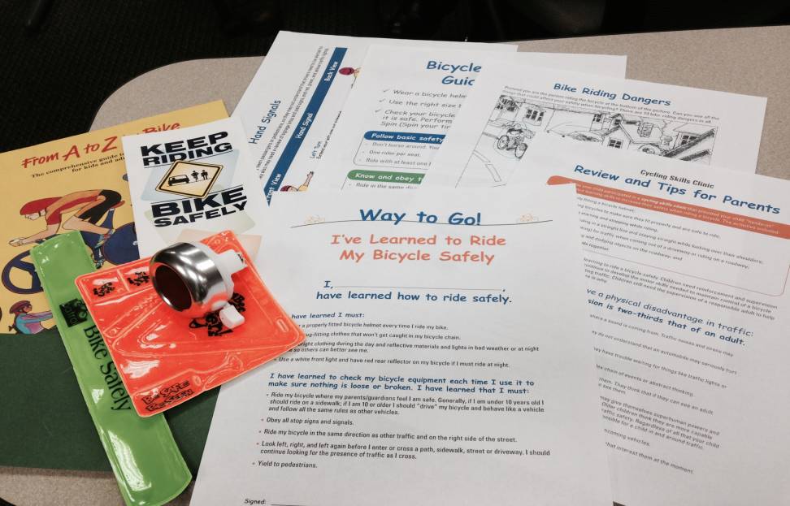
Implementation
Challenges of our implementation phase:
  Winter- we were in the wrong season for outdoor bike teaching so it was done inside.
  Population- 20 boys ages 6-12 are VERY rowdy and easily distractible. It was difficult to keep their attention. Six to 12 is quite an age difference from the youngest to oldest. Not everyone learned on the same level. We tried to make our materials “user-friendly”. We didn’t take into account how many of the younger ones would need help reading and understanding the tests and handouts.
  Prizes- the bells were a great idea, however, the last 5 minutes of the presentations was a symphony of 20 bells ringing.
This is the contents of the folder that was given to each child.

Slide 14
Evaluation
Due to time constraints of class, tools and the season, we chose to only evaluate short term effectiveness of our presentation and we did this by using a pre and post test for road signs and hand signals.

Slide 15
Evaluation

Slide 16
Evaluation
Our outcomes were a little different than expected.
  We didn’t realize how much the students already knew.
  We didn’t take into account the assistance from parents/adults on both the pre and post tests.
  We were please that they actually did retain something in the brief time that we had with them to teach them about bike safety.
  Follow-up:
  We feel that there is a never ending need for bicycle and roadway safety.
  Each new generation will need to be taught this so that our kids can have fun riding their bikes but remain safe and do it in accordance with local, state, and national laws and regulations.

Slide 17
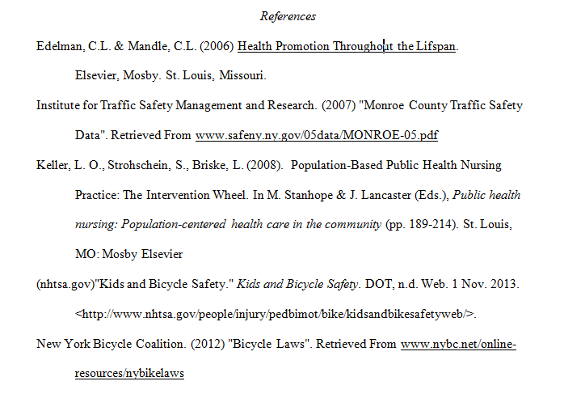

Slide 18
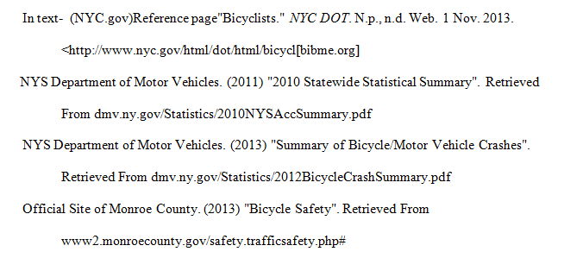

Slide 19
