Slide 1
Injury Prevention Through Education
Dana Hudson RN
Patricia James RN CNOR
Katrina Lorenzetti RN

Slide 2
Need
To reduce the incidence and severity of childhood injury in Rochester NY
Increase education to school age children in Rochester, NY the importance and proper use of helmets, we will decrease fatalities and traumatic brain injuries (TBI) relating to bicycling without helmets.
In 2007, 203 people were killed from bicycle accidents in Monroe County. 100 of those people were reported to have not worn helmets.
27 fatalities were reported to have worn helmets. 76 fatalities were unknown to have been wearing helmets or not
School age children under 15 represent a large amount of the population sustaining head injury from bicycling.
(Monroe County, 2014)
In 2011, 677 bicyclists were killed in traffic/vehicle accidents. This is a 9% increase from the 623 bicyclists killed in 2010. The 677 deaths account for 2% of traffic fatalities.
The age group 16 and younger accounted for 10 percent of all bicyclists killed and 19 percent of all those injured in traffic crashes in 2011, compared to 23 percent of those killed and 39 percent of those injured in 2002.
The US Dept of Transportation Highway Traffic Safety Administration strongly encourages all bicyclists to wear a properly fitted bicycle helmets every time they ride. A helmet is the single most effective way to prevent head injury.
(US DOT, 2011)

Slide 3
Goals and SMART Objectives
R
Goals of at least 50 % improvement from pre to post test
T
Will be meet by end of 1 hour lesson
A
1st grade students
M
This will be measured by a pre and post test
S
Education: Current safety laws regarding bicycle helmet use

Slide 4
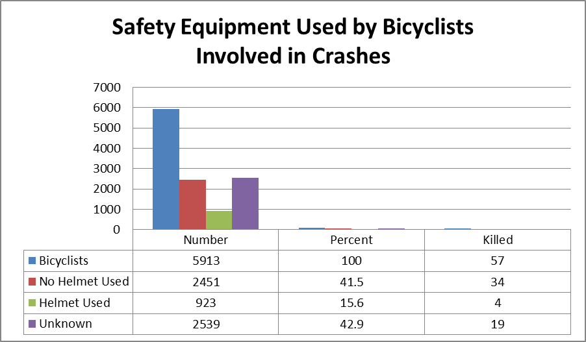
NYS- Statistics
New York State Department of Motor Vehicles
Summary of Bicycle/Motor Vehicle Crashes
2012
TABLE 10(P) Safety Equipment Used by Bicyclists
Total Bicyclists |  |  |  |  | Bicyclists by Severity of Injury
Number |  | Percent | Killed (K) | Serious (A) | Moderate (B) | Minor (C) | Unk Injury | Uninjured (O)
Bicyclists | 5,976 | 100.0 | 45 | 585 | 1,793 | 3,210 | 142 | 201
No Helmet Used | 2,500 | 41.8 | 22 | 273 | 749 | 1,333 | 40 | 83
Helmet Used | 947 | 15.8 | 10 | 93 | 320 | 487 | 19 | 18
Unknown | 2,529 | 42.3 | 13 | 219 | 724 | 1,390 | 83 | 100
NYS Department of Motor Vehicles Data 2011
Institute for Traffic Safety Management and Research, 2009

Slide 5
Purpose
To work with 6-7 year old 1st graders on bicycle helmet safety due to accidents being the number one cause of death in this age group.
They will understand the need for bicycle helmets when riding bikes, using skate boards and roller blades. This will be achieved by the use of pre and post tests as well as demonstrations and videos.
Hand-outs for the students to take home will be provided as well. This will educate the parents of NYS law regarding bicycle helmets

Slide 6
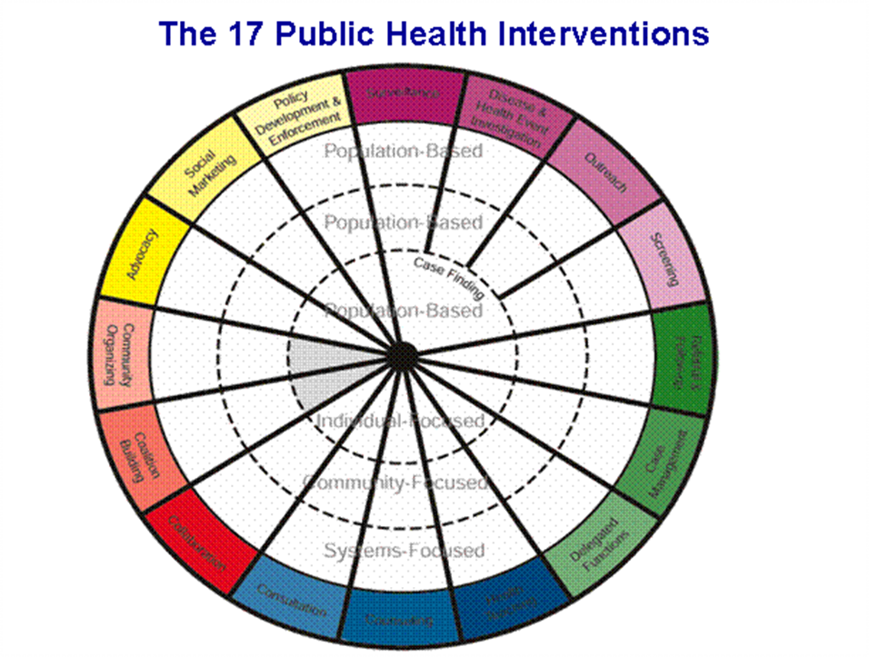
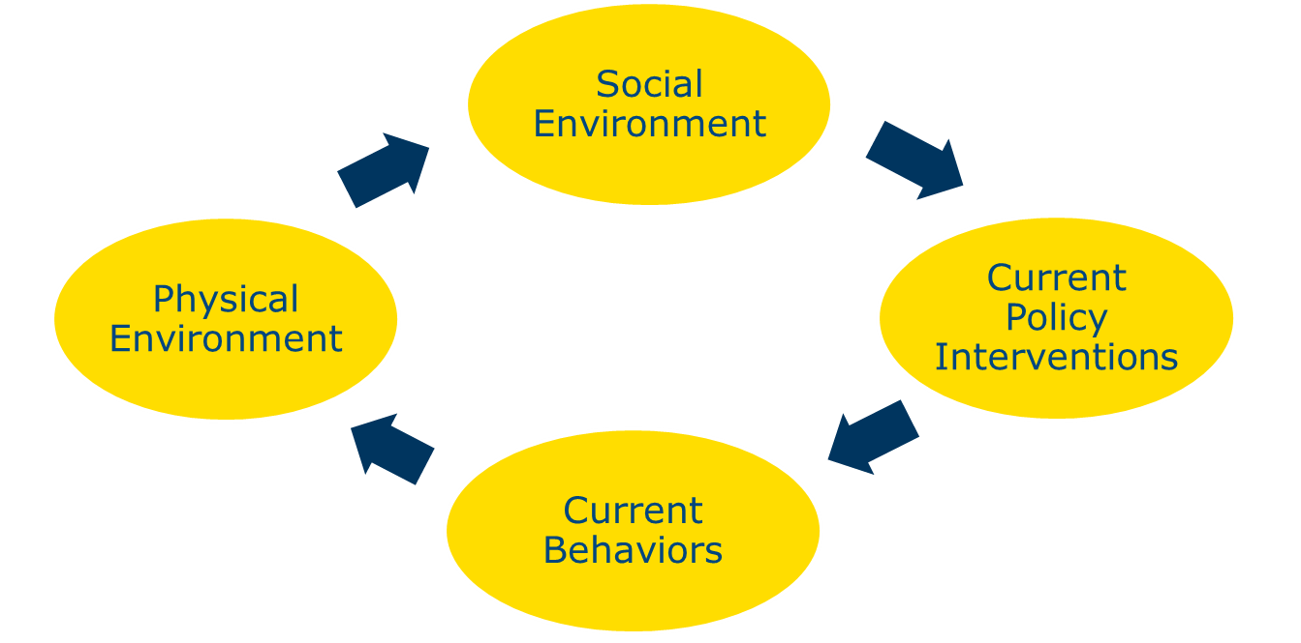
Public Health Wheel Intervention
Planning Stage
Surveillance: research on local, state, and national statistics
Disease & Other Health Event Investigation- bicycle injury with and without helmet use
Outreach- School Age Children
Implementation Stage
Screening- pretest regarding wearing helmet and understanding of helmet use
Health Teaching- presentation target group
Referral & Follow-Up- post test
Policy Enforcement –encouragement to wear helmet not only for safety but because of the law for children under 14
Hodges, B. C. & Videto, D. M. 2011

Slide 7
Planning Model Precede -Proceed
Phase 1
Needs were assessed b statistics regarding Trauma Brain Injury (TBI) from bicycling injuries and death
Phase 2
We know now by assessing the Monroe County Traffic Data Set how many bicycle deaths and injuries occur from no helmet use
Phase 3
Increasing bicycle safety education will be able increase bicycle helmet usage throughout the community.
NYS Department of Health, 2014)
Phase 3
Increasing bicycle safety education will be able increase bicycle helmet usage throughout the community.
Phase 4
Administrative and policy assessment and intervention alignment Bicycle Helmet Law:
“ By law, all bicyclist under the age of 14 are required to wear approved bicycle helmets when bicycling or riding as passengers on bicycles in NYS. The maximum penalty for an offense is a $50 fine. However, if a parent can prove that the helmet has been obtained...”
(NYS Department of Health, 2014)

Slide 8
Planning Model Precede -Proceed
Phase 5- Implementation
The 3 presenters as well as the program director meet with a class of 1st graders at the Taylor Winslow Elementary school in the Rush Henrietta School District class.
We introduced ourselves and talked a little as to way we were at their school.
We showed the children pictures of animals with shells to get them thinking about protection and how shells protect these animals
We then conducted a pre-test on their knowledge of the importance of bicycle helmets
A short video played about the importance of helmet use
A demonstration showing the destruction of a brain in a helmet and without a helmet will be done with the group, by using a peeled and unpeeled orange
We will then demonstrate the proper use of the helmet and explain dangers of not wearing a helmet
Question and answer session
Challenges of our implementation phase
Never being at the school to know the lay out and how are education would flow
Technology and the YouTube video cause a moment of distress.
First day back from Spring break, the children were not use to routine and a little harder to keep focused.
Children needed a little help with reading the 2 questions
Peer pressure that the children did not want to be the only one not raising their hands if they did not have a helmet or bike at home.

Slide 9
Phase 6, 7 and 8
The knowledge gained by students was evaluated using summative evaluation. The post test given will test whether or not the students met the goals set at the beginning of the presentation.
By the end of the program, knowledge, attitudes and behaviors that are relevant to students engagement in bicycle safety and helmet use will 50% from the beginning of the program
Children will be able to state benefits to wearing helmet by end of presentation
Children will be able to state dangers to not wearing a helmet by end of presentation
Children will be able to demonstrate proper way to wear helmet by end of presentation

Slide 10
Evaluation
Our outcomes were a little different than expected.
We did not realize that the 1st graders would know so much already
We did not realize the peer pressure that would keep the students from not raising their hands regarding having a helmet or not having a helmet
Follow-up:
There will always be a need for training students and parents for the need for helmet safety as well as bicycle safety.
Each year new students will need to be to have programs on bicycle and helmet safety to keep them safe and be aware of the local, state and national laws regarding helmet wearing.
Kohl’s Pedal Patrol in alignment with Injury Free Coalition will be working with our 1st teacher next fall to bring in helmets for 1st graders as well as talking about car seats for this age group.

Slide 11
Reference
Abularrage, J. J., De Luca, A. J., & Abularrage, C. J. (1997). Effect of education and legislation on bicycle helmet use in a multiracial population. Archives of Pediatric and Adolescent Medicine (151)1. Pp 41-44. Retrieved from http://www.ncbi.nlm.nih.gov/pubmed/9006527
Center for Disease Control and Prevention website. (2011). Bicycle helmet usage and head injury prevention. Retrieved from http://www.cdc.gov/program/performance/fy2000plan/2000xbicycle.htm
Center for Disease Control and Prevention website (CDC) (2013) http://www.cdc.gov/healthcommunication/toolstemplates/entertainmented/tips/headinjuries.html. 18 Mar. 2013. Web. 18 Mar. 2014

Slide 12
Reference
Finnoff, J. T., Lasowski, E., & Altman, K. &. (2001). Barriers to Bicycle Helmet Use. Pediatrics 2001, 1-7. doi:DOI: 10.1542/peds.108.1.e4.
Hodges, B. C. & Videto, D. M. (2011). Assessment and planning in health programs, 2nd Ed. Sudbury, MA: Jones & Bartlett.
Institute for Traffic Safety Management and Research. 2009. Monroe county traffic safety data. Retrieved from http://www.safeny.ny.gov/07data/MONROE- 07.pdf
Karkhanh, M., J-C Kalenga, B. E. Hagel, and B. H. Rowe. "Effectiveness of Bicycle Helmet Legislation to Increase Helmet Use: A Systematic Review." Injury Prevention 12.2 (2006): 76-82.
Monroe County. (2014). Monroe County Health . Retrieved 2014, from Monroe County Health : http://www2.monroecounty.gov/health-healthdata.php

Slide 13
Reference
National Highway Traffic Safety Administration website. (2011). Traffic safety facts. Retrieved from http://www-nrd.nhtsa.dot.gov/Pubs/811743.pdf
New York State Department of Motor Vehicles website. (2011). Summary of bicycle/motor vehicle crashes. Retrieved from http://dmv.ny.gov/sites/default/files/legacy_files/statistics/2011bicyclecrashsummary.pdf
New York State Department of Health. 2014. Bike helmets save lives! & it’s the law! Retrieved from https://www.health.ny.gov/publications/3128

Slide 14
Reference
O’Connor, A. 2013, June 3. Really? Cycling is the top sport for head injuries. Retrieved from http://well.blogs.nytimes.com/ 013/06/03/really-the-claim-cycling-is-the-top-sport-for-head-injuries/? _php=true& _ type =blogs&_r=0
Oswalt, A. 2010. Jean Piaget’s theory of cognitive development. Retrieved from http://www.mentalhelp.net/poc/view_doc.php?type=doc&id=41157&cn=1310
Parkin, P. C., Khambalia, A., Kmet, L., & Macarthur, C. (2003). Influence of socioeconomic status on the effectiveness of bicycle helmet legislation for children: A prospective observational study. Pediatrics (112)3. Pp 192-196. Retrieved from http://pediatrics.aappublications.org/content/112/3/e192.full
Pierce, S., Palombaro, K. & Black, J. (2013). Barriers to bicycle use in young children in an urban elementary school. Health Promotion Practice, Online 1-7. Retrieved from http://hpp.sagepub.com/content/early/2013/12/13/1524839913512329

Slide 15
Reference
Rivara, F. P., S. J. Astley, S. K. Clarren, D. C. Thompson, and R. S. Thompson. "Fit of Bicycle Safety Helmets and Risk of Head Injuries in Children." Injury Prevention 5.3 (1999): 194-97.
Safe Kids Worldwide. 2014. Bike and helmet safety policy brief. Retrieved from https://www.safekids.org/bike-and-helmet-safety- policy-brief
Seymour, L. 2006. Bicycle related traumatic brain injury. Retrieved from http://enhs.umn.edu/current/6120/bicycle/prevention.html
Tri-State Transportation Campaign Website. (2013). 2,679 Vehicle collisions with pedestrians and bicyclists in monroe county. Retrieved from http://tstc.org/press/2013/10232013_Monroe_BP_release.pdf

Slide 16
Reference
U.S. Department of Health and Human Services. (2013, August 28). Healthy People 2020 . Retrieved 2014, from Healthy People 2020: http://www.healthypeople.gov/2020/default.aspx
Vavilala, Monicas, Parichat Curry, and Ramesh Ramaiah. "Current Trends and Update on Injury Prevention." International Journal of Critical Illness and Injury Science 1.1 (2011): 57-74.
Watts, D., O’Shea, N., Flynn, E., Trask. A, Kelleher, D. (1997). Effect of a bicycle safety program and free bicycle helmet distribution on the use of bicycle helmets by elementary school children. Journal of Emergency Nursing (23)5. Pp. 417-419.

