Slide 1

AMERICA'S GOT REGULATORY SCIENCE COMPETITION
RESHUL NARHARI & STELLA NANTALE
UNIVERSITY OF ROCHESTER - BIOMEDICAL ENGINEERING
MARCH 1ST, 2023

Slide 2
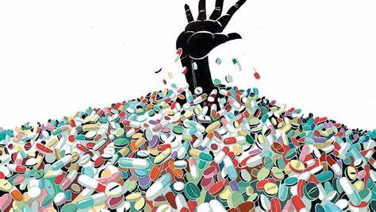
Problem
The US Opioid Epidemic
Twenty-four percent of opioid overdose deaths in Americans involve a prescription opioid. (CMS.gov)

Slide 3
FDA Priority Area
Public Health Preparedness and Response
Section 3: Substance Use Disorder – Opioids
Decreasing exposure and preventing new addiction
Digital Health Technologies
(FDA.gov)

Slide 4

Proposed Solution
The proposed solution is a biometric-controlled medicine container. Patients will take the required dosage by scanning their fingerprint to open the box with the timestamp recorded and tracked. Another dosage cannot be taken until the next prescribed time.

Slide 5
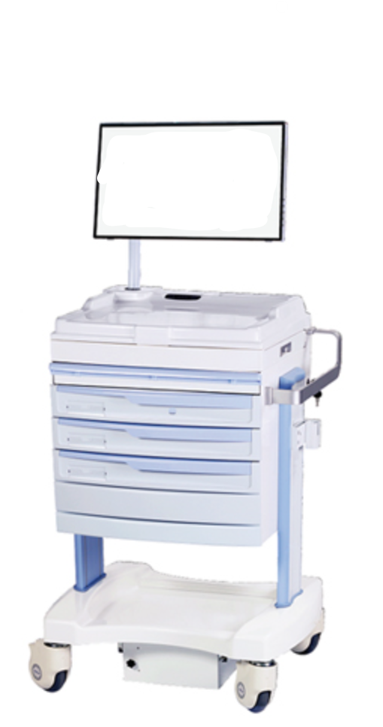

Combination of Existing Resources and Technology for Faster Implementation
FDA Digital Health Center for Excellence (FDA.gov)
Automated Medication Carts (Jessurun, 2021)
Notes:
FDA Digital Health Center: https://www.fda.gov/science-research/focus-areas-regulatory-science-report/focus-area-digital-health-technologies
We are saying we are going to combine two existing technology platforms
1 FDA digital
2 Medical Cabinets
Innovative point is that this is for commercial use by patients themselves thus attacked the root cause of this issue

Slide 6
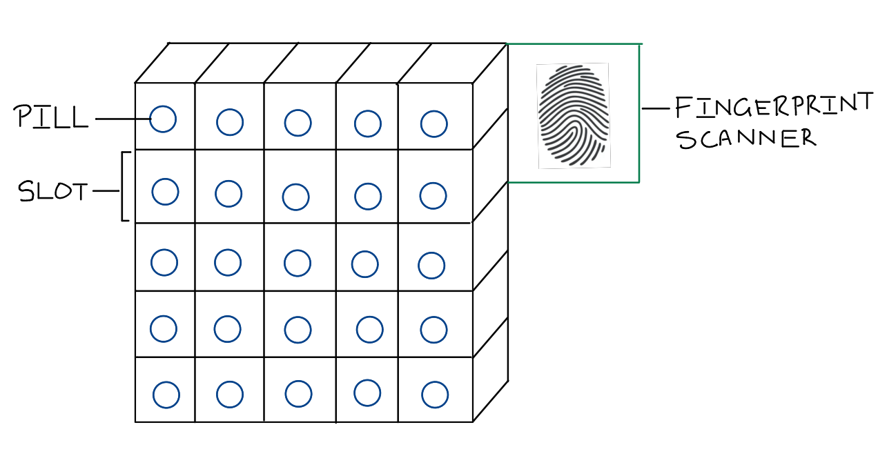
Biometric controlled pill box
Opens one pill upon each scan
Time delay before next pill can be taken
Doctor notified when pill taken and if tampering done

Slide 7
Solution Map
Biometric-controlled medication container
Doctor's prescription sent to pharmacy
Patient accesses pills with biometrics
Pills are placed in slots
Attempt to access before scheduled time
Slot opens with pill after time delay at scheduled time
Patient takes pills
Physician notified

