Slide 1
FoodWarn A.I.
America’s Got Regulatory Science Talent
Competition 2023
Justin Jablonski, Dan Farchione

Slide 2
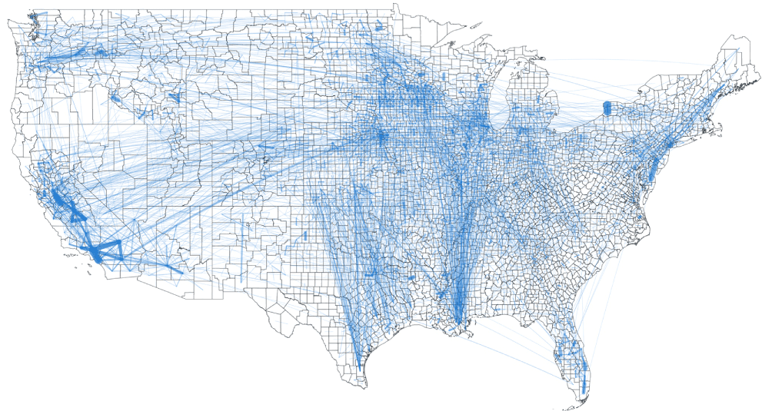
Shortcomings of the Food Supply Chain
Insufficient Traceability Protocols
Pressure to Produce
Lack of Communication
Creates blind spots and unnecessary risks
Decreases the quality and safety of food products
Leads to food waste and mishandling
HBR.org
Lin et al., IOPScience, 2019
Notes:
Over 9.5 million blue links between counties

Slide 3
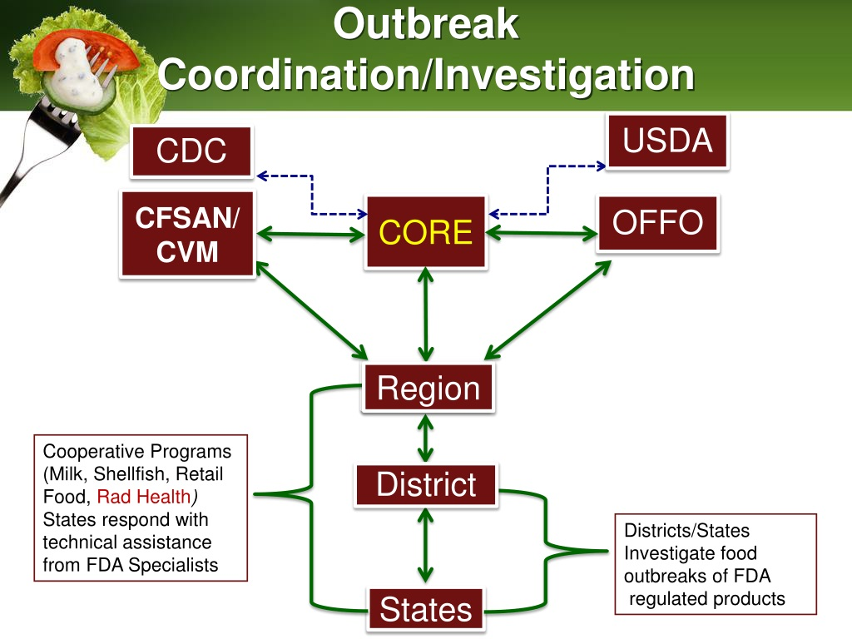
How Does the FDA Manage?
FDA can track reports via¹
CAERS
Reportable Food Registry
Safety Reporting Portal
PulseNet
FDA CORE team investigates
outbreaks²
FDA 2022 FARS Report
FDA ‘About the CORE Network’

Slide 4
Is This Sufficient?
The FDA’s CORE team reports identification of 959 outbreaks since 2011¹
However, the CDC estimates an average of 800 foodborne disease outbreaks yearly²
FDA ‘About the CORE Network’
CDC Surveillance Summaries

Slide 5
Data Management Difficulties
Addressing outbreaks requires:
Identification of the Outbreak
Confirmation of the Food Source
Tracing of the Contaminated Food
Must confirm and correlate reports to localize outbreak
Must contact consumers, distributors, and food manufacturers to identify possible sources of the outbreak
Must obtain and correlate distribution reports to identify spread of contamination
FDA 2022 CAERS Excel

Slide 6
FDA Regulatory Science Focus Areas
Public Health Preparedness and Response:
“FDA faces unique challenges in the oversight of human and animal food safety… . This oversight involves continuous surveillance of the human and animal food supply for ongoing and emerging threats…”
Unleashing the Power of Data:
“FDA is working to improve ways to identify new safety signals with increased precision in decreased time. Some of the approaches being evaluated for feasibility rely on incorporating [AI, RWE, surveillance]”
FDA 2022 FARS Report

Slide 7
FoodWarn AI: The Solution
An AI developed to identify and predict outbreaks in our food supply
1
2
3
4
Input of Unstructured Data
Implementation of Deep Learning Algorithm
AI Analysis of Data
Output of Prediction
Can come in the form of:
Videos
News articles
Social media posts
Training the AI to recognize certain patterns, keywords, etc. from unstructured data
Creation of an iterative process that is then used on actual datasets
Results that can be used as preventative or reactive measures

Slide 8
What FoodWarn Brings
1
2
3
Faster analysis and correlation of:
  Reports
  PulseNet data
  Distribution information
Ability to contact distributors, manufacturers, and customers:
  Faster
  More
Predictive modeling
  Distribution patterns
  Contamination patterns

Slide 9
References
Lin, Xiaowen et al (2019) Environ. Res. Lett. 14 084011
Konar, Megan (2019). We Mapped How Food Gets from Farms to Your Home. The Conversation, Accessed Feb. 2023
Bateman, Alexis, and Leonardo Bonanni (2019). What Supply Chain Transparency Really Means. Harvard Business Review, Accessed Feb. 2023
FDA (2022). Advancing Regulatory Science at FDA: Focus Areas of Regulatory Science (FARS) 2022 Report. FDA.gov, Accessed Feb. 2023
FDA (2022). About the CORE Network. FDA.gov, Accessed Feb. 2023
Dewey-Mattia et. al. (2018). Surveillance for Foodborne Disease Outbreaks — United States, 2009–2015. CDC.gov/Morbidity and Mortality Weekly Report, Accessed Feb. 2023
FDA (2022). CFSAN Adverse Event Reporting System (CAERS). FDA.gov, Accessed Feb. 2023

