Slide 1
Developing Posters for Professional Conferences:
Practical Tips for Novice to Expert Presenters
Susan Ciurzynski, PhD RN-BC MS PNP VCE
Director of the Center for Lifelong Learning and
Associate Professor of Clinical Nursing, University of Rochester School of Nursing
Senior Advanced Practice Registered Nurse, University of Rochester Medical Center
Study Coordinators Organization for Research & Education (SCORE)
Thursday, February 9, 2016

Slide 2
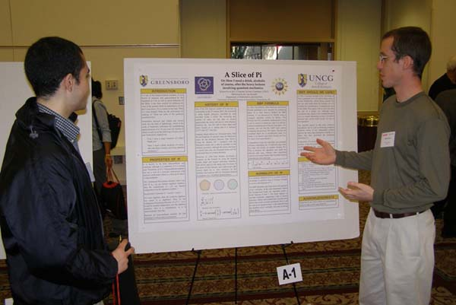
Purpose of a Professional Poster
Attract attention
Engage colleagues in conversation
Make your main points accessible even when you are not there
Provide information about your project/findings
Advertise your (& your department’s) work
Ward, 2011

Slide 3
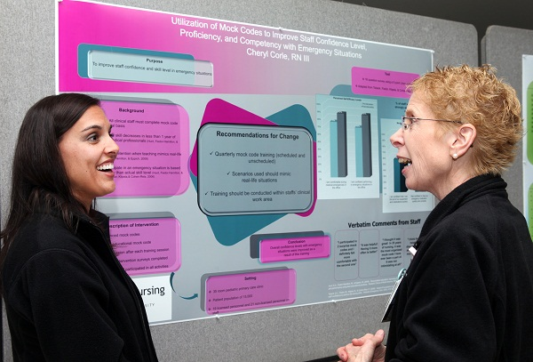
Benefits of a professional poster presentation
Can help justify funding to attend the conference
Looks great in your professional portfolio/resume
May lead to interesting/fruitful networking & collaboration opportunities
Help novice presenters develop regional/national reputation (others associate your name with the topic)
Invaluable for future podium presentation/manuscript development

Slide 4
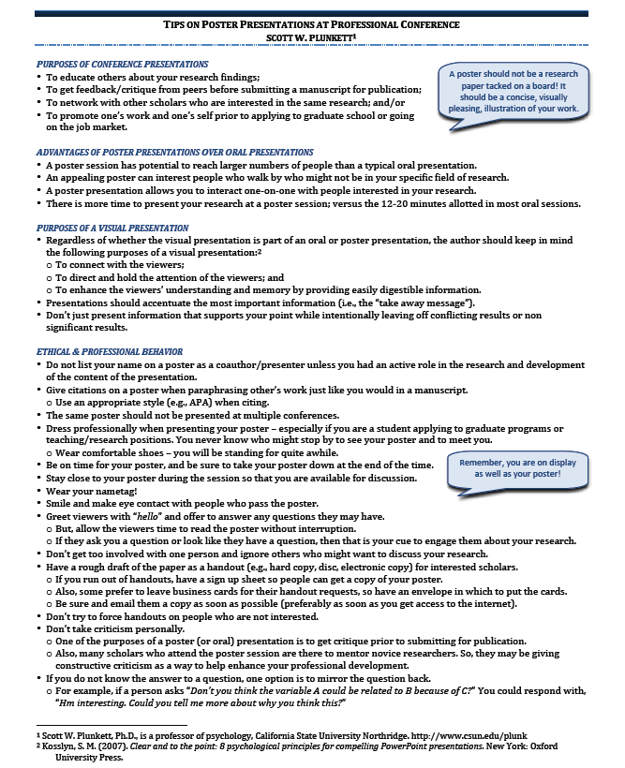
Resources for Creating a Poster
“Tips on poster presentations at a professional conference”
“Creating a poster in Powerpoint in 2010”
“How to create an effective poster presentation”
“Using Powerpoint to create posters”
“A guide to creating posters”
“Poster request form”

Slide 5
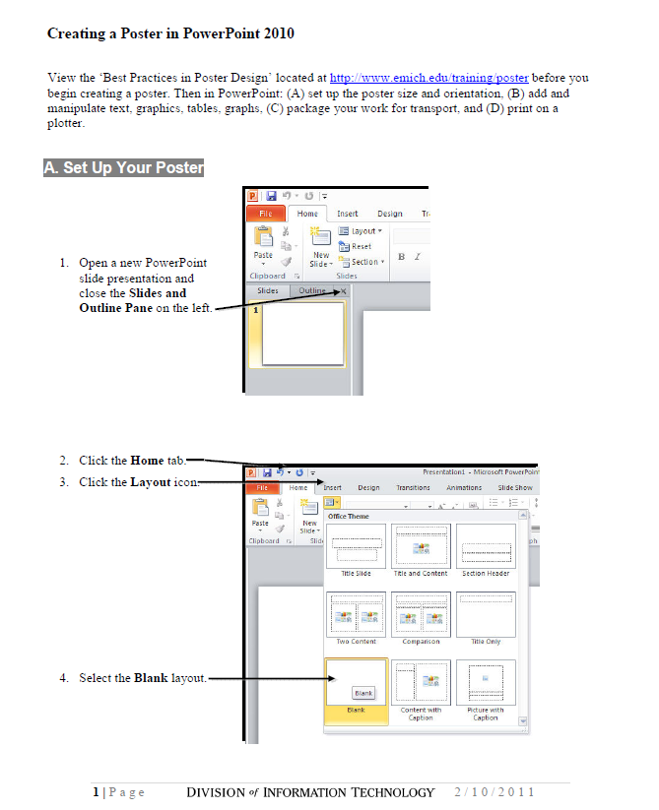
Resources for Creating a Poster
“Tips on poster presentations at a professional conference”
“Creating a poster in Powerpoint in 2010”
“How to create an effective poster presentation”
“Using Powerpoint to create posters”
“A guide to creating posters”
“Poster request form”

Slide 6
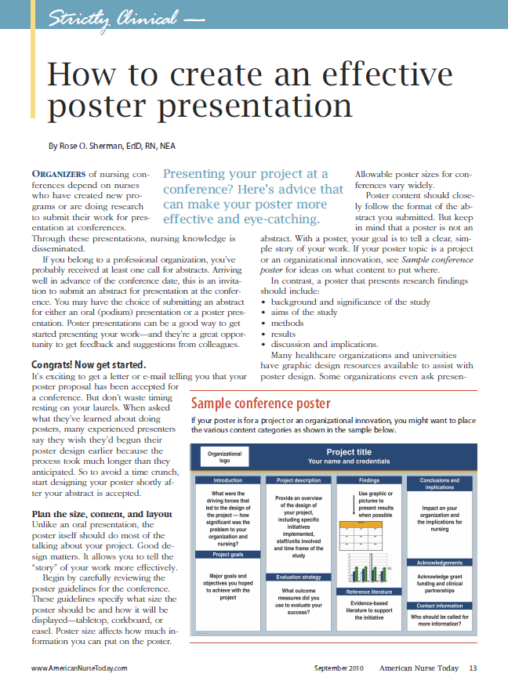
Resources for Creating a Poster
“Tips on poster presentations at a professional conference”
“Creating a poster in Powerpoint in 2010”
“How to create an effective poster presentation”
“Using Powerpoint to create posters”
“A guide to creating posters”
“Poster request form”

Slide 7
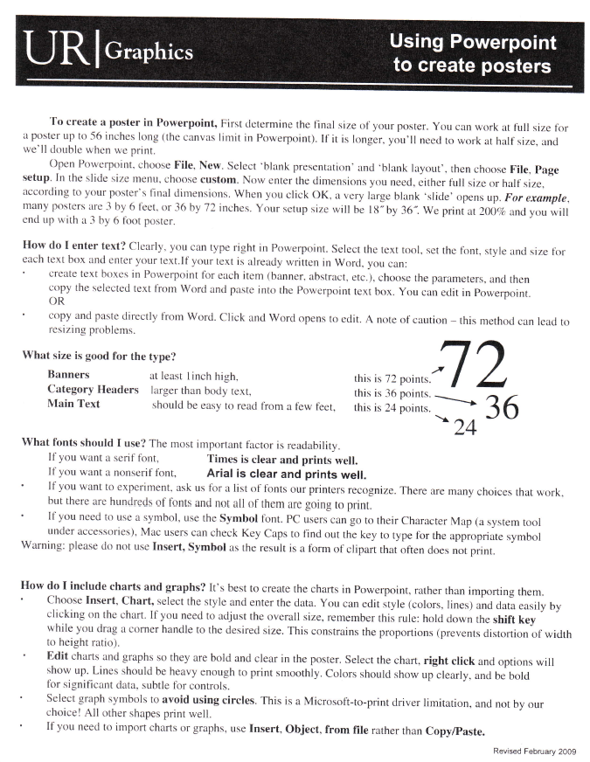
Resources for Creating a Poster
“Tips on poster presentations at a professional conference”
“Creating a poster in Powerpoint in 2010”
“How to create an effective poster presentation”
“Using Powerpoint to create posters”
“A guide to creating posters”
“Poster request form”

Slide 8
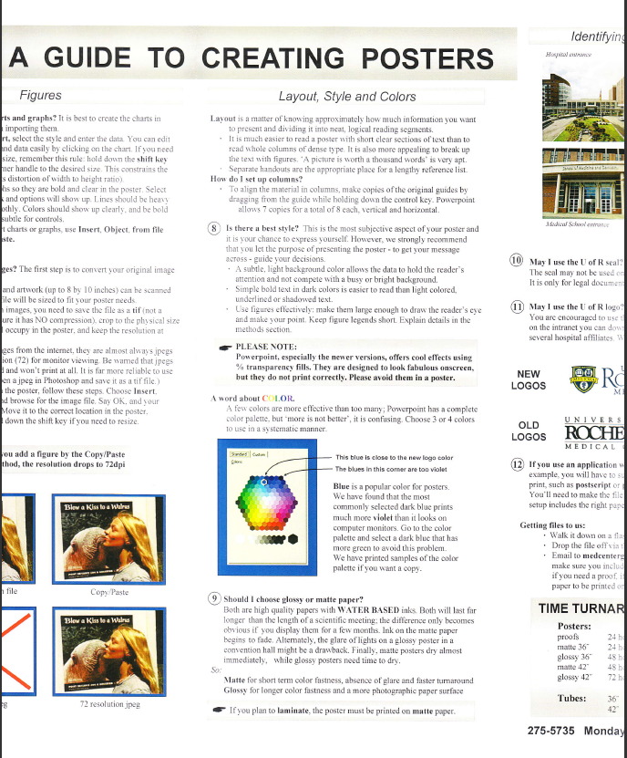
Resources for Creating a Poster
“Tips on poster presentations at a professional conference”
“Creating a poster in Powerpoint in 2010”
“How to create an effective poster presentation”
“Using Powerpoint to create posters”
“A guide to creating posters”
“Poster request form”

Slide 9
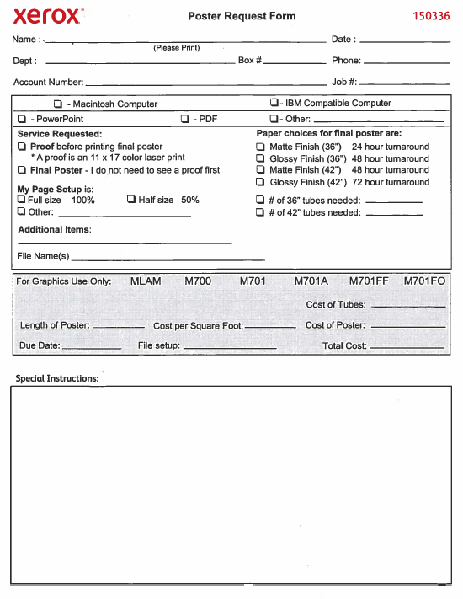
Resources for Creating a Poster
“Tips on poster presentations at a professional conference”
“Creating a poster in Powerpoint in 2010”
“How to create an effective poster presentation”
“Using Powerpoint to create posters”
“A guide to creating posters”
“Poster request form”

Slide 10
Creating a Poster Using PowerPoint
Getting Started (Templates)
Size Considerations
General Layout/Content/Logical Flow
Background/Color Themes
Font Sizes
Alignment/Spacing/Aesthetics
Graphics
http://www.posterpresentations.com/html/free_poster_templates.html
http://www.makesigns.com/SciPosters_Templates.aspx
http://www.postersession.com/poster-templates-special-sizes.php
http://www.studentposters.co.uk/templates.html
http://www.omniposters.com/free-scientific-poster-templates/

Slide 11
Input
Logo Here
Title Indicates the Nature of the Practice Investigation
Names, Credentials of Poster Presenters
Input
Logo Here
PROJECT OBJECTIVES
OUTCOMES
METHODS
BACKGROUND
DISCUSSION / CONCLUSIONS
SETTING/PARTICIPANTS
ALIGNMENT WITH CONFERENCE GOALS
ACKNOWLEDGMENTS

Slide 12
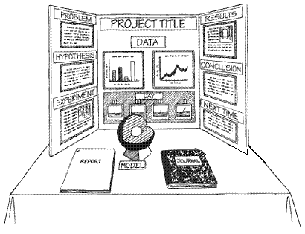
Creating a Poster Using PowerPoint
Note: a 3’x4’ (36”x48”) poster fits perfectly onto a Tri-Fold Poster Display Board
Getting Started (Templates)
Size Considerations
General Layout/Content/Logical Flow
Background/Color Themes
Font Sizes
Alignment/Spacing/Aesthetics
Graphics

Slide 13
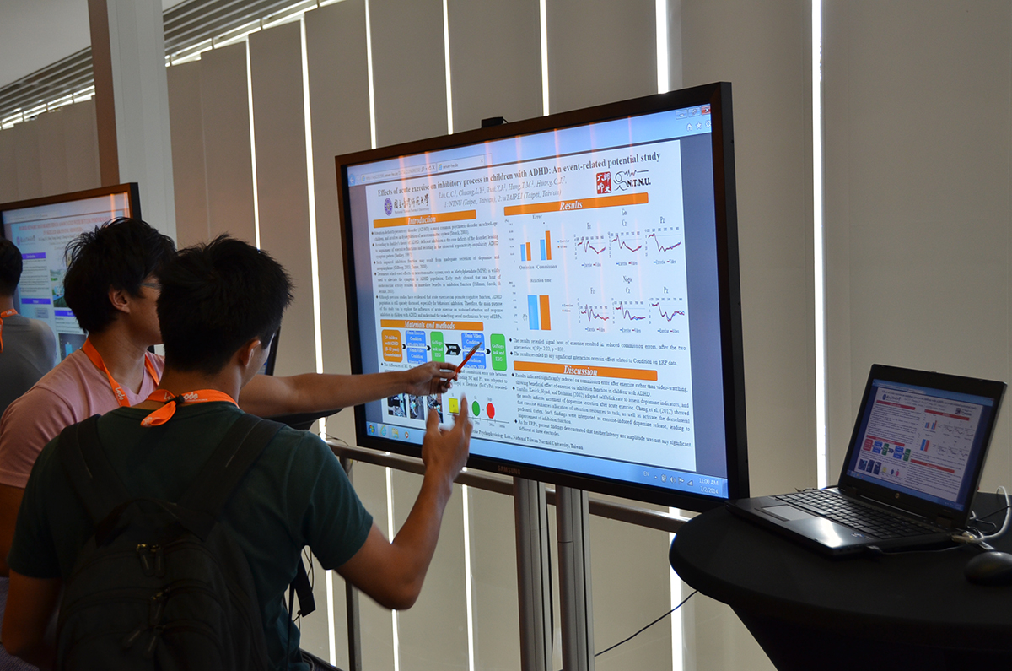
Creating an e-Poster Using PowerPoint
Getting Started (Templates)
Size Considerations
General Layout/Content/Logical Flow
Background/Color Themes
Font Sizes
Alignment/Spacing/Aesthetics
Graphics
Note: If preparing an e-Poster, must find out the dimensions of the digital display to prevent distortion once displayed

Slide 14

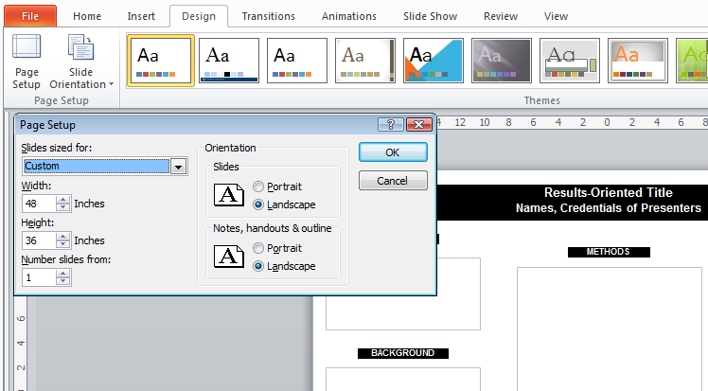
Page Set-Up: Refer to UR Graphics “Poster Request Form”
“My Page Set Up” is:
Full size 100% (select if you have entered the “real dimensions” in PP; see arrow #4? Do you want your final poster to be 3x4 feet?)
Half size 50% (select if you needed to enter ½ size dimension in PP—max allowed in PP is 56 inches—they will enlarge these by 200% or twice the size of your PP page. Your final poster would be 6x8 feet or twice the size listed on your Page Setup in PP)
1
2
3
4

Slide 15
Creating a Poster Using Powerpoint
Getting Started (Templates)
Size Considerations
General Layout/Content/Logical Flow
Background/Color Themes
Font Sizes
Alignment/Spacing/Aesthetics
Graphics

Slide 16
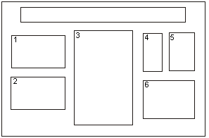
Poster Layout/Logical Flow

Slide 17
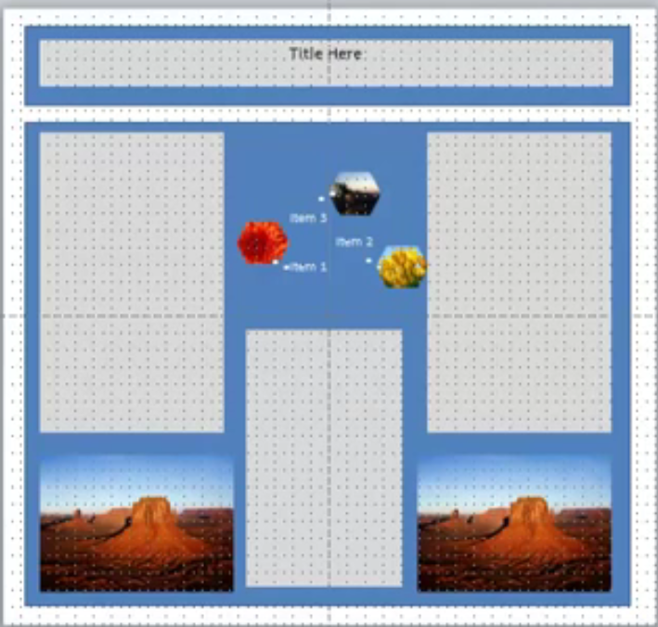
Poster Layout: Triangle Effect
https://www.youtube.com/watch?v=1c9Kd_mUFDM

Slide 18
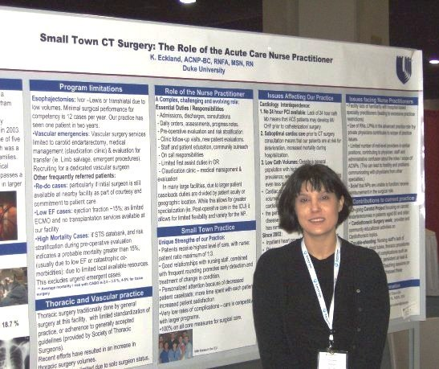
Content/White-Space
Both the content and the visual appeal are important¹!
One study found that visual appeal of the poster was more important than content for knowledge transfer².
Wood & Morrison (2011)
Rowe & Ilic (2009)

Slide 19
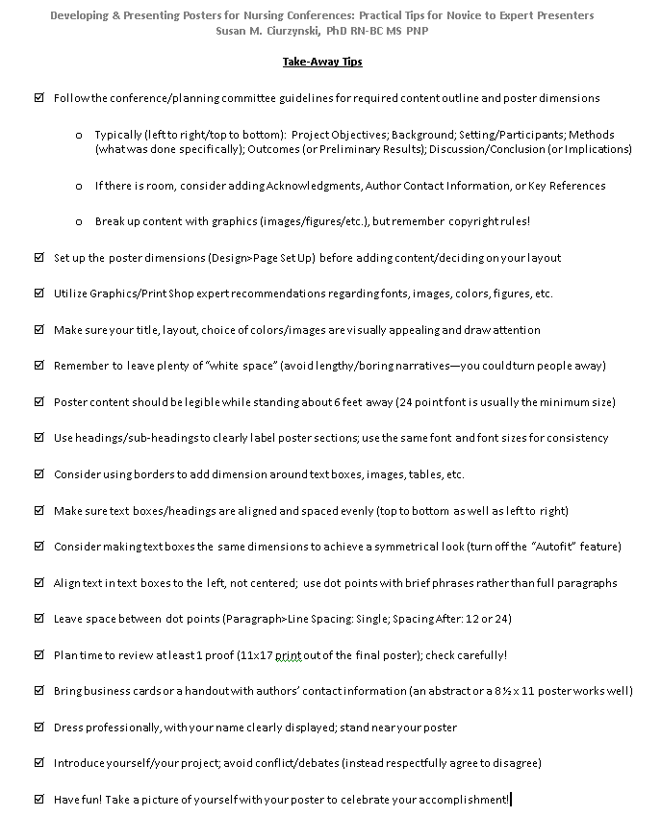
Content/White-Space

Slide 20

Creating a Poster Using Powerpoint
Getting Started (Templates)
Size Considerations
General Layout/Content/Logical Flow
Background/Color Themes
Font Sizes
Alignment/Spacing/Aesthetics
Graphics

Slide 21

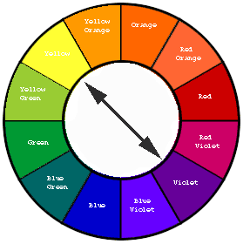
Background/ Color Themes
Complimentary:
Avoid:
Light Background
Blue/Red
Dark Background
Green/Blue

Slide 22
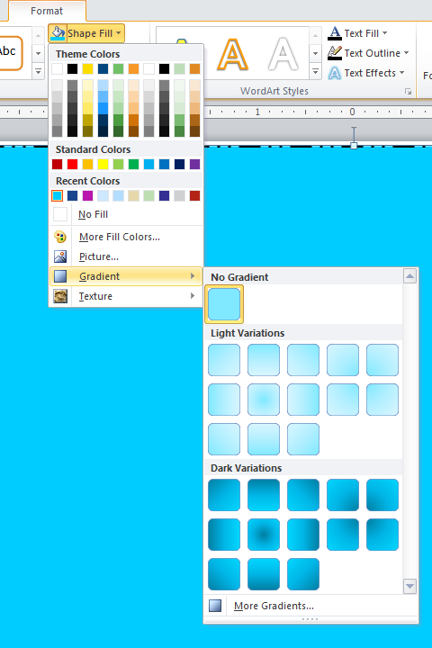
Insert Text Box (this is to insert a full background color—you won’t actually have any text in this box)
Format Shape
  Text Box →Do Not Autofit
  Size (full size of poster)
  Shape Fill (see gradient examples on right)
  Shape Outline (probably not applicable)
Arrange
  Send to Back
  Align Left
  Align Top

Slide 23
Creating a Poster Using Powerpoint
Getting Started (Templates)
Size Considerations
General Layout/Content/Logical Flow
Background/Color Themes
Font Sizes
Alignment/Spacing/Aesthetics
Graphics
Refer to UR Graphics
A Guide to Creating Posters

Slide 24
Creating a Poster Using Powerpoint
Getting Started (Templates)
Size Considerations
General Layout/Content/Logical Flow
Background/Color Themes
Font Sizes
Alignment/Spacing/Aesthetics
Graphics
Gridlines are your friends!

Slide 25
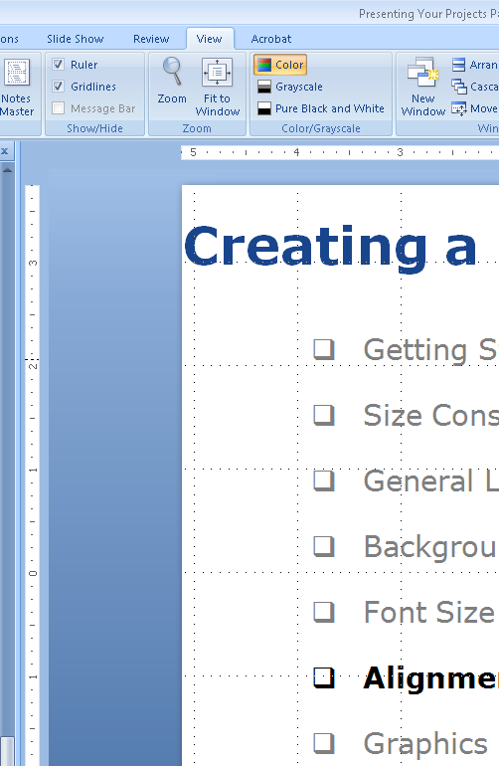
Alignment/Spacing/Aesthetics
Getting Started (Templates)
Size Considerations
General Layout/Content/Logical Flow
Background/Color Themes
Font Sizes
Alignment/Spacing/Aesthetics
Graphics

Slide 26
Which is easier to read (L or R)?
1.5 Spacing 0 pt After
Single Spacing 24 pt After
Line 1 statement continued
Line 2 statement continued
Line 3 statement continued
Line 4 statement continued
Line 1 statement continued
Line 2 statement continued
Line 3 statement continued
Line 4 statement continued

Slide 27
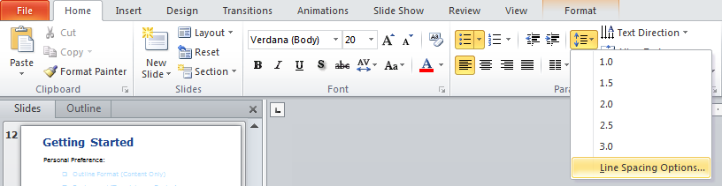
Spacing
Paragraph Formatting
  Home > Paragraph > Line Spacing Options > Indents & Spacing
Continued→

Slide 28
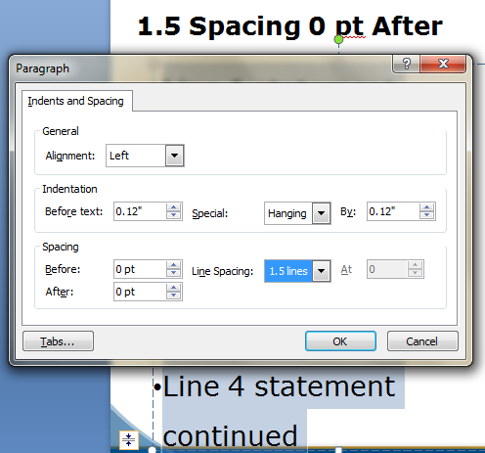
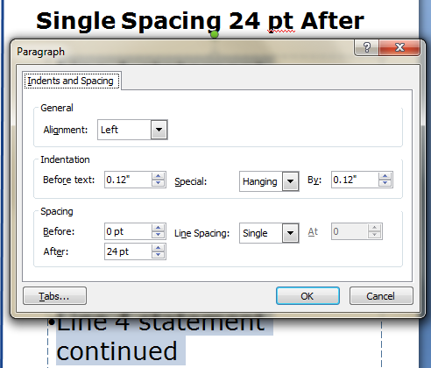
Spacing
Paragraph Formatting (continued)
  Home > Paragraph > Line Spacing Options > Indents & Spacing

Slide 29

Creating a Poster Using Powerpoint
Getting Started (Templates)
Size Considerations
General Layout/Content/Logical Flow
Background/Color Themes
Font Sizes
Alignment/Spacing/Aesthetics
Graphics
Refer to UR Graphics
A Guide to Creating Posters

Slide 30
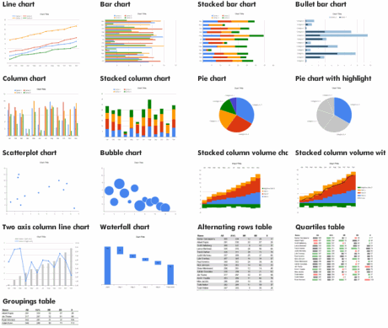
Proof will determine clarity

Slide 31
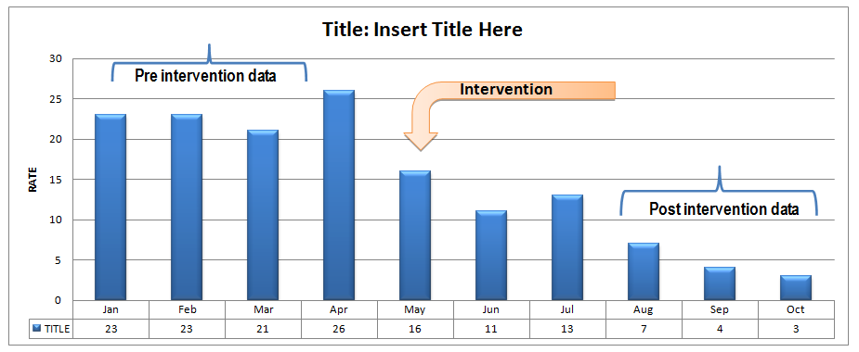
Data Display Requirements
Label axes with dates, times, & title
Include a legend
Pre-data, intervention/initiative data, & post-data should use same timeframes/measurement unit

Slide 32
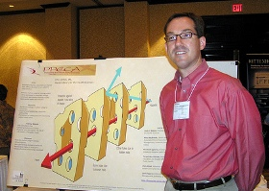

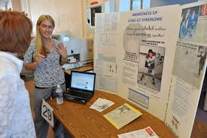

Presenting Your Poster
Strategies for Success:
Get a good night sleep (if possible, don’t work before)
Dress/act professionally; wear name tag
Stand near (not in front of) your poster
Have business cards/handouts/something to share your contact information
Smile! Be proud of your accomplishments!
Continued…

Slide 33

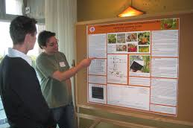
Presenting Your Poster
Have a phrase planned in advance to capture passers-by:
    “Where do you work?”
    “Do you care for [asthma] patients?”
    “Are you interested in helping [families in crisis]?”
    “Hi! I’m [Sue. I work in pediatric nursing]. Would you like to hear about my project?”
Briefly “walk them through” your poster in logical order:
      Left to right (remember the logical flow/layout?)
      Explain what you did/summarize findings/next steps
      “Thank you for listening, do you have any questions?”
      Respond to feedback professionally & without defensiveness

Slide 34
Presenting Your Poster
Next Steps/Resources:
Develop a timeline (work backward from your goal date):
  SCORE Half-day (Summer, 2017), Rochester, NY
  SOCRA 2016 Annual Conference (Oct 6-8, 2017), Orlando, FL
  ACRP 2018 Meeting and Expo (Apr 28 - May 01, 2018), Washington, DC
Know your resources:
    Handouts/Links from today’s presentation (Box/SCORE poster development Feb 2017)
    REDCap-based survey*
    *SCORE Mini-Workshop: Hands-on Session to Develop an e-Poster in PowerPoint: March 2nd (Teaching Learning Lab: 2-8513) 2:15-4:15pm
    Peer Review: poster content needs to make sense to someone who hasn’t heard about your project before

Slide 35
References:
Anonymous (2013). Creating a poster in Power Point 2010. Available at http://www.emich.edu/apc/guides/apcposterpowerpoint2010.pdf
Center for Nursing Excellence (2013). Evidence Based Practice and Research Guide for Nursing Practice: Poster Presentations. Available at http://libguides.lhl.uab.edu/content.php?pid=196639&sid=1646544
Durso, F. T., Pop, V.L., Burnett, J.S., & Stearman, E.J. (2011). Evidence-Based Human Factors Guidelines for PowerPoint Presentations. Ergonomics in Design: The Quarterly of Human Factors Applications, 19 (4), 4-8. DOI: 10.1177/1064804611416583
Ohio State (2013). 101 Tips for effective presentations. Available at http://feh.eng.ohio-state.edu/design-project/References/101%20Tips%20for%20Effective%20Presentations.htm
Plunkett, S. W. (2013). Tips on poster presentations at professional conference. Available at http://www.csun.edu/plunk/documents/poster_presentation.pdf
Sherman, R. (2010). How to create an effective poster presentation. American Nurse Today, 5(9), 13-15.
TalkPath LLC (2013). Tips for Effective Presentations. Available at http://www.accuconference.com/resources/effective-presentations.aspx
UNC Health Sciences Library (2016). Designing effective posters: Using Power Point 2016 for Windows and 2013 for Windows. Available at http://guides.lib.unc.edu/posters/pptwindows2016

Slide 36
Additional Resources:
Briggs, DJ. (2009). A practical guide to designing a poster for presentation. Nursing Standard, 23(34), 35-39.
Video: Making Academic Posters Using Power Point (9:46 minutes) – Jerry Overmeyer
http://www.youtube.com/watch?v=MqgjgwIXadA
Video: Producing an Academic Poster (18:58 minutes)
http://www.youtube.com/watch?v=GJwcVWszLC4
Video: How to download a template (1:33 minutes)
http://www.youtube.com/watch?v=0UXwdMJ0C_Q
Free poster templates and tutorials on template use:
http://www.posterpresentations.com/html/free_poster_templates.html

