Slide 1

University of Rochester
School of Medicine & Dentistry
Graduate Education & Postdoctoral Affairs (GEPA)
Rick Libby, Ph.D.
Vice Provost and University Dean of Graduate Education and Postdoctoral Affairs
Professor of Ophthalmology
Notes:
Activity Question 1- Worksheet

Slide 2
Incoming Class
Certificate, Masters, Doctoral Programs
  8, 15, 12
104 incoming students
  15, 50, 39
Range of Disciplines
  Epidemiology to Genetics to MFT
Diverse Student Population
Average Age 27

Slide 3
What we strive for
At the University of Rochester School of Medicine and Dentistry, an environment of respect, inclusiveness, and support is of utmost importance for our learners. You will have the opportunity to learn with and from a diverse group of peers, mentors, faculty, and staff—people are here to help.

Slide 4
Core Tenets of Graduate Education
AAMC
  Institutional Commitment
  Program Commitment
  Quality Mentoring
  Provision of Skill Sets and Counseling
URochester SMD
  Formal classroom education
  An apprenticeship
  Student support
  Career preparation

Slide 5
Balancing it all in Graduate School
Classes
Rotations
Family obligations
Social interactions
Health and wellness
Career development

Slide 6
People are here to help
(academically, personally, professionally)
GEPA Office
Program Directors
Faculty (thesis committee)
Department Chairs and Center Directors
Other trainees
Program Coordinators

Slide 7
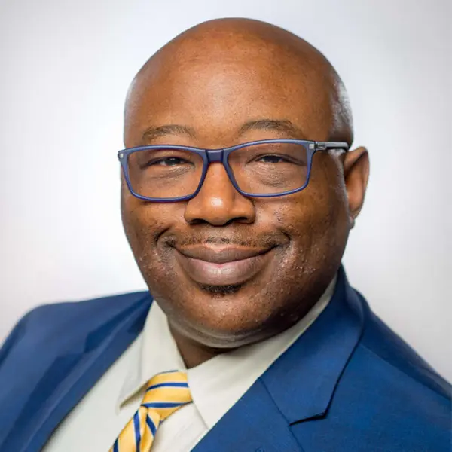
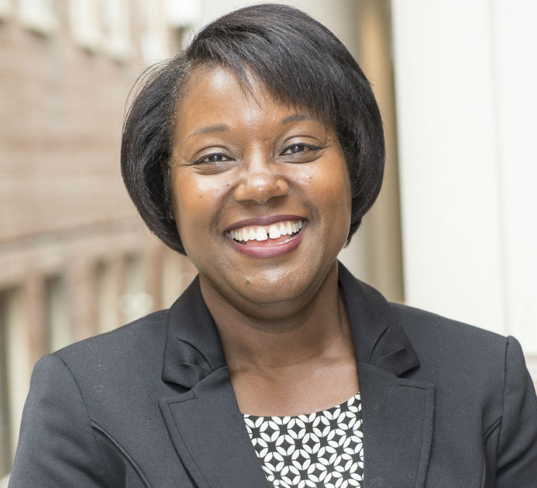
People are here to help
(academically, personally, professionally)
John Blackshear, PhD
Vice Pres.
Student Life
URochester
Adrienne Morgan, PhD
Vice Pres.
Engagement & Enrichment
URochester

Slide 8
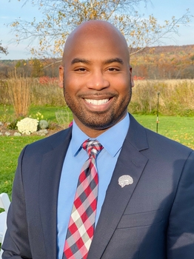
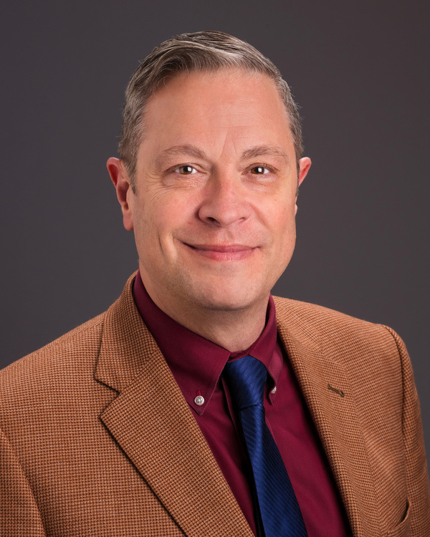
People are here to help
(academically, personally, professionally)
Nathan A. Smith, Ph.D. (’13)
Associate Dean of Research Mentorship, SMD
Craig Rooney, Ph.D.
Chief Wellbeing
URM

Slide 9
People are here to help
(academically, personally, professionally)
CARE Network (support and student concerns)
International Services Office (resource for international students)
University Counseling Center (UCC; Counseling for students)
University Health Service (UHS; illness)
Ombudspersons (confidential, neutral, independent, and informal)
Office of Engagement & Enrichment
Office of Disability Resources (ODR; accommodations)

Slide 10
People are here to help
(academically, personally, professionally)
Policy against discrimination and harassment
  https://www.urmc.rochester.edu/about-us/values-culture/policies-reporting-resources.aspx
Title IX office
  https://www.rochester.edu/sexualmisconduct
General Reporting information
  https://www.urmc.rochester.edu/about-us/values-culture/policies-reporting-resources.aspx

Slide 11
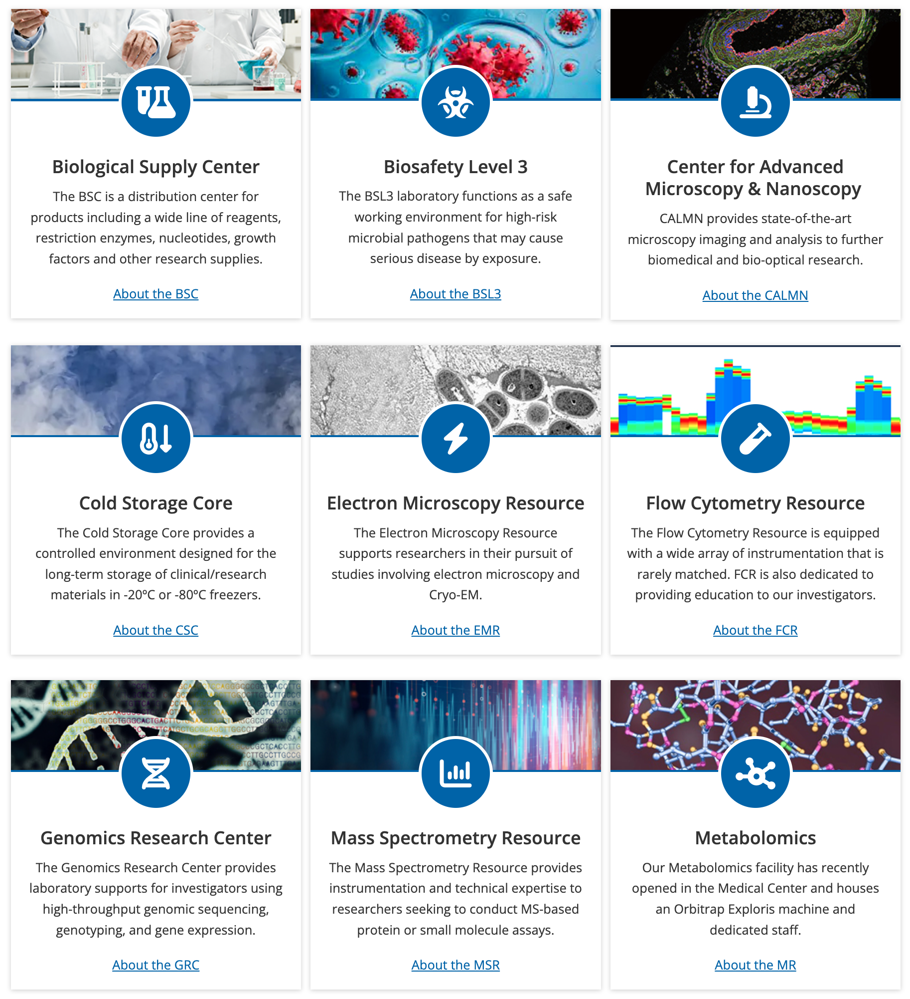
People are here to help
(academically, personally, professionally)
Center for Advanced Research Technologies (CORES)

Slide 12

People are here to help
(academically, personally, professionally)
hg
Bringing Together 8 Critical Areas
Learner Life and Wellness
Writing Services
Fellowships and Grants
Career Services
Internships
Mentorship Support
Graduate Student and Postdoctoral Groups,
Alumni Connections

Slide 13

Mentoring
Build strong, supportive relationships
WHAT YOU CAN TAP INTO
Monthly mentor meet-up sessions
Peer mentoring discussions
Mentoring with Intent (Quarterly mentoring development workshops)
Individualized mentoring learning meetings
Mentorship at SMD is structured, ongoing, and built around your goals — not left to chance.
— student quote

Slide 14
Writing Resources and Grant Development
Develop strong writing skills that will catapult your professional trajectory
PROGRAMS & RESOURCES
Individualized scientific writing consultations
Group workshops on writing & publishing topics
Writing retreats
Writing & grant-development internship opportunities
Self-paced accelerated online learning modules for grant development
Tailored coaching for grant applications
Mock NIH study sections
Writing, in traditional & contemporary forms, requires process, planning, & patience. ~~ myHub's writing services will help you build this skill to complement your professional journey!

Slide 15
Career Services
Coaching, networking, and skills for your next step
HOW YOU'LL BE PREPARED
Career coaching and advising (1:1 and group formats)
Professional-development workshops, retreats, and networking events
Alumni Career Stories and Meliora Mentoring Program
Experiential career-exploration opportunities, including job-shadowing and internships
Teaching and mentoring skill-building, including the Higher-Education Teaching Certificate
Employer information sessions and career fairs, including the Graduate Career Consortium's Annual Virtual Career Expo
From first-year exploration to alumni networks, career support spans your whole time here and beyond.
— what myHub means for you

Slide 16
Life & Wellness
Thrive inside and outside your work
SUPPORT FOR THE WHOLE YOU
Individual wellness consultations, stress-management coaching, and short-term counseling support
Referrals to resources on- and off-campus
Leadership development and trainee group advising
Workshops focused on mindfulness, creativity, workplace health, and resilience
Mental health first aid training
Programs supporting belonging and community
Support and emotional safety to help you prioritize wellness that contributes to your productivity rather than straining it.

Slide 17
People are here to help
(academically, personally, professionally)
SMD Graduate Student Society
https://www.urmc.rochester.edu/education/graduate/current-students/graduate-student-society/graduate-student-life.aspx

Slide 18
People are here to help
(academically, personally, professionally)
ADSE, Alliance for Diversity in Science and Engineering
GSOC, Graduate Students of Color
GWIS, Graduate Workers in Science
International Students & Scholars Association (ISSA)
SMD Ambassadors
SMD Entrepreneurs
SACNAS, Society for Advancement of Chicanos/Hispanics and Native Americans in Science
UR Thinkers
University of Rochester Science Policy Initiative
UR Writing

Slide 19
Expectations
Expectations of Graduate Students
Expectations of Research Advisors
https://www.urmc.rochester.edu/education/graduate/home/forms.aspx

Slide 20
Expectations
I acknowledge that I have the primary responsibility for the successful completion of my degree.
I will be committed to the education and training of the graduate student.
I will be committed to the research project of the graduate student.

Slide 21
First Year
Complete classes, successfully (grades)
Complete 3 rotations with a satisfactory score (basic science PhDs)
Find a research “home” or thesis project (where applicable)
Build your skill base
Explore

Slide 22
Advice for your First Year
Good time to stick your toes in the water
  Focus on exploration and skills for your research
  One year Master’s programs—get going!
Explore your career options throughout your time here
Begin to develop your network and connect with fellow trainees and UR alumni: Alumni Group on LinkedIn and The Meliora Collective
Stay connected with what is happening in myHub Opportunities to Explore (OTE)

Slide 23
Advice for your First Year
Set goals and work to meet them
Seek help when needed
Develop mentor, advisor, and peer networks
Be scientifically/academically curious
Make friends/socialize
Learn and make use of new technologies
Become part of the community
Enjoy the process

Slide 24
Choosing a project/mentor!
Perhaps the most important decision you make in grad school and in postdoc
  Oversees the environment you will spend considerable time in
  Responsible for providing most of your scientific training
  Attack questions like your advisor
  In some ways, also picking an area of expertise
Can be a great asset for your entire career
Purpose of rotation (where applicable)
Something wrong, reach out—people are here to help!

Slide 25
Choosing a project/mentor!
What we tend to look for
  Trendy science
  High impact papers
What we should look for
  Good solid science
  Something that we are very interested in
  Good, attentive advisor (and mentor)
  Environment where you think you will thrive
    Big difference between an advisor and a mentor
    Bullet points are not mutually exclusive

Slide 26
Individualized Development Plans
Go to: http://myidp.sciencecareers.org/
  Evaluate skills, values, and interests
  Explore and evaluate career opportunities
  Set specific goals for your career path
Discuss with your advisor/mentor
Put your plan in place

Slide 27

ORCID
ORCID is a unique identifier that makes it easier to distinguish, organize, and share your work
Free, researcher-controlled, and owned
Can use for grant applications, manuscript submissions, and reviewer credit
Register and complete your profile at orcid.org
Please take a moment to connect to the UR Reporting System, takes less than a minute - orcid.lib.rochester.edu
Need help, contact your librarian or Miner_Information@urmc.rochester.edu at Miner Library

Slide 28




Communications

Slide 29
Orientation Resources
https://www.urmc.rochester.edu/education/graduate/incoming-graduate-student-orientation.aspx
Student Handbook
  GEPAs
  Individual programs
University GEPA
  https://www.rochester.edu/college/gradstudies/current/policies/index.html

Slide 30
Questions?
Progress is made by young scientists who carry out experiments that old scientists said wouldn't work. – Frank Westheimer

