Slide 1
Graduate Student Society (GSS)
New Student Orientation 2025

Slide 2
What is the Graduate Student Society (GSS)?
The Graduate Student Society represents all students enrolled in the University of Rochester School of Medicine and Dentistry graduate programs by:
Monitoring issues of importance to the graduate student community
Representing the concerns of graduate students to University administration
Advocating for changes to enhance the quality of graduate education
Serving as a liaison among the student populations of the graduate programs
Sponsoring academic and social events of interest to the graduate student community
https://www.urmc.rochester.edu/education/graduate/current-students/graduate-student-society.aspx

Slide 3
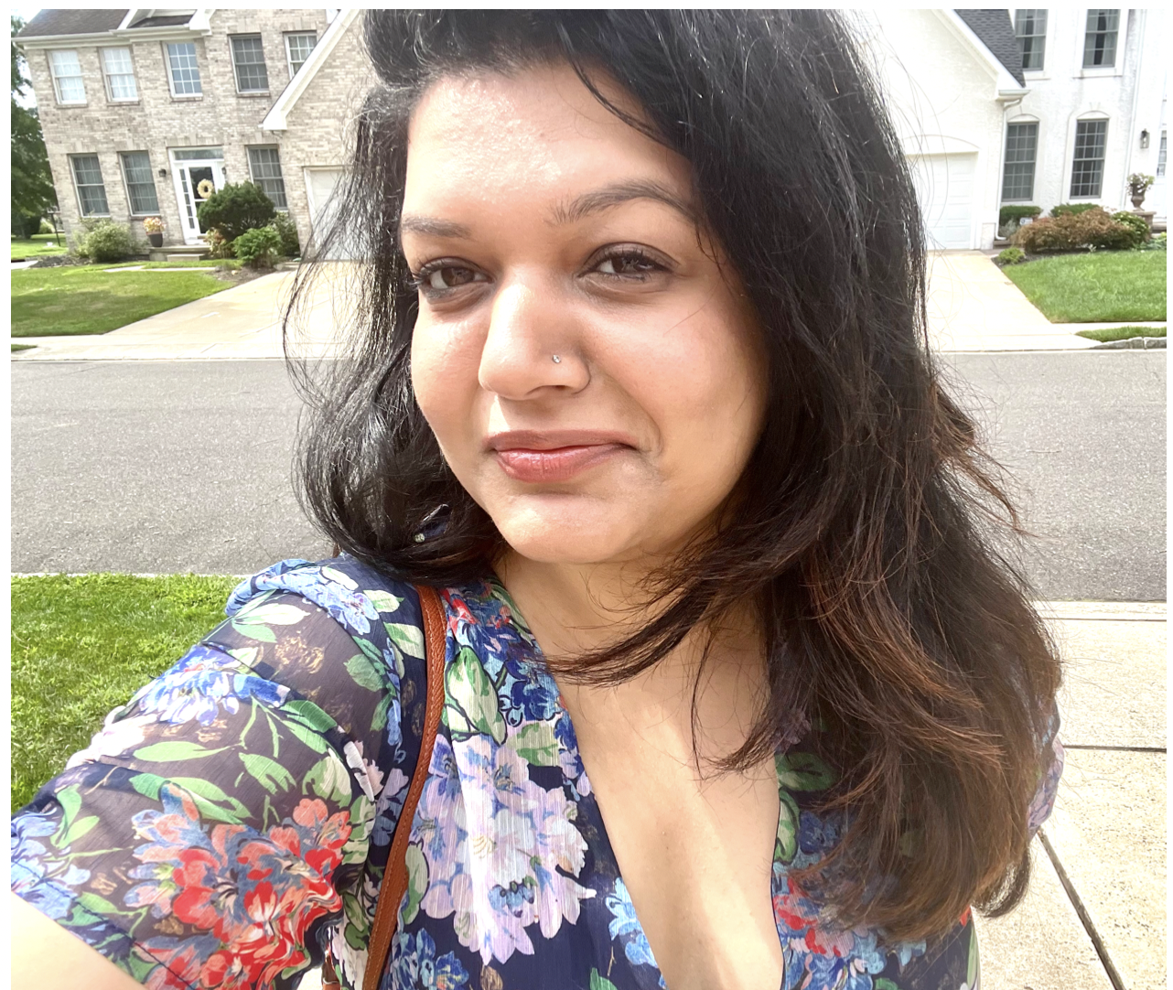
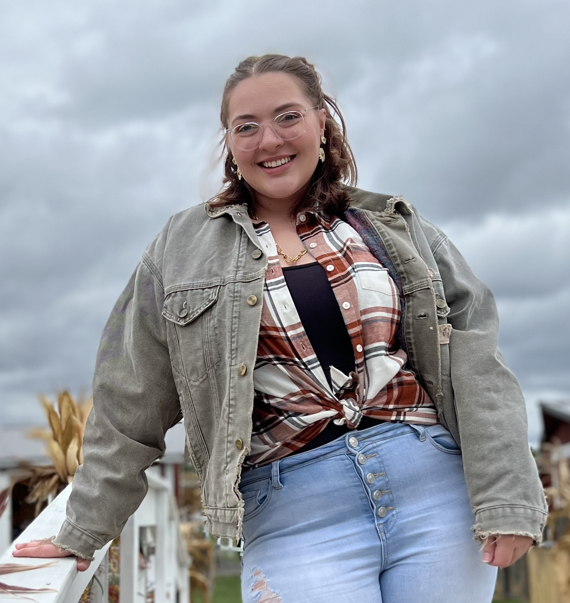
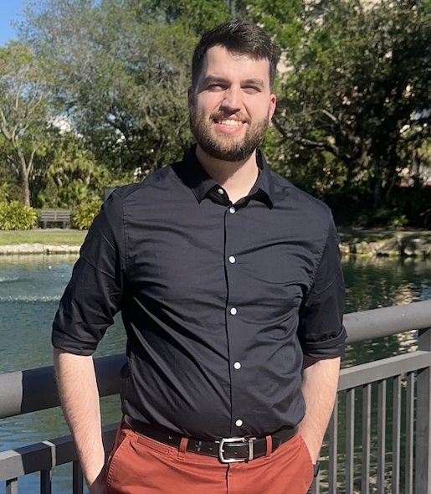
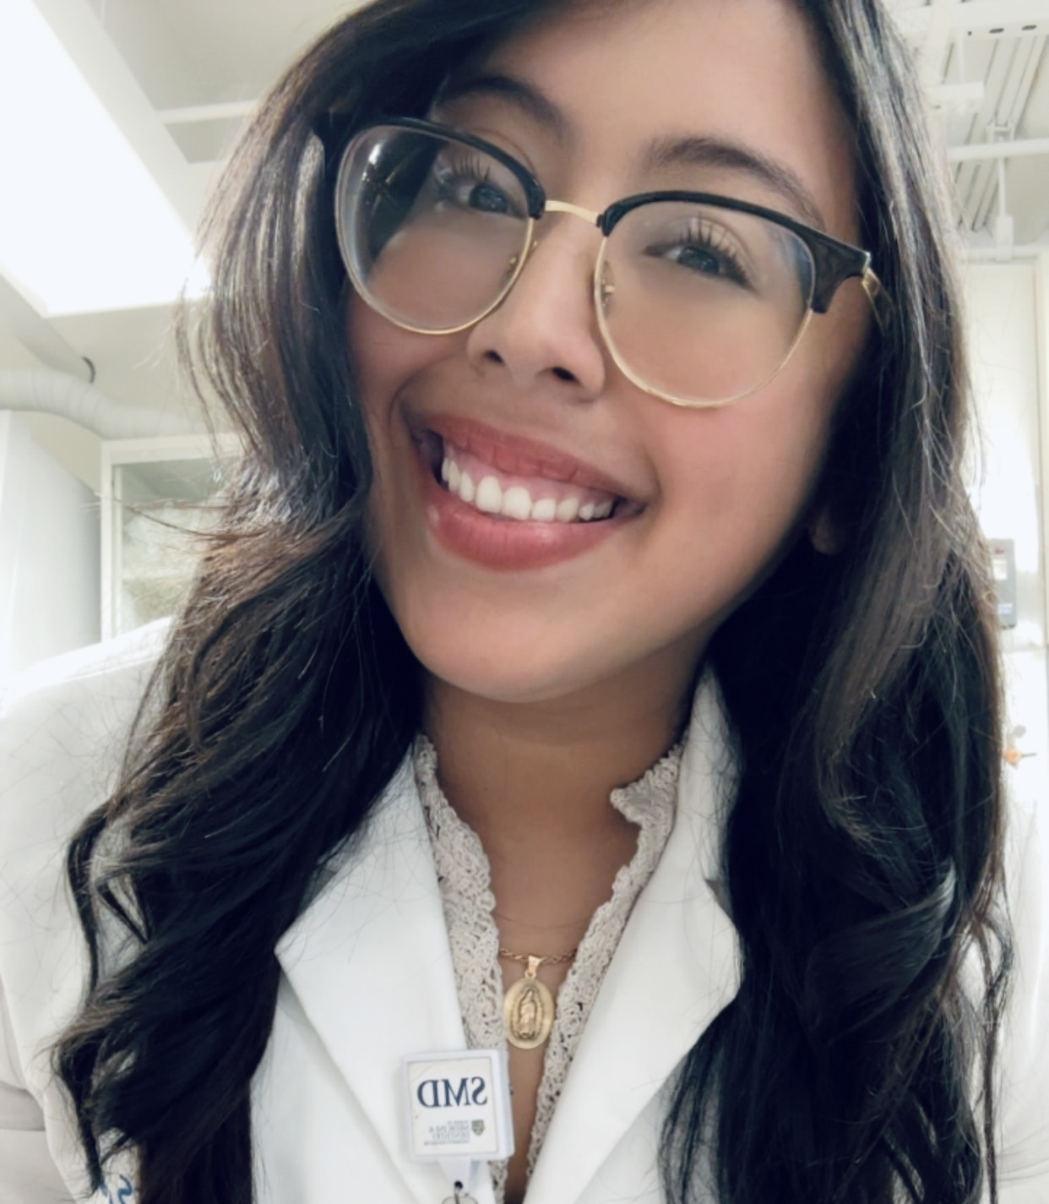
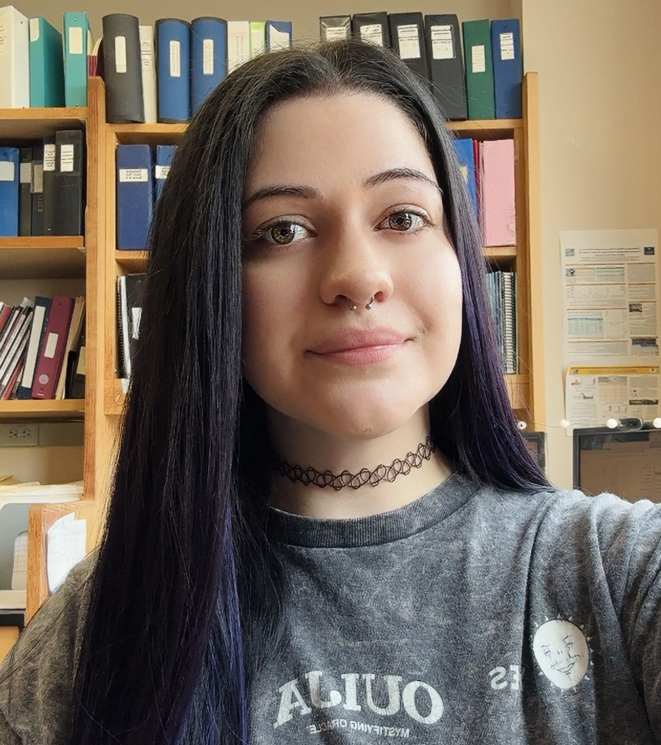
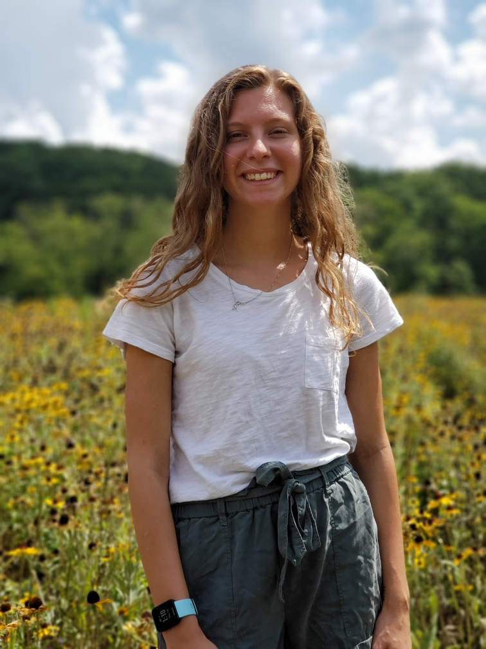
Executive Officers 2025-2026
Shivali Vashisht, President
Translational Biomedical Science
Abby L. Manning, Vice President
Biophysics and Structural Biology
Ethan Lewis, Treasurer
Toxicology
Alma Avila Oropeza, Social Media
Toxicology
Jessica Enos, Secretary
Toxicology
Alissa Beam, Membership Chair
Biochemistry & Molecular Biology

Slide 4
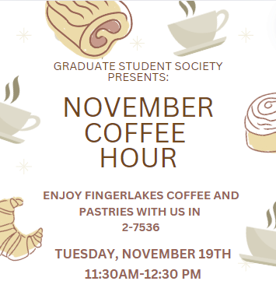
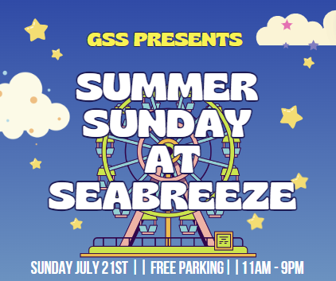
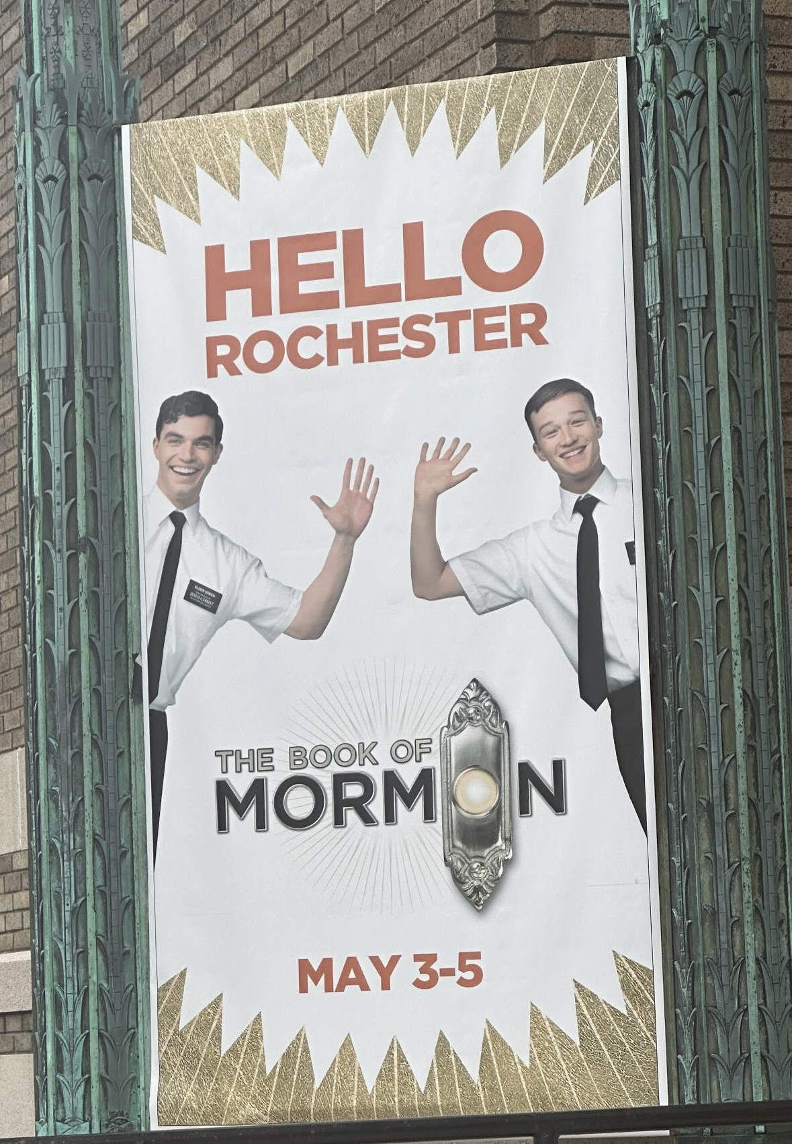
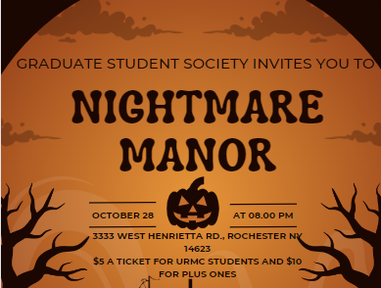
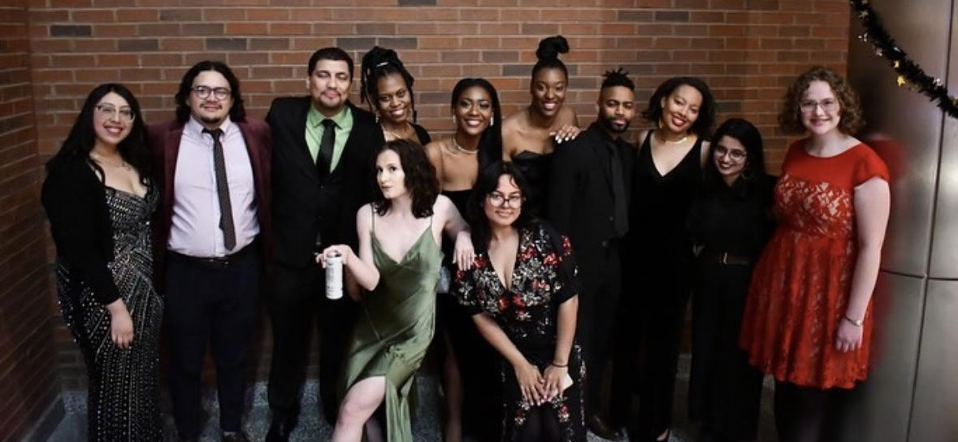
EventS
Monthly coffee hours
Apple picking
Broadway shows
Haunted House
Graduate Giving Gala
Roc Holiday Village
Sports Events

Slide 5
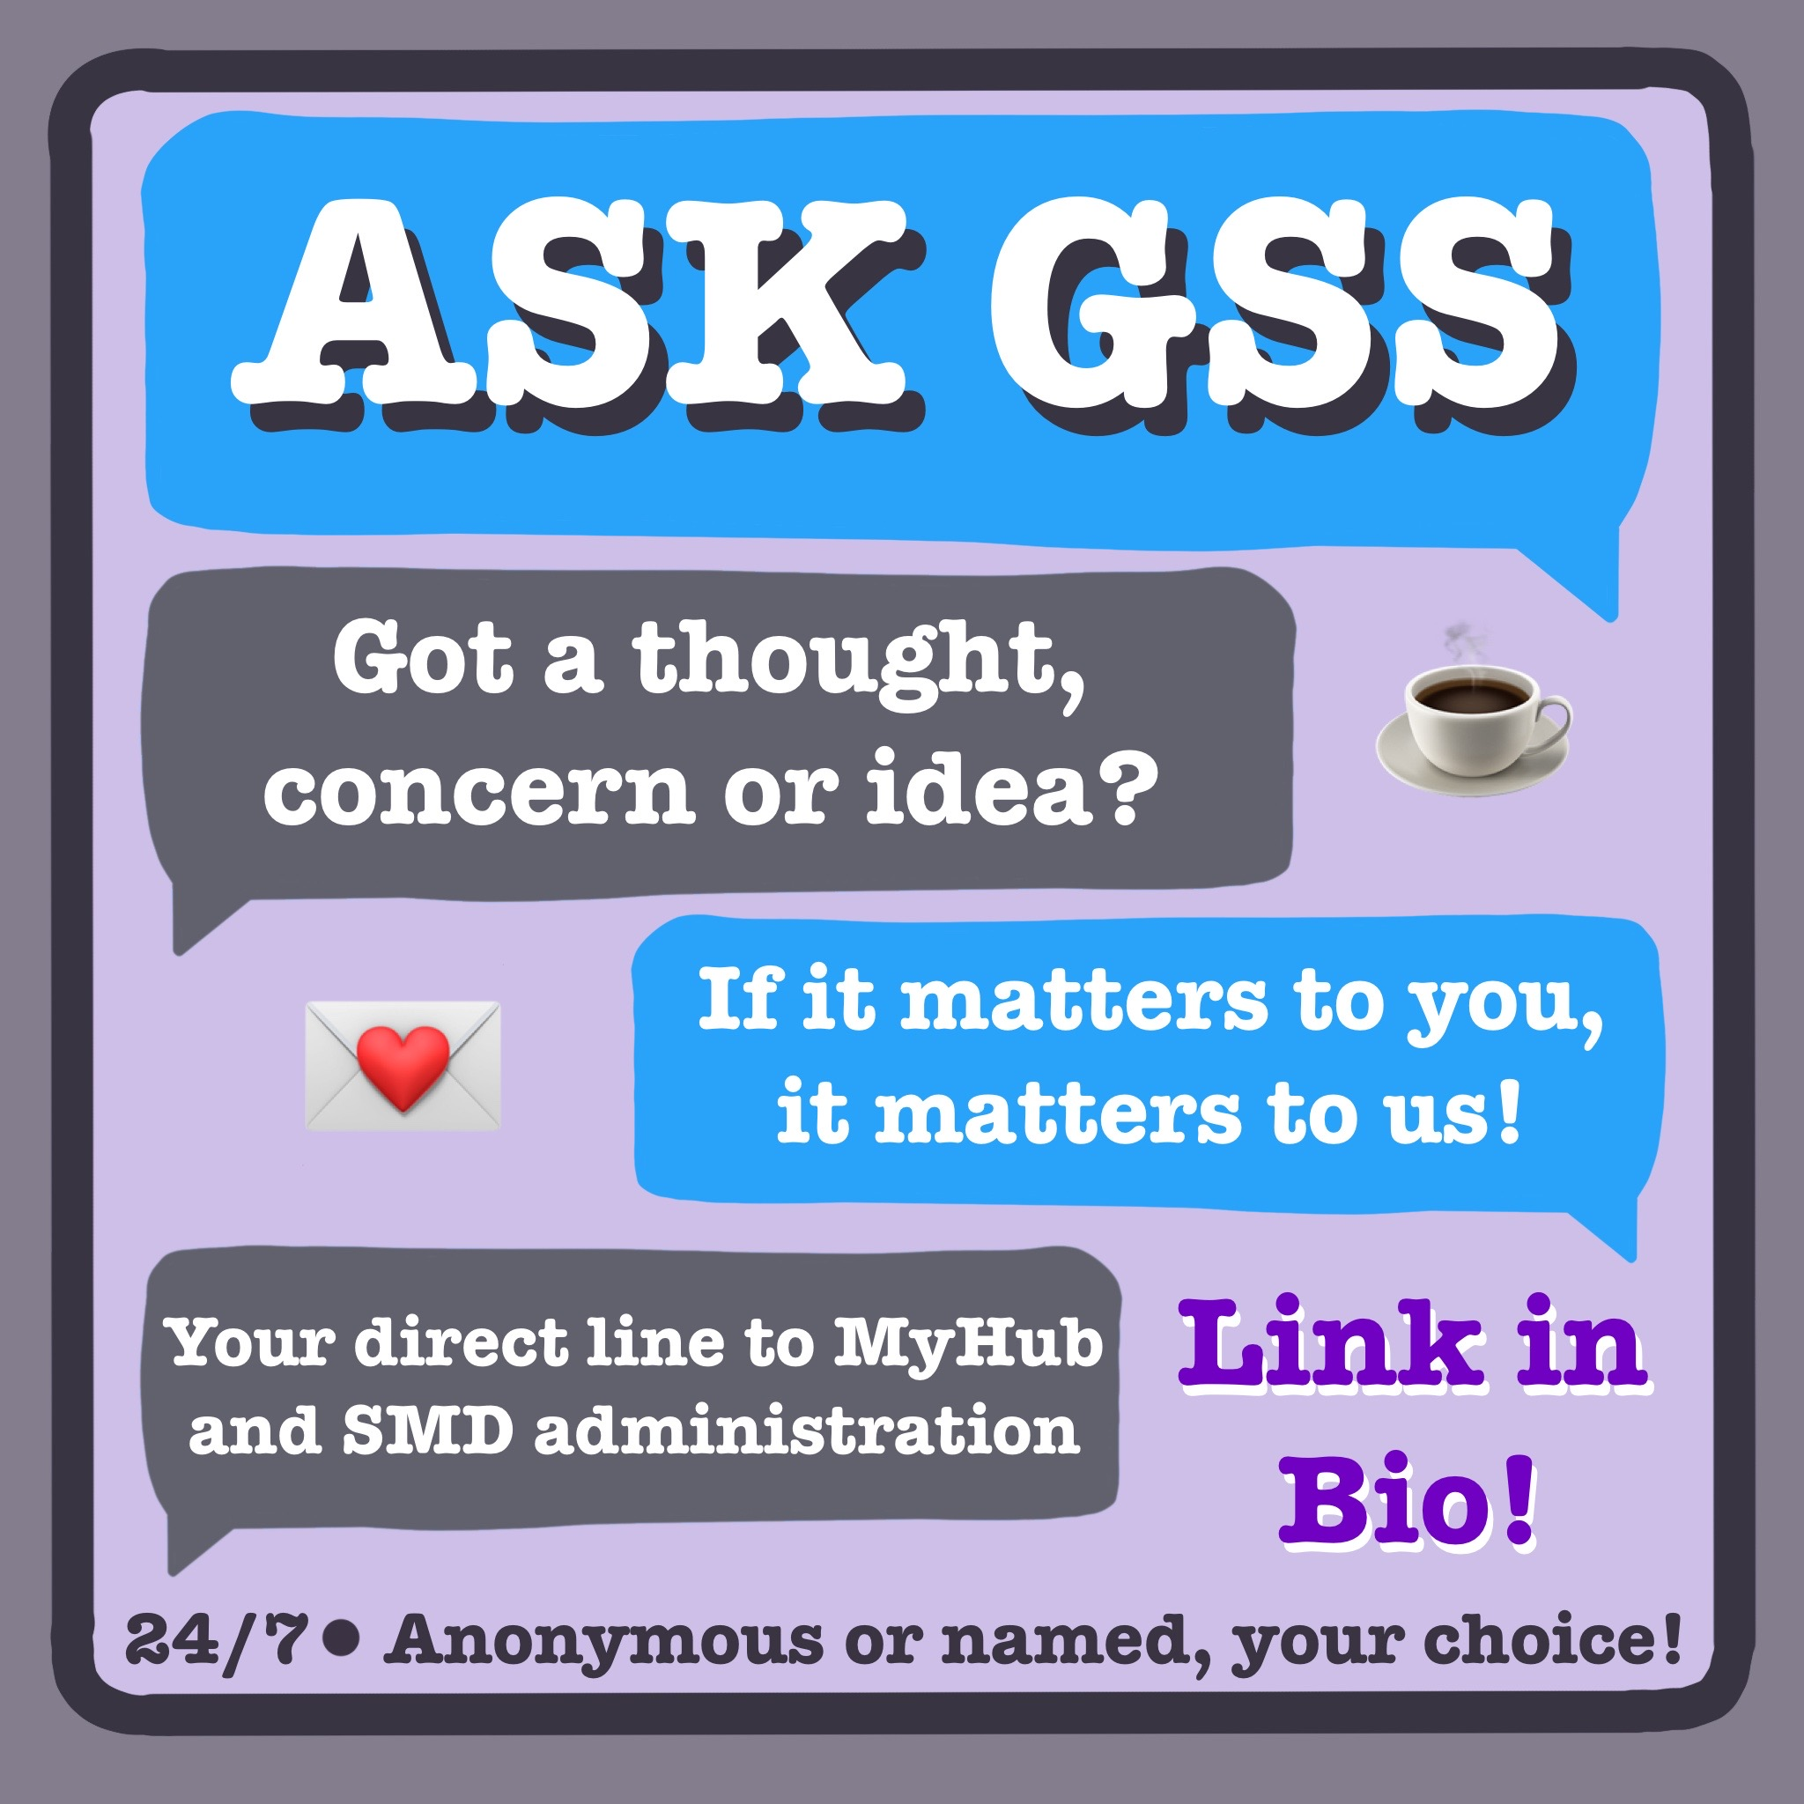
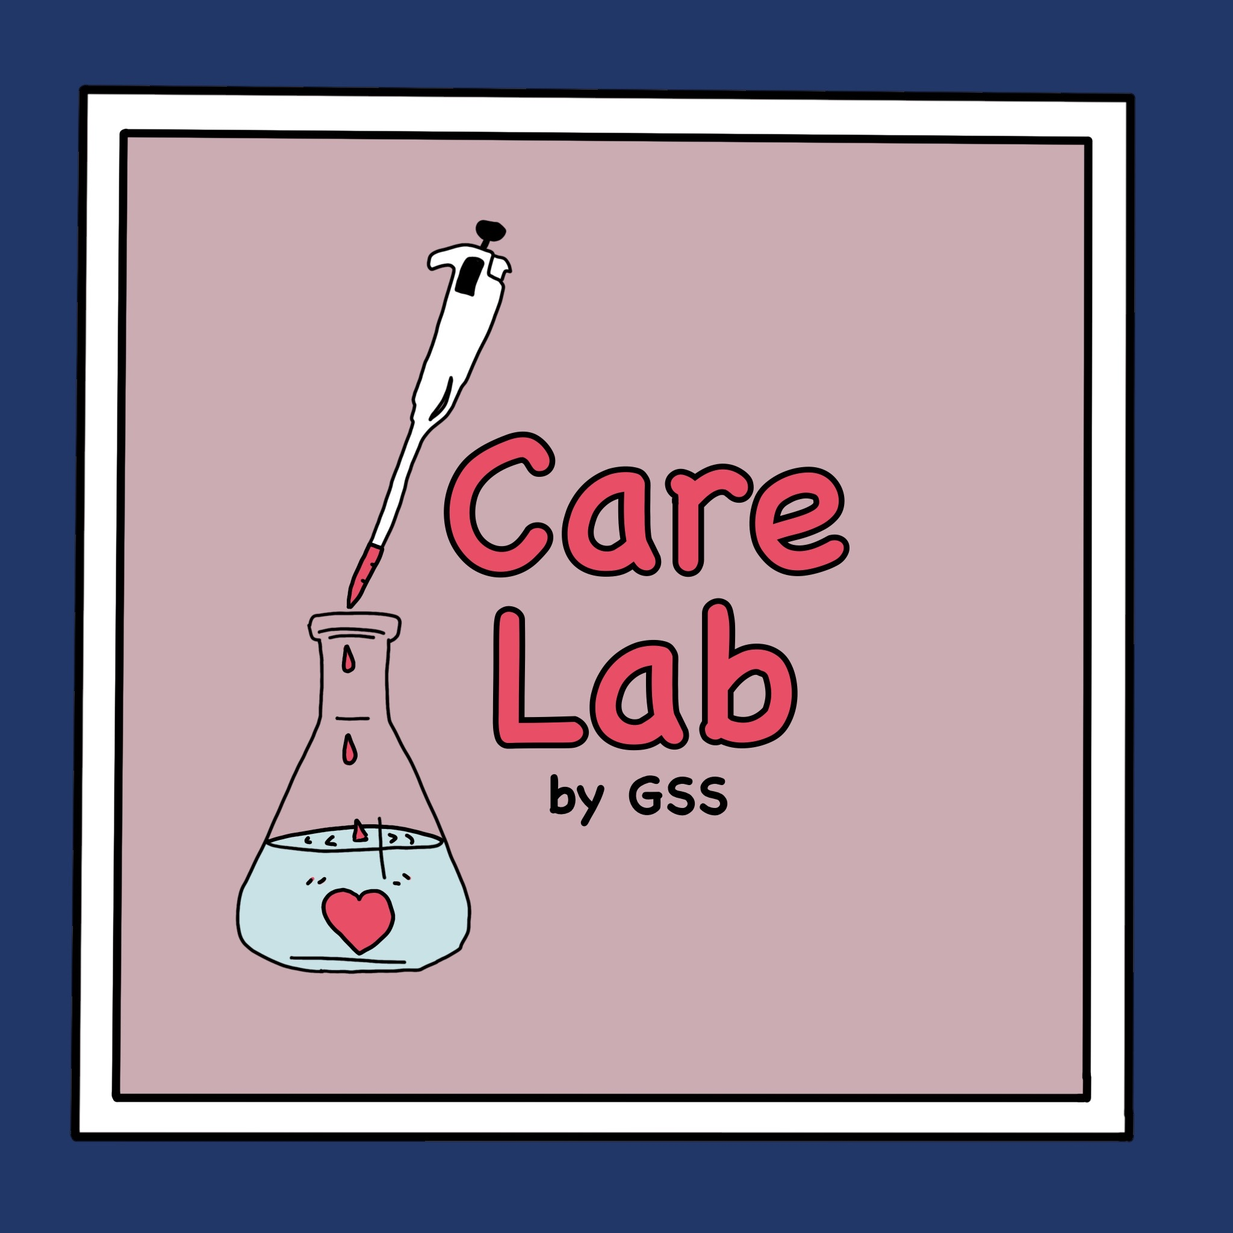
Initiatives
Monthly Meetings
2-3PM Northeastern Rm 1-9525
Oct. 6, Nov. 3, Dec. 1
Ask GSS
Care Lab
Dear Future Grad
Myhub collabs

Slide 6
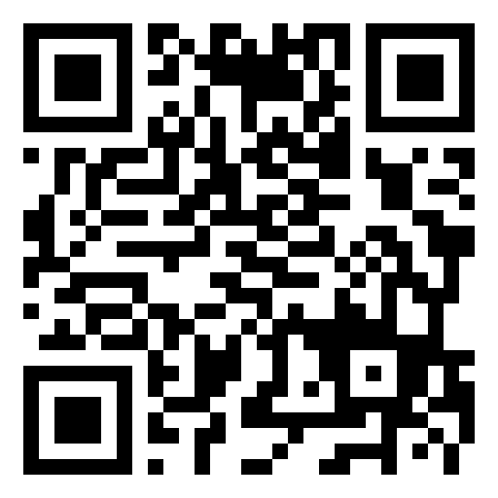
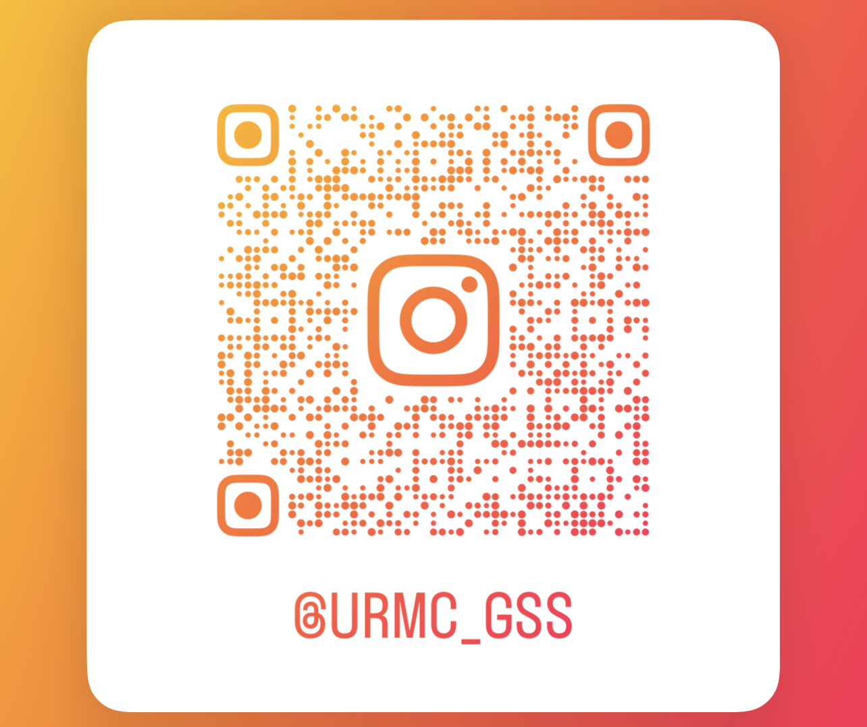
Stay connected and Get involved
Email us GSSBoard@URMC.Rochester.edu
Ask GSS https://tr.ee/L7WWLm4EK-
Slack https://join.slack.com/t/gssmembers/shared_invite/zt-3bqxshzld-thxuvG3Xb9XvSXQPCRhZAQ
QR Code to join GSS on CCC
GSS on Instagram

Slide 7
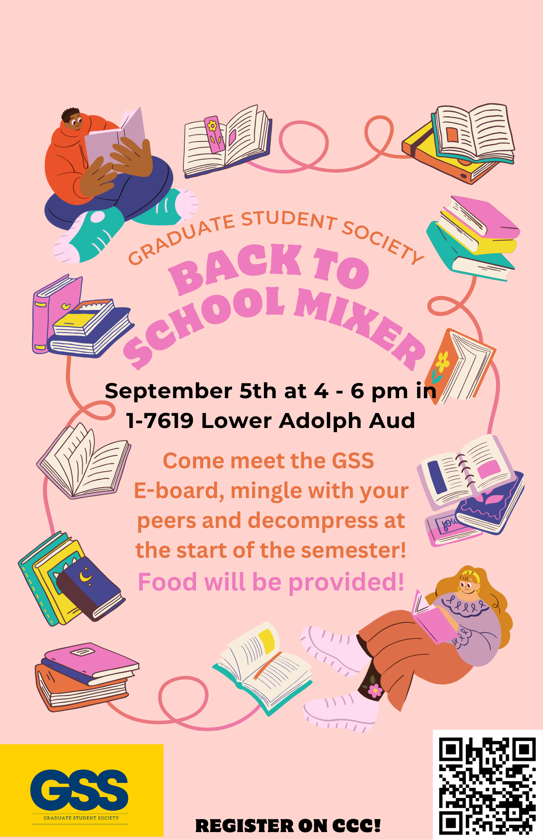

Next Events to look forward to
Back to School Mixer
Redwings Baseball Game
(GSS uses CCC for students to register for events)

Slide 8
SEE YOU around
Come chat with us at the Activities Fair for a chance to win cool prizes!

