Slide 1
Graduate Student Society (GSS)
New Student Orientation 2026

Slide 2
What is the Graduate Student Society (GSS)?
The Graduate Student Society represents all students enrolled in the University of Rochester School of Medicine and Dentistry graduate programs by:
Monitoring issues of importance to the graduate student community
Representing the concerns of graduate students to University administration
Advocating for changes to enhance the quality of graduate education
Serving as a liaison among the student populations of the graduate programs
Sponsoring academic and social events of interest to the graduate student community

Slide 3
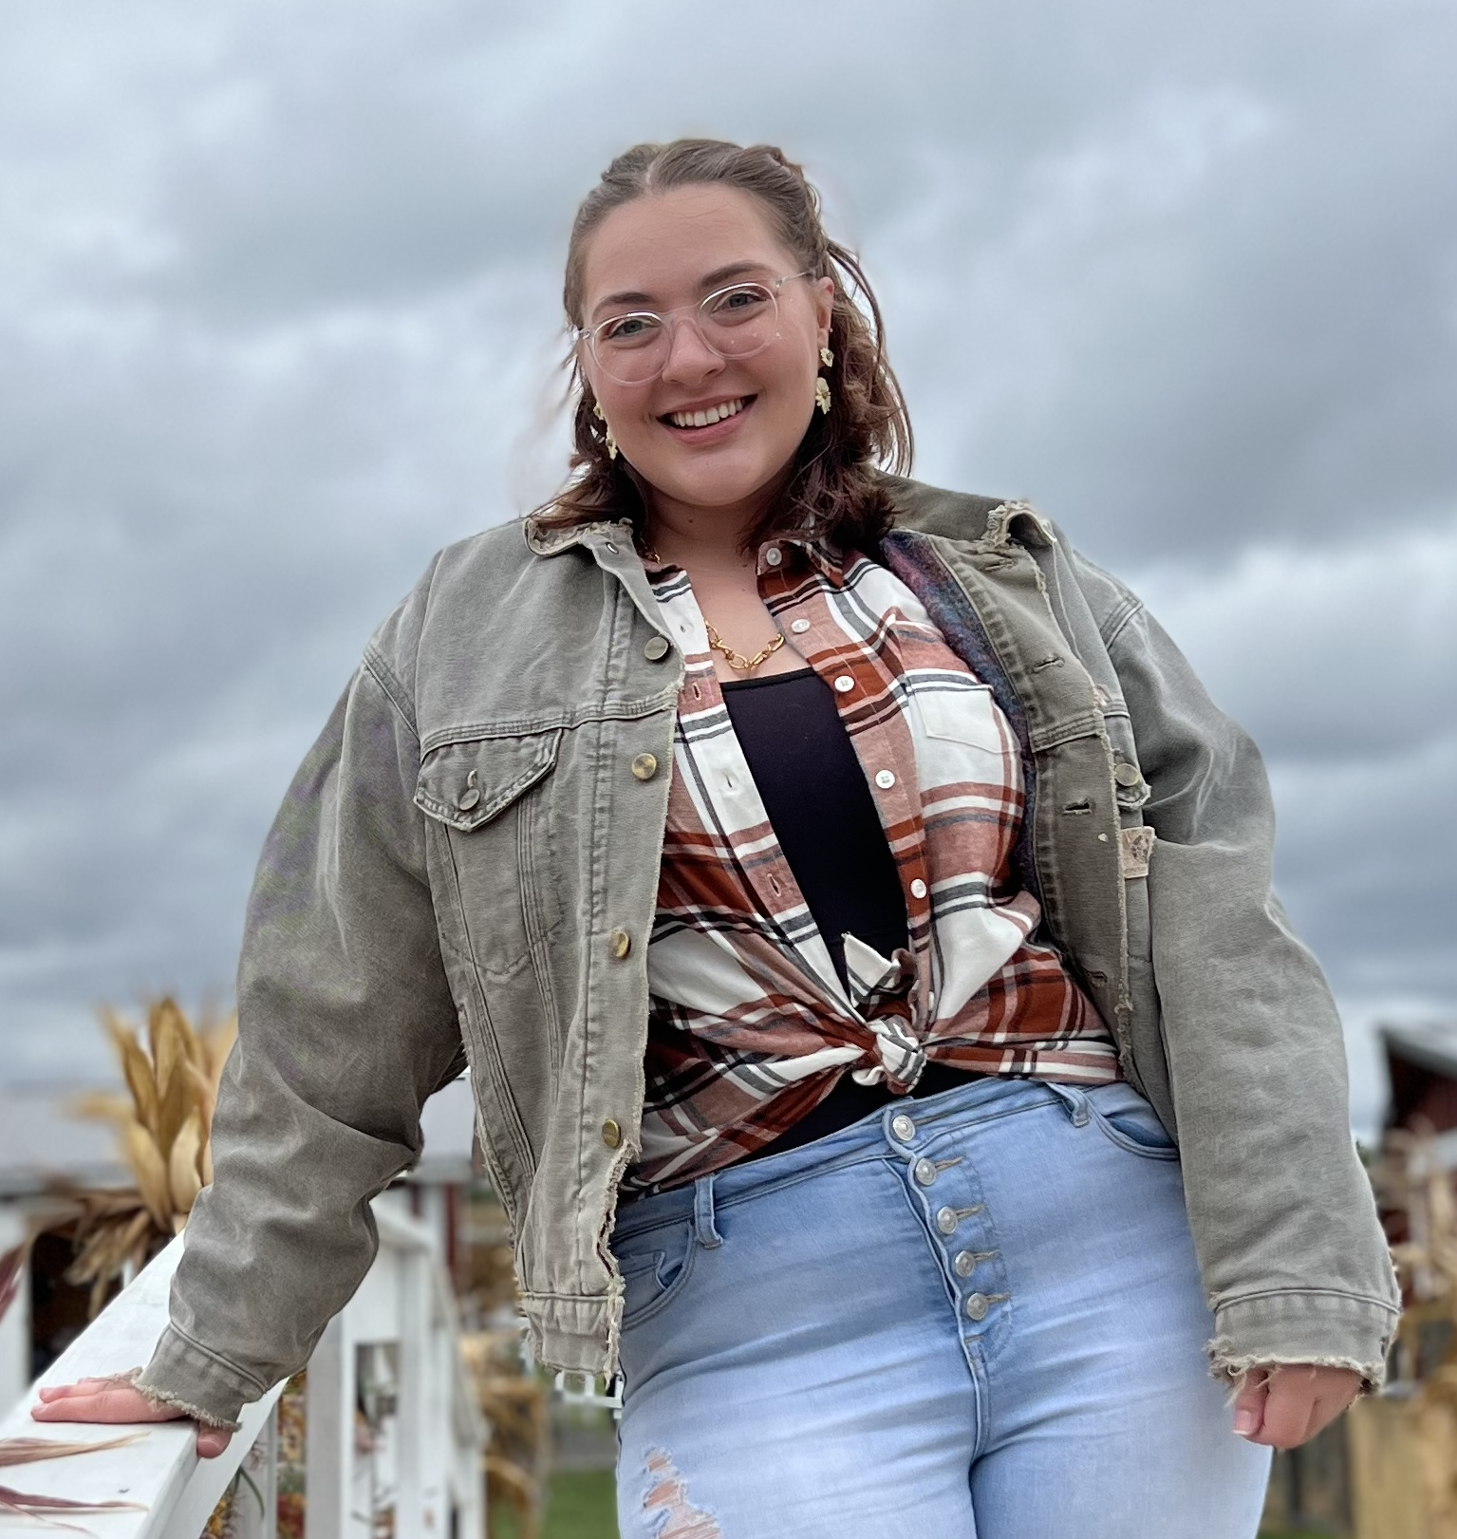
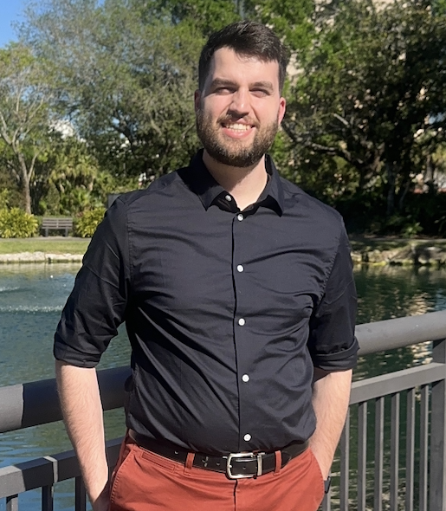
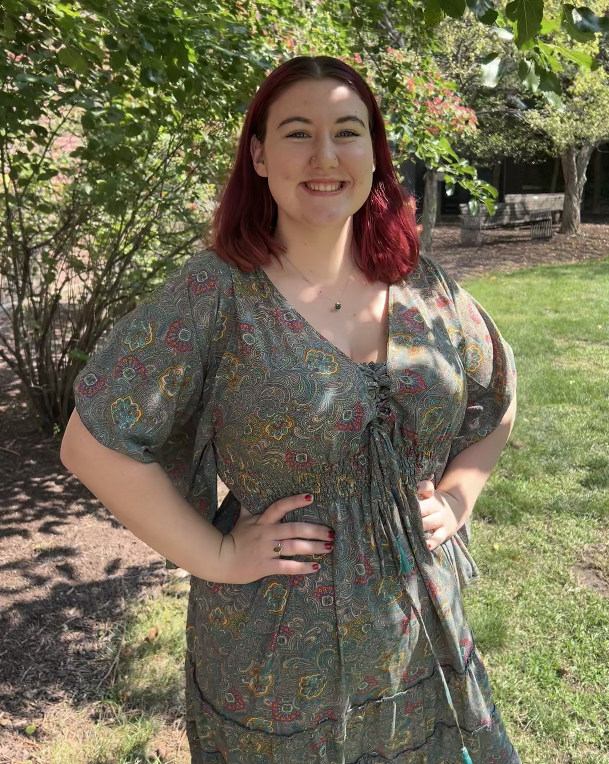
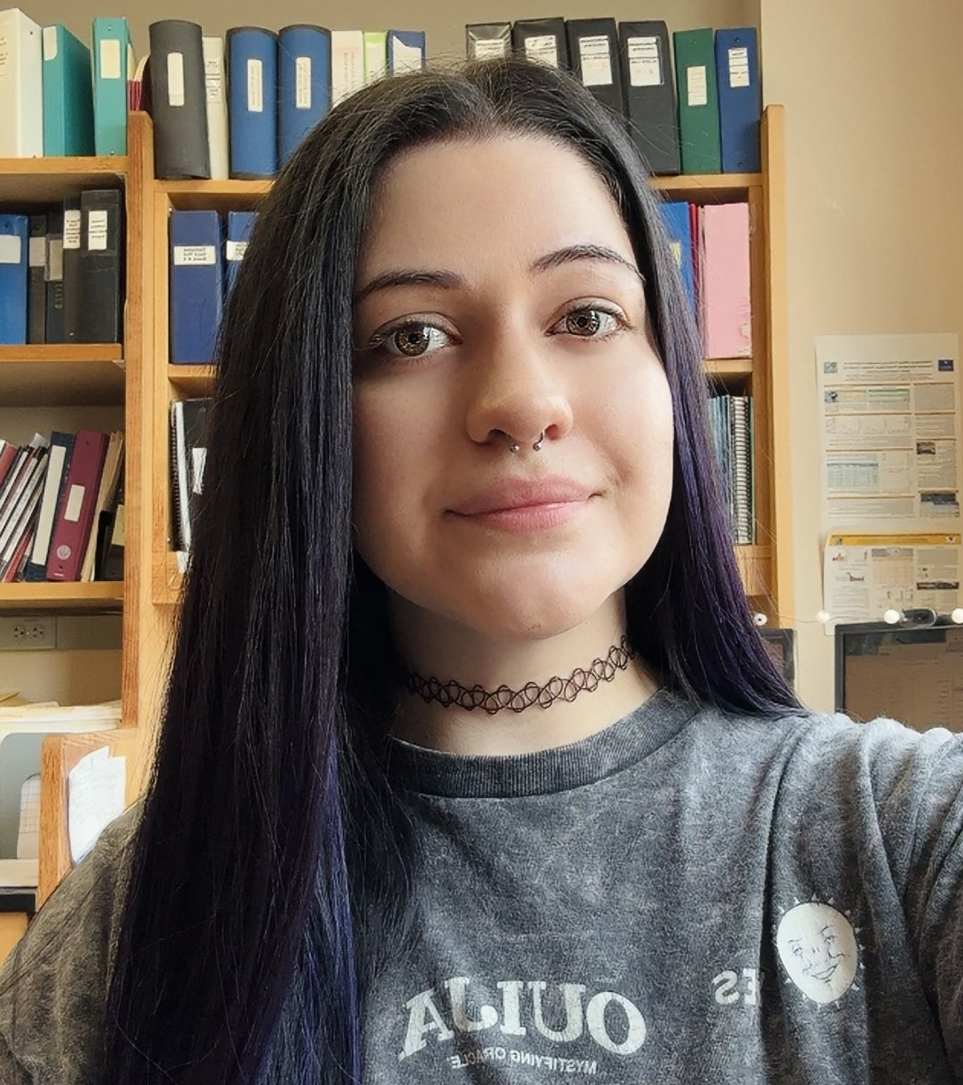
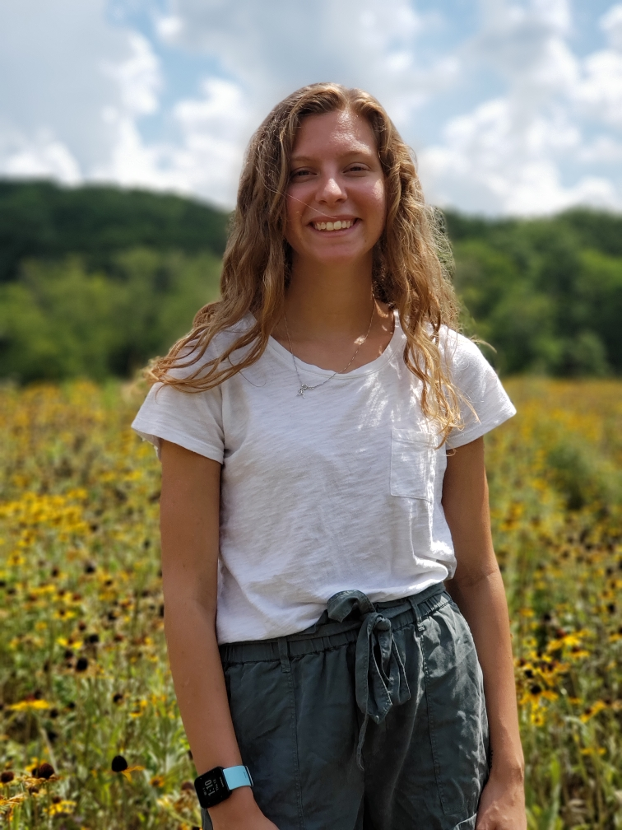
Executive Officers 2026-2027
Abby L. Manning, President
Biophysics and Structural Biology
Ethan Lewis, Vice President
Toxicology
Tianna Torrice, Treasurer
Toxicology
Jessica Enos, Secretary
Toxicology
Alissa Beam, Membership Chair
Biochemistry & Molecular Biology

Slide 4
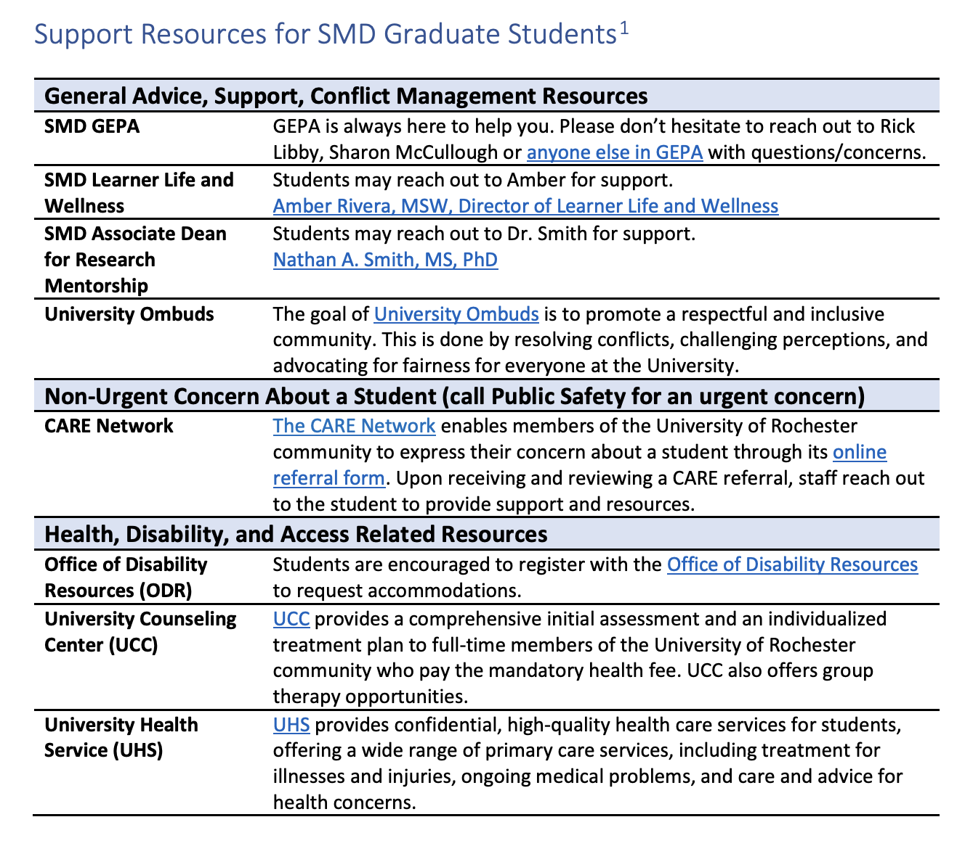
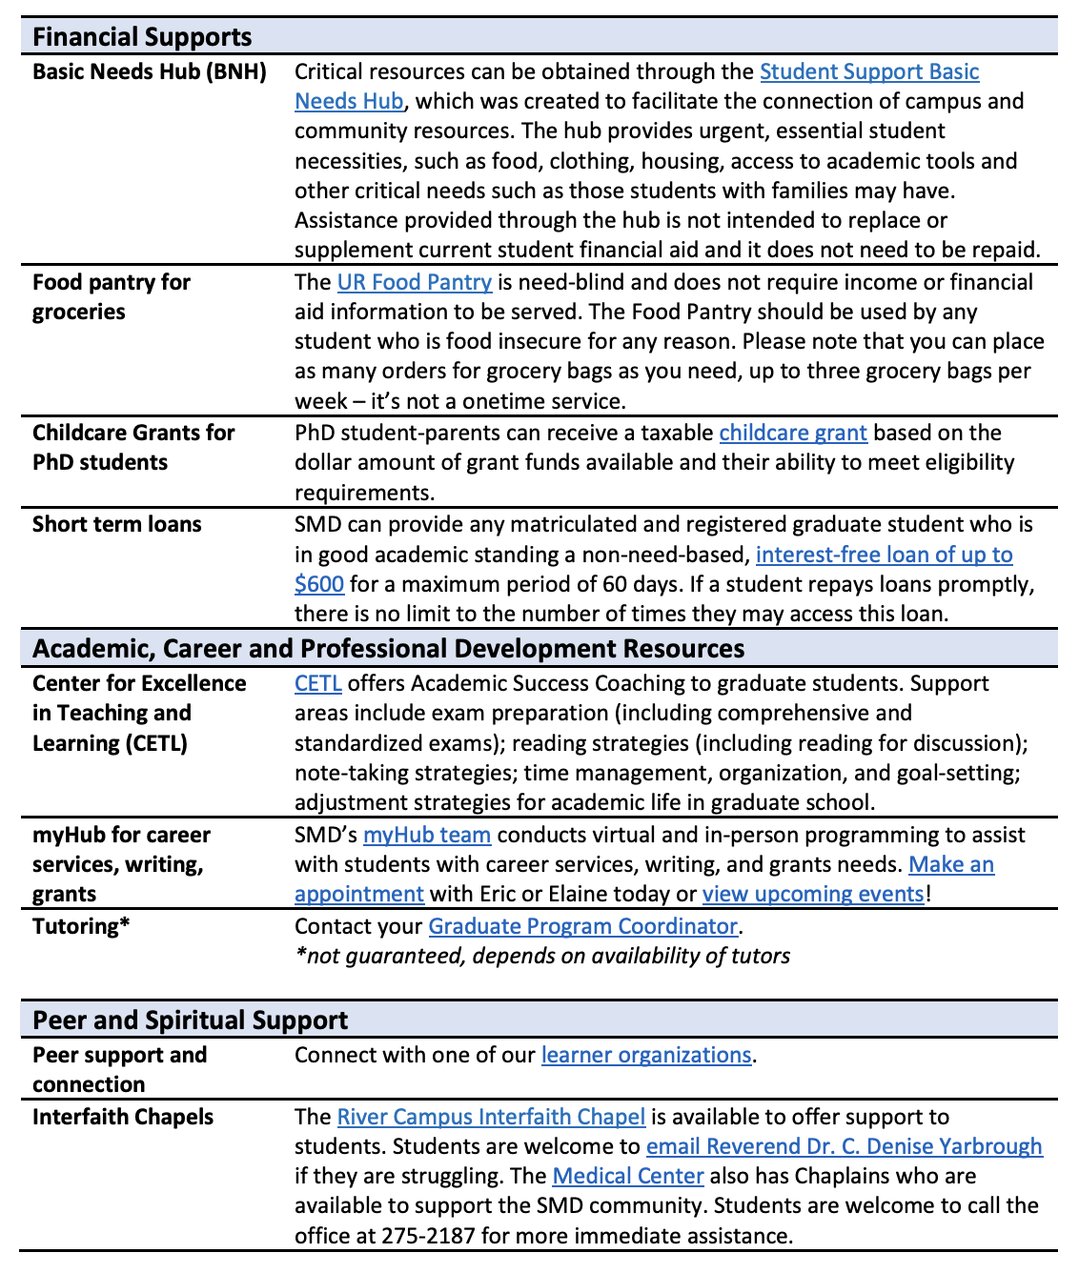
Asking is the best resource
GEPA
MyHub
Peers
CARE Network
GSS!

Slide 5
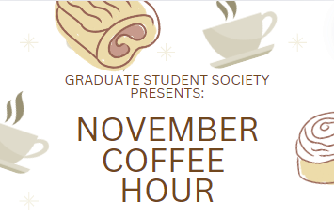
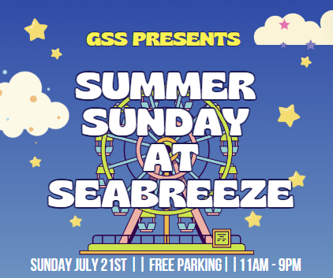
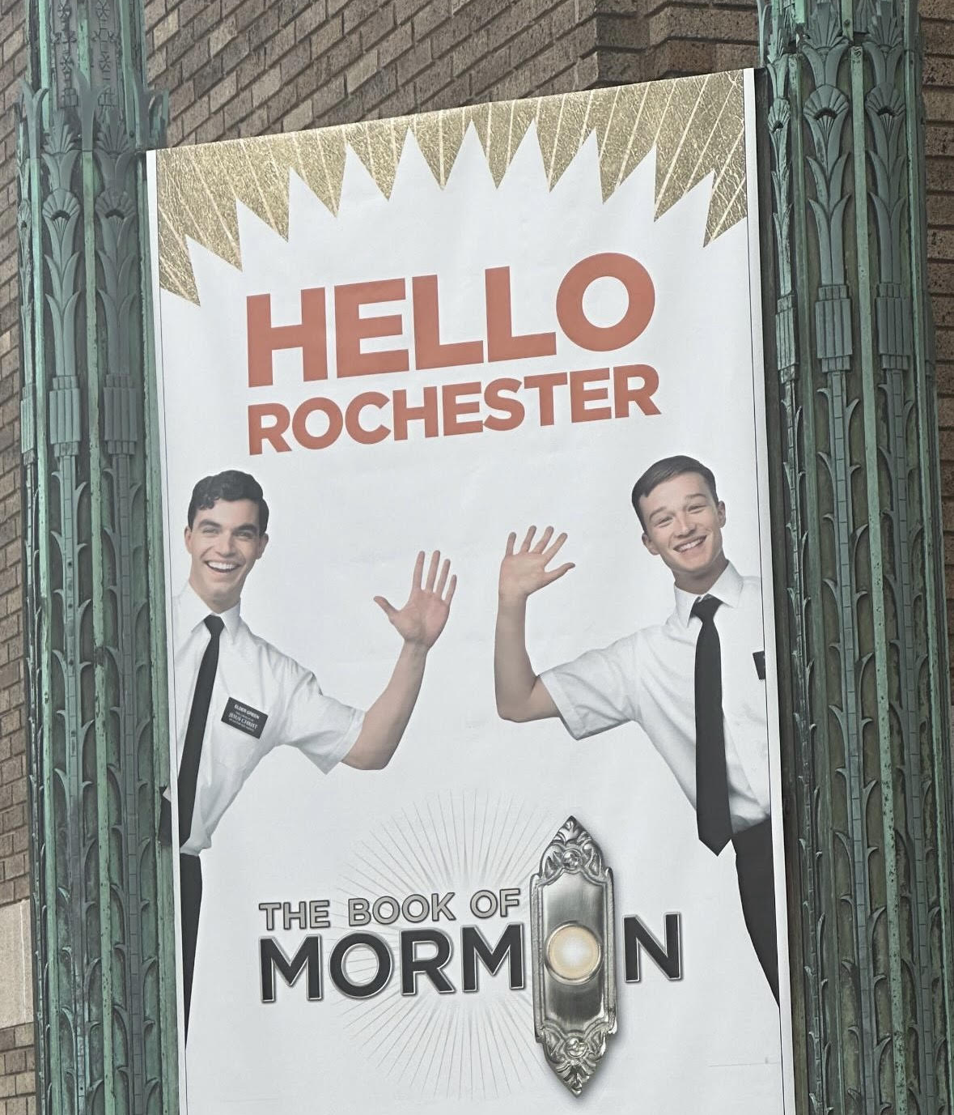
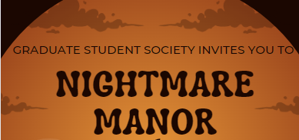
EventS
Monthly coffee hours
Apple picking
Broadway shows
Haunted House
Graduate Giving Gala
Roc Holiday Village
Sports Events

Slide 6
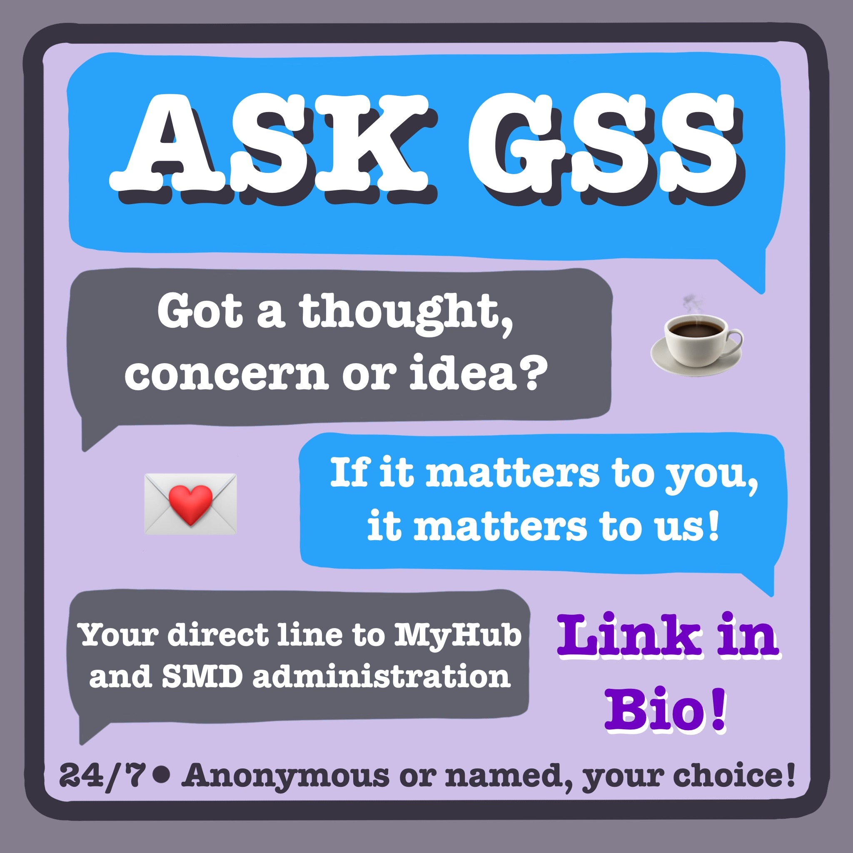
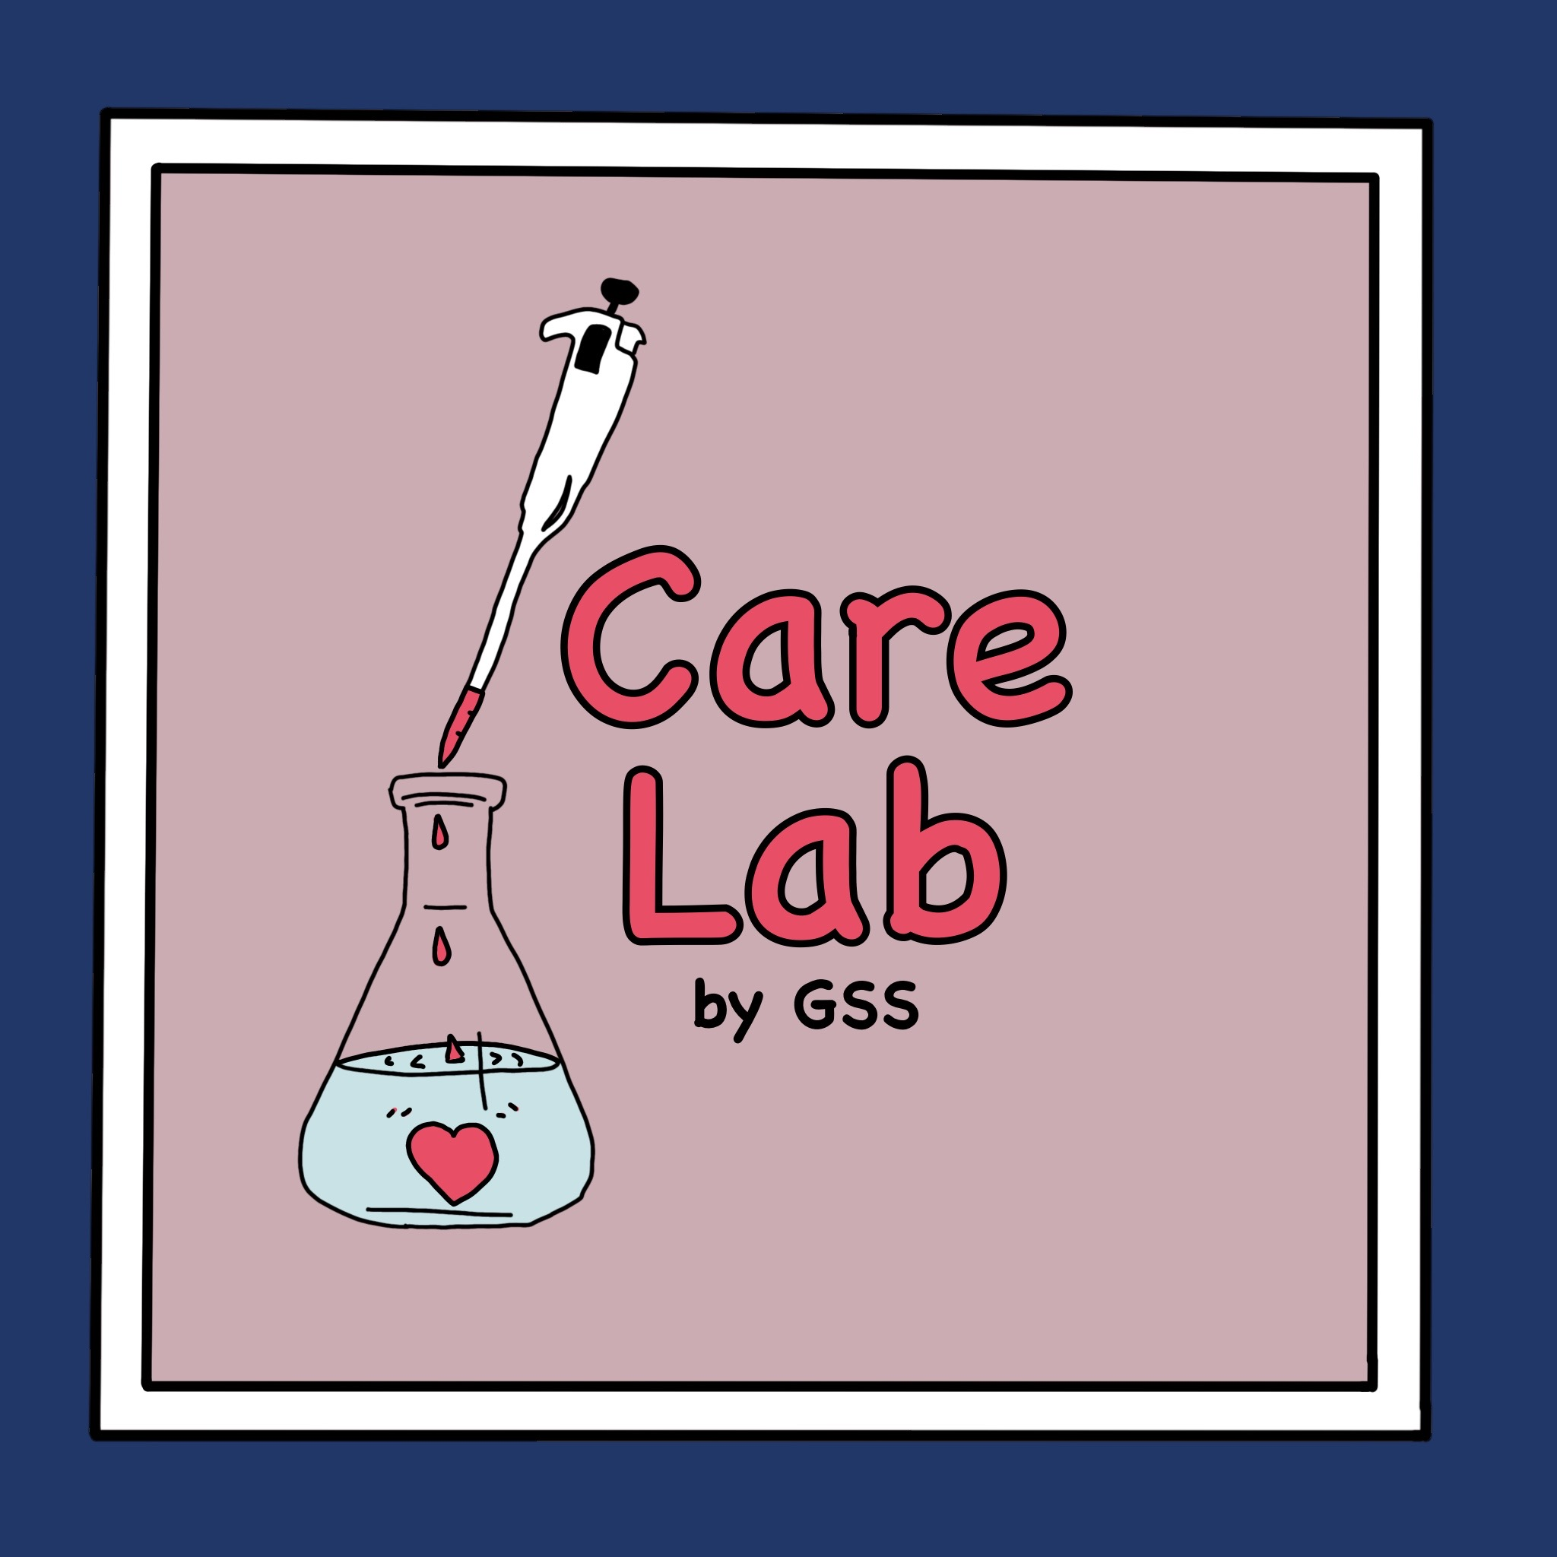
Initiatives
Monthly Meetings and Coffee Hour
  10 AM – 11 AM
  Sept. 8, Oct. 13,
  Nov. 10, Dec. 8
Ask GSS
Care Lab
Dear Future Grad
Myhub collabs

Slide 7
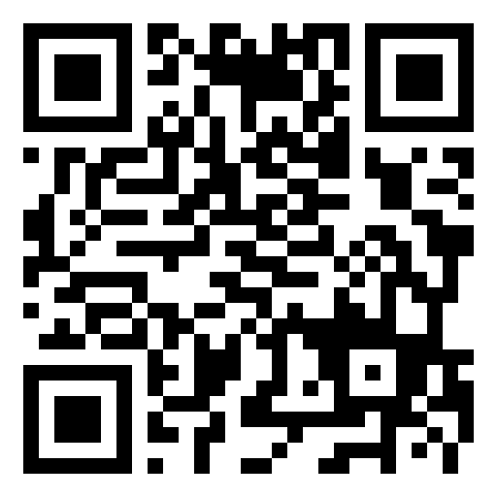
Stay connected and Get involved
ADSE
SACNAS
SMD Entrepreneurs
ISSA
UR Science Policy Initiative
outGRADS
GSOC
Sustainable Labs Initiative
Email us GSSBoard@URMC.Rochester.edu
Ask GSS https://tr.ee/L7WWLm4EK-
QR Code to join GSS on CCC
GSS on Instagram

Slide 8
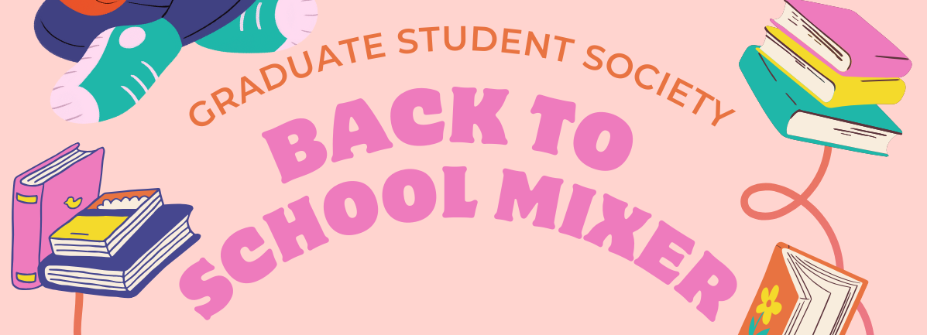
SEE YOU around
COMING SOON!
Come chat with us at the Activities Fair for a chance to win cool prizes!

