Slide 1

myHub Overview
New Trainee Orientation 2026
Amber Rivera, MSW - Director of Learner Life/Wellness
Elaine M. Smolock, Ph.D. - Director of Writing Services and Training Grant Development and Associate Director of Mentor Development
Nathan Smith, Ph.D. – Associate Dean of Research Mentorship
Eric Vaughn, M.Ed. - Director of Career Services
Notes:
Activity Question 1- Worksheet

Slide 2
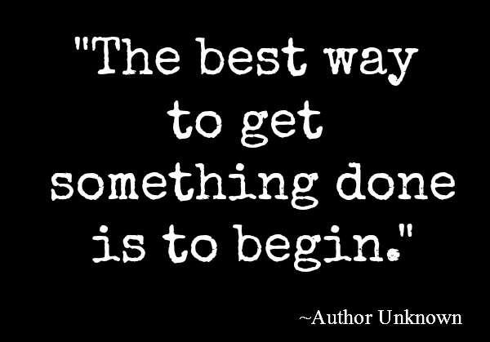
Notes:
Elaine

Slide 3

What is myHub?
myHub assists in supplementing every trainee's scientific education with the wellness, writing, grant support, professional and career development opportunities most appropriate to each individual trainee’s interests and skills.
The 8 spokes of myHub include….
Alumni
Mentorship Support
Fellowships & Grants
Learner Life/Wellness
Student & Postdoc Groups
Career Services
Internships
Writing Services
Notes:
Elaine

Slide 4
Goal of the Writing Assistance Resource
  The primary goal is to improve your writing by discussing your research and providing tools to develop your fundamental writing skills.
  The resource is intended to be a learning experience where you can learn skills related to:
  Organization, Logic, Structure, Communication and presentation
  *This is NOT a copy editing or re-writing service!*

Slide 5
Writing Assistance is Offered in:
Individual sessions providing detailed discussions about your writing project(s)
Workshops & group-based learning experiences to encourage and promote writing development
Notes:
Elaine

Slide 6
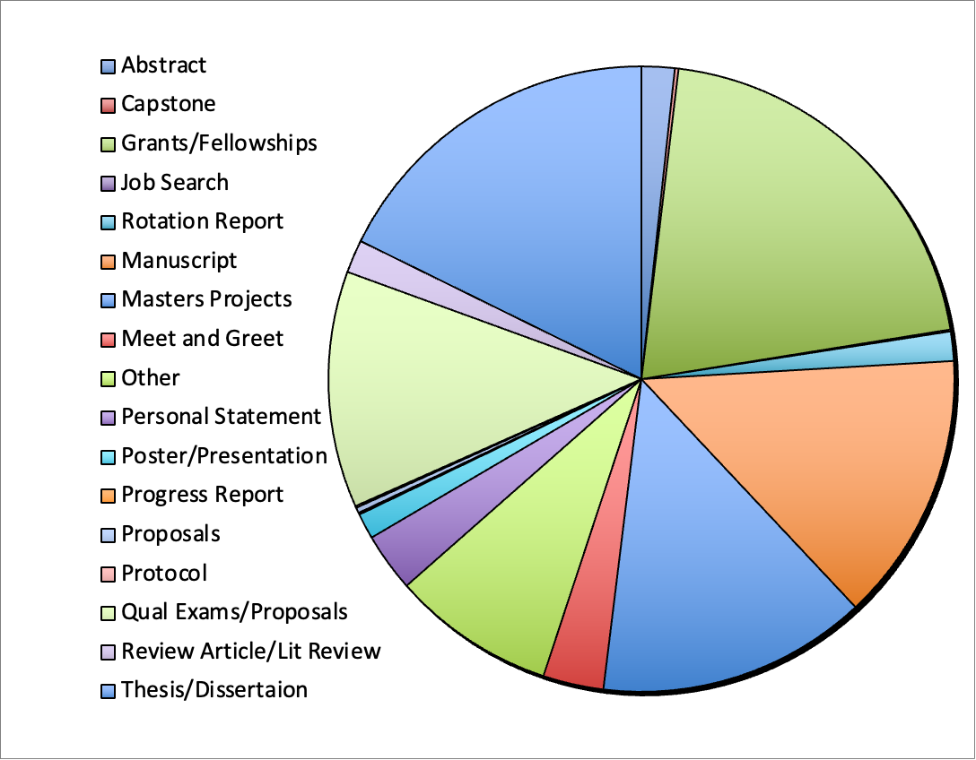
The Wheel of Writing Assistance
>300
I have worked on
~1500
writing projects with our trainees
>160
>145
>150
>200
Notes:
Elaine

Slide 7
Workshops and Social Content to be on the lookout for:
NIH F-Series Grant Writing Sessions and Writing Clubs (3x per year)
Thesis Writing
Manuscript Writing
Qualifying Exam Preparation
Writing Retreats

Slide 8
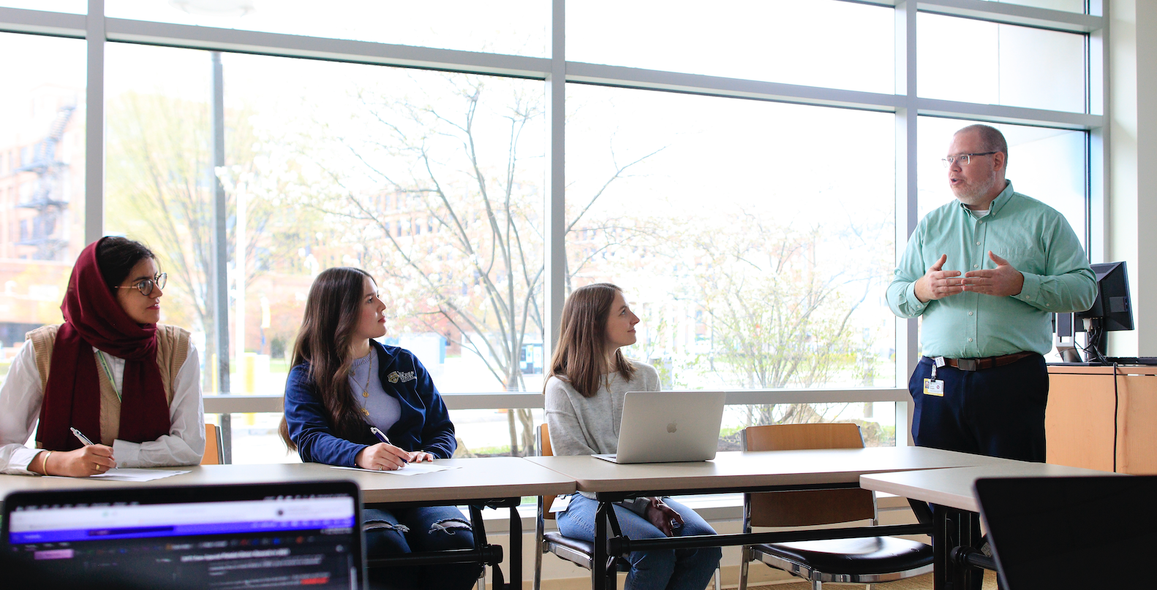
Goal of myHub Career Services
& Internships
As the myHub Career Coach, I want to help you with…
exploring careers
advancing your professional development skills
discovering your post-graduate next steps
Notes:
Elaine

Slide 9
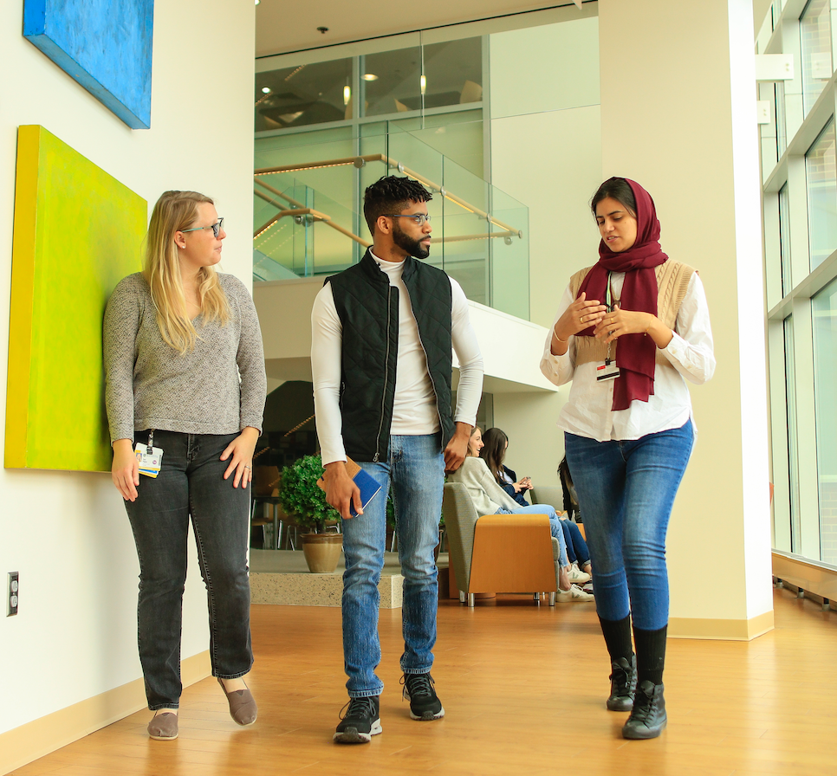
Explore options while you are here….
Who knows what they want to do after receiving their graduate degree?
On average, how many hours will you work within your lifetime?
myHub offers 1:1 appointments, interactive workshops, experiential learning opportunities, networking opportunities, and much more
~90,000 hours = 11,250 days
Notes:
Eric Vaughn

Slide 10
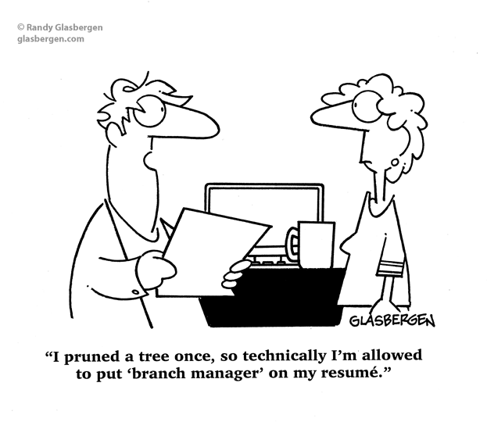
Career Services
I can assist you with your…
Academic & Career Goals Development
CV/Resume & Cover Letter Writing
Career exploration & Job search strategy
LinkedIn Profile
Internship/Job Interview prep
Networking Strategy
Teaching Opportunities and Teaching Recognition Programs

Slide 11

Experiential Learning & Internship Experiences. ---Funding
Funding for unpaid internships
Assistance with travel and lodging costs for internships
Job Shadowing & Exploration Mini Grants through the myHub Career Exploration Modules
Notes:
Eric

Slide 12
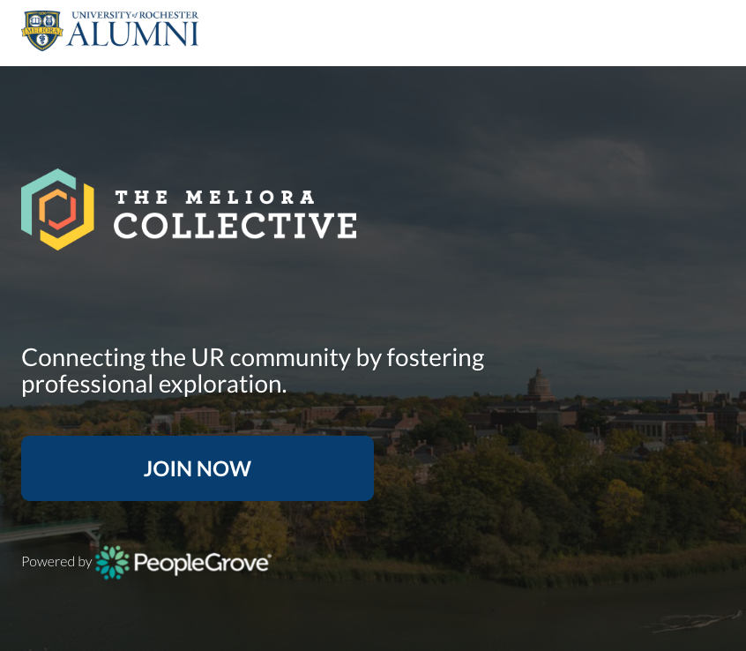
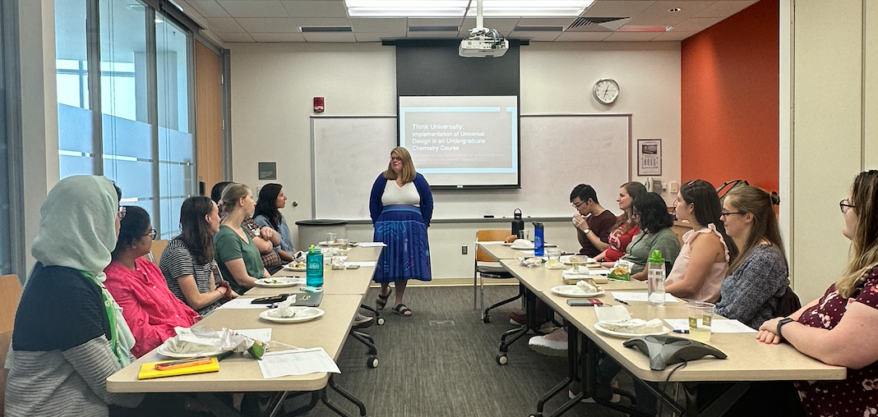
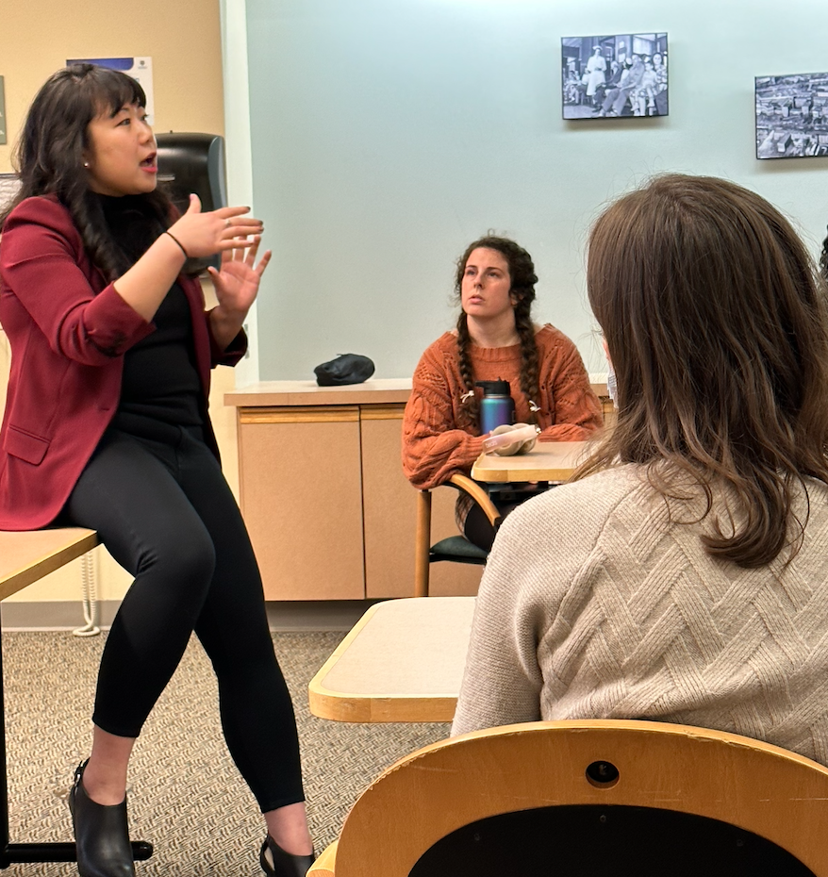
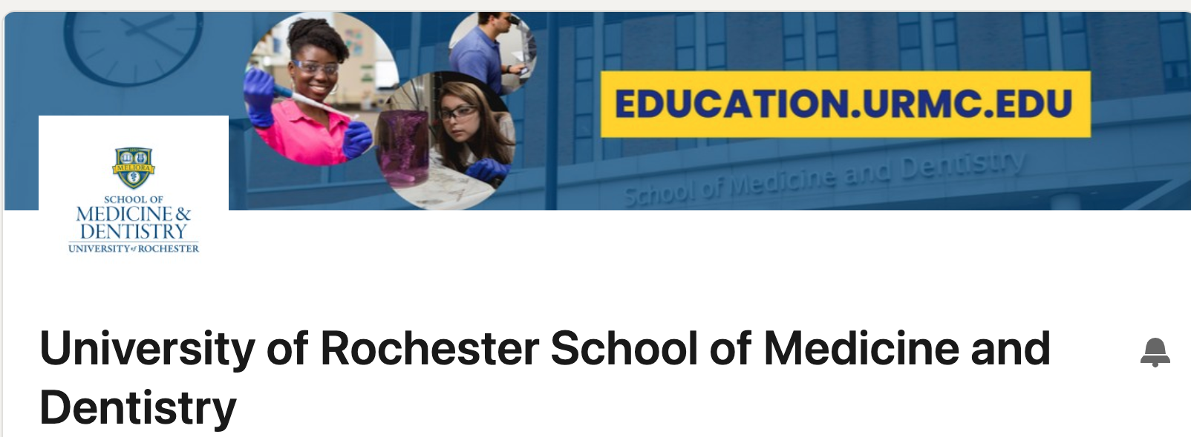

Alumni Community
Notes:
Eric

Slide 13
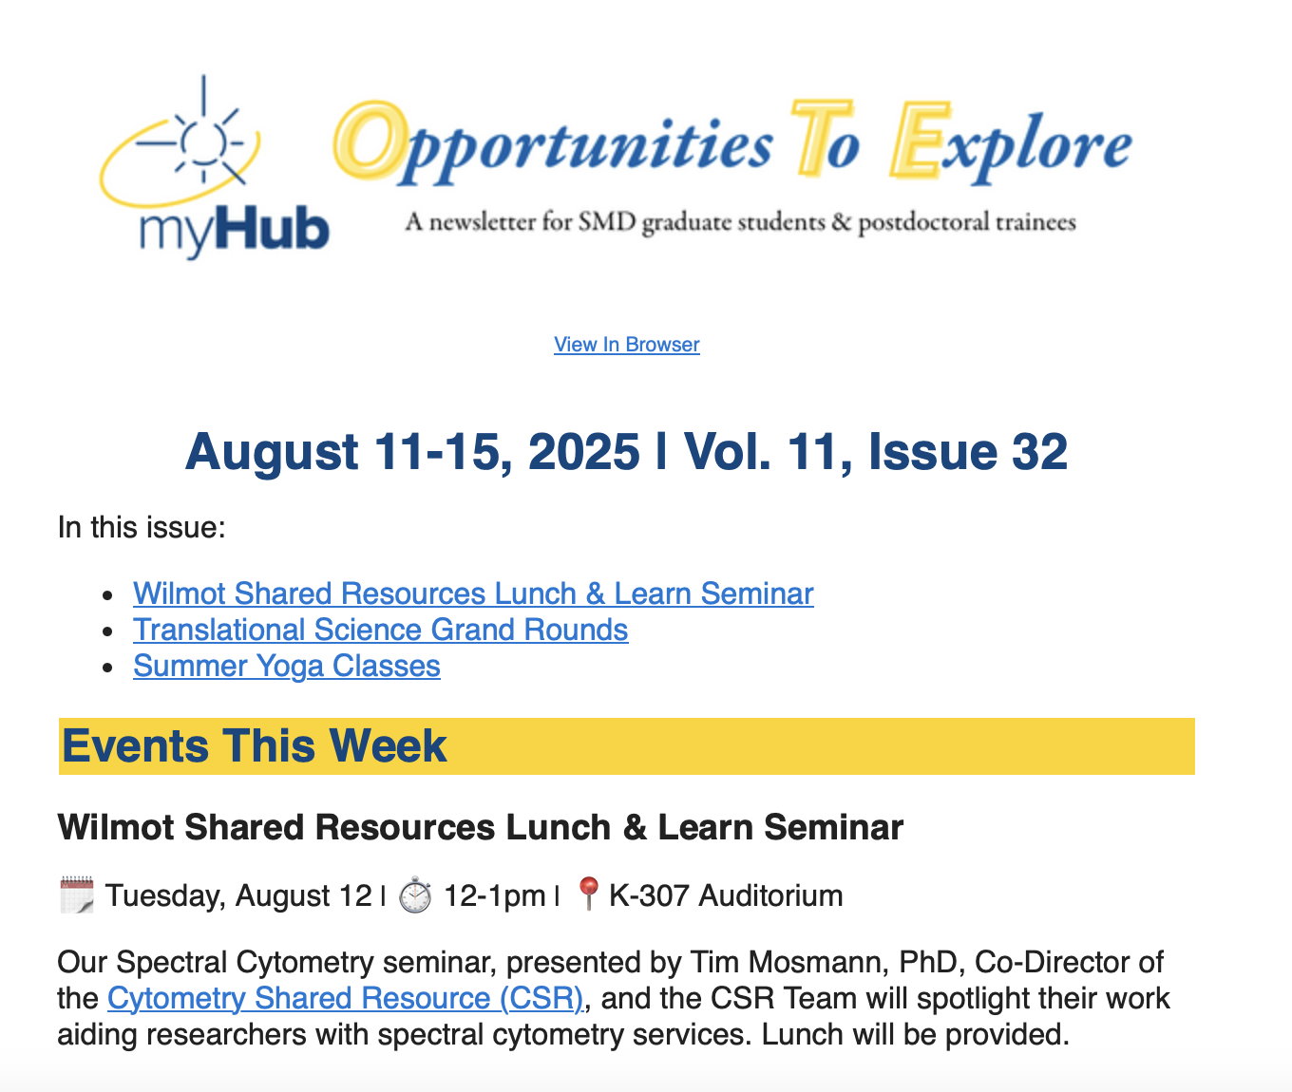
Weekly Digest of..
Events
News
Travel Award Info
Postdoc/Internship/Jobs
Resources
And much much more

Slide 14
Learner Life and Wellness Services
Available to all SMD graduate students and postdocs.
Learner Support & Wellness – Discuss how SMD GEPA can support your educational journey, personal development, and personal wellness.
Counseling – Preliminary and short-term counseling in response to a personal concern. Everyone has the capacity for growth; sometimes we need a space to explore thoughts and feelings, and discover strength, wisdom, and grace within. All discussions will be held in confidentiality.
CARE Network – Discuss CARE Network referrals. Whether you have been referred for support through the CARE Network, are considering making a self-referral, or a referral concerning someone else, you can safely discuss the CARE Network’s role in addressing concerns.

Slide 15
Learner Life and Wellness Services
Available to all SMD graduate students and postdocs.
Access to University Support Services – The School of Medicine and Dentistry graduate and postdoctoral experiences are unique, and the University offers a variety of resources to help you be successful on your own path. Discuss ways to connect and receive support.
Trainee Group Advising – Discuss leadership development, program planning, group development concerns, and learner needs for your Trainee Group.
Wellness Programs and Initiatives – Meet and greet to discuss wellness topics that are of interest to you and other graduate and postdoctoral learners. Suggest your ideas for wellness programs and initiatives that address challenges commonly faced by SMD graduate students and postdocs.

Slide 16
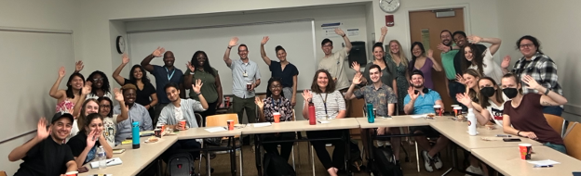
Become Active in an
SMD Trainee Group
  Alliance for Diversity in Science and Engineering (ADSE)
  Graduate Students of Color (GSOC)
  Graduate Student Society (GSS)
  Graduate Workers in Science (GWIS)
  International Students & Scholars Association (ISSA)
  outGRADS
  The Society for Advancement of Chicanos/Hispanics
  and Native Americans (SACNAS)
  SMD Ambassadors
  SMD Entrepreneurs
  UR Postdoctoral Association (PDA)
  UR Thinkers
  UR Writing
Notes:
Eric

Slide 17

We Use Handshake ---
Schedule an appointment with us!
Register for 1:1 appointments with Amber, Elaine, & Eric
Schedule of myHub Events & Register for Events
Explore internship & job postings
Notes:
Eric

Slide 18
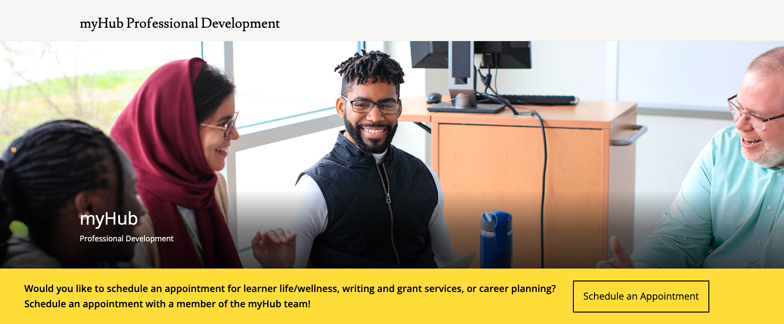
Schedule an appointment with the myHub Team!!!

Slide 19
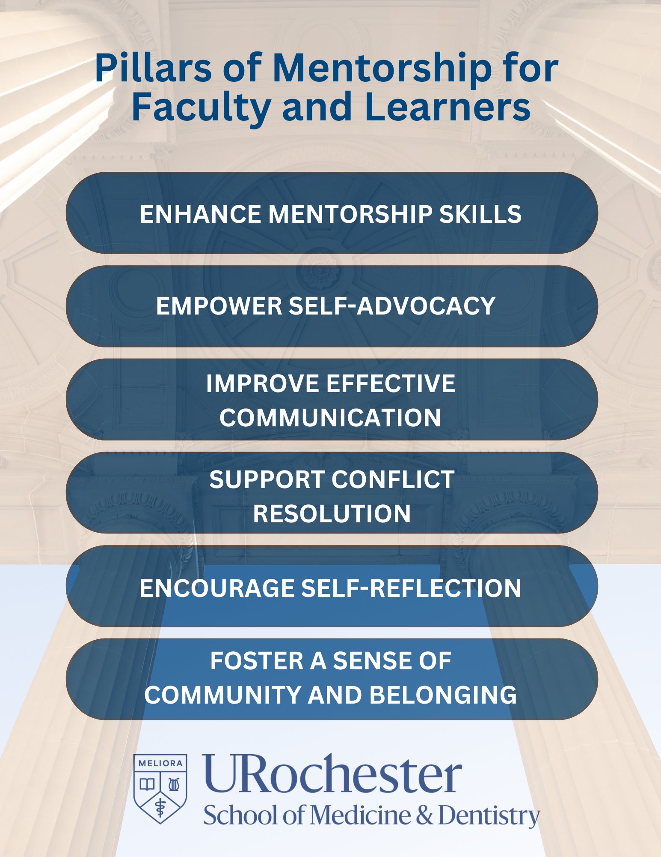
Mentoring

Slide 20

Mentoring with Intent
Quarterly Meetings that Cover Topics Including:
Communication is Bidirectional - You Have a Voice- Use It with Intention and Purpose
Understanding Expectations as a Mentee and Recognizing One’s Responsibility as a Trainee
Managing Conflict and Exercising Agency
Avoiding Complacency and Adjusting Mentee Status with Career Advancement

