Slide 1

Harassment-Free Workplace Training
Stephen Burke, Director of Civil Rights Investigations
Senovia Moncada, Associate Director of Civil Rights Investigations

Slide 2
The Civil Rights Compliance Team (CRCT) conducts neutral and impartial investigations under the following University policies:
Policy Against Discrimination, Harassment, and Discriminatory Employment/Service Practices (PADH)
Title IX Policy

Slide 3
PADH

Slide 4
What is the purpose of the PADH?
To comply with state and federal laws and consistent with University values, the PADH prohibits discrimination and harassment based on any protected characteristic(s) in University of Rochester workplaces
To explain the options for addressing and resolving allegations of discrimination and/or harassment on the basis of protected characteristics
To establish that retaliation against someone because they report or oppose discrimination/harassment or participate in any process used to resolve a report is unacceptable, and that engaging in retaliation will result in consequences, including counseling or discipline

Slide 5
What is the scope of the PADH?
The PADH applies to reports alleging discrimination and/or harassment by employees (staff/faculty), as well as contractors, vendors, and visitors, because of a person’s protected characteristic
Students can make a PADH report about any category of individual listed above
The PADH does not apply to reports of harassment or discrimination by students. Those reports should be directed to Student Conduct in the Office of Dean of Students

Slide 6
How does the PADH define Discrimination?
Discrimination involves:
an adverse action or decision, or treating a person or group of people differently,
because of a protected characteristic or because of perceived or actual affiliation/association with other individuals in a protected characteristic
To rise to the level of discrimination, there must be evidence of intention connected to the adverse action, decision or different treatment.

Slide 7
How does the PADH define Harassment?
Harassment is a form of discrimination that involves verbal, written, physical or electronic conduct that is:
unwelcome;
based on the protected characteristic(s) of the person subject to the treatment; and
rises above the level of what a reasonable person, who is subject to harassment with the same protected characteristic, would consider more than a petty slight or trivial inconvenience.
The harassment analysis focuses on impact, not intent.

Slide 8
How does the PADH define Retaliation?
Retaliation is an action taken by the University or a member of the University community that would dissuade a reasonable person (an employee or other member of the University community) from engaging in a protected activity.
Protected activity can include, but is not limited to:
personally complaining of or opposing perceived Discrimination or Harassment because of a Protected Characteristic;
testifying, assisting or participating in an investigation, proceeding, hearing or legal action involving a claim of Discrimination or Harassment based on a Protected Characteristic; or
exercising rights under a relevant law that involves a Protected Characteristic.

Slide 9
What are protected characteristics?
Age
Color
Disability
Domestic violence victim status
Ethnicity
Gender identity or expression
Genetic information
Marital status
Familial status
An individual’s reproductive health decision making
Military/veteran status
National origin
Non-pending arrest or conviction record
Race (including hair style)
Religion/creed (including religious attire and facial hair)
Sex
Sexual orientation
Citizenship status
Any other status protected by law

Slide 10
How many reports do you receive?
In academic year 2024-2025, we received …
787 PADH reports

Slide 11
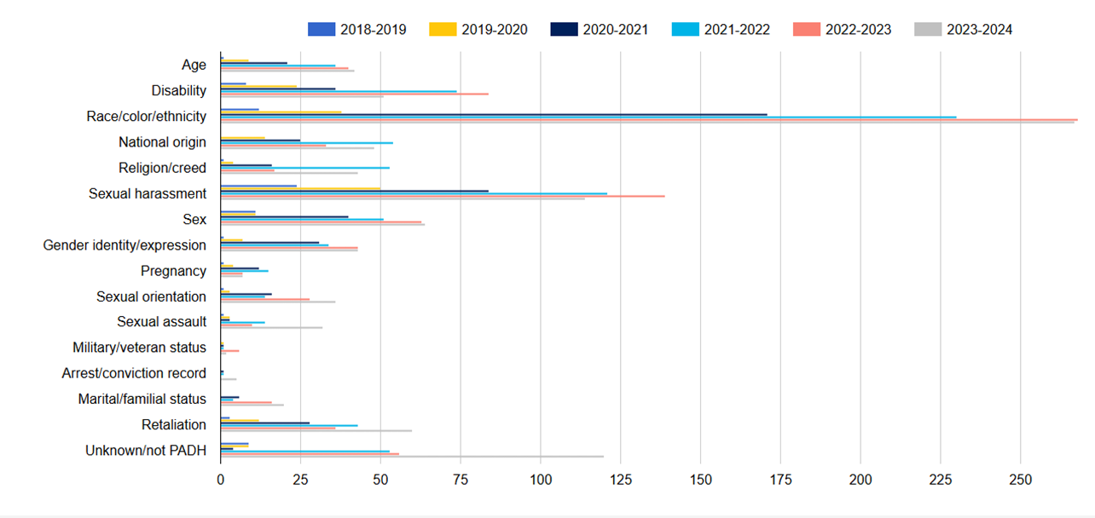
What protected characteristics are most frequently listed in reports?

Slide 12
Who must report PADH concerns?
The following individuals are considered mandatory reporters:
Any employee having supervisory responsibility over employees, including student employees and faculty members
All faculty
Engagement and Enrichment Officers;
Principal Investigators on a grant or contract;
Individuals who have been designated as a Campus Security Authority pursuant to the Clery Act;
Deputy Title IX Coordinators
Individuals who work in any of the following departments/offices:
Department of Public Safety
Student Life
Department of Residential Life

Slide 13
Who should report PADH concerns?
The University encourages everyone to report
discrimination, harassment, and retaliation
that they experience,
that they observe or
that they learn occurred.
Reports can be submitted anonymously.

Slide 14
What if someone asks me not to report?
Not reporting may seem the easiest route,
but failing to report discrimination, harassment or
retaliation in our workplaces will allow it to
continue, and potentially escalate.
Timely, detailed reporting contributes to a healthier work environment.

Slide 15
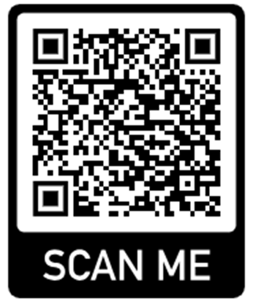
How do I report?
Use our online reporting form: www.uofr.us/padh-report
Call and leave us a detailed voice mail: 585-275-2430
Scan this QR code -------------------------------------------------→
Not sure?
Report anyway. Our team reviews reports regularly,
and we will redirect to the appropriate person or office if necessary.

Slide 16
How does the CRCT address reports?
We analyze each report to determine the appropriate way to address it, including:
Investigation
Alternative resolution
Referral to another policy or process that applies
Closure because it does not allege behavior prohibited by the PADH
However we address a report, we are committed
to protecting confidentiality and maintaining privacy
to the fullest extent possible.
Civil Rights Investigators keep all conversations and evidence confidential within the process
Only the parties (complainant and respondent), and appropriate administrative personnel, are made aware of the outcome of the investigation

Slide 17
Investigation
An investigation typically consists of interviews with the complainant(s), respondent(s), and witnesses, as well as the collection of documents.
All interviewees have the option to bring a support person.
The investigation may conclude with:
an investigation report sent to a decision-making panel;
referral for an alternative resolution;
referral to another policy or process; or
closure of the report with no further action

Slide 18
Alternative Resolution
The PADH permits and encourages alternative resolution of a report when it is most efficient and effective to address without a full investigation and decision-making process.
An alternative resolution will be tailored to the specific circumstances and may include referral to Human Resources, mediation, education, training, and/or restorative practices.

Slide 19
Referral to another policy/process
When a report and/or investigation does not raise PADH concerns, but includes issues that should be addressed in some way, we will refer for action under a more applicable policy or process. Examples of what doesn’t fall within the PADH:
Interpersonal conflicts
Political differences
Professionalism concerns
Reports involving profanity or name calling not related to a protected characteristic
Alleged unfair treatment on the basis of union membership
Issues of nepotism
Policies that could apply are: Workplace Values Policy (Policy 100), Grievance Procedure (Policy 160), and Corrective Discipline Policy (Policy 154)

Slide 20
Can I get support during the PADH process?
The CRCT can recommend interim measures during the investigation, which may include:
placing persons on temporary leaves of absence
exclusion from programs and/or facilities
altering working, learning, patient care or living arrangements
Can a department take action on its own before or after reporting?
Discuss with CRCT first, when possible
“Business as usual”

Slide 21
Other support options during the PADH process
Employees have access to the following internal confidential resources:
Employee Assistance Program (EAP)
University Chaplains
University Ombuds

Slide 22
Example PADH Matters
These matters have been anonymized for the purpose of this presentation.
Names, gender identifying information, roles, and departments have been removed.
Outcomes of PADH investigations are highly fact-specific. There is no guarantee that similar allegations will lead to the same outcome.

Slide 23
Example Matter #1
Report: During an argument related to a patient incident, a coworker pushed complainant back down into their chair and blocked them from leaving.
Analysis: No protected class alleged, not related to the PADH, interpersonal/professionalism issue.
Resolution/Outcome: Referred to HR to address professionalism issues. Written warning and mandatory training for Respondent.

Slide 24
Example Matter #2
Report: Third-party reported on behalf of someone else regarding an alleged race-based comment/joke made to a coworker.
Analysis: While the comment/joke was clearly related to a protected characteristic (race/ethnicity/color), the allegation contained a single comment initially without context from either party. Both parties acknowledged that the comment was made but agreed that it was in a joking manner between the two of them.
Resolution/Outcome: Single comment, “joking” between the parties. Referred to HR to address from a professionalism standpoint. HR issued final written warning to respondent as next step in progressive discipline initiated due to previous conduct.

Slide 25
Example Matter #3
Report: Over a year of respondent making unwelcome comments and “jokes” related to race, ethnicity, sex, and religion (e.g. jokes about a colleague's turban, slavery, r*pe, undesirable places in the city, mocking accents, pornography, etc.).
Analysis: Investigation gathered information from eight witnesses and multiple complainants supporting that the comments/jokes were made and were unwelcome. Investigative Report was sent to a decision-making panel.
Resolution/Outcome: Panel determination found PADH violations which resulted in termination from employment.

Slide 26
Example Matter #4
Report: Gender-based comments towards complainant and complainant feeling forced off a team due to their gender.
Analysis: Investigation gathered information supporting that the gender-based comments were made. Information also provided context that some of the gender-based comments were related to the specific area of medical care, whereby some patients requested providers of a specific gender. Investigative Report sent to decision-making panel.
Resolution/Outcome: Panel determination directed a written warning to be placed in personnel file and additional training on workplace discrimination.

