Slide 1

Intro to UCC
Michael Siembor, pHD
Michael.siembor@rochester.edu

Slide 2

UCC Services
Available to all full-time students (and partners) who have paid the mandatory student health fee
Health insurance is separate – required for all students, may or may not be student health insurance. Health insurance is NOT used at UCC.

Slide 3
24/7 emergency mental health response
Same day appointments during business hours
After hours on-call via phone with UCC therapist
After hours in person response by Counselors in Residence(CIRs), including with all DPS after hours mental health responses
TELUS Health offers on demand support in five languages and via text or phone

Slide 4
Initial Assessments
All students have access to one each academic year (8/1-7/31)
Explore current concerns, history of treatment, etc.
Create a treatment that plan that may include:
Short term therapy at UCC (averages 6-8 sessions)
Help with referral off campus for longer term or specialized care
Medication referral (three psychiatry providers)
Group therapy – 15 groups on average each semester
Connection to other campus supports

Slide 5
2024-2025 Stats
1500 UR students received some sort of care from UCC (that’s 15% of full-time students!)
162 students joined 16 therapy groups
UCC therapists provided after hours crisis support 135 times, both in person and over the phone
95% of students reported being mostly or very satisfied with their visit(s) to UCC
UCC staff provided more than 181 hours of outreach programming to the university community

Slide 6

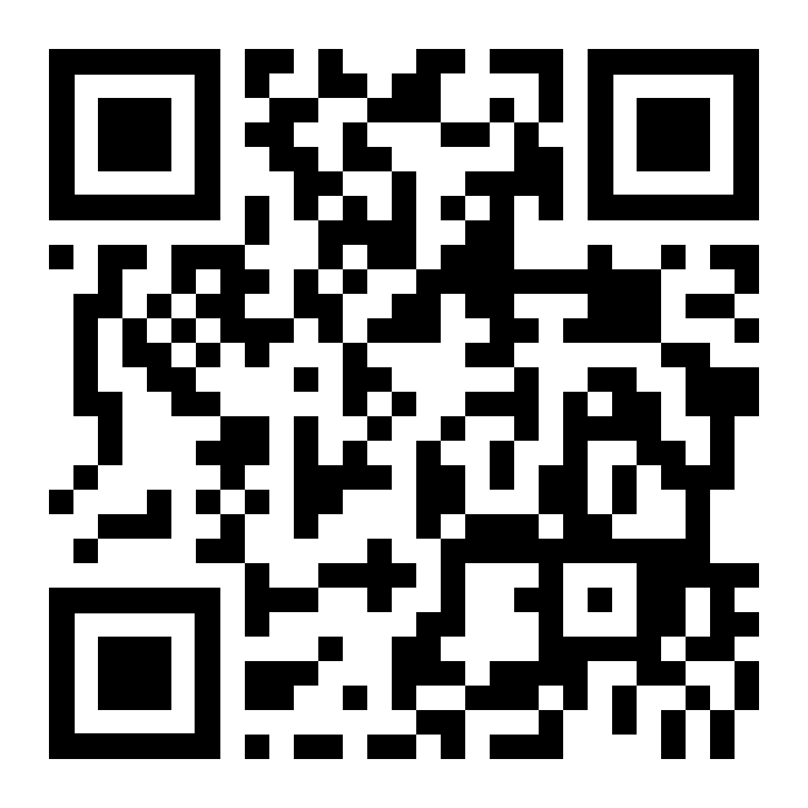
CONTACT US
585-275-3113
Download TELUS
Follow us on Instagram

