Slide 1

myHub Overview New Trainee Orientation 2025 Amber Rivera, MSW Director of Learner Life/Wellness Elaine M. Smolock, Ph.D. Director of Writing Services and Training Grant Development and PREP Co-Director Eric Vaughn, M.Ed. Director of Career Services
Notes:
Elaine & Eric

Slide 2
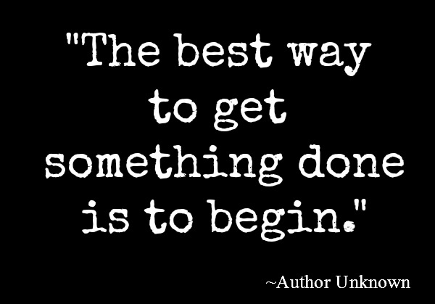
Notes:
Elaine

Slide 3
Writing & Grant Assistance
Elaine M. Smolock, Ph.D.
Director of Writing Services and Training Grant Development
myHub
Graduate Education and Postdoctoral Affairs
Notes:
Elaine

Slide 4
What is myHub?
myHub assists in supplementing every trainee's scientific education with the wellness, writing, grant support, professional and career development opportunities most appropriate to each individual trainee’s interests and skills.
The 8 spokes of myHub include….
Alumni
Mentorship Support
Fellowships & Grants
Learner Life/Wellness
Student & Postdoc Groups
Career Services
Internships
Writing Services
Notes:
Elaine

Slide 5
Self-Determination Theory (SDT)
Three key components of SDT…
Competence: People need to gain mastery of tasks and learn different skills.
Connection or Relatedness: People need to experience a sense of belonging and attachment to other people.
Autonomy: People need to feel in control of their own behaviors and goals.
myHub utilizes SDT in all the work we do and encourage our trainees to help us develop programming and connections that will impact their work and goals.
Notes:
Elaine
SDT is a theory of human motivation which posits that people are most engaged and self-motivated when they act through internal motivation, and feel autonomous, competent and relationally/socially connected in what they do (i.e., are part of a community) (2). SDT based trainings have resulted in significant improvement in motivation and outcomes in education and in the corporate sector (3-6); moreover, the autonomy support of instructors (mentors) has a profound impact on the career choices of adult students (7, 8). Thus, autonomy-supportive mentoring may not only improve outcomes and productivity of URBEST trainees, but it may also increase their willingness to explore more diverse career choices.

Slide 6
Goal of the Writing Assistance Resource
The primary goal is to improve your writing by discussing your research and providing tools to develop your fundamental writing skills.
The resource is intended to be a learning experience where you can learn skills related to:
Organization, Logic, Structure, Communication and presentation
*This is NOT a copy editing or re-writing service!*

Slide 7


Writing Assistance is Offered in:
Individual sessions providing detailed discussions about your writing project(s)
Workshops & group-based learning experiences to encourage and promote writing development
Notes:
Elaine

Slide 8
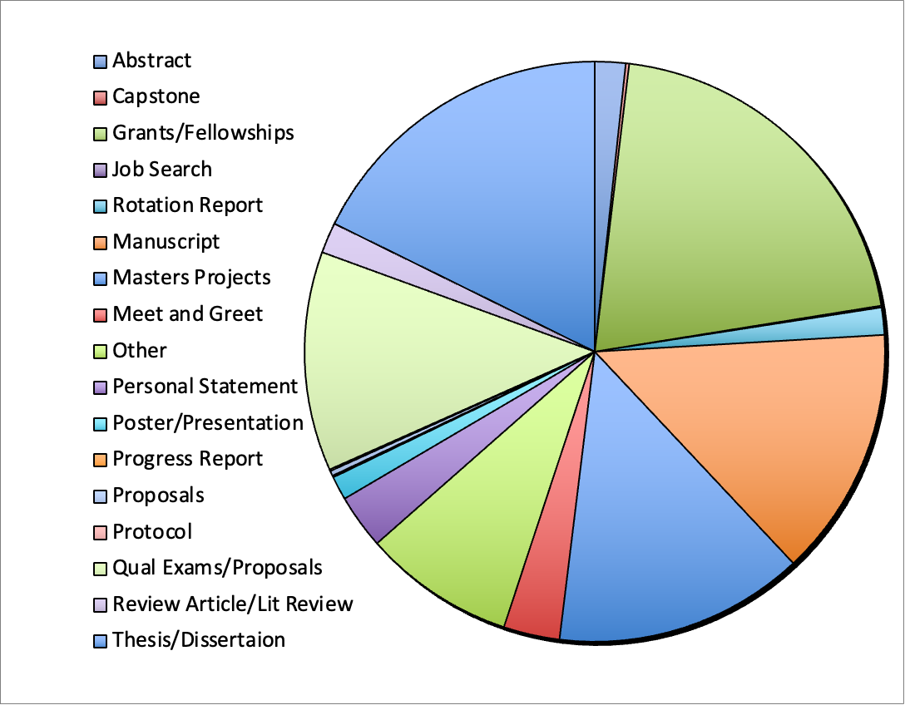
The Wheel of Writing Assistance
>210
I have worked on
~1100
writing projects with our trainees
>145
>145
>125
>180
Notes:
Elaine

Slide 9
Best ways to improve your writing in graduate school:
Get Started! – You can NEVER start too early – WRITE Now!
Accountability – Create a plan and stick to it
Space/Time – Find your happy writing place and use designated time
Read – The more you read, the better you will write
Organize – Start creating literature databases NOW (visit Miner Library for help)

Slide 10
Workshops and Social Content to be on the lookout for:
NIH F-Series Grant Writing Sessions and Writing Clubs (3x per year)
Thesis Writing
Manuscript Writing
Qualifying Exam Preparation
Writing Retreats

Slide 11
Career & Internship/Shadowing Experience
Eric Vaughn, M.Ed.
Director of Career Services
myHub
Graduate Education and Postdoctoral Affairs

Slide 12
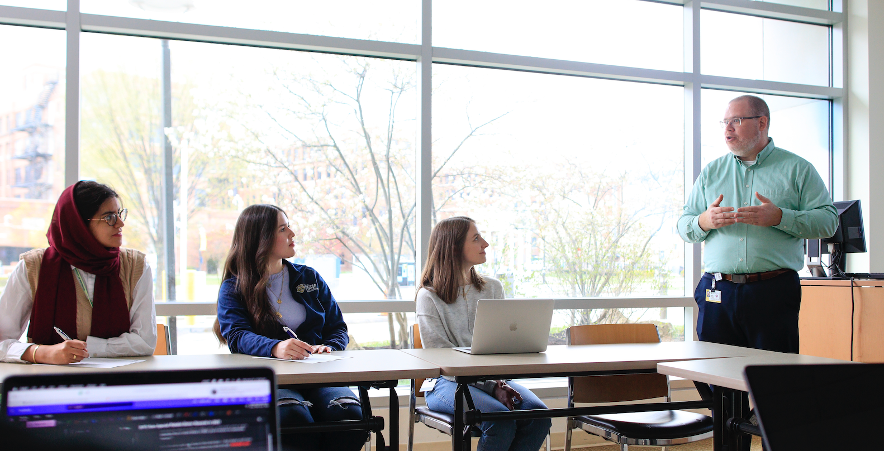
Goal of myHub Career Services & Internships
As the myHub Career Coach, I want to help you with…
exploring careers
advancing your professional development skills
discovering your post-graduate next steps.
Notes:
Elaine

Slide 13
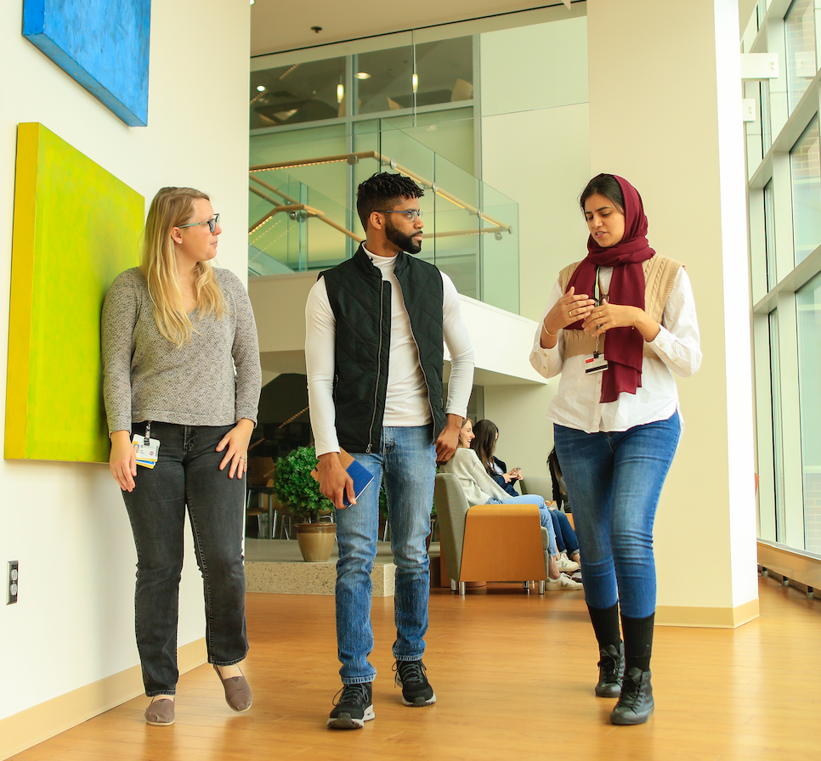
Explore options while you are here….
Who knows what they want to do after receiving their graduate degree?
On average, how many hours will you work within your lifetime?
myHub offers 1:1 appointments, interactive workshops, experiential learning opportunities, networking opportunities, and much more
~90,000 hours = 11,250 days
Notes:
Eric Vaughn

Slide 14
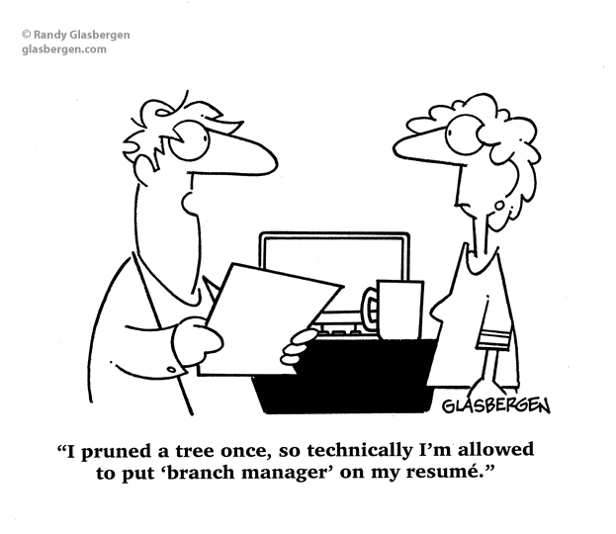
Career Services
I can assist you with your…
Academic & Career Goals Development
CV/Resume & Cover Letter Writing
Career exploration & Job search strategy
Marketing plans (LinkedIn)
Internship/Job Interview prep
Networking strategy & development (Alumni, Social Media)
Teaching opportunities and teaching recognition programs

Slide 15

Experiential Learning & Internship Experiences. ---Funding
Funding for unpaid internships
Assistance with travel and lodging costs for internships
Job Shadowing & Exploration Mini Grants through the myHub Career Exploration Modules
Notes:
Eric

Slide 16
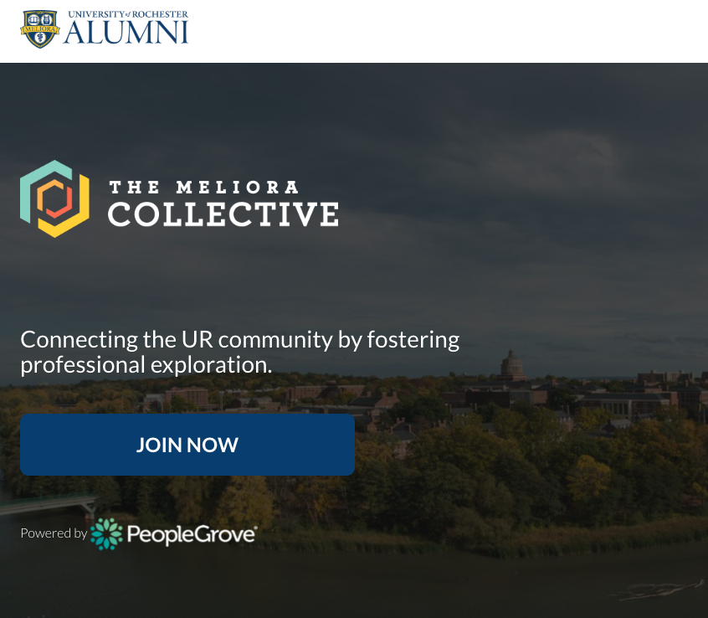
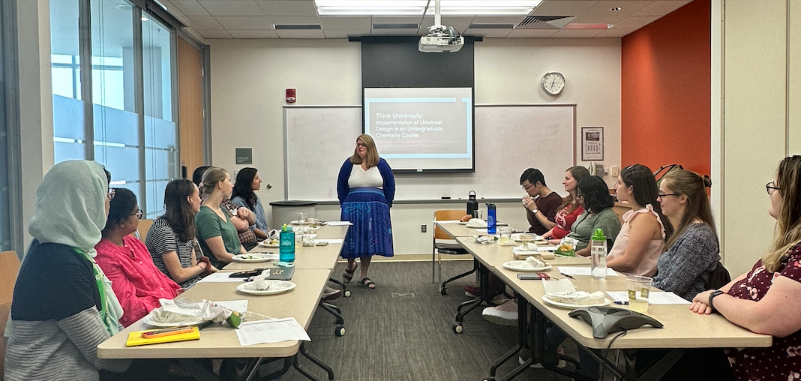
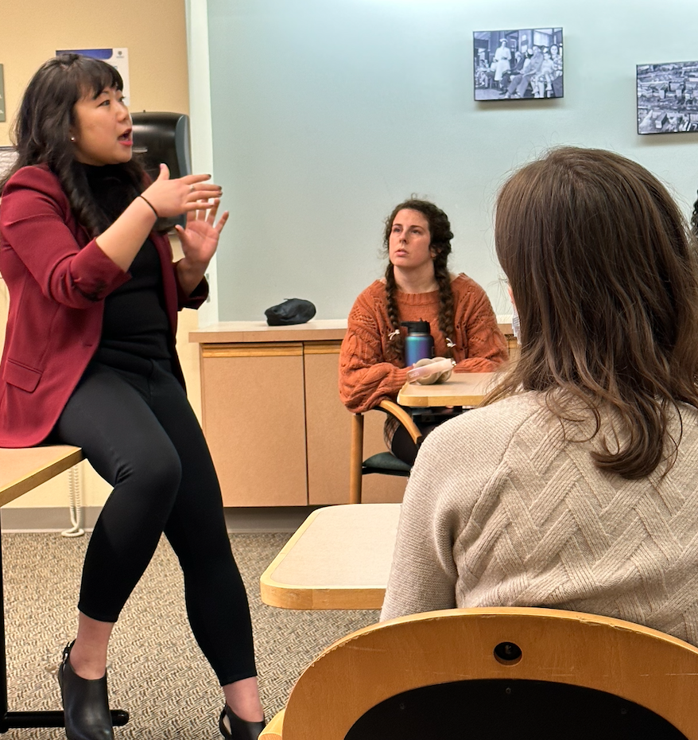
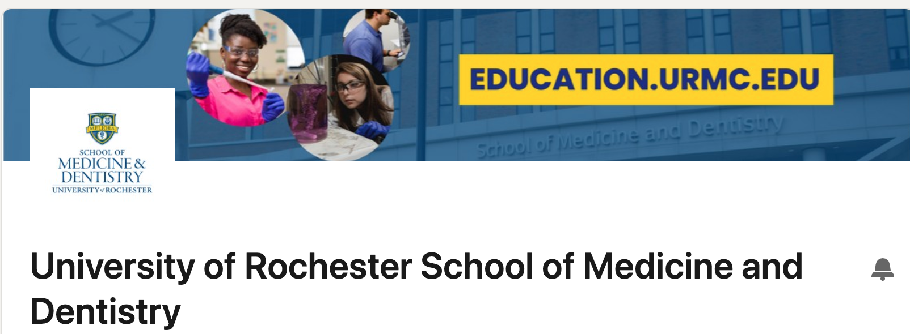

Alumni Community
Notes:
Eric

Slide 17
IND 439: Leadership & Management for Scientists
Topics and Instructors include:
Building Your Support Network
Time Management
Wellness
Managing People
Communicating and Resolving Conflict as a Leader
Teamwork and Collaboration
Strategic Planning
Negotiating
Budgeting
Cultural Humility
Project Management
Interviewing: Selecting Teams
StrengthsFinder
Notes:
Eric
Topics include….
Managing People
Strategic Planning
Cultural Humility
Overseeing Resources Effectively
Mindfulness Coaching- Sabrina Vogler, CPC, CEC, CGSS

Slide 18
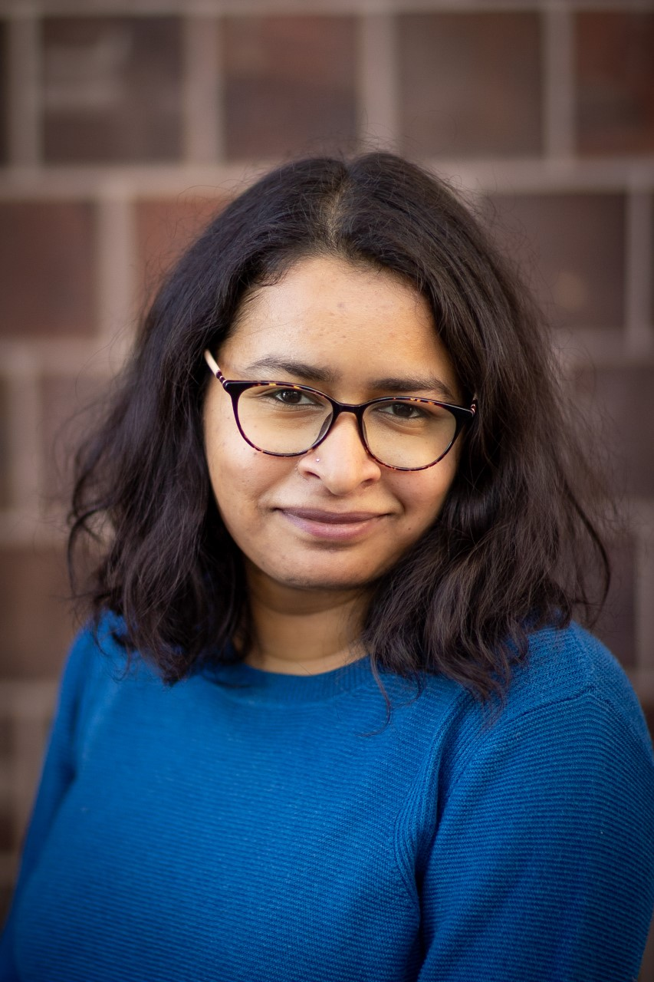
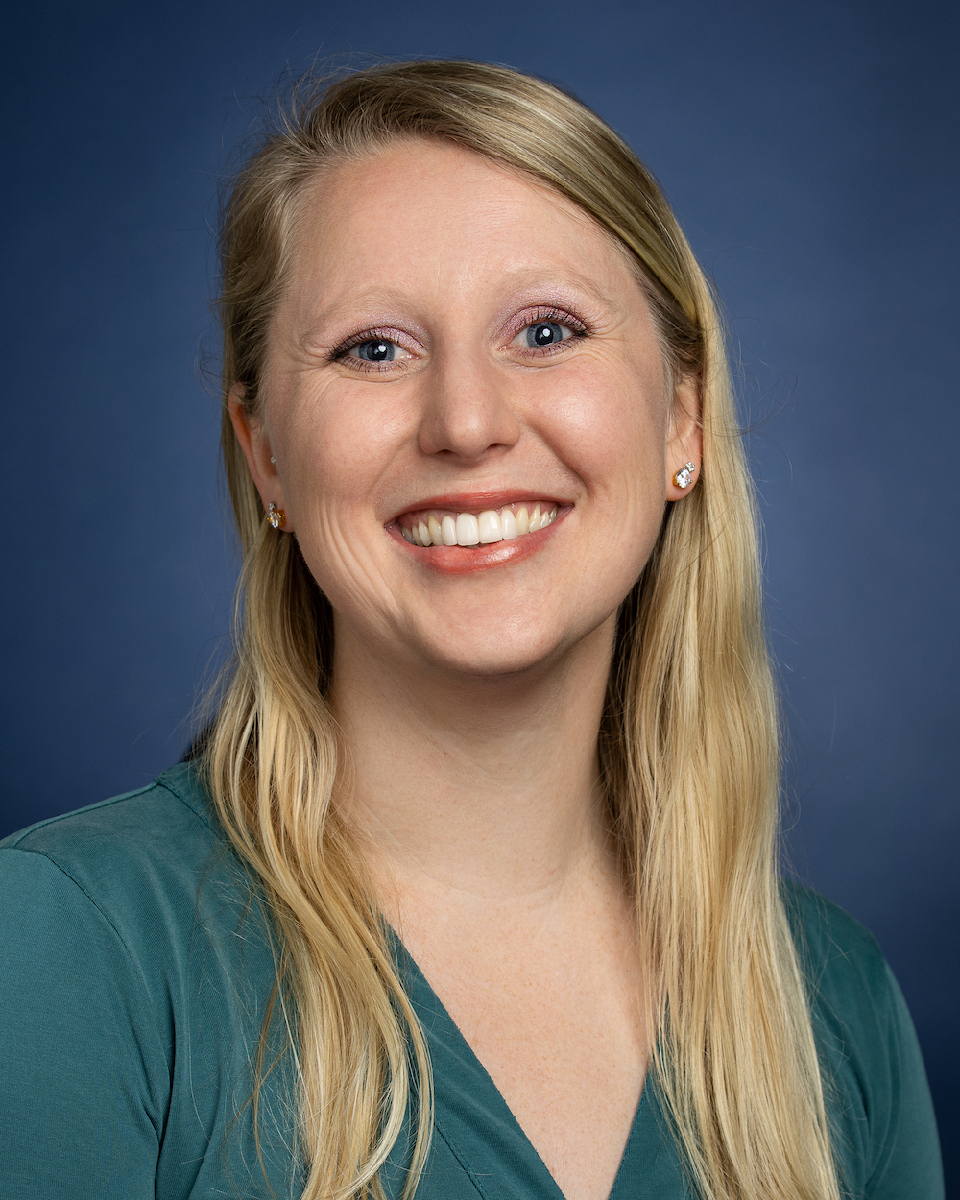
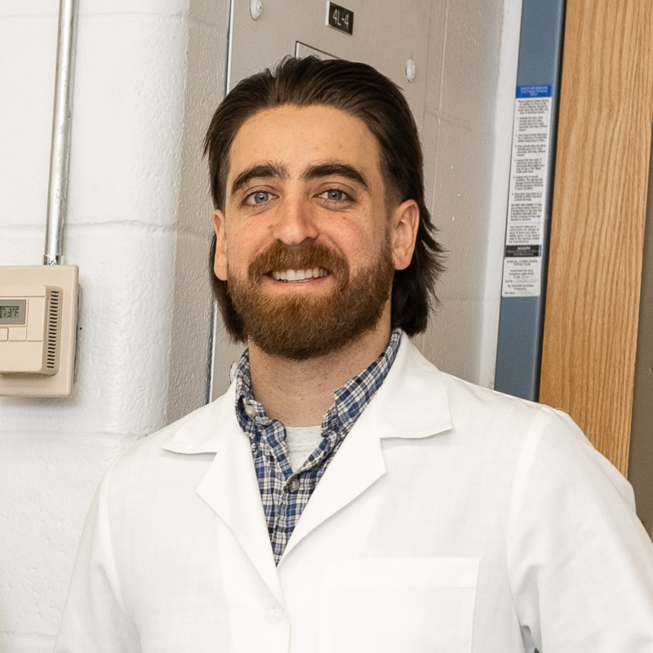
Leadership & Management for Scientists Testimonials
Tori Popov, Ph.D. Trainee from Neuroscience
A critical skill I learned and gained through course was informational interviewing and developing more in-depth and comprehensive questions to gain the knowledge and personal experiences I was seeking.
Gayathri Guru Murthy, Ph.D. Trainee from Translational Biomedical Science
This course was the missing puzzle piece that helped me become an improved leader. You learn how to be a bridge yourself. This course gave me several new tools to use when it comes to leadership and also helped me assess myself and hone my management skills.
Makenna Cealie, Ph.D. Trainee from Neuroscience
Enjoyed identifying my strengths and comparing them to others to form a more cohesive team. After taking this course, I'm better at managing conflict and understanding others' perspectives.
Ian Krout, Ph.D., Alumni from Toxicology
Used the techniques discussed in this class including, informal interviews, cold emails, negotiating and budgeting to secure a postdoctoral position in a lab I had aspired to join during my tenure as a graduate student.
Notes:
Eric
Topics include….
Managing People
Strategic Planning
Cultural Humility
Overseeing Resources Effectively
Mindfulness Coaching- Sabrina Vogler, CPC, CEC, CGSS

Slide 19
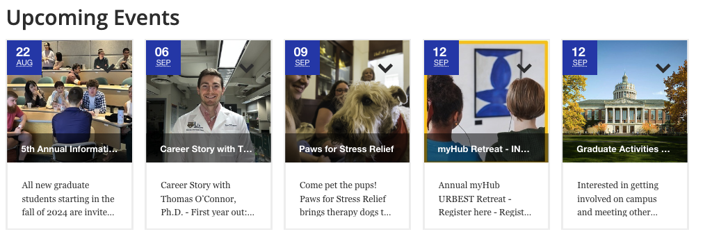
myHub & GEPA Upcoming Events
Alumni Career Stories
Certificate Programs
Career Exploration Workshops
Self-Paced Career Modules
Networking Events
Social Events
Grant & Writing Events
Wellness Events
Visit myHub.URMC.Edu for full details- Upcoming Seminars, Career Stories, and Workshops
Notes:
Eric

Slide 20
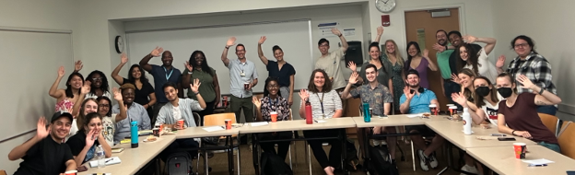
Become Active in an SMD Trainee Group
Alliance for Diversity in Science and Engineering (ADSE)
Graduate Students of Color (GSOC)
Graduate Students Raising Families (GSRF)
Graduate Student Society (GSS)
Graduate Women in Science (GWIS)
National Postdoctoral Association (NPA) membership
outGRADS
The Society for Advancement of Chicanos/Hispanics and Native Americans (SACNAS)
SMD Ambassadors
SMD Entrepreneurs
UR Postdoctoral Association (PDA)
UR Thinkers
UR Writing
Notes:
Eric

Slide 21

Q & A and Quotes to think about
“Planning is bringing the future into the present so that you can do something about it now.” ― Alan Lakein, author
“A clear vision, backed by definite plans, gives you a tremendous feeling of confidence and personal power.” ― Brian Tracy, author and motivational speaker
“Plan your next move because every step contributes towards your goal.” ― Sukant Ratnakar, author and motivational speaker
Notes:
Elaine

Slide 22
Learner Life and Wellness
Amber Rivera, MSW
Director of Learner Life & Wellness
myHub
Graduate Education and Postdoctoral Affairs

Slide 23
Learner Life and Wellness Services
Available to all SMD graduate students and postdocs.
Learner Support & Wellness – Discuss how SMD GEPA can support your educational journey, personal development, and personal wellness.
Counseling – Preliminary and short-term counseling in response to a personal concern. Everyone has the capacity for growth; sometimes we need a space to explore thoughts and feelings, and discover strength, wisdom, and grace within. All discussions will be held in confidentiality.
CARE Network – Discuss CARE Network referrals. Whether you have been referred for support through the CARE Network, are considering making a self-referral, or a referral concerning someone else, you can safely discuss the CARE Network’s role in addressing concerns.

Slide 24
Learner Life and Wellness Services
Available to all SMD graduate students and postdocs.
Access to University Support Services – The School of Medicine and Dentistry graduate and postdoctoral experiences are unique, and the University offers a variety of resources to help you be successful on your own path. Discuss ways to connect and receive support.
Trainee Group Advising – Discuss leadership development, program planning, group development concerns, and learner needs for your Trainee Group.
Wellness Programs and Initiatives – Meet and greet to discuss wellness topics that are of interest to you and other graduate and postdoctoral learners. Suggest your ideas for wellness programs and initiatives that address challenges commonly faced by SMD graduate students and postdocs.

Slide 25
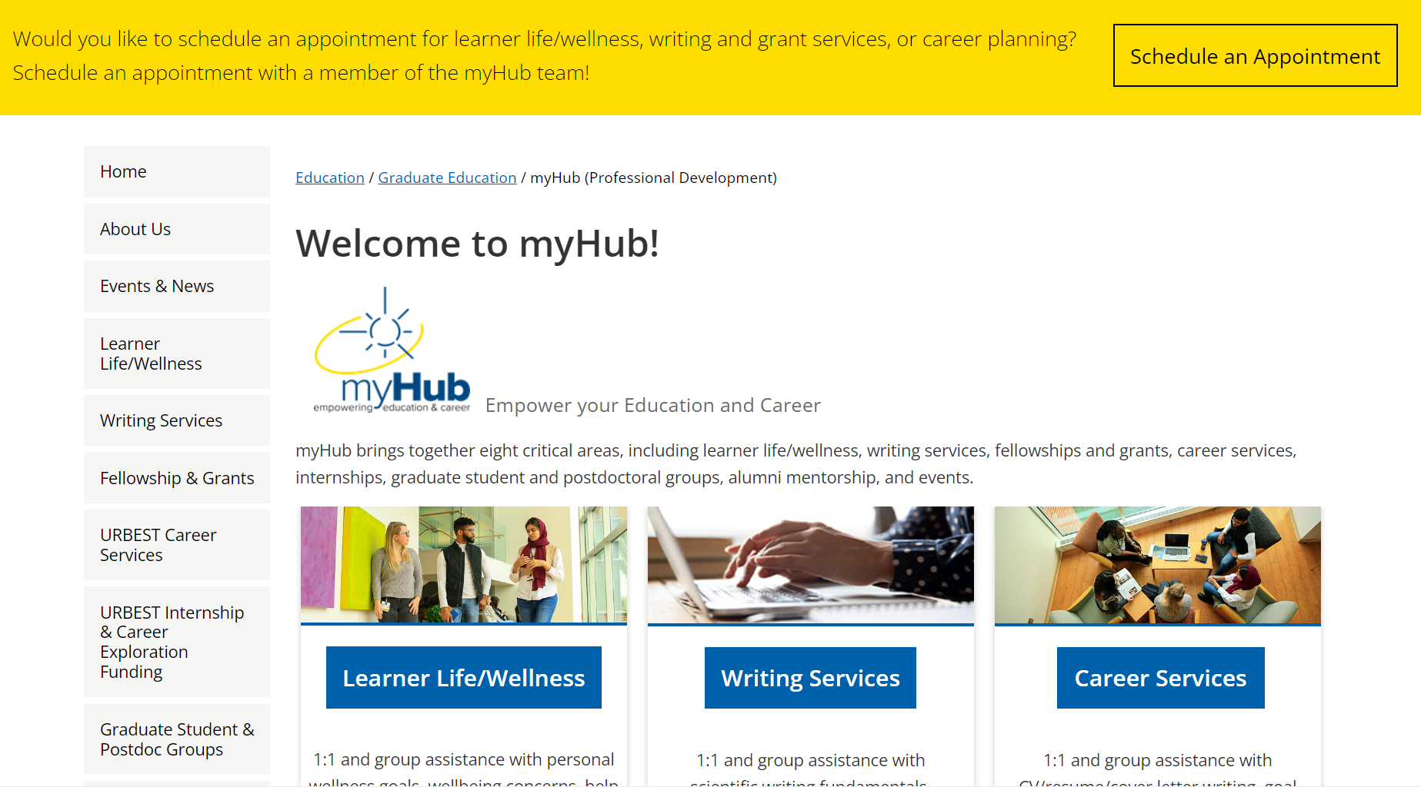
Schedule an appointment for Learner Life/Wellness on myHub

Slide 26

We Use Handshake --- Schedule an appointment with us!
Register for 1:1 appointments with Amber, Elaine, & Eric
Schedule of myHub Events & Register for Events
Explore internship & job postings
Notes:
Eric

Slide 27
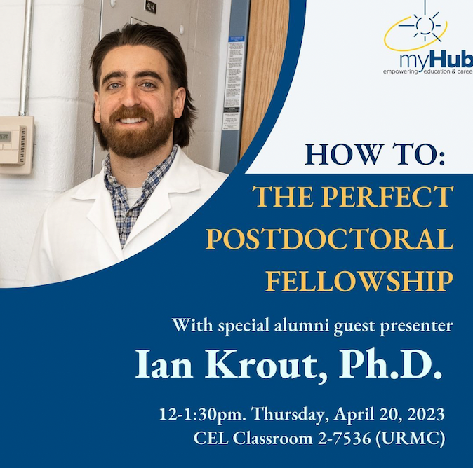
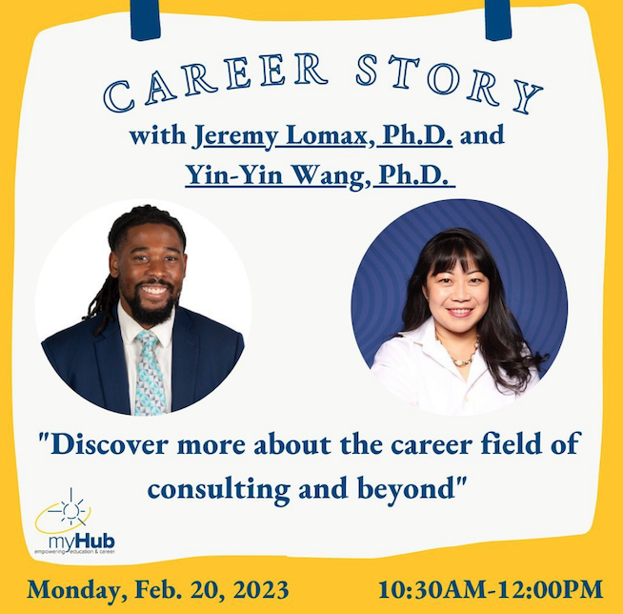
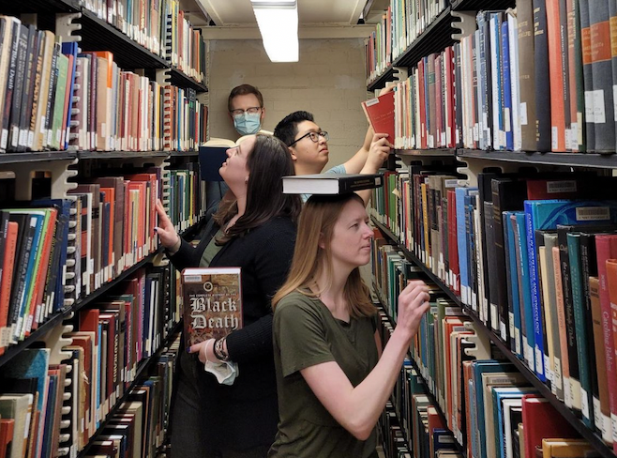
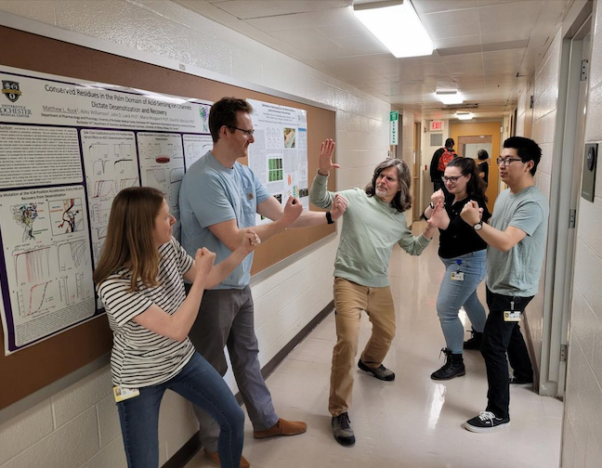
Connect with us on Instagram ursmd_myHub
Notes:
Eric

Slide 28
Contact Information
Writing Services
Elaine Smolock, Ph.D.
Director of Writing Services
Elaine_Smolock@URMC.Rochester.edu
linkedin.com/in/elaine-smolock/
Career Services
Eric Vaughn, M.Ed.
Director of Career Services
Eric_Vaughn@URMC.Rochester.edu
linkedin.com/in/ervaughn/
Learner Life & Wellness
Amber Rivera, MSW
Director of Learner Life & Wellness
Amber_Rivera@URMC.Rochester.edu
linkedin.com/in/amberriverallw

