Slide 1
WELCOME to Graduate School
Rick Libby, Ph.D.
Professor of Ophthalmology
Senior Associate Dean of Graduate Education and Postdoctoral Affairs

Slide 2
Who GEPA serves
Service Department at its core
  University, integrity of degree
  Scientific mission
  Programs
  T and F grants
  Students & Postdocs
    HR
    Education
    Career development
    Student life and student welfare
Provide a learning environment where trainees can develop the skills necessary to succeed in their chosen career paths.

Slide 3
Orientation Resources
https://www.urmc.rochester.edu/education/graduate/incoming-graduate-student-orientation.aspx
Student Handbook
  GEPAs
  Individual programs
University GEPA
  https://www.rochester.edu/college/gradstudies/current/policies/index.html

Slide 4
Incoming Class
Certificate, Masters, Doctoral Programs
  9, 15, 12
139 incoming students
  19, 51, 69
Range of Disciplines
  Epidemiology to Genetics to MFT
Diverse Student Population
  15 countries
Average Age 25

Slide 5
Core Tenets of Graduate Education
AAMC
  Institutional Commitment
  Program Commitment
  Quality Mentoring
  Provision of Skill Sets and Counseling
URMC
  Formal classroom education
  An apprenticeship
  Student support
  Career preparation

Slide 6
Goals to Accomplish in your First Year
Complete classes, successfully (grades)
Complete 3 rotations with a satisfactory score (basic science PhDs)
Find a research “home” or thesis project (where applicable)
Build your skill base

Slide 7
Balancing it all in Graduate School
Classes
Rotations
Family obligations
Social interactions
Health and wellness
Career development

Slide 8
People are here to help
(personally, professionally and experimentally)
GEPA
  Sharon McCullough, Director of GEPA
  Kandice King, Director of Enrollment
  Tracy Pezzimenti, Registrar
  myHub
    Eric
    Elaine
  Entire GEPA staff

Slide 9
People are here to help
(personally, professionally and experimentally)
Program Directors
Faculty (thesis committee)
Department Chairs and Center Directors
Other trainees
Program Coordinators

Slide 10
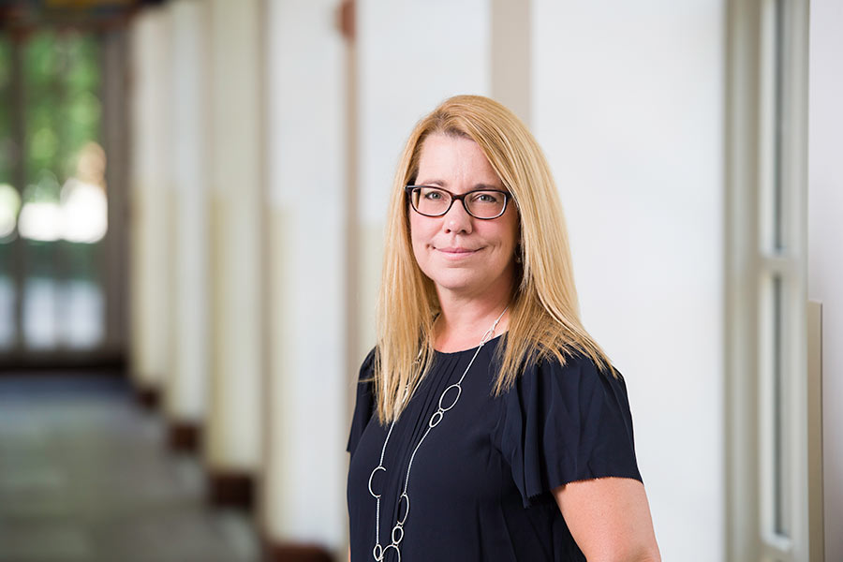
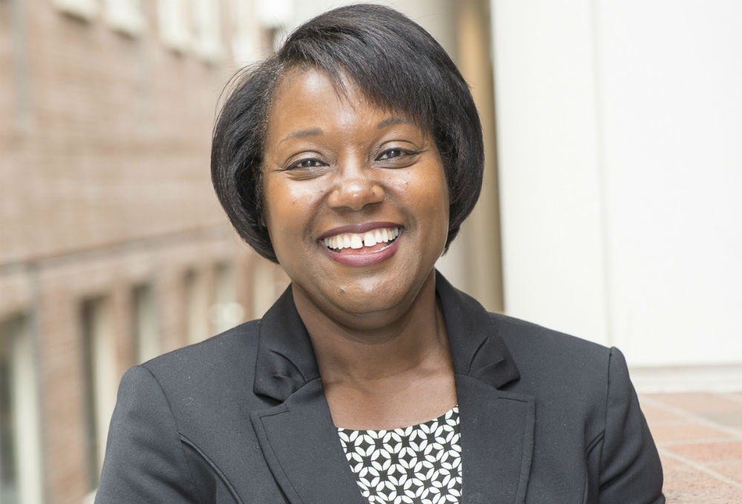
People are here to help
(personally, professionally and experimentally)
Adrienne Morgan PhD
Sr. Assoc. Dean for Equity and Inclusion (URMC) &
Vice Pres. for Equity and Inclusion (UofR)
Melissa Sturge Apple PhD
Vice Provost
Graduate Dean
UofR

Slide 11
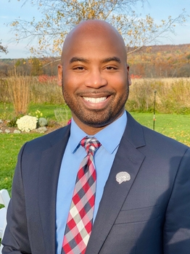
Why URMC: Student Support
To be hired/announced
Associate Dean
for Mentor Development
Associate Dean
Equity & Inclusion, R & RE
Chief Wellness Officer
Nathan A. Smith, Ph.D. (’13)
Director of Student Life

Slide 12
People are here to help
(personally, professionally and experimentally)
CARE Network (support and student concerns)
  https://www.rochester.edu/care/resource-center/
International Services Office (resource for international students)
  http://iso.rochester.edu/
University Counseling Center (UCC; Counseling for students)
  http://www.rochester.edu/uhs/ucc/
University Health Service (UHS; illness)
  http://www.rochester.edu/uhs/
Ombudspersons (confidential, neutral, independent, and informal)
  https://www.urmc.rochester.edu/education/post-doctoral/ombudspersons.aspx
Office of Equity and Inclusion
https://www.urmc.rochester.edu/smd/office-of-equity-and-inclusion.aspx
Office of Disability Resources (ODR; accommodations)
https://www.rochester.edu/college/disability/

Slide 13
People are here to help
(personally, professionally and experimentally)
Policy against discrimination and harassment
  https://www.urmc.rochester.edu/about-us/values-culture/policies-reporting-resources.aspx
Title IX office
  https://www.rochester.edu/sexualmisconduct
General Reporting information
  https://www.urmc.rochester.edu/about-us/values-culture/policies-reporting-resources.aspx

Slide 14
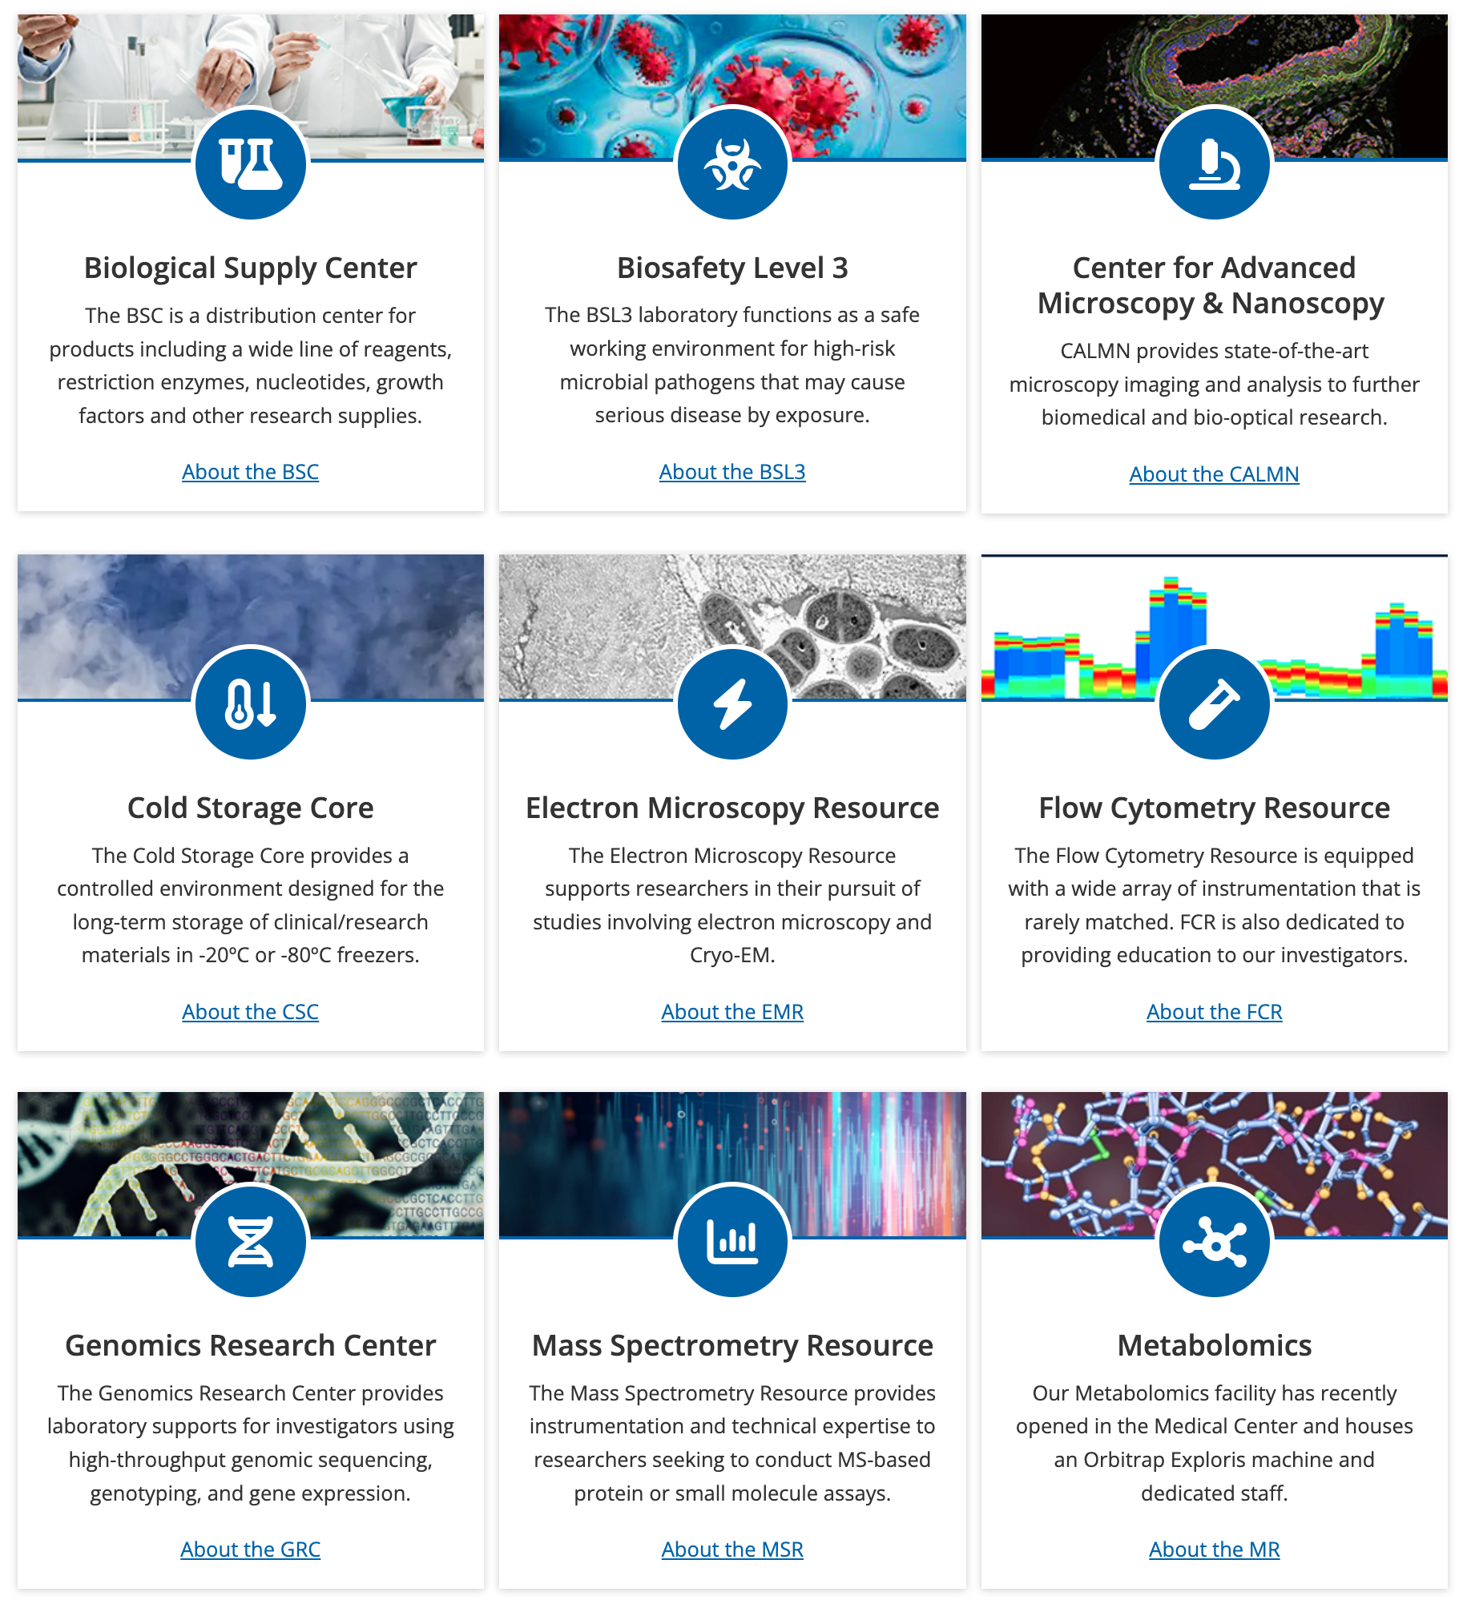
People are here to help
(personally, professionally and experimentally)
Center for Advanced Research Technologies (CORES)

Slide 15

Why URMC, Career Development
8 spokes of myHuB
  Alumni
  Events
  Fellowship & Grants
  Research Ethics
  Student & Postdoc Groups
  URBEST Career Services
  URBEST Internships
  Writing Services
Find a career
Build skills/get experience
Network with our alumni
  Meliora collective
Outcomes
  industry, pharm, postdocs, academics, advocacy, writing, government….

Slide 16
Peer Groups
https://www.urmc.rochester.edu/education/graduate/current-students/graduate-student-society/graduate-student-life.aspx

Slide 17
Peer Groups
ADSE, Alliance for Diversity in Science and Engineering
  to increase the participation of underrepresented groups in academia, industry, and government through graduate student organizations that reach out to students and scientists of all ages and backgrounds.
GWIS, Graduate Women in Science
  to provide mentoring for the professional and personal development of all graduate women at the URMC and ASE.
GSRF, Graduate Students Raising Families
  to find solutions to alleviate the problems that students have while balancing family life and pursuing their degrees.
Spectrum
  to support, educate, and offer targeted resources to the lesbian, gay, bisexual, and transgender community training at URMC
GSS, Graduate Student Society

Slide 18
People are here to help
(personally, professionally and experimentally)
Graduate Student Association

Slide 19
Getting Going
First year good time to stick you toes in the water
  Focus on exploration and skills for your research
  One year Master’s programs, get going!
Explore your career options throughout your time here
Begin to developing your network and connect with fellow trainees and UR alumni: Alumni Group on LinkedIn and The Meliora Collective
Stay connected with what is happening in myHub Opportunities to Explore (OTE)

Slide 20
Individualized Development Plans
Go to: http://myidp.sciencecareers.org/
  Evaluate skills, values, and interests
  Explore and evaluate career opportunities
  Set specific goals for your career path
Discuss with your advisor/mentor
Put your plan in place

Slide 21
Advice for your First Year
Set goals and work to meet them
Seek help when needed
Work with multiple mentors
Be scientifically curious
Make friends/socialize
Learn and make use of new technologies
Become part of the community
Enjoy the process

Slide 22
Choosing a project/mentor!
Perhaps the most important decision you make in grad school and in postdoc
  Oversees the environment you will spend considerable time in
  Responsible for providing most of your scientific training
  Attack questions like your advisor
  In some ways also picking an area of expertise
Can be a great asset for your entire career
Purpose of rotation (where applicable)

Slide 23
Choosing a project/mentor!
Perhaps the most important decision you make in grad school.
What we tend to look for
  Trendy science
  High impact papers
What we should look for
  Good solid science
  Something that we are very interested in
  Good, attentive advisor (and mentor)
  Environment where you think you will thrive
    Big difference between an advisor and a mentor
    2nd and 3rd bullets are not mutually exclusive

Slide 24
Expectations
Expectations of Graduate Students
Expectations of Research Advisors
https://www.urmc.rochester.edu/education/graduate/home/forms.aspx

Slide 25
Expectations
I acknowledge that I have the primary responsibility for the successful completion of my degree.
I will be committed to the education and training of the graduate student.
I will be committed to the research project of the graduate student.

Slide 26
Expectations
I will be knowledgeable of the policies and requirements of my graduate program, graduate school, and institution.
I will comply with all institutional policies, including academic program milestones.
I will be knowledgeable of, and guide the graduate student through, the requirements and deadlines of his/her graduate program as well as those of the institution, including teaching requirements and human resources guidelines.

Slide 27
I will provide for every graduate student under my supervision an environment that is intellectually stimulating, emotionally supportive, safe, and free of harassment.
Throughout the graduate student’s time in my group, I will strive to be supportive, equitable, accessible, encouraging, and respectful.

Slide 28

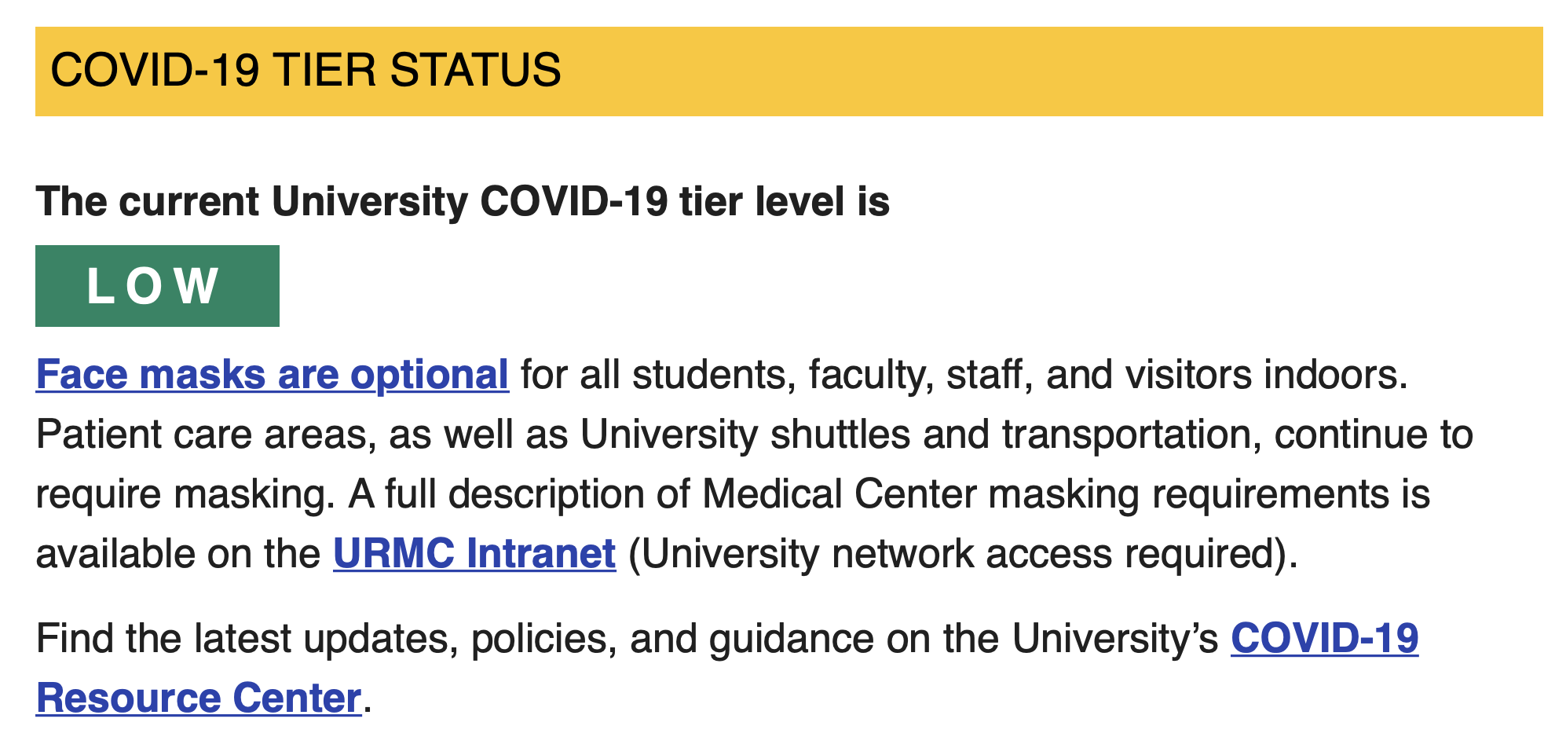
Communications

Slide 29
Communications
https://sites.urmc.rochester.edu/urmc-operations/urmc-redesigned/

Slide 30

ORCID
ORCID is a unique identifier that makes it easier to distinguish, organize, and share your work
Free, researcher controlled and owned
Can use on grant applications and manuscript submissions
Register and complete your profile at orcid.org
Please take a moment to connect to the UR Reporting System, takes less than a minute - orcid.lib.rochester.edu
Need help, contact your librarian or Daniel_Castillo@urmc.Rochester.edu at Miner Library

Slide 31
What we strive for
At the University of Rochester School of Medicine and Dentistry, an environment of respect, inclusiveness and support is of utmost importance for our learners. You will have the opportunity to learn with and from a diverse group of peers, mentors, faculty and staff. We want to know how your experience is going as you pursue your academic goals. The GEPA office is a place to offer you support and resources through your academic career at SMD.

Slide 32
Orientation Resources
https://www.urmc.rochester.edu/education/graduate/incoming-graduate-student-orientation.aspx
Student Handbook
  GEPAs
  Individual programs
University GEPA
  https://www.rochester.edu/college/gradstudies/current/policies/index.html

Slide 33
Questions?
Progress is made by young scientists who carry out experiments that old scientists said wouldn't work. – Frank Westheimer

