Slide 1
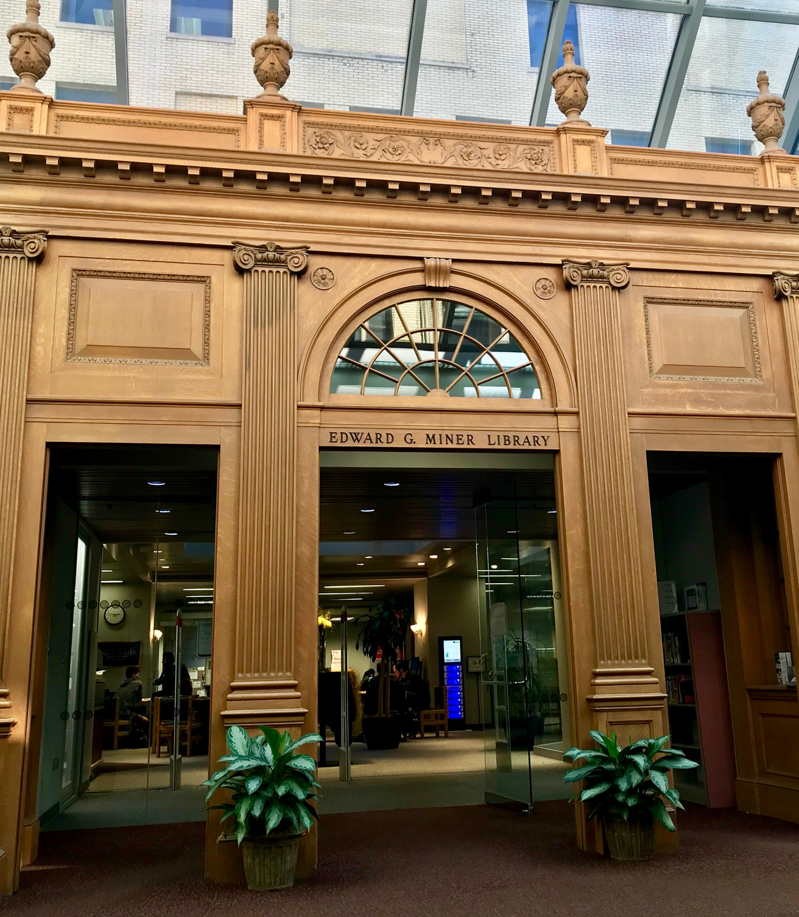
Miner Library Introduction
Darcey Rodriguez, MLIS
Edward G. Miner Library
University of Rochester Medicine

Slide 2
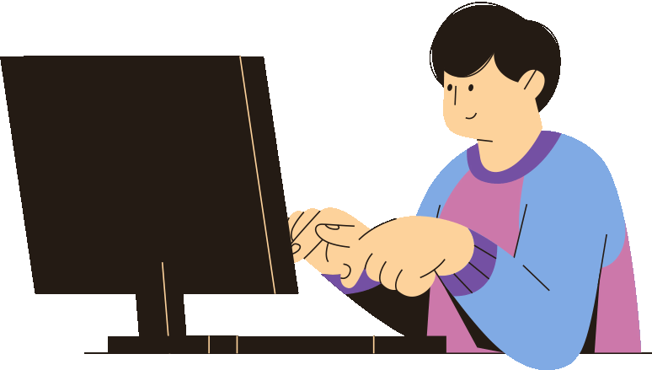
Agenda
  Overview of Miner Library
  Key Resources

Slide 3
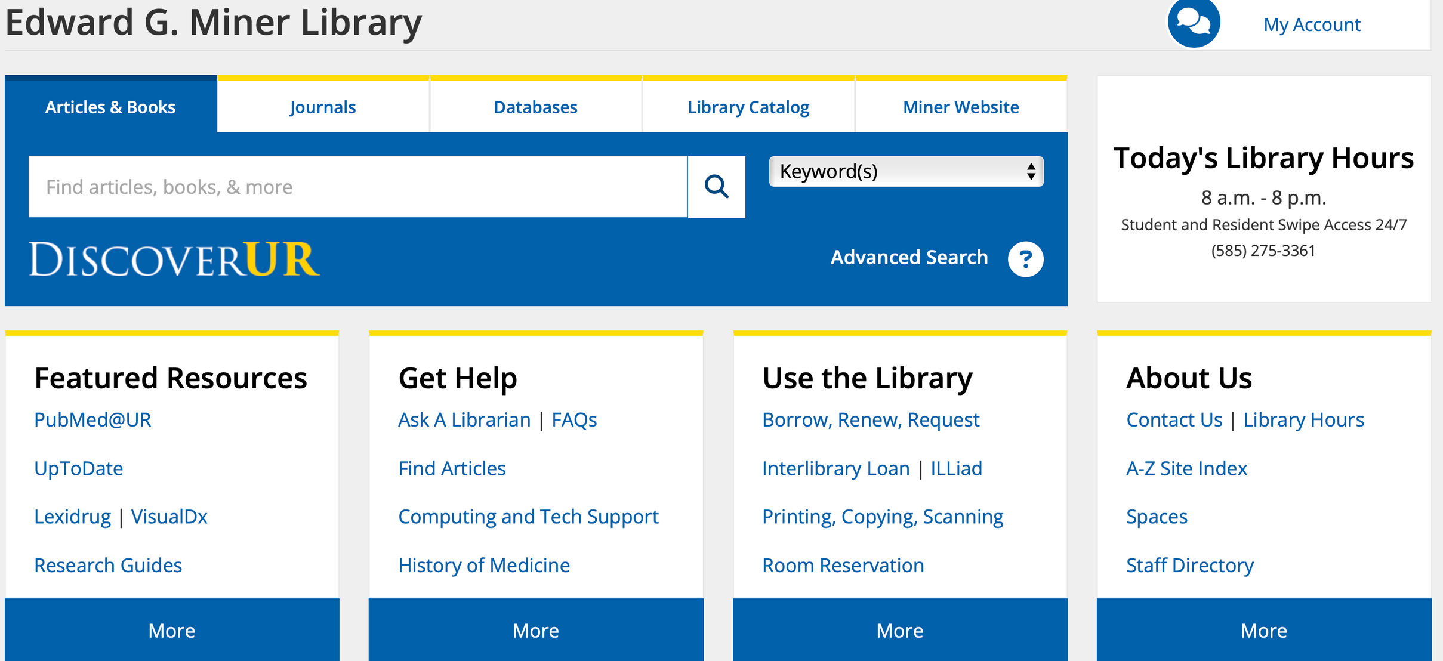
Miner Homepage
Notes:
All searches should start at the Miner Library homepage. You can find the Miner homepage linked directly in Blackboard, the URMC intranet, or a google search for Miner Library. Under the get help section you will find a number of helpful links such as Interlibrary Loan if you need to request an article, the link to book and appointment with me, and a link to our librarian created subject guide where you can find the School of Nursing guide I’ve created.
Under ask a librarian you will find a link to submit a question to our on-call librarian. We have a librarian on-call Monday- Friday from 9 am to 5 pm to help with any questions you might have. You can chat, submit a question, call, or drop in at Miner for help. You will also find a link to book an appointment.

Slide 4
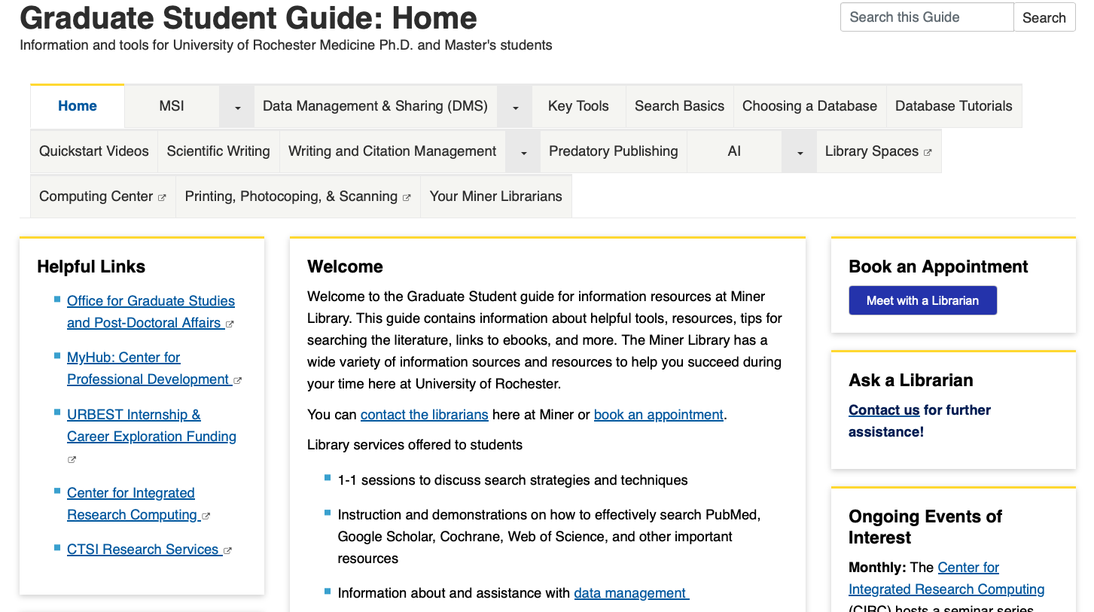
Graduate Student Guide
Notes:
The Graduate Student guide was built to act as a one stop shop for bust students to find resources and support.
This includes Videos on how to search databases like PubMed, instructions on submitting Interlibrary Loan links, information about writing and citing, and more. You will find links to book an appointment with a librarian if you need help, information about library spaces, and more. Take some time and explore this guide.

Slide 5
Miner Homepage
Notes:
All searches should start at the Miner Library homepage. You can find the Miner homepage linked directly in Blackboard, the URMC intranet, or a google search for Miner Library. Under the get help section you will find a number of helpful links such as Interlibrary Loan if you need to request an article, the link to book and appointment with me, and a link to our librarian created subject guide where you can find the School of Nursing guide I’ve created.
Under ask a librarian you will find a link to submit a question to our on-call librarian. We have a librarian on-call Monday- Friday from 9 am to 5 pm to help with any questions you might have. You can chat, submit a question, call, or drop in at Miner for help. You will also find a link to book an appointment.

Slide 6
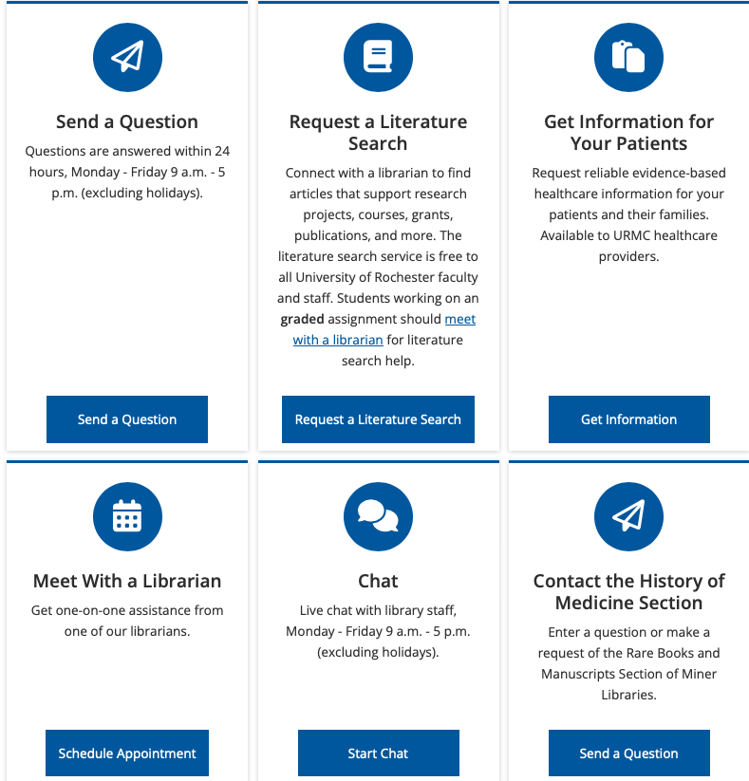
Ask a Librarian
Notes:
Ask a Librarian gives you a few different ways to get in touch with us! Submit a question, chat, or schedule an appointment with an available librarian. Literature search requests are reserved for faculty and staff.

Slide 7
Miner Homepage
Notes:
All searches should start at the Miner Library homepage. You can find the Miner homepage linked directly in Blackboard, the URMC intranet, or a google search for Miner Library. Under the get help section you will find a number of helpful links such as Interlibrary Loan if you need to request an article, the link to book and appointment with me, and a link to our librarian created subject guide where you can find the School of Nursing guide I’ve created.
Under ask a librarian you will find a link to submit a question to our on-call librarian. We have a librarian on-call Monday- Friday from 9 am to 5 pm to help with any questions you might have. You can chat, submit a question, call, or drop in at Miner for help. You will also find a link to book an appointment.

Slide 8
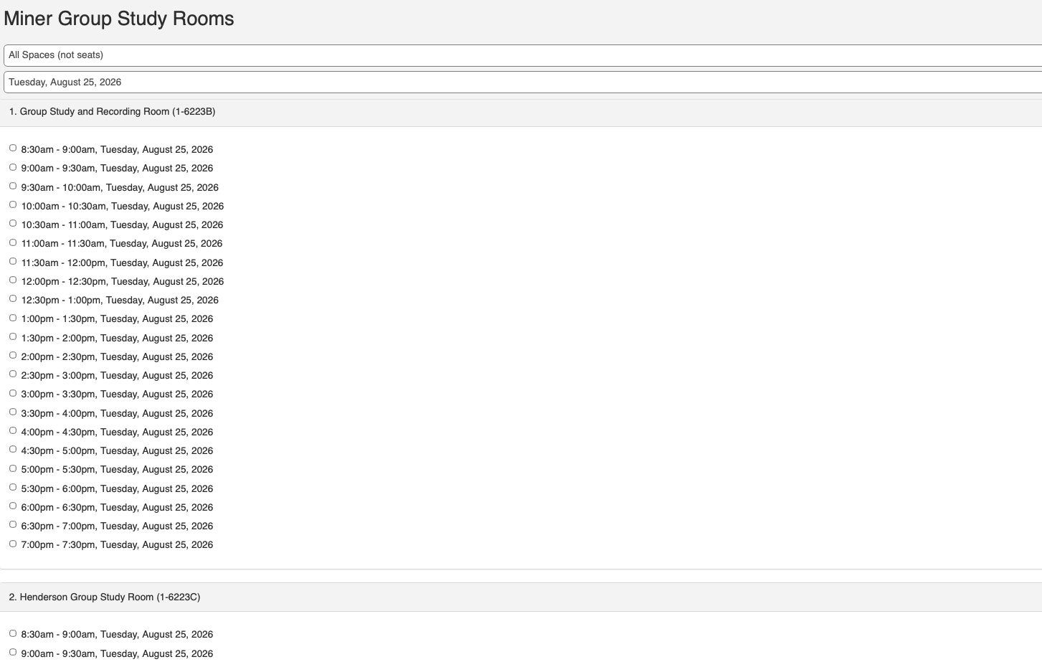
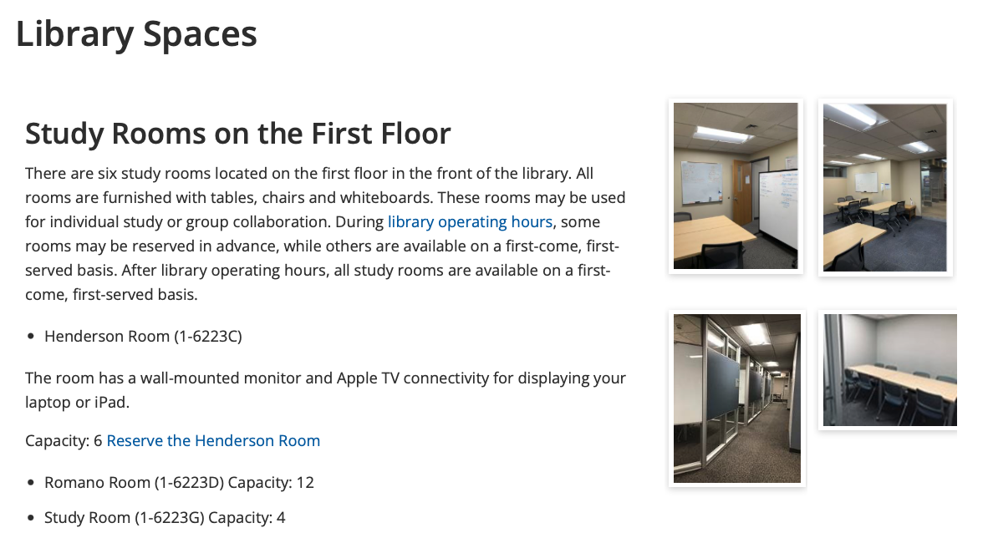
Room Reservations
Notes:
Reserving a room allows you to reserve a space in Miner Library ahead of time. You can learn more about the available rooms to reserve in Miner Library

Slide 9
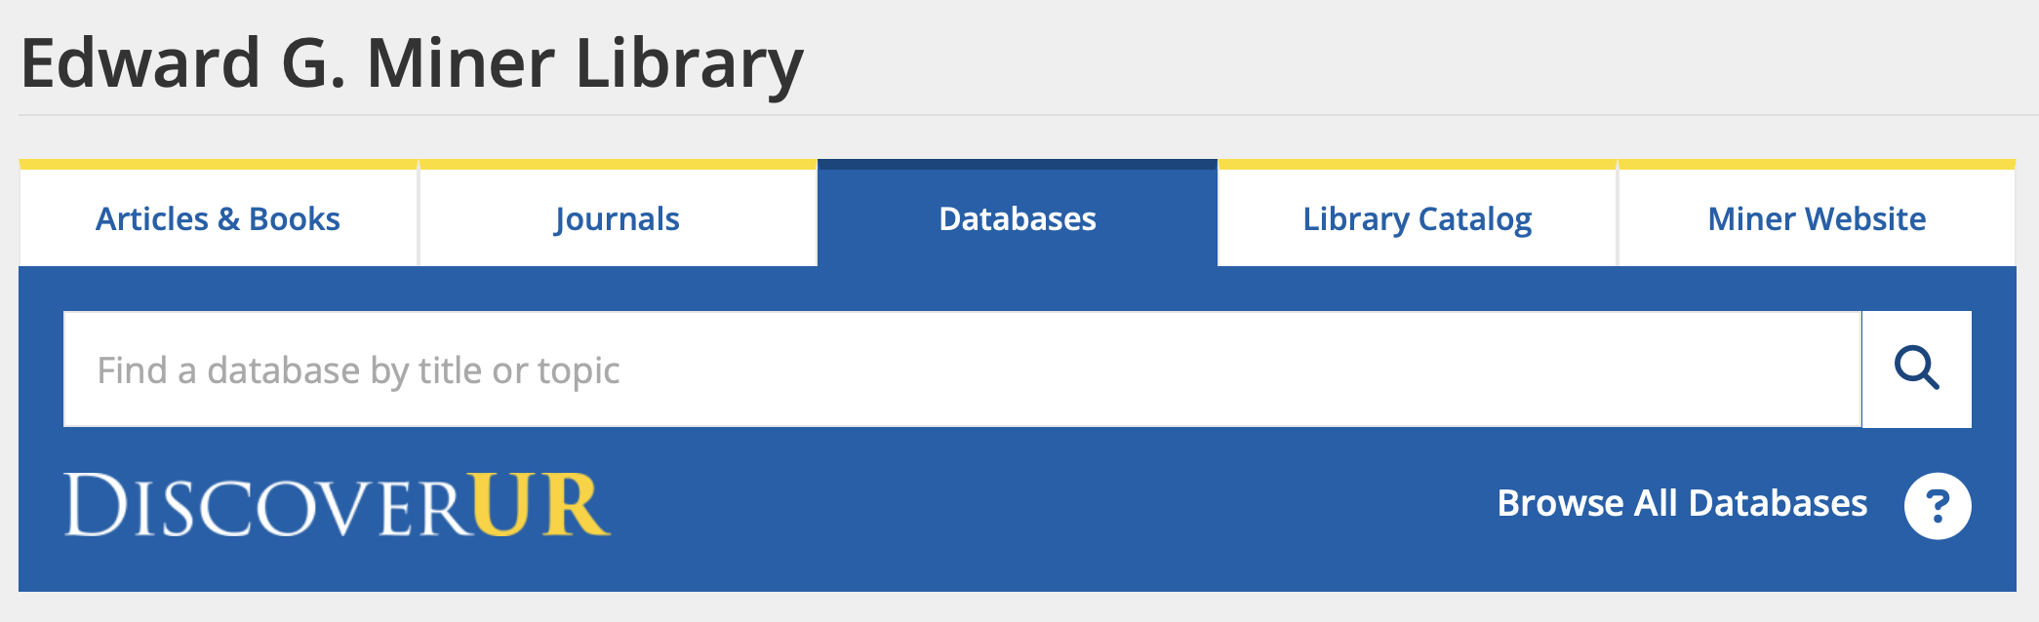
Choosing a Database

Slide 10
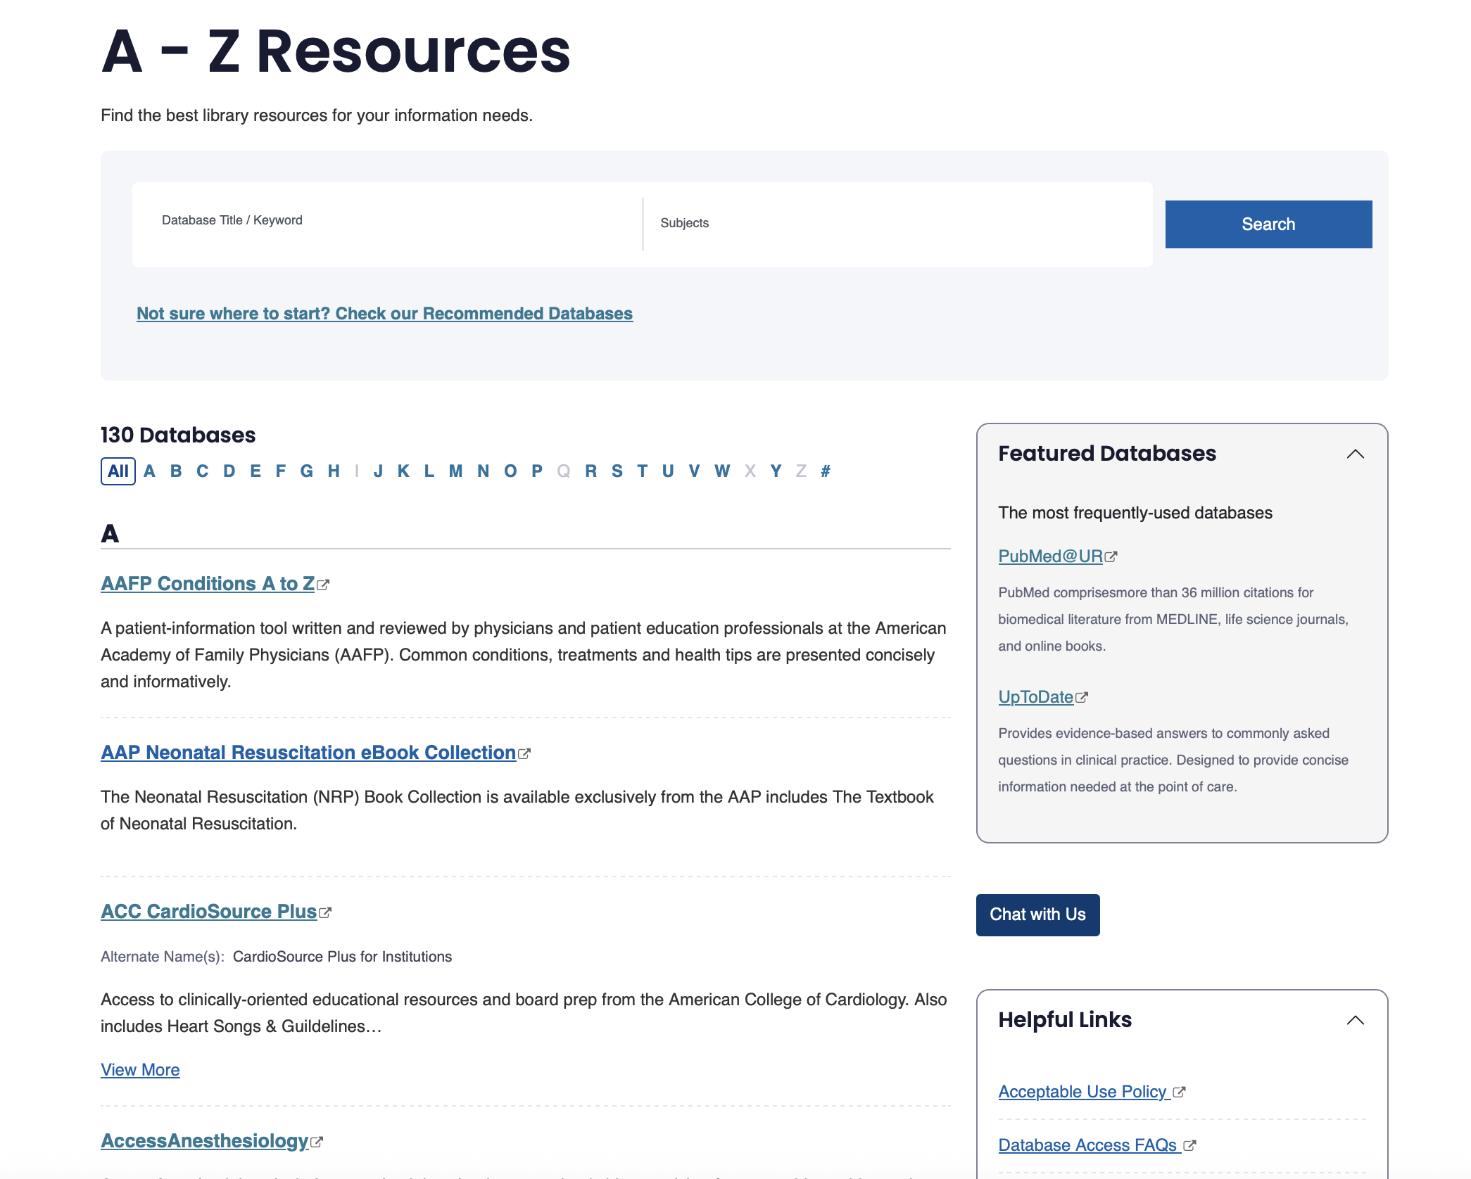
Notes:
Browse or search by name of database

Slide 11
Popular Database
PubMed: Biomedical
ClinicalTrials.gov: Clinical Trials
Cochrane Library: Reviews, clinical trials, clinical answers
PsycINFO: Psych
Web of Science: Multidisciplinary
Embase: Biomedical with a focus on drugs and devices
Scopus: Multidisciplinary

Slide 12

Drug Databases
Lexidrug
NatMed Pro
NeoFax
ReproTox
PubChem
Notes:
Lexidrug is a URMC's primary drug resource providing access to clinical drug resources including: calculators, identifiers, interaction & overdose assessments, and patient education resources.
NatMed Pro (Fomerly Natural Medicines) provides information about dietary supplements, natural medicines, and complementary, alternative, and integrative therapies. Including interactions, effectiveness, and adverse effects.
NeoFax Evidence-based, fully referenced neonatal-specific drug information to efficiently and safely manage drug therapy for neonatal patients.
ReproTox contains summaries on the effects of medications, chemicals, infections, and physical agents on pregnancy, reproduction, and development. Open Reprotox then click "Sign In with IP to search database".
PubChem is an open chemistry database at the National Institutes of Health (NIH). Find chemical information using chemical names, identifiers, structures, molecular formulas, gene symbols, proteins, pathways, taxons, cell lines, and patent numbers.

Slide 13
Citation Managers
What they do
Save and organize references
Insert citations into Word, Google Doc, or Pages
Automatically format bibliographies
Support multiple citation styles ( APA, AMA, MLA…)
Notes:
As graduate and PhD students, you’ll be reading and citing a lot of literature. Citation managers can really streamline your workflow. Both EndNote and RefWorks help you collect references, organize them by topic or project, and then insert properly formatted citations into your writing.
EndNote is more powerful and customizable. It’s desktop-based, so you install it on your computer. There is a learning curve with Endnote, you can expect to spend about 2-3 hours learning how to proficently use Endnote
RefWorks is web-based and great for quick access, especially if you're working in teams or want something simpler. Expect to spend about an hour to learn RefWorks.
I recommend exploring both and choosing the one that best fits how you work. We have tutorials for both linked in the SON Guide, and I’m always happy to help you get started.

Slide 14


Citation Managers
Software installed on computer
Learning curve
Advanced features
  Retraction Watch, PDF annotation
Free with UR license
Web-based
User friendly
Free with UR license
Find both tools, video tutorials, and help in the Writing & Citation Management tab on the Graduate Student Guide.

Slide 15

LibKey Nomad
  Browser extension that facilitates access to the Libraries' full text resources as you find research on the web
  One-click access to full text from websites like PubMed, Web of Science, Scopus and publisher pages.
Notes:
Available on Chrome, Firefox, Edge, Safari, Brave, and Vivaldi
This is one of the MOST helpful tools available through the library. It makes getting full-text access to articles quick and easy .

Slide 16
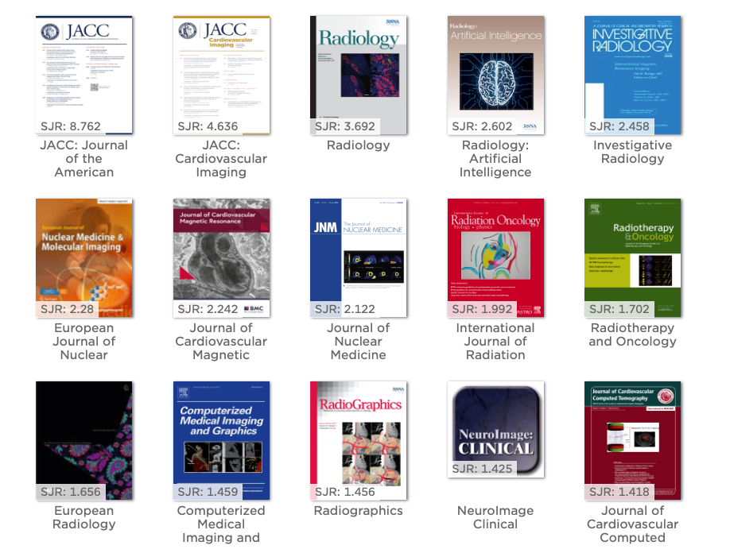
BrowZine
  Browsable news stand of the library’s top journals
  Easy and fast way to stay current on the literature
  Available on browser or download the app
  Requires account to save a bookshelf of favorite journals
Notes:
Browzine makes it easy to keep current on the literature. I can build my bookshelf of journals I like to follow and receive notifications when a new issue is available. Many times, if I find myself with a little bit of downtime, I can open my ipad, read an article, and save it for the future.

Slide 17

Questions?
Notes:
Please let me know if you have any immediate questions. Any questions that come up, please reach out to us! We are here and always happy to help!

Slide 18

Happy Searching!

