Slide 1

Office of Research Integrity, Stewardship & Ethics
(ORISE)
Sonya Maria Hadrigan, APRN, MLS, CIP
AVP Research Integrity

Slide 2
Research Integrity: Building Trust
The ORISE team is responsible for co-creating a University-wide framework for research integrity, building a unified structure across policies, processes, and cultural norms.
This includes working across schools and departments at all stages of researchers’ careers to ensure the ethical conduct of research is embedded in everyday practices, not just during crises.
ORISE works collaboratively with the Office of Counsel and partner offices within the Office of the Vice President for Research to support several mission-critical functions.

Slide 3
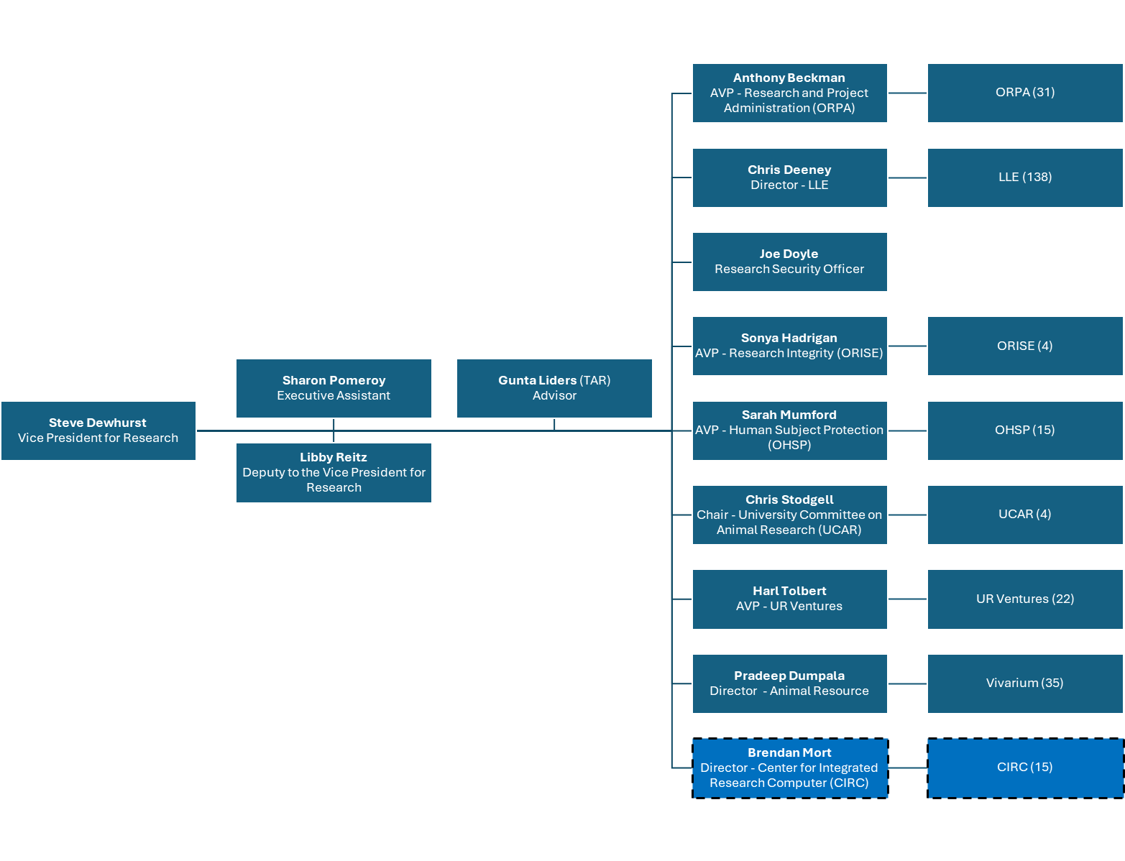

Slide 4

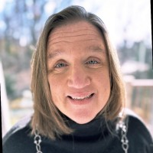
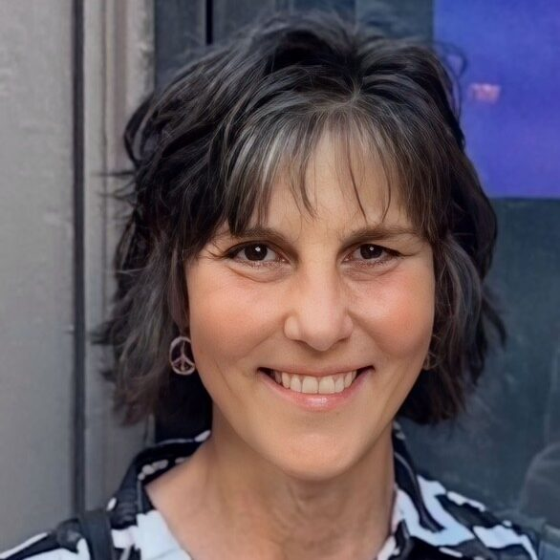
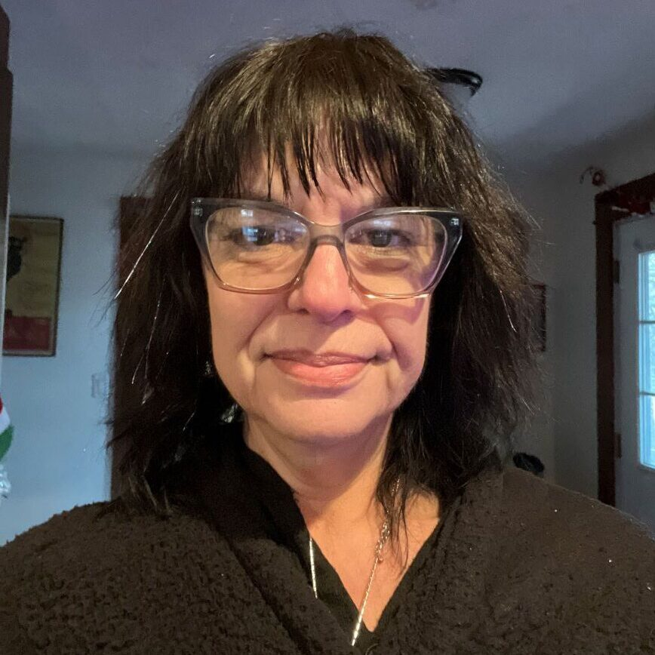
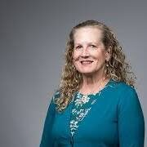
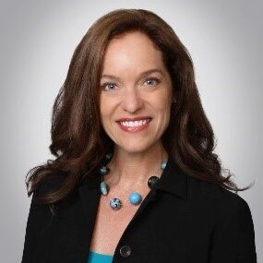
Meet the ORISE Team
Kelly O’Keefe
Research Integrity Director
Patty Guinan
COI Administrator
Sharon Pomeroy
Department Coordinator
Gunta Liders
Advisor
Zoe Hammatt
Advisor

Slide 5
Core Responsibilities
Serve as University’s Research Integrity Officer (RIO)
  Sonya Hadrigan, AVP, Research Integrity
Management of research misconduct allegations and proceedings
  Questionable and Detrimental Research Practices
  Authorship Disputes
Oversight of research conflicts of interest/commitment (COI/C) and related committees
Responsible and Ethical Conduct of Research (RECR) education
  In collaboration with the University Libraries, SMD Bioethics Center, GEPA, Office for Undergraduate Research and others!
Support for data stewardship and governance
QA, monitoring, and compliance reviews related to these areas
Notes:
For trainees, these issues most often show up as questions about authorship, mentorship, data management, disclosure requirements, or what to do when something just doesn’t seem right.

Slide 6
What ORISE Has Been Building for Researchers
A central resource for research integrity, ethics, and stewardship
Streamlining guidance and support for COI/Conflicts of Commitment and the research disclosure process
New educational programs, seminars, and workshops
Enhanced guidance on authorship, integrity, and responsible research practices
Coordinated support across research administration, compliance, and oversight offices
Greater support for navigating complex research integrity and related compliance issues
Notes:
The theme here is that we're trying to make research integrity less about compliance and more about supporting researchers. Whether you have a disclosure question, an authorship concern, a trainee education need, or a complicated situation that doesn't fit neatly into a policy, ORISE is a resource to help you navigate it.

Slide 7
Current Priorities
Modernizing Policies, Processes & Guidance
  Faculty (Research) COI/C Policy updates
  2026 Disclosure Redesign
  Institutional COI Policy Updates
  Organizational COI Policy and SOP Development
  Ethico (myCM) Research Complaint Form Development
Expanding Education & Researcher Development
  Fall 2026 & Spring 2027 RECR Seminar Series
  Integrity Workshops: Federal Funding Stewardship 101
  Research COI Education Refresh
Strengthening Research Integrity Support & Engagement
  ORISE Website development
  Partnerships and collaborations
  Communication, outreach, and marketing strategies

Slide 8
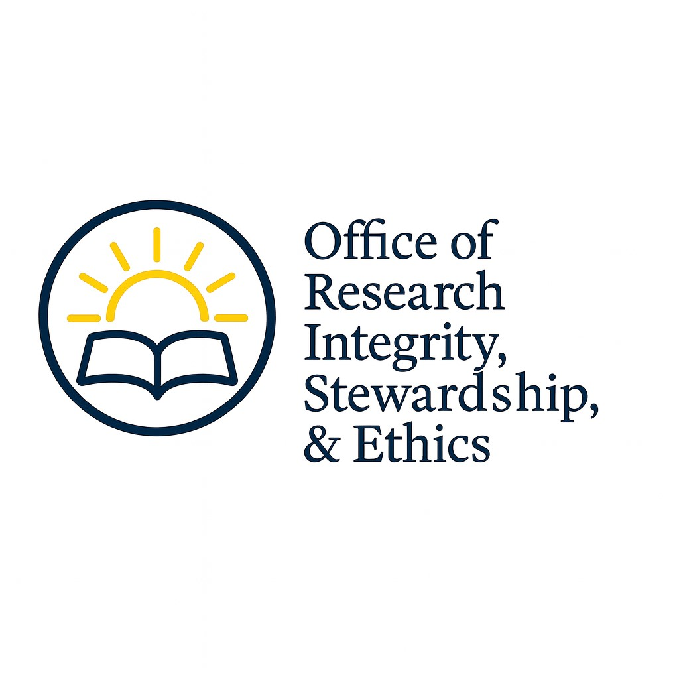
When should you reach out to ORISE?
Questions about authorship
Research integrity concerns
COI/C disclosure questions
Responsible conduct of research training
Data stewardship questions
Unsure where to go? Start with us ☺

Slide 9
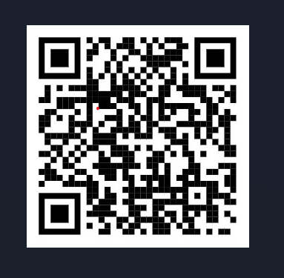
ORISE Contact Information:
ORISE website
ORISE@rochester.edu | (585) 276-0485
COI@ur.rochester.edu
Hylan Hall
140 Trustee Road, Suite 509

Slide 10
Questions?

