Slide 1
Capacity Building Projects Applicant Webinar
Dec. 7, 2023
University of Rochester
Environmental Health Sciences Center Community Engagement Core

Slide 2

Who are we?
University of Rochester Medical Center
National Institute of Environmental Health Sciences
Environmental Health Sciences Center (EHSC)
Community Engagement Core
Institute for Human Health and Environment (IHHE)
Engagement Pillar

Slide 3
What do we do?
Translate environmental health research to meet community needs
Identify community concerns to guide environmental health research
Focus on environmental justice in City of Rochester, but scope extends to other cities, regions, and issues
Historical focus on environmental exposures (lead, air pollution, chemicals in consumer product & food); IHHE broader (climate change & environmental justice)
Informed by Community Advisory Board
Sustain and participate in community partnerships

Slide 4
Capacity Building Project Program - why
Many groups have environmental concerns, but lack capacity to “take the first step”
Many groups that work in environmental justice communities have health concerns, but no track record of environmental work
Need to develop “capacity” to

Slide 5
Capacity Building Projects - who
Any non-profit organization in the Rochester region
Project should focus on environmental health disparities, but group
doesn’t need to
Key goal is building applicant’s capacity to grow and sustain future environmental health “work,” whether educational, policy, analysis
Potential for future research partnerships

Slide 6
Capacity Building Program - what
$10,000 for 9-month grant; quarterly vouchers (reimbursement)
Short proposals due in January
Reviewed by team of EHSC/Community Advisory Board members
Supported April 1-Dec 31 – funding and technical support
Reporting Jan-Feb
Short written report
Short presentation to EHSC faculty
Community Advisory Board meeting or other event

Slide 7
Criteria for Selection
Potential to address environmental health disparities in the greater Rochester region
Potential to build the organization’s capacity for future environmental health work
Feasibility of the project (i.e., ability to achieve stated goals during project period)
Evidence of support by contractors, partners, or participants (letter, past work, etc.)
Project’s Budget is complete, reasonable to meet the project’s goals, and is within
funding guidelines
Potential of the project to establish a new partnership with the EHSC
Plan for future action, funding, replicability, or sustainability

Slide 8
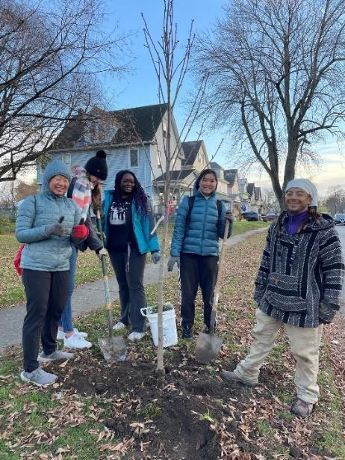
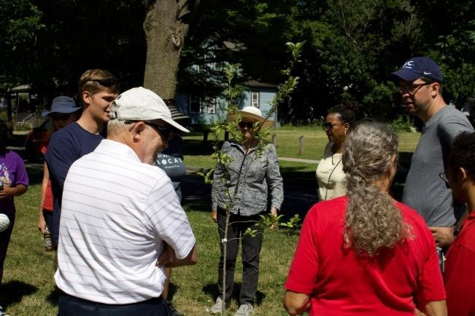
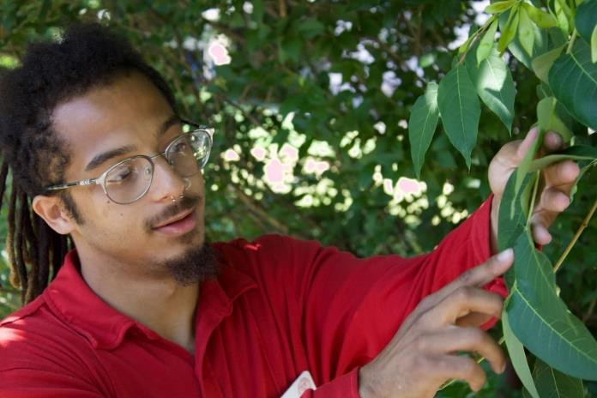
2022 Capacity Building Project: Tree Canopy Initiative
Cornell Cooperative Extension of Monroe County
Partnered with Marketview Heights Association and City
Conducted guided tree walk, neighborhood workshops, resident surveys, identified locations and planted 30 trees
Also worked with student volunteers and capstone project to support ongoing/future education
Wrote 2 related proposals for future funding
Continue to engage with citywide stakeholders interested in trees
Joined Community Advisory Board ☺

Slide 9
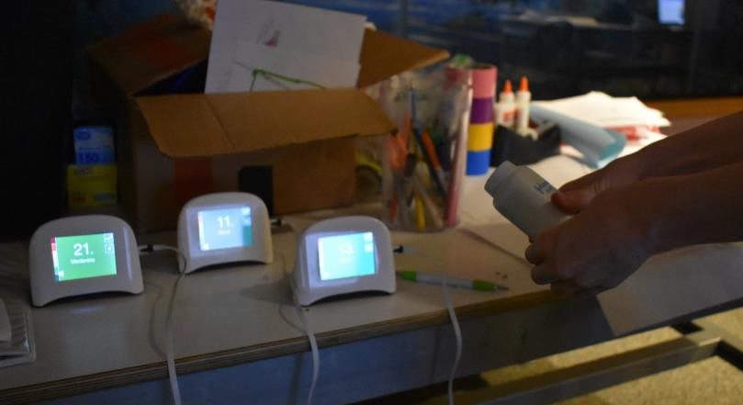
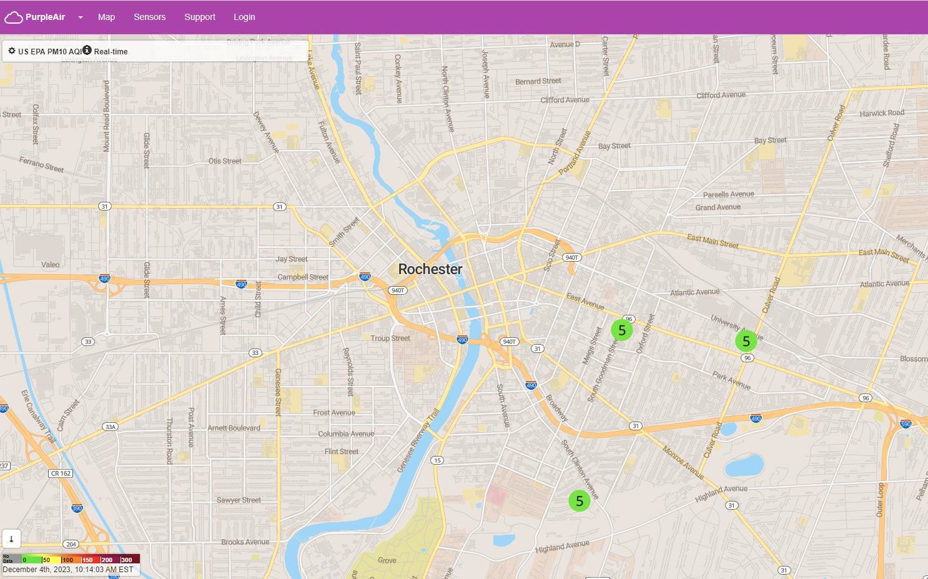
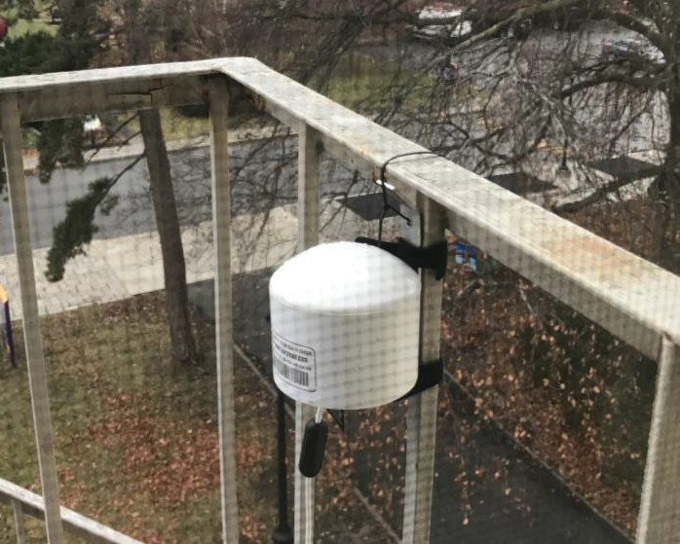
2023 Capacity Building Project: Climate Action Days
Rochester Museum and Science Center
Supported student and community presenter costs to attend “Climate Action Days”
Trained Discovery Guides about low-cost air sensors, air pollution, and health
Installed air sensor at RMSC
Ongoing intern developing activities for future use by RMSC

Slide 10

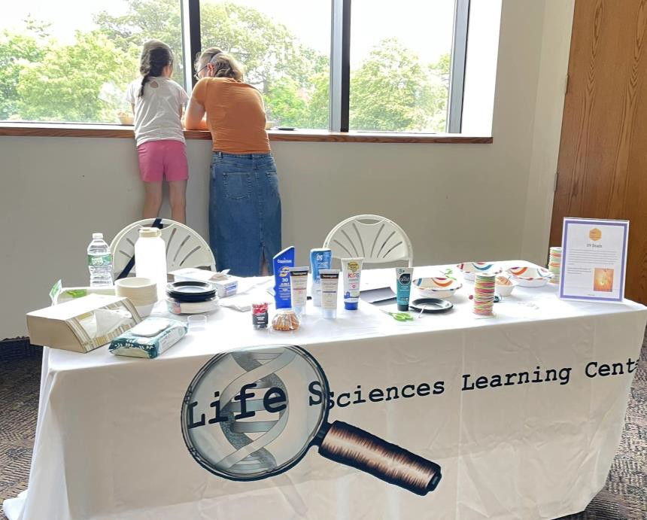
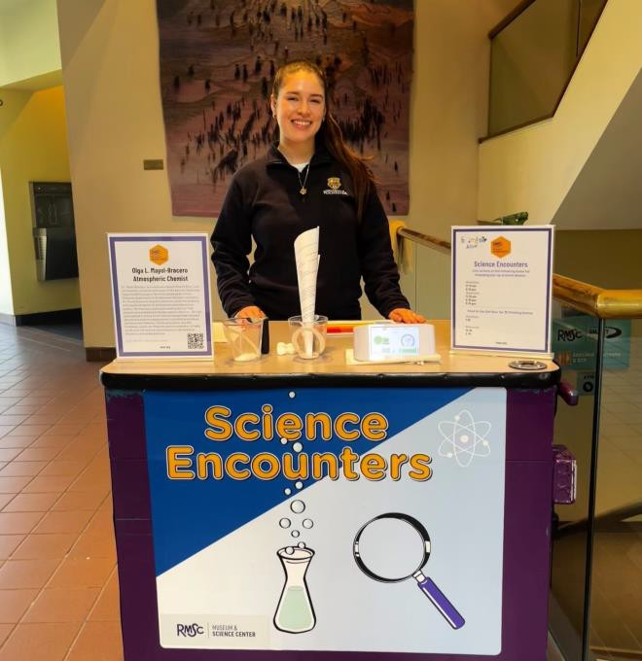
What’s up this year?
Possibility to support up to two projects
Due Jan 19, 2024
Open to many TYPES of projects:
Data collection/background research
Staff training or education
Grantwriting (up to $5000) support
Project supplies, materials, computer/technology, space
Staff or student time (ours or yours)
Ask us!

Slide 11
Your ideas and questions?

