Slide 1

Potential Health Effects of Marcellus Shale Activities:
University of Rochester
Bernard D. Goldstein, MD
Interim Director
Center for Healthy Environments and Communities
Professor of Environmental and Occupational Health and Dean Emeritus
Graduate School of Public Health
University of Pittsburgh

Slide 2
Community Health Concerns and the Marcellus Shale
In our six years of responding to community environmental and health issues, CHEC has never experienced the breadth and depth of concern that exists about Marcellus Shale
Notes:
Put that aside for now

Slide 3
“Fracking”
Technique for extracting natural gas from deep below surface
Horizontal hydrofracking
Drilling a well deep down below earth
Turning drill to horizontal
Injecting fluid into well to fracture shale
Extracting natural gas

Slide 4
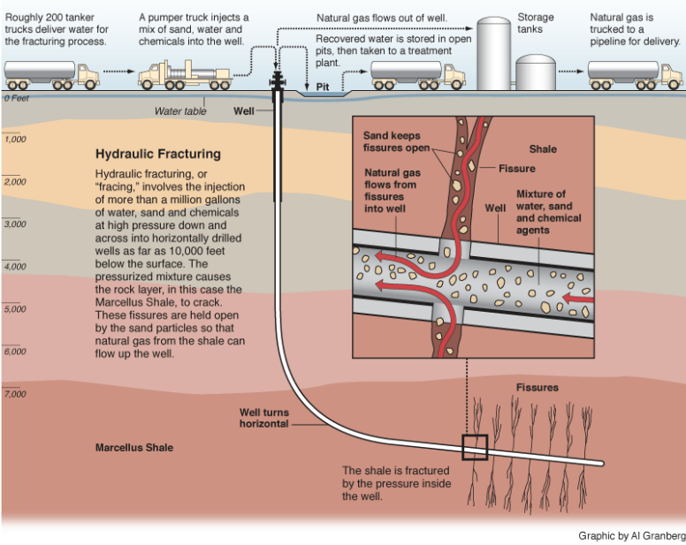
Horizontal hydraulic hydrofracturing. Courtesy www.propublica.org/special/hydraulic-fracturing
Notes:
www.propublica.org/special/hydraulic-fracturing
WIKIPEDIA http://en.wikipedia.org/wiki/Shale_gas (Global), http://en.wikipedia.org/wiki/Shale_gas_in_the_United_States
Shale Gas Water Lifecycle: Water Lifecycle Issues (generalities)
http://www.all-llc.com/projects/shale_water_lifecycle/page.php?13

Slide 5
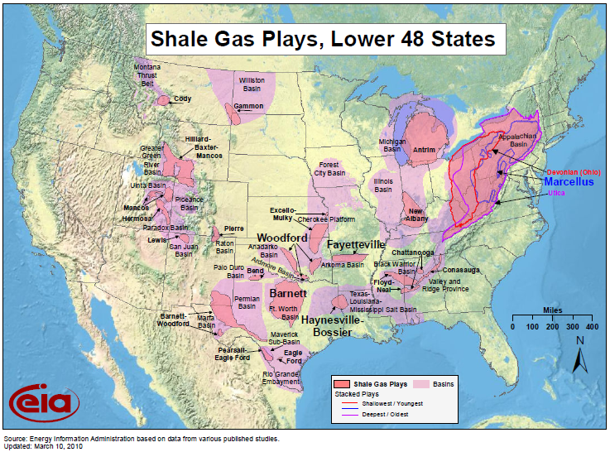
Notes:
Horizontal hydrofracturing has been performed in TX, CO, WY for 10-15 years. We can learn a lot about health & socioeconomic effects of shale gas plays by paying attention to lessons learned those communities.
http://www.alternet.org/water/149211?page=2
7. Industry claim: "Enough natural gas has been discovered to supply North America for well beyond 100 years."
TRUTH: No one really knows exactly how much natural gas exists until it is extracted. The U.S. Energy Information Administration estimates there are "2,587 trillion cubic feet (Tcf) of technically recoverable natural gas in the United States." The Potential Gas Committee estimates "total U.S. natural gas resources at just over 1,836 Tcf." Currently the U.S. uses 22,739 million cubic feet of natural gas per year. That means, if these rough estimates are right (and there is no way of knowing how right they are), the gas would last, at current consumption levels, between 80 and 113.76 years in the United States, but this excludes the other two countries that make up North America, Mexico and Canada.

Slide 6
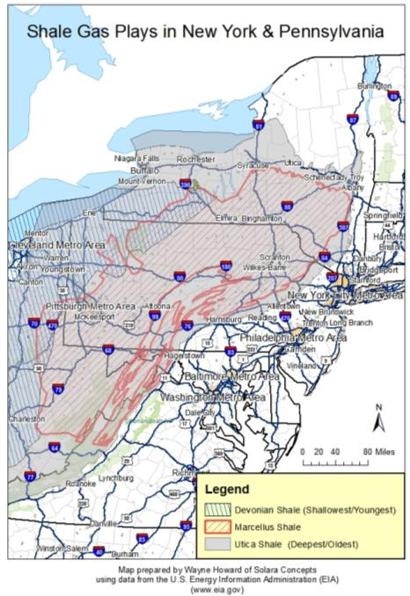
An estimated 500 trillion cu ft of natural gas lies embedded in the shale layers 1-4 miles deep (20-100 yrs supply?).
“While the sweet spots of the Marcellus tend to be in Broome, Tioga and Delaware Counties, the prime location for the Utica tends to be in Central New York,” said Bill Kappel, a USGS hydrogeologist. Interview by Tom Wilber twilber@gannett.com 6/5/2010
Typical Well Depth:
Devonian: 3,000-5,000 feet
Marcellus: 1 to 2 miles
Utica: 2+ miles

Slide 7
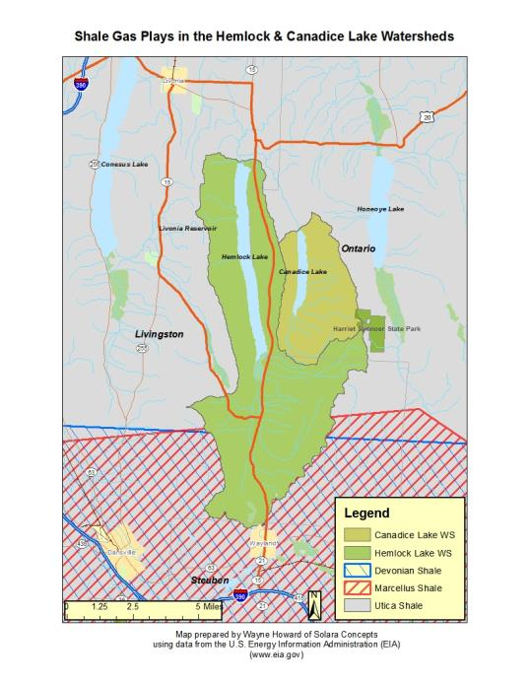
Utica Shale (deepest)
Marcellus Shale (middle)
Devonian/Ohio Shale (shallowest)

Slide 8
The promise of natural gas
Huge untapped reserves
Reduce dependence on foreign fue
Cleaner than coal
Existing technology
Existing pipeline network

Slide 9
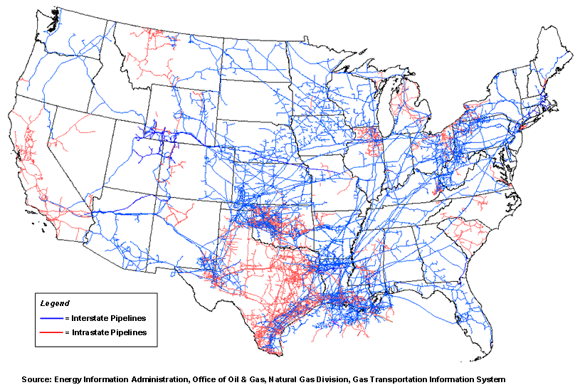
http://geology.com/articles/marcellus/natural-gas-pipeline-map.gif

Slide 10
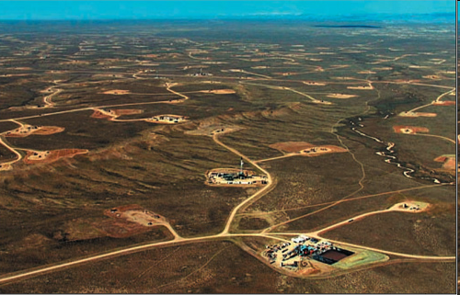
View of 40-acre spacing. Jonah field in Rocky Mountains. Courtesy of www.shaleshock.org
Notes:
Tioga State Forest, Ward Township, Tioga County Fortuna Energy Inc. Tract 587 #1H (Permit # 117-20285) Permit includes 5,648 acres
Aerial Photo #8320.
Details are based on a file search at the Williamsport DEP office on November 18, 2009.
Location: N 41 42' 7.27" W 76 58' 21.24" Gleason USGS Quadrangle
All photos were taken on October 1, 2009
View east of the complex being constructed at Fallbrook Road
Total disturbed area: 105.1 acres. Total may not include roads and pipeline ROW (right of way).
Well site 02-001 is on the left, north of Fallbrook Road.
Impoundment #2 is on the right — 14,841,128 gallons.
Water for the site will be withdrawn from the Fallbrook and Fellows Creeks. Drainage from the site is to the same two creeks, then to the Tioga River.
Well site 02-002 (top-right of photo 8320)
Each well site may contain multiple wells. Each individual well will be drilled vertically to the target depth, then horizontally in a different compass direction in order to maximize gas production.
At center of photo 8320 is a compressor station pad. This area is 300 x 360 feet.
The tan area between the compressor site and impoundment #2 is being cleared for an 8,515,651 gallon reservoir (this is also visible at left in photo 8311 and center of 8320). This area is approximately 200 x 600 feet.
Not shown in the original photo, but noted by a line trending north is the area of a 40-foot right-of-way for Fortuna Mt. Ridge Pipeline, which will export the gas. This pipeline will extend from 4,500 to 5,000 feet to another pipeline.
Fortuna will use a Polymer Brine mud system. Function tests up to 2,500 PSI.
A wetland exists immediately south of this site. The effects of water withdrawal and drainage on the wetland is unknown.
Courtesy of D. Martin, Coordinator www.PaForestCoalition.org The Pennsylvania Forest Coalition is a unique alliance of hunters, hikers, anglers, landowners, wildlife-watchers, paddlers, bikers, churches and conservation groups who are united in our concern for the stewardship of our public lands.
SIGN UP FOR CONSERVATION UPDATES with www.PaForestCoalition.org. Please mention your affiliation(s) (such as Hunter, Angler, Hiker, Watershed, Birdwatcher). PA Forest Coalition messages are brought to you as a public service; in compliance with Title 17 U.S.C. section 107 this material is distributed free and without profit or payment for educational purposes only.

Slide 11
So, what does this mean for upstate New York?
Economic benefit to state
Individual property owners (lease mineral rights to gas companies)
Rural communities (jobs/business)
All taxpayers benefit (taxes from drilling)
Communities near drilling have health and environmental concerns

Slide 12
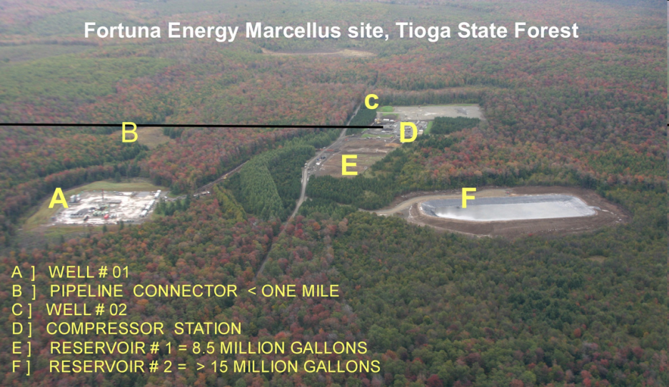
Oct 1, 2009 about 20 miles south of Elmira, NY and 35 miles north of Williamsport, PA. Total disturbed area: 105.1 acres. The reservoir holds 14,841,128 gallons of hydrofracking flowback water. The tan area near B is being cleared for a 8,515,651 gallon reservoir. Water for the site will be withdrawn from the Fallbrook and Fellows Creeks. A wetland exists immediately south of this site; the effects are unknown. Courtesy of www.PaForestCoalition.org
Notes:
Tioga State Forest, Ward Township, Tioga County Fortuna Energy Inc. Tract 587 #1H (Permit # 117-20285) Permit includes 5,648 acres
Aerial Photo #8320.
Details are based on a file search at the Williamsport DEP office on November 18, 2009.
Location: N 41 42' 7.27" W 76 58' 21.24" Gleason USGS Quadrangle
All photos were taken on October 1, 2009
View east of the complex being constructed at Fallbrook Road
Total disturbed area: 105.1 acres. Total may not include roads and pipeline ROW (right of way).
Well site 02-001 is on the left, north of Fallbrook Road.
Impoundment #2 is on the right — 14,841,128 gallons.
Water for the site will be withdrawn from the Fallbrook and Fellows Creeks. Drainage from the site is to the same two creeks, then to the Tioga River.
Well site 02-002 (top-right of photo 8320)
Each well site may contain multiple wells. Each individual well will be drilled vertically to the target depth, then horizontally in a different compass direction in order to maximize gas production.
At center of photo 8320 is a compressor station pad. This area is 300 x 360 feet.
The tan area between the compressor site and impoundment #2 is being cleared for an 8,515,651 gallon reservoir (this is also visible at left in photo 8311 and center of 8320). This area is approximately 200 x 600 feet.
Not shown in the original photo, but noted by a line trending north is the area of a 40-foot right-of-way for Fortuna Mt. Ridge Pipeline, which will export the gas. This pipeline will extend from 4,500 to 5,000 feet to another pipeline.
Fortuna will use a Polymer Brine mud system. Function tests up to 2,500 PSI.
A wetland exists immediately south of this site. The effects of water withdrawal and drainage on the wetland is unknown.
Courtesy of D. Martin, Coordinator www.PaForestCoalition.org The Pennsylvania Forest Coalition is a unique alliance of hunters, hikers, anglers, landowners, wildlife-watchers, paddlers, bikers, churches and conservation groups who are united in our concern for the stewardship of our public lands.
SIGN UP FOR CONSERVATION UPDATES with www.PaForestCoalition.org. Please mention your affiliation(s) (such as Hunter, Angler, Hiker, Watershed, Birdwatcher). PA Forest Coalition messages are brought to you as a public service; in compliance with Title 17 U.S.C. section 107 this material is distributed free and without profit or payment for educational purposes only.

Slide 13
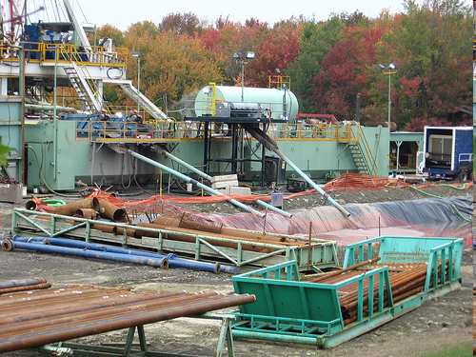
Filling a hydrofracturing reservoir. Courtesy of www.shaleshock.org
Notes:
Tioga State Forest, Ward Township, Tioga County Fortuna Energy Inc. Tract 587 #1H (Permit # 117-20285) Permit includes 5,648 acres
Aerial Photo #8320.
Details are based on a file search at the Williamsport DEP office on November 18, 2009.
Location: N 41 42' 7.27" W 76 58' 21.24" Gleason USGS Quadrangle
All photos were taken on October 1, 2009
View east of the complex being constructed at Fallbrook Road
Total disturbed area: 105.1 acres. Total may not include roads and pipeline ROW (right of way).
Well site 02-001 is on the left, north of Fallbrook Road.
Impoundment #2 is on the right — 14,841,128 gallons.
Water for the site will be withdrawn from the Fallbrook and Fellows Creeks. Drainage from the site is to the same two creeks, then to the Tioga River.
Well site 02-002 (top-right of photo 8320)
Each well site may contain multiple wells. Each individual well will be drilled vertically to the target depth, then horizontally in a different compass direction in order to maximize gas production.
At center of photo 8320 is a compressor station pad. This area is 300 x 360 feet.
The tan area between the compressor site and impoundment #2 is being cleared for an 8,515,651 gallon reservoir (this is also visible at left in photo 8311 and center of 8320). This area is approximately 200 x 600 feet.
Not shown in the original photo, but noted by a line trending north is the area of a 40-foot right-of-way for Fortuna Mt. Ridge Pipeline, which will export the gas. This pipeline will extend from 4,500 to 5,000 feet to another pipeline.
Fortuna will use a Polymer Brine mud system. Function tests up to 2,500 PSI.
A wetland exists immediately south of this site. The effects of water withdrawal and drainage on the wetland is unknown.
Courtesy of D. Martin, Coordinator www.PaForestCoalition.org The Pennsylvania Forest Coalition is a unique alliance of hunters, hikers, anglers, landowners, wildlife-watchers, paddlers, bikers, churches and conservation groups who are united in our concern for the stewardship of our public lands.
SIGN UP FOR CONSERVATION UPDATES with www.PaForestCoalition.org. Please mention your affiliation(s) (such as Hunter, Angler, Hiker, Watershed, Birdwatcher). PA Forest Coalition messages are brought to you as a public service; in compliance with Title 17 U.S.C. section 107 this material is distributed free and without profit or payment for educational purposes only.

Slide 14
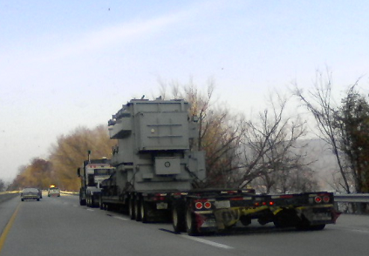
Photo (c) 2010, Sally S. Howard
A Hydrofracking Tank on double tractor trailer – Rt 15 near Trout Run, PA Nov, 2010

Slide 15
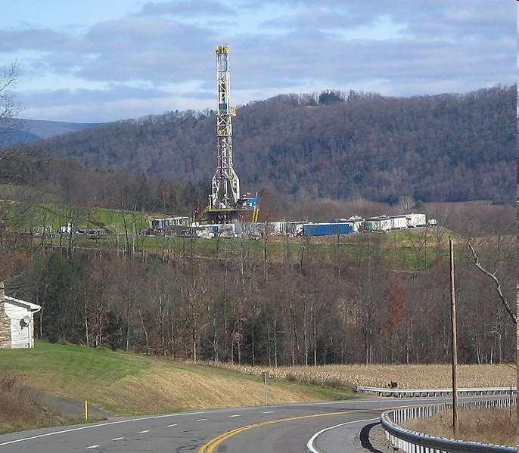
Horizontal Hydrofracturing Rig, November 2009 in Moreland, PA. Wikipedia Commons – photo by Ruhrfisch
Notes:
Photo from http://commons.wikimedia.org/wiki/File:Marcellus_Shale_Gas_Drilling_Tower_1_crop.jpg
Stories:
http://blog.pennlive.com/leftcoast/2009/11/the_great_marcellus_shale_swin.html
http://dcbureau.org/20091204299/Natural-Resources-News-Service/the-marcellus-shale-new-york-is-the-natural-gas-industrys-new-lab-rat.html

Slide 16
Concerns for Local Communities
... where Hydrofracturing is occurring
Truck traffic – diesel pollutants (asthma, etc.), accidents, noise, road damage
Water contamination of streams with chemicals, silt, salt
Depletion of smaller water sources (streams, lakes)
Air pollution – Volatile Organic Compounds (VOCs), ozone, asthma
Future suburban & urban drilling near schools & homes
Unknown hazards with persistent pollutants in rivers
Baseline (before) and continuous environmental & health monitoring.
Community character changes permanently from rural agricultural to rural industrial
Boom & Bust economic & community dynamics
A few benefit; many endure

Slide 17
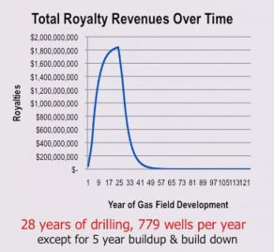
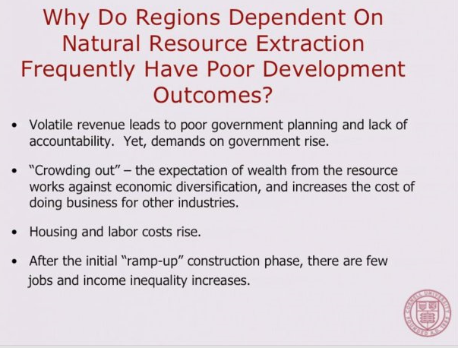
Concerns for Local Communities – Socioeconomic
Susan Christopherson, PhD, Professor, City and Regional Planning, Cornell University -
How Should We Think About the Economic Consequences of Shale Gas Drilling?”
Boom-Bust Economics – plan for it!
The long-term job growth is in TX (headquarters).
Long-term population, business & income growth is slower than in adjacent counties.
Courtesy of Susan Christopherson, PhD at University of Pittsburgh Conference, Nov 19, 2010
Notes:
Over a 10-year period the economic impact of drilling alone could exceed $15 billion, supporting more than 16,000 person-years of employment and generating salaries and wages of $792 million. State and local tax coffers would receive $85 million of new revenues. (Potential Econ. & Fiscal Impacts from Natural Gas Production in Broome Co., NY; 7/09) --http://www.energyindepth.org/news/
http://www.theecologist.org/trial_investigations/687515/us_natural_gas_drilling_boom_linked_to_pollution_and_social_strife.html
... What has really shocked Carolyn isn't just what she has given up in selling mineral leases on her land, but who she has effectively sold them too. As she explained, from the topsoil downwards, every portion of the rock strata on her organic farm has now been divided and repeatedly resold by the company she originally leased it to, so that individual investors in Australia now have financial interests in one particular subsurface rock formation, while a Chinese company now owns the rights to mine for coal.
... After a week investigating the impacts of fracking on rural Pennsylvania, it's clear that it's not just the land that is being fractured but perhaps the communities as well. What were once sleepy towns are now clogged bumper-to-bumper with water trucks carrying water containers and fracking chemicals to and from the thousands of well-sites that increasingly dot the landscape. As one diner owner dryly observed to the Ecologist: 'If these trucks were all painted green, you would think we were being invaded.' Stories of group fights and tension in towns caused by the so-called 'gashole' employees are told bitterly by town residents, shocked at how quickly their rural idyll has changed. The impacts stretch beyond bar brawls, though. In 2010 alone, it was reported that more than a dozen children around the small town of Towanda had been put into foster care, their families turfed out of low-rent accommodation by unscrupulous landlords to make way for gas-industry employees who are able to offer higher rents. 'The feel of the place has just changed,' remarked Tom and Amy, a couple from Towanda, lifelong local residents who have recently put their house on the market and are looking to move away. 'Greed is ugly and greed is rampant in Bradford county today.'
... Professor Anthony Ingrafea, one of the world's leading experts on fracture mechanics, based at Cornell University, told the Ecologist: 'Oil and gas are not interchangeable. We are not going to decrease oil imports by increasing gas production. Whereas the national energy plan that says over some period of time, 20 years maybe, at most, we are going to downplay and downsize the use of coal and increase the use of natural gas in what are coal-fired power plants. That would be a great thing to do, except 20 years from now we're now out of natural gas... then what are we going to use for electricity? Natural gas burns cleaner than any other fossil fuel, but it is not cleaner in its lifecycle. The lifecycle cost, in terms of carbon dioxide emission, and methane emission, from the development of gas from unconventional sources like shale is at least as dirty as coal.'
... As Norma Fiorentino predicts: 'Your beautiful countryside will never be the same. Your peace and serenity will be gone. For a few bucks, and basically, that's just what it is.'

Slide 18
THE ONLY TWO CERTAINTIES
Surprises
Every location where natural gas is extracted is different. Western New York and Pennsylvania differ from other heavily extracted regions in its geology; surface and subsurface water flows; past subsurface perturbations; weather; ecosystems; population density and demography, etc. Extraction procedures are evolving; and the sensitivity of analytical techniques to detect contaminants is increasing.
We can be certain that unforeseen threats to human health will be detected.
Notes:
Bromine; arsenic

Slide 19
THE ONLY TWO CERTAINTIES
2) Disease Clusters and Law Suits
It is certain that in a community with Marcellus Shale activity there will be a highly publicized statistically significant increase in a disease. This will result in worried community members, loss of property values and law suits. The concern will spread to other Marcellus Shale communities
When this occurs Health Department or university epidemiologists will be asked to help determine whether the observed increase in disease incidence is a result of Marcellus Shale activity. This will require retrospective reconstruction of exposure to various chemicals. At best there will be a high degree of uncertainty in the exposure assessment that will complicate determination of cause and effect relationships
Notes:
BG active plaintiff and defense

Slide 20
A THIRD CERTAINTY
3) Reducing emissions is a money saver
In virtually every similar situation, industry has eventually realized that it saves money to decrease emissions. In addition to the costs of health and environmental impacts, and the litigation and clean-up expenses, it is more profitable to sell product than to release it to the environment.

Slide 21
Implications of the Gulf Oil Spill to Marcellus Shale Activities
- Environmental and human health are closely linked.
- Worker health and environmental health are linked by the culture of the workplace
- Independent governmental oversight is necessary: and costs money that should be paid by the industry
- Regulatory reform is required to better balance the protection of the environment and public health with business needs
Notes:
Valde and Louisiana

Slide 22
COREXIT 9500 MSDS: NALCO (edited)
2. COMPOSITION/INFORMATION ON INGREDIENTS
Our hazard evaluation has identified the following chemical substance(s) as hazardous:
Hazardous Substance(s) (w/w)
- Distillates, petroleum, hydrotreated light 10.0 - 30.0%
- Propylene Glycol 1.0 - 5.0%
- Organic sulfonic acid salt (Proprietary) 10.0 - 30.0%

Slide 23
Implications of the Gulf Oil Spill to Marcellus Shale Activities
-Psychosocial health impacts of energy extraction can be as important as direct health effects.
-It is in everyone’s best interest to determine the potential environmental and human health impacts of energy extraction prospectively, rather than retrospectively.
- Over time it is virtually certain that all the nation’s oil and gas sources will be tapped.
- So what’s the rush?
Notes:
NIEHS; More of a rush for gulf - china

Slide 24
Pathways to Adverse Health Impacts of Marcellus Shale Operations
Worker health and safety
Air pollution
Water pollution
Soil pollution
Noise pollution
Community safety: traffic, explosions, fires; crimes
Psychosocial disruption
Sustainability
Global climate change
Notes:
Gulf

Slide 25
Questions Include
How is flow back and produced water disposed of?
Is the disposal of water affecting ground water or municipal and/or private drinking water supplies?
Water withdrawal and management?
Is there an additional burden to already compromised air quality in New York State?
Movement of radionuclides?
What kind of stress and health issues are related to people living in communities where gas extraction and development activities are taking place?
How will pipelines and heavy road traffic affect the infrastructure of communities?
How long do well-casing last with corrosive fluids running through them?
What are the plans for emergency response?

Slide 26
Key Policy Issues Related to Human Health
The need for vigorous governmental oversight
Aggregate sources vs a single source (air sheds and water sheds)
Individual risk vs community risk vs population risk
Sustainability

Slide 27
Center for Healthy Environments and Communities Preliminary Findings

Slide 28
Implications of the CHEC evidence of a diverse safety culture within the Marcellus Shale industry
Vigorous oversight and enforcement is necessary, including heavy fines and loss of permit for repeat offenders.
Weeding out of those with an inadequate safety culture is in the best interest of the industry as well as the public.
Perhaps some companies think of fines for violations as just part of their business costs.
Notes:
The public views the industry as monolithic – you are all branded by your worst offender; BG Dow; good business reasons to work together; can the state prohibit short-term leases

Slide 29
Alcoa Lost Workday Performance 1987-2004
Notes:
BG DOW

Slide 30
Point Sources as Non-Point Sources
Allowable emissions from the thousands or tens of thousands of Marcellus Shale sources easily exceed that of a major new point source (e.g., an oil refinery)
Classically, non-point sources do not pose immediate risks in their neighborhood (e.g., nitrogen runoff from individual farms), but do so in aggregate (e.g., the dead zones of Chesapeake Bay or Gulf of Mexico)
Marcellus Shale activities pose both local and aggregate risk
They are being regulated solely as individual local point sources
Notes:
Whatever number is the carrying capacity – if we cut emissions by factor of ten, could have ten times as many

Slide 31
Drinking Water Health Issues
Contaminants of concern to drinking water include:
Fracturing fluid chemicals
Degradation products
Naturally occurring materials in the geologic formation (e.g. metals, radionuclides, bromides) that are mobilized and brought to the surface during the hydraulic fracturing process
Notes:
Arsenic?

Slide 32
Watch out for TE-NORM Technologically-Enhanced Naturally Occurring Radiation
Naturally occurring radioactivity is not infrequently associated with oil and gas deposits
Working these deposits can lead to the unanticipated concentration or displacement of radioactivity (e.g., will there be more radioactivity in drinking water? Will more radon be off-gassed into the basements of homes near a drill site?)
Notes:
Radon high risk: can not sue G-d: Marcellus Shale industry not G-d. You will be sued

Slide 33
Crime and Police Response – PA
"More and more, it seems the police reports coming out of the northern tier include arrests because of drug use and trafficking, fights involving rig workers, DUIs, and weapons being brought into the state and not registered properly," said the commissioner. "We've even encountered situations where drilling company employees who have been convicted of a sexual assault in another state come here to work and do not register with our Megan's Law website. Each of these issues is unacceptable and places an even greater burden on our law enforcement and local social programs meant to help those in need.“ (State Police Commissioner Frank Pawlowski)
State and local governments need additional resources to address the problems that have accompanied the arrival of drilling companies to Pennsylvania.
Notes:
From previous CHEC report

Slide 34
Community Health Concerns and the Marcellus Shale
Even if it were true that Marcellus Shale activities present no health risk, and we do not believe it is true, it is unreasonable to expect that communities will be reassured by statements from industry asserting that their activities are safe.
Safety statements from industry or government are particularly problematic given well-publicized Marcellus Shale incidents indicating an inability to fully contain the processes at all times

Slide 35
Community Health Concerns and the Marcellus Shale
The absence of thorough ongoing health studies, with community engagement, is compromising the ability of state government to be viewed as a knowledgeable source of information concerned about protecting public health

Slide 36
Community Engagement
Any attempt to understand and respond to the potential adverse health consequences of Marcellus Shale activities will fail unless the community is involved.
Causally-related health impacts will be missed
Negative findings will be dismissed

Slide 37
The Three Rules of Interacting with the Community.
1) Trust must be earned
2) Never pretend to give the community options when you have already made up your mind
3) Every community and every situation is different. But transparency, openness and sympathetic understanding are central

Slide 38
Sustainability
Requires transdisciplinary approaches to complex environmental issues.
Approaches must include a comprehensive evaluation of environmental, economic and social/health issues. (e.g., in considering preventing on-site problems by trucking waste elsewhere, the diesel emissions of the trucks, impact on roads and dust generation, auto and pedestrian fatalities, etc need to be considered)
Multigenerational equity is central. What happens to the community when the gas runs out?
Notes:
Call it holistic, multidisciplinary: govtal silos

Slide 39
Life Cycle of Natural Gas Production Through Fracking
Hydraulic fracturing (fracking) and completion: While oil and gas have always been extractable from the natural fissures in certain rock formations, some of these deposits are too diffuse to be economically feasible to exploit using traditional drilling methods. Increased demand, however, has spurred the evolving development of fracturing technology. Pioneered in west Texas, fracking is being used to increase the productivity of drill sites in shale, coalbed methane, and tight sands formations that previously were too expensive to drill
Source: Global Community Monitor. (July 2011). Gassed! Citizen investigation of toxic air pollution from natural gas development.

Slide 40
Life Cycle of Natural Gas Production Through Fracking
Though fracking enables cost effective production of natural gas for the gas companies, it also comes with risks to public health and the environment. One of the least documented risks has been from air pollution caused by fracking compounds during their use, storage, or waste disposal.
Source: Global Community Monitor. (July 2011). Gassed! Citizen investigation of toxic air pollution from natural gas development.

Slide 41
Life Cycle of Natural Gas Production Through Fracking
Fracking is dependent on fracturing fluid, typically composed of water-based concoctions riddled with assortments of chemicals and proppants like sand. The fluid varies from company to company and site to site, and is often kept secret. The process of fracking involves perforating deep into the rock formation fissures under the earth at very high pressure, the cracks are expanded horizontally and then propped open with the proppant. These expanded cracks allow a single well to tap into multiple diffuse deposits. Large volumes of water potentially become contaminated with fracking compounds and with natural brine components including bromides and radiation
Source: Derived from Global Community Monitor. (July 2011). Gassed! Citizen investigation of toxic air pollution from natural gas development.

Slide 42
Life Cycle of Natural Gas Production Through Fracking
Construction activity: Construction activity presents safety hazards to workers and results in air pollution from trucks and other equipment. Air pollutants are emitted at well pads, pipelines, roads, and compressor stations
Drilling: During the drilling of a well, air pollution is generated by diesel engines powering the drill rig, as well as by any natural gas emissions being vented from the hole in the ground. These emissions could include not only methane but other associated volatile organic compounds, including benzene.
Source: Derived from Global Community Monitor. (July 2011). Gassed! Citizen investigation of toxic air pollution from natural gas development.

Slide 43
Life Cycle of Natural Gas Production Through Fracking
Pits: Waste from drilling, fracking, or production may be dumped into open air pits to allow some of the toxic material to evaporate into the air. This can result in significant air and water pollution.
Land application (including land farming): Waste from drilling, fracking, or production may be spread on the ground or otherwise applied to the land. This can result in significant air and water pollution.
Source: Derived from Global Community Monitor. (July 2011). Gassed! Citizen investigation of toxic air pollution from natural gas development.

Slide 44
Life Cycle of Natural Gas Production Through Fracking
Compressor station: Gas from wells is collected at central locations and compressed into smaller volumes at stations. Another type of compressor is located on the well site. Both types of compressors can leak into air and water and release a variety of toxic agents. Compressor stations also can be sources of noise pollution
Condensate tanks: Some well sites produce semi-liquid gases along with natural gas that are stored in tanks, which can leak various toxic agents into the air and water.
Source: Global Community Monitor. (July 2011). Gassed! Citizen investigation of toxic air pollution from natural gas development.

Slide 45
Life Cycle of Natural Gas Production Through Fracking
Dehydrators: These systems are needed to remove water from natural gas and can release toxic gases in the process. The contaminated water needs to be treated
Flaring: Unwanted gases in the production process may be burned off in the open air through flares, which can produce other toxic gases as a result.
Fugitive emissions: Leaks in equipment such as pumps, valves, compressors, pipes and tanks can result in significant air and water pollution releases because of the number of components in gas processing
Source: Derived from Global Community Monitor. (July 2011). Gassed! Citizen investigation of toxic air pollution from natural gas development.

Slide 46
Life Cycle of Natural Gas Production Through Fracking
Venting: During various stages of gas exploration, production and maintenance, gases are vented directly into the air rather than contained or flared. Venting can release large volumes of toxic gases.
Gas processing plant: The last stage of gas production involves the refining of the raw gas into the final product. This occurs at large gas processing plants, which have many sources of air and water emissions.
Source: Global Community Monitor. (July 2011). Gassed! Citizen investigation of toxic air pollution from natural gas development.

Slide 47
Life Cycle of Natural Gas Production Through Fracking
Additional waste disposal sites: Wastes from various stages of gas production and processing may be sent to treatment sources including landfills, injection sites and wastewater treatment sites, which can also release air and water pollution.
Source: Global Community Monitor. (July 2011). Gassed! Citizen investigation of toxic air pollution from natural gas development.

