Slide 1
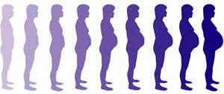
Overview of Perinatal Mood Disorder Treatment
Guidelines and clinical pearls
MCH Grand Rounds- August 3rd, 2016

Slide 2
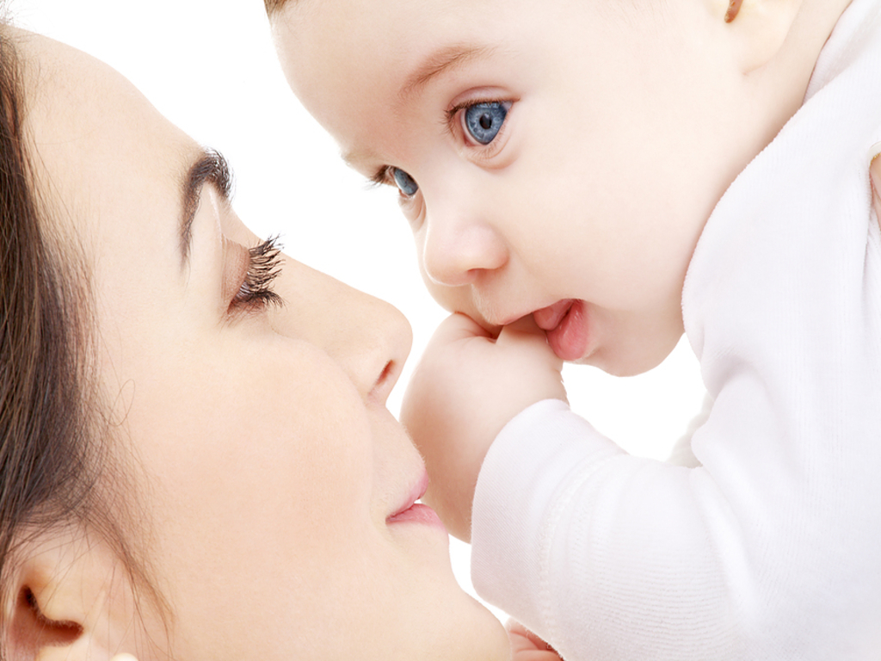
Our goals…
Providers would be screening, starting during pregnancy
Decision making regarding prescribing psychotropic medications to pregnant/lactating patients.
Referral to Community Resources if screen positive; warm hand-off when possible.

Slide 3

PMAD not PPD
PMAD incompasses all postpartum mood and anxiety disorders.
  Postpartum Depression
  Postpartum Anxiety
  Postpartum OCD
  Postpartum Psychosis
  Postpartum Bipolar Disorder
  Postpartum PTSD
PPD includes only postpartum depression.

Slide 4
Incidence of Sx in Postpartum
Depression symptoms 70%
Major Depression 10-16%
Bipolar relapse 32-67%
Anxiety symptoms 22-25%
1st Psychotic episode 1:500
Relapse after ANY previous psychotic episode 1:7
Sit, Rothschild, Wisner, 2006
Claessen, Josefsson, Sydsjo, 2010
Armstrong, 2008

Slide 5
Consequences of untreated
PMADs:
Long term attachment difficulties = increased chance of mental/emotional and behavioral risks for child in adolescence and adulthood
Increased risk of abuse for fathers/anger
Increased risk to baby/fetus of untreated health concerns or neglect (including use of substances)
Relationship stress/divorce

Slide 6

Screening Options
Edinburgh Postnatal Depression Scale (EPDS).
Free, most validated instrument;
Con: only assesses depression
DSM V criteria
PHQ or GAD
Verbally asking if either parent has a previous traumatic experience, or mental health history.

Slide 7
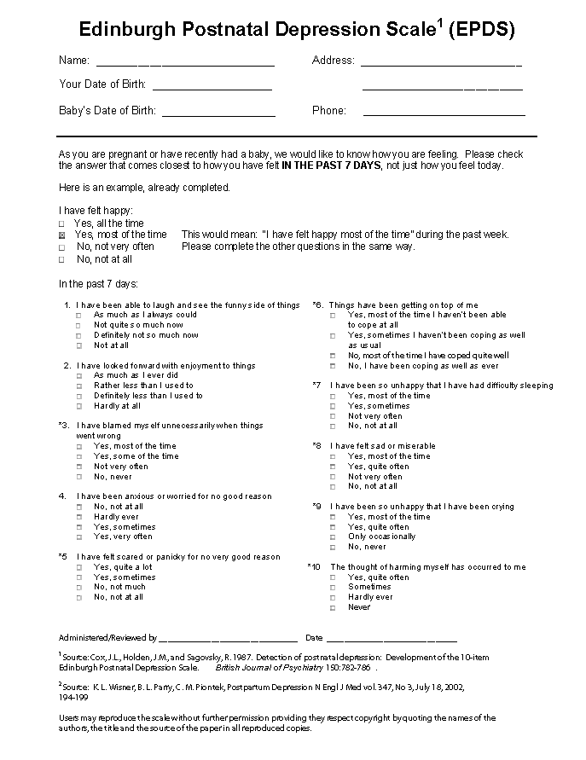
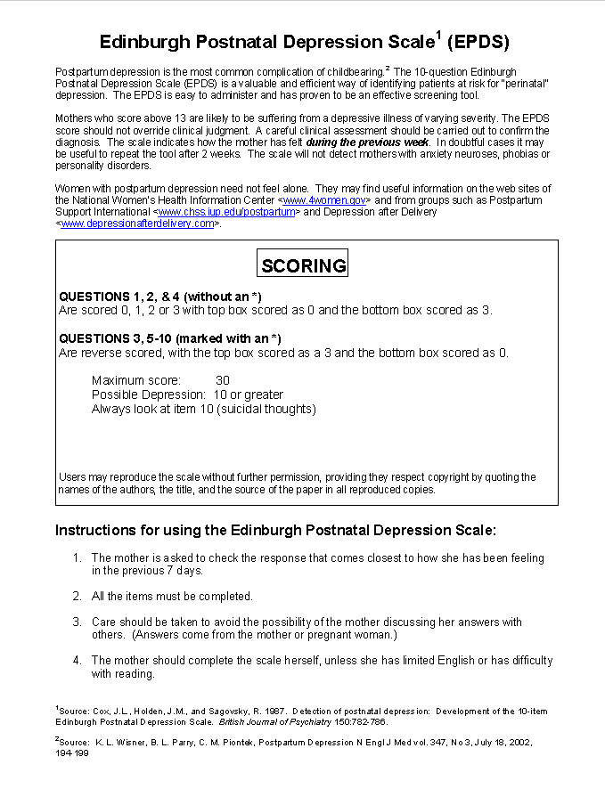
Tools Edinburgh Postnatal Depression Scale 1 (EPDS)

Slide 8
Who gets PMADs?
Incidence : 25-30%
Risk factors:
Family history of psychiatric illness
Social isolation
Limited social support
Partner/ relational problems
Domestic violence
Child abuse history
History of attachment problems
Low education level
Low socioeconomic status
Perfectionistic personality style
Previous mental health issues
Health condition with baby
Numerous situational stressors
Inherent risk of negative outcomes in pregnancy

Slide 9
Barriers to Accessing Care
Stigma of mental health and psychiatric illness in general
Lack of timely intervention with knowledgeable providers
Aversion to taking medication - mostly fear based due to lack of knowledge
Lack of knowledge
Negative feedback from support system on symptoms or use of medications
Sometimes providers are quick to offer a prescription without listening which disrupts the therapeutic alliance

Slide 10
Who should screen?
OB/Gyn, Nurse Midwives, MD- starting prenatally, and again postpartum
Pediatricians- well checks
Social Workers, NICU staff (if appropriate)
Other birthing professionals- doulas, lactation consultants
Anyone can screen- it is free, does not have to take a lot of time, and do not need knowledge of diagnosis.

Slide 11
Why aren’t we screening?
Time
Ethical dilemma-- resources?
“Who is the patient?”

Slide 12
Clinical Guidelines Established by AHRQ
Scientific evidence- Level A
Lithium is associated with congenital cardiac defects
Valproate increases risk of fetal anomalies
Carbamazepine syndrome
Benzodiazepines near delivery cause floppy infant syndrome
- Should be avoided if possible.

Slide 13
Clinical Guidelines Established by AHRQ
Limited evidence- Level B
Paxil exposure early pregnancy may cause heart defects, benzodiazepine exposure increases oral cleft by 0.01% suggest to avoid both.
Lamictal may protect against bipolar depression, relative safe profile.
Maternal psych illnesses if inadequately treated result in poor compliance w/ prenatal care, inadequate nutrition, exposure to herbal remedies, increased ETOH and tobacco use, mother-infant bonding and family disruptions.

Slide 14
Clinical Guidelines Established by AHRQ
Expert Opinion - Level C
Whenever possible, multidisciplinary management involving the patient's obstetrician, mental health
clinician, primary health care provider, and pediatrician is recommended to facilitate care.
Use of a single medication at a higher dose is favored over the use of multiple medications for the treatment of psychiatric illness during pregnancy.
The physiologic alterations of pregnancy may affect the absorption, distribution, metabolism, and elimination of lithium, and close monitoring of lithium levels during pregnancy and postpartum is recommended.
For women who breastfeed, measuring serum levels in the neonate is not recommended.
Treatment with all selective serotonin reuptake inhibitors (SSRIs) or selective norepinephrine reuptake inhibitors or both during pregnancy should be individualized.
Fetal assessment with fetal echocardiogram should be considered in pregnant women exposed to lithium in the first trimester.

Slide 15
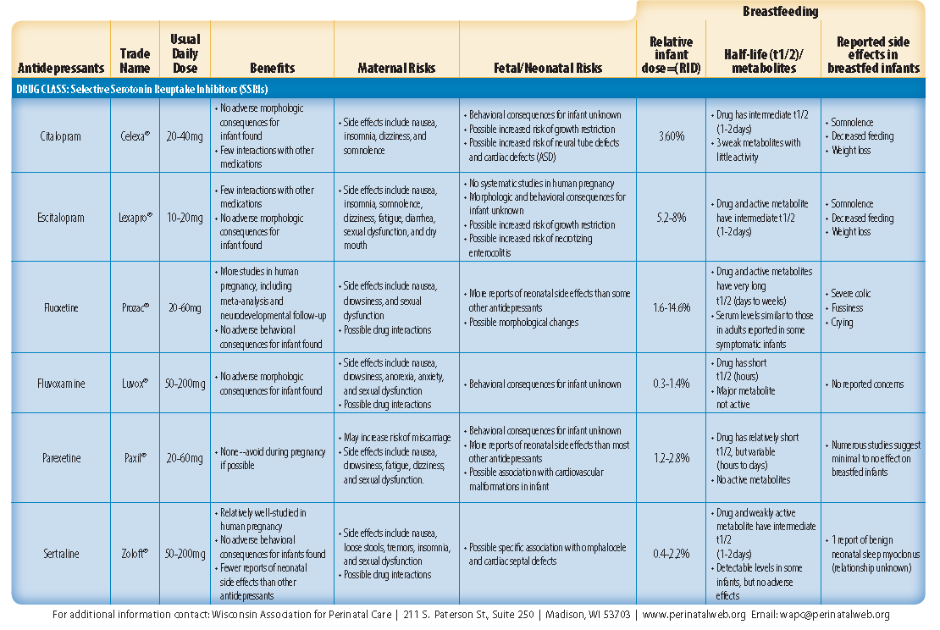

Slide 16
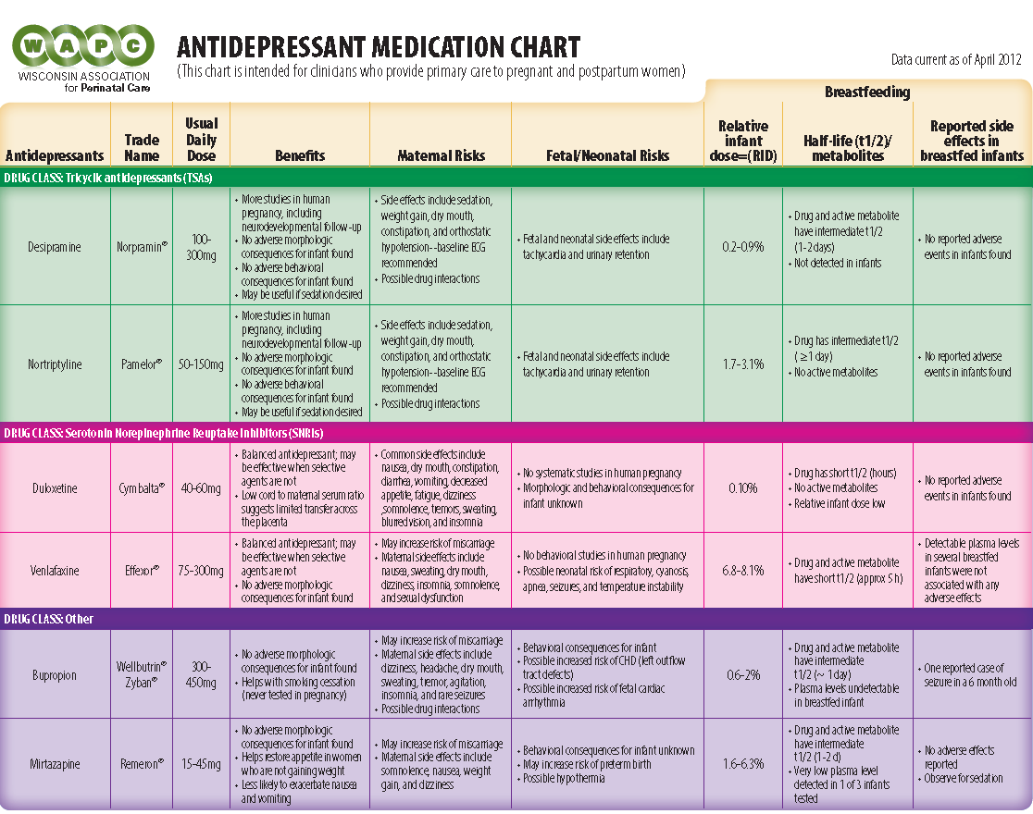

Slide 17
Number of Studies Showing Risk
 | Increased risk | No increased risk
wellbutrin | 2 | 2
celexa | 4 | 4
cymbalta | 1 | 0
lexapro | 0 | 4
prozac | 4 | 7
luvox | 0 | 4
remeron | 0 | 2
paxil | 8 | 7
zoloft | 3 | 6
trazodone | 0 | 2
effexor | 1 | 3

Slide 18
Risks associated with Antidepressants
 | Inherent Risk | On AD Risk
Spontaneous Abortion | 8.7% | 12.4%
Low Birth Weight | 8.2% | 9.6%
Preterm Labor | 5.4% | 8.8%
Cardiac Malformation | 1% | 2%
Persistent Pulmonary Hypertension | 0.7% | 3.7%
Postnatal Adaption Syndrome | 6.9% | 10-30%
Mother Baby Risk Program 2015
Einarson et all 2014
Notes:
Pulmonary hypertension risk increases on antidepressant after 20 weeks gestation with a 10-20% mortality rate

Slide 19

Number of studies finding risk: 6 Number of studies finding no risk: 6
Two of the studies finding a correlation w/ AD use found the same correlation with maternal history of depression.
None of the studies finding and association w/ ADS controlled for all impacting comorbid considerations; socioeconomic status, age of mother, gestational age, obesity, smoking, maternal hx depression, chronic health conditions, prenatal care.
General consensus from + findings; risk of ASD on AD increase from 1% to 1.5% similar to ASD risk of babies born to mothers w/ hx of depression.

Slide 20
Study | Found ASD/AD | No ASD/AD | Notes
2013- Wangari |  | X = N 589,114
2016 - Castro |  | X = N 3000
2015 - Erb |  | X = N 3600
2104 - Gidaya | X = N 628,408 |  | No MD control
2013 - Rai | X = N 60,000 | MD as much risk ADS | As the AD exposure
2013 - Sorensen |  | X = N 668,468 | Did control MD, age
2013- Hviid |  | X = N626,875
1997- Nulman |  | X = N 164
2011 - Croen | X = N 1507 |  | No depression control
2015 - Boukhris | X = N 145,456 |  | Control issues
2015 - Man | X = Meta analysis |  | No control MD,age, $
2014- Marroun | X = N 4264 | AD risk same in SSRI | As w/ MD

Slide 21
Postnatal Adaption Syndrome Symptoms
Insomnia or somnolence
Agitation, tremors, jitteriness, shivering and/ or altered tone
Restlessness, irritability & constant crying
Poor feeding, vomiting or diarrhoea
Poor temperature control, hypoglycaemia
Tachypnoea, respiratory distress, nasal congestion or cyanosis
Seizures

Slide 22
Postnatal Adaption Syndrome
10-30% babies born mom’s on SRRI
Usually short lived with a median duration of 3 days
75 % complete resolution by 5 days
reports of adaptation signs lasting up to 4 weeks
Premature babies are more vulnerable to PNAS
Symptoms can vary greatly in severity from mild transitory symptoms to more severe symptoms including seizures and dehydration
Increased PNAS in babies born to mom’s that have Cyp mutations resulting in drug level elevations

Slide 23
What do Genomics Matter? Pregnancy causes:
CYP 1A2 = decreased processing in pregnancy
CYP 2C9 = decreased processing
CYP 2C19 = decreased processing
CYP 2D6 = increased clearance in pregnancy, 48% by 3rd trimester
CYP 3A4 = increased by 35-38% in all stages of pregnancy

Slide 24
Everyday medications affect other drugs
PPI’s/ H2 agonists inhibit CYP function
Dexamethasone inhibits 2C9 but induces 3A4
Erythromycin 3A4 inhibitor
Nifedipine 2C9 and 3A4 inhibitor

Slide 25
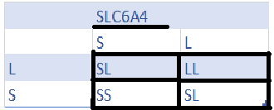
Gene Expression
MTHFR-
C677T variant more likely to have depression
SLC6A4-
babies born with this SNP are more likely to have postnatal adaption syndrome.
Babies will have this SNP mutation based on maternal/paternal.

Slide 26
Relative infant dose SSRI’s
citalopram 3.6%
escitalopram 5.2-8%
fluoxetine 1.6-14.6%
fluvoxamine 0.3-1.4%
paroxetine 1.2-2.8%
sertraline 0.4-2.2%
Wellbutrin 0.6-2%
Remeron 1.6-6.3%
Effexor 6.8-8.1%
Cymbalta < 1%
WAPC_med_chart_2012
Amitriptyline 1.9-2.8%
Imipramine 0.1-4.4%
Hale’s breastfeeding rating 2012

Slide 27
Resources for patients
PPSM- www.ppsupportmn.org (in Minnesota)
Postpartum Support International- www.postpartum.net
http://www.infantrisk.com
https://womensmentalhealth.org
http://perinatalweb.org/assets/cms/uploads/files/WAPC_Med_Chart_2012_v9%281%29.pdf

Slide 28
Resources for Providers
http://Reprotx.com
http://www.medsmilk.com
http://toxnet.nlm.nih.gov/newtoxnet/lactmed.htm
https://womensmentalhealth.org
http://ajp.psychiatryonline.org/doi/abs/10.1176/appi.ajp.2015.15040506
Standardized Clinical Guidelines
https://www.guideline.gov/content.aspx?id=12490
Antidepressant use in pregnancy: Knowledge transfer and translation of research findings
http://dspace.library.uu.nl/bitstream/handle/1874/311668/Einarson.pdf?sequence=2#page=23
Hope Line HCMC Mother Baby. 612-873-HOPE (medication information, may be 2 day turnaround on message) (MN)

Slide 29
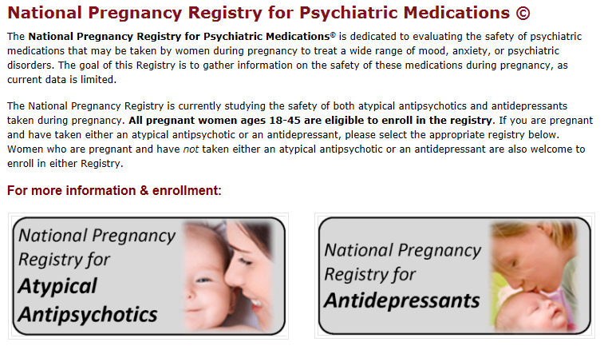
Please Register Your Patients!!
Antidepressants--1-844-405-6185
Antipsychotics--1-866-961-2388

Slide 30
References
Boukhris, T., Sheehy, O., & Bérard, A. (2014). Antidepressant use during pregnancy and risk of autism spectrum disorders in children: A population-based cohort study. Value in Health, 17(3), A211.
Boukhris, T., Sheehy, O., Mottron, L., & Bérard, A. (2015). Antidepressant use during pregnancy and the risk of autism spectrum disorder in children. JAMA pediatrics, 1-8.
Brummelte, S., et al. "Antidepressant use during pregnancy and serotonin transporter genotype (SLC6A4) affect newborn serum reelin levels." Developmental psychobiology 55.5 (2013): 518-529.
Castro, V. M., Kong, S. W., Clements, C. C., Brady, R., Kaimal, A. J., Doyle, A. E., ... & Perlis, R. H. (2016). Absence of evidence for increase in risk for autism or attention-deficit hyperactivity disorder following antidepressant exposure during pregnancy: a replication study. Translational psychiatry, 6(1), e708.
Clements, C. C., Castro, V. M., Blumenthal, S. R., Rosenfield, H. R., Murphy, S. N., Fava, M., ... & Robinson, E. B. (2015). Prenatal antidepressant exposure is associated with risk for attention-deficit hyperactivity disorder but not autism spectrum disorder in a large health system. Molecular psychiatry, 20(6), 727-734.

Slide 31
References
Harrington, R. A., Lee, L. C., Crum, R. M., Zimmerman, A. W., & Hertz-Picciotto, I. (2014). Prenatal SSRI use and offspring with autism spectrum disorder or developmental delay. Pediatrics, 133(5), e1241-e1248.
Hviid, A., Melbye, M., & Pasternak, B. (2013). Use of selective serotonin reuptake inhibitors during pregnancy and risk of autism. New England Journal of Medicine, 369(25), 2406-2415.
Jani, S., Banu, S., & Shah, A. A. (2015). SSRI Use During Pregnancy and Autism: Is It a Real Threat?. Psychiatric Annals, 45(2), 83-88.
King, B. H. (2015). Assessing Risk of Autism Spectrum Disorder in Children After Antidepressant Use During Pregnancy. JAMA pediatrics, 1-2.
Man, K. K., Tong, H. H., Wong, L. Y., Chan, E. W., Simonoff, E., & Wong, I. C. (2015). Exposure to selective serotonin reuptake inhibitors during pregnancy and risk of autism spectrum disorder in children: A systematic review and meta-analysis of observational studies. Neuroscience & Biobehavioral Reviews, 49, 82-89.
Rai, D. (2013). Environmental risk factors for autism spectrum disorders.
Rai, D., Lee, B. K., Dalman, C., Golding, J., Lewis, G., & Magnusson, C. (2013). Parental depression, maternal antidepressant use during pregnancy, and risk of autism spectrum disorders: population based case-control study.

Slide 32
References
Rosenberg, K. (2016). A Possible Link Between Antidepressant Use During Pregnancy and Autism Spectrum Disorder. AJN The American Journal of Nursing, 116(3), 58-59.
Shea, A. K., & Oberlander, T. F. (2012). Fetal serotonin reuptake inhibitor antidepressant exposure: maternal and fetal factors. Canadian Journal of Psychiatry, 57(9), 523.
Wemakor, A., Casson, K., Garne, E., Bakker, M., Addor, M. C., Arriola, L., ... & O’Mahoney, M. (2015). Selective serotonin reuptake inhibitor antidepressant use in first trimester pregnancy and risk of specific congenital anomalies: a European register-based study. European journal of epidemiology, 30(11), 1187-1198.

Slide 33
References
Meridith Corp, 2011- http://www.parents.com/pregnancy/my-life/emotions/understanding-pregnancy-hormones/
Lactmed - https://www.nlm.nih.gov/news/lactmed
Mothers Milk- http://www.halepublishing.com/medications-mothers-milk-online-10
Hales Breastfeeding Rating
Croen, L. 2011. Antidepressant Use During Pregnancy and Childhood Autism Spectrum Disorders. file:///C:/Users/Owner/Downloads/yoa15049_1104_1112.pdf

