Slide 1
Firearm-Related Trauma
Response Toolkit
Designed to help individuals, families, and community members
navigate the immediate aftermath of firearm-related trauma,
access long-term support and recovery resources,
and help our community prevent violence.
Developed by University of Rochester Medicine
in collaboration with government and community partners
Last updated: May 20, 2026

Slide 2





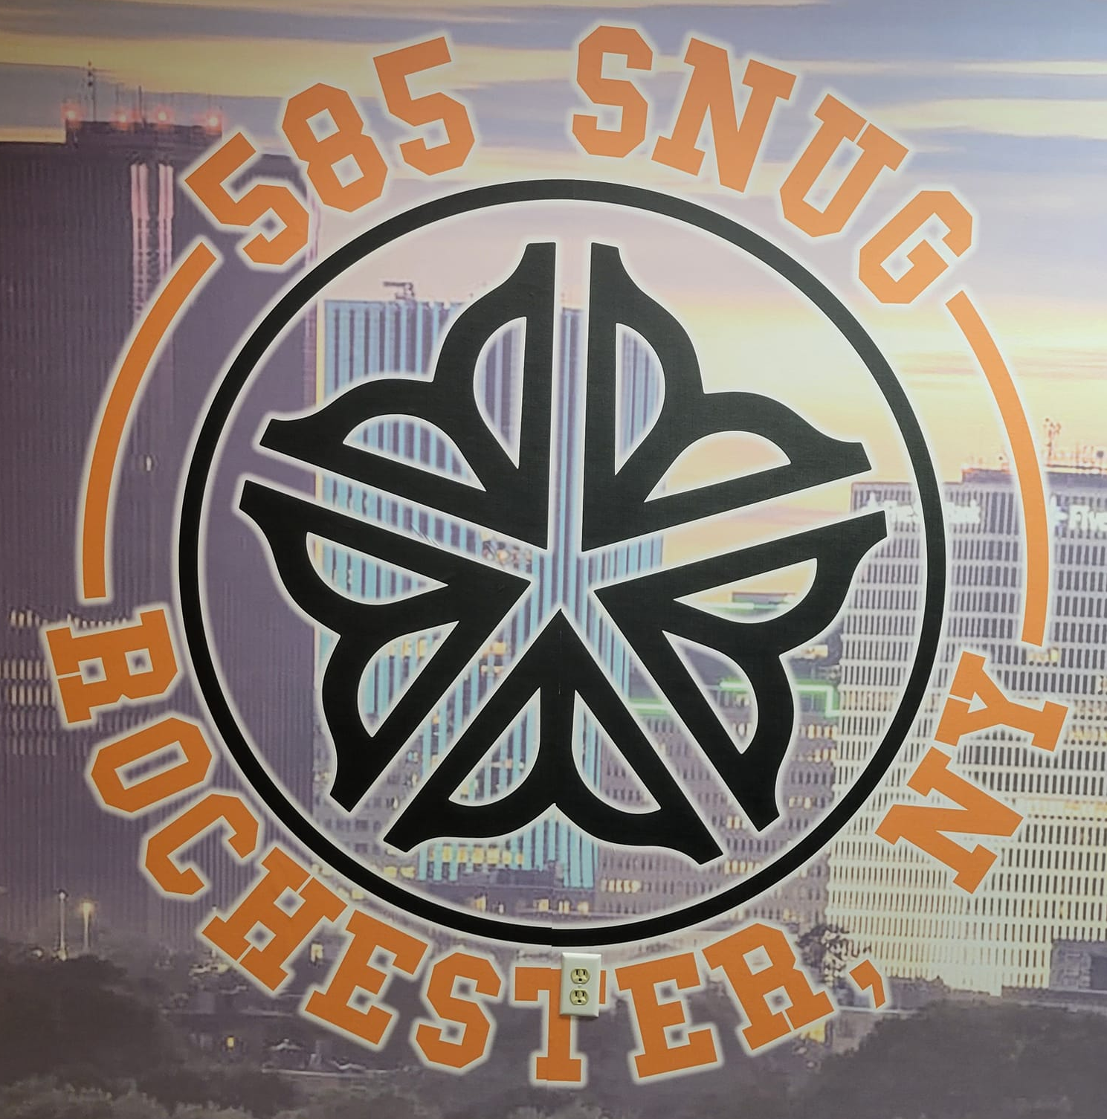
Partners Who Collaborated to Create This Toolkit

Slide 3
Objective
Our goal is to connect community members with resources that enable them to:
Navigate the immediate aftermath of firearm-related traumatic events
Access long-term support and recovery resources
Support community efforts to prevent violence
This resource will be available in both printed and digital formats, accessible to the general public through the websites of health systems and key community partners. Each section includes local health system and community resources, with contact details and links.

Slide 4
Section I: Immediate Help After a Violent or Traumatic Event

Slide 5
What to Expect at the Emergency Department
Understanding the process and resources available during emergency care.
Hospital EDs have Emergency Medicine trauma teams who assess and treat patients
The medical staff’s first priority is to stabilize and care for the patient
  Information that can be relayed to family members may be limited while this is happening
  Family members should request a point of contact to provide updates as available
  Families can help with care by providing details on medications, allergies, and prior treatments
  Depending on their loved one’s condition, family may not be able to visit right away
  Medical staff must adhere to privacy laws and limit information to people not listed
  as a contact
ED Security staff and law enforcement are required to ensure everyone’s safety
  They will never interfere with patient care
  They may need to limit patient visitation or sharing of information with families
  Directives related to ED safety and ongoing investigations must be obeyed

Slide 6
Health System Resources for Families in Crisis
URochester Medicine Services:
Crisis Call Line (24/7)
Phone: 585-275-8686
Website: https://www.urmc.rochester.edu/conditions-and-treatments/crisis-call-line-counseling
On-Demand Telehealth
Website: https://www.urmc.rochester.edu/get-care-now/virtual-mental-health-urgent-care
Brighter Days Pediatric Mental Health Urgent Care Center (up to 18)
Phone: 585-273-5050
Address: 300 Crittenden Blvd, Rochester, NY 14642
Website: https://www.urmc.rochester.edu/locations/mental-health-wellness-brighter-days-pediatric-urgent-care-center
Mobile Crisis Team
Phone: 585-275-5151
Website: https://www.urmc.rochester.edu/conditions-and-treatments/mobile-emergency-psychiatric-care
Comprehensive Psychiatric Emergency Program (CPEP)
Phone: 585-275-4501
Address: 300 Crittenden Blvd, Rochester, NY 14642
Website: https://www.urmc.rochester.edu/conditions-and-treatments/cpep
Rochester Regional Health Services:
Crisis Call Line
Phone: 585-368-3950 (open 9:00 am - 9:00 pm daily)
Website: https://www.rochesterregional.org/services/youth-family-behavioral-health/crisis-care
Behavioral Health Access & Crisis Center (18+)
Phone: 585-368-3950
Address: 89 Genesee Street, Rochester, NY 14611
Website: https://www.rochesterregional.org/locations/st-marys-campus/bhacc
Clifton Springs Comprehensive Psychiatric Emergency Program (CPEP)
Phone: 315-462-1080
Address: 2 Coulter Road, Clifton Springs, NY 14432
Website: https://www.rochesterregional.org/locations/clifton-springs-hospital-clinic/cpep

Slide 7
Common Responses After Trauma: Children and Teens
There is no one way that children will respond, and responses will vary depending on the age of children and their experience of the event (for example, whether they witnessed it or someone close to them was injured or killed).
Common reactions that youth experience include:
  Physical: stomach discomfort, headaches
  Emotional: anxiety, sadness, guilt, irritability, anger, increased fears that something scary or bad will happen; difficulty regulating emotions
  Difficulty paying attention and concentrating
  Changes in appetite, difficulty sleeping
  Behavior: increased clinginess, increased or decreased energy level, an increased desire to stay at home, less interest in usual activities, increased sensitivity to noises, decline in school/work performance, difficulty regulating behavior, changes in self-care, and engaging in risky/unsafe behaviors.
  Strong emotional and/or behavioral reactions to reminders of the shooting
These reactions usually decrease over time. When they persist or seriously impact the child’s ability to participate in normal activities, it is important to seek help from a medical or mental health professional. Seek immediate help if your child demonstrates urgent concerns related to safety (engaging in self-harm, expressing thoughts of wanting to hurt themselves or others).

Slide 8
Supporting Children and Teens After Trauma:
Guidance for Caregivers
Let children know that all of their feelings are okay and normal.
Encourage children to express their feelings with their words, through play, through art (drawing, dance, music) or exercise.
Maintain routines (mealtimes, bedtimes, school/activity attendance), expectations, rules and structure.
Reassure children that you and other caring adults in their lives (family, friends, teachers) are there to support them and remind them of the ways that you and others keep them safe
You and your children may have a desire to do something helpful, such as, participating in a community group event, writing thank you letters to first responders or bringing a meal to others impacted by the tragedy.

Slide 9
Supporting Children and Teens After Trauma:
Guidance for Caregivers cont’d
Find quiet times to talk about what happened and how children are feeling. Start by asking them what they already know and what questions they have which will help guide your conversation. It’s okay if you don’t have all the answers. Talking about what happened may happen over many conversations. If it’s not the right time because you are busy or feeling overwhelmed, make a plan for when you can sit down to listen.
Limit media exposure, which can heighten anxiety in children. If children are exposed to violent images, try also to find images of people being helpful in response to the tragedy.
It’s okay and may be helpful for children to see you feeling sad or crying, but if you are experiencing intense emotions, it may be helpful to express those away from children.
Take care of your own feelings by talking with other trusted adults, making time for self-care, and taking media breaks, or engaging in empowerment by taking action and getting involved in anti-violence initiatives.

Slide 10
Supporting Children and Teens After Trauma:
Helpful Messages
“What you saw/experienced was scary. I will always do my best to keep you safe, and there are lots of other grown-ups/adults who also help keep you safe in our neighborhood/community and at school.”
“There are lots of different ways that kids feel after something like this. All of your feelings are okay. I’m always here to listen, give you a hug, or help you figure out what to do when your feelings seem really big or difficult.”
“Going to school/activities, going to bed and eating at our regular times will help you feel better. I will also make extra time for us to be together.”
“What do you know about what happened, and what questions do you have? I might not have all the answers, but I am here to listen whenever you want to talk. If I’m busy, I’ll find a time when we can have a conversation.”

Slide 11
Common Responses After Trauma: Adults
Adults are affected by the traumatic event of a shooting in a range of ways, and there is no one way that individuals respond. Individuals who were injured, experienced the loss or injury of someone they knew, were present when the shooting happened, or who have previously experienced a similar event may experience more intense reactions and/or ones that last longer.
Common and normal reactions after a shooting can include the following and usually lessen over the first few weeks:
  Physical symptoms: feeling on edge, jitteriness, pain and muscle tension, stomach aches, nausea
  Emotional symptoms: anxiety, panic, low motivation, sadness, depression, loneliness, irritability, anger, desire for revenge
  Cognitive symptoms: difficulty concentrating or remembering things, hard to stop thinking about what happened
  Changes in appetite, difficulty sleeping

Slide 12
Ways to Cope After Trauma: Adults
There is no one right way to cope, but some helpful ways can include:
  Connecting with those in your life you care about and who care about you and who provide you with a sense of calmness, safety, or happiness.
  Talking about the event with family members, friends, and other supportive people in your life to express your thoughts and feelings.
  Resuming normal routines (work, school, exercise, worship) and schedules (sleep, meals) to help re-establish a sense of control and safety.
  Finding ways to get involved in supporting and helping others who were impacted.
  Being compassionate with yourself – reminding yourself that your feelings are normal and ok and that recovery takes time.
Many adults recover from the trauma on their own and with the support of members of their support systems.
It is recommended that individuals experiencing symptoms that continue for more than one month after the traumatic event make an appointment with their primary care provider or a mental health professional.
Adults should seek immediate help if they experience urgent concerns related to safety (engaging in self-harm, expressing thoughts of wanting to hurt themselves or others).

Slide 13
National Resources and Guidelines
Comprehensive support for individuals and families in crisis.
Parent Guidelines for Helping Youth After the Recent Shooting: Practical advice for supporting children emotionally.
  Resource: https://www.nctsn.org/resources/parent-guidelines-helping-youth-after-recent-shooting
Coping After Mass Violence: Strategies for families to manage stress and grief.
  Resource: https://www.nctsn.org/resources/coping-after-mass-violence
Talking to Children: Guidance for age-appropriate conversations.
  Resource: https://agreetoagree.org/conversation-guides/talk-with-kids-about-a-community-tragedy
  Resource: https://www.nctsn.org/resources/talking-to-children-when-scary-things-happen
  Resource: https://everytownsupportfund.org/report/talking-to-children-about-gun-violence/
Supporting Adults After Trauma
  Resource: https://istss.org/public-resources/trauma-basics/trauma-during-adulthood/
Helping Youth after Community Trauma: Tips for Educators: Tools for creating supportive classroom environments.
  Resource: https://www.nctsn.org/resources/helping-youth-after-community-trauma-tips-educators
  Resource (Video): Violence - Sesame Workshop
Together, We Can Build a Safer, Healthier Community
For more resources and information, visit https://www.urmc.rochester.edu/firearm-injury-prevention-program.aspx.

Slide 14
Section II: Longer Term Recovery and Support

Slide 15
Mental Health and Wellness Support After Trauma –
University of Rochester Medicine
Pediatric Behavioral Health: Care for youth with emotional and behavioral challenges.
Pediatric Behavioral Health & Wellness
  Phone: 585-279-7800
  Website: https://www.urmc.rochester.edu/childrens-hospital/behavioral-health-wellness/outpatient.aspx
Adult Mental Health: Treatment for adults managing anxiety, depression, and psychosis.
Adult Outpatient Mental Health Services
  Phone: 585-237-5050
  Website: https://www.urmc.rochester.edu/conditions-and-treatments/adult-outpatient-mental-health-care
Trauma Survivors Network at Kessler Trauma Center: Provides information and support linkages.
  Website: https://www.traumasurvivorsnetwork.org/trauma-centers-172/

Slide 16
Mental Health and Wellness Support After Trauma – Rochester Regional Health
Adult Mental Health: Treatment for adults managing anxiety, depression, and psychosis.
Phone: 585-922-9206
Website: https://www.rochesterregional.org/services/behavioral-health
Youth and Family Services: Offering psychiatric evaluation, school-based care, and individual and family therapy.
Phone: 585-922-9900
Website: https://www.rochesterregional.org/services/youth-family-behavioral-health/individual-and-family-therapy

Slide 17
Section III: Community Partners
Resources to support victims of firearm-related trauma and their families, and to reduce
violence in our community.

Slide 18
Community Resources for Violence Intervention and Prevention
Local organizations offering education and support for individuals affected by violence
Rise Up Rochester: Rise Up Rochester provides victim support, mediates disputes, and promotes nonviolence in schools and neighborhoods.
  Phone: 585-454-3060
  Address: 244 S Plymouth Ave, Rochester, NY 14608,
  Website: Rise Up Rochester
SNUG / SNUG@RRH: Reduces gun violence by mediating conflicts and supporting at-risk individuals.
  Phone: 585-615-4315
  Phone SNUG@RRH Landline: 585-922-4826
  Address: 189 N Water St Suite 1, Rochester, NY 14604
  Website: 585 SNUG on Facebook
Pathways to Peace: Offers nonviolent alternatives and support for youth involved in gangs or violent disputes.
  Phone: Call or text 585-428-SAFE (585-428-7233)
  Address: 57 St. Paul Street, Rochester, NY 14604
  Website: Pathways to Peace

Slide 19
URochester Medicine Prevention Programs
UR Medicine Firearm Injury Prevention Program (FIPP) Collaborates with health care providers, community agencies, and community members in Rochester and the Finger Lakes region to find effective ways to prevent firearm-related suicide, unintentional injury and death, assaults, and homicides through education, resource-sharing, research, and open dialogue.
  Phone: 585-276-8605
  Website: https://www.urmc.rochester.edu/firearm-injury-prevention-program.aspx
Rochester Youth Violence Partnership A hospital-based program connecting trauma victims with resources to reduce violence.
  Contact: For more information, please contact: preventing_firearm_injury@urmc.rochester.edu
  Website: https://www.urmc.rochester.edu/burn-trauma/kessler-trauma-center/prevention-outreach.aspx

Slide 20
Additional Resources
City of Rochester Services: Office of Violence Prevention
Contact: Zequa Tookes, OVP Director
Phone: 585-428-7233
Address: 57 St. Paul St., 3rd Floor, Rochester, NY 14604
Website: https://www.cityofrochester.gov/departments/office-violence-prevention
Monroe County Office of Mental Health's local community guide provides a comprehensive list of community resources focused on violence prevention.
Phone: 585 753-6047
Address: 1099 Jay Street, Bldg. J, Rochester, NY 14611
Email: MentalHealth@monroecounty.gov
Website: https://www.monroecounty.gov/mh
PDF: Monroe County Crisis Services
https://www.monroecounty.gov/files/mh/MC-CrisisServices.pdf
Monroe County District Attorney's Office: Legal support and resources for crime victims.
https://www.monroecounty.gov/da
Address: 47 S. Fitzhugh St., Rochester, NY 14614
Phone: 585 753-4500, Fax: 585 753-4576

