Slide 1
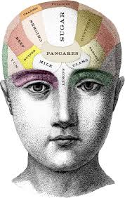
Food and Mood
Strong Employee Assistance Program
Tracy Bussey, LMHC
Notes:
This slide has the Slide Design template “content” applied.
The first level bullet has been set up with a “null” character to make it appear unbulleted and still allow automatic bullets for subsequent levels. The second through fifth levels have bullets: from the left margin, tab once (or click the “increase indent” button) and the second level bullet will appear; further tabbing increases the indent and produces the corresponding bullet.

Slide 2
The Wizard behind the Curtain
Strong Employee Assistance Program
The brain regulates activities we rarely give any thought to-heartbeat and respiration, wakefulness and sleep and digestion- just to name a few.
The brain also directs our thoughts, actions, emotions and basic desires.
In support of this tremendous workload, the brain utilizes 20 percent of the entire energy supply from the body.
Where does this energy supply come from???

Slide 3
The Standard American Diet
Strong Employee Assistance Program
“In the so-called Western diet, food has been replaced by nutrients, and common sense by confusion.”-Michael Pollan, In Defense of Food
In the last 75 years, we have moved from a primarily whole foods diet to one that is primarily based on processed foods and refined plants.
The main features of the Standard American Diet (SAD) consist of lots of meat and processed food, lots of added fat and sugar, lots of everything-except fruits, vegetables and whole grains.

Slide 4
S.A.D. Part II
Americans suffer with much higher rates of cancer, heart disease, diabetes and obesity than people eating more traditional diets.
Traditional diets-foods your great grandmother would have eaten(whole, unprocessed, nutrient dense foods)-have been consistently associated with significantly lower risks of mental health issues.
“The food that you eat can either be the safest & most powerful form of medicine or the slowest form of poison.” –Anne Wigmore
Notes:
The single biggest environmental influence you can control is what you eat. Eating is our most profound engagement with the natural world, we take nature into our bodies and express our values-what we choose to eat, what not to eat embodies what we care about.
Food is not just calories-it is information. It tell our genes what to do. This communication is very clear with the negative impact of SAD on our health.

Slide 5
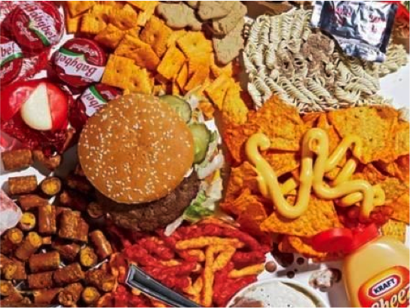
Standard American Diet (SAD)

Slide 6
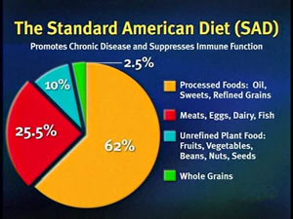
Standard American Diet (SAD)

Slide 7
SAD-US Sugar Consumption History

Slide 8
The Shape of things to Come The Economist Dec.11,2003
Strong Employee Assistance Program

Slide 9
Your Brain on S.A.D.
We are experiencing a bad mood epidemic-100 times more likely to have significant mood problems than people born 100 years ago.
Your mood is the first casualty of malnutrition-even before your physical health begins to deteriorate.
Forty percent of how you feel right now is related to your last meal.
“Junk moods come from junk food”. –Julia Ross, The Mood Cure

Slide 10
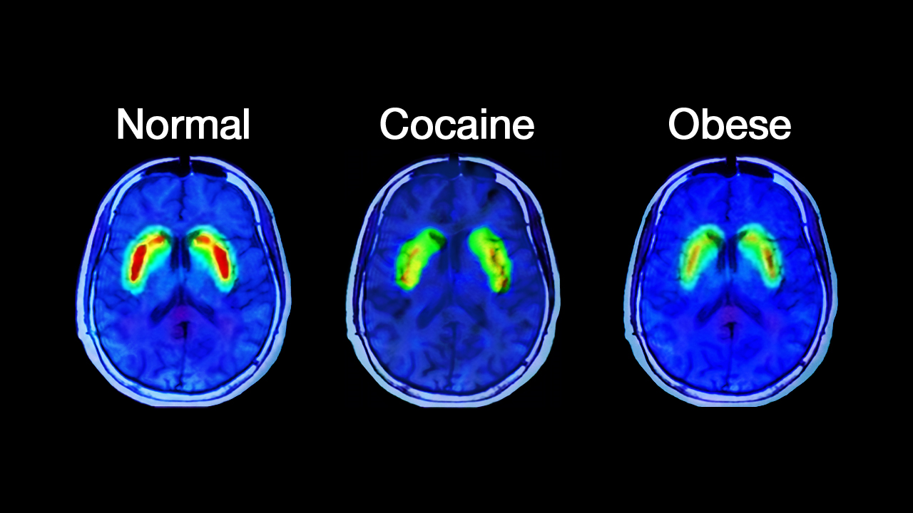
Your Brain on Sugar
According to brain scans-sugar is as addictive as cocaine. Just like cocaine, sugar intake eventually blunts dopamine release.
High sugar consumption is linked to-lower IQ, anxiety, aggressive behavior, hyperactivity, depression, learning difficulty, fatigue , dementia and Alzheimer’s.
Notes:
High fructose corn syrup-Completely unknown to us before 1980, we know make 17.5 billion pounds of it and consume 66 pounds per person every year. It is a more potent form of sugar, increases appetite, promotes obesity and leads to diabetes and an inflamed brain. It is the main form of sweetener in all processed food and junk food, from cola to turkey slices.

Slide 11
Your Brain on Trans Fats (Franken Fats)
2009-WHO declared that trans fats (from hydrogenated vegetable oils) really are toxic. Most sensible countries now ban them.
These “fake fats” raise the risk for-Type II diabetes, Cardiovascular disease, Obesity and Inflammation.
Trans Fats are associated with-Depression, anxiety, memory problems and irritability and aggression.
Trans fats are hidden in almost all convenience food and fried.
Notes:
In a recent study, conducted at the University of Las Palmas de Gran Canaria in Spain has found that trans fatty acids leads to biological changes that are linked not only to heart disease, but also to depression. Among those who consumed the most trans fat (1.5 grams per day), the researchers found a 48% increased risk of depression.
Conversely, those who consumed mostly unsaturated oils such as olive oil had a 30% lower risk of depression.

Slide 12
Your Brain on Grain
Gluten free isn’t new or a fad. It’s the diet that humans have consumed for more than 99.9% of our existence on this planet.
Recent review in New England Journal Of Medicine listed 55 diseases that are related to consuming gluten including disease such as anxiety, depression, schizophrenia, dementia and migraines.
Gluten contains significant amounts of glutamate-an excitotoxin (a substance that overexcites and kills or damages brain cells)
Notes:
Wheat was introduced into our diet in the Middle Ages
American strains of wheat have a much higher gluten content (which is needed to make light, fluffy Wonder Bread and giant bagels) than those traditionally found in Europe. This super-gluten was recently introduced into our agricultural food supply and now has “infected” nearly all wheat strains in America.
.

Slide 13
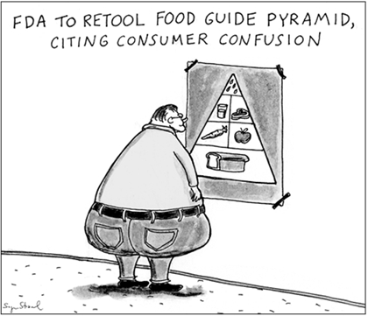
Nutritional Confusion
Notes:
We’ve lost our basic knowledge and intuition when it comes to food. Where else in life do you need so much science to get through the day? When you focus on nutrition you rely on experts to tell you how to eat.
For example by demonizing fat in the late ‘70s and early ‘80s we ended up with margarine and a whole lot of low fat processed goods on the supermarket shelves (which are still there, by the way). It gave a ‘free pass’ to eat and drink as much as you want because it was low fat.
But instead we became fat.

Slide 14
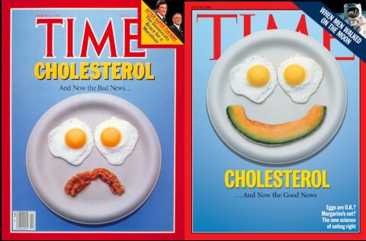
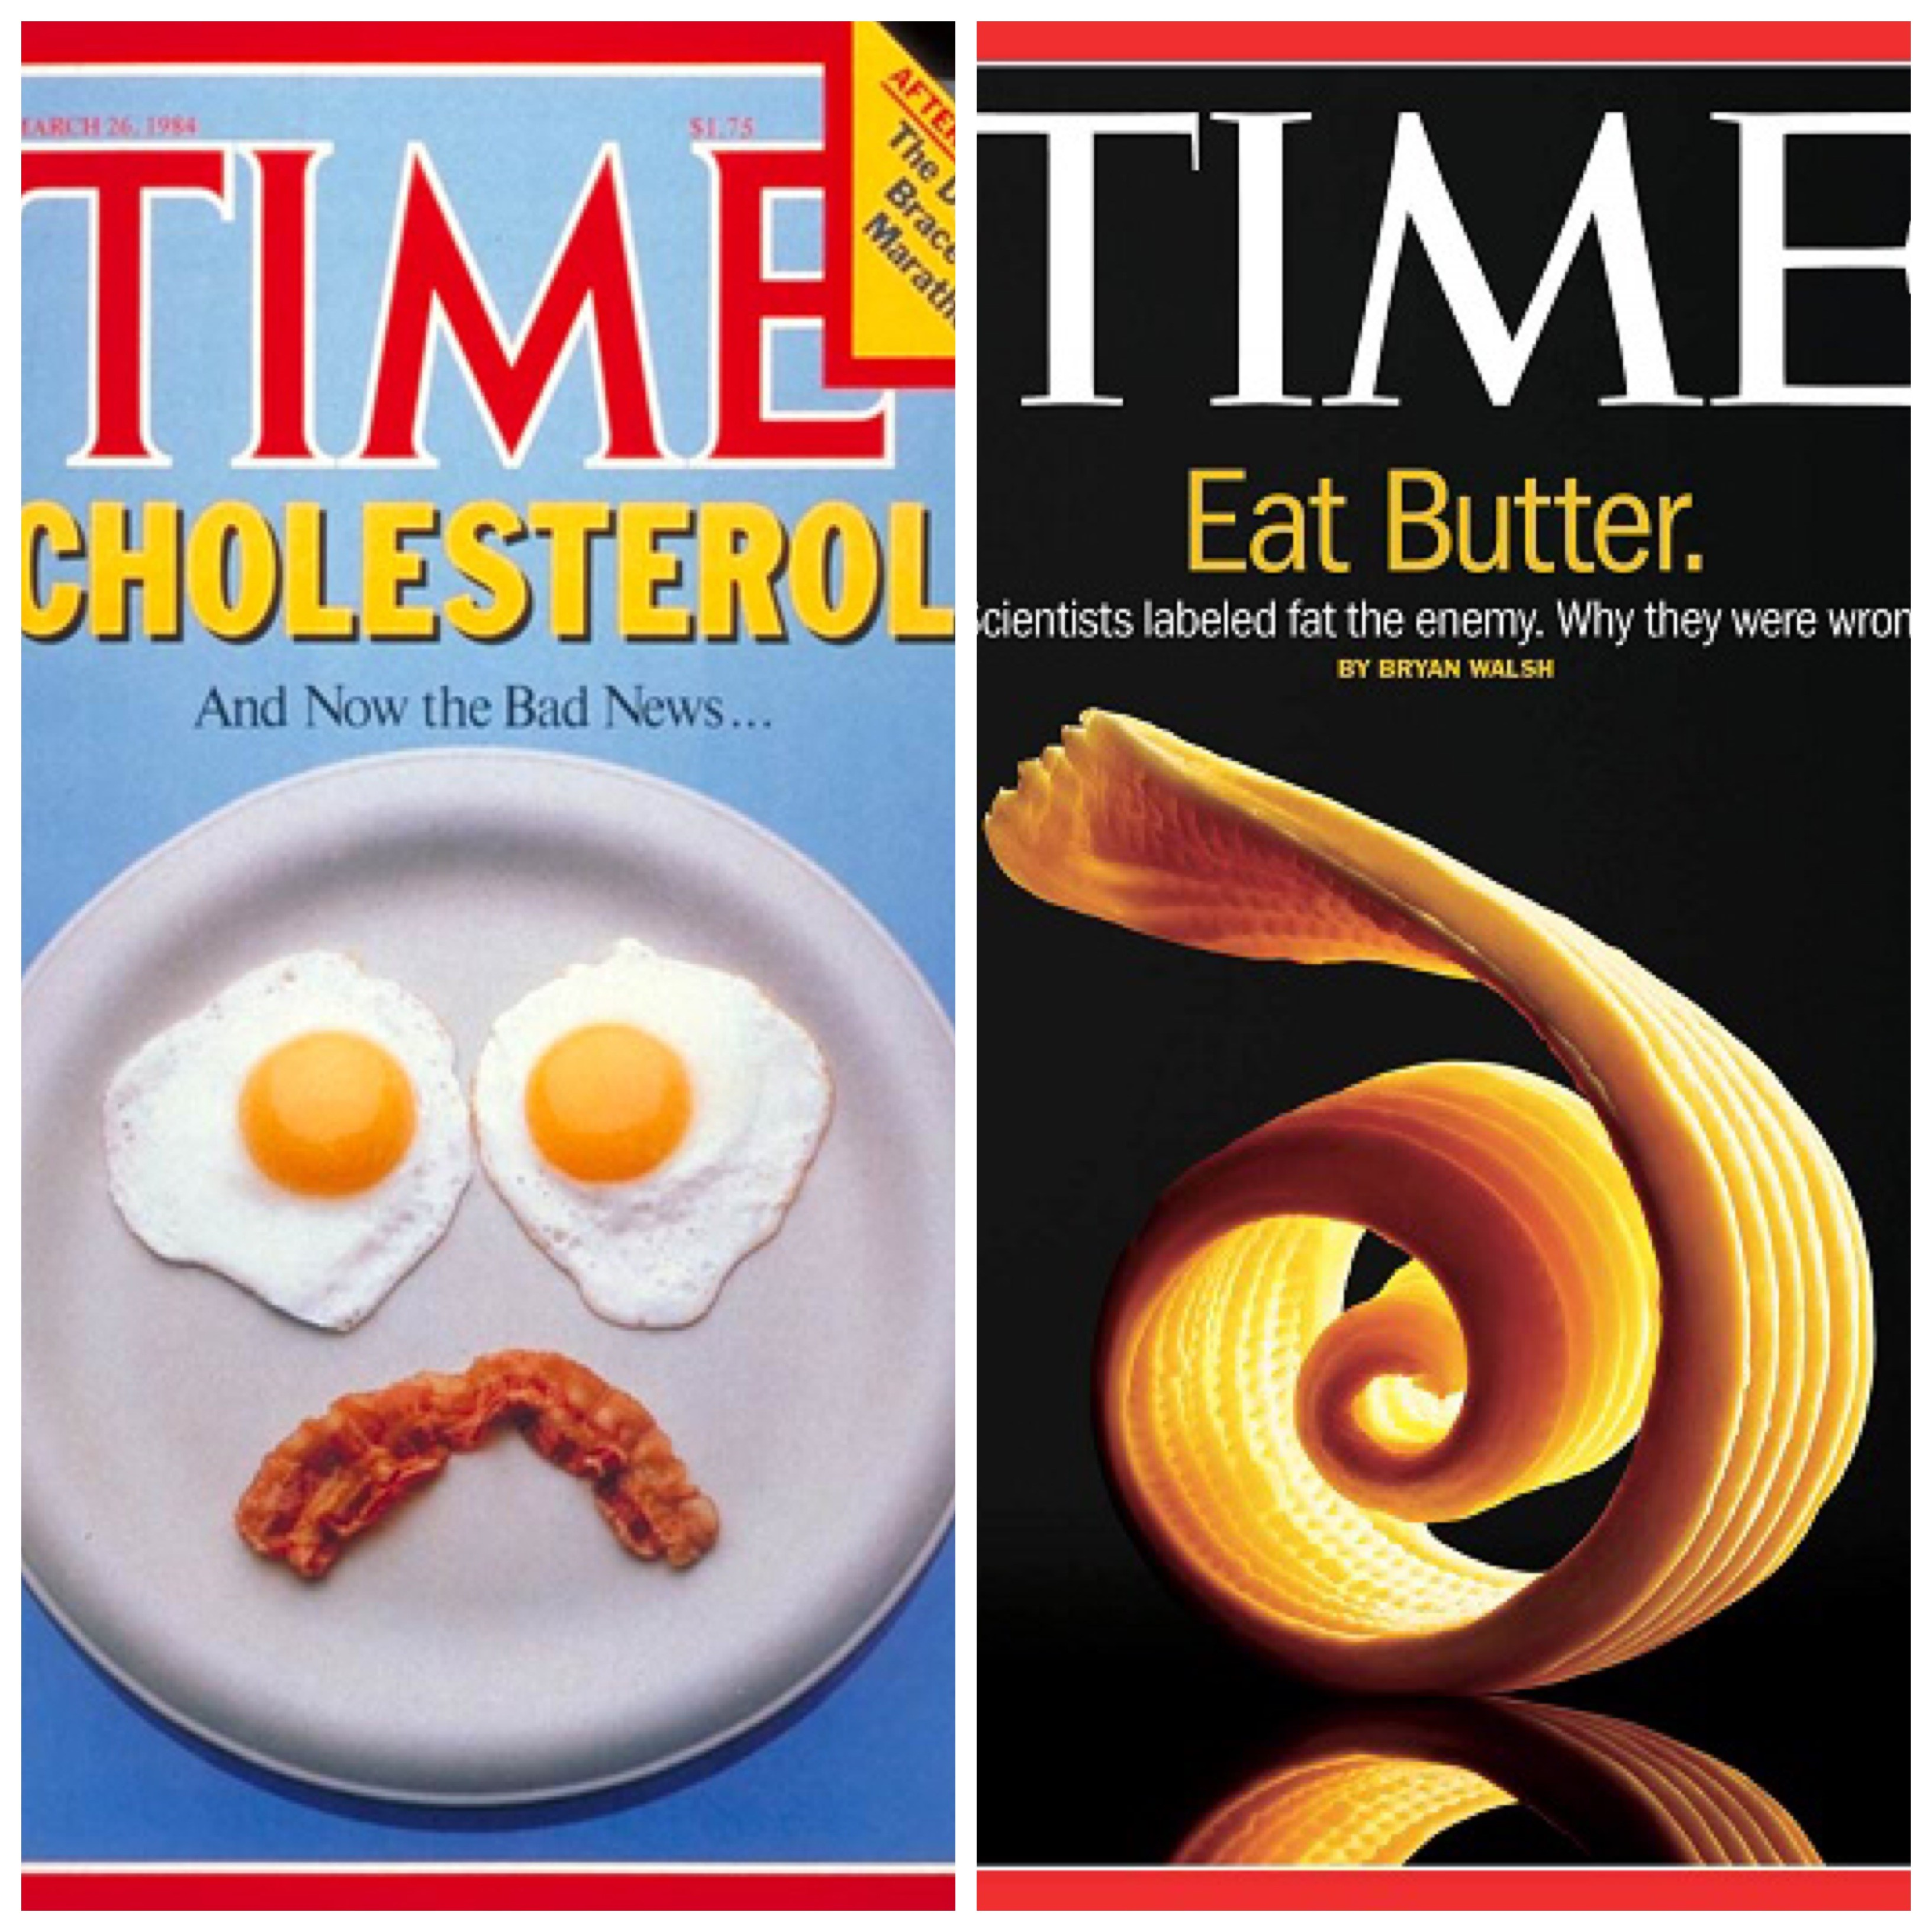

Slide 15
Nutritional Neuroscience
Strong Employee Assistance Program
Definition-The nutritional influences on mental and neurological health.
Nutrition-historically glossed over in medical school and post graduate mental health programs.
While the idea that dietary choices impact health is not a new one, nutritional neuroscience is in it’s infancy.
Notes:
Less that 6% of medical doctors take at least one nutrition course in their training.

Slide 16
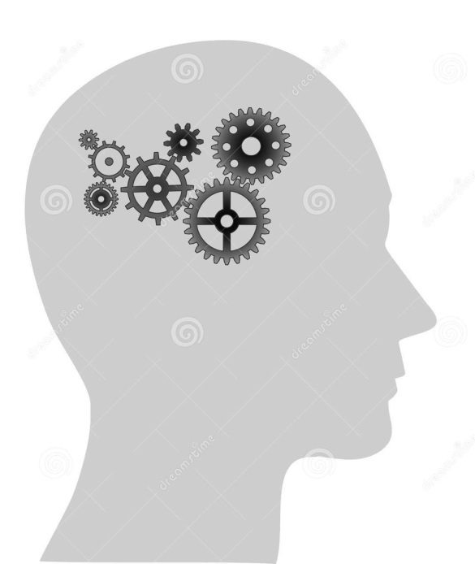
Fat heads??
Strong Employee Assistance Program
Human beings are literally fat heads with fat(DHA)accounting for 60% of our dry brain weight.
The two most important omega-3 fats are eicosapentonic acid (EPA) and docosahexaenoic acid (DHA).
Without these, the brain does not work.

Slide 17
Omega-3 Fats demystified
Strong Employee Assistance Program
Omega 3’s build all cell membranes(along with the help of other fats called phospholipids).
They reduce inflammation-which has been linked to autism, ADHD, Alzheimer’s and depression.
They balance blood sugar-which is essential for a healthy brain.
They increase the activity of a key molecule in you brain, (BDNF-brain derived neurotropic factor) which stimulates new cell growth and increased cell connections.

Slide 18
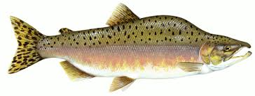
Sources of Omega 3
Strong Employee Assistance Program
Omega 3 fats come in two forms:
A ready for brain use form (EPA and DHA) found primarily in wild fish and game.
Best sources of EPA and DHA are found in wild salmon, sardines, anchovies and mackerel.
A cruder form of Omega 3 fats, alpha linolenic acid (ALA) found in sources such as walnuts, flax seeds, chia and hemps seeds.

Slide 19
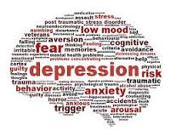
Omegas and Mood
Strong Employee Assistance Program
Following the SAD leaves most Americans deficient in Omega 3’s.
Mental and emotional conditions that recent research has connected to low tissue levels of Omega 3: Depression, Anxiety, ADHD, Autism, Bipolar Disorder, learning disabilities, Post-partum Depression, Schizophrenia, Multiple Sclerosis and Seasonal Affective Disorder.

Slide 20
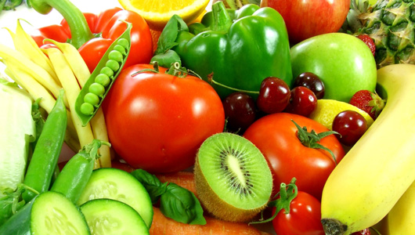
Micronutrients-Vitamins & Minerals
Critical for optimal brain function-sadly lacking in the current SAD.
Half of the U.S. populations does not meet the recommended dietary allowance (RDA) for important brain vitamins and minerals, including calcium, magnesium, zinc, vitamin A, and Vitamin B6. These are the minimal recommended intakes!
Notes:
Important to remember-Every time we remove a nutrient — so that we can just consume the nutrient — it doesn’t work like it should, as it does in the whole food.
Get nutrients from food first-best option, supplements are just that, to supplement your diet where lacking.

Slide 21
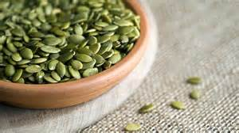
Zinc
Strong Employee Assistance Program
Zinc is involved in many enzymatic reactions inside of the brain and it assists with the metabolization of omega 3s.
More than one third of the world’s population is zinc deficient.
Research has linked low dietary zinc intake to depressive symptoms-the lower the zinc levels, the greater the depression.
Zinc levels are 30% lower in individuals with ADHD.
Sources of Zinc: lean meats, beans, nuts, oatmeal, egg yolks, fresh gingerroot and pumpkin seeds.

Slide 22
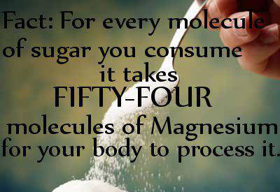
Magnesium-The Relaxation Mineral
Strong Employee Assistance Program
Like Zinc, magnesium is involved in many enzymatic reactions that take place in the human brain.
More than 60% of North Americans are magnesium deficient.
Magnesium level are decreased by excess alcohol, salt, coffee, sugar, soda and antibiotics.
Low levels of magnesium have been implicated in mood disorders, depression and suicide.
Sources: kelp, wheat and oat bran, brown rice, nuts and dark leafy green vegetables.

Slide 23
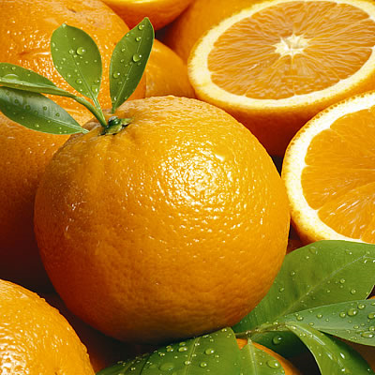
Vitamin C
A 2002 German study found that a hefty dose of vitamin C (1000mg a day) helped people bounce back more easily from a stressful situation. Both blood pressure and cortisol levels decreased faster in people given a vitamin C supplement than the study participants given a placebo.
Sources-bell peppers, dark leafy greens, kiwis, broccoli, berries, citrus fruits, tomatoes, peas, and papayas.

Slide 24
Vitamin D
Strong Employee Assistance Program
Vitamin D levels are known to be low in populations residing in the Northern latitudes due to lack of sun and shorter days.
In a double-blind, placebo-controlled study, researchers demonstrated that 400-800 IU of Vitamin D improved mood during the winter months. Vitamin D significantly influenced aspects of positive affect, attention, enthusiasm, motivation, and alertness.
Additional research has demonstrated correlations between cognitive impairment and memory loss and Vitamin D deficiency.
Sources: Cod liver oil, herring, salmon, sardines, shrimp and egg yolk.

Slide 25
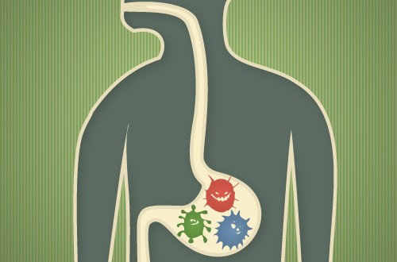
Feed Your 100 Trillion Friends
Your body is colonized by a multitude of organisms that outnumber your cells on a 10-1 ratio.
For each human gene in your body-there are 360 microbial ones!
Many of these organisms live in your digestive tract and take center stage in every conceivable aspect of your health.
No other system in the body is more sensitive to changes in gut bacteria than the central nervous system, especially the brain.

Slide 26
Feed Your BUGS!
Anyone can change the state of their microbiome-and the fate of their health-through dietary choices.
Choose foods rich in probiotics-Yogurt, Kombucha, Kimchi, Sauerkraut, Pickles-anything pickled.
Eat vegetables, low-sugar fruits, healthy fats-extra virgin olive oil, coconut oil, pasture fed butter, nut butters, protein-pasture raised eggs, wild fish, grass fed meat, wild game.
Enjoy wine, tea and coffee!! Wine, tea, coffee and chocolate contain polyphenols which are powerful antioxidants found in plants that support the health of gut bacteria.

Slide 27
Rules for Eating-Michael Pollan
Strong Employee Assistance Program
“Eat food, not too much, mostly plants”
“Don’t eat anything your great grandmother wouldn’t recognize as food.”
“Don’t eat anything with more than five ingredients or ingredients you can’t pronounce.”
“Don’t eat anything that won’t eventually rot.”
“Shop the perimeter of the grocery store, stay out of the middle of the store”.

Slide 28
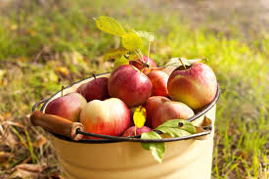
Use yourself as a Food &Mood lab rat
Strong Employee Assistance Program
Ask what AM I eating?
Read nutrition labels and question ingredients. What the heck is aspartame anyway? What are the side effects of these ingredients?
How does my diet impact my mood?What are the foods that positively impact my mood and vice versa?

Slide 29
Questions
Strong Employee Assistance Program
“The most powerful tool you have to change your brain and your health is your fork.” Dr. Mark Hyman, The Ultramind Solution

Slide 30
References
Strong Employee Assistance Program
Logan, Alan. 2007. The Brain Diet. Cumberland House Publishing
Hyman, Mark. 2009. The Ultramind Solution. Scribner Publishing
Ross, Julia. 2002. The Mood Cure. Penguin Books.
Weil, Andrew. 2011. Spontaneous Happiness. Little Brown and Company Publishing.
Pollan, Michael. (2007) The Omnivore’s Dilemma. A Natural History of Four meals. Penguin.
Pollan, Michael.(2009) In Defense of Food: An Eater’s Manifesto. Penguin

Slide 31
Contact US
Telephone: 475-0432 or 1-888-764-3456
E-mail: Strong_EAP@urmc.rochester.edu
Website: www.urmc.rochester.edu/EAP/
Call between 8:00am – 4:30 pm to schedule an appointment
Day and evening appointments available
Location: 496 White Spruce Blvd.

