Slide 1
Healthy eating on a budget

Slide 2
Overview
Plan
Creating a Game Plan
Purchase
Tips and Tricks for Filling Your Cart
Understanding the Price Tag
Reading the Food Label
Prepare
Minimizing Waste
Storage
Tips for Saving Near You

Slide 3
What are some strategies that you use to save at the grocery store?
What are some challenges we face with eating healthy on a budget?

Slide 4
Creating a game plan
Check your inventory
What can you use in next week’s meals?
Plan your meals for the week
Use a work sheet or list to plan ahead
Include meals that will stretch expensive food items
Create a list of new recipes to try
USDA Mixing Bowl
Consider your schedule
Make a list
Eat before you shop!
Join your store’s loyalty program

Slide 5
Tips and tricks for the store
Buying in bulk
Compare unit prices
Shop around the perimeter
Buy in season
Pay attention to expiration dates
Look for store brand items
Shop at farmers markets
Notes:
Only buy as much as you need for certain perishable items such as produce and dairy

Slide 6
Fruits and vegetables
Buy fruits and vegetables in-season
Purchase only what you plan to use
Understand the shelf life of different fruits and vegetables before purchasing
Canned and frozen vegetables and fruit
Purchase whole fruits and vegetables

Slide 7
grains
Rice and pasta are budget friendly options
Instant rice and hot cereal typically more costly
Remember to make ½ your grains whole!
Use the food label to choose whole grain options
“Whole Grain” listed as first ingredient

Slide 8
Protein
Purchase family pack meat options and freeze
Low cost protein options
Beans
Peas
Canned fish
Eggs

Slide 9
Dairy
Choose low fat or fat free milk
Purchase larger size of low fat plain yogurts
Add flavor by mixing in fruit yourself

Slide 10
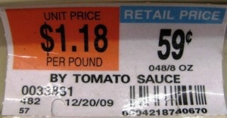
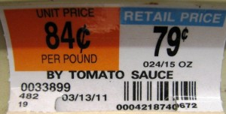
Comparing unit prices

Slide 11
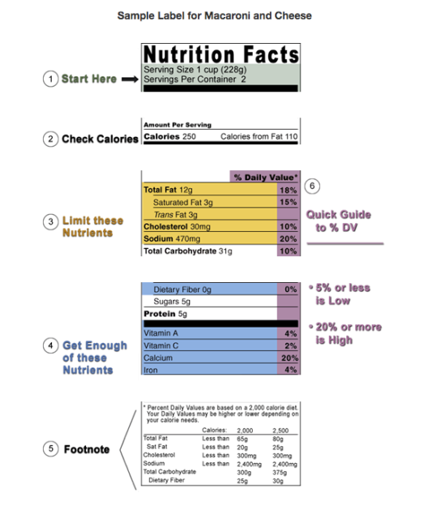
Interpreting the food label

Slide 12
Prepare
Prepare meal items in advance and store
Minimize waste when cooking
Store leftovers
Make recipes that stretch more expensive ingredients
Casseroles, Soups
Use plant based proteins to stretch meals

Slide 13
Store
Think of ways to incorporate leftovers into next week’s meals
Freeze and refrigerate
Understand the shelf life of various fruits and vegetables
Only buy as much as you need

Slide 14
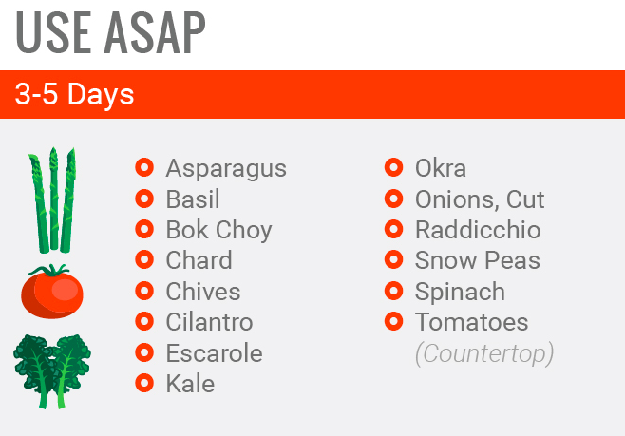

Slide 15
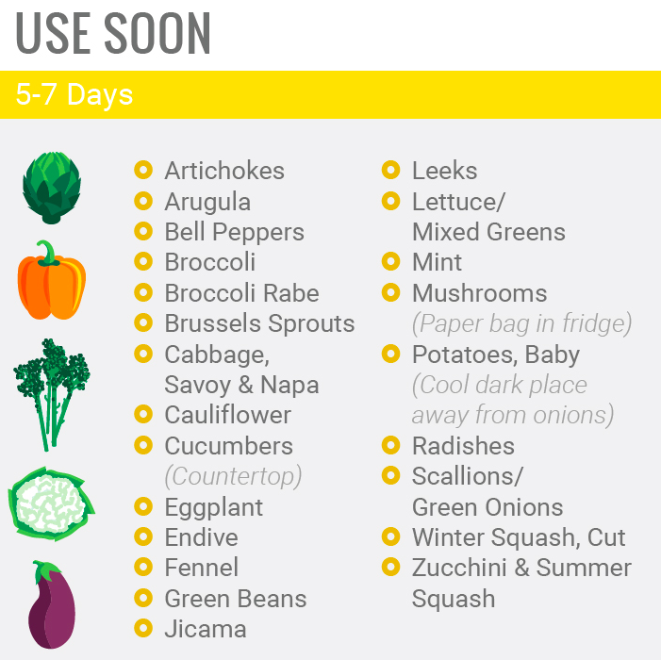
Notes:
Benefit of using

Slide 16
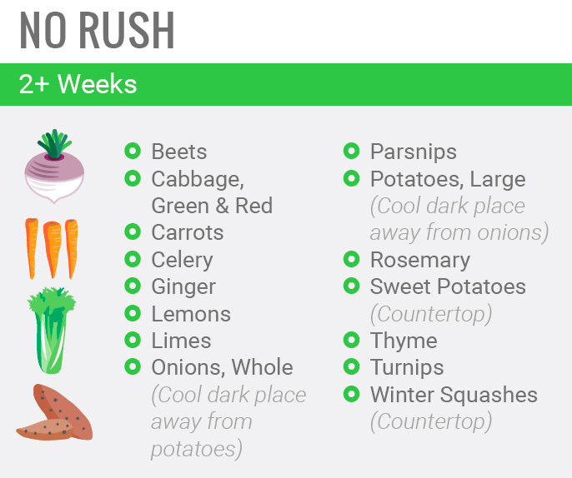

Slide 17
Where can you save?
Public Market
Farmers Markets
USDA Farmer’s Market directory
Whole sale clubs such as Costco or BJs
Join the loyalty program at any of your local supermarkets
Home gardens

Slide 18
Setting goals: how can you adapt your grocery routine to save money and eat healthy?

Slide 19
Thank you!
Questions?

