Slide 1
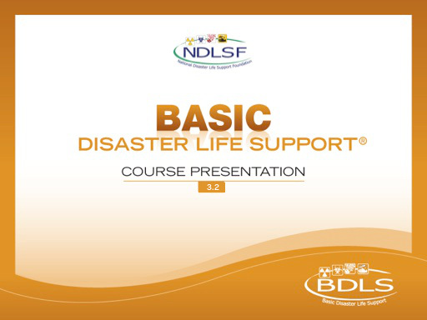
Interactive Webinar Component
Applied Learning Exercise
Mass Casualty Triage

Slide 2
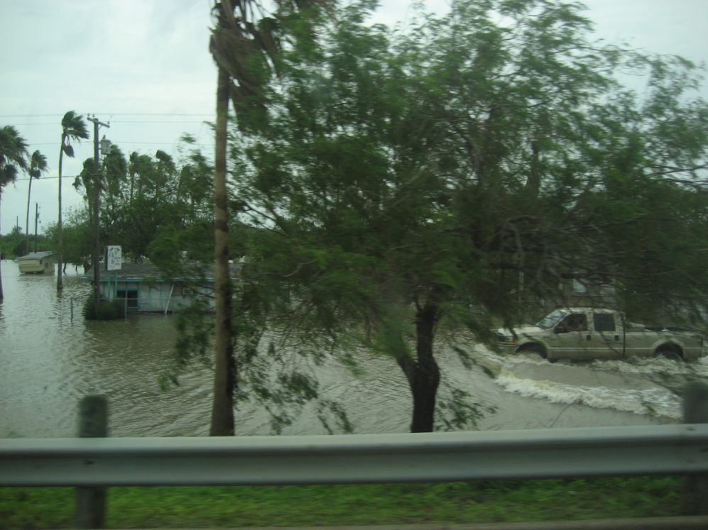
P | lanning and preparation
R | esilience
E | ducation and Training
D | etection
I | ncident Management
S | afety and Security
A | ssess Hazards
S | upport
T | riage and Treatment
E | vacuation
R | ecovery
Are my needs > resources?
Putting the PRE-DISASTER Paradigm™ into practice!
Notes:
We are about to begin a series of Applied learning exercises – to provide an example of how to apply the PRE-DISASTER Paradigm into practice.
As was explained in the first online module, lesson 1: “Disaster Basics,” the PRE-DISASTER Paradigm™ is a useful tool to both learn and organize your approach to many of the key areas and topics relevant to being prepared disaster health and medical personnel.
Clearly, having excellent health and medical skills is essential to helping meet the needs of the casualties and impacted communities after a disaster; however, it is equally important that each health and medical provider be properly skilled in the basic tenets and practices of a disaster in order to be an effective asset to the situation.
CLICK
Always be asking yourself with each step or area considered, am I in a needs > resources situation? If so, prioritize the action items and information sharing required to solve and address it.

Slide 3

Scenario
Upscale shopping center
Suspicious car
Explosion and gunfire erupt
You and local paramedic are nearby and uninjured
What issues need to
be addressed?
Notes:
Scenario:
You are seated in the outdoor patio area of a local restaurant at a popular upscale shopping district; seated a few tables away you recognize an EMT paramedic eating lunch with his family. You hear a couple of car horns blowing and notice that a car has pulled up in front of a theater nearby and is blocking the intersection. The driver of this vehicle is noticed to get out of the car and begins walking toward your restaurant. Traffic jams around it and people gather around the suspicious car. The driver of this suspicious car, who is now standing across the street from you, turns around looking at the crowd gathering and appears to be using his cell phone…
…moments later, “EXPLOSION”! The car in the intersection has just exploded. Debris has landed near your location but you are uninjured.
As you stare in disbelief at what just happened, you remember the driver… he is seen still standing watching from across the street, while the crowd is frantically attempting to flee from the scene around him… you contemplate whether you should run to help or flee the scene as well.
A police car immediately rounds the corner near where the driver is standing. It stops abruptly. As the officer attempts to get out of the car, the suspicious driver pulls out a handgun and fires several times. The officer is down, and the now driver-gunman is running away from the scene.
As you turn around, you notice that the EMT paramedic, previously also having lunch, is now standing next to you.
As the dispersing crowd continues to move further away, the scene is now eerily quiet and time appears to be standing still. No other obvious medical personnel or uniformed law enforcement are seen.

Slide 4
Situational Awareness
Needs > resources = ____? What can I do? | Detection
Who is in charge? | Incident Management
Immediate considerations and actions? | Safety and Security
Explosions? Gunman? Contamination? | Assessing Hazards
What do I have? What is needed and who has it? | Support
Can I now perform triage and treatment?
Notes:
Gaining situational awareness involves asking important and timely questions. The “DISAS” portion of the DISASTER Paradigm™ is a good method of remembering which issues are important to address promptly and ready you for the delivery of triage, if needed, and treatment of the casualties present.
Using the Chat Function Respond to the following questions:
1: Is a disaster present? Are your needs greater than resources
2: Who is in charge?
3: What are your immediate considerations, actions, assessments, hazards?
4: What do you have? What do you need?
5: Can you now perform triage & treatment?

Slide 5
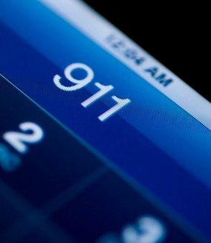
Scenario
Update
911 Operator informs you:
Do NOT hang up phone
Two ambulances (MICU) are nearby but in traffic
Police car has first aid and safety equipment in trunk
What is the next step?
Notes:
Scenario:
You call 911 and the operator gives you the instructions noted on the slide. She also informs you that the police car should have a first aid kit, fire extinguisher, cones/flares, and safety equipment available in the trunk.
After introducing yourself to the paramedic, you ask him, “Do you know SALT triage?” to which he responds “Yes, let’s get to work!”
Use CHAT to answer the following questions:
6. What is the next step (the first step) of Disaster Triage?
Answer: Global Sorting
How do you perform Global Sorting
Answer: Voice Commands – if you can hear me and can walk over here. If you can’t walk, wave your hand

Slide 6
Global Sorting
Outcomes
Walk | 2 patients
Wave | 3 patients
Still | 7 patients
Who needs to know this information?
Notes:
The goal of global sorting is quickly to prioritize casualties for individual assessment. This is accomplished through simple voice commands. Evidence indicates that motor response carries reproducible prognostic validity. This identifies those casualties who are most likely to need immediate lifesaving interventions such as hemorrhage control.
Note that language barriers, disabilities, and hearing loss can be confounders in the global sorting process with voice commands.
Global sorting has identified the following groups with the number listed in each.
Use Chat to answer the following questions
8: What is the total estimated number of casualties?
Answer: 12
9. Who needs to know this information?
Answer: The 911 operator as well as any scene leadership that has arrived.
10: What is the next step in Disaster Triage?
Answer: Individual Assessment

Slide 7
SALT Triage
Step 2: Individual Assessment
L S I *
Control major hemorrhage
Open airway (if child, consider 2 rescue breaths)
Chest decompression
Autoinjector antidotes
Breathing?
Obeys commands or makes purposeful movement?
Has peripheral pulse?
Not in respiratory distress?
Major hemorrhage in control?
All
Yes
Minor injuries only?
Yes
Yes
Minimal
No
No
Dead
No
Delayed
Likely to survive
given current resources?
Yes
Immediate
No
Expectant
*LSI = lifesaving interventions
Notes:
Step 2, individual assessment, purposes to assess individual casualties within the prioritized groups identified in Step 1: global sorting. Step 2 begins with providing immediate lifesaving interventions where needed, and then assigns each casualty a triage category, as outlined in this flow diagram.
Use Chat to Answer the Following Questions
10: Who do you assess first?
Answer: Remember to assess first those casualties who do not move or have clear evidence of life-threatening, salvageable injuries; assess second those casualties who are able to only wave; and assess third those casualties who could walk during global sorting.
11: Does walking automatically make a person green?
Answer: It is important to note that the ability to “walk” or “wave” does NOT determine the individual triage category, as triage category assignment is determined once lifesaving intervention need has been completed and a trained health professional has evaluated a casualty, as outlined in this diagram.
.

Slide 8
POLLING
STARTS
NOW
Notes:
As we go through the individual assessment of each casualty, be prepared to use the polling function to identify Life Saving Interventions and triage category. We will move through each casualty very quickly.
Polling will be open for ~10 seconds. Don’t forget to hit the submit button after selecting your response to each poll

Slide 9
Still
24-year-old woman
Lying face down in a pool of blood
RR 0
Extensive head and face trauma
“ID-ME”
Immediate
Delayed
Minimal
Expectant
Dead ☑
Lifesaving intervention
Control major hemorrhage ☑
Open airway ☑
Decompress chest
Autoinject antidote
Response: Unchanged
Notes:
The seven still casualties are evaluated first.
This is the First casualty presentation.
LSI POLL - What lifesaving interventions could you apply?
Wait 5-10 seconds…..CLICK
Response: After opening airway and controlling hemorrhage the response is unchanged
IDME POLL – What is the triage category?
Wait 5-10 seconds…..CLICK
DEAD

Slide 10
Still
40-year-old man
Contusions on head and face
Gasping, rapid, and shallow breathing
Left chest distended and immobile
“ID-ME”
Immediate ☑
Delayed
Minimal
Expectant
Dead
Lifesaving intervention
Control major hemorrhage
Open airway ☑
Decompress chest ☑
Autoinject antidote
Response: Left chest moving, shallow rapid breathing
Notes:
This is the 2nd Still casualty presentation.
LSI POLL - What lifesaving interventions could you apply?
Wait 5-10 seconds….CLICK
Response: Improvement seen with needle decompression but breathing remains rapid & shallow. We expect survival if we can get him further treatment….
IDME POLL – What is the triage category?
Wait 5-10 seconds…..CLICK
Immediate

Slide 11
Still
19-year-old man
Appears in severe pain, cannot hear you
Rapid symmetric breathing
Near amputation above R knee, bleeding
“ID-ME”
Immediate
Delayed ☑
Minimal
Expectant
Dead
Lifesaving intervention
Control major hemorrhage ☑
Open airway
Decompress chest
Autoinject antidote
Response: Bleeding controlled, RR 20
Notes:
This is the 3rd STILL casualty presentation.
LSI POLL - What lifesaving interventions could you apply?
Wait 5-10 seconds….CLICK
Response: Bleeding controlled and respirations normalized
IDME POLL – What is the triage category?
Wait 5-10 seconds…..CLICK
DELAYED
NOTE: if no improvement with LSI he would be immediate

Slide 12
Still
48-year-old woman
Unresponsive
Normal breathing and radial pulse present
Obvious injury to her head
“ID-ME”
Immediate ☑
Delayed
Minimal
Expectant
Dead
Lifesaving intervention
Control major hemorrhage
Open airway
Decompress chest
Autoinject antidote
Notes:
This is the 4th STILL casualty presentation.
LSI POLL - What lifesaving interventions could you apply?
Wait 5-10 seconds….CLICK
Response: NO LSI needed
IDME POLL – What is the triage category?
Wait 5-10 seconds…..CLICK
Immediate – Yes breathing and has pulse but since Unresponsive (doesn’t obey commands) she would be immediate – will likely survive with further intervention

Slide 13
Still
55-year-old man
Unresponsive with contusions on head/face
Snoring sounds with breathing
Deformity of left arm noted
“ID-ME”
Immediate ☑
Delayed
Minimal
Expectant
Dead
Lifesaving intervention
Control major hemorrhage
Open airway ☑
Decompress chest
Autoinject antidote
Response: Normal breathing, remains unresponsive
Notes:
This is the 5th STILL casualty presentation.
LSI POLL - What lifesaving interventions could you apply?
Wait 5-10 seconds….CLICK
Response: Snoring sounds with breathing improves after opening airway but remains unresponsive
IDME POLL – What is the triage category?
Wait 5-10 seconds…..CLICK
Immediate – Will likely survive given resources

Slide 14
Still
10-year-old girl
Head trauma with protruding brain matter
Slow, deep respirations
Mother holding her on lap in damaged car
“ID-ME”
Immediate
Delayed
Minimal
Expectant ☑
Dead
Lifesaving intervention
Control major hemorrhage
Open airway and give two rescue breaths ☑
Decompress chest
Autoinject antidote
Response: Unchanged
Notes:
This is the 6th STILL casualty presentation.
LSI POLL - What lifesaving interventions could you apply?
Wait 5-10 seconds….CLICK
Response: pediatric patient with protruding brain matter. Slow respirations with no improvement after opening airway and giving 2 rescue breaths.
IDME POLL – What is the triage category?
Wait 5-10 seconds…..CLICK
Expectant – not likely to survive.
Will it be a difficult decision to place an Expectant Tag on a 10 year old girl?

Slide 15
Still
38-year-old man
Unresponsive with GSW to head and neck
Gurgling respiratory sounds
Wearing a ballistic vest
“ID-ME”
Immediate
Delayed
Minimal
Expectant
Dead ☑
Lifesaving intervention
Control major hemorrhage
Open airway ☑
Decompress chest
Autoinject antidote
Response: Not breathing
Notes:
This is the 7th STILL casualty presentation.
What should you think when you see a ballistic vest?
- could be policeman or bad guy…doesn’t matter still treat but look for secondary device.
LSI POLL - What lifesaving interventions could you apply?
Wait 5-10 seconds….CLICK
Response: Still not breathing after open airway
IDME POLL – What is the triage category?
Wait 5-10 seconds…..CLICK
Dead

Slide 16
Wave
28-year-old man
Grimacing in pain saying “I can’t breathe”
Holding R anterior chest near apparent GSW
Right chest distended and immobile
“ID-ME”
Immediate ☑
Delayed
Minimal
Expectant
Dead
Lifesaving intervention
Control major hemorrhage
Open airway
Decompress chest ☑
Autoinject antidote
Response: Improved breathing but still labored, symmetric chest movement
Notes:
The wave casualties are evaluated second.
This is the 1st Wave casualty presentation.
LSI POLL - What lifesaving interventions could you apply?
Wait 5-10 seconds….CLICK
Response: Note improved breathing after you decompress the chest but breathing is still labored
IDME POLL – What is the triage category?
Wait 5-10 seconds…..CLICK
Immediate – will likely survive with further treatment

Slide 17
Wave
17-year-old woman
Sitting on curb, uninjured, hoarse voice
Face is swollen, loud expiratory wheezing
Points to a dead wasp on the ground nearby
“ID-ME”
Immediate ☑
Delayed
Minimal
Expectant
Dead
Lifesaving intervention
Control major hemorrhage
Open airway
Decompress chest
Autoinject antidote ☑
Response: Some improvement but still labored, EpiPen available in first aid kit
Notes:
This is the 2nd Wave casualty presentation.
LSI POLL - What lifesaving interventions could you apply?
Wait 5-10 seconds….CLICK
Response: This patient is not a typical casualty related to the explosion. We need to consider severe allergic reaction/anaphylaxis. The antidote (EpiPen) is serving as a reversal medication for her life threatening condition. After the EpiPen you note some improvement but breathing is still labored.
IDME POLL – What is the triage category?
Wait 5-10 seconds…..CLICK
Immediate – survival is likely

Slide 18
Wave
63-year-old woman
Fell while running after explosion
Gross deformity of left ankle
Contusions and bruising on both arms
“ID-ME”
Immediate
Delayed ☑
Minimal
Expectant
Dead
Lifesaving intervention
Control major hemorrhage
Open airway
Decompress chest
Autoinject antidote
Response: Unchanged
Notes:
This is the 3rd Wave casualty presentation.
LSI POLL - What lifesaving interventions could you apply?
Wait 5-10 seconds….CLICK
Response: No LSI indicated – the woman is breathing, not in distress, obeys commands, has pulse, no bleeding but has a gross deformity to left ankle
IDME POLL – What is the triage category?
Wait 5-10 seconds…..CLICK
Delayed

Slide 19
Walk
33-year-old woman
Crying inconsolably, holding 10-year-old child in car
Superficial abrasions to arm and scalp
Demands you take her daughter to hospital
“ID-ME”
Immediate
Delayed
Minimal ☑
Expectant
Dead
Lifesaving intervention
Control major hemorrhage
Open airway
Decompress chest
Autoinject antidote
Response: Unchanged
Notes:
The walk casualties are evaluated last.
This is the mom of the little girl you triaged as expectant
LSI POLL - What lifesaving interventions could you apply?
Wait 5-10 seconds….CLICK
Response: She has only minor injuries
IDME POLL – What is the triage category?
Wait 5-10 seconds…..CLICK
MINIMAL
** Do you move mom to the minimal area or keep her with her daughter?

Slide 20
Walk
36-year-old man
Laceration to right hand, bone and tendon visible
Bleeding controlled, shirt used as bandage
Wants to stay and help you
“ID-ME”
Immediate
Delayed ☑
Minimal
Expectant
Dead
Lifesaving intervention
Control major hemorrhage
Open airway
Decompress chest
Autoinject antidote
Response: Unchanged
Notes:
LAST CASUALTY - This is the 2nd Walk casualty presentation.
LSI POLL - What lifesaving interventions could you apply?
Wait 5-10 seconds….CLICK
Response: Has a significant injury to right hand. Visible bone and tendon but bleeding controlled. No other issues
IDME POLL – What is the triage category?
Wait 5-10 seconds…..CLICK
Delayed

Slide 21
SITREP:
Triage Status Report
Immediate | 5
Delayed | 3
Minimal | 1
Expectant | 1
Dead | 2
Notes:
Once you have completed the initial mass casualty triage, it is important to report the findings in a useful manner to the emergency operations center or key emergency management point of contact.
Make the point there may be a variable number in immediate vs delayed represents the fact that some variability in triage category assignment is normal and depends on clinical judgment in interpreting response to interventions as well as answering key questions for triage category assignments. For example, the 28-year-old man with the chest injury that was treated with chest decompression may be assigned the triage category immediate (if you feel that the casualty still has ongoing respiratory distress by virtue of having sustained an intrathoracic penetrating injury) or delayed (if you feel that the improvement noted after needle chest decompression has resolved the immediate respiratory distress).
Also remind that the categories may change

Slide 22
SITREP:
Triage Status Report
Immediate | 5
40-year-old, M, right chest trauma
48-year-old, F, head injury
55-year-old, M, head injury
17-year-old, severe allergic reaction
28-year-old, M, GSW right chest
Delayed | 3
19-year-old, M, leg amputation
63-year-old, F, left ankle injury
36-year-old, M, laceration right hand
Minimal | 1
33-year-old, F, superficial abrasions
Dead | 2
24-year-old, F, severe head injury, RR-0
38-year-old, M, GSW head and neck, RR-0
Expectant | 1
10-year-old, F, severe head injury
Notes:
After initial SALT triage, these are the casualty groupings. [Engage audience—any surprises?]
These summary tables list the casualties assigned to each triage category after the initial lifesaving interventions. This is important to do after the initial triage prioritization, as you will soon need to determine the transportation order and ongoing scene treatment of the casualties. This will require effective communication as well as effective utilization of available resources.
Keep in mind - this artificial scenario likely does not reflect reality and there would be far more minimal patients
In terms of the Dead – this is where public safety and medical response cross, goal is not to move these casualties to preserve evidence and bring perpetrators to justice.

Slide 23
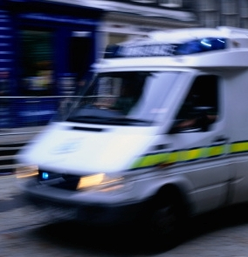
Scenario
Update
EMS and law enforcement on scene:
Ask if you are injured
Briefly discuss the SITREP findings with you
Request that you have a seat in a nearby police car
What are your thoughts now?
Notes:
Once EMS and law enforcement professionals are on the scene, it is important to listen and follow the directions that they provide you. As they assume control of the scene, they are viewing you as an important source of situational awareness, as you have first-hand information on the scene management that has occurred; however, they also view you as a possible casualty, and they will want to ask you and address any injuries you may have sustained. They will likely, if you are not injured, want you to be placed in a safe but accessible site as noted on the slide.

Slide 24
SALT Triage
After-Action Review
The purpose of SALT triage is to identify those most likely to survive
Global sorting identifies where lifesaving interventions will be most needed
Lifesaving interventions (LSI) should always be done before triage category assignment
Available resources will influence triage category assignment
Notes:
Following an event, it is important to complete an after action review. Mass casualty triage is a challenging task requiring simple, effective methods that can be completed very timely. The purpose of SALT triage is to identify those most likely to survive. Global sorting identifies where lifesaving interventions will be most needed. Lifesaving interventions should always be done before triage category assignment. Available resources will influence triage category assignment.

Slide 25


Questions?

