Slide 1
96 HOUR
SUSTAINABILITY
ASSESSMENT TRAINING
NSR – November 12, 2012 (9:30 - 11:00am)
SSR – November 19, 2012 (12:00 - 1:30 pm)
ESR – November 26, 2012 (1:00 - 2:30 pm)

Slide 2
Hospital Training Objectives
Understand how to utilize the 96 Hour Sustainability Assessment Tool
Complete the 96 Hour Sustainability Assessment Chart in fulfillment of OHEP Deliverable No. 4 ($5,000).
Notes:
Our goal today is:
1. To provide you with another tool you can use in assessing your resource sustainability for a 96 hour period.
2. To provide you with the training you need to complete the CHART – which is the element of completion worth $5,000 OHEP dollars
We do acknowledge that some of you
May not have a tool – and this will fill a gap in your preparedness
Others already use a tool and/or chart to assess sustainability as part of your 96 hr plan. You may wish to consider working through this process as another way to validate what you have already determined.

Slide 3
Training Contents
96 Hour Sustainability Assessment Overview
Project History & Resource Development
Project Resources & Documents
Concepts & Assumptions
Determining Resource & Asset Sustainability
Sustainability Process (Pre-Planning to Use Tool)
Using the 96 Hour Sustainability Tool
Using the 96 Hour Sustainability Chart
Notes:
Here is the course overview
We will review the first half rather quickly so we can open the tool and begin inputting data

Slide 4
Project History
In 2010, Iroquois Healthcare Association and HANYS assumed leadership of a project from FLRRC to assess existing 96 Hour Sustainability resources, and to recommend, modify or create an assessment tool which could be used by hospitals in NYS.
Created a workgroup consisting of RRCs, Field Staff, and Associations.
Notes:
Quick background – Iroquois Healthcare Association and HANYS were the project leads in packaging the program and tools

Slide 5
Resource Development
Workgroup selected two existing resources and adapted them for use in this project.
Selected because they were recognized by JC, had been successfully used, and were scalable and user friendly.
Notes:
They adapted 2 existing resources – both of which have been piloted and tested by Albany Medical Center

Slide 6
Resource Development
96 Hour Sustainability Tool: Adapted from “A Process for Determining Resource and Asset Sustainability During Emergencies”
Developed by the American Society of Healthcare Engineers (ASHE) .
Inside ASHE, September – October 2008
Notes:
The first resource is the Sustainability Tool which was slightly modified from a tool developed by the American Society of Healthcare Engineers.
You may refer to the article that accompanied the handouts – which explains in good detail the methodolgy used in formulating the tool

Slide 7
Resource Development
96 Hour Sustainability Assessment Chart: Adapted from 96 Hour Operational Impact Chart developed by Mercy Health Partners in Cincinnati.
Notes:
The other resource is the CHART.
Hospitals use various versions of the CHART – the one provided in this program has been modified from one developed by Mercy Health Partners.

Slide 8
Resources & Documents
96 Hour Sustainability Assessment Chart: Visual representation and analysis of sustainability periods and gaps that may impact on operations.
96 Hour Sustainability Tool: Calculates the number of hours resources and assets (RA) may be sustained, based on census and inventory data.
Notes:
Throughout the training we’ll be referring to the Tool and Chart
Use the Tool to calculate sustainability in hours
Use the Chart to document your sustainability period for 96 hr timeframe and identify your potential “failures” or gaps in 96 hr sustainability
The Assessment Chart is the document that hospitals will submit to NYSDOH per deliverable.

Slide 9
Concepts and Assumptions
The Assessment Chart and Tool are pre-populated with some generally applicable resources and assets (RA).
The Assessment Chart and Tool are scalable. They should be modified based on your resources and operations.
Notes:
There are several concepts and assumptions you must consider in using these resources:
Both the tool and chart can be scaled/modified to reflect what is identified as essential resources and assets
What RA loss/depletion would impact your normal and emergency operations?
The tool and chart has been pre-populated with some general items you may consider – which you can edit, delete, modify, and add

Slide 10
Concepts and Assumptions
The Chart and Tool will tell you how long something will last…
…not what if it runs out. Look to your plan for mitigation strategies.
Notes:
The tool is designed to look at 3 major areas:
Census
Consumption Rate
Inventory
And based on that data will calculate the length of time – IN HOURS – a resource will last
SO you can identify your points of failure if your supply chain is interrupted. Understand your inventory plan.

Slide 11
Concepts and Assumptions
A multi-disciplinary process is recommended in determining essential resources, and in making calculations and reasonable assumptions.
This process should be conducted by the organization’s Emergency Management Committee (EMC) or similar venue.
Notes:
The tool will only calculate resources and assets that can be consumed and quantified.
For essential resources that can’t be calculated (we use Elevator services as an example) – you will need to determine your sustainability period using planning assumptions, estimates and conclusions based on experiences - if there is a disruption in that service
The pre-planning portion of the tool uses data based on your averages (average census, average consumption, average inventory) – it does not take into consideration seasonal variances, extremes in census which may effect consumption rates. This is to provide you with a baseline to plan from

Slide 12
Process for Determining Sustainability
For sustaining an emergency response, a healthcare facility needs a process to determine the length of time it can remain in existence by supplying the necessary services, protection, and nourishment to its staff and patients.
Notes:
Going through this process will give you a general idea of how long certain critical resources will last if there is a disruption in supply and identify areas where you don’t meet the goal of 96hr sustainability without adjusting consumption, curtailing services, or employing mitigation strategies.

Slide 13
EMC Determine List of Essential RA
Tool = Quantify RA Sustainability
EMC = Reasonable Assumptions
Populate RA List in Chart
Transfer Tool Data & EMC Assumptions
Use Chart to Determine Gaps
EMC = Mitigation Strategies &
Plan Review
Notes:
Here is a flow chart to illustrate the progression of this process

Slide 14
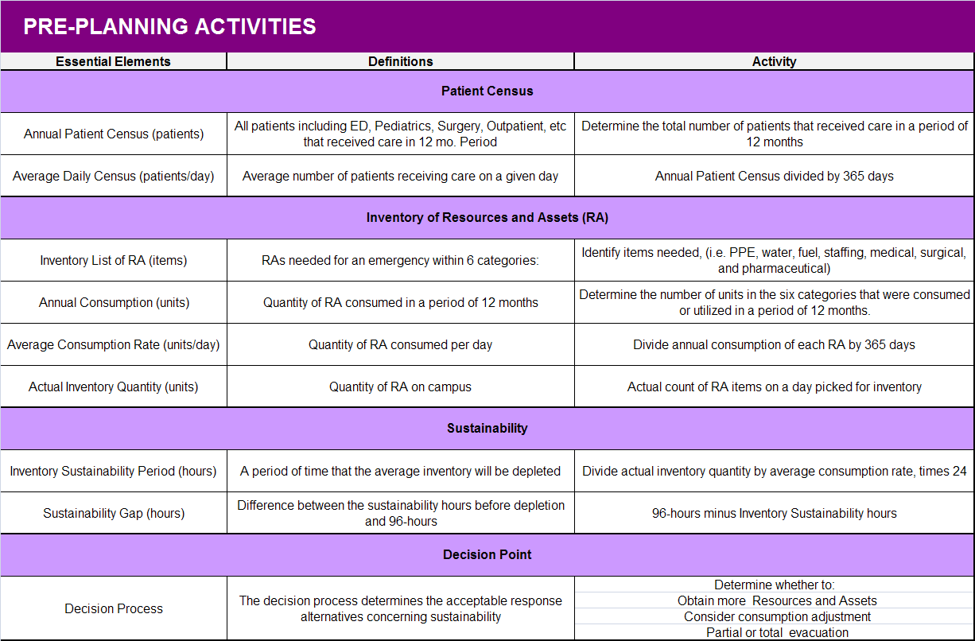
Pre-Planning to use the Tool
Notes:
This table lists pre-planning activities that need to be accomplished before you can actually use the tool.
This is the “homework” you were given in preparation for this training. Hopefully you brought some data with you so when we practice using the tool you are inputting actual numbers.
These pre-planning activities are necessary to do if you intend to use the tool during an actual event to monitor your sustainability because it establishes basic assumptions basic assumptions based census, consumption and inventory
This table can be found in the tool as Tab II
This activity should be done initially and on an annual basis, according to the Joint Commission

Slide 15
Average Daily Census
Determine Annual Consumption Rate
Determine Actual Inventory
Calculate/Estimate Sustainability Period
Determine Essential RA
Notes:
Another visual of the data needed to use the tool
We are going to first talk through the process…then pull up the tool and work through the process

Slide 16
Patient Census
Patient census provides a vital baseline for determining sustainability.
Average Daily Census is needed to use the Tool.
Hospital Name
Licensed beds =
Patients | Annual | Daily
Adults
Nursery
Outpatient
ED
Surgeries
Other
Total |  | XXX
Notes:
The Patient Census should account for all patients, including those in the emergency, pediatrics, outpatient, nursery, and other departments that received care over a 12-month period.
This number provides us with a planning guideline when/if you start analyzing consumption during an event.
Overall, the more patients in the facility, the more individuals, including staff and visitors, will be consuming the RA.
For example, if an organization determines an Average Daily Census of 749 patients and an emergency occurs with 800 patients in the facility, we can estimate that the inventory will deplete at a higher rate than normal.
For now this gives us a best guess for planning purposes.

Slide 17
Determine List of Critical Resources & Assets
The Emergency Management Committee should identify the items essential to the functions of the organization.
A general rule is that if the RA can be a) quantified and b) consumed, the Tool may be used to determine sustainability.
The sustainability of RA that cannot be determined using the Tool , should be estimated using a multi-disciplinary approach, applying reasonable assumptions.
Notes:
The next step that you either conducted OR will need to conduct is your list of your critical resources and assets
As mentioned before, the tool has been pre-populated with some general items. Joint Commission recommends, at a minimum, you consider:
PPE Water Fuel Staffing Medical Supplies Surgical Supplies Pharmaceuticals

Slide 18
Annual Consumption Rate
Once the list of RA is developed, the Annual Consumption of each item can be researched from ordering records, utilization analysis, or any other means.
Knowing this quantity, a baseline Average Consumption Rate (units/day) can be calculated for the 12-month period using the Tool.
Notes:
For each item you identify, you need to know your annual consumption.
When the annual consumption is entered into the tool, the Average Consumption Rate will auto calculate
We do recognize that there might be seasonal variances in the consumption of certain assets (heat in winter months) – which is why you are asked to provide the annual consumption rate to calculate the average on a given day
How do you determine consumption rate? This is the quantity of inventory consumed on a daily basis, under normal conditions. Establish from ordering records or purchase orders for a 12-month period or any other method to estimate quantity consumed

Slide 19
Actual Inventory
Determine the actual count of RA items in the facility on a given day.
Notes:
You will need to conduct an actual count (inventory) of RA items on a given day.
To determine average, consider conducting the inventory count on a tues, wed or thur

Slide 20
Inventory Sustainability Period (Hours)
By knowing the Actual Inventory and the Average Consumption Rate the Inventory Sustainability Period (hours) can be calculated.
Once the Sustainability Period is determined, the Sustainability Gap can be defined.
Notes:
When you enter your actual inventory data into the tool, the inventory sustainability period in HOURS will autocalculate
All of these Pre-Planning assumptions and calculations are based on the Census, which ties consumption to a measurable number.
Not perfect, but it provides the organization with an initial estimation to begin planning for an emergency.
And through this process you can identify your 96hr Sustainability Gaps
(the difference between the time the organization can sustain on an Average Inventory and 96 hours)
Actual Inventory
__________________ X 24
Average Consumption

Slide 21
Decision Process
Identifying the Sustainability Period and Gaps allows the organization to make decisions relating to mitigation and plan review as necessary.
Consumption Adjustments should be developed for each major item on the inventory list by the departments that consume the RA.
Notes:
FINAL STEP OF THIS PROCESS:
Now that you have awareness of your failed points in meeting 96hr sustainability, what are you going to do?
How can you increase inventory of those identified assets?
-begin stockpiling pre-event?
-will you make consumption adjustments or operational changes during an event?
What mitigation strategies will you use?

Slide 22
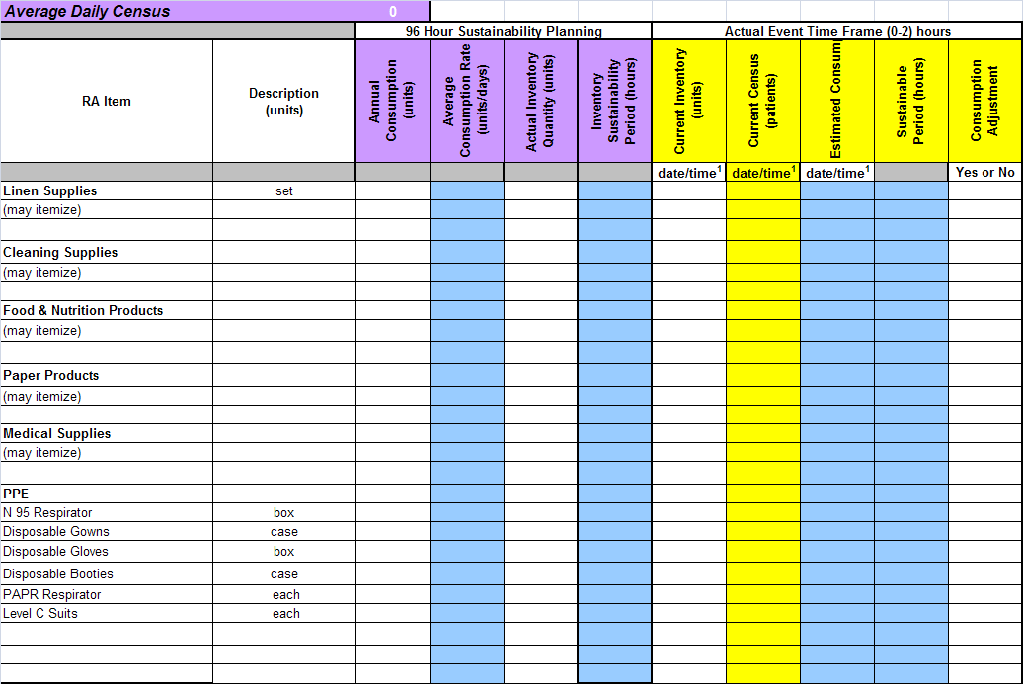
Using the 96 Hour Sustainability Tool
Notes:
Lets pull up the tool
This is a quick snapshot of one of the tabs
As you can see – the table is divided into Planning (purple) and Actual Event (yellow)
We will be concentrating on the PURPLE sections

Slide 23
96 Hour Sustainability Tool
Includes Tabs for the following Critical Functions: Tab 1. Communications Tab 2. Resources & Assets Tab 3. Safety & Security Tab 4. Staffing Tab 5. Utilities Tab 6. Clinical
RA listed in each Tab correspond to those in the 96 Hour Sustainability Chart.
Notes:
The tool as it has been provided to you - has 11 tabs
Tabs I-IV include instructional tables, the table of pre-planning activities, and a table of suggested response activities, and an resource/asset example with data
Tab A is where you enter Census which then auto-populates into tabs 1-6
Tabs 1-6 are the areas you input consumption and inventory
They are designed to represent resources/assets for each JC critical function. You can add or eliminate tabs based on your needs and as determined by your facility
Pre-populated with generally applicable RA.

Slide 24
96 Hour Sustainability Tool
To complete the calculations, you will need to input the following data:
Average Daily Census
List of essential RA/units
Annual Consumption of RA
Actual Inventory Quantity of RA
Notes:
If you did homework – get out the following data elements

Slide 25
96 Hour Sustainability Tool
On Tab A. Average Daily Census, calculate and enter the Average Daily Census (into purple cell J13).
Average Daily Census will be automatically populated into Cell 2C in Tabs 1 – 6.
Notes:
Start with TAB A
A vital baseline for determining sustainability is the Average Daily Census of patients. This includes patients in the patient care area, emergency room, surgery, nursery and pediatrics, outpatient surgery and clinics, etc, over a 12-month period.
Average Daily Census may be entered as a total
Or
Calculated Annual Census divided by 365
All that matters here for using the Tool is the Average Daily Census and entering it in the purple cell. Other rows and columns may be used and changed
*Categories may be changed to reflect how census data is collected and defined by facility.

Slide 26
96 Hour Sustainability Tool
Populate RA into the most appropriate Tab 1-6.
Enter Annual Consumption data for each RA in Annual Consumption (Column C).
The Average Consumption Rate will be automatically calculated and populated in Column D.
Notes:
Annual Consumption = Quantity of RA consumed in a period of 12 months
For example, determine the number of N95 masks purchased Jan, 2011 through Dec, 2011. This is the Annual Consumption of that item. For water, obtain the monthly water bills and determine the quantity consumed. Gather that same data for each of those items.
See Tab IV. RA Sustainability Examples for examples.

Slide 27
96 Hour Sustainability Tool
Determine actual inventory of each RA.
Enter the inventory data into the Actual Inventory Quantity (Column E).
The Inventory Sustainability Period/Hours (Column F) will be automatically calculated and populated.
Notes:
For each RA item in Tab 1-6, pick a day and do an actual inventory on each RA item. For example, count the amount of IV bags that are in Pyxis machines, in the warehouse, pharmacy, and on the floors. This may be labor intensive, but it is vital in getting a baseline for determining sustainability.
See Tab IV. RA Sustainability Examples for examples.

Slide 28
96 Hour Sustainability Tool During Response
Populate the Yellow Columns ,entering the Current Daily Census into Tab A time frames.
Tool will automatically determine the sustainable hours for current inventory.
Notes:
As I have indicated earlier but important to repeat is that this tool can be used quite effectively during a response. Using the tool for response becomes easier and more effective if a facility has used it for planning prior to the event. During a response you may or may not take the time to use the Chart but it is an option and could be projected on a screen or white wall in the EOC.
Response: During response to actual events, populate the 96 Hour Sustainability Chart as described above, using the data from the yellow Actual Events Sustainability Period and the organization's internal, reasonable assumptions.

Slide 29
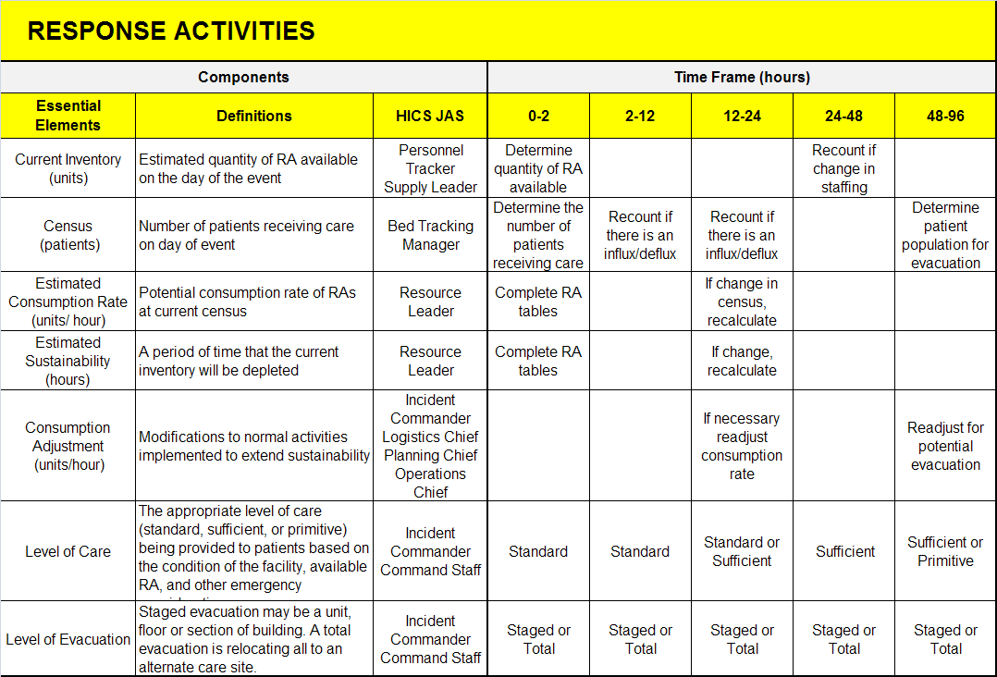
Notes:
This chart, found in Tool TAB III, identifies the suggested Job Action Sheet from the organization HICS structure that could be used to obtain the information or make decisions.

Slide 30
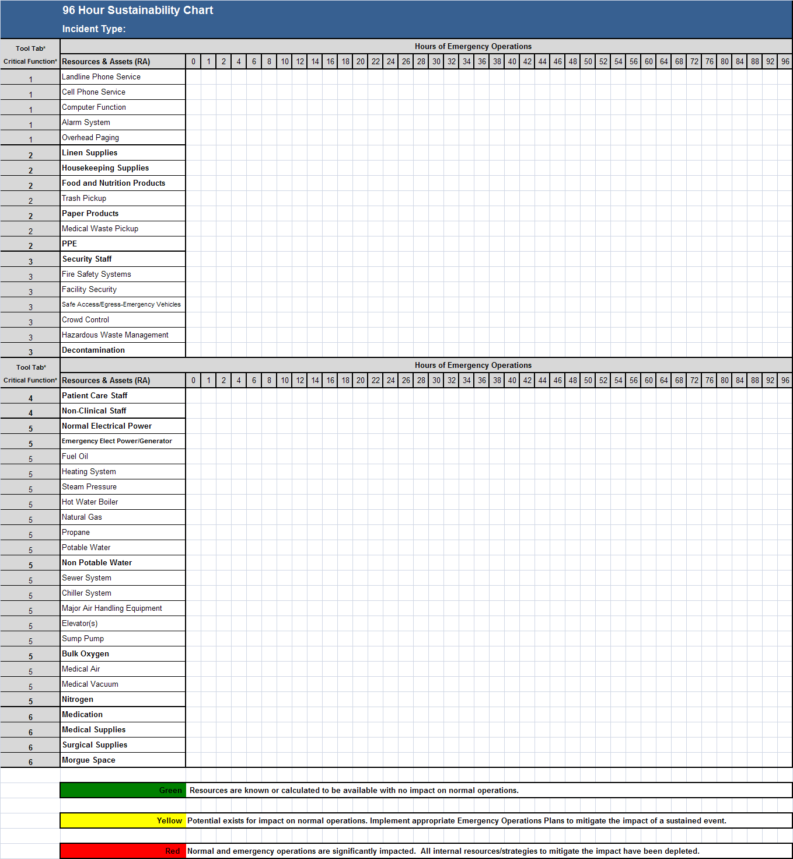
96 Hour Sustainability Assessment Chart
Notes:
Here is what the 96 Hour Sustainability Chart looks like prior to using the tool and completing the chart. This chart is what needs to be submitted to fulfill the hospital deliverable. The results from the tool are used to populate the chart.

Slide 31
96 Hour Sustainability Assessment Chart
Populate essential RA List into Column B of the 96 Hour Sustainability Assessment Chart.
Pre-populated RA should be deleted, supplemented, itemized or otherwise changed to best reflect your operational needs.
Notes:
Determine whether each RA may have its sustainability calculated using the accompanying 96 Hour Sustainability Tool. A general rule is that if the RA can be a) quantified and b) consumed, the Tool may be used to determine sustainability. RA which is pre-populated in Bold can be calculated using the Tool. These pre-populated RA are correspondingly pre-populated in the Tool. The sustainability of some RA cannot be determined using the Tool (including pre-populated RA that is not in Bold). A multi-disciplinary approach, applying reasonable assumptions is recommended and described in the Guidance.(This Chart is pre-populated with RA which may or may not be essential to your facility's operation. Pre-populated RA may be deleted, supplemented, itemized or otherwise changed to best reflect your operational needs, and may also be categorized by different Critical Function than in this Chart and in the corresponding Tabs of the 96 Hour Sustainability Tool.) Categorize as facility determines most appropriate and

Slide 32
96 Hour Sustainability Assessment Chart
Using the results from Inventory Sustainability Period/Hours (Column F) in the Tool, and the organization's internal, reasonable assumptions, populate the 96 Hour Sustainability Assessment Chart rows using Green, Yellow, or Red.
Notes:
RA in Bold and other quantitative and consumable RA, calculate the Inventory Sustainability of each RA using the 96 Hour Sustainability Tool.
Using the results from Column F - Inventory Sustainability Period/Hours in the 96 Hour Sustainability Tool, populate this Chart using Green, Yellow, or Red.
For RA not in Bold, and for RA added by facility which may not be quantitatively calculated using the 96 Hour Sustainability Tool, sustainability should be determined through a multi-disciplinary process using reasonable assumptions to make determinations relating to sustainability periods.

Slide 33
96 Hour Sustainability Assessment Chart
Green Resources are known or calculated to be available with no impact on normal operations.
Yellow Potential exists for impact on normal operations. Implement appropriate Emergency Operations Plans to mitigate the impact of a sustained event.
Red Normal and emergency operations are significantly impacted. All internal resources/strategies to mitigate the impact have been depleted.
Notes:
Step 2A. RA in Bold and other quantitative and consumable RA, calculate the Inventory Sustainability of each RA using the 96 Hour Sustainability Tool.
Using the results from Column F - Inventory Sustainability Period/Hours in the 96 Hour Sustainability Tool, populate this Chart using Green, Yellow, or Red.
For RA not in Bold, and for RA added by facility which may not be quantitatively calculated using the 96 Hour Sustainability Tool, sustainability should be determined through a multi-disciplinary process using reasonable assumptions to make determinations relating to sustainability periods.

Slide 34
96 Hour Sustainability Assessment Chart
You may insert text within color coding to reference applicable plans, describe mitigation strategies, consumption adjustments or helpful notations.
Notes:
Mitigation strategies an decisions can be inserted into the chart so that at a glance one can see what is being done to extend the sustainability of certain RA’s.

Slide 35
Decision Time
Now the organization needs to decide how they will sustain on those items that cannot make it for 96 hours or adjust the Consumption Rate by limiting services, reducing use, etc.
Notes:
Identifying the Sustainability Period allows the organization to make a number of decisions:
Increasing inventory
Consumption adjustment
Mitigation strategies
Operational changes
See Tab II. Pre-Planning Activities.

Slide 36
EMC Determine List of Essential RA
Tool = Quantify RA Sustainability
EMC = Reasonable Assumptions
Populate RA List in Chart
Transfer Tool Data & EMC Assumptions
Use Chart to Determine Gaps
EMC = Mitigation Strategies &
Plan Review
Notes:
Here again is a flow chart to illustrate the process.

Slide 37
Summary
The 96 Hour Sustainability Assessment Chart may be used for:
Deliverable No. 4 ($5,000) – Submit Assessment Chart as itemized and completed by facility to NYSDOH.
Planning including HVA specific
Response

Slide 38
Summary
Utilizing the basic assumption that inventory consumption can be linked to Average Daily Census allows the organization to develop the fundamentals of a sustainability process.
This process can be used for planning purposes and for forecasting sustainability during an event.

Slide 39
Summary
The 96 Hour Sustainability Assessment Chart and Tool are presented as resources to help hospitals identify sustainability periods and gaps and to assist in making calculations to better understand how long resources might last.

Slide 40
Questions
?

Slide 41
Contact Info for questions/support re: 96 Hr Sustainability Assessment Tool & Chart
FLRRC – Anne D’Angelo (585) 758-7642
anne_dangelo@urmc.rochester.edu
HANYS - Chris Smith (518) 431-7769
csmith@hanys.org
Iroquois HA - Andrew Jewett (315) 410-6470
ajewett@iroquois.org

