Slide 1
WNY Hospital Security Coordinators
Workgroup Meeting
Friday January 22, 2016
1200 – 1500
at the
WNY Healthcare Association

Slide 2

Agenda
Healthcare Specific Issues
ALICE Overview & Delivery Model
The Problem / The Myth
New National Standard of Care
Citizen Certification
ARC Services Married within ATI Training Decks
Partnership Opportunity
Work/Shop

Slide 3
Background to share with our “C” Suite…
Why Healthcare Facilities have unique Challenges
Active shooter events at a healthcare facility present unique challenges; healthcare professionals may be faced with a decision about leaving patients; visitors will be present; and patients or staff may not be able to evacuate due to age, injury, illness, or a medical procedure being in progress.

Slide 4
There is no single method to respond to an active shooter event, but prior planning and ALICE training will allow healthcare professionals to choose the best option during an active shooter situation, with the goal of maximizing lives saved.

Slide 5
ALICE can help answer the following questions.
What does a healthcare facility do…
  when so many people CAN’T evacuate?
  when there is no way to “Lockdown” every room?
  how can a hospital “lockdown” or secure in place
  hospitals are limited on staff until help arrives, how would a limited staff counter?

Slide 6
Today more than 5 million U.S. healthcare workers from many occupations perform a wide variety of duties. They are exposed to many safety and health hazards, including violence. Recent data indicate that healthcare workers are at high risk for experiencing violence in the workplace. With proper training, even healthcare facilities with limited staff can decrease risk in the rare event of an armed intruder.

Slide 7
Hospital-Based Shootings in the United States: 2000 to 2011
59% of all shootings happen inside the hospital.
Hospital shootings occurred in 40 states.
235 injured or died in hospital shootings.
The Emergency Department were the most common location for shootings to occur (29%).
In 23% of shootings with the Emergency Department, the weapon was a security officers gun taken by the perpetrator.

Slide 8
10 Reasons Why Violence in Healthcare Facilities is Increasing.
- According to both OSHA and the Centers for Disease Control and Prevention (CDC), risk factors vary from healthcare facility to healthcare facility depending on location, size, and type of care.
- Common risk factors for healthcare violence including the following:
1 - Staff population is approx 80% female,
2 - 24 hours operations,

Slide 9
3 - Working directly with volatile people, especially if they are under the influence of drugs or alcohol or have a history of violence or certain psychotic diagnoses,
4 - Numerous points of ingress and egress with unrestricted movement of the public within the healthcare facility,
5 - The carrying of handguns and other weapons by patients, their families or friends,

Slide 10
6 - The use of healthcare facilities by police and the criminal justice system for the care of acutely disturbed, violent individuals,
7 - The increasing number of acute and chronically mentally ill patients being released from healthcare facilities without follow-up care,
8 - The availability of drugs at healthcare facilities and pharmacies,
9 - Distraught family members and long waits in emergency or clinic areas,
10 - Lack of resources (funding) for healthcare security departments.

Slide 11
Workplace Safety & Occupational Safety and Health Act
The failure of an employer to address the threat of an active shooter in the workplace can be an Occupational Safety and Health Act (OSHA) violation under the General Duty Clause (Section 5(a)1). OSHA requires employers to provide their employees a place of employment that is free from recognizable hazards that are causing or likely to cause death or serious harm. OSHA violations can lead to citations, fines, lawsuits and damage to institutional reputation.

Slide 12
Recent court rulings throughout the country have allowed negligence suits filed by victims of Active Shooters to proceed against employers for failing to provide defensive training to their employees. In other words, companies can no longer avoid their corporate responsibility to provide training on both how to spot potential active shooters and on how react if so confronted.

Slide 13
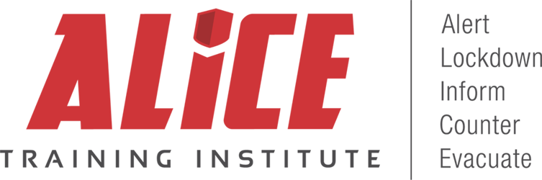
ALICE is a research-based, proactive approach to responding to an active shooter situation which authorizes and empowers those engaged in such an event to utilize existing building infrastructure, technology, and human action to increase their chance of survival
www.AliceTraining.com
Notes:
Proactive vs Reactive
Multiple response options / tactics vs Single tactic
Dynamic vs Static, Active vs Passive
Empirically-driven, research based Strategies vs Policies, Dictates, Mandates
Utilizes building infrastructure, technology and human action
Not spend $500 – 1M
Concentrate on human reaction
All technology can be defeated
Everything can be defeated
Except human reaction
Technology is great
Human action is better
Technology increases survivability
Only bus that doesn’t say you need $1m
Court house in Iowa – spet 10, tech failed gun gut in, infrastructure meaningless – human action won
That great product barricading door abc but how does it apply in your car, home, mall, in the cafeteria of yoru office – this is life long training program, mental prep and training for life – not just about your desk at school and or work

Slide 14
ALICE At A Glance:
First to market with proactive, options-based violent intruder workplace training 2001
Nationally recognized blended certification training
  Instructor-led Train the Trainer Instructor Certification Programs
  eLearning driven Citizen / Staff Certification Programs
Adopted by over 50,000 K-12 Schools, Universities, F1000 Companies, Government Agencies, and Non-profits
Trained all 50 States, District of Columbia, Canada, Japan
Federal, state legislators’ violent intruder guidelines include ALICE protocols or actually name ALICE as the state standard of care for all public emergency response plans
45 National Trainers
Over 20,000 Certified Instructors; 1,000+ new per month
Distance Learning web-based training for all staff

Slide 15
A.L.I.C.E.
Proactive approach
Provides additional options beyond traditional lockdown
Assumes every event is not the same
ALICE is NOT sequential
Increases odds of survival
Research based

Slide 16




Organizations we Served
50 States
Organizations who we have already Served
3,500
3,000
800
500
500
LE Agencies
K-12 Districts
Workplaces
Universities
Hospitals
25+ Millions Educated
Notes:
ALICE has organization specific training programs. Each organization type has their own unique challenges to increase survivability in violent intruder incidents. Contact ALICE to find out how to bring ALICE to your unique organization.
Example:
Evacuating long term care patients may not always be as feasible as evacuating a school.
Places of worship …….
ALICE is an active shooter response protocol that empowers individuals to proactively respond with options to improve their chances of survival during a violent intruder event.
Information, pre-authorization, and proactive training is what makes ALICE work.
Alert: all are authorized to announce, no codes are used
Lockdown: must include barricade training
Inform: use technology to provide play-by-play information
Counter: interrupt the skill set needed to shoot accurately
Evacuate: get away from danger if possible
ALICE is a comprehensive response plan that maximizes the use of technology to share real-time information, teaches how to fortify infrastructure, and empowers people to be proactive in their own defense when action is necessary before professional assistance can arrive. During an Active Shooter event, those at or in the scene are the real first responders, and as such should have been provided the ability and authority to appropriately respond.
ALERT: The initial ALERT should be informative. Provide information that gives answers to Who, What, Where, When, and How (Why is irrelevant). Plain language should be used as recommended by FEMA. Do not use codes as they can be confusing and non-communicative.
LOCKDOWN: Do not rely on a door lock if securing-in-place is the best initial response option. Training is required for building occupants to understand best methods to barricade doors.
INFORM: Use all forms of technology available to communicate (in as real-time as possible) any and all details about the activities of the gunman to both building occupants and the police.
COUNTER: If contact is made, and shooter is targeting people, the use of counter strategies is warranted in order to harden the targets. The numerical advantage of the building occupants can be utilized in order to SWARM the shooter and take back control.
EVACUATE: If the opportunity exists, removal of as many as possible is the primary survival option.

Slide 17













Hospitals
Major Health Care Systems

Slide 18








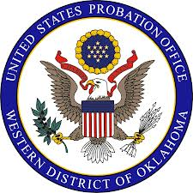


Government

Slide 19
Police Response
Can they Ever be quick Enough?
The Problem with the Status Quo
Notes:
How fast do the police need to respond to save lives?
Quotes, Data,

Slide 20
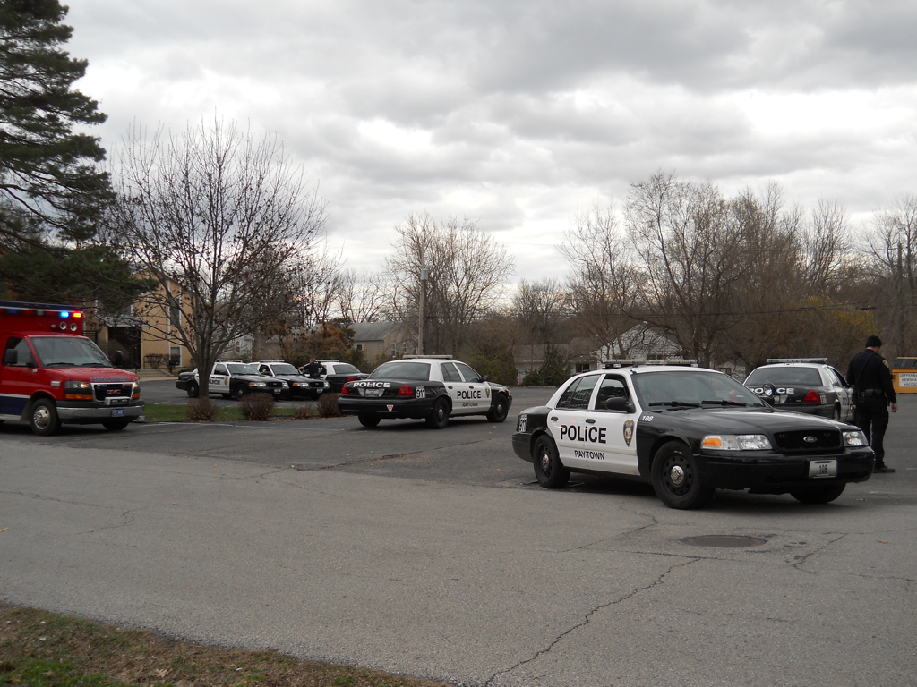
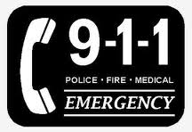
Critical Steps
{
}
0:01 Shot’s Fired 1min
?.?? Citizen dials 911 2min
+ ??? 911 Dispatch Call 1min
+ ??? Officer Response Time 3-10min+
+ ?.?? Officer Makes Entry
+ ?.?? Officer Contact Time - locates aggressor
?.?? Total Time already at 7minutes and police just in the parking lot
Notes:
<insert historical stats, Sandy hook, VT, Colmbine, Chardon, etc. Insert FBI crime report stats>
Just using average event times, factual times documented by the event itself, not ALICE, we are at 7 minutes plus before the police even begin to get out of their car and proceed to find, and make contact with shooter, which in an of itself can take 10 minutes to 4 hours….and these events typically end within 5-8 minutes….so police will never get there on time.
Time Line of Violence
The period of time from the suspects 1st violent action until suspects action is stopped .
Prior to Dialing 911? (3-5 minutes)
ID Threat
Confirm Threat
Report to supervisor, administrator, principle?
“Dial 911 when it is safe”
Do you know how to dial 911 from building? Dial 9-911 vs 7-911?
Examples where 911 was not utilized.
Dispatch Time (starts when 911 call received until LE dispatch) (1.5 mins. nationally)
Collecting information. (who, what, where, why, weapons)
Response Time (from Dispatch to arrival on scene)
Proximity of Officer
Number of patrol units.
Time of day.
Locate Threat. Time for Officer to seek/hunt Aggressor?
Solo Entry or does first officer on scene wait for backup? 4-man team?
Larger building/school may take longer.
Sandy Hook union chief comments
Columbine, Sandy Hook. Aurora Movie theater
TACTICAL Loitering
Tactical Loitering concept introduced Policeone.com “Is tactical loitering costing lives?” August 2013.
The terms refer to first responders who arrive at the scene of a life-threatening crime-in-progress — particularly an active shooting — but instead of taking immediate action, they stall, waiting either for other officers or a supervisor to show up or, in the most extreme cases, waiting for SWAT (a la pre-Columbine).
Don Alwes, a nationally recognized tactical trainer who moderated a panel on active-shooter response at the latest ILEETA conference, told me he has it on “good authority” that entry into several mass murder scenes of late was delayed unnecessarily for as long as five minutes after the first officers arrived. At one high-fatality event, Alwes said, a reliable source who was present told him “officers looked for other things to do rather than go inside and try to confront the killer.” The shooting continued until the assassin exited the location and “inadvertently encountered an officer outside.”
Borsch, law enforcement’s preeminent phrasemaker, has coined the term “tactical loitering” In Borsch’s mind, it includes waiting for someone else to join in or take charge of the response, employing a “containment strategy,” using “slow and methodical” search tactics, and becoming distracted by wounded innocents. “These activities can be valuable tools on some calls,” he explains. “But on active-killer calls they assist the murderer in getting what he wants. With active killers, precious manpower is urgently needed inside the facility to stop the bloodshed.”
What’s behind the persistent hesitancy that these trainers perceive? They suspect it’s a blend of several influences.
Antiquated Training
“As I go around the country teaching, I encounter many departments still instructing officers to wait until four or six are present before making entry,” said Alwes. “These departments haven’t yet gotten on board with current thinking.”
Borsch, who has researched active killer cases extensively, has been able to document only one instance where a formation of four or more officers successfully interrupted a murder spree — a far poorer record than that of single officers who have initiated fast, aggressive action alone.
“It’s key for agencies and officers to understand that stubbornly clinging to a multi-officer response reduces the success potential significantly,” Borsch said.
Confusion of Priorities
Alwes speculated that the current emphasis in training on teaching tactical combat casualty care may unintentionally be causing officers to rearrange their priorities, so that aiding victims is moved ahead of closing on the active killer.
“On these calls, first aid is not your first priority,” he says. “It’s something you do after the shooter is no longer a threat. The first goal is always to stop the threat. All other missions are secondary.”
Overemphasis on Officer Survival
“Undoubtedly,” Alwes said, “an overemphasis on officer safety is part of the hesitancy equation. We’ve told officers that their most important job is to go home alive and uninjured at the end of their shift. But how many officers would believe that if their own family was inside a place where shots are going off? I would never ask an officer to throw his life away on a suicide mission. But there are times when it’s important for us to put ourselves at great personal risk to fulfill our sworn duty to protect.” Borsch added, “For first responders, it’s a forced choice: either place yourself at risk to stop the killer or allow innocents to continue being at risk of being murdered while you play it safe.” “‘Good tactics’ does not always mean ‘taking no risk’,” Farnam said. “‘Good tactics’ means ‘taking the best risk’ at the critical moment.”
Agency Culture
In some departments “officers are actually discouraged from taking assertive action on their own,” Farnam said. “When dynamic personal initiative is not encouraged, officers arriving at the scene will predictably loiter about ineffectively, waiting for some supervisor to finally arrive rather than step up to the plate without delay and start making decisions.”
Cowardice and Fear
“There are cases of hesitancy where cowardice is an issue,” said Alwes. “Most officers are brave and will do what needs to be done. But a small few are truly cowards. Their fear of personal harm or of making the wrong decision leads to inaction. We must recognize that and have a way to deal with it when it’s encountered.” “The ‘risk-averse’ cop who won’t step up to the plate regardless of the danger of doing nothing needs to do something else for a living,” said Farnam. “The ever-fearful are fond of saying ‘Don’t be a hero.’ That’s rubbish! We need to be heroes, and we need to train heroes. Others need not apply!”
Response Times – as soon as dispatch notifies them and clock ends when they arrive on scene
Dept of justice
23% of le agency have 7 min or faster response time
St Louis 11.20
Response Time Facts vs Lockdown and Wait for Cops to eliminate threat
911 Call
How long take someone from first sign of danger to place call to 911 3-5 min
Landlines in phone, 9911 or 8911, or simply don’t think of calling
Dispatch call
How long answer call, collect info, and place call to local police 2+ min
Response Time for Local LE to Arrive on Scene (presentation city??) 8 min
1 Officer to reach scene 13-15
Local policy (how many till 4 officers arrive to scene before they enter bldg.) 3-5 ????
AVERAGE RESPONSE TIMES 16-20
But still NO ENTERY YET TO LOCATE THREAT
Average length of Active Killer Event 7-8 min
7 min event affects organization for years
PLUS
Contact Time (time get bldg. to time to locate shooter) ????
Wash Navy Yard 2+ hrs
Case Western University 7.5 hrs
If there was a fire in your building would you hide under a desk and wait for a fireman to come and save u.
There is not a police officer in the country who would recommend you do the same for a man made disaster like active killer event….crawl under your desk and wait.

Slide 21
Why Citizen Preparation is Necessary?
Most active shooter events are over in less than 5 minutes
25 years of mass shooting events have yielded a national average for the average arrival response time of Law Enforcement to an Active Killer scene.
How long:
8 Min, Avg is 10+ Min

Slide 22
YOU are 1st Responder
“Active Shooter situations evolve quickly. Individuals must be prepared to deal with an active shooter situation before law enforcement officers arrive. ” [US Dept. of Education, REMS – page 57, 2013]
Law Enforcement, handicapped by time, distance and delayed notification, usually arrives minutes AFTER the attack ends. [Ron Borsch, SEALE Academy, 17 Year SWAT member]
Notes:
Chardon – shot through book bag
US Naval Yard – Guard shot first
Ron Borsch Southeast Area Law Enforcement Regional Training Academy-Bedford OH.
Researched 100 “rapid mass murder” episodes

Slide 23



Happens Everywhere
Business
K-12
Worship
University
Gov’t
Hospitals
Accent Signage
LA Airport
Hartford Beer
Aurora Theater
Safeway (Gifford)
Sandy Hook
Chardon HS
Columbine HS
Sparks MS
FL school Brd
Sikh Temple
Illinois First Baptist
New Life Springs
Wedgewood Baptist
Virginia Tech
Oikos Univ.
Santa Monica
Case Western
Naval Yard
Fort Hood
Pentagon
Holocaust Mem.
Pitts Med Ctr.
Parkwest Med
Pinelake Health
Notes:
During the past several years, there have been many active shooter incidents:
Stats: http://www.thenation.com/blog/171774/fifteen-us-mass-shootings-happened-2012-84-dead#
http://www.cnn.com/2013/09/16/us/20-deadliest-mass-shootings-in-u-s-history-fast-facts/
Work:
Learn: Sandy Hook, Columbine, Virginia Tech
Shop:
Worship:
The Wisconsin Sikh temple shooting took place on August 5, 2012. Wade Michael Page fatally shot six people and wounded four others at a Sikh temple in Oak Creek, Wisconsin.^{[3][4]} Page took his life by shooting himself in the head after he was shot in the stomach by a responding police officer.
Govt: The phrase, “Going Postal” was coined after
Most active shooter situations are unpredictable and evolve quickly. Because most incidents are over within minutes, we must be prepared to deal with the situation until law enforcement personnel arrive.
Preparedness and awareness are the keys to helping protect our employees, our customers and ourselves.
We tend to frequent areas we feel safe

Slide 24
Inadequate Policies…
Results of 15 Years of Passive Response Strategies being taught in Schools:
 | Columbine Library 1999 | Virginia Tech 2007
Number of Bad Guys | 2 | 1
Minutes of Shooting | 8.5 | 8
Numbers Present | 56 | Approx. 100
Age of Victims | Minors | Adults
Casualty Percentage | About 50% | About 50%
Number Wounded | 12 | 17
Number Killed | 10 | 30
Sandy Hook 2013
1
5
Approx. 50
Minors and Adults
About 50%
2
26
Notes:
Has 15 years of Lockdown training yielded a mitigation of casualities?
Police Tactics have change since Columbine
Air travel has changed since 911
Civilian response to Active Shooter has NOT Change

Slide 25
Citizen preparation for danger is nothing new. Where do we first learn what to do when…
There is a fire?
There is a tornado?
There is an active shooter/violent intruder?
Who and/or what is responsible for developing the information that is taught?

Slide 26
New Standard of Care
A concept argued in courtrooms

Slide 27
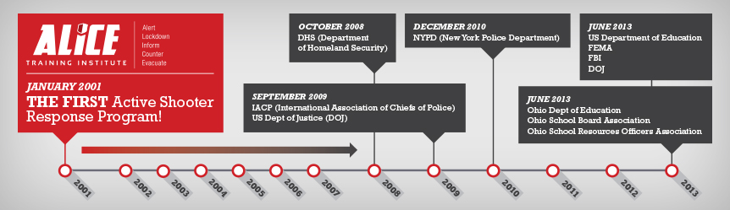
ALICE History
Greg Crane
Lisa Crane
Founded 2001
Law Enforcement
School Admin
Notes:
Original Goal – Keep Wife Safe
2001 – First company with proactive responses to active shooter
Original goal: Safety for his wife
Then: Local schools in Texas
Then: drive to the next school…anywhere/anyone who would listen
THE ALICE STORY
Law enforcement officer who couldn’t believe his wife, a k-12 principal, could not tell him what she and her students would do if an active shooter situation event occurred at their school. – Lockdown and wait. Greg began questioning?
How can a one size strategy/tactic fit all situations; how can a singular strategy address all variable; what are the recommendations when passive measures fail, what do police officers teach their kids, who dictates fire response? … (Alice genesis)
Who are we really trying to protect … (Raider genesis)
What did the event data teach us about these events – what is really happening?
What kind of training, preparation, conditioning did the schools have?
Alice didn’t start after sandy hook or navy yard
Or after the fbi said start suggesting rhf in 2008
Or fed dept of ed 360% turn in 2013 saying we must move beyond lockdown
But we started this in 2001 and now everyone agrees with us
YEAR ADVISING ENTITY
2001: ALICE Training - Response Options
2008: Department of Homeland Security
2009: International Association of Chiefs of Police
2010: New York Police Department
2013: Ohio Department of Education (Ohio Attorney General)
2013: US Department of Education (FEMA, FBI, DOJ)

Slide 28

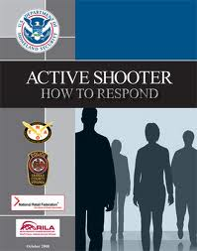
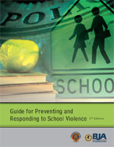
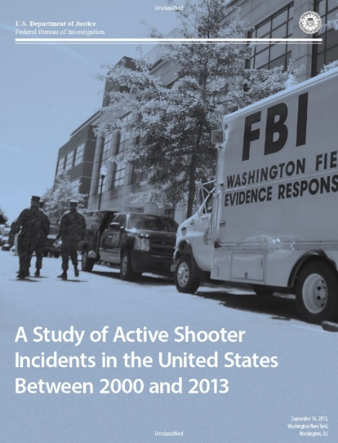
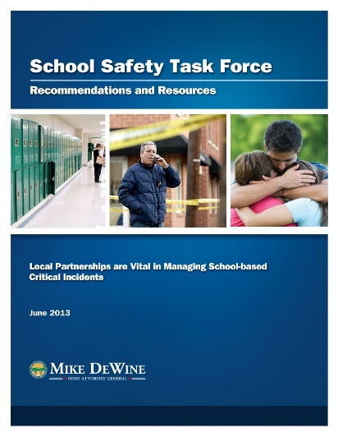
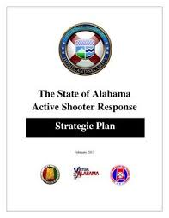
Research Supporting ALICE
State & Federal Agencies moving away from Lockdown-Only Response

Slide 29


FBI
Document Title
A Study of Active Shooters Incidents in U.S. (2014)
Agencies Issuing Guidance
• US Department of Justice
• Federal Bureau of Investigation
“In 13.1% of incidents, the situation ended after unarmed citizens safely and successfully restrained the shooter. In 52% of those incidents, unarmed principals, teachers, other school staff and students confronted the shooters to end the threat. [Page 21]
“A total of 60% of the incidents ended before police arrived.” [Page 6] “When the duration of the incident could be ascertained, 69% of the incidents lasted 5 minutes or less with 36% of those ending in 2 minutes or less.” [Page 8]
“An average of 6.4 incidents occurred in the first 7 years studied, and an average of 16.4 occurred in the last 7 years studied.” [Page 6]
Notes:
On September 24, 2014, the FBI released a study of 160 active shooter incidents that occurred between 2000 and 2013 throughout the United State.
The information contained in this study can benefit anyone who could potentially be in an active shooter situation—like emergency personnel, educators, students, employees of retail corporations and other businesses, government and military personnel, members of the general public, by giving a better understanding of how these incidents play out.
the FBI identified 160 active shooter incidents that occurred in the United States between 2000 and 2013. Though additional active shooter incidents may have occurred
during this time period, the FBI is confident this research captured the vast majority of incidents falling within the search criteria. To gather information for this study, researchers
relied on official police records (where available), FBI records, and open sources. The time span researched was intended to provide substantive results to aid in preparedness and
response efforts. This study is not intended to explore all facets of active shooter incidents, but rather is intended to provide a baseline to guide federal, state, tribal, and campus law
enforcement along with other first responders, corporations, educators, and the general public to a better understanding of active shooter incidents.

Slide 30
Why ALICE?
Mitigate LEGAL Liability – Right Thing to Do
Workplace Violence & OSHA
Legal Liability – Civil Actions
Increase odds of Survival
It can happen Anywhere
Police Response will rarely be quick enough
Prepare for FIGHT – FLIGHT - FREEZE
Building Occupants will ALWAYS be 1st – First Responder

Slide 31
Comments
Questions
Concerns

