Slide 1
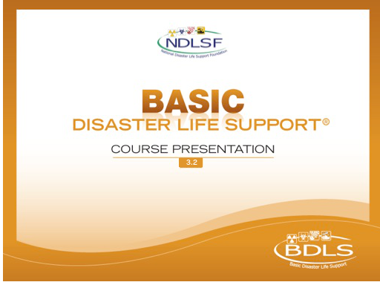

Slide 2

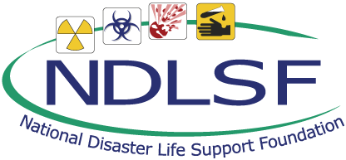
Session 1 – Lesson One
Disaster Basics

Slide 3
Learning Objectives
Discuss each component of the PRE-DISASTER Paradigm™ as it pertains to all-hazards disaster preparedness.
Discuss each component of the DISASTER Paradigm™ as it pertains to all-hazards disaster response and recovery.
Discuss health-related aspects of all-hazards disaster preparedness, including risk analysis, population vulnerability assessment, health system surge planning, and legal and ethical considerations.
Describe principles for all-hazards disaster response and recovery with attention to situational awareness, incident management, health care facility surge management, continuity of operations, and after-action review.
Notes:
It is important to point out that these objectives frame two key aspects, all-hazards preparedness and all-hazards response/recovery. The PRE-DISASTER Paradigm™ focuses our attention on preparedness, while the DISASTER Paradigm™ focuses us on response/recovery.
Actual objectives

Slide 4
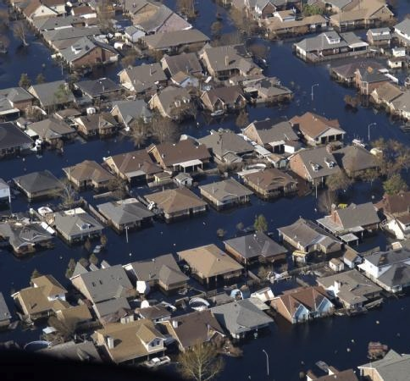
Background
Over 200 million disaster deaths occurred worldwide in the last century
Health professionals play a critical role in disasters
All-hazards principles and practices are important
Michael Rieger/FEMA
Notes:
In the last century, 3.5 million people were killed by natural disasters, and another 200 million were killed by man-made disasters (such as war, genocide, and terrorism). [BDLS 3.0 Course Manual, pp 1-2]
As the number of disasters, both natural and man-made, continues to rise, it is more important than ever for our communities and responders to train, educate, and prepare.
In the United States every year, there are hundreds of deaths and thousands of injuries due to disasters.
Disasters disrupt commerce, critical infrastructure, and our everyday lives.
All-hazards preparedness is the principles and practices that facilitate an effective response and recovery to a wide variety of disaster typologies and their resulting casualties.
NOTE: Use example (such as cardiac arrest management) to emphasize the importance of all-hazards approach.
IMAGE -- New Orleans, LA, September 8, 2005: FEMA's US&R teams in route by helicopter to conduct a search in St. Bernard Parish, view the flooding in New Orleans. Michael Rieger/FEMA.

Slide 5
What is a disaster?
“An event and its consequences that result in a serious disruption of the functioning of a community and cause widespread human, material, economic, or environmental losses that exceed the capacity of the affected area to respond without external assistance to save lives, preserve property, and maintain the stability and integrity of the affected area.”
Operational Definition
Disaster = Needs > Resources
Notes:
There are many definitions of what a disaster is. This is the definition promoted by the National Disaster Life Support program, in accordance with the all-hazards framework. [BDLS 3.0 Course Manual, pp 1-4]
Simply, do you know when YOU are in a disaster? Answer, any time your “needs exceed your resources”! That is the operational application of the definition of a disaster.
Animation: The phrase “Operational Definition: Disaster = Needs > Resources” will fade in on next click.

Slide 6
Categories of Disaster
Human Systems Failure
War and Conflict
Natural
Notes:
There are many different classifications of disasters. The most inclusive is this three-category classification:
Natural disasters (such as hurricanes, tornadoes, wildfires, or floods)
Human systems failures, which are failures in human technology (such as the Chernobyl nuclear reactor meltdown in Russia; the Fukushima, Japan, nuclear power plant destruction during the tsunami of 2011; and other examples such as levee or dam breaks, structural collapse after hurricanes, and regional flooding)
War and conflict, including the effects of war, terrorism, genocide, etc. Many other related topics, definitions, and acronyms could be introduced here at the presenter’s discretion (bioterrorism, WMD, WME, asymmetric warfare, CBRNE).
A disaster is NEVER “just one thing”! Any given disaster can overlap multiple categories. Consider the example of the 2011 tsunami in Japan, which began as a natural disaster with earthquakes, causing a tsunami, resulting in flooding, leading to multiple human systems failure-based disasters (including seawall failures, structural collapse of buildings, nuclear power plant reactor failures, etc).

Slide 7
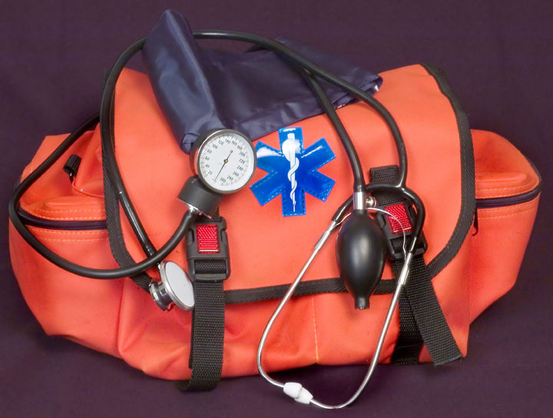
All-Hazards Preparedness
A uniform approach to prepare and respond
to any given hazard or event that may
affect the community regardless
of cause…
… to do the greatest good for the greatest number of potential survivors
Thinkstock
Notes:
All-hazards preparedness is an important concept and is reinforced throughout all the NDLS courses.
All-hazards preparedness is the principles and practices that facilitate an effective response and recovery to a wide variety of disaster typologies and their resulting casualties (as was introduced on a previous slide). It is a uniform approach to prepare and respond to any given hazard or event that may affect the community, regardless of cause.
The overarching purpose of all-hazards preparedness regarding the health and medical response and recovery is…. To do the greatest good for the greatest number of potential survivors!
Animation: The “purpose” (bottom line of text) as described above will appear on the next click.
IMAGE -- ©2012 Thinkstock.

Slide 8
The PRE-DISASTER Paradigm™
Planning and Practice
Resilience
Education and Training
Notes:
The PRE-DISASTER Paradigm™ was developed by the NDLS Program to reinforce key elements for enhancing personal, organizational, and community preparedness. The “PRE” mnemonic includes: planning and practice, resilience, and education and training.
As the prefix suggests, the PRE portion really is geared toward planning and the preparation needed before an event occurs.
Animation: The words of the “PRE” acronym will appear automatically in sequence on the next single click.

Slide 9
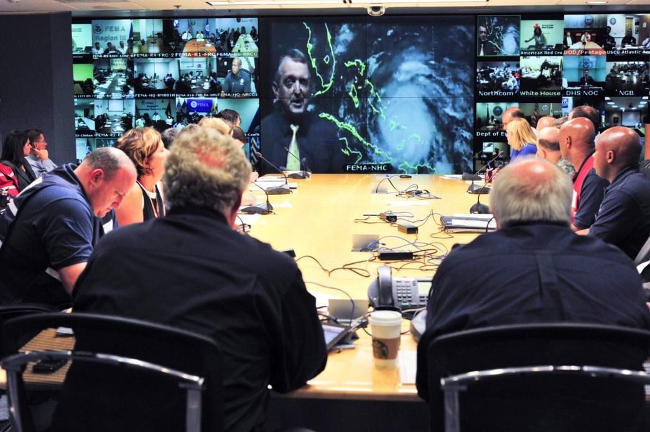
PRE-DISASTER Paradigm™
Planning and Practice
At-risk populations
Identify stakeholders
Develop a valid plan
Training and education/ exercise and drills
Plan review and revision
Aaron Skolnik/FEMA
Notes:
The P in the PRE-DISASTER Paradigm™ is planning and practice.
To initialize the planning phase, the community must:
Identify the at-risk populations, which include the workforce; people at the extremes of age; those with chronic disease; those with cognitive, functional, and sensory limitations; and people in threatening environments such as poorly ventilated buildings or those lacking air-conditioning, heating, or proper shelter site access. Certain populations within our communities are disproportionately affected by disasters. The particular needs of this part of the community must be considered early on. Items to consider are staffing, access, transport, evacuation, medications and supplies, treatments, special housing considerations, communications, etc.
Identify the stakeholders and bring them to the table. Identify and involve in the planning process all agencies, nongovernment organizations (NGOs), businesses, and individuals who will be responding to a disaster on any level. The adage “you never want to meet a stranger in a disaster” reinforces the importance of meeting and bringing key people/organizations together early. Suggested stakeholders include hospitals, EMS agencies, fire, police, public health, government, community groups, and relevant private businesses.
Develop the plan using input from all stakeholders. Use historical data as a starting point, adding a hazard vulnerability analysis and other valid data as needed.
Drill and exercise the plan
Review the results of the drills and exercises, and the data from actual disasters and emergencies, to review and revise plans
IMAGE -- Bill Read, director of NOAA's National Hurricane Center (on-screen, center), provides a briefing to federal and state partners on Hurricane Irene via teleconference. Aaron Skolnik/FEMA.

Slide 10
PRE-DISASTER Paradigm™
Planning and Practice
Risk Analysis
Assess potential vulnerabilities
Understand the consequences
When we understand our vulnerabilities, we can mitigate and plan for them
Notes:
Effective disaster planning begins with an assessment of potential hazards, followed by an attempt to understand and anticipate the effects of those hazards.
Risk analyses are relevant to local hazards, geography, population, and resources. They can be done at the micro to macro level – from the individual and family level and expanding to the hospital/health facilities and to community, state, and federal levels.
When we understand our vulnerabilities, we can mitigate and plan for them.

Slide 11
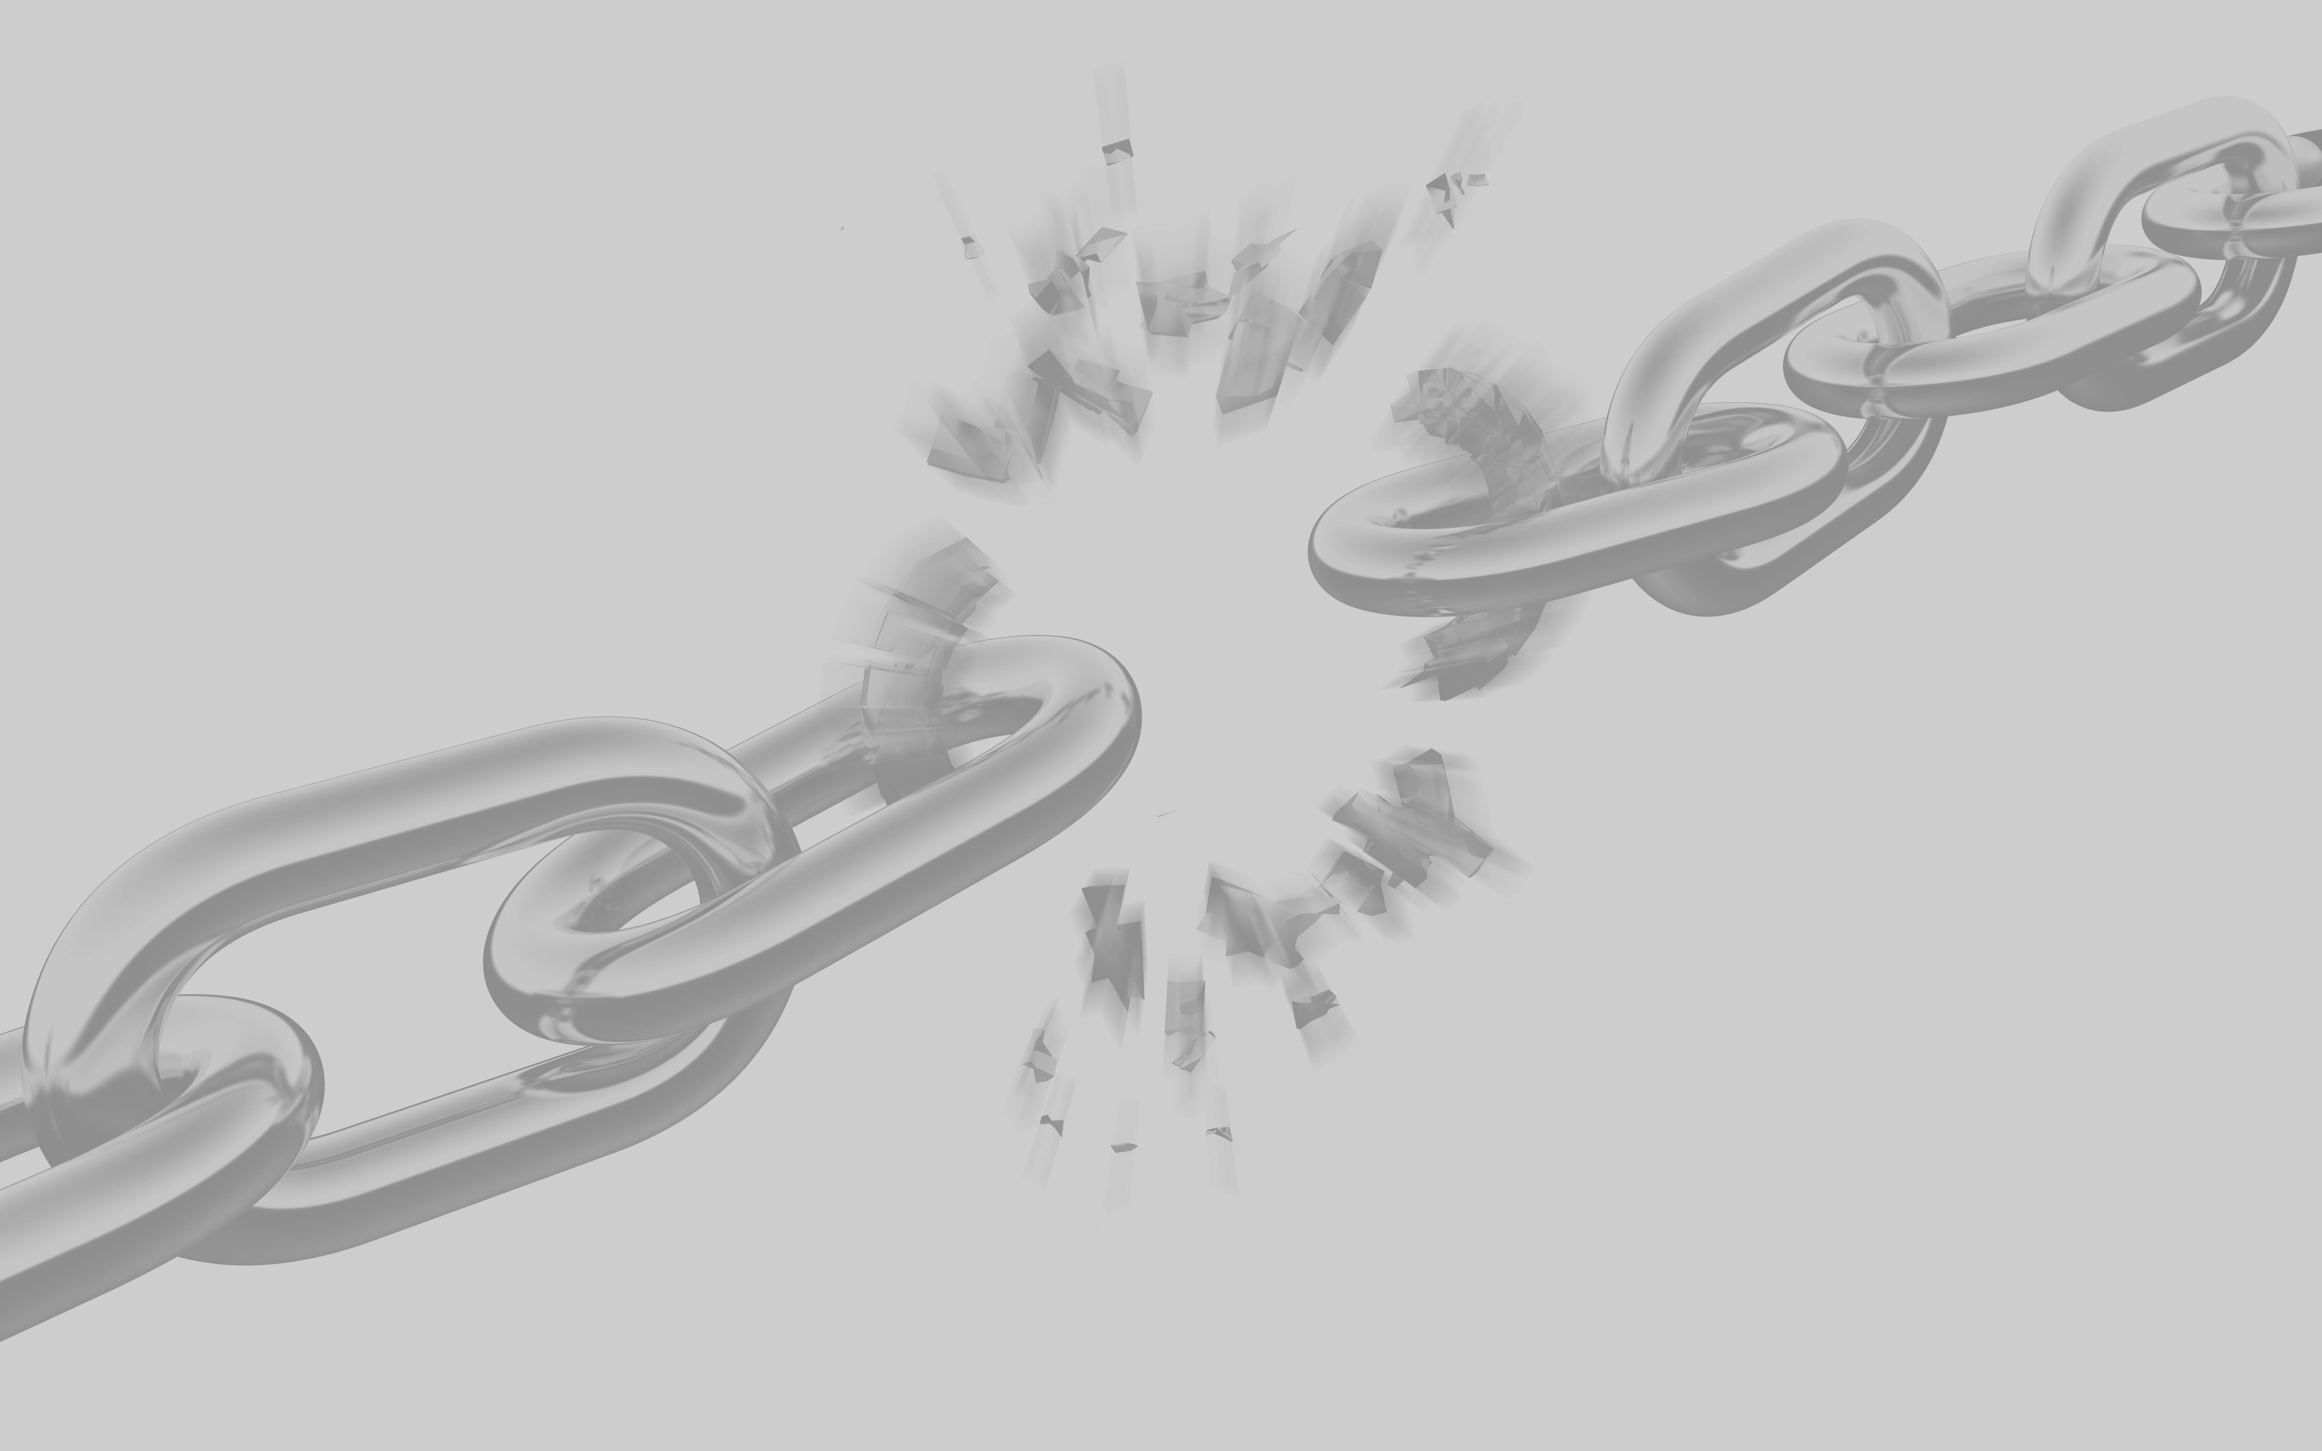
PRE-DISASTER Paradigm™
Planning and Practice
Continuity of Operations
Each stakeholder must identify mission-critical functions to meet the demands
Contingency planning must support these mission-critical functions
Thinkstock
Notes:
Facilities and agencies must have plans that maintain or return essential functional services during and after a disaster.
The planning phase should identify mission-critical functions, supplies, and staff, and contingencies for each must be developed.
This involves asking and answering many questions, such as: Where will electricity come from after a power outage? How about extra diesel fuel, fresh food, clean linens? Where will the extra staff you need come from and how will they get there? How will you document without an electronic medical record?
The graphic illustration of the chain represents a broken link in the figurative chain of continuity of operations and obviously is to be avoided.
IMAGE -- ©2012 Thinkstock.

Slide 12
PRE-DISASTER Paradigm™
Planning and Practice
Space
Staffing
Supplies
Systems
Health System Surge
Surge capacity
Where do you put the extra patients?
Surge capability
How do you take care of them?
Notes:
Surge capacity: the ability of a system to rapidly expand beyond normal services to meet increased demand for care of patients.
Surge capability: combines capacity with what can actually be done to care for the patients. Surge capability is measured in terms of staff, supplies, and systems truly available to provide services and care.
Planning for a surge of patients presenting to the health system is a must. This situation is a health care disaster – when the number of patients seeking care exceeds your staffing, space, supplies, or systems (needs > resources):
Staffing – What personnel do you need, where, and when?
Space – Consider shuttered wards, unused or underutilized flat spaces, or repurposing existing spaces.
Supplies – What do you need? Where do you get it? When can it arrive?
Systems – How do you expand the capacity of existing systems? Can systems capability be added?
Other discussion points regarding surge-based planning are to consider:
Increasing health care facility capacity
Planning for supporting acute care sites/alternate care site
Developing electronic registries of volunteer health care providers
Planning for altered care delivery (ie, crisis standards of care)
Planning for patients with special needs (ie, children, elders, institutionalized, technology dependent)
Mobilizing general and specialty care resources as necessary (ie, adult and pediatric subspecialists)
Surge planning requires a health system to go beyond its door for help. It requires involving outside agencies, suppliers, mutual aid, other health care facilities. These plans demand diverse community and stakeholder involvement.

Slide 13

PRE-DISASTER Paradigm™
Planning and Practice
Plans must follow legal and ethical principles
Plans are guided by acceptable scientific and medical practice
Plans must aid decision making
Thinkstock
Notes:
In a crisis, state and local emergency management and public health leaders need a clearly defined set of legal and ethical principles to help them make sound, real-time decisions for managing the consequences of a disaster.
Planning should consider potential moral and ethical challenges, as well as the legal powers available. Considering the health and medical needs of all affected persons without regard to age, race, ethnicity, nationality, religious beliefs, sexual orientation, residency status, or socioeconomic status is important.
Decisions involving the health and lives of individuals must consider areas such as evacuation orders, allocation of scarce resources, quarantine, isolation, distribution of medications, etc. Scientific principles and acceptable best medical practices should guide planning where possible.
IMAGE -- ©2012 Thinkstock.

Slide 14
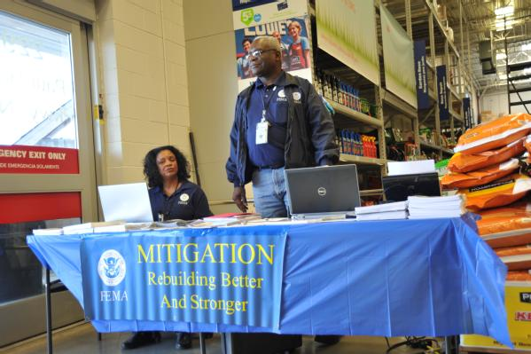

PRE-DISASTER Paradigm™
Resilience
Ability of individuals and communities to adapt and overcome adversity due to disaster
Tim Burkitt/FEMA
Ruth Kennedy/FEMA
Notes:
Resilience is the ability of individuals and a community to rebound to a reasonable state of normalcy after exposure to disasters, serious emergencies, and other traumatic, tragic, and stressful events. Resilience is inherent in many communities and cultures, but it is largely built by planning, preparation, communication, education, and training. [BDLS 3.0 Course Manual, , pp 1-5]
IMAGES --
Cleveland, TN, March 25, 2012: Mitigation Specialists Joyce Price and Sam Walthour pass out pamphlets and answer questions about how to prepare for and rebuild stronger after a storm or disaster. FEMA sets up the displays in home improvement stores throughout states where a disaster has been declared. Tim Burkitt/FEMA.
Rainsville, AL, August 22, 2011: Abby Carson of Rainsville works alongside other Rainsville residents in a FEMA ESF#14 group exercise designed to help citizens express their needs for rebuilding their town, during a meeting at the Tom Bevill Enrichment Center in Rainsville. Three tornadoes destroyed a large portion of Rainsville on April 27th. Currently the FEMA ESF#14 team is working closely with Rainsville to rebuild the community to be better and stronger than before. Ruth Kennedy/FEMA.

Slide 15
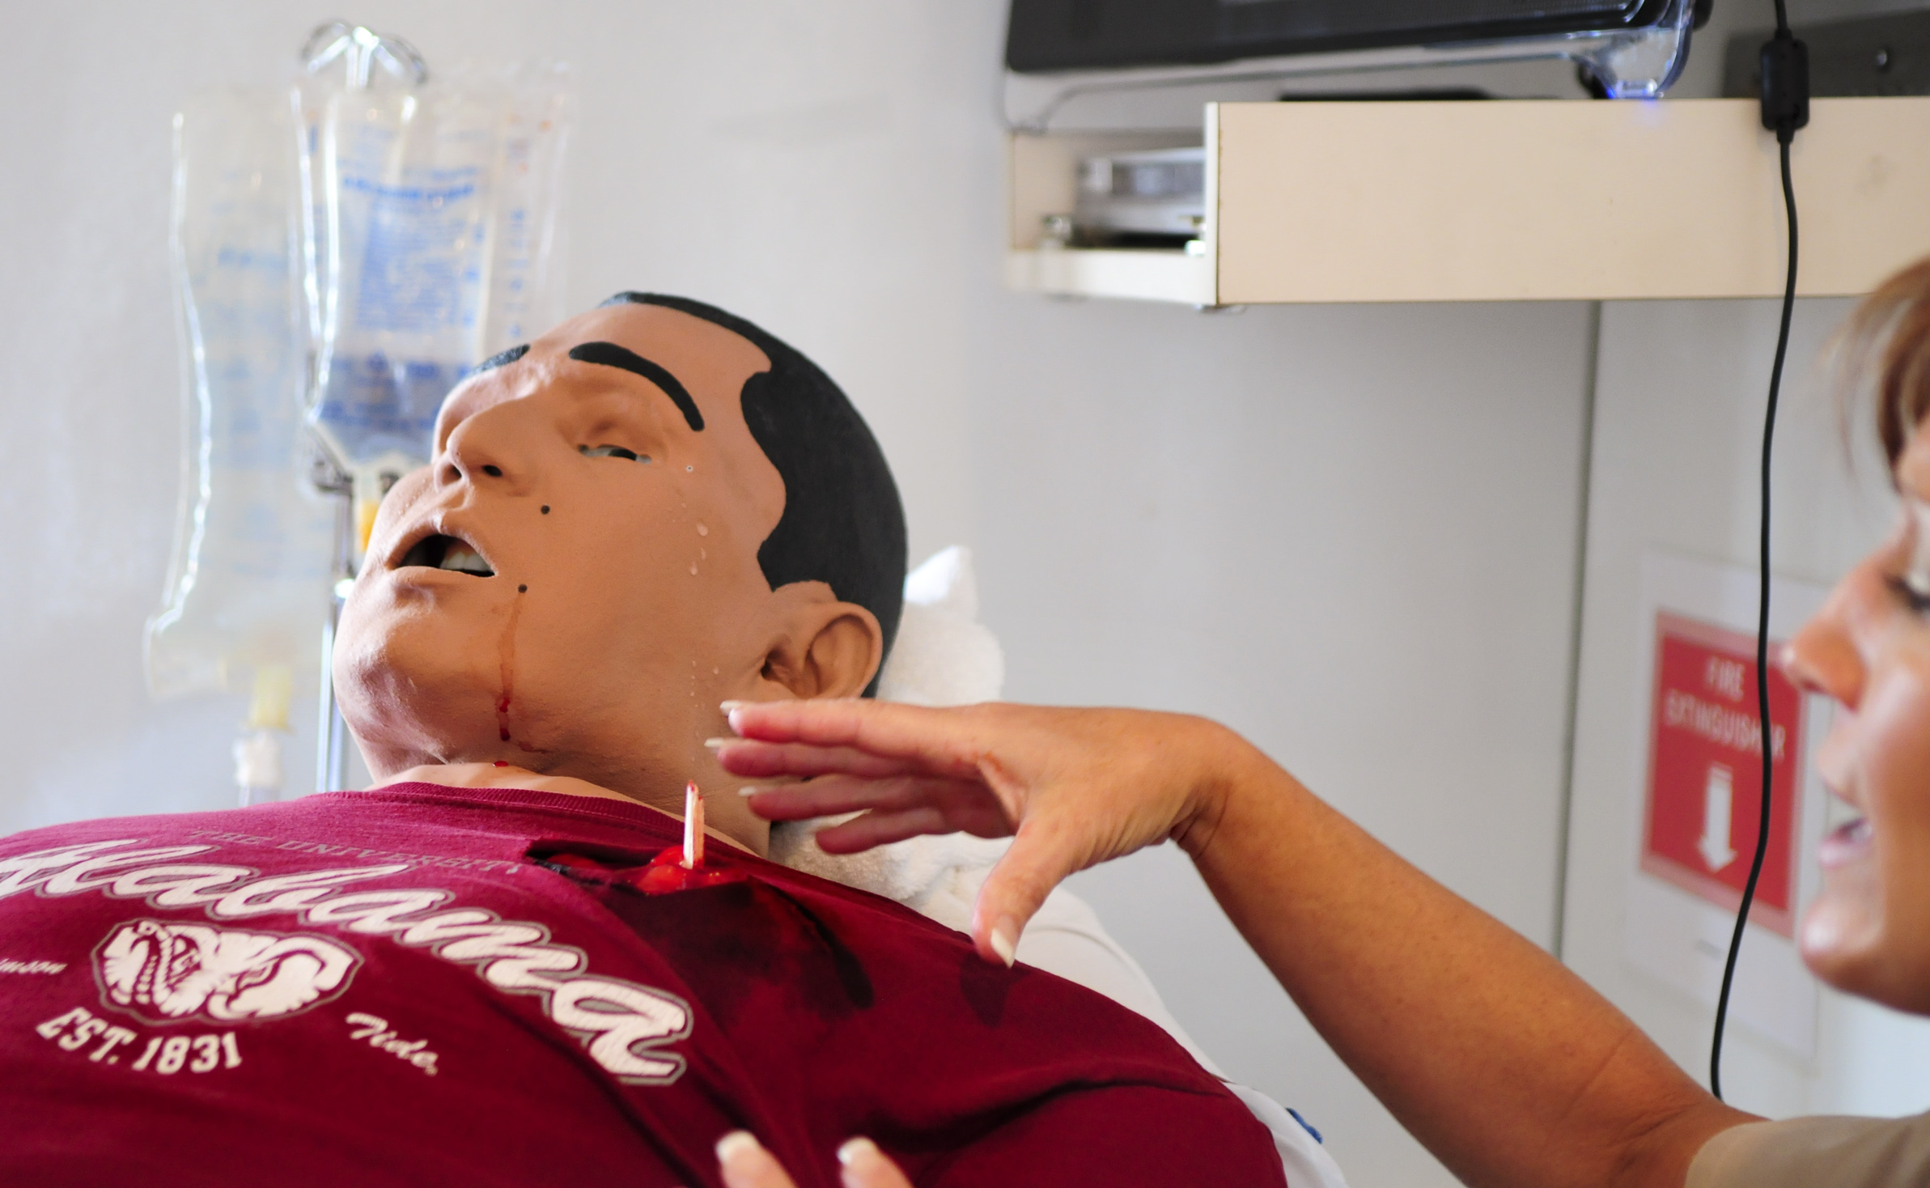
PRE-DISASTER Paradigm™
Education and Training
Essential to the workforce and community
Competency based
Standardized
Setting performance expectations
Ruth Kennedy/FEMA
Notes:
Education and training are essential to effective disaster mitigation and the community.
It is critical that the training be standardized and competency based to ensure an effective and consistent response.
Standardization leads to improved “performance expectations”!
Like-training establishes uniform expectations, allowing providers to function seamlessly and foster team integration.
NDLS course series provides a foundation for responder and community training.
It is important to train not only your community officials and disaster responders, but also all possible stakeholders (public health, emergency management, EMS, fire, police, charity groups, volunteer responders) and the community at large.
Educate citizens and families, help them prepare for a disaster, understand the community’s plans, and let them know what to expect in the aftermath of a disaster. Individuals and families involved in a disaster need to know several things:
How to stay safe
How and when to shelter in place
How and when to safely evacuate
Where and when to seek medical help, supplies, food, and shelter as required
How and when to volunteer services and supplies in an emergency
How to access critical information to enable all of the above
Such preparation not only decreases the impact of the disaster on the community but also greatly improves the community’s resilience.
CPR works because there is a single, standardized methodology that allows the performance of CPR to be conducted in a near-identical manner among a wide variety of people who may be called upon to perform such resuscitative measures, ranging from lay-citizens to the most highly trained health professionals. This expectation of performance is critical to facilitating the best possible outcome for the patient requiring CPR.
IMAGE -- Troy, AL, September 8, 2011: Robi Mobley, FEMA Patient Simulation Specialist, explains the functions of a simulator, including moving, crying, bleeding and talking at Be Ready Day. In remembrance of September 11, 2001, Be Ready Day, hosted by Troy University and sponsored by the EMA, emphasized teaching students about safety in a number of areas, including tornado preparedness. Ruth Kennedy/FEMA.

Slide 16
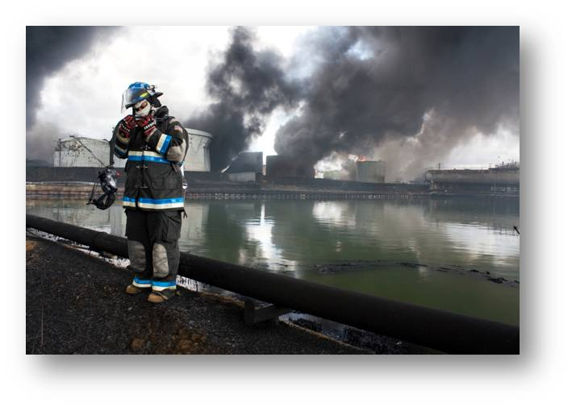
The DISASTER Paradigm™
D | etection
I | ncident Management
S | afety and Security
A | ssess Hazards
S | upport
T | riage and Treatment
E | vacuation
R | ecovery
Yuisa Rios/FEMA
Always ask Are my needs > resources?
Notes:
The DISASTER Paradigm™ is a practical learning and organizational tool. The DISASTER Paradigm™ is a useful reminder of key operational elements.
At each area of the DISASTER Paradigm™, you should be asking: “Do my needs exceed my resources?”
For example, you may be ready, willing, and able to deliver clinical treatment, but overlooking that you have safety or security needs that are unmet is “a disaster” as any need exceeding resources defines a disaster and identifies an immediate action item or critical task that must be addressed.
IMAGE -- Cataño, PR, October 25, 2009: Inside the Gulf explosion perimeter. Yuisa Rios/FEMA.

Slide 17
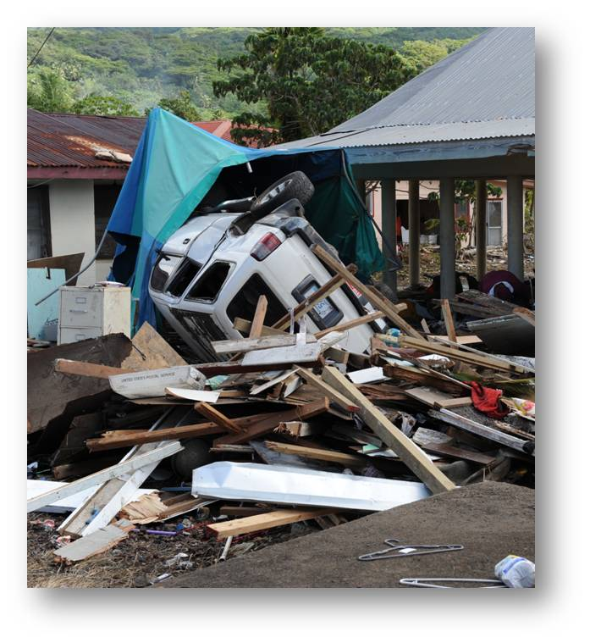
The DISASTER Paradigm™
Detection
Situational awareness:
  Is a disaster present?
  What has happened?
  What is needed now?
  Whom should I call?
Casey Deshong/FEMA
Detection is awareness!
Notes:
The first step in any disaster response is to detect that a disaster or mass casualty incident has occurred. Ask yourself, “Do my needs exceed my resources?” If they do, you have a disaster.
Situational awareness is a responder’s and community’s constant awareness of the evolving disaster environment. Information may be difficult to obtain, but timely and credible information on hazards, status of infrastructure, and needs of the population is essential to safe and effective operations. Information is potentially available from multiple sources – witnesses, media, internet, social media, public health reporting, and hospital data. Communication between all stakeholders is key.
Detection is awareness that something has happened or is evolving, that hazards could exist, and that further action, communication, people, supplies, and/or equipment are necessary.
IMAGE -- Leone, American Samoa, October 2, 2009: A car sits upside down among other debris that was caused by the earthquake and tsunami in American Samoa. The tsunami spread debris throughout the village of Leone. Casey Deshong/FEMA.

Slide 18
The DISASTER Paradigm™
Incident Management
Incident
Commander
Public
Info Officer
Safety Officer
Liaison Officer
Planning
(“Thinkers”)
Logistics
(“Getters”)
Operations
(“Doers”)
Finance
(“Payers”)
National Incident Management System
Emergency Management Command and Control
Improves Coordination and Communication and Reduces Redundancy
Notes:
the key reasons for a defined incident mgmt structure – to ensure all necessary functions/roles covered and avoid redundancy and waste
Born of the Fire Service during the 1970s, the incident command system (ICS) was expanded and adapted for use in all response agencies and hospitals throughout the US. On February 28, 2003, President George W. Bush issued Homeland Security Presidential Directive (HSPD)-5, Management of Domestic Incidents, which directed the Secretary of Homeland Security to develop and administer the National Incident Management System (NIMS). NIMS is now in full use throughout the United States.
The NIMS is intended to provide a consistent, flexible, and adjustable national framework to enable federal, state, local, and tribal governments and private sector and nongovernmental organizations to work together effectively and efficiently to prepare for, prevent, respond to, and recover from domestic incidents, regardless of cause, size, or complexity, including acts of catastrophic terrorism. On the basis of this goal, the NIMS consists of the following:
Command and management (ICS)
Preparedness
Resource management
Communications and information management
Supporting technologies
Ongoing management and maintenance
It is very important that everyone involved in disaster response have a working understanding of the incident command system commensurate with their role and experience.
ICS includes command, coordination, and communication. An important element of incident management, and disaster response in general, is communication (information flow).
ICS principles and practices include such items as scalability (adapting a response to event size and evolution), span of control (a finite number of reporting lines to any command position), and interoperability (allowing for integration between agencies and organizations).
A hospital version of ICS is HICS (hospital incident command system), which is part of the Joint Commission standard for use in the hospital environment.

Slide 19
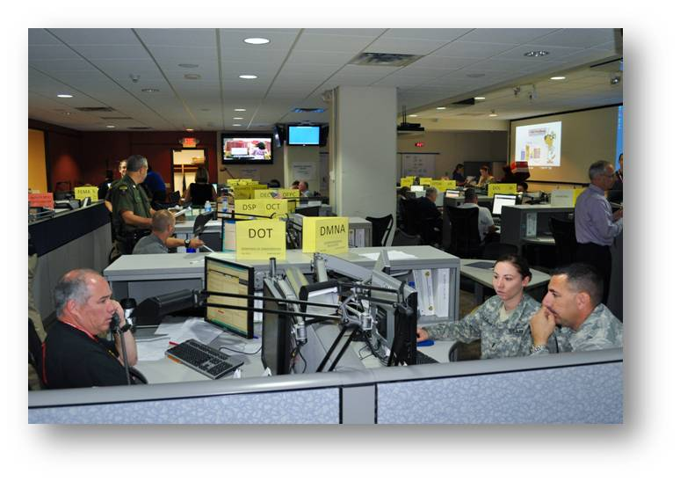
The DISASTER Paradigm™
Incident Management
  Communication is challenging:
  Establish plans and protocols
  Establish key relationships
  Understand the equipment
  Drill and exercise
Elissa Jun/FEMA
Make effective use of technology
Information Sharing
Effective = Timely + Accurate
Notes:
Communication during times of disaster is notoriously problematic. Any disaster response must include a robust communications plan. This is essential because lives can be saved by having accurate and timely information reach your stakeholders and citizens. Many challenges and communication-based items must be addressed. Hardening of your communication methods includes ensuring redundancy, alternate forms of communications, common protocols and language use, and interagency cooperation.
Animation: With sequential clicks, the “Information sharing…” , followed by the “Effective = Timely …” items are displayed.
IMAGE -- Albany, NY, September 2, 2011: New York State Emergency Operations Center is activated in response to Hurricane Irene that passed through New York State in August 28, 2011. The President declared a disaster for the State of New York to supplement state and local recovery efforts in the area affected by Hurricane Irene. Elissa Jun/FEMA.

Slide 20
The DISASTER Paradigm™
Incident Management
  Educate and inform the community
  Reduce fear and panic
  Guide and direct
  Controlled message
  Risk communication is important and vital
One voice … one message.
Notes:
Risk communication is information for individuals and communities to support the best possible decisions to protect health, safety, and security. Risk communication is a vital component of any disaster communication strategy.
During emergencies, the public may receive information from a variety of sources. Effective communication of clear, concise, and credible information will help assure the public that the situation is being addressed effectively, while reaching broad audiences to inform regarding health and medical care access, immediate and anticipated hazards, appropriate health and safety precautions, the need for evacuation or sheltering in place, alternative travel routes, etc.
Under NIMS, state and local health authorities must have established procedures for providing the news media with timely and accurate public information. Risk communication is discussed further in Chapter 2, “Public Health Response to Disasters.”
“One voice … one message”: Speaking with/as a common voice, delivering a consistent message, is the purpose of risk communication.

Slide 21
The DISASTER Paradigm™
Safety and Security
Priorities:
1st – Self and team
2nd – Uninjured public
3rd – Casualties
4th – Environment
Action steps: mitigate a dangerous or threatening situation
Notes:
Disaster response is inherently dangerous. One of the most important considerations is the safety of the responders.
The first priority regarding safety and security is the protection of yourself and your team. The old adage “don’t become part of the problem” is still valid. If you or a team member become injured or acutely ill, you or they will not be managing the casualties; even worse, you have now increased the number of casualties and removed the use of your skills.
Identifying possible life threats or hazards should prompt immediate action steps on your part. Utilizing proper barriers to entry, PPE, etc, are some of these important safety and security measures that every responder must adopt.
It may be prudent to delay or prevent responders from entering a disaster zone pending hazard identification and mitigation (ie, likelihood of an explosive device that has not yet detonated). Just as important, every responder must constantly reassess the situation and always have an “exit” plan in mind.
Considerations pertinent to safety and security may include the following suggestions:
Regulating access to a scene (barriers and control)
PPE, shielding, helmets (protective equipment)
Communication (information exchange)
Police protection (situational control)

Slide 22
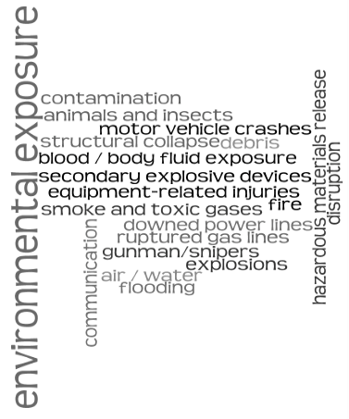
The DISASTER Paradigm™
Assess Hazards
Recognition of likely causes of safety and security concerns
Risk of causing additional casualties
Sean Covant, MD/ Preston Fedor, MD
Notes:
On the previous slide we learned that safety and security involve the action steps to mitigate a dangerous or threatening situation (ie, donning PPE even though the exact chemical or substance is yet unknown); now assessing hazards will work toward the specific identification and management of actual or evolving threats (ie, specific chemical or substance identification is determined).
Multiple hazards can exist on a scene. It is important to remember that hazards may change or new hazards may develop as the situation is ongoing.
IMAGE -- Sean Covant, MD/ Preston Fedor, MD.

Slide 23
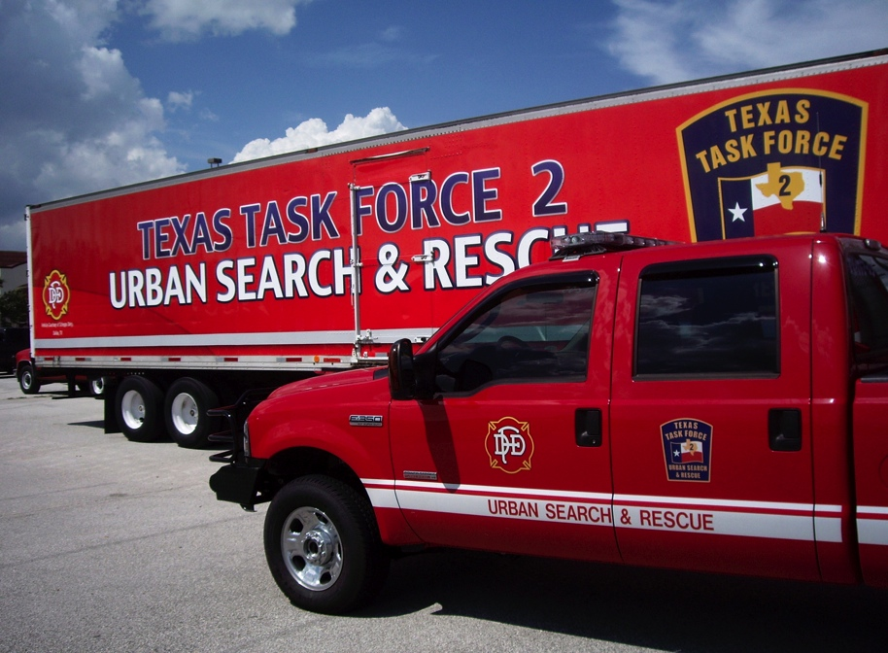
The DISASTER Paradigm™
Support
Support is logistics:
What do I have?
What is needed?
Where is it?
When will it arrive?
What if it is unavailable?
Don Jacks/FEMA
Notes:
Support is logistics and requires answers to several questions, including:
What do I have? Clear determination of your present capabilities and capacities
What is needed? Knowing exactly what to ask for
Where is it? The location and access
When will it arrive? Timely arrival determined by access, method of transport, and receipt
What if it is unavailable? Contingency plans and scarce resource management
Other considerations may be a factor (ie, readily accessible, cost prohibitive, require special permission, etc).
The value of appropriate “local preparedness” should be emphasized. A sufficient quantity of life-sustaining supplies, personnel, and other equipment must be immediately available. Plans should include stockpiles of supplies, ability to obtain extra personnel, fuel caches, surge planning, etc.
IMAGE -- San Antonio, TX, August 21, 2007: Texas Task Force 2, an integral part of our country's search and rescue capability, awaits forward deployment to Texas' Gulf Coast as part of this nation's Hurricane Dean response. Don Jacks/FEMA.

Slide 24
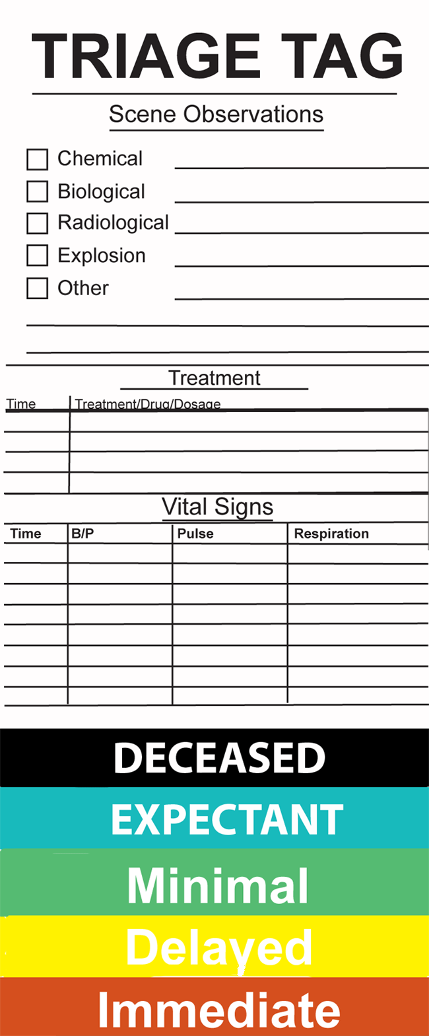
The DISASTER Paradigm™
Triage and Treatment
Disaster triage must…
Work with a large number of casualties
Be easily performed
Prioritize both treatment and transport
Be standardized
Tom Lehman, NTC-W
Notes:
Triage and treatment: In a disaster involving multiple casualties, the goal of triage and treatment is to do the greatest good for the greatest number of possible survivors.
Disaster triage must work with a large number of casualties, be easily performed, prioritize both treatment and transport and be standardized.
Triage involves the removal of possible survivors (ie, ambulatory casualties, bystanders, etc) from likely hazards as an important first consideration.
Identifying casualties in need of lifesaving interventions (LSIs) is a critical early action.
The labeling of casualties in designated categories, once LSIs have been addressed, is the next important action.
This prioritization of casualties is important to both treatment and transport decision making.
Communicating triage information in a concise and consistent manner from the scene and ultimately to receiving facilities is the next action.
IMAGE -- Tom Lehman, NTC-W.

Slide 25
Walk
Assess 3rd
SALT Mass Casualty Triage
Sort
Assess
Lifesaving interventions
Treatment/transport
Step 1 – Sort:
Global Sorting
Wave/Purposeful Movement
Assess 2nd
Still/Obvious Life Threat
Assess 1st
Step T2– Assess:
Individual Assessment
LSIs*
Control major hemorrhage
Open airway (if child, consider 2 rescue breaths)
Chest decompression
Autoinjector antidotes
Breathing
Obeys commands or makes purposeful movement?
Has peripheral pulse?
Not in respiratory distress?
Major hemorrhage in control?
Minor injuries only?
Yes
All Yes
Yes
Minimal
No
No
No
Dead
Delayed
Likely to survive
given current resources
Yes
Immediate
*LSIs: Lifesaving interventions
No
Expectant
Notes:
This is a preview of the SALT triage methodology. SALT triage will be presented in a separate session today. It consists of four stages: sort, assess, lifesaving interventions, and treatment/transport.
Global sorting is the initial step, followed by completing individual assessment, which includes identifying and completing lifesaving interventions, determining triage category assignment, and readying for transport.
IMAGE --Disaster Medicine and Public Health Preparedness, 2008 (Suppl 1): S30.

Slide 26
The DISASTER Paradigm™
Triage and Treatment
Casualties overwhelm available resources
Goal of disaster triage:
Do the greatest good for the greatest number of potential survivors
I
D
M
E
IMMEDIATE
DELAYED
MINIMAL
EXPECTANT
DEAD
Notes:
By definition, a disaster overwhelms existing resources in an area. A mass casualty incident is having more casualties than available resources can take care of without additional support. This requires responders to triage patients to decide who needs the most immediate care and the allocation of available limited resources.
The goal of triage is to do the greatest good for the greatest number of people. We do that by appropriately utilizing our limited resources and staff.
The “ID-ME” acronym refers to the phrase ID (identify) me and is used to both remind the triage personnel of the action (to identify the most serious casualties first) and to reinforce memory of the proper order assignment of all the categories for triage of live casualties.
It is always best to refer to the triage categories by name (immediate, delayed, etc), rather than by color or letter, as the later can be confusing or even perceived as culturally insensitive if taken out of context by those not familiar with this process.
Animation: With sequential clicks the NDLS triage color bar, followed by the word description, and then followed by the first letter of the “IDME” acronym is presented. Note that the last category “dead” remains spelled out, as once a person has been identified as dead, no further triage category or reassessment component is needed.

Slide 27
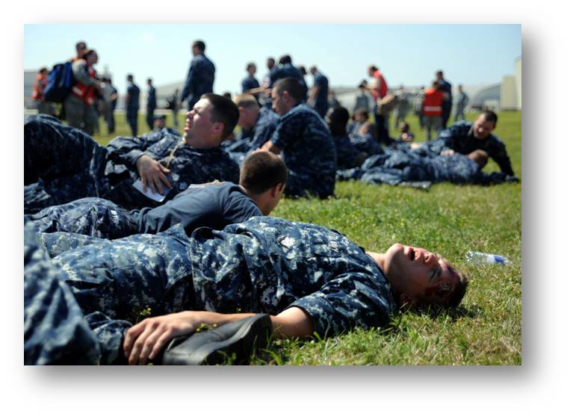
The DISASTER Paradigm™
Triage and Treatment
Treatment continues until:
All casualties have been transported from scene
Available resources have been exhausted
Comfort care is treatment!
Senior Airman Timothy Taylor/U.S. Air Force
Notes:
Treatment is resource dependent. It is impacted not only by available supplies and equipment but also by the skill sets of the responders present on the scene.
Treatment on the scene continues until all casualties have been transported from the scene or available resources have been exhausted.
Remember: COMFORT IS CARE! This simple phrase emphasizes the importance and life-sustaining value of a safe shelter, a comfortable environment, access to water, food, and sanitation, etc.
IMAGE -- March 22, 2011: Simulated victims act out various injuries and symptoms at a triage area as emergency responders provide medical care during a major accident response exercise (MARE) at Joint Base Charleston (JB Charleston), SC, March 22, 2011. The MARE simulated an airplane crash on the flight line to prepare JB Charleston members for the upcoming 2011 Air Expo. Senior Airman Timothy Taylor/US Air Force.

Slide 28
Special Considerations
Unique or special medical needs populations
  Age: Including the very young and the very old
  Functional or access needs secondary to motor, sensory and cognitive limitations
Unique social situations
  Cultural, religious, or ethnic communities
  Language usage
  Rural or isolated communities
Notes:
The following elements must be considered when caring for vulnerable populations:
Unique or special medical needs may be encountered among several groups in any population. Formerly referred to “special needs” or “disabled” populations, these terms although commonly used did not communicate effectively an understanding of these populations who are “able” but may require assistance based on their functional limitations and related challenges that may be faced during the triage, treatment and evacuation phases of disaster management.
Age: The very young:
Need for pediatric drug dosages and delivery systems, including use of length based resuscitation tapes
Enhanced focus on airway opening and breathing support during the Assessment phase of SALT triage
Pre-identification and prenotification of health care facilities and alternate care sites staffed and equipped for disasters involving pediatric patients
Nonseparation and reunification of families with young children, particularly if decontamination is needed
Identification and tracking system for children who become separated from their families, especially preverbal and nonverbal children
Potential need for family support and information center, especially for relatives of unidentified or missing children
Age: The very old:
Recognition of and reliance on advance directives
Enhanced focus on chronic disease management during the impact and emergency relief phases of the response and recovery periods
Preidentification and prenotification of health care facilities and alternate care sites staffed and equipped for disasters involving geriatric patients
Potential need for nonambulance transport capabilities, particularly to alternate care sites
Function or access needs imposed by motor, sensory and cognitive limitations:
Specific knowledge of where such patients are located within each community
Need for additional specialized equipment, personnel, and transport resources
Unique social situations:
Need for culturally appropriate and sensitive risk communication strategies
Early notification of potential risks and early provision of adequate shelter
Tribal nations, aboriginal peoples

Slide 29
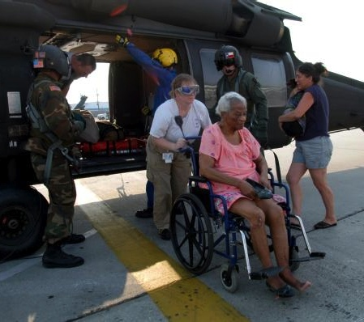
The DISASTER Paradigm™
Evacuation
Relocation due to disaster
Getting affected to safety
Transportation methods
Win Henderson/FEMA
Notes:
Evacuation is the relocation of an affected population or workforce personnel in response to a threatening situation (eg, pre-event evacuation from a hurricane threatening landfall), an actual threat (eg, rescue of flood-trapped persons), or a newly developing threat (rising flood waters, chemical containers leaking, etc).
Evacuation involves challenging decision making. Determination of the need and timing to evacuate a group or area should consider the following: threat analysis and impact timetable, identification of at-risk populations and destinations able to care for them, planning of routes and transport methods, destination shelters and supplies, health and medical care throughout transport and sheltering, safety and security throughout, etc.
An evacuation may result in a human systems failure disaster (eg, a bus fire accident outside of Dallas in 2005 during Hurricane Rita that killed more than 20 people). Any evacuation has associated and inherent risks and must be carefully considered and planned accordingly.
Every workforce member must have a personal evacuation plan; simply, what is your “exit strategy” going to be and what conditions or changes will activate it?
IMAGE -- New Orleans, September 3, 2005: One of the thousands of elderly residents evacuated from the city is being wheeled from the evacuation helicopter to the triage area set up inside the New Orleans Airport. Helicopter rescue missions continued nonstop, ferrying those left homeless and injured out of the city to the airport. Win Henderson/FEMA.

Slide 30
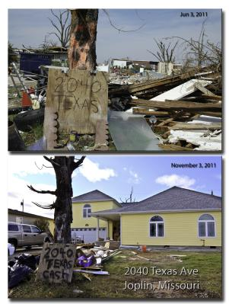
PRE-DISASTER Paradigm™
Recovery
Following disaster, community needs:
Relief
Rehabilitation
Restoration
Leo Anderson and Steve Sumwat/FEMA
Notes:
Recovery planning begins now!
Recovery actions commence immediately after a disaster occurs.
Recovery can be considered in three areas: relief, rehabilitation, and restoration.
The recovery phase of a disaster is the longest phase. It can take months to years to complete the infrastructure repair and restoration of physical and economic damages.
The impact of a disaster may last a lifetime for the resulting casualties with serious and chronic medical or mental health implications.
The implementation of good recovery efforts helps decrease the impact of future disasters.
IMAGES -- Joplin, MO, November 9, 2011: A home was leveled by an EF-5 tornado in May 2011. FEMA began coordinating debris removal so that neighborhoods and homes could start rebuilding. Leo 'Jace' Anderson and Steve Zumwalt/FEMA.

Slide 31

PRE-DISASTER Paradigm™
Recovery
After-Action Review (AAR)
Structured analysis of disaster response
Done as soon as possible
Identify gaps and weaknesses
Hans Pennink/FEMA
AAR is a duty not an option!
Notes:
An after-action review is a structured analysis of a disaster response. It must be done as soon as possible after response with all stakeholders, responders, and community leaders to ensure the integrity of the information reviewed.
Continued after-action review processes continue throughout the recovery phase as well, noting that the recovery phase (see previous slide) is a long-term (possibly years) initiative.
Identify gaps, weaknesses, and fixes and incorporate them into the next set of plans.
Emphasize that an AAR is a duty … not an option! This reminds the learners of the importance of “learning from our mistakes”; this step cannot be forgotten or avoided.
IMAGE -- Prattsville, NY, April 30, 2012: Congressman Chris Gibson, R-NY, speaks with representatives from FEMA along with state and local officials during a Prattsville Recovery Executive Meeting on the town’s recovery efforts. FEMA plays a vital role supporting state, tribal, and local governments as they respond with recovery efforts. Hans Pennink/FEMA.

Slide 32
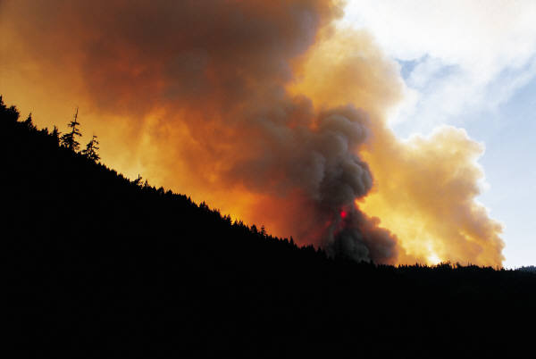
P | lanning and Practice
R | esilience
E | ducation and Training
D | etection
I | ncident Management
S | afety and Security
A | ssess Hazards
S | upport
T | riage and Treatment
E | vacuation
R | ecovery
Are my needs > resources?
Notes:
In summary, the PRE-DISASTER Paradigm™ is a useful tool to both learn and organize your approach to many of the key areas and topics relevant to being prepared disaster health and medical personnel.
Clearly, having excellent health and medical skills is essential to helping meet the needs of the casualties and impacted communities after a disaster; however, it is equally important that each health and medical provider be properly skilled in the basic tenets and practices of a disaster in order to be an effective asset to the situation.
Always be asking yourself with each step or area considered, am I in a needs > resources situation? If so, prioritize the action items and information sharing required to solve and address it.

Slide 33
Question 1
Approximately how many disaster-related deaths occurred in the last century?
100,000
200,000
120,000,000
200,000,000
Notes:
Question:
Approximately how many disaster-related deaths occurred in the last century?

Slide 34
Question 1
Approximately how many disaster-related deaths occurred in the last century?
100,000
200,000
120,000,000
200,000,000
Notes:
Answer:
200,000,000

Slide 35
Question 2
Which of the following is NOT a category of disasters?
Human systems failure
Natural
War and conflict
Drowning
All are disaster categories
Notes:
Question:
Which of the following is NOT a category of disasters ?

Slide 36
Question 2
Which of the following is NOT a category of disasters?
Human systems failure
Natural
War and conflict
Drowning
All are disaster categories
Notes:
Answer:
Drowning

Slide 37
Question 3
Which of the following does the “P” in the PRE-DISASTER Paradigm™ represent?
Planning and preparation
Planning and priorities
Planning and practice
Planning and participation
Notes:
Question:
Which of these four does the “P” in the PRE-DISASTER Paradigm™ represent?

Slide 38
Question 3
Which of the following does the “P” in the PRE-DISASTER Paradigm™ represent?
Planning and preparation
Planning and priorities
Planning and practice
Planning and participation
Notes:
Network television
Planning and Preparation

Slide 39
Lesson Summary
A standardized, competency-based approach to disaster training and education is important
Utilizing an all-hazards disaster approach is important to planning and preparation
The PRE-DISASTER Paradigm™ and DISASTER Paradigm™ are helpful learning and organizational tools
Notes:
In summary, a standardized, competency-based approach to disaster training and education is important. Utilizing an all-hazards disaster approach is important to planning and preparation. The PRE-DISASTER and DISASTER Paradigm™ are helpful learning and organizational tools.

Slide 40
Questions?

