Slide 2
Session 4 – Lesson Eight
Biologic Disasters

Slide 3
Objectives
Describe six key factors that compose the “chain of infection”
Identify clinical and epidemiologic clues suggestive of a biologic disaster
Discuss actions that can be taken to protect the health, safety, and security of responders and affected populations in a biologic disaster
Describe essential infection control strategies to prevent the spread of biologic agents
Discuss appropriate clinical management guidance for CDC category A biologic agents
Notes:
Describe six key factors that compose the “chain of infection.”
Identify clinical and epidemiologic clues suggestive of a biologic disaster.
Discuss actions that can be taken to protect the health, safety, and security of responders and affected populations in a biologic disaster.
Describe essential infection control strategies to prevent the spread of biologic agents.
Discuss appropriate clinical management guidance for CDC category A biologic agents.

Slide 4
Background
Infectious diseases are a threat to everyone
Rising global concern about epidemics/pandemics, emerging infections, bioterrorism
Public health and medical professionals are at the front lines of detection, diagnosis, treatment, and response
Notes:
Infectious diseases are a continuing threat to all persons, regardless of age, gender, lifestyle, ethnic background, and socioeconomic status.
In recent years, global concern has increased about epidemics/pandemics (an epidemic is when new cases of a certain disease, in a given human population, and during a given period, substantially exceed what is expected based on recent experience; a pandemic is an epidemic that has spread through human populations across a large region) such as influenza, emerging infections (infections that are newly recognized as occurring in humans [although they can also affect animals and plants], newly appearing in a different population than previously affected though previously recognized, newly affecting many more individuals, or having evolved new attributes such as resistance or virulence features), and bioterrorism (the deliberate use of certain pathogens or biologic products by terrorists to influence the conduct of government or to intimidate or coerce a civilian population).
Health professionals need to be prepared to detect, diagnose, characterize, and respond appropriately to use of biologic weapons and to the threat of new and reemerging infections.

Slide 5
Key Terms
Emerging infection – Newly recognized, new population, new virulence or resistance
Epidemic – An illness in higher than expected numbers
Pandemic – Epidemic across large geographic region
A disease outbreak in one country = A CONCERN FOR ALL
Notes:
It is important to understand the difference between an epidemic and a pandemic. An epidemic is defined by an illness or other health-related issue that occurs in higher numbers than would be expected normally within a country or region. A pandemic is an epidemic that has spread through human populations across a large region.
Three conditions must be met for a pandemic to occur: (1) a new disease emerges to which a population has little or no immunity; (2) the disease is infectious for humans; and (3) the disease spreads easily among humans.
In today’s world, where anyone with any disease can travel around the world in less than 24 hours, an outbreak of a communicable disease in one country should be a concern for everyone in the world.

Slide 6
Chain of Infection
Infectious agent
Reservoirs
Portal of exit
Mode of transmission
Portal of entry
Susceptible host
Notes:
Portal of exit: How does the organism leave the reservoir? In emesis, a sneeze, diarrhea?
Mode of transmission: How is the infection spread: airborne, droplet, contact, vector-mediated, fecal-oral?
Portal of entry: Infectious agents may enter the host through the skin, mucous membranes, lungs, gastrointestinal tract, or genitourinary tract. They may also enter through foreign bodies such as medical devices, eg, Foley catheters, IVs, or feeding tubes.
Susceptible host: The characteristics of the host that make him or her susceptible to a particular infection may include genetic factors, immunity, vaccinations, age, nutrition status, or underlying medical conditions (pregnancy, HIV infection, etc).

Slide 7
Bioterrorism/Biowarfare
Both involve use of a biologic agent or product to cause harm
A matter of scale
Difficult to detect research, production, transportation of BT agents
A criminal act that requires ➔ Public Health + Law Enforcement/military
Notes:
Bioterrorism (BT) and biologic warfare involve the intentional use of a biologic agent or biologic product to cause harm to humans and other living organisms. The distinction between these two is blurry and may be only a matter of scale.
It is very difficult, if not impossible, for an intelligence service to detect the research, production, or transportation of these agents. It is equally difficult to defend against these agents once they have been released.
Because BT, by definition, is a criminal act that causes illness, both law enforcement and public health authorities have responsibilities for responding to the event.

Slide 8
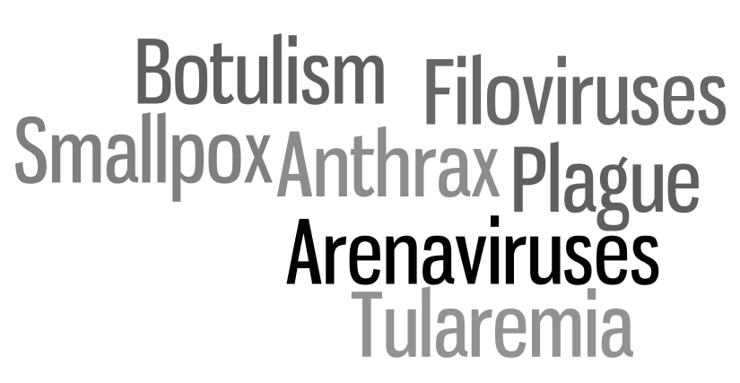
CDC Categories
A B C
Notes:
The CDC categorizes potential bioterror threats into three distinct categories, in decreasing severity and priority. Category A is the highest category and the one we will touch on here.
Category A is the highest national priority. The bioterror agents listed in this category have the following characteristics:
Can be easily disseminated or transmitted from person to person
Cause high mortality with potential for a major impact on public health
May cause public panic and social disruption
Require special action for public health preparedness
Categories B and C are still important, but they pose less of a threat and are believed to be less devastating or likely a threat than category A. A complete list is available in your textbook or on the CDC website.

Slide 9
Detection Situational Awareness
The first to detect a biologic event incident will be a healthcare provider (primary care, school nurse, prehospital personnel, etc.) who:
Has a high index of suspicion
Notes something unusual happening
Seeks the answer
Notes:
A clinician who notes that something unusual is happening and seeks assistance for an explanation is likely to be first to detect a covert release of a biologic agent or (re)emerging infectious disease outbreak.
The most important aspect is for all health care providers to have a high index of suspicion for biologic events and to avail themselves of public health reporting.

Slide 10
Detection Situational Awareness
EMS | Multiple calls in same area, same complaints
Primary Care Provider | Unusual patterns of disease, increased numbers of patients with unusual disease, disease affecting different ages or healthy patients
Public Health | Patterns at multiple facilities, atypical season for event
Medical Examiner | Rapid rise in mortality rate
Notes:
Each component of the public safety and public health framework can make its own unique observation that may contribute to the identification of a possible biologic event in the community. Sometimes it takes a combination of these to make the identification.
EMS, along with dispatchers, may note an unusual increase in the number of calls to a specific geographic area, or note multiple reports of the same type of complaints.
Primary providers are key and have to recognize different patterns such as new constellations of symptoms, increased numbers of common diseases or common diseases out of season, diseases affecting different populations, etc.
Public health professionals have the unique ability to monitor multiple hospitals, clinics, and laboratories simultaneously, and thus be able to appreciate patterns across multiple facilities.
Medical examiner’s offices may note an unexpected rise in mortality rate that is unexplained, which may be a clue of an attack.
Other potential resources for detection are clinical laboratories, which may detect an increase in ordering of certain tests, or unexpectedly identify a BT agent in a culture or specimen.
BioWatch program is a system of sensors in major cities throughout the country that monitor for intentional release of biologic agents into the air.

Slide 11
Epidemiologic Clues
Increase in number of unexplained deaths
Atypical age
distribution
Unusual seasonality
Uncommon manifestation of disease or new cluster of symptoms
Notes:
Epidemiologic cues of a bioterrorist attack
In addition to an increased number of patients, other clues that may signal a biologic disaster include:
An increase in unexplained deaths
Unusual age distribution of the patients (eg, occurrence in healthy patient, severe illness among persons 20 to 50 years old)
Unusual seasonality (eg, severe widespread respiratory illness during the summer months)
An unusual manifestation of disease (eg, new cluster of symptoms, inhalational anthrax) or the occurrence of animal die-off

Slide 12
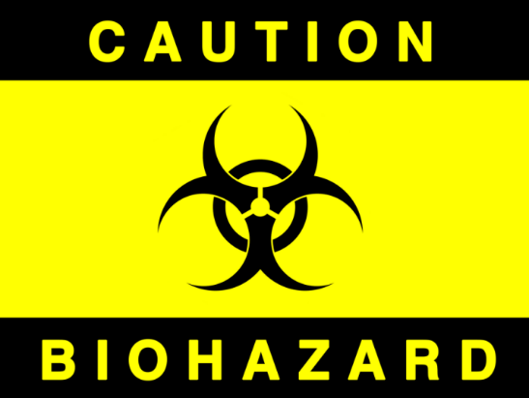
Detection Bioterrorism Agents
Victims initially may present with subtle symptoms or those resembling normal disease, such as flu-like symptoms
Few tests available for quick diagnosis
Notes:
Before we continue, it is important to mention a couple caveats when dealing with bioterror threats. The assessment and diagnosis of many of these conditions are complicated by the fact that (1) most diseases present initially with generic, nonspecific flu-like symptoms – fever, malaise, body aches, shortness of breath, etc; and (2) few to no specific diagnostic tests are available for the frontline provider in the emergency department, outpatient clinic, or prehospital.
As mentioned, you need to have a high index of suspicion, and consider bioterrorism to make the presumptive diagnosis. By the time a definitive diagnosis formally confirms your suspicions, many more people may have become infected.

Slide 13
Symptom / Finding | Potential BT Disease | Differential Diagnoses
Chest x-ray with wide mediastinum | Anthrax | Trauma, cancer, postoperative
Symmetric/flaccid paralysis | Botulism | Guillain-Barre syndrome
Hemoptysis | Pneumonic plague, inhalational anthrax | TB, pneumonia, carcinoma, PE, cancer, trauma
Pox-like rash | Smallpox | Chickenpox, monkeypox, cowpox
Diarrhea (maybe bloody) | Cholera, shigellosis | Multiple diseases
Notes:
To add a layer of complexity – let me show you how tricky this process can be. Many natural diseases can present very similarly to bioterror agents. This table shows just a handful of such instances.

Slide 14
Incident Management Public Health Notification
Likely no “scene” as in other events but more diffuse
Lead agency will be public health
Conduct epidemiologic investigation
Identify those who need prophylaxis, treatment, and quarantine
Public health authorities MUST be alerted as soon as any biologic event is suspected (emerging infection, unusual disease incident or patterns, or bioterrorism)
Notes:
As soon as suspicion of potential bioterrorism arises, the proper public health authorities must be notified immediately. This will set in motion many essential activities, including investigation into the case and source of infection, confirmatory tests of the patients, public notifications, measures to control the outbreak (such as quarantine/isolation, mass vaccination), early treatment of known exposures, and identification of other potentially exposed victims.

Slide 15
Safety and Security Infection Control
With all biologic events, cornerstone of management and limitation of effects is infection control
Even bioterrorism agents can be prevented and controlled by basic infection control
Precautions based on mode of transmission
If unsure, wear most protective gear
Consult infectious disease specialist
Notes:
Infectious diseases, even bioterror agents, can be prevented and controlled by basic infection control, such as hand washing, PPE wearing, and equipment and surface cleaning.
Infection control precautions required for any disease are based on the mode of transmission, whether that is direct contact, airborne, droplet, or vector borne.
If you are unsure what to wear (and you likely will be, early on), wear the most protective available PPE. You may need the assistance of your local infectious disease specialist or public health office to determine the appropriate level of protection.

Slide 16
Assess the Hazard Preventing Disease Spread
Medical | Public Health
Immunizations Chemoprophylaxis Infection control | Infection control Sheltering in place Social distancing Risk communication Isolation/quarantine
Notes:
Disease spread requires many actions on the part of public health and the medical community. These can be divided into medical and public health interventions. Medical interventions include immunizations (if available); chemoprophylaxis (medications to treat or provide prophylaxis); and infection control, such as provider infection control steps and patient actions such as respiratory protection (ie, patients wearing masks). Public health interventions are arguably the most important to preventing secondary spread and also include infection control (as just mentioned), sheltering in place, social distancing, risk communication, and isolation and quarantine.

Slide 17
Triage and Treatment Bioterrorism Threats
Scott Smith/CDC
Scott Smith/CDC
Notes:
Now we will transition and discuss individual bioterror threats. The entire list of threats is lengthy and is beyond the scope of the BDLS course. However, we will touch on the highlights and the interesting aspects of the major threats, those in CDC’s Category A. These, as mentioned, are smallpox, plague, anthrax, tularemia, botulism, and the viral hemorrhagic fevers.
IMAGE -- This 2007 image shows a Centers for Disease Control and Prevention microbiologist peering out from inside the BSL-4 laboratory autoclave room into the outer corridor. Scott Smith/CDC.

Slide 18
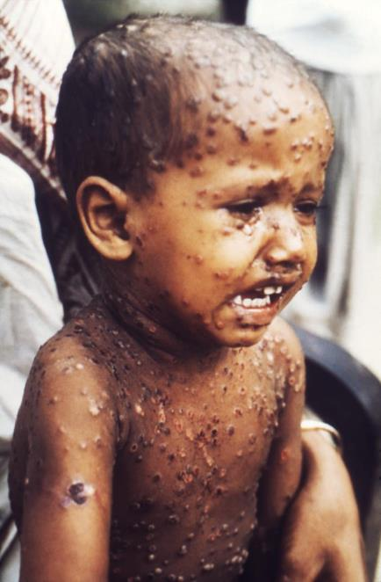
Smallpox
Severe prodrome
Fever, body aches
Prostration, delirium
Rash: 2-3 days later
Palms, soles, face
Crops of vesicles
All in same stage
Very contagious
Michael Schwartz/CDC
Differentiate: monkeypox, chickenpox
Notes:
Smallpox is one of the deadliest diseases known to man. Smallpox was declared eradicated in 1980; however, stocks of smallpox virus continue to be stored in government facilities in the United States and Russia (and likely other unknown sites).
Historically, the mortality rate for this virus is over 30%. Today, due to large numbers of immune-compromised and naïve populations, the mortality rate could be much higher.
Smallpox is characterized by severe symptoms that occur before the development of a rash. These symptoms include a high fever, generalized severe muscle aches, prostration (total exhaustion/inability to function), and delirium.
About 2 to 3 days after symptoms begin, a rash begins to develop. Classically, the rash begins on the face, palms, and soles (which few other rashes do). It then spreads toward the trunk and the rest of the body. The rash starts as small red dots, then becomes little fluid-filled sacs (vesicles), which eventually grow together. The lesions look similar to chickenpox; however, smallpox lesions will all be in the same stage of healing and tend to be smaller than chickenpox lesions.
The rash will scab over in 1 to 2 weeks. The scabs actually contain live smallpox virus and can be a reservoir for additional infections.
It is important to differentiate from other pus-producing lesions such as chickenpox and monkeypox.
IMAGE -- This 1975 image shows a young child in Dhaka, Bangladesh, who was suffering from the ravages of smallpox, displaying the maculopapular skin rash, which was distributed over his face, arms, and torso in a manner classically representing smallpox. Michael Schwartz/CDC.

Slide 19
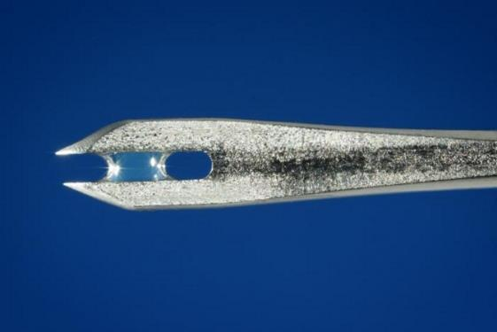
Smallpox
Diagnosis: clinical
Special tests at CDC and some state labs
Treatment: vaccination (if <3 days)
Supportive care, +/- antivirals
Airborne and contact precautions
Negative-pressure room
James Gathany/CDC
Notes:
The diagnosis of smallpox is largely a clinical one. Especially early on in the course (before the classic rash appears), a provider must have a high index of suspicion to make the diagnosis. The patient is contagious even before exhibiting the rash, so it is important to identify smallpox as soon as possible.
Treatment involves giving the smallpox vaccine, which is effective if given within 3 days of exposure. Additional treatment is largely supportive with IV fluids, pain control, and eye irrigation. Animal studies have suggested that antivirals, such as cidofovir, may be effective in treating smallpox.
Prophylaxis for exposed citizens and responders is the smallpox vaccine, again if given within 3 days of exposure.
Infection control requires airborne (N95) and contact (gloves, gown, mask, eye protection) precautions, and the patient should be in a negative-pressure room.
IMAGE -- A close-up of the tip of a bifurcated needle used to vaccinate individuals, containing some vaccine solution. Vaccinia (smallpox) vaccine, derived from calf lymph, and currently licensed in the United States, is a lyophilized, live-virus preparation of infectious vaccinia virus. It does not contain smallpox (variola) virus. James Gathany/CDC.

Slide 20
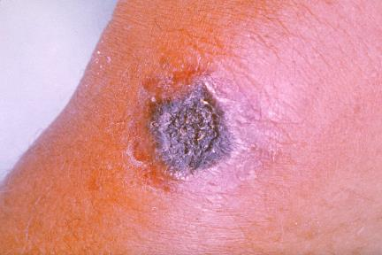
Anthrax
Inhalational: Flu-like symptoms, SOB, CP
Evolves to severe respiratory distress, shock
High fatality rate
Cutaneous: small itchy bumps turn into deep black ulcers, swollen lymph nodes
Can be natural or bioterrorism
James Steele/CDC
James Steele/CDC
Notes:
Anthrax is caused by the bacterium Bacillus anthracis. Anthrax illnesses exist in three forms – cutaneous, inhalational, and GI. The cutaneous and inhalational forms are the most common and the ones most likely to be the result of a bioterror attack.
Inhalational anthrax is by far the worst. It has an exceptionally high mortality rate. The symptoms begin very vaguely, with nonspecific flu-like symptoms, cough, shortness of breath, chest pain, fever, and fatigue. They then rapidly progress to severe respiratory distress, profuse sweating, and shock.
Cutaneous anthrax is isolated to lesions on the skin. This typically begins with nonspecific small itchy red bumps, but then progresses and grows into deep black ulcers. There is often surrounding swelling and swollen lymph nodes.
Bacillus anthracis gets its name from the blackness of the ulcers – anthracis is Greek for coal.
Anthrax is one of the agents that can affect people naturally, as well as from a bioterror attack. Natural avenues of infection include cutaneous (handling infected animal products), inhalation (breathing in anthrax spores from animals, such as wool products), and GI (consuming undercooked infected animal meat). However, if you see multiple patients with the same symptoms, you should immediately assume a bioterror attack until proven otherwise.
IMAGE -- Anthrax lesion on the skin of the forearm caused by the bacterium Bacillus anthracis. Here the disease has manifested itself as a cutaneous ulceration that has begun to turn black, hence the origin of the name anthrax, after the Greek word for coal. James Steele/CDC.

Slide 21
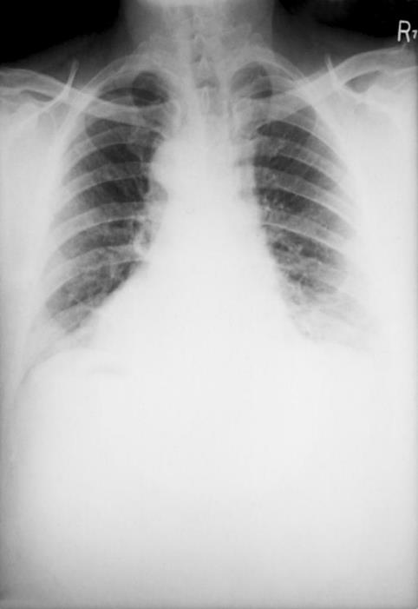
Anthrax
Diagnosis: clinical
CXR: wide mediastinum, effusions, infiltrates
Blood/sputum cultures
Early antibiotics for treatment and prophylaxis
Standard PPE
No person-to-person spread
Arthur Kaye/CDC
Notes:
The diagnosis of anthrax is initially clinical, and again requires a high index of suspicion. The inhalational form especially is a very quickly progressing, severe respiratory illness. Multiple cases with similar symptoms that are unexplained should be presumed to represent a biologic attack.
A chest x-ray may demonstrate a wide mediastinum (from enlarged mediastinal lymph nodes) in 70% of cases, bilateral infiltrates, and pleural effusions. These are not diagnostic, as many other processes may have these XR findings, but they certainly aid in your diagnosis.
Early antibiotics are the treatment of choice. IV ciprofloxacin and doxycycline are the standard treatments, but many other antibiotics in combination may be recommended.
Prophylaxis for potentially exposed individuals includes a 100-day course of oral ciprofloxacin.
Anthrax is not known to spread from person to person, so standard precautions are recommended.
IMAGE – This posteroanterior (PA) chest x-ray was taken 4 mo. after the onset of anthrax in a 46 yr. old male. This patient, who’d worked for 2 yrs. as a card tender in a goat hair processing mill contracted anthrax, and after having been x-rayed, revealed bilateral pulmonary effusion, and a widened mediastinum, which are hallmarks of the disease process. Arthur Kaye/CDC.

Slide 22
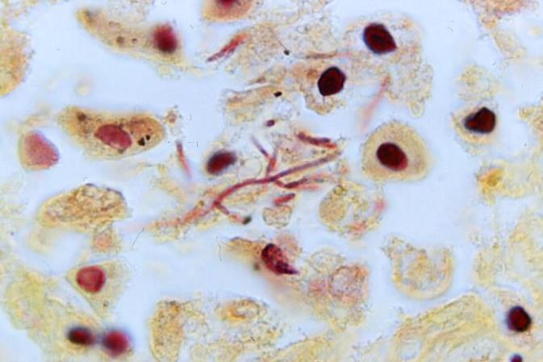
Pneumonic Plague
High potential for use as bioweapon
Easy to grow and aerosolize
Person-to-person spread, high mortality rate
Abrupt onset of flu-like symptoms
Progresses to severe pneumonia, sepsis
Brachman/CDC
Notes:
Pneumonic plague is caused by the bacterium Yersinia pestis. Plague is endemic throughout the world, with multiple animal reservoirs. Did you know that the major reservoir for plague in the United States is the prairie dog? Natural outbreaks occur occasionally, particularly in the southwestern United States. Natural outbreaks typically occur by transmission of the bacterium by fleas or biting flies. This results in bubonic plague, involving skin lesions and large swollen lymph nodes, which is distinct from pneumonic plague.
Plague is thought to be a disease at high probability for use as a bioweapon. The bacterium is easy to grow in large quantities and relatively easy to disseminate, especially as an aerosol. Plague spreads from person to person and has a high mortality rate.
Symptoms include the abrupt onset of flu-like symptoms, including high fever, chills, cough, shortness of breath, chest pain, nausea, and vomiting. This evolves into a rapidly progressive pneumonia, respiratory failure, and overwhelming sepsis.
IMAGE -- Under a high magnification of 1200x, this Brown and Brenn-stained lung tissue sample revealed the histopathologic changes indicative of what was diagnosed as a case of fatal human plague from Nepal. Brachman/CDC.

Slide 23
Pneumonic Plague
Clinical diagnosis
CXR: patchy infiltrates
Blood/sputum cultures
Early antibiotics for treatment/prophylaxis
Highly contagious
Droplet precautions
Bettmann/Corbis
Notes:
The diagnosis of pneumonic plague is clinical. Your high suspicion can be aided by a chest x-ray with patchy fluffy infiltrates, and positive blood and sputum cultures (remember that cultures may take days to weeks to get a result).
Treatment and prophylaxis for exposed individuals are antibiotics. Patients with pneumonic plague may need to be on a ventilator for a prolonged period and will need multiple IV antibiotics. Prophylaxis is with oral ciprofloxacin or doxycycline.
This disease is highly contagious. Droplet precautions must be strictly adhered to.
Common practice for prevention of plague outbreaks in the 1700s rings true today as well – most people, when confronted by the plague, followed the collective wisdom to "flee immediately" (cede mox), "stay far away" (recede longe), and "be late in returning" (redi tarde).
IMAGE -- The protective clothing worn by a 17th-century plague physician. Etching by Paulus Furst of Nuremberg, Germany, 1656. Illustration from Bettmann/Corbis.

Slide 24
Botulism
Gradual onset of symptoms
Facial paralysis
Difficulty speaking and swallowing
Blurry vision
Progresses to muscle weakness, diaphragm paralysis
Notes:
Botulism is caused by the toxin of the bacterium Clostridium botulinum. In that sense the process is more like a chemical exposure than an infectious disease. Natural outbreaks occur occasionally. The most common presentation would be an infant who was fed honey that was tainted.
The toxin of botulism is one of most poisonous substances known to man. In a biologic attack, botulism would be spread via the aerosolized route as a toxic contaminant of food or water.
Symptoms include the gradual onset of bulbar palsies – facial and eyelid drooping, difficulty speak and swallowing, trouble handling secretions, and dry mouth. Multiple cranial nerves must be involved for botulism to be the cause.
Symptoms progress to weakness and paralysis of skeletal muscles, and eventually complete paralysis of the diaphragm, which causes respiratory failure.
The effects of botulisms occur with no fevers or mental status changes.

Slide 25
Botulism
Diagnosis: clinical
Confirmed by toxin assay
Must stay on ventilator until toxin wears off
Weeks to months
Antitoxin available
Limited supply for episodic single cases
Standard PPE
Not contagious
Notes:
The diagnosis of botulism is clinical. The features of the condition are distinct; however, mild cases can easily be confused with other medical problems. The diagnosis can be confirmed by a toxin assay performed by the CDC or some state laboratories.
The treatment is largely supportive. Since the diaphragm is paralyzed, the patient will need to be on a ventilator for a prolonged period, until the toxin wears off. This could take anywhere from weeks to months. An antitoxin is available and can be obtained from state health departments or the CDC. However, the supply of antitoxin is severely limited and is designed for single episodic cases.
As botulism is not contagious, only standard PPE is recommended during evaluation and treatment of these patients.

Slide 26
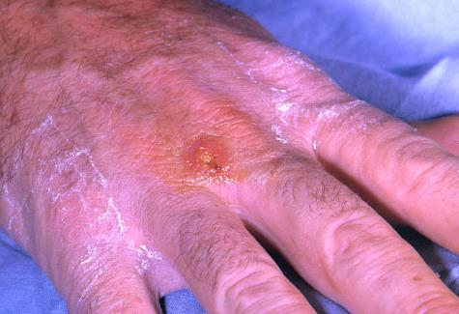
Tularemia
High potential to be weaponized
Likely attack via aerosol
Symptoms: acute febrile illness
Prostration
Conjunctivitis
Lymph node swelling
With/without pneumonia
Brachman/CDC
Notes:
Tularemia is a bacterial infection caused by Francisella tularensis. It is endemic in animals in North America, Europe, and Asia. Sporadic natural cases occur from ticks, biting flies, and infected rabbits.
Multiple countries have a history of weaponizing tularemia for biologic warfare. The most likely route would be via an aerosol.
Symptoms include acute febrile illness with prostration (complete utter exhaustion), conjunctivitis, and regional swelling of lymph nodes. Pneumonia occurs in 80% of cases.
IMAGE -- A tularemia lesion (the site where the infection infiltrated the body) on the dorsal skin of the right hand. Tularemia is caused by the bacterium Francisella tularensis. Symptoms vary depending on how the person was exposed to the disease and, as is shown here, can include skin ulcers. Brachman/CDC.

Slide 27
Tularemia
Diagnosis: CLINICAL
Gram stain, cultures, antibody tests
80% CXR with pneumonia
Treatment/prophylaxis with antibiotics
Standard PPE
Not contagious
Notes:
The diagnosis of tularemia is clinical. It does not have any symptoms that are pathognomonic by themselves, but the constellation of fever, prostration, conjunctivitis, lymph node swelling, and pneumonia is highly suggestive.
Multiple lab tests can be sent for to aid in diagnosis. A Gram stain may show Gram-negative coccobacillus. Blood and sputum cultures are diagnostic but may take days to weeks. Additionally, labs can do antibody testing or PCR.
Treatment is with IV antibiotics – streptomycin and gentamicin. Prophylaxis for exposed individuals is with ciprofloxacin or doxycycline.

Slide 28
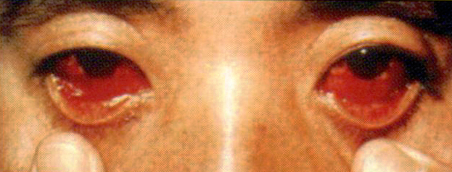
Viral Hemorrhagic Fevers
Examples: Ebola, Marburg, Lassa,
Omsk
Potential to be weaponized
Fatality rate has been up to 90%
Symptoms depend on virus
Flu-like symptoms, rash, joint pains, vomiting, diarrhea
Bleeding from everywhere, shock
Notes:
Viral hemorrhagic fevers are the diseases in bioterrorism that strike fear into the hearts of everyone. This is largely caused by urban legend and popular books and movies (like Contagion and Andromeda Strain). This class of diseases encompasses multiple strains of RNA viruses, most commonly the arenaviruses and filoviruses. They are typically named by the area in which they were first discovered, hence the names such as Marburg, Lassa, Omsk, and Machupo fevers.
These have been weaponized by several countries. The fatality rate is dependent on the virus but may be as high as 90%.
Symptoms also depend highly on the specific virus. Symptoms range from flulike symptoms, joint pains, and small rashes to progressive diffuse bleeding (blood in vomit, stool, sputum, mucous membranes, and urine) and hemorrhagic shock and death.
IMAGE --Bioterrorism. Chicago: American Medical Association, 2003.

Slide 29
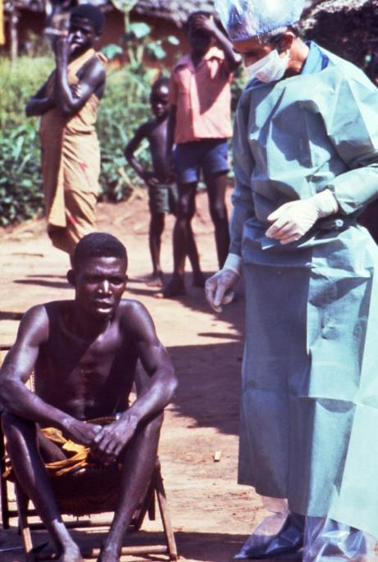
Viral Hemorrhagic Fevers
Diagnosis: clinical
Multiple tests available depending on stage
Presume VHF if:
Severely ill, fever +
bleeding from 2 sites
High index of suspicion with travel to area with outbreak or close contact
Treatment: supportive
No prophylaxis
Extremely contagious
Blood and body fluids
PPE more than universal precautions
Lyle Conrad/CDC
Notes:
The diagnosis of VHF is largely clinical. There are special labs available at the CDC to assist in diagnosis. The recommendation is that a clinician presume VHF in the right clinical circumstances in a patient who is severely ill, has a fever, and is bleeding from two different sites.
Treatment is largely supportive, though ribavirin may be a therapeutic option.
There is no prophylaxis for exposed persons at this time. Vaccines are in development.
VHFs are extremely contagious. Patients must be in strict isolation in negative-pressure rooms.
Recommended PPE for Suspected Ebola
PAPR or N95 Respirator
PAPR: A PAPR with a full face shield, helmet, or headpiece
A PAPR with a self-contained filter and blower unit integrated inside the helmet is preferred.
N95 Respirator: Single-use (disposable) N95 respirator in combination with single-use (disposable) surgical hood extending to shoulders and single-use (disposable) full face shield
Single-use (disposable) fluid-resistant or impermeable gown that extends to at least mid-calf or coverall without integrated hood.
Single-use (disposable) nitrile examination gloves with extended cuffs. Two pairs of gloves should be worn. At a minimum, outer gloves should have extended cuffs.
Single-use (disposable), fluid-resistant or impermeable boot covers that extend to at least mid-calf or single-use (disposable) shoe covers.
Single-use (disposable), fluid-resistant or impermeable apron that covers the torso to the level of the mid-calf should be used if patients with EVD have vomiting or diarrhea.
IMAGE – This photograph shows a health official (right), dressed in protective garments, standing next to a Zairian during a 1976 Ebola investigation. The 1976 outbreak in Zaire started in the town of Yambuku and spread to surrounding areas. In Kinshasa, Zaire’s capital city, an area hospital was sealed off during the outbreak, and the situation came under control. The total number of cases in Zaire, which is now called the Democratic Republic of Congo, was 318, with a mortality rate of 88%. Lyle Conrad/CDC.

Slide 30
Triage and Treatment Summary
Recognition is key – any pattern outside norm
Different ages, severity, populations, symptoms, etc
Early on, most have flulike symptoms
Diagnosis clinical – requires high index of suspicion
Largely supportive treatment, some respond to antibiotics or vaccines
Responder safety and infection control paramount
Notes:
The key point is recognition. This is based on any pattern outside the norm triggering a reaction in all health care providers. Depending on the situation, as a minimum this is followed by discussion with local public health officials.
You will undoubtedly have noticed some common themes among these diseases. Nearly all of them present early on with nonspecific flu-like illness. The diagnoses are largely clinical, with the assistance of specialized confirmatory blood tests that will not be available in the first couple of days.
Most of these diseases have no silver bullet for treatment. Many require broad-spectrum antibiotics and supportive care. Vaccines are available as an option for some if given early enough in the course.
When a patient has symptoms from a potential bioterror source, responder safety and the prevention of spread of infection are paramount concerns. Appropriate PPE is mandatory and will vary by disease process.

Slide 31
Issues to Consider
Vaccination, Chemoprophylaxis, and Treatment Medications
How many doses are available?
How easy is it to mass vaccinate?
Can you accomplish vaccination in time?
Provider safety/infection control
Do you have enough PPE for multiple patients?
Is PPE worn 100% of the time?
How will you ensure compliance with prophylaxis?
Notes:
Having a specific vaccination for a biologic agent is complicated by the availability of it in a timely fashion, initial effective dose administration and subsequent dose requirements to be effective, as well as the many logistical challenges and operational challenges with a successful mass vaccination event. This is why that even though some category A agents have a vaccine, these complicating delivery and distribution issues still cause it to be a significant national biologic threat. On a broader note, having sufficient quantities of PPE, compliance with their use, etc. make PPE an ever-important provider safety issue of concern. Prophylaxis, should it need to be administered to an at-risk provider group, presents may challenges as well. For example, ensuring compliance is extremely difficult, especially when prolonged medication courses are required, as well when side-effects even if mild are anticipated (nausea, diarrhea, limitations in sun exposure, etc.).

Slide 32
Evacuation and Recovery
Evacuation
Issues with moving patients and protecting transporting staff
Issues with using public transportation to seek medical care
Issues with identifying receiving facilities capable and willing to accept patients
Recovery
Stop the reemergence of disease
Address stigma for both survivors and treatment facilities
Healthcare can be hardest hit sector for casualties

Slide 33
Lesson Summary
Biologic disasters require observation for both clinical and epidemiologic clues
There is increasing global concern about the possibility of bioterrorism
Medical and public health professionals play a key role in preparedness, early identification, and intervention
Notes:
Biologic disasters require observation for both clinical and epidemiologic clues.
There is increasing global concern about the possibility of bioterrorism.
Medical and public health professionals play a key role in preparedness, early identification, and intervention.

Slide 34
Questions?

