Slide 1


Train the Trainer
Presented by:
URMC - Finger Lakes Regional Training Center
Anne D’Angelo, MS, RN
Phone: (585) 758-7640
anne_dangelo@urmc.rochester.edu
Notes:
Updated March 2020– Have slide 1 displaying as participants arrive to course.
Introduce yourself <insert your biography here>, share contact info, and your experiences with eFINDS. Make yourself available for questions during and after the session.

Slide 2

Module 1: eFINDS Intro

Slide 3
OBJECTIVES
Proficiency in the eFINDS application.
Your advanced eFINDS skills will help you to train other facility staff, and allow you to support your colleagues during a real or practice evacuation- whatever your professional background is, or role in a response.
Notes:
Upon completion of this training, we do expect a higher level of expertise in eFINDS. You <the participant> will be prepared to train other facility staff in the use of eFINDS, and should also be able to support your colleagues in eFINDS during a real or practice evacuation.
Remember, just because you know a system does not mean that you can teach it.

Slide 4
AGENDA
Evacuations Happen – Start thinking about if your facility needed to evacuate
Module 1: Practical Exercise (group exercise)
Module 2: Hands-on Exercises (work independently)
Module 3: Teach Back (TtT ONLY)
Notes:
This is what we plan to accomplish during today’s session:
*The TtT course is NOT to introduce you to eFINDS. We are presenting this in-person session for you to take back what you have learned about eFINDS and be able to train other staff. This session may also give you ideas on how to update your facility’s evacuation plan.
When you complete this course, you are expected to go back to your facility and train other staff on eFINDS.*
We will begin with a BRIEF Overview of eFINDS (this will be a review of what you learned by completing the CTI-502 course on-line).
Then we will move to the practical exercise where every participant will register an evacuee and receive an evacuee at a pre-determined location. This portion of the training is for participants to get a feel for the movement of evacuees during an evacuation and get their hands on the basic eFINDS transaction.
Next, we will move to the Hands-on Exercises where I will walk you through the scenarios, and you will follow along on your computer. During these facilitated exercises, we expect you (the participant) to ask questions, and if you fall behind then you must let the trainer know immediately!!
TtT ONLY Finally, because we expect you to go back to your facility and train your staff, participants will be given a training scenario (or two) and is expected to present the training back to your fellow trainees for their critique. This portion of the class is called the Teach Back.

Slide 5
Ground Rules
Please turn off email, phones, instant messaging tools and clear other distractions away from your training area
Participate and prepare to be called on by name
Raise your hand, if you have a question or comment
If you need to leave the training for a short time, please let the Master Trainer know, as they will review with you what you missed at the close of the session.
Notes:
We appreciate the time you are taking to be in this training today. You are here to learn more about eFINDS, and then take what you learned back to your facility and deliver a training to other facility staff.
I know it will take tremendous effort to stay focused on just this training for the whole day, but we ask for your undivided attention during the entire program. If you get lost, please let me (the instructor) or my assistant know immediately.

Slide 6
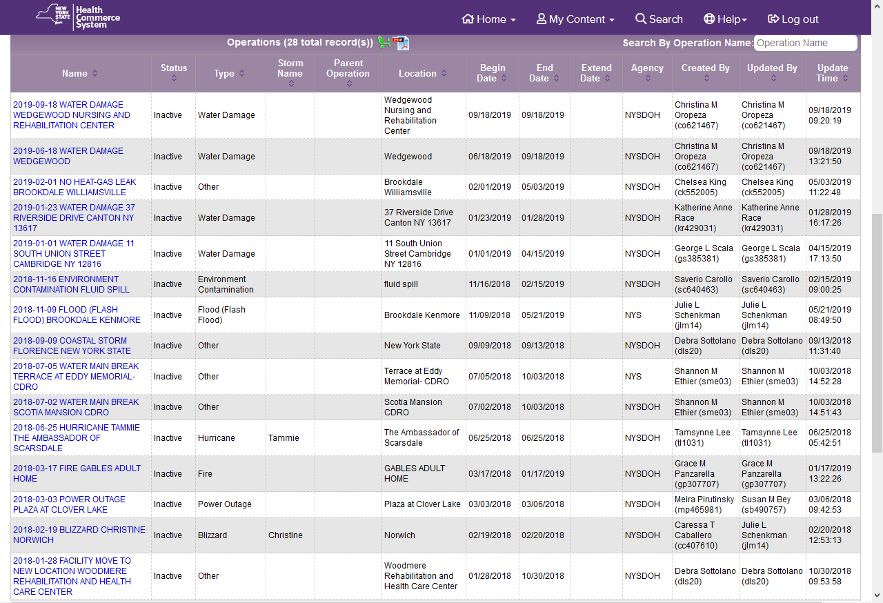
Evacuations Happen!
Notes:
TtT ONLY: Who has a census of less than 100? 100 - 200? 200 – 300? 300 – 400? Over 400?
Have you thought what you would need to do if a full facility evacuation was warranted?
<Go to the HCS and open eFINDS Evacuation site and show list of “Real” Evacuations.
View active and inactive Operations by clicking box to Exclude Inactive Operations to see just current ones.>
eFINDS was used six times in 2018 due to heating problems, a move, power outages, a fire, and two water main breaks?

Slide 7
Review of
CTI-502
Notes:
For TtT session Only:
We will now review what you may have learned during the one-hour instructor-led Webinar: CTI-502.
This webinar was the prerequisite for this in-person training. It was only a demonstration, went very fast, and unless you completed the review questions or the hand-on exercises on your own, there were no hands-on.

Slide 8
What eFINDS is?
Secure Evacuee Tracking System
  Where did person come from
  Where are they now
  What is their evacuation status
?
?
?
Notes:
eFINDS does not make decisions, it tracks decisions. Person to person dialogue is still necessary.

Slide 9
What eFINDS is NOT?
Planning tool for where to send your evacuees.
Platform for sharing medical information.
Tracking employees.
Facilities still need to communicate with
each other during an event!
Notes:
Your facility evacuation plans should include where you anticipate sending your people if a full or partial evacuation was needed.
This could be another facility that provides similar care, or a temporary location, such as a school or church down the street.
When you are making plans with another facility, you are discussing and agreeing to how you will share the medical information about an evacuee. Will it be a face sheet or an electronic health record? Agree to sending additional staff or supplies with your evacuees. Review your send/receive arrangements in the Facility Evacuation Planning Application (FEPA).
In regard to tracking employees, there are other methods to do this. Staff do not have wristbands, but they may accompany one or more evacuees to the receiving location. Because they leave the facility when their shift is over, the statuses do not apply.

Slide 10






  eFINDS for Other NYS Agencies
Notes:
All NYSDOH managed facilities, that is all hospitals, nursing homes and adult care facilities use eFINDS.
Programs overseen by other NYS agencies, also use eFINDS. They include:
OASAS – Clinics
OMH – Psychiatric Centers and Licensed Housing
OPWDD – Residential Homes & Developmental Centers
OCFS – Juvenile Facilities
OTDA – Supportive Housing
Currently other “O” agencies are not able to scan the evacuating healthcare facility barcodes to receive evacuees across those org types. As with other temporary locations, it is the responsibility of the evacuating facility to ensure all appropriate updates to evacuee status are made within the eFINDS system. This includes documenting evacuees have been received at the temporary location and following through to repatriated status.

Slide 11
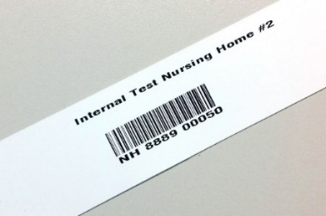
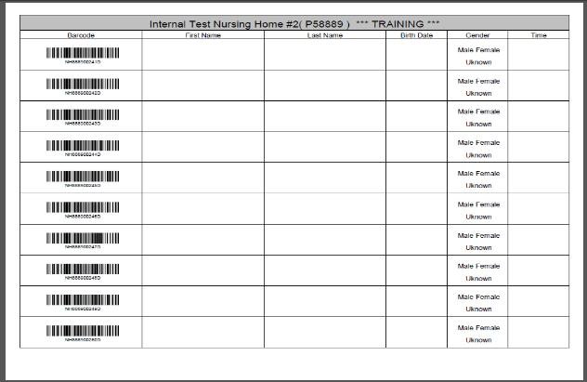
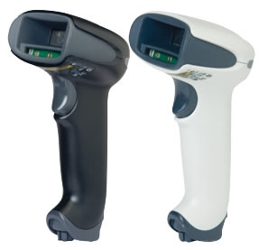
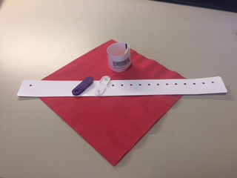
eFINDS Supplies
Adhesive-style wristbands
Clip-style wristbands
Scannable (PDF) Barcode Log
Scanners: white for use at facilities where more stringent disinfectants are used
Notes:
These are the supplies you need.
Just wristband your evacuees and get them to a safe location.
See Appendix J for instructions on how to order supplies and Appendix E.
Each facility received a specified number of wristbands, based on their licensed beds, and corresponding scannable barcode log sheets.
The barcodes/wristbands provided will have a special sequence number used solely for your facility. Each wristband will contain the facility name, a scannable barcode, and the barcode number. If needed, you can write on them.
The barcodes on the wristbands have a prefix that corresponds to the type of facility (HO, NH, ACF) followed by your agency’s unique identifier code (pfi or license #), followed by a changing sequential number or evacuee number.
Facilities also received a small set of training bands (15). You will clearly know that they are for training, because “Training” can be found in three places, and the barcode number ends in a D for demo.
Training wristbands can only be used in the eFINDS Demo/Practice application. Production or “Real” barcodes numbers are only recognized in the “Real” or Evacuate side of eFINDS. Barcodes cannot be used in the wrong application by mistake. Usually when a barcode number is not recognized, it is a training barcode being scanned in the “real” or Evacuate side of eFINDS.
NOTE: Barcodes are one-time use. If a facility has used all their training barcodes it may be necessary to generate additional barcodes. NYSDOH will not issue additional training wristbands unless a specific request is made, such as a drill with multiple facilities involved.
Each facility also received one bar code scanner programmed to work with the eFINDS application. The budget only allowed one scanner per facility. Information regarding the purchase of replacement scanners can be found in Appendix K.
Your other facility scanners may also work with the eFINDS program but may require a manual “enter” with the keyboard or extra characters to be removed from the scan.
Facilities also received a copy of their facility’s scannable barcode log (PDF) – which contains your facility name, a space for a patient/resident’s first name, last name, date of birth and gender. These logs can be used if a facility has no power or no internet or just to document who received which wristband.

Slide 12
Don’t get hung up by the electronic process!!
If all else fails….
  Just wristband your evacuees and get them out the door…
  Hand write first name and the barcode number on a sticker and apply to person’s medical record
Notes:
Don’t get hung up by the electronic process!!
If all else fails….
Remember that if you only have time to get a wristband on the person, and get them to a safe location, then registration can occur later. With a wristband, you can always determine the facility that a person originated from. This could be very important especially during large-scale events with people ending up in temporary shelters or not where they were intended to go.

Slide 13
Need “Real” eFINDS Supplies
Only users assigned to the eFINDS Reporting Administrator role can order supplies from within the eFINDS application.
Open eFINDS
Click Evacuate
Select your facility (if necessary)
Click Supply Requests from main menu
Choose Create a New Supply Request
Fill in the form and click Submit New Supply Request.
You will receive email notifications regarding the status of your request.
Notes:
If you check your eFINDS supplies and determined you are in a deficit, then submit a Supplies Request.
You can only request “real” evacuation supplies.
When your request is updated with a question or your supplies are shipping, then you will receive an email with the status.
Check your supplies request at any time for updates.
Generally speaking, eFINDS Training wristbands are not printed or shipped, as the facility can utilize the PDF logs for training and exercises.
We will explore this in the Hands-on modules.

Slide 14

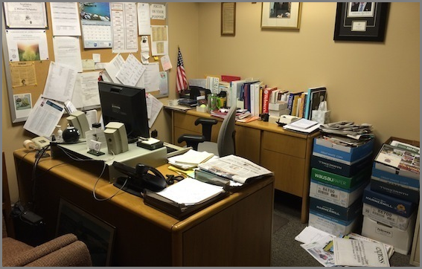
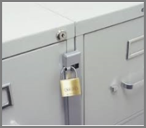
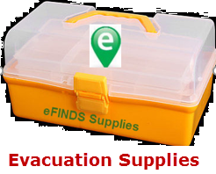
Where is the best place to keep your eFINDS supplies?
A
C
B
Notes:
In a cluttered room or Administrator’s Office?
In a locked cabinet or
Someplace where EVERY Staff member has access.
KNOW where eFINDS supplies are kept!!!! That is NOT in a locked storage closet, but in a safe place where your staff can access them whenever needed. Try labeling supplies as EVACUATION SUPPLIES, and not eFINDS. Who knows what eFINDS means?

Slide 15
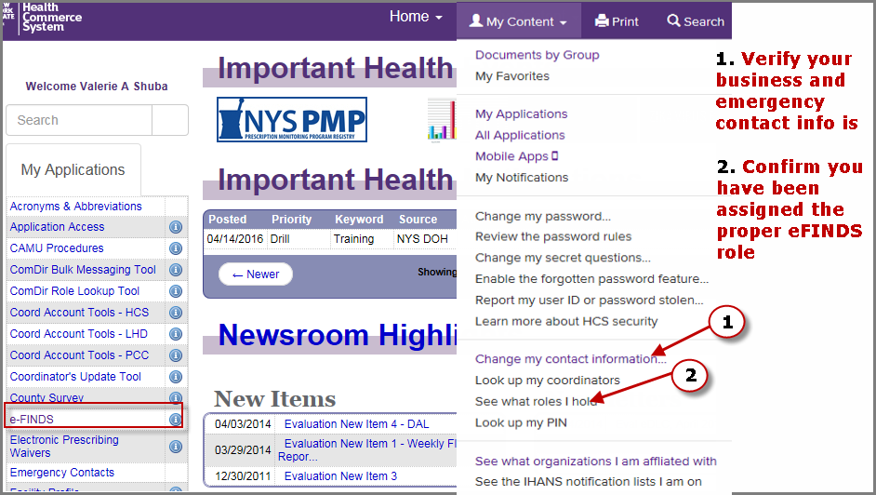
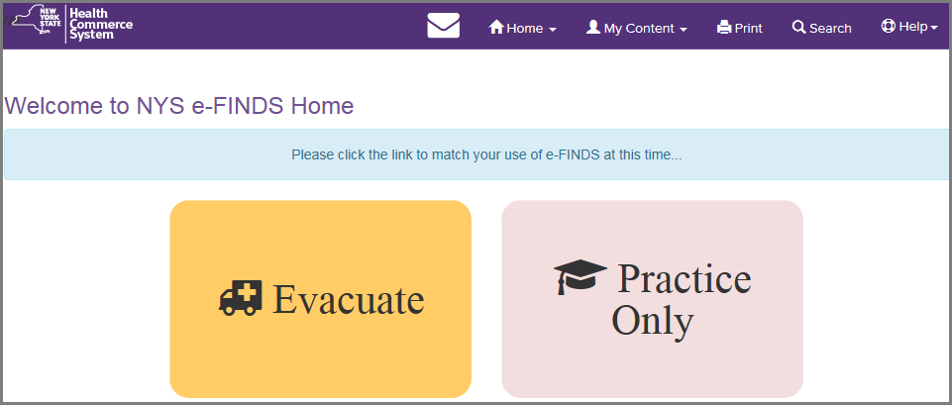
Access to eFINDS
Notes:
eFINDS is a role-based application - once you are added to an eFINDS role, the application will appear in your My Applications list on the HCS Home page. If you confirmed that you are assigned an eFINDS role and do not see eFINDS in your My Apps list, then click Refresh My Applications located at the bottom of the list if necessary.
To verify your role assignments, go to My Content > click See what roles I hold.
If you are not in an eFINDS role, then click Look up my coordinators. They are the ones who will assign you to the role.
FRIENDLY REMINDER: To ensure that you receive timely communications from your county health department and/or the state, please make sure your business and emergency contact information is correct;
Click My Content > Change my contact information.

Slide 16
eFINDS Roles for Facilities
eFINDS Reporting Administrator (@admin)
Same as eFINDS Data Reporter (user) plus: Create an operation when evacuation event impacts a single facility (e.g., fire or no heat) Create temporary locations Order eFINDS supplies Register or update info in tracking history Generate Barcode Assignment: Scannable Log (PDF log) or Download or Upload Spreadsheet (Excel) Register people without having barcodes to scan using the Multi-Person Input
eFINDS Data Reporter (@user)
Register people with or without scanner Update info in tracking history Upload the eFINDS spreadsheet (Excel) to register evacuees
Notes:
There are two roles for facility employees:
The (1) eFINDS Data Reporter can do everything needed to register and update evacuee information. They can do this with or without a scanner; one at a time or multiples.
If they need to register multiple evacuees at one time, then they can upload an eFINDS spreadsheet generated by the eFINDS Reporting Admin.
The (2) eFINDS Reporting Administrator can do everything the eFINDS Data Reporter can do, PLUS generate a PDF scannable log or an eFINDS spreadsheet. They can also register multiple evacuees at one time without having the barcodes to scan. They can add operations and temporary locations, request supplies and generate more training barcodes.
The eFINDS Reporting Admin does NOT need to be management. Administrator is a technical reference for having higher permissions but does not need to be the facility administrator.

Slide 17
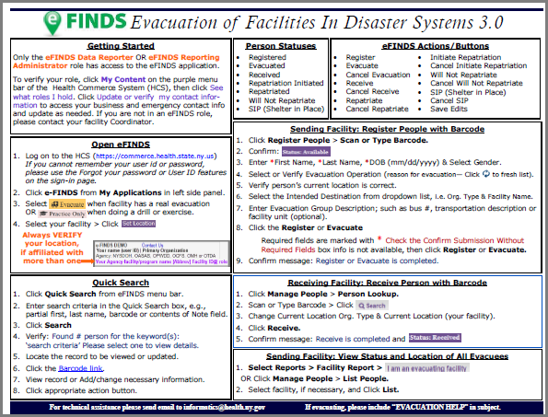

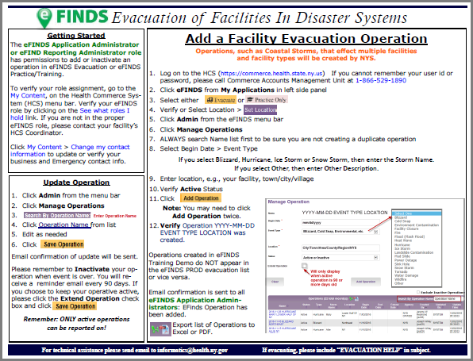
eFINDS Quick Reference Cards
Notes:
Click on the eFINDS application profile (blue circle with an I inside) to go to the folder with the most up-to-date quick cards and other materials. Please keep the Scannable log and quick cards with your eFINDS Supplies.
Keep training supplies separate from the real supplies. An un-trained person may not know the difference.

Slide 18
eFINDS Evacuee Statuses:
Registered: person to be evacuated is in eFINDS
Evacuated: person has left evacuating facility, and is enroute to intended destination
Received: arrived at intended destination/receiving facility and current location is updated
Repatriation Initiated: receiving facility returns evacuee to their original facility
Repatriated: evacuees arrive back to their original location/evacuated facility
Will Not Repatriate: evacuees will not be returning to their original facility
SIP (Shelter in Place): If the Chief Elected Official issues a mandatory evacuation order that includes a SIP option, evacuees can only remain in the defined evacuation zone with consent of NYSDOH.
Notes:
Know what these statuses mean? These statuses tell you where an evacuee is or isn’t during an event.

Slide 19
Basic Evacuee Flow:
Evacuating
Facility
Registers People & Repatriates
Registered
Evacuated
Received
Repatriation Initiated
Repatriated
Will Not Repatriate
SIP (Shelter in Place)
Evacuates
Receiving Facility
Updates Location & Receives People
Initiate Repatriation
Notes:
These statuses define the state of the person during an event and when the event is over.
The slide describes the path of an evacuee in eFINDS and how it translates into the evacuee’s status.
It also describes the responsibilities of the evacuating facility vs the receiving facility.

Slide 20
Module 2:
Facilitated Hands-On Exercises
Notes:
Now that you completed the most basic transaction in eFINDS, we will now work through the first 18 training scenarios and then take our lunch break.

Slide 21
HCS Basics
Log into your Health Commerce System account
  https://commerce.health.state.ny.us/
Verify eFINDS is in your My Applications List
Go to eFINDS Info/Help > click
HCS Account Questions can be answered later by calling 866-529-1890. Ask for App Support if needed
Notes:
Let’s all sign into our Health Commerce System (HCS) accounts. HCS User IDs and Password are for individuals, not facilities, and passwords should never be shared.
If you forgot your User ID or Password, then use the Forgot your password? Or Forgot your User ID? links on the HCS Sign In page (bottom left).
Is everyone logged in?
Do you see eFINDS in your My Apps List? If not, then click Refresh My Applications.
Everyone should open the eFINDS Info/help link to see where the resource materials are.

Slide 22
HCS Basics
Is your Business and Emergency Contact Info correct?
  Click My Content > Change my contact information…
What roles do you hold?
  Click My Content > See what roles I hold
Who is your Coordinator?
  Click My Content > Look up my coordinators
Notes:
Please update or verify your business and emergency contact info.
< Please make sure everyone completes these three steps before moving on >
Any HCS user can verify/confirm they are properly assigned an eFINDS role. If a user is not assigned a role, then Coordinator will need to be contacted. All course participants needed the eFINDS Reporting Admin role prior to registering for this course.
HCS Account Questions can be answered later by calling 866-529-1890. Ask for App Support if needed.

Slide 23
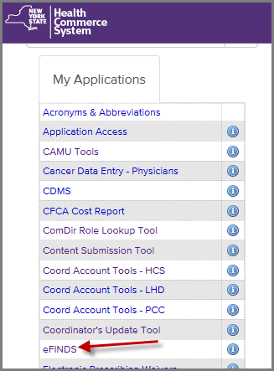

Open eFINDS Practice
Sign In to Health Commerce System (HCS)
https://commerce.health.state.ny.us.
Click eFINDS from My Applications List.
Click .
Verify or Select your facility name.
Click
For help with eFINDS click the Info Button.
Open eFINDS

Slide 24
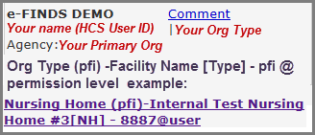
Your eFINDS Location
Upon opening eFINDS, you need to tell the system where you are.
This is the facility you can
evacuate from, or receive
evacuees at
Set Location
Notes:
If you affiliated via an eFINDS role with more than one facility, then you need to tell the system where you are evacuating from or receiving evacuees at.
If you are receiving evacuees at a Temporary Location, then your Set Location does not matter.
For hands-on module, this portion of the training will be instructor-led with demonstration. Students will follow along with scenarios from their computers.
It is important that all participants stay together as me move through the scenarios. If you feel that you are falling behind, please let the instructor know immediately!
We will evacuate from your facility. Remember you can see what eFINDS roles you have by going to My Content > See what roles I have.
If you only have eFINDS roles for one facility, you still need to Set Your Location.
See your facility name and identifier/license number. @user means you are an eFINDS Data Reporter / @admin is eFINDS Reporting Administrator.
***Demonstration Begins - Please refer to participant handouts if dual presentation (slides and web demo) is not available***

Slide 25
Evacuee Names
You will be working independently through 39 Training Scenarios.
It is crucial that you stay with the group! If you get lost, please let the instructor know immediately.
  During the Hands-On portion of this training you will be evacuating a total of seven (7) people.
  Write down seven fictitious names on scrap paper or your Scannable Log.
  Keep in mind that one evacuee will expire after being evacuated.
  Go to BehindTheName.com/random for help coming up with names.
Notes:
Let’s prepare to work independently.
On your note pad or Scannable PDF Log, write down seven fake names. These people will be your evacuees. You can give them a made-up DOB when entering the patient info. It just needs to be a real date from the past.
If you need help thinking of names, use actor names or the Behind the Name website for assistance.

Slide 26
SCENARIO 1
Download and Print the Barcode Assignment:
Scannable Log (PDF)
  Having one or more copies of the Scannable PDF log will be extremely helpful if there is no power or an internet outage.
  Keep copies with your eFINDS Supplies.
  If an urgent evacuation is needed, there may be no time for electronic registration of people, you can document the barcode/wristband that an evacuee received on this Log.
Notes:
Scannable Logs should be stored with your eFINDS supplies. These logs can be used when there is no internet or no power – just document the wristband number/barcode that an evacuee received by writing the person’s name, DOB and gender on the log. No other info is needed.
Options for Use:
The Scannable Log can be filled-in as wristbands are being distributed. Any staff member can document who received a wristband. They do not need an HCS account.
The eFINDS Data Reporter can register evacuees in eFINDS by scanning the barcode on the PDF log and entering the evacuee info.
Copies of the log can be sent to the receiving facility and the receiving facility can register and receive the evacuees at the same time, if needed.
*If instructor did not go over this scenario in the practical, then instructor should demonstrate by scanning any facility’s barcode and receive them. Show Tracking History displays: Registered, Evacuated and Received at one time. *

Slide 27
Generate a Scannable Log (PDF)
eFINDS Administrator Role Only
Click Manage Barcodes.
Select Download Barcode Documents.
Verify your current location.
Leave Start Number and End Number blank OR Enter barcode numbers, e.g., 7 and 13 for seven barcodes for your seven evacuees.
Select the Barcode Assignment: Scannable Log (PDF) option.
Check Exclude used barcodes from List? box.
Click .
Print the PDF.
Scenario 1
Notes:
IMPORTANT: If a facility has more than one training participant, then each participant should print and use different sets of barcode numbers. Barcode are unique to each facility and evacuee. Talk to your co-worker(s) to determine which barcodes are available to use.
When downloading the PDF log, you can exclude used barcodes. The “Confidential (exclude facility name)” option is not for DOH managed facilities.
“Confidential (exclude facility name)” feature was developed with OASAS Programs (drug treatment) and OHM clinics in mind specifically. This feature is also available for the Avery Label Document (Product No. 5262) PDF.
Follow Steps 1-7 on the slide.
Please note the differences between the PDF and Excel options:
PDF LOGS:
cannot be electronically updated or uploaded, but evacuee info can be hand written and log sent with transportation.
contains a scannable barcode that matches the wristband.
provides a PDF for ALL barcodes allotted to your facility. Note which barcodes have already been used.
EXCEL FILES:
Can be electronically updated and uploaded to eFINDS system.
Does not contain scannable barcodes.
Defaults to the first available/unused barcode numbers in your sequence.

Slide 28
SCENARIO 2
Need more training barcodes?
Generate more:
  If you need supplies for a real evacuation, then you can request them.
  If you need more training barcodes, then you can provision yourself more at anytime.
Notes:
Generally speaking, eFINDS Training wristbands are not printed or shipped, as the facility can utilize the PDF logs for training and exercises.
< Instructor Action> Go around room and ask each person how many training barcodes they have. If necessary, more training barcodes should be generated and printed.

Slide 29
Generate More Training Barcodes
eFINDS Administrator Role Only
Are you seeing this?
If yes, then you are in Practice Only.
If no, then return to Practice.
Click Manage Barcodes.
Select Generate Barcodes.
Verify your facility type and facility name.
View # of existing barcodes you have for this location.
Enter quantity needed.
Click Generate Barcodes.
Return to Scenario 1 if necessary.
Scenario 2
Notes:
IMPORTANT You cannot generate REAL Evacuation wristbands/barcodes for your facility. For Evacuation Supplies, please complete a Supply Request in eFINDS Evacuate.
Once you successfully generated more training barcodes, return to Manage Barcodes > Download Barcode Documents and select Barcode Assignment: Scannable Log (pdf) as you did in the previous scenario (#1).
Note: Training Barcodes cannot be reused. Once you register a person to a barcode, they cannot be removed.

Slide 30
SCENARIO 3
Add an Operation (reason for evacuation)
  Your facility has a power outage, and there is not enough generator fuel to support the residents for more than two days.
  A full facility evacuation is warranted.
  This event only affected your facility.
  An evacuation operation needs to be added.
Notes:
The power outage only affected your facility, therefore the facility’s eFINDS Reporting Admin. will need to add the operation – also known as the reason for the evacuation.
Large scale events, such as Hurricanes, affect multiple facilities and facility types. When this type of event is predicted, the State adds the operation and all facilities will use the operation the State created.
IMPORTANT: If there is more than one training participant from a facility, then each participant needs to add a unique operation. Do so by adding your HCS User ID or initials to the Operation Location.
Talk to your co-worker(s) in the training to be certain the operation names are unique.

Slide 31
Add Operation
eFINDS Administrator Role Only
Click Admin.
Click Manage Operations.
Review list of Active and Inactive Operations.
Select Begin Date.
Select Event Type.
  If you select Blizzard, Hurricane, Ice Storm or Snow Storm, then enter the Storm Name.
  If you select Other, then enter Other Description.
Enter location, e.g., your facility name, town/city/village
Verify Active Status
Click Note: You may need to click Add Operation twice
8. Verify Operation YYYY-MM-DD EVENT TYPE LOCATION was created in table below.
Scenario 3
NOTE: Email confirmation is sent to all NYSDOH eFINDS Application Administrators: “eFINDS Operation has been added”.
Notes:
See eFINDS_QuickReferenceCard_Operation_3.0
An operation is the reason for the evacuation. It simply refers to an event, incident or drill. Please keep in mind that multiple operations can happen concurrently, so be sure to select the right operation when registering your evacuees.
Note: In Manage Operations the sort order default is by date – the newest are at the top (year, month, day).
Operations created in eFINDS Practice/Training Demo do NOT appear in the eFINDS “real” evacuation list or vice versa.
You will receive an email in two days asking you to review an operation that remains active. You can either make it inactive or check the box to Extend it. This is why we will inactive the operations at the end of the training.
eFINDS Practice sends email notice after 2 days and another reminder every 2 days until extension is saved or operation is inactive.
eFINDS Real Evacuation sends notice to creator after first 90 days and then reminders every 30 days.

Slide 32
SCENARIO 4
Add a Temporary Location [TMP]
  Due to the Power Outage (operation created in scenario 1), you will be sending some evacuees to the High School across the street until another facility can accept them.
  Add a unique Temporary Location [TMP] to send evacuees to.
  Note: You do NOT need to create a Temporary Location for any New York State hospital, adult care facility or nursing home.
  NYS Hospitals [HO], Adult Care Facilities [AC] or Nursing Homes [NH] are available in eFINDS when you select the Intended Destination Org. Type and then Intended Destination facility name next.
Notes:
If you would prefer to use a church or other location as your TMP location, you can. It just needs to be unique.
Hotels, churches, schools, are not managed by NYSDOH, so they are examples of Temporary Locations [TMP].
All 550+ Adult Care Facilities in NYS are list in eFINDS, 600 Nursing Homes and 238 Hospitals.
Hospitals outside of NYS are considered Temporary Locations [TMP], because they are not overseen by NYS and are not available from the dropdown list.
< Instructor Action> Show Intended Destination Type Drop Down.
When updating an evacuee in eFINDS, the reason you need to select the facility type first (Intended Destination Org. Type) is because some nursing homes have the same name as a hospital, but the level of care is different. By breaking them out, the drop-down lists are shorter, and you have a lesser chance of selecting the wrong facility.

Slide 33
Add Temporary Location
e-FINDS Administrator Role Only
1. Click Admin > Manage Locations
Enter Location Name (e.g. Public School# 304), Description (e.g. HS), town or city (e.g. Albany) Note: this will display in Operation drop down list when registering a person
Enter Description, Address, City, State, Zip, Phone and County
Click
Verify your temporary training location has been saved.
Please Note: New TMP location names must be unique
Check list of existing TMP locations first
Scenario 4
Notes:
A temporary [TMP] location can also be a stopover point used before evacuees arrive at their final receiving destination.
A TMP Location can only be added by an eFINDS Reporting Administrator
NOTE: If your evacuation plan includes the use of a stop-over point, these TMP locations can be pre-identified/added to the eFINDS “Evacuation” application so they are available to you when you need to evacuate and register your evacuees.
Please Note: Check list of existing TMP locations first. Adding your user ID or initial can make location unique if necessary.
To search list of locations prior to entering a new one sort column heading by name, address, description, etc. Be sure to view all pages.
Check the Exclude Inactive Locations, because they will not appear in the drop down lists anyway.
See eFINDS_QuickReferenceCard_TempLocation_3.0

Slide 34
Scenario 5
Register Evacuee #1 with Scanner
Your facility is preparing to evacuate.
Wristbands have been placed on the evacuee’s wrists.
You will scan one wristband and register evacuee #1 without an intended destination.
Notes:
Two Basic Methods for registering a person: With scanner and without a scanner (i.e., Scan or Type Barcode).
For the first evacuee, we will register without an Intended Destination.
Note that without an Intended Destination, there is no Evacuate button.

Slide 35
Register Evacuee #1 by Scanning Barcode
Do Not Add Intended Destination
Click Register People.
Select Scan or Type Barcode.
Scan barcode.
Enter Evacuee’s First Name, Last Name, DOB & Select Gender.
Select the name of the Operation you added in scenario 3. (reason for evacuation— Click to fresh list).
Confirm Current Location is your facility.
Click Register.
Confirm message: Register is completed.
Scroll down to Tracking History to view the blank Intended Destination field, current Action and Status of evacuee #1.
Scenario 5
Notes:
You will use the Operation you just created BUT leave Intended Destination Blank.
At this point in the scenario there is enough lead time to place wristbands on the evacuees and register them in eFINDS.
Again, if you do not have wristbands with you today, work from your Scannable PDF log.

Slide 36
Scenario 6
Register Evacuee #2 without Scanner
Register the second evacuee by typing in the barcode from the wristband.
Skip over the Date of Birth field.
Enter Intended Destination Org. Type [TMP] and Intended Destination as the unique temporary location you just added.
Notes:
If you don’t have a scanner, you can always type in the barcode and bring up a record.
Upon scanning a barcode be sure the status is available. This means you are not overwriting anyone else’s info.

Slide 37
Register Evacuee #2 by Typing in Barcode,
Skipping DOB, and Selecting Intended Destination
Click Register People.
Select Scan or Type Barcode.
Type in barcode.
Enter Evacuee’s First Name, Last Name & Select Gender. Skip DOB.
Verify correct Operation is selected.
Select Intended Destination Org. Type [TMP].
Select Intended Destination-the TMP Location you created in scenario 4.
Click Register.
View Error Message: DOB is Required.
Check Confirm Submission Without Required Fields box.
Click Register again.
Confirm message: Register is completed.
Scroll down to Tracking History to view the blank DOB field, Intended Destination, current Action and Status of evacuee #2.
Scenario 6
Notes:
Remember: If time does not allow evacuees to be registered, then the Evacuating facilities only need to place the wristbands on their evacuees and send them to a safe location.
The receiving location can scan the wristbands, update the current location, and change status to received when the evacuee arrives.
By design EVACUATION OPERATION is truly the only required field to register an evacuee. You can OVER-RIDE lack of name, birthdate, etc…but you cannot override evacuation operation.
Note: When sending patients home there is no way to verify “arrival” through eFINDS. One best practice suggestion is to enter Home Address Info into the eFINDS records and include date and time of departure in the notes field. For Intended Destination Org. Type select [Home] Person’s Own Home and for Intended Destination select Person’s Own Home [Home] again.

Slide 38
Scenario 7
Shelter In Place (for full facility evacuations only)
It has been determined that one of the evacuees was wrist-banded, but is medically fragile and cannot be moved.
Scan or type in barcode for Evacuee #3.
The Intended Destination Org. Type and Intended Destination must equal the facility on the wristband/barcode.
Update status to SIP.
Notes:
<Guidelines for SIP are below – we teach technical content and not policy. Have participants read below>
Shelter-In-Place Consideration
For the purpose of NYSDOH evacuation planning and incident management, SIP policy and process (2016) the potential to SIP is defined as: The ability of a NYSDOH regulated health care facilities (HCF)(hospitals, nursing homes, ACF, etc.) to retain for at least 96 hours a small number of residents that are too critical to be moved or where moving them may have a negative health outcome, while the remainder of the facility is evacuated, in accordance with a mandatory evacuation order by a local chief elected official that includes an option to SIP.
HCFs and agencies should appreciate that as defined, SIP represents an unusual incident related action which permits the HCF to remain in an active hazard zone. This action can place the facility’s patients/residents and staff at considerable risk. As such SIP does not represent business as usual and should be differentiated from defending in place or “hunkering down” during a storm. SIP must also be differentiated from staying put simply because an HCF ran out of time to conduct necessary evacuation procedures during the appropriate pre-storm period.
NYSDOH reviews all materials in the Facility Evacuation Planning Application (FEPA), and any other information deemed appropriate, and may conduct outreach to health care as part of the review to determine a facility’s pre-storm season potential eligibility to SIP during the current Atlantic Hurricane Season. If authorized, the SIP option would be in place for those patients/residents, as described above and in FEPA, that facility leadership judge to be at greater risk if transferred/transported then if they SIP. Phase specific details are outlined below.
If you have questions about SIP, send email to efinds@health.ny.gov.

Slide 39
Register Evacuee #3 to Shelter In Place (SIP)
Scan or type in barcode.
Enter Evacuee’s First Name, Last Name, DOB & Select Gender.
Verify Operation is still correct.
Select your facility type in Intended Destination Org. Type.
Select your facility name for Intended Destination.
Click SIP.
Confirm message: SIP is completed.
Scroll down to Tracking History to view the Intended Destination is the same as the Current Location; Action and Status is SIP.
Scenario 7
Notes:
The SIP action button only displays if Intended Destination equals facility on the wristband. In other words, if the Original Location (Evacuating Facility) is the same as the Intended Destination, then the evacuee is not intending to go anywhere-they will SiP.

Slide 40
Scenario 8
Select [TMP] Destination and evacuate Evacuee #1:
The first evacuee was registered without an intended destination.
Transportation will be taking evacuees to the TMP location.
Include the transportation method in the Evacuation Group field.
Notes:
Hover over the question mark icon to the right of the Evacuation Group field. This is the definition of the field.
“If the multiple people are being evacuated together, this may be considered the group. For example, a group of patients or resident being evacuated from a specific unit at your facility or a group of evacuees being transported in the same ambulette, bus or other means of transportation.”
Think about Evacuation Group based on your evacuation plans, and how will you evacuate? By floor, by unit, condition, wing, or transportation method etc.
Most facilities do not evacuate in alphabetical order.

Slide 41
Evacuate Person #1 by Selecting Intended Destination and Entering Evacuation Group.
Scan or type in barcode.
Select Intended Destination Org. Type [TMP].
Select TMP Location for Intended Destination.
Enter type of transportation in Evacuation Group Description.
Click Evacuate.
Confirm message: Evacuate is completed.
Scroll down to Tracking History to view the Intended Destination is the TMP location you created; Action and Status is Evacuated.
Scenario 8

Slide 42
Scenario 9
Enter DOB AND Medication for Evacuee #2:
The second evacuee was registered without DOB.
Transportation will be taking this evacuee to the TMP location.
Update DOB, include the transportation method in the Evacuation Group
Add a medication to the Medical Info or Notes Field
Notes:
An evacuee record can be updated at any time. In this scenario, we will update the record for Evacuee #2 by adding the DOB, Evacuation Method, add a medication to the Medical Info or Notes field and change status to Evacuated

Slide 43
Evacuate Person #2 by Typing in Barcode, Entering DOB and Evacuation Group.
Select Manage People.
Select Person Lookup.
Type in barcode number.
Click Search.
Enter DOB.
Enter type of transportation in Evacuation Group Description.
Add a medication to the medical info or notes field
Click Evacuate.
Confirm message: Evacuate is completed.
Scroll down to Tracking History to view DOB field has been updated; Action and Status is Evacuated.
Scenario 9
Notes:
The first step is to select Manage People because you are updating a record.
If you selected Register People, you would be brought to the same screen.
If you just scan a barcode (when in the eFINDS app with location set) you do not have to select a menu item. eFINDS will bring up the record.

Slide 44
Scenario 10
Cancel Shelter In Place (SIP)
Evacuee # 3’s condition has stabilized, therefore you can cancel their SIP status.
Notes:
All actions can be cancelled, and status will revert to previous.

Slide 45
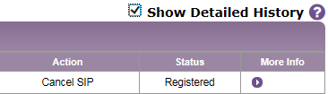
Cancel Shelter In Place (SIP)
Scan barcode.
Click Cancel SIP.
Confirm message: Cancel SIP is completed.
Scroll down to Tracking History to view the Intended Destination is now blank and the Status is Registered.
If you check the Show Detailed History box, you will see all of the actions and prior status.
Scenario 10
Notes:
Every action is tracked in the evacuees Tracking History – even cancelled actions.

Slide 46
Scenario 11
Evacuee #3 is being sent to the TMP Location
Former SIP Evacuee’s Intended Destination needs to be updated to the TMP location like the other two evacuees.
Status also need to be changed to Evacuated.
Notes:
Upon cancelling the SIP status, the evacuee will be transported to the TMP location and marked as Evacuated like the other two evacuees.

Slide 47
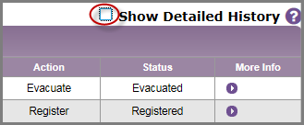
Update Destination for Evacuee #3 and change Status to Evacuated.
Select TMP for Intended Destination Org. Type.
Select the TMP Location for Intended Destination.
Enter Evacuation Group Description.
Click Evacuate.
Confirm message: Evacuate is completed.
Scroll down to Tracking History to view the Intended Destination is now TMP Location and Status is Evacuated.
Uncheck the Show Detailed History box
Scenario 11
Notes:
Always verify that action is complete, and status of the evacuee is correct.

Slide 48
Scenario 12
View Facility Report
Three evacuees should be listed.
Each should have an Intended Destination of the Temporary Location and a status of Evacuated.
Notes:
Reports are very helpful to know where all the evacuees are and what their status is.
Facilities are responsible for correcting statuses and current location info. If a location or status is not correct, then contact the facility as needed.
The current location for your three evacuees should be your facility. The status should be Evacuated, and the Intended Destination is the TMP facility you added in scenario 4.
Please be sure the report is correct before moving on to the next scenario.

Slide 49
View Facility Report
Select Reports.
Select Facility Report.
Click I am an evacuating facility.
Select your facility type and facility name if necessary.
Select your Operation.
Click Generate Report.
Confirm your three evacuees are listed, the Intended Destination is your TMP Location, and status for all three is Evacuated.
Scenario 12

Slide 50
Lunch Break
45 minutes
Notes:
Start countdown clock

Slide 51
Scenario 13
Receive Evacuees
You were transported to TMP Location with the three evacuees:
Scan or type in barcode number for Evacuee #1.
Change Current Location Org. Type [TMP] and Current Location to the TMP Location you created.
Repeat for other two evacuees.
Notes:
When transportation took the three evacuees to the TMP location, you went with them and brought your laptop.
Now you need to update the current location and mark the evacuees as received.

Slide 52
Receive Evacuees to TMP Location by Scanning or Typing barcode
Scan barcode OR Select Manage People > Person Lookup.
Change Current Location Org. Type to [TMP] Temporary.
Select the TMP location you created from the dropdown list.
Click Receive.
Confirm Receive is Complete.
Repeat Steps 1 – 5 for other two evacuees.
Scenario 13
Notes:
By changing the Current Location and the status to received you know where the evacuee is.

Slide 53
Scenario 14
View Facility Report
Current location for the three evacuees should be TMP Location and their status is received.
Notes:
Let’s check the report to verify that the three evacuees have the correct TMP location and their status is received.

Slide 54
View Facility Report
Select Reports.
Select Facility Report.
Click I am an evacuating facility.
Select your facility type and facility name if necessary.
Select your Operation.
Click Generate Report.
Confirm your three evacuees are listed, the Current Location is your TMP Location, and status for all three is Received.
If any evacuee’s current location is NOT your TMP Location or status is not Received, you will need to return to scenario 13 and make edits.
Scenario 14
Notes:
If any evacuee’s current location is NOT your TMP Location or status is not Received, you will need to return to scenario 13 and make edits.

Slide 55
Scenario 15
Initiate Repatriation
Power has been restored and transportation is ready to take the three evacuees back to your facility.
Use Multi Person Update to Initiate Repatriation for the three evacuees.
Notes:
Event is over, and time for the three evacuees to be sent back to your facility.
We could do this by scanning the wristbands and doing one at a time, but why not try a Multi Person Update.
You will see that the end results will be the same.

Slide 56
Initiate Repatriation using the Multi Person Update
Select Manage People.
Select Multi Person Update.
Select Operation.
Change Location Org. Type to [TMP] Temporary.
Select your TMP Location from the dropdown list.
Select the Initiate Repatriation Action.
Click List.
Check the All box (top left) OR the box corresponding the evacuee #1 – 3.
Click Initiate Repatriation of Selected.
Confirm Initiate Repatriation complete for 3 persons.
Scenario 15
Notes:
Note: You can only use the Multi Person Update to Initiate Repatriation, if the evacuees have already been received.

Slide 57
Scenario 16
View Facility Report
Status of three evacuees should be Repatriation Initiated and Intended Destination as your facility.
Notes:
Let see if we are still on the right path. The statues of the three evacuees should be Repatriation Initiated.

Slide 58
View Facility Report
Select Reports.
Select Facility Report.
Click I am an evacuating facility.
Select your facility type and facility name if necessary.
Select your Operation.
Click Generate Report.
Confirm your three evacuees are listed, the Intended Destination is your facility, and status for all three is Repatriation Initiated.
Scenario 16
Notes:
Confirm your three evacuees are listed, the Intended Destination is your facility, and status for all three is Repatriation Initiated.
If your report is not correct, please let me know and we will make necessary edits to get it right.

Slide 59
Scenario 17
Repatriate – Event is over
Receiving evacuees back to where they originated from is Repatriation
Use Multi Person Update to change status to Repatriated for the three evacuees.
Notes:
The evacuation cycle is complete and eFINDS needs to indicate that.
Only when evacuees return to their original location can they be repatriated.
Refer to the status definition if necessary.

Slide 60
Repatriate Evacuees using the Multi Person Update
Select Manage People.
Select Multi Person Update.
Select Operation.
Verify or Select your facility’s Org. Type.
Verify or Select your facility.
Select the Repatriation Action.
Click List.
Check the All box (top left) OR the box corresponding the evacuee #1 – 3.
Click Repatriate Selected.
Confirm Repatriate complete for 3 persons.
Scenario 17
Notes:
Note: You can only use the Multi Person Update to Repatriate, if Repatriation has been Initiated.
The alternative it to scan or type in the barcode and update them individually.

Slide 61
Scenario 18
View Facility Report
Event is over, so three evacuees should have your facility listed as current location and status of Repatriated.
Notes:
During a real event, more time will pass, and it is important to know where all your evacuees are and what their statuses are.
*If you send an evacuee home, you select [Home] Person’s Own Home from Intended Destination Org Type, Person’s Own Home [HOME] for Intended Destination and Evacuate them when they leave. Put a note in the record of when they left and who transported them.
In the facility reports you will see Home as intended destination and status of Evacuated. The status indicates that they left your facility.
When they return to the Sending/Evacuated Facility the only option is to cancel their evacuation status, and they will be Registered –Not Repatriated. *

Slide 62
View Facility Report
Select Reports.
Select Facility Report.
Click I am an evacuating facility.
Select your facility type and facility name if necessary.
Select your Operation.
Click Generate Report.
Confirm your three evacuees are listed, the Current Location is your facility, and status for all three is Repatriated.
Scenario 18
Notes:
Are all your evacuees back with a Repatriated Status??
This indicates that the event is over and all evacuees that were supposed to come back have.

Slide 63
Break
15 minutes
Notes:
Start countdown clock

Slide 64
Scenario 19
List Available Barcodes
Let’s check to see what barcodes are still available
Notes:
This feature can be used to register evacuees if you do not have the wristbands to scan.
For our purposes, we just want to see what barcodes are available still.

Slide 65

List Available Barcodes
Select Register People.
Select List Available Barcodes.
Verify your Location Org. Type and Original Location.
Click List.
View message at top, “There are ## unused barcodes for the location.
Scroll down through list and if needed change number of records to display on page:
Note: If you click on the barcode link, you can register an evacuee.
Scenario 19
Notes:
This is an easy way to see how many barcodes you have and what numbers are available.
It is also another method for registering evacuees if you do not have the wristbands to scan.
For our purposes today, we will not be registering anyone this way.

Slide 66
Scenario 20
Multi Person Input
You will use the same Operation and TMP Location
Another evacuation is warranted.
This time you cannot locate the wristbands, but you need to evacuate two people.
Notes:
This is another method of registering evacuees.
This was really used by a facility that had a fire. The eFINDS Administrator was told by the fire department that she could not return to the building to get her wristbands.
She needed to evacuate and did not have the wristbands to scan. Luckily, she had the info needed to register all her people.

Slide 67
Use Multi Person Input to Register
Two More Evacuees
Select Register People.
Select Multi Person Input.
Select your Operation (the one you added).
Select your facility type and facility name if necessary.
Enter two (2) in the Number of People field.
Click Generate Fillable Grid.
Enter First Name, Last Name, DOB and Gender for two more evacuees (# 4 and 5).
Click Register.
Confirm Registered 2 people.
Scenario 19
Notes:
Register evacuees # 4 and 5 that you created names for in the beginning of the training session.
Coordinate with your facility colleagues participating in this training.
When you get to step 5, and you both need to enter 2 evacuees, and you could potentially get the same barcode numbers. In a real event, this is not likely to happen. Please be sure to use different barcode numbers to register your evacuees.
To help training participants from the same facility, please request four or six barcode numbers from the Multi Person Input screen, and then communicate which barcodes you will use (first set of two, second set of two, and so on).

Slide 68
Scenario 21
Multi Person Update
When you used the Multi Person Input to Register two evacuees, the system provided you with available barcode numbers, but does not ask where you are sending the evacuees.
Update the Intended Destination Org. Type [TMP] and Intended Destination for the two new evacuees.
Notes:
You registered two people in the last scenario but did not tell eFINDS where they were Intended to go.

Slide 69
Update Intended Destination to the TMP Location and Evacuate
Using Multi Person Update
Select Manage People > Multi Person Update.
Select your Operation (the one you added).
Select your facility type and facility name if necessary.
Select the Evacuate Action.
Select [TMP] Temporary Intended Destination Org. Type.
Select your TMP Location for Intended Destination.
Click List.
Select Only Evacuee # 4 and 5. Their status is Registered.
Click Evacuate Selected.
Confirm Evacuate complete for 2 people.
Scenario 21
Notes:
Again, if more than one training participant is in the same session, then each needs to select their own operation to update their own people.

Slide 70
Scenario 21
Evacuees arrive at the TMP Location
Use the Multi Person Update to change status to Received
You are at the TMP location with the two new evacuees.
Update their Current Location Org. Type [TMP], Current Location and change to the status to Received.
Notes:
We have used this Multi Person Update feature to Evacuate people, and in previous scenarios to Initiate Repatriation and Repatriate them.

Slide 71
Receive Two Evacuees at the
TMP Location
Using Multi Person Update
Select Manage People > Multi Person Update.
Select your Operation (the one you added).
Select [TMP] Temporary Intended Destination Org. Type.
Select your TMP Location for Intended Destination.
Select the Receive Action.
Click List.
Select the two evacuees you just evacuated.
Click Receive Selected.
Confirm Receive completed for 2 people.
Scenario 21
Notes:
The reason you only have two evacuees in your list this time is because only two evacuees had the TMP location in Intended Destination field, and their status was either Registered with Intended TMP Location or Evacuated.

Slide 72
Scenario 22
View Facility Report
Current location for the two new evacuees should be the TMP Location and their status is Received.
Notes:
Let’s see what the facility report says now.
If your reports do not reflect what they should, then an action was missed.

Slide 73
View Facility Report
Select Reports.
Select Facility Report.
Click I am an evacuating facility.
Select your facility type and facility name if necessary.
Select your Operation.
Click Generate Report.
Confirm your two newest evacuees are listed, the Current Location is your TMP Location, and status for all three is Received.
You should also see your first three evacuees with a status of Repatriated.
Scenario 22
Notes:
You should see five evacuees listed, because they are under the same operation.
Are three showing as Repatriated, and two Received?

Slide 74
Scenario 22
Excel File Upload is another method of registering evacuees.
Generate and Download the eFINDS Uploadable Spreadsheet to the Desktop.
You need to register two more evacuees using the File Upload Method.
Notes:
This method is like the Multi Person Input as it only captures first name, last name, DOB and Gender. No Intended Destination.
An eFINDS Spreadsheet can be maintained on our network or local drive and would not be uploaded until an evacuation is warranted and evacuees have an operation to be registered under.
As a matter of fact, you cannot upload an eFINDS spreadsheet without selecting an operation, and you want to be sure that you have added an operation for your facility or you are using the one the state added for a large-scale event.

Slide 75
Generate a Barcode Assignment:
Uploadable Spreadsheet (Excel)
Select Manage Barcodes
Select Download Barcode Documents.
Skip Start Number and End Number – You want all available, but will only use two.
Select Barcode Assignment: Uploadable Spreadsheet.
Click Download Document.
Click Open NYS_eFINDS …TRAINING.xls from commerce.health.state.ny.us?
Enable Editing if necessary.
By not entering the start and end number in step 3,
you will get a spreadsheet with all available barcodes.
Scenario 23
Notes:
AGAIN, please coordinate with your other facility colleagues (in the training) which barcodes you will be using.
Only the eFINDS Reporting Administrator can generate (download) the eFINDS spreadsheet. Anyone with access to Microsoft Excel or Google docs can populate it and maintain it.
You may consider using this option if you have a stable/static population. When an evacuation is warranted, then the user in an eFINDS role can upload the file. Either the eFINDS Data Reporters or eFINDS Reporting Admins can upload the file.

Slide 76
Scenario 23
Now that you have an Excel File with all of the available barcodes, input two more evacuees.
The only info you can provide on the spreadsheet is name, DOB and gender.
No other info can be uploaded.
Input info for two more evacuees and save the file to the Desktop.
Notes:
When an Excel file is generated, all available barcodes are provided.
Coordinate with your fellow facility trainees which barcodes will be used. If you happen to assign an evacuee to the same barcode and both spreadsheets get uploaded and error will occur, and only one evacuee will be registered.

Slide 77
Enter Info for Two Evacuees on the Uploadable Spreadsheet
Enter First Name, Last Name, DOB and Gender for two evacuees (#7 & 8).
Save the file to your desktop.
Close Excel file.
Use a file name that will be easy to identify on the desktop.
The default file name is NYS_eFINDS_...TRAINING.
Scenario 24
Notes:
Enter info for evacuees # 6 and 7 that you created in the beginning of the training session.
Enter first name and last name. Use proper cell format for DOD and select Gender from dropdown list. If any other cells contain data, an error will occur.
You can only assign evacuees to the barcodes provided. The file will not upload if more info is added to the spreadsheet.

Slide 78
Scenario 24
Register Evacuees using the File Upload
Upload the file you just saved to your Desktop to register the two evacuees.
Notes:
If only two barcodes contained info, then only two evacuees will be registered, and the remaining barcode will stay available.
If you want a “real” Evacuation spreadsheet then the barcodes do not end in a D and will need to be downloaded from the Evacuate side of eFINDS.

Slide 79
Upload eFINDS Spreadsheet to
Register Evacuee # 6 and 7
Select Register People > File Upload.
Select Operation.
Click Browse…
Open Desktop and click on eFINDS Spreadsheet you just saved.
Click Open.
Click Upload.
See message: Please review uploaded information for 2 people.
Make edits if needed on the screen.
Click Register.
Confirm Registered 2 people.
Scenario 25
Notes:
If you filled in evacuee info on the spreadsheet incorrectly, you can make edits before clicking Register > See step 7.
Note: This method only allows you to register evacuees without an intended destination.
You cannot upload this file without selecting an operation, so select the operation you created today.

Slide 80
Scenario 25
Multi Person Update
When you used the File Upload to Register two more evacuees, the system did not ask where you are sending these evacuees.
Update the Intended Destination Org. Type [TMP] and Intended Destination for the two evacuees on the eFINDS Spreadsheet.
Notes:
We registered two more evacuees without an intended destination. In this scenario, we will input the intended destination and mark the two people as evacuated.

Slide 81
Update Intended Destination to the TMP Location and Evacuate
Using Multi Person Update
Select Manage People > Multi Person Update.
Select your Operation (the one you added).
Select your facility type and facility name if necessary.
Select the Evacuate Action.
Select [TMP] Temporary Intended Destination Org. Type.
Select your TMP Location for Intended Destination.
Click List.
Select Only Evacuee # 6 and 7. Their status is Registered.
Click Evacuate Selected.
Confirm Evacuate complete for 2 people.
Scenario 26
Notes:
You followed these steps before in scenario 20 when you evacuated the two people you registered using the Multi Person Input.
See how the Multi Person Input and the File Upload features are similar.

Slide 82
Scenario 26
View Facility Report
See the statuses for all seven (7) evacuees, because they were all under the same Operation.
Notes:
We always like to be sure we are doing things correctly, and all participants in this training are on the same scenario.
Let’s check our work.

Slide 83
View Facility Report
Select Reports.
Select Facility Report.
Click I am an evacuating facility.
Select your facility type and facility name if necessary.
Select your Operation.
Click Generate Report.
Confirm your two newest evacuees are listed, the Current Location is your TMP Location, and status for all three is Received.
You should also see all seven evacuees. Confirm the status of evacuee # 4-7 is Evacuated.
Scenario 27
Notes:
You should see all seven evacuees listed, because they are under the same operation.
Are three evacuees Repatriated?
Are the last two that you uploaded Evacuated?
What status are your evacuees # 4 and 5? Their status should be??? [Received]

Slide 84
Scenario 27
Quick Search Name
Use Quick Search to find one of your eight evacuees (pick one).
Enter first name only.
View results.
Click on barcode link to view Tracking History.
Notes:
Quick Search allows you to find people using only two characters, just a first name or just a last name, medical record (MR), employee, or by any detail in the Note, Medical Info or Contact Info field.
You can also search by barcode #.

Slide 85
Quick Search Evacuee by Name
Select Quick Search.
Select Enter the first name of one of your evacuees.
Find evacuee in results table.
Verify Name, Operation and Status is correct.
Click on barcode link.
Scroll down to view tracking history for this evacuee.
Scenario 28
Notes:
Pick an evacuee from #1 – 7.
What is their status?
What does their tracking history tell you?

Slide 86
Scenario 28
Quick Search Barcode
Use Quick Search to find one of your eight evacuees (pick one).
Enter the evacuees barcode number.
View results.
Click on barcode link to view Tracking History.
Notes:
Pick another evacuee from # 1 – 7.
Now let’s search by their barcode #.

Slide 87
Quick Search Evacuee by Barcode
Select Quick Search.
Select Scan or Type the barcode of one of your evacuees.
Find evacuee in results table.
Verify Name, Operation and Status is correct.
Click on barcode link.
Scroll down to view tracking history for this evacuee.
Scenario 29
Notes:
What is their status? Where are they located now? Is what you are seeing correct?

Slide 88
Scenario 30
Update Notes Field for Evacuee
For the barcode you just searched, click on the barcode link to open evacuee record.
Enter a medicine or medical condition about this evacuee.
Save edits without changing the status.
Notes:
While you have an evacuee record open, let’s add details about this evacuee, like medicine needed or medical condition, such as insulin, dialysis, dementia, etc.

Slide 89
Update Medical Info or Notes Field
Select Quick Search.
Select Scan or Type the barcode of one of your evacuees.
Find evacuee in results table.
Verify Last Name, Operation and Status is correct.
Click on barcode link.
Scroll down to Medical Info or Note field.
Enter medical details about this evacuee.
Click Save Edits.
Confirm Edit is complete.
Scenario 30
Notes:
This is just another method of finding all the evacuees that you have access to.
In other words, you will only see info about an evacuee that you registered or was intended to come to you.
This protects evacuee info from being disclosed to just anyone.

Slide 90
Scenario 29
Use Quick Search to find one of your evacuees
Enter transportation mode used in evacuees 1-3 OR medication listed for evacuee 2.
View results.
Click on barcode link to view Tracking History.
Notes:
Let’s try another way to search.

Slide 91
Quick Search Medical Info or Note Field
Select Quick Search.
Select text you just entered for one of your evacuees in the Medical Info or Note field.
Find evacuee in results table.
Verify Name, Operation and Status is correct.
Click on barcode link.
Scroll down to view tracking history for this evacuee.
Scenario 31
Notes:
This search only brings up results for your evacuees or evacuees that were intended to come to you. You would not need to receive them prior to finding them using this search.

Slide 92
Scenario 30
4 Evacuees arrive at the TMP Location
Use the Multi Person Update to change status to Received
You are at the TMP location with the last four evacuees.
Update their Current Location Org. Type [TMP], Current Location and change to the status to Received.
Notes:
Now let’s receive our last two evacuees.

Slide 93
Receive FOUR Evacuees at the
TMP Location
Using Multi Person Update
Select Manage People > Multi Person Update.
Select your Operation (the one you added).
Select [TMP] Temporary Intended Destination Org. Type.
Select your TMP Location for Intended Destination.
Select the Receive Action.
Click List.
Select the 4 people (#4-7) you just evacuated.
Click Receive Selected.
Confirm Receive completed for 4 people.
Scenario 21
Notes:
This method should be familiar to you. We have done this before in scenario 21.

Slide 94
Scenario 31
Evacuate to Another Location
One of the evacuees that you just Received will not be staying at the TMP Location:
Open a record for one of the evacuees (#6) you just Received.
Update their Intended Destination Org. Type and Intended Destination to the Instructor’s Location and change their status to Evacuated.
Notes:
Now for something new. If you are a receiver and an evacuee needs to go to another location, then you will need to update the intended destination and evacuate them. This indicates the person is on their way to someplace else.
Note that unless the instructor receives them, their status will remain as Evacuated.
If this were a real event, then you would need to contact the facility and have the evacuee received. You want your reports to be accurate.
Also note, that if you do not have an eFINDS role at the receiving facility, then you cannot Receive them. This is why, for training purposes you created a TMP location- everyone has access to the TMP locations.
Look at the evacuees record and see that you cannot select the Instructor’s Current Location. That is, of course, if you do not have a role there.

Slide 95
Evacuate to Another Location
Use Quick Search to find evacuee just received at TMP Location – search by name or barcode.
Find evacuee in results table.
Verify Name, Operation and Current [TMP] Location is correct.
Click on barcode link.
Change Intended Destination Org. Type to [HO] Hospital.
Change Intended Destination to Instructor’s facility.
Click Evacuate.
Scenario 33
Notes:
We are moving this evacuee to another location, but not the original facility they evacuated from.
If you did change intended destination to the original facility, you would see an Initiate Repatriation button instead of an Evacuate button.
<Instructor Action: Give the participants your Intended Destination Org. Type and facility.>
<As the instructor you do not need to receive them.>

Slide 96
Scenario 32
Mark Evacuee as Deceased
Another evacuee that you just Received at the TMP Location has Expired:
Open a record for another evacuee (#7) you just Received.
Check the Decease box.
Enter expiration date and time in the notes field.
Save Edits.
Notes:
If an evacuee dies, their eFINDS record can be updated to indicate the person is deceased.
You may want to communicate this info to the evacuating facility somehow (phone call or email), but you can also mark their record.

Slide 97
Mark Evacuee as Deceased
Use Quick Search to find other evacuee just received at TMP Location – search by name or barcode.
Find evacuee in results table.
Verify Name, Operation and Current [TMP] Location is correct.
Click on barcode link.
Check Deceased box.
Enter “Expired on <today’s date>.
Click Save Edits.
Confirm Edit is complete.
Stay on this evacuee’s record for next scenario.
Scenario 34
Notes:
Marking a person deceased is just a check box, but entering info in the notes fields is also helpful such as date and time of expiration.
Stay on this record for next scenario.

Slide 98
Scenario 33
Will Not Repatriate Status
Deceased person will not be returning to your facility. When an evacuee expires, is discharge or will not be leaving the current location, then their status is Will Not Repatriate.
Open the record for the deceased person.
Remove the Intended Destination Org. Type by clicking Select One.
Update status to Will Not Repatriate.
Notes:
We have seen the following statuses: Available (no one registered to this barcode), Registered, Evacuated, Received, Repatriation Initiated, and Repatriated.
When a person will not be returning to their original location, their status is Will Not Repatriate.
Sometimes an evacuee gets discharged, or they want to stay at the facility they are currently at.
OR, in this case, an evacuee expires (dies) after they are received at a destination.
A deceased person is not returned to the sending/evacuating facility. In the eFINDS System, we know the person is deceased, and will be taken to the funeral home or morgue, and their status is updated to Will Not Repatriate.

Slide 99
Update Status of Deceased Person to Will Not Repatriate
If you stayed on this evacuee’s record, you will have two statuses: Evacuate and Cancel Receive.
Verify Name, Operation and Current [TMP] Location is correct.
Change Intended Destination Org. Type to “Select One.”
Click Will Not Repatriate.
Confirm Will not Repatriate is completed.
Scenario 35
Notes:
When an evacuee expires, the only way to get the Will not Repatriate button to appear is to blank out the Intended Destination.
The current location will not change.
From the History, you will know where the person originated from, when they expired, and where they were last.

Slide 100
Scenario 34
View Facility Report
Evacuees statues should be
3 Repatriated (Evacuee 1-3)
2 Received (Evacuee 4-5)
1 Evacuated (Evacuee 6)
1 Will Not Repatriate/Dead (Evacuee 7)
Notes:
Let’s check the report again.

Slide 101
View Facility Report
Select Reports.
Select Facility Report.
Click I am an evacuating facility.
Select your facility type and facility name if necessary.
Select your Operation.
Click Generate Report.
Confirm your two newest evacuees are listed and one has true in the Reported Deceases column.
You should also see all seven evacuees. Confirm the statuses of evacuee # 6 and 7 are Evacuated and Will Not Repatriate.
Scenario 36
Notes:
You should see all seven evacuees listed, because they are under the same operation.
Are your statuses for evacuee 6 and 7 correct? What about their current locations?

Slide 102
Locate People
Scenario 35
Click Locate People from eFINDS menu bar
Enter your Location Org. Type and your Location
Select your Operation
Click Search
View search results, including current location, intended location and status.
You should also see all seven evacuees. Confirm the statuses of evacuee # 6 and 7 are Evacuated and Will Not Repatriate.
Scenario 36
Notes:
This is just another method of searching for evacuees, but allows you to perform a more advance search, such a DOB or All Males/Females.
Here you should see the same seven evacuees listed as you did in the Facility Report, because they are under the same operation.

Slide 103
Scenario 36
Inactivate Operation
Event is over.
Remove Operation for the Dropdown list.
Notes:
Generally speaking, you would inactive an operation if all statuses were either Registered, Repatriated or Will Not Repatriate.

Slide 104

Inactive Operation
Select Admin > Manage Operations.
Locate and Select Operation you added for this training.
  Use the Search by Operation Name or “power outage” if necessary or check Exclude Inactive Operations.
Click on Name link.
Change Status to Inactive.
Click Save Operation.
Scenario 37
Notes:
Search by Operation Name if needed.

Slide 105
Scenario 37
Inactivate TMP Location
Event is over.
Remove TMP Location for the Dropdown list.
Notes:
You can always re-activate if needed.

Slide 106

Inactive TMP Location
Select Admin > Manage Location.
Locate and Select TMP Location you added for this training.
  Check Exclude Inactive Operations.
Click on Name link.
Change Status to Inactive.
Click Save Location.
Scenario 38
Notes:
Search by TMP location name if needed.

Slide 107

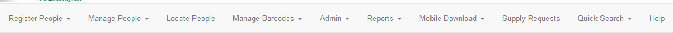
Quick Review of
REAL eFINDS Application
Scenario 38
Sign In to Health Commerce System (HCS)
https://commerce.health.state.ny.us.
Click eFINDS from My Applications List.
Click
Verify or Select your facility name.
Click
Open eFINDS
Notes:
Manage Barcodes – print pdf copy of your REAL scannable barcode log
Supply Requests – if you need to order more REAL wristbands or scanner (if never received one from DOH)
Admin – where you can add a REAL operation or a REAL temporary location if you have an established stop over points for evacuations

Slide 108
Scenario 39
Install eFINDS Mobile
Go to Google Play Store
or App Store and install mobile application.
eFINDS Mobile is a supplement to the Web
application, because it does not have all of the
features that the Web application has.
Scenario 39
Notes:
More detailed instructions on how to use the eFINDS Mobile are in the Web version of eFINDS. Select Mobile Download from the eFINDS menu.
See eFINDS Mobile Quick Reference card.

Slide 109
Break
15 minutes
Notes:
Start countdown clock

Slide 110

HCS RESOURCES
Support Documents on HCS
https://commerce.health.state.ny.us
Application Updates/Release Notes
eFINDS Quick Reference Cards
Recorded CTI-502 – Refresher of instructor-led webinar
CTI-502 course participant guide
Scanner specs
Train the Trainer Folder
Current CTI-502 training schedule
Notes:
Don’t’ forget to check for updated training materials and eFINDS Release Notes.
Scroll down to Application Assistance after you click the blue info icon and click the eFINDS document folder.
When a document is updated, the Date Posted will be updated also, so you will know if something has changed since your last training or download

Slide 111
NYSDOH RESOURCES
TECHNICAL
Example Issues:
I cannot find or open eFINDS.
I do not see my facility listed in eFINDS.
Valerie Shuba
Shared Solutions – Informatics
518-486-1029
valerie.shuba@health.ny.gov
Gregory Sweet
Shared Solutions – Informatics
Gregory.sweet@health.ny.gov
I cannot log into the HCS
  Use Forgot your User ID? Or Forgot your password? features on the Sign In page or call CAMU help desk: 1-866-529-1890
PROGRAMMATIC
Example Issues:
Implementation Questions
Regulatory or policy issues/concerns
Debra Sottolano
Office of Primary Care & Health Systems Management,
518-485-9914
debra.sottolano@health.ny.gov
Shannon Ethier
Office of Health Emergency Preparedness
518-474-2893
Shannon.ethier@health.ny.gov
Notes:
The Health Commerce System trainers are the team responsible for providing technical assistance with eFINDS, so if you find that you are having a technical issue with eFINDS or the Health Commerce System in general you should contact the Health Commerce System Trainers at the number or email listed on the screen.
Contact the CAMU help desk for password and account questions, if results from the sign in page’s Forgot your password or Forgot your User ID are not successful.
For non-technical issues that lean more towards implementation, operations and regulatory concerns, please address those to the Office of Primary a Systems Management, Director of Preparedness Care & Health

Slide 112

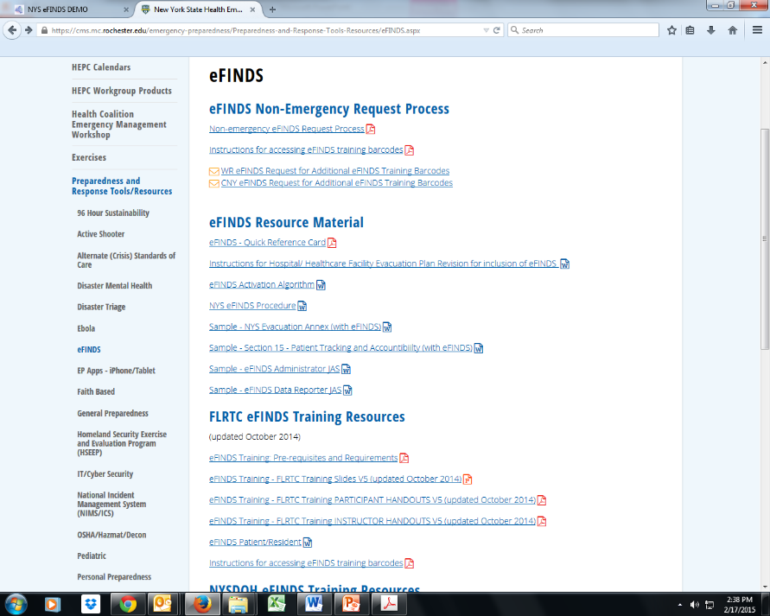

RTC RESOURCES
WRHEPC.URMC.EDU
  preparedness and response tools/resources
  eFINDS
Finger Lakes Regional Training Center
Anne D’Angelo
Phone: (585) 758-7640
anne_dangelo@urmc.rochester.edu
CNY Regional Training Center
Kelsey Wagner
Phone: (315)464-7597 Ext: 4-7597
WagneKel@upstate.edu
CDR Regional Training Center
Jenette White
Phone: (518) 262-1070
whitej4@amc.edu
MARO Regional Training Center
Connie Kraft
Phone: (631) 444-9074
Connie.Cincotta-Kraft@stonybrookmedicine.edu
Notes:
Documents that can be used to incorporate eFINDS into your Evacuation and/ or Disaster Plan can be found:
WRHEPC.URMC.edu
http://www.urmc.rochester.edu/emergency-preparedness/Preparedness-and-Response-Tools-Resources/eFINDS.aspx

Slide 113
Teach Back

Slide 114
TB1: Create Operation
e-FINDS Administrator Role Only
Click Admin from the menu bar
Click Manage Operations
ALWAYS search Name list first to be sure you are not creating a duplicate operation
Select Begin Date – TODAY’S DATE
Select Event Type: OTHER then enter TEACHBACK in description
Enter location
Verify Active Status
Click
Note: You may need to click Add Operation twice
8. Verify Operation YYYY-MM-DD EVENT TYPE LOCATION was created.
NOTE: Email confirmation is sent to all NYSDOH eFINDS Application Administrators: “eFINDS Operation has been added”.
Notes:
An operation is the reason for the evacuation. It simply refers to the event, incident or drill. Please keep in mind that multiple operations can happen concurrently or simultaneously, so be sure to make the correct operation selection. The determined eFINDS operation can be added to the application by an eFINDS Reporting Administrator OR your state or state agency eFINDS administrator.
Important Reminder! Inform the participants that in the event of a large scale emergency involving multiple facilities the NYSDOH will create the Operation and inform all facilities, using the HCS Integrated Alerting and Notification System (IHANS) which Operation will be used for that emergency. A facility will only create an Operation when it is an emergency involving only their facility
Please Note: Operation names must be unique. Check list of existing operations first, and use naming convention for training operation.
The Naming Convention for a Training Operation is:
The date of the Operation in the following format: mm/dd/yyyy (In other words, one operation per training session)
Following the date give a brief description of the nature of the emergency, e.g., “facility flooding”, “extended power loss”, etc.
Hospital name should be facility (facilities) involved e.g. “all nursing homes in county X”. If just one facility then use facility name.
When an regional operation is created, an IHANS Alert will be sent to let facilities know which operation to select. Updating operation name for multiple p/r can be accomplished using the Multi P/R Update and Update Type “Change Operation”

Slide 115
TB2: Receive Person with Barcode
Receiving Facility
1. Click Manage People > Person Lookup
2. Scan or Type Barcode > Click
Change Current Location Org Type & Current Location (your facility)
Click Receive.
Confirm message: Receive is completed &
RECEIVE/UPDATE 1 PATIENT/RESIDENT USING THIS PROCESS
Notes:
Switching gears - now you are the receiving facility. A patient has just arrived from an evacuating facility. All patients/residents have barcoded wristbands, and need to be checked in. remember if you have the scanner you can use it – it will be faster, but you can always type the numbers in as well.
Steps 1-5
And that’s it/ Receiving a patient in eFINDS is nothing more than updating the current location to your facility.

Slide 116
TB3a: Register Person with Barcode Using Mobile Device
Tap eFINDS mobile icon
Login with your HCS User ID and password
Select Practice Only
Select Location > tap OK and tap Set Location
Tap Scan and center red line over the eFINDS barcode
Verify Status is “barcode is unused and available” tap Proceed to begin the registration process
Enter: First Name, Last Name, DOB (mm/dd/yyyy), Gender and Operation
Select the Intended Destination Organization type (HO, NH, ACF)
Select the Intended Destination (TB3b):____________________________________
Tap Evac
Confirm message: Evacuation is completed
Register 1 patient/resident using this process – leave barcode/wristband at workstation
Notes:
Our first evacuation exercise is to register a single patient into eFINDS. At this point in the scenario there is sufficient lead time to place wristbands on the patients and scan them into eFINDS for registration. Again if you do not have wrist bands with your today, work from your paper log.
Steps 1-10
REMEMBER: At the very minimum, the evacuating facilities will only need place the barcoded wristbands on their patient/residents and send them to a safe location. The receiving locations can scan wristbands, and update the location information when they arrive.
However, if the evacuation facility is able to scan a patient, the minimum field input must be the EVACUATION OPERATION (select the operation you created for the training session)
You can OVER-RIDE name, birthdate, gender, etc….but can not override evacuation operation.
Note: when sending patients home or to a shelter there is no way to verify “arrival” through eFINDS. One best practice suggestion is to develop ground rules or policy that once the patient/resident physically leaves the facility a note is added to the “bulk group” section of the patient/resident file. The change will be reflected in the updated time stamp of the patient/resident file

Slide 117
TB3b: Receive Person with Barcode using Mobile Device
Receiving Facility
Tap eFINDS mobile icon
Login with your HCS User ID and password
Select Practice Only
Select Location > tap OK and tap Set Location
Tap Scan and center red line over the eFINDS barcode
Review Barcode Profile for evacuee and tap Proceed
Select your Location Org Type and Location
Note: this is the evacuees current physical location
Tap Receive
Verify Message stating Receive was successful
RECEIVE/UPDATE 1 PATIENT/RESIDENT USING THIS PROCESS
Notes:
Switching gears - now you are the receiving facility. A patient has just arrived from an evacuating facility. All patients/residents have barcoded wristbands, and need to be checked in. remember if you have the scanner you can use it – it will be faster, but you can always type the numbers in as well.
Steps 1-5
And that’s it/ Receiving a patient in eFINDS is nothing more than updating the current location to your facility.

Slide 118
TB4a1: Register Multiple People
Sending Facility: Registers Multiple People
e-FINDS Administrator Role Only
Register 2 patients/residents using this process
Click on Register People > Multi Person Input
Select Evacuation Operation > Sending Location Org. Type > Location
Enter number of People/Barcodes needed
Click Generate Fillable Grid
Enter known information, such as name, DOB and gender
Click Register
Verify message: Registered # people and note barcode #s assigned
Note barcode # assigned to person.
Notes:
This feature works best for registering P/R with a known intended location. Unlike FINDS spreadsheet upload it does not allow you to indicate intended destination.
If you are running short on time you have the option to register multiple patients without the need to scan wristbands or barcodes log. This is especially useful for a group of patients going to the SAME destination and perhaps on the SAME transportation vehicle. The eFINDS administrator has the option of registering patients en masse through the web interface.
NOTE: system defaults to the FIRST available unused barcode in your sequence. Before you enter patient information on the web-interface, verify that the barcode listed matches up with the barcode number on your patients/residents wristband. If you want a list of all available barcodes (if you do not see your barcode in the list) enter the total number of barcodes you have available in the “barcodes to be assigned” field (step 4) and search through the list.

Slide 119
TB4a2: Evacuate Multiple People
(from same facility as TB4a1)
Sending Facility:
e-FINDS Administrator Role Only
Click on Manage People > Multi Person Update
Select Evacuation Operation
Verify Organization Type and Location, if necessary
Select Action: Evacuate > Click List
Select People (from TB3a1) going to same Intended Destination
Select the Intended Destination Organization type (HO, NH, ACF).
Select the Intended Destination (TB3b):____________________________________
Confirm message: Evacuate completed for # people
Notes:
This feature works best for registering P/R with a known intended location. Unlike FINDS spreadsheet upload it does not allow you to indicate intended destination.
If you are running short on time you have the option to register multiple patients without the need to scan wristbands or barcodes log. This is especially useful for a group of patients going to the SAME destination and perhaps on the SAME transportation vehicle. The eFINDS administrator has the option of registering patients en masse through the web interface.
NOTE: system defaults to the FIRST available unused barcode in your sequence. Before you enter patient information on the web-interface, verify that the barcode listed matches up with the barcode number on your patients/residents wristband. If you want a list of all available barcodes (if you do not see your barcode in the list) enter the total number of barcodes you have available in the “barcodes to be assigned” field (step 4) and search through the list.

Slide 120
TB4b: Receive Multiple People
Receiving Facility
Click Manage People > Multi Person Update
Select Operation, Current location org. type (TMP Location) and location
Select Action Receive
Click List
Select people with check/click OR select all by checking box in column heading
Click Receive Selected
Verify Receive completed for # people.
RECEIVE 2 PEOPLE USING THIS PROCESS
Notes:
Description of Scenario:
A transportation vehicle just arrived with multiple patients/residents who need to be checked in at the temporary location
Follow steps 1-7
NOTE: This procedure can be used to view any/all “registered patients” intended to come to your facility. Make sure you only “check in” patients that have actually arrived.
If a receiving facility wants to see all of the patients that are intended to come to their facility they will select the Update Type “Checking in Patient/Resident into this location and click. In the report that displays look in the Intended Dest column. This shows all of the patients/residents with their facility as the intended location that have not been received in or location updated yet. Select all records or individual records and click.

Slide 121
TB5a1: Generate/Populate/Save/Upload
Fillable Spreadsheet
Sending Facility
e-FINDS Administrator Role Only
Step 1: Generate/Populate/Save
Click Manage Barcodes > Download Barcode Documents
Enter Start & End Barcode Number (optional)
Select Barcode Assignment: Uploadable Spreadsheet (excel)
Click Download Document
Click Save and Open NYS_eFINDS_<facility ID Date Time>_Training
Populate First Name, Last Name, DOB and Gender
Save file
Print file (optional, but recommended).
Step 2: Upload
Click Register People > File Upload
Select Operation
Click recycle icon, if operation does not display
Locate Excel file with saved person information (NYS_eFINDS file name with facility id, date and time or other file name)
Click Open to add file
Click Upload
Verify Info is correct, and edit if necessary
Click Register
Verify message: Registered # people.
Notes:
Description of Scenario:
Your facility is in an evacuation zone and you want to be ready to register all of your patients/residents for evacuation with one file upload
For this exercise we will learn how to download, populate/maintain and upload the “Fillable Spreadsheet.” Only the eFINDS administrator can generate (download) the spreadsheet. Anyone can fill-in the spreadsheet offline. You may consider using this if you have a stable/static population and want to maintain the spreadsheet off line to be ready if and when an evacuation is called for. This process also allows clerical, non-commerce users to enter the patient data electronically (offline) – for later upload into the eFINDS system.
A facility can prepare and maintain this spreadsheet incrementally when not in the midst of an emergency
The First step is for the eFINDS admin to generate the spreadsheet
Steps 1-6
NOTE: The spreadsheet can be opened in Microsoft Excel or Open Office and can be transmitted electronically around your facility. Do not change the file name however as the filename designates the spreadsheet as a valid, uploadable file. If you change the file name the file upload will fail.

Slide 122
TB5a1: Generate/Populate/Save/Upload
Fillable Spreadsheet
Sending Facility
e-FINDS Administrator Role Only
Step 1: Generate/Populate/Save
Click Manage Barcodes > Download Barcode Documents
Enter Start & End Barcode Number (optional)
Select Barcode Assignment: Uploadable Spreadsheet (excel)
Click Download Document
Click Save and Open NYS_eFINDS_<facility ID Date Time>_Training
Populate First Name, Last Name, DOB and Gender
Save file
Print file (optional, but recommended).
Step 2: Upload
Click Register People > File Upload
Select Operation
Click recycle icon, if operation does not display
Locate Excel file with saved person information (NYS_eFINDS file name with facility id, date and time or other file name)
Click Open to add file
Click Upload
Verify Info is correct, and edit if necessary
Click Register
Verify message: Registered # people.
Notes:
Description of Scenario:
Your facility is in an evacuation zone and you want to be ready to register all of your patients/residents for evacuation with one file upload
For this exercise we will learn how to download, populate/maintain and upload the “Fillable Spreadsheet.” Only the eFINDS administrator can generate (download) the spreadsheet. Anyone can fill-in the spreadsheet offline. You may consider using this if you have a stable/static population and want to maintain the spreadsheet off line to be ready if and when an evacuation is called for. This process also allows clerical, non-commerce users to enter the patient data electronically (offline) – for later upload into the eFINDS system.
A facility can prepare and maintain this spreadsheet incrementally when not in the midst of an emergency
The First step is for the eFINDS admin to generate the spreadsheet
Steps 1-6
NOTE: The spreadsheet can be opened in Microsoft Excel or Open Office and can be transmitted electronically around your facility. Do not change the file name however as the filename designates the spreadsheet as a valid, uploadable file. If you change the file name the file upload will fail.

Slide 123
TB5a2: Evacuate Multiple People
(from same facility as TB5a1)
Sending Facility:
e-FINDS Administrator Role Only
Click on Manage People > Multi Person Update
Select Evacuation Operation
Verify Organization Type and Location, if necessary
Select Action: Evacuate > Click List
Select People (from TB5a1) going to same Intended Destination
Select the Intended Destination Organization type (HO, NH, ACF).
Select the Intended Destination (TB5b):____________________________________
Confirm message: Evacuate completed for # people
Notes:
This feature works best for registering P/R with a known intended location. Unlike FINDS spreadsheet upload it does not allow you to indicate intended destination.
If you are running short on time you have the option to register multiple patients without the need to scan wristbands or barcodes log. This is especially useful for a group of patients going to the SAME destination and perhaps on the SAME transportation vehicle. The eFINDS administrator has the option of registering patients en masse through the web interface.
NOTE: system defaults to the FIRST available unused barcode in your sequence. Before you enter patient information on the web-interface, verify that the barcode listed matches up with the barcode number on your patients/residents wristband. If you want a list of all available barcodes (if you do not see your barcode in the list) enter the total number of barcodes you have available in the “barcodes to be assigned” field (step 4) and search through the list.

Slide 124
TB5b: Receive Multiple People
Receiving Facility
Click Manage People > Multi Person Update
Select Operation, Current location org. type (TMP Location) and location
Select Action Receive
Click List
Select people with check/click OR select all by checking box in column heading
Click Receive Selected
Verify Receive completed for # people.
RECEIVE 2 PEOPLE USING THIS PROCESS
Notes:
Description of Scenario:
A transportation vehicle just arrived with multiple patients/residents who need to be checked in at the temporary location
Follow steps 1-7
NOTE: This procedure can be used to view any/all “registered patients” intended to come to your facility. Make sure you only “check in” patients that have actually arrived.
If a receiving facility wants to see all of the patients that are intended to come to their facility they will select the Update Type “Checking in Patient/Resident into this location and click. In the report that displays look in the Intended Dest column. This shows all of the patients/residents with their facility as the intended location that have not been received in or location updated yet. Select all records or individual records and click.

Slide 125
TB6a: Register Person without Barcode
Sending Facility: Registers Person without Scanner
1. click Register People > List Available Barcodes
2. Verify Org Type/Facility Name
3. Click List
4. Click Barcode Link
5. Enter known person information (name, DOB, gender)
6. Select or Verify Evacuation Operation (reason for evacuation)
7. Select the Intended Destination Organization type (HO, NH, ACF)
8. Select the Intended Destination (TB6b):_______________________________________________
9. Click Register or Evacuate > Confirm is correct.
Register 1 patient/resident using this process
Notes:
Description of Scenario:
Wristbands are not available to be scanned and eFINDS Data Reporter does not know which barcodes have already been used and which are available
eFINDS Data Reporter will register one, or any number of patients/residents , without having wristbands or barcode log to scan using the “Register Patient/Resident without Scanner” function

Slide 126
TB6b: Locate Person and Receive
Receiving Facility
Click Locate People from eFINDS menu bar
Enter the Intended Destination Org. Type
Select Operation
Click Search
View search results, including current location, intended location and status.
6. Click on appropriate barcode
Change Current Location Org Type & Current Location (your facility)
Click Receive
Confirm message: Receive is completed

Slide 127
T7:View Status and Location of All People
Click Manage People > List People
Select facility, if necessary
Click List
Notes:
If a person has never been to your facility, you will NOT be able to search for them.

Slide 128
TB8: Generate a Scannable Log (pdf)
e-FINDS Administrator Role Only
Click Manage Barcodes > Download Barcode Document
Verify your Org Type and Location
Enter Start and End barcode numbers (Optional)
Select Scannable Log
Check box to exclude used barcodes or to exclude facility name
5. Click Download Document
6. Open and print or Save the scannable log as a PDF
Notes:
Your current location is the facility you are entering data for. If you have access to multiple facilities then make sure you are entering data for correct location.
eFINDS also allows you to download and print a paper log that can be used to track patients if you don’t have power or internet. You get one copy of the paper log with your kit from NYSDOH, which can be useful just to see what your barcode numbers are. If lost or misplaced you can create additional copies of the paper log.
Follow Steps 1-6
Please note the differences between the PDF and Excel options:
PDF FILES:
- cannot be electronically updated or uploaded, but could be data can be hand written and sent with transport
contains a scannable barcode.
provides a list of ALL barcodes allotted to your facility but notes which barcodes have been used. (without inputting patient data)
EXCEL FILES:
Can be electronically updated and uploaded to eFINDS system
Does not contain scannable barcodes
Defaults to the first available/unused barcode in your sequence

Slide 129
TB9: Quick Search
Click Quick Search from eFINDS menu bar
Enter search criteria in the Quick Search box
Click Search
Verify: Found # person for the keyword(s): ‘search criteria’ Please select one to view details
Locate the record to be viewed or updated
Click the Barcode link (optional)
View record or Add/change the necessary information
Click appropriate action button
Notes:
You can use the Quick Search find and Update information. You can search by LAST name or by barcode. You would search by name if you were looking for the current location of a patient or resident you evacuated or if your receive someone and the person is not wearing a wristband, or otherwise has a visible barcode. You can also search by notes, all of which can be found in the detail section
Note that there is some privacy built in and if a person was never at your facility, or intended to come to your facility, you will not be able to find them in eFINDs through Quick Search or Locate Patient functions. However, as long as you have the wristband (to scan or manually enter barcode) you can update a patient/resident record in tracking system
Updating a record would be used to add more information or change info. such as correct spelling, DOB, location, notes, etc.
Steps 1-7
Note: the Patient/Resident Tracking History has been updated

Slide 130
TB10: Create Temporary Location
e-FINDS Administrator Role Only
1. Click Admin > Manage Locations
Enter Location Name (e.g. Public School# 304), Description (e.g. HS), town or city (e.g. Albany) Note: this will display in Operation drop down list when registering a person
Enter Description, Address, City, State, Zip, Phone and County
Click
Verify your temporary training location has been saved.
Please Note: New TMP location names must be unique
Check list of existing TMP locations first
Notes:
A temporary location (ie: stopover point used before a patient/resident can arrive at final destination) can be added to the eFINDS application by an eFINDS Reporting Administrator OR your state or state agency eFINDS administrator.
NOTE: If your evacuation plan includes the use of a stop-over point, these TMP locations can be pre-identified/created in the eFINDS application so they are available to you before an event/exercise/etc.
For Facility Based Training: This location is specific to your training session, i.e., one receiving location per training. This will allow participants to play both the sending and the receiving facility roles.
Follow Steps 1-5
Please Note: Operation names must be unique. Check list of existing operations first. Adding the training date or trainer’s userID can make location unique if necessary.
Search for location prior to entering a new one by sorting column heading by name, address, description, etc. Be sure to view all pages.

Slide 131
QUESTIONS
TEACH BACK
FEEDBACK
EXPECTATIONS
NEXT STEPS
EVALUATION
CERTIFICATE

