Slide 1
Finger Lakes Regional Training Center
Introduction to BP3
July 1, 2014 – June 30, 2015
Presented by: The Finger Lakes Regional Training Center
September 05, 2014 – WNY All-Partners Subregion Meeting (Cheektowaga, NY)
September 12, 2014 – CNY West Subregion Meeting (Syracuse, NY)
September 16, 2014 – CNY South Subregion Meeting (Binghamton, NY)
September 22, 2014 – FL Regional Meeting (Rochester, NY)

Slide 2
RRC/RTC Structure: 2002-2014

Slide 3
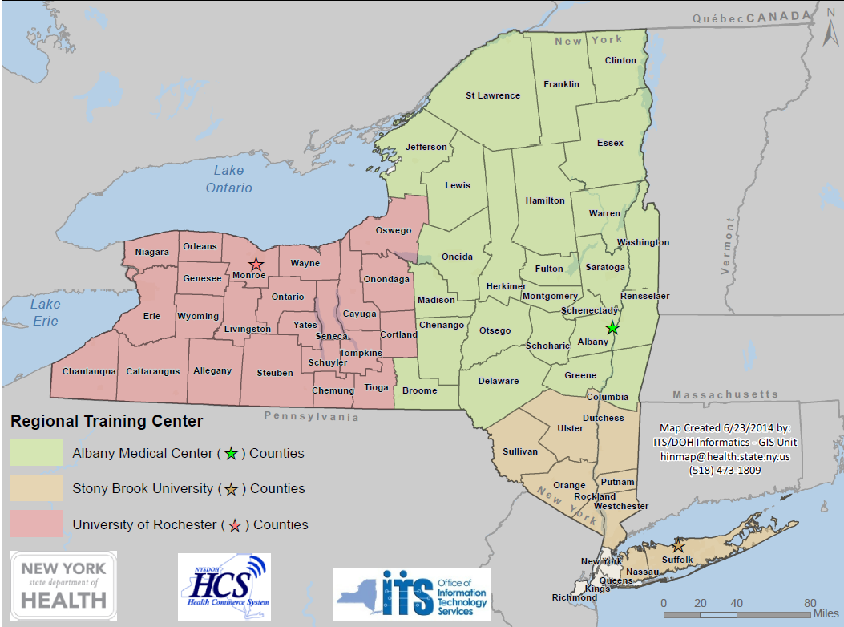
Current RTC Structure (as of 7/1/14)

Slide 4
BP3 RTC Catchment Area
University of Rochester “Finger Lakes”
  23 counties
  47 HPP funded hospitals
  2 HEPCs
  4 Subregions (and 6 local areas)
Albany Medical Center
  25 counties
  44 HPP funded hospitals
  2 HEPCs
  5 Subregions
Stony Brook University Hospital
  9 counties
  49 HPP funded hospitals
  1 HPECs
  2 Subregions
Total funding to RTCs in BP3 has been reduced by 50% compared to BP2
Notes:
Prior to this grant cycle, FLRTC served
-9 counties
-17 hospitals
-1 HEPC
-1 Subregion
-3 local areas

Slide 5
RTC WORKPLAN
A Collaborative Approach

Slide 6
OBJECTIVES
Identify, coordinate, deliver, evaluate maintenance training
Identify healthcare and HEPC training gaps
Develop a regional training calendar
Evaluate training
Identify and implement a variety of delivery modalities
Participate in regional HEPC activities
Coordinate and host OHEP sponsored training
Provide updates and progress reports to OHEP Training Manager
Notes:
Objective 1:
Identify, coordinate, deliver and evaluate maintenance training that will continue to maintain and sustain the required expertise, knowledge, skills and abilities needed to prepare and respond to disaster(s).
Objective 2: Identify healthcare and HEPC training gaps based upon assessments, corrective actions, after action report improvement plans and on-going evaluation methods and deliver training to address gaps.
Objective 3:
Develop a regional training calendar that is accessible to healthcare and HEPC members
Objective 4: Evaluate training conducted and examine the impact of training on healthcare skills in the jurisdiction and the ability to prepare and respond to a disaster.
Objective 5:
Identify and implement a variety of delivery modalities that includes in-person and technology based formats (e.g., webinars, on line)
Objective 6:
Participate in regional HEPC activities including regional and sub-regional meetings.
Objective 7:
Coordinate and host OHEP sponsored training as appropriate and needed.
Objective 8:
Provide updates and progress reports: Regular updates with OHEP Training Manager; progress reports based on work plan and timeline; monthly milestone progress reports via conference call; detailed quarterly written progress reports; final report submitted 30 calendar days after the end of the project period

Slide 7
ACTIVITIES
Current & Proposed

Slide 8
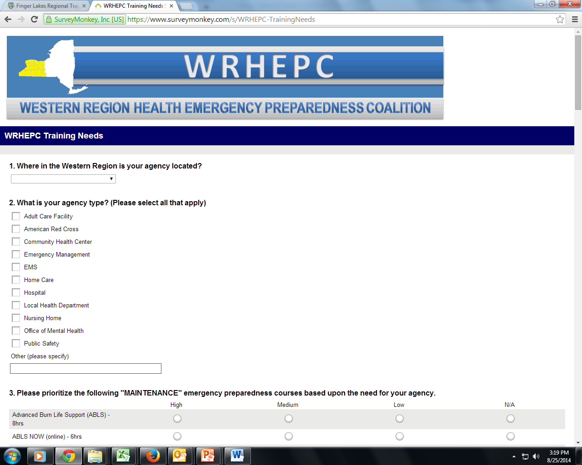
WRHEPC Training Needs Survey
https://www.surveymonkey.com/s/WRHEPC-TrainingNeeds
  Released 7/31/14
  Closed 8/15/14
  Results - September HEPC sub-regional meetings
Notes:
Training Needs Survey
-Requesting input from all HEPC partners
-Requesting One submission/agency (completed with input from EP committee)
-Will be utilized to assess the following:
Priority Maintenance Training: (High, Medium, Low)
Other Priority EP Training Needs
Preferred alternate training modalities for maintenance courses
Support to TtT initiatives (to build/increase agency sustainability)
Capability/Capacity to host courses
Other suggestions for RTC to assist

Slide 9
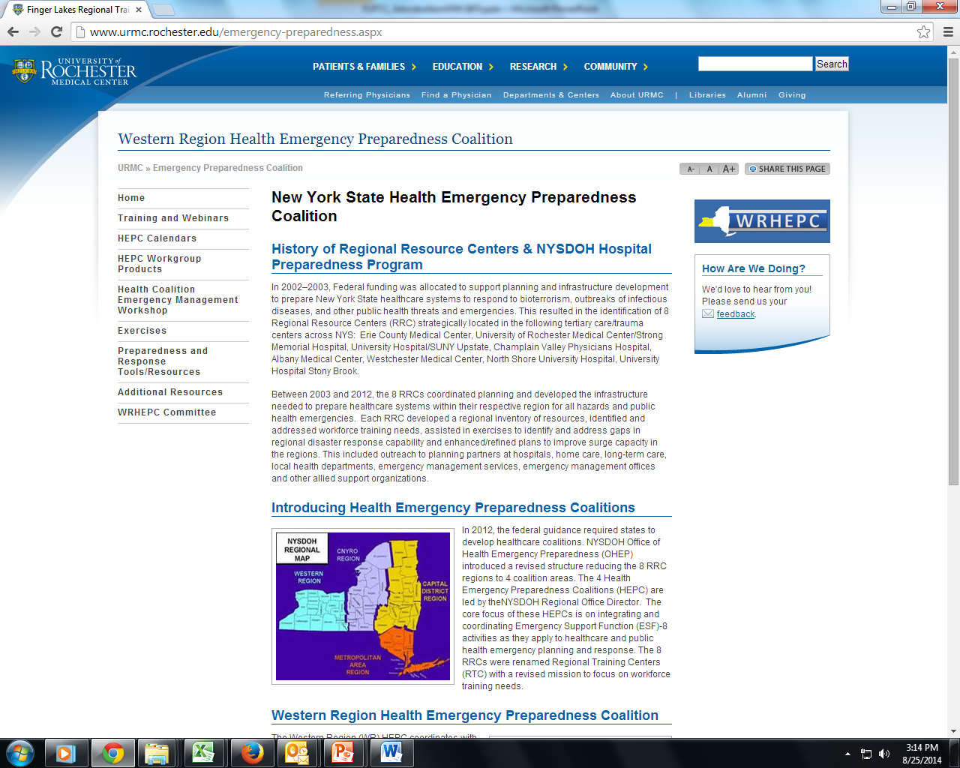
WRHEPC Website
wrhepc.urmc.edu
Notes:
Website: wrhepc.urmc.edu
Training, Calendars, Workgroup Products, EP Training/Planning/Response Resources, Links

Slide 10
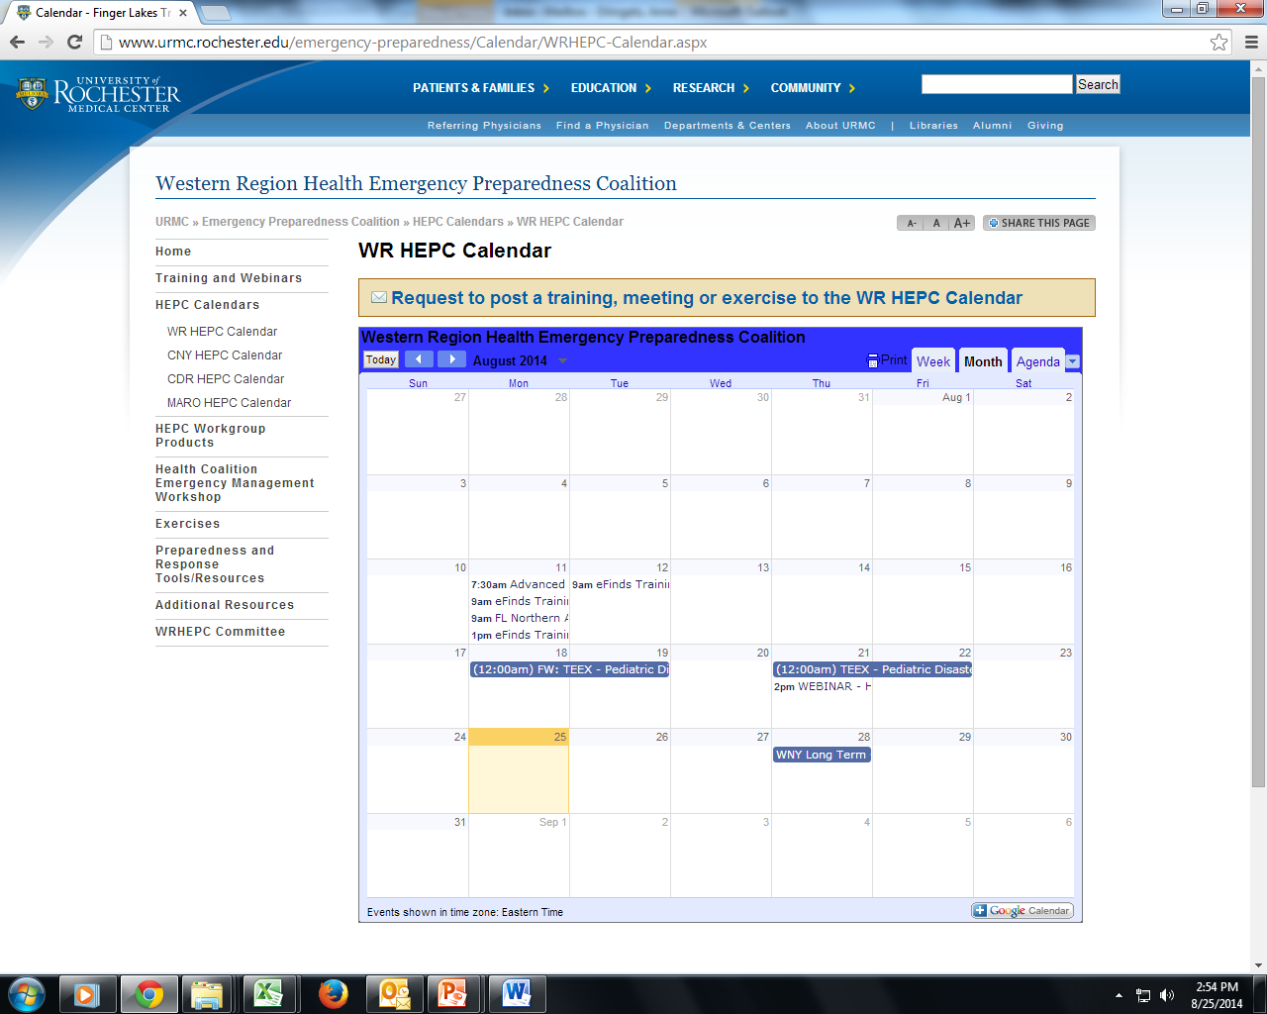
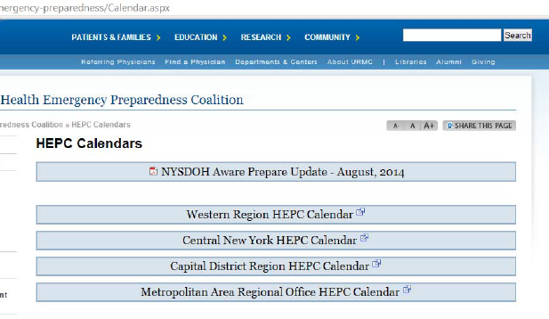
HEPC Calendars
Western Region Health Emergency Preparedness Coalition Calendar (wrhepc@gmail.com)
Central New York Health Emergency Preparedness Coalition Calendar (cnyhepc@gmail.com)
Capital District Region Health Emergency Preparedness Coalition Calendar (cdrhepc@gmail.com)
Metropolitan Area Regional Office Health Emergency Preparedness Coalition Calendar (marohepc@gmail.com)

Slide 11
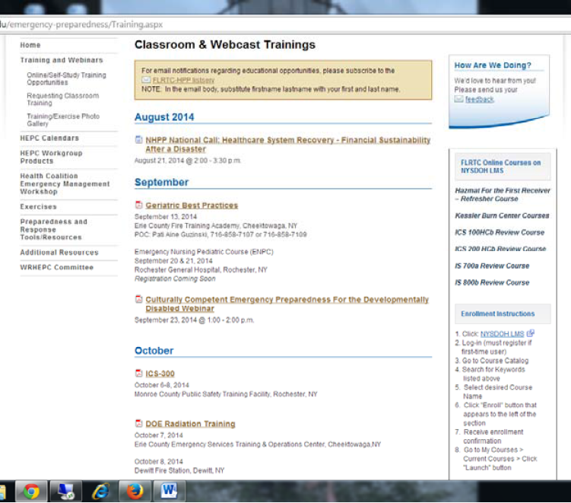
Trainings
  Conducted/Scheduling
    eFINDS (CNY)
    ABLS (CNY, FLR)
    MGT-431 (WNY, FLR)
    Radiation (WNY, FLR, CNY)
    ENPC
    TNCC
    BDLS/ADLS (CNY, FLR, WNY)
  Future Scheduling - based on survey results
  Posted on website/calendar
  Notifications via FLRTC Listserv
  LMS Registration (when applicable)
  Self Paced (online) available via LMS
  Webinars to be scheduled

Slide 12
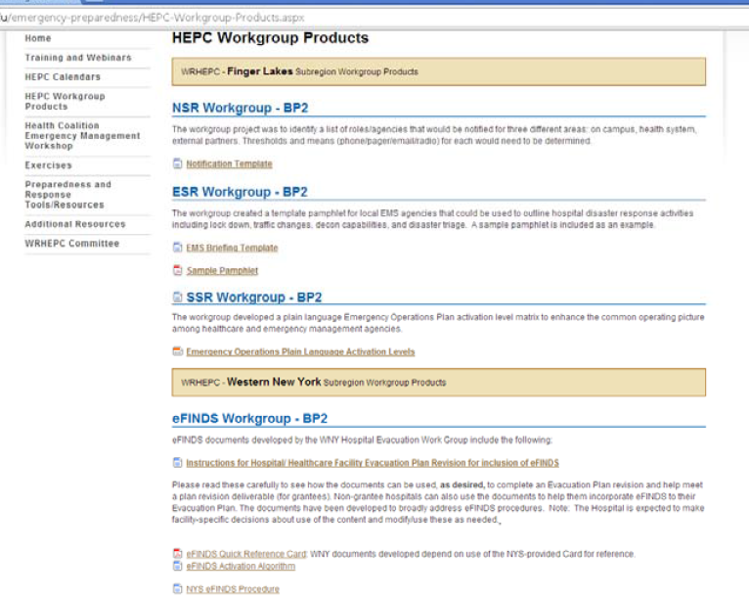
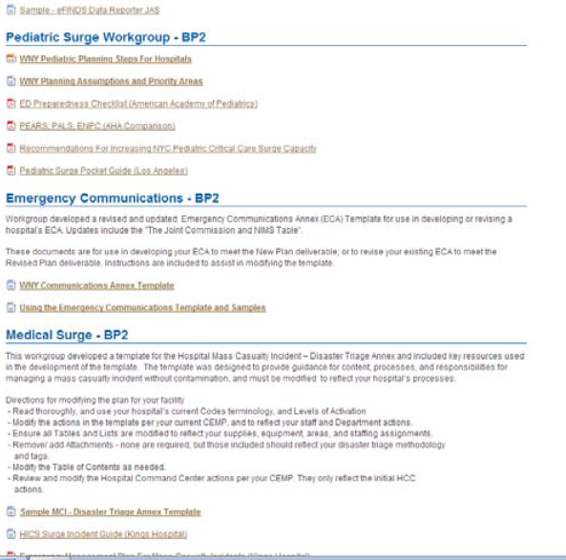
Workgroup
Products

Slide 13
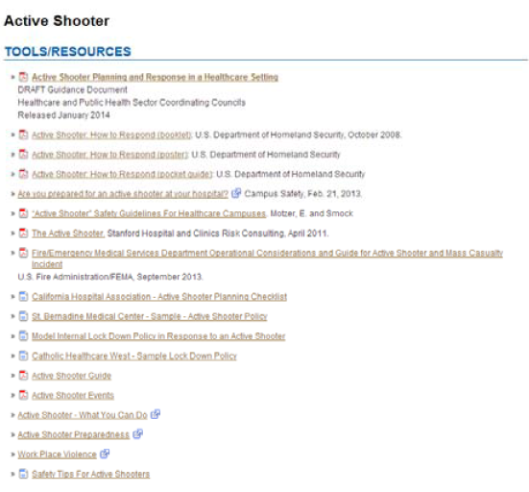
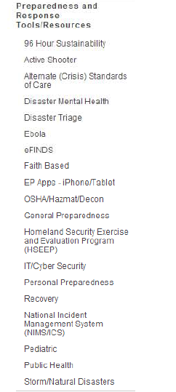
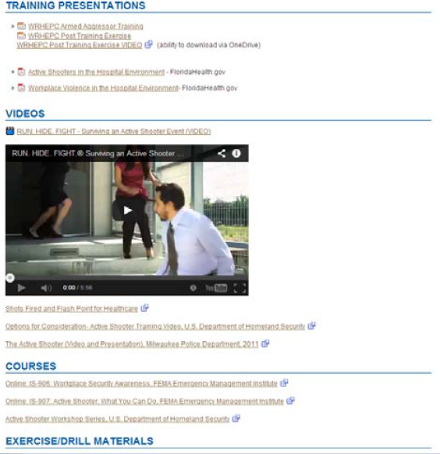
Other EP Tools
& Resources

Slide 14
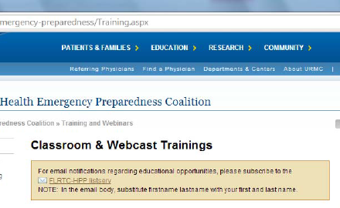
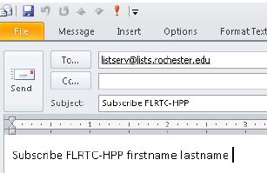
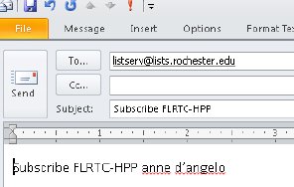
Join FLRTC-HPP listserv
For email notifications regarding educational opportunities

Slide 15
FLRTC Contact Information
  Anne D’Angelo (Program Director)
  anne_dangelo@urmc.rochester.edu
  Eileen Spezio (Administrative Assistant)
  eileen_spezio@urmc.rochester.edu
  Kathee Tyo (Lead Instructor)
  kathee_tyo@urmc.rochester.edu
  585-758-7640
  Mondays, Tuesdays, Thursdays
  wrhepc.urmc.edu
  please subscribe to the FLRTC-HPP listserv
  send an email to: listserv@lists.rochester.edu
  In the email BODY write: Subscribe FLRTC-HPP firstname lastname

Slide 16
RTC Contact Information
Albany Medical Center– RTC
Christopher Smith, BS, EMT-P
Program Coordinator
  Regional Training Center
  Trauma Outreach & Injury Prevention
Phone: (518) 262-1070
SmithC12@mail.amc.edu
Scott Heller, MBA, CHEP
Director of Emergency Management
Phone: (518)262-1071
HellerS@mail.amc.edu
Stony Brook University - RTC
Connie Kraft, RN,MSN,CEN
Emergency Management Department
  Clinical Assistant Professor
  Regional Resource Center Coordinator
Phone: (631) 444-9074
Connie.Cincotta-Kraft@stonybrookmedicine.edu

