Slide 1
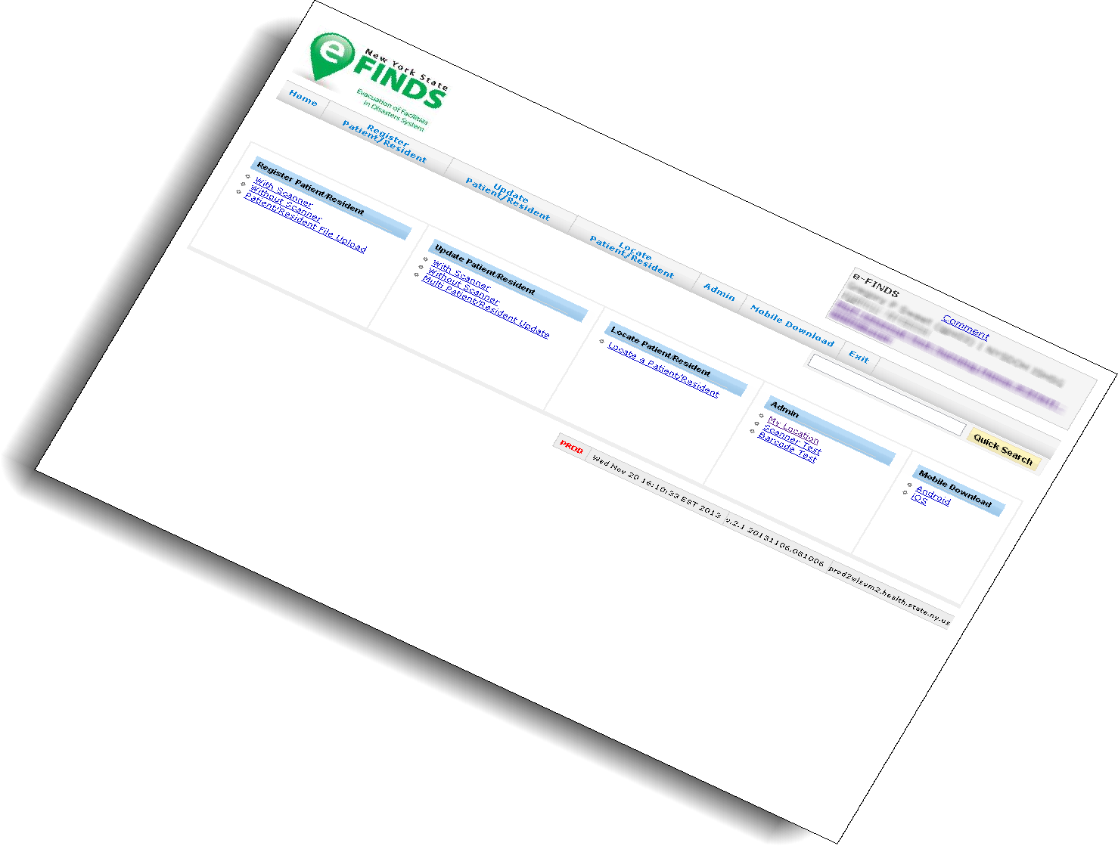

Facility Training

Slide 2

AGENDA
eFINDS INTRODUCTION
Planning Considerations & Implementation
Tailor Your Facility Training Session
HANDS-ON EXERCISES
  Administrative
  Register
  Update/Receive
  Repatriate
  Search/Reports
Frequently Asked Questions
Notes:
This is what we hope to accomplish during today’s session:
BRIEF Overview of eFINDS (more in-depth review was covered during the NYSDOH Webinar roll-out) followed by several hands-on training exercises
Hands-on Exercises are divided into 4 sections – Admin, Evacuate, Receive, Search. This will allow sites the ability to focus on a particular aspect of eFINDS when doing training (perhaps JIT) at their facility.
The “OPTIONAL” component is a True/False test to help summarize important aspects covered in the training.
WNY workgroup developed some scenarios to help EP committees discuss various ways they might consider implementing eFINDS in their facility based on an emergent, urgent or planned evacuation.

Slide 3
Introduction to eFINDS

Slide 4
eFINDS is …
… a statewide, patient/resident (P/R), tracking system, mandated by Governor Andrew Cuomo for use by healthcare and human services facilities, and designed to ensure the safety of patients, residents and staff during a forced evacuation of their location, that is the result of a natural disaster or other physical damage to their location that jeopardizes their
life-safety.
eFINDS provides ongoing awareness of the current location of each evacuated P/R, across any and all relocations during the emergency, captures information about essential care needs of the P/R, as well as key contact information for loved ones and care givers of the P/R.
Notes:
What is e-FINDS? Evacuation of Facilities IN Disasters System
NYSDOH mechanism for Patient Tracking, Repatriation, Reunification during an Hospital, LHD, ACF evacuation.
Secure, real time & easy to use common platform for sharing patient and resident location information - Used for incidents, events or practice exercises when facilities need to relocate their patients or residents
The system captures minimal amounts of data, can accommodate multiple updates and allow facilities to track their patient’s and resident’s movement to other facilities, including temporary shelters. More importantly, where ever the patient/resident resides, the system has hard coded the original location, that is, the location they will return to.
** The application is time saving, especially for the evacuating facilities. At the very minimum, the evacuating facilities will only need place the barcoded wristbands on their patient/residents and send them to a safe location. The receiving locations can scan wristbands, and update the location information when they arrive.
e-FINDS continues to be enhanced and with new features. Currently on eFINDS 2.7 (released 11/30/14)

Slide 5
2012-Hurricane Sandy Evacuations
    56 Facilities evacuated in NYC, Nassau, Westchester and Suffolk Counties
    7,820 HCF Patients/Residents evacuated from NYC, LI and Lower Hudson Valley
Patient Tracking Imperative
Previously NO formal mechanism for tracking evacuees statewide was available
Notes:
Module 2.
Your are building a case for why eFINDS was needed and developed:
NH patients particularly sent out without meds, complete patient records.
Not sent to original expected areas or even traditional facilities; on the fly creation of shelter sites, including hotels must be something system can handle.
ACFs – 2550 evacuated
NHs – 3683 from NHs
Hospitals -- 1587
Regarding their evacuated patients/residents, facilities
Often didn’t know their location, condition; unable to provide ongoing guidance to receiving facility
Had difficulty in repatriating or discharge to other facilities
Families did not know where loved ones were located; some still searching weeks after the storm
Residents sent without basic health records; medication information
Much of this data had to be manually tracked and verified by phone calls to facilities for several months after the storm.

Slide 6
The Directive
Following Sandy, the Governor’s office identified three essential types of data that must be collected in emergencies
    Vulnerable Populations Database
    Tracking of Patient and Resident locations
    Assure essential medical, other vital info accompanies evacuees or is electronically available to receiving locations
Notes:
This initiative was directed by the Governor’s office; eFINDS addresses the two areas of data that are in red text on this slide.

Slide 7
The Requirements
Key Data Requirements – System must:
    Track current location of all evacuees
    Track non-traditional/temp locations like hotels/shelters
    Provide summary stats/status of all individuals evacuated
    Enable quick recognition of missing individuals
    Minimize data collected to only essential fields
    Enable capture of basic medical and additional care requirements
Key Functional Requirements
    Must be quick, easy to use; user friendly
    Must protect sensitive data from those not authorized
    Enable key data tracking even if HCFs have lost power
    Enable data exchange with other tracking systems (HEC)
    Required to be built within 3 weeks
    Equipment disbursed and all facilities trained
    within 2 months
Notes:
This slide lists the critical data and functional elements that the system had to provide.

Slide 8
Evacuated Patients/Residents
Facilities:
    Often didn’t know their location, condition; unable to provide ongoing guidance to receiving facility
    Had difficulty in repatriating or discharge to other facilities
    Families did not know where loved ones were located; some still searching weeks after the storm
    Residents sent without basic health records; medication information
    Patient Tracking Imperative - Previously NO formal mechanism for tracking evacuees statewide
Notes:
This slide is regarding the patients evacuated during Sandy and justifies the need for a patient tracking system. Much of this data had to be manually tracked and verified by phone calls to facilities for several months after the storm.

Slide 9
  Current eFINDS Deployment
  “O” Agencies and their facilities
      OASAS – Clinics
      OMH – Psychiatric Centers and Licensed Housing
      OPWDD – Residential Homes & Developmental Centers
      OCFS – Juvenile Facilities
      OTDA – Supportive Housing
Notes:
This slide lists the big picture for role out and includes all the “O” agencies that are currently using eFINDS.

Slide 10

Current eFINDS Deployment (cont’d)
DOH Facilities
  Hospitals, nursing homes, adult care facilities
  NYCDOHMH and upstate Local Health Departments
  NYSDOH Regional Offices

Slide 11
The Regulations
eFINDS use by all NYS Hospitals, Nursing Homes and Adult Care Facilities (ACF)
is Required for all Evacuations
Health facility electronic data exchange with NYSDOH Health Commerce System (HCS):
  Title 10: Section 400.10 9 -- Nursing Homes and Hospitals
  Title 18: Section 487.12/488.12 -- ACFs
Active HCS Accounts; Up to date, HCS Communications Directory role assignment and business AND emergency contact information
HIPAA Privacy/disclosure of data during emergencies:
Providers/health plans covered by the HIPAA Privacy Rule may share patient information if to provide treatment, inform families; and if in imminent danger situations
Notes:
This slide identifies the regulations that require facilities to use eFINDS.

Slide 12
Planning Considerations

Slide 13
Why Plan??
Lessons Learned from Twenty-one (21) Actual Events
Flooding damage, winter storms, facility relocation
Issues seen in practice:
    Didn’t know how to use system; no protocol in place
    Didn’t know where supplies are stored or lost them
    Not enough people in eFINDS roles; none present onsite at time of emergency
    Removed wristbands from evacuee; couldn’t register
    Didn’t know difference between “real” and “training” applications and/or wristbands
    Didn’t understand concept of the “operation” as where to record data for event at hand
    Confusion regarding data entry process if receiving a facility must register patient
  Didn’t realize need to repatriate returning patients/residents in system/sending facility
    Didn’t understand concept of “shelter in place”
    Didn’t know how to find/track their evacuees in system

Slide 14
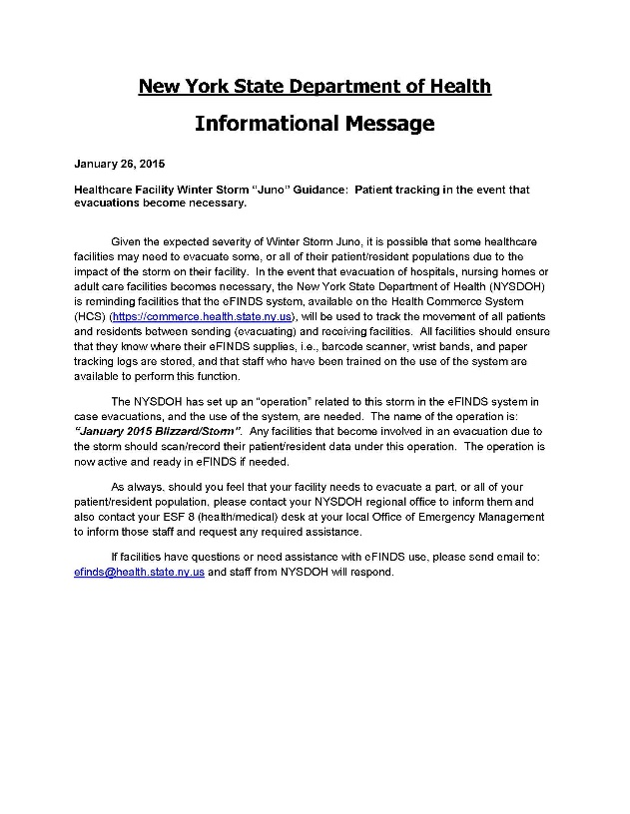
Planning Considerations - Activating eFINDS Large-scale event that affects multiple facilities
NYSDOH will create the operation and notify HCFs that they must use eFINDS
The Health Commerce System (HCS), Integrated Health Alerting and Notification System (IHANS) will be used to send the notification
  HCS Communications Directory business hours and emergency contact information will be used for this notification
  PLAN TO HAVE THIS INFORMATION MAINTAINED:
    Phone/e-mail
    During business hours vs after-hours notifications

Slide 15
Planning Considerations - Activating eFINDS
Individual Facility Event
Facility staff assigned to the eFINDS Administrator Role, can create the Operation themselves as soon as they need to use eFINDS;
  inform any receiving facilities of the Operation name to use in eFINDS when the sending facility’s evacuees arrive at their location
Facility staff should also always contact their NYSDOH Regional Office Program Representatives to inform them of the emergency and gain assistance as needed

Slide 16
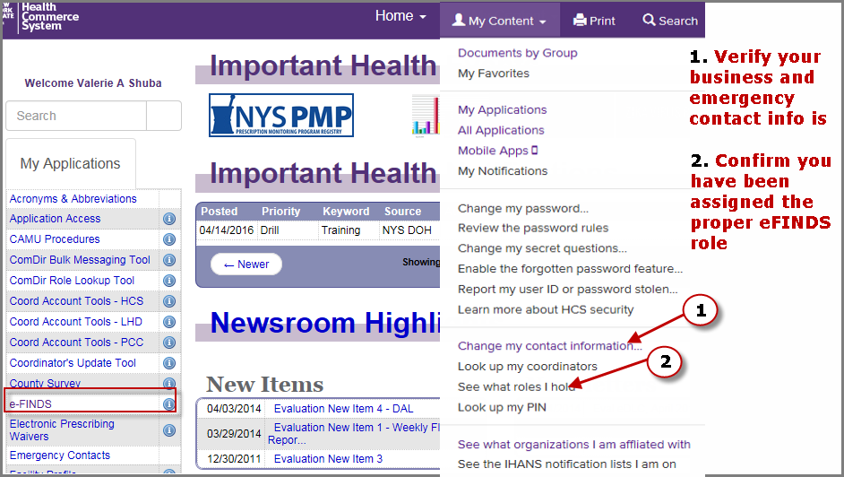
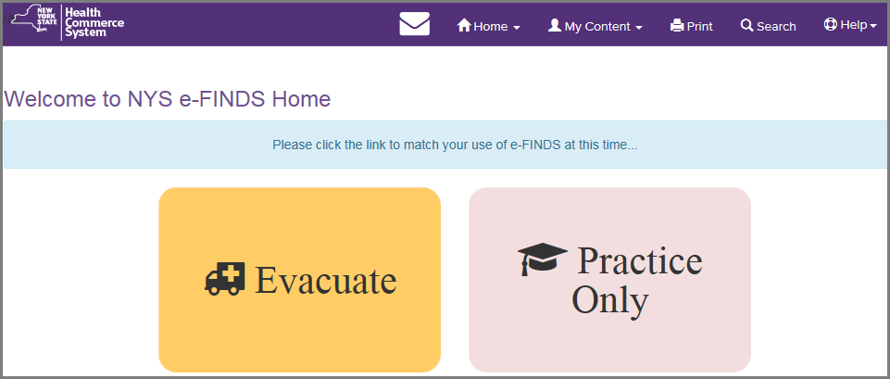
Planning Considerations
Notes:
Because e-FINDS is a role based application, once you are added to an e-FINDS role, the application will appear in your My Applications list in the left side panel.
e-FINDS can also be access from the main list of applications.
To verify your role assignment, go to the My Account link and click See what roles I hold. If you are not in an e-FINDS and would like to be, then click on the Look up my coordinators. They are the ones who will add you to the role.
FRIENDLY REMINDER: To ensure that you receive timely communications from your county health department and/or the state, please make sure your business and emergency contact information is correct and updated. To do so, click on the Update or verify my contact information.

Slide 17
Planning Considerations eFINDS Roles
eFINDS Data Reporter (@user) | eFINDS Reporting Administrator (@admin)
Register patient/resident with or without a scanner one patient/resident at a time, or upload spreadsheet provided by eFINDS Reporting Admin Update patient/resident Information with or without a scanner one patient/resident at a time or multiples | Same as data reporter (user) plus: Generate patient/resident barcode PDF log or spreadsheet Register multiple patients/residents without pre-printed barcode wristbands to scan Create, activate and inactivate an Evacuation Operation Create, activate and inactivate Temporary Locations
Notes:
eFINDS is a commerce based-application and relies on Communications Directory role assignments to access the system. There are two roles for healthcare facility employees that provide access (facility permission assignments)
1. The e-FINDS Data Reporter can register patients/residents in the system with or without a scanner, one at a time or multiples by using the e-FINDS spreadsheet provided by the e-FINDS Admin. They can also update with or without a scanner, one at a time or more than one.
2. The e-FINDS Reporting Administrator role can accomplish more tasks such as: generate a PDF of used and unused barcodes, generate a spreadsheet that can be populated with patient/resident information and uploaded by the e-FINDS Data Reporter. The Admin also has the ability to register multiple patient/residents, at a time, without scanning the barcodes.
**Because the Admin can do everything that a data reporter can, you only need to be added to the admin role; both roles are not needed. Also, a facility can have more than one person assigned to either role.

Slide 18
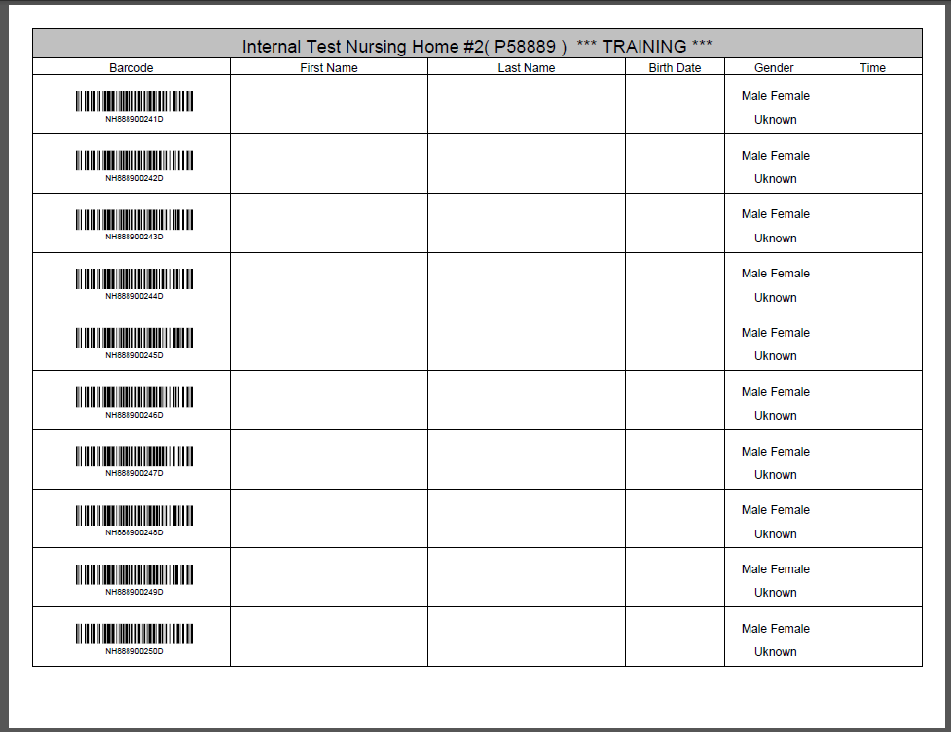
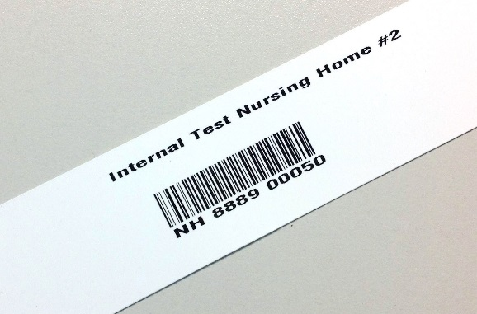
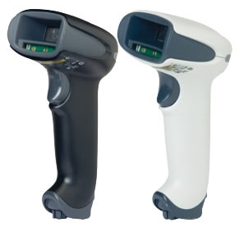
eFINDS Supplies/Equipment
(from DOH)
Notes:
KNOW where these supplies are kept!!!! Each facility received a number of wristbands, based on the licensed bed, and the corresponding log sheets.
The barcodes provided will have a special sequence number used solely for your facility to allow for better patient and resident relocation management. Each wristband will contain the facility name, a scannable barcode, and the barcode number. If needed, you can even write on them. The barcodes on the wristband have a prefix that corresponds to the type of facility (HO, NH, ACF) followed by your agency’s unique identifier code, followed by a changing number sequence
Facilities also received a small set of training bands (16). You will clearly know that they are for training, because they are marked for training in two places, and the barcode number ends in a D for demo. Training wristbands can only be used in the e-FINDS Demo application and the production bands are only recognized in the production e-FINDS. The bands cannot be used in the wrong application by mistake.
NOTE: barcodes are one time use. If a facility has used demo barcodes in a training (demo) it may be necessary to request additional barcodes be added to the facility e-cache. NYSDOH will not issue additional barcode wristbands unless a specific request is made.
Each facility also received one bar code scanner select to work with the e-FINDS application. The budget only provides for one scanner per facility.
Information regarding the purchase of replacement scanners at a discounted price is listed on the “Vendor resources” slide at the end of the presentation.
Other hospital scanners do work with the eFINDS program but because they are not “programmed” use of non-DOH scanners may require a manual “enter” with the keyboard ..
Finally, each facility received a copy of their facility paper log (PDF) – which contains facility name, a space for a patient/resident’s first name, last name, date of birth and gender. These logs can be used if a facility has no power or not internet.

Slide 19

eFINDS Quick Reference Cards
Notes:
Click on the eFINDS or eFINDS Training (Demo) info icon (blue circle with I in it) also known as the application profile button.
Find other quick reference material in the profile.

Slide 20
Facility Supplies/Procedures
(facility provided)
  Additional Handheld Scanner(s)
  Mobile Application
  Computer (laptop/WOWs) with internet Health Commerce System access
  Evacuation Annex (eFINDS Policy and Procedures)
  Patient/ Resident wristband used for identification
  “Go Pouch”
  Internal tracking (Unit to staging area to portal?)
    HICS Tracking Log
    Patient/Resident “Evacuation Tag”
Where are supplies located in your facility?
What is the access procedure? Who, when?
Notes:
Facilitator/ trainer should review the procedures and locations where the equipment can be accessed. Is it a 24/7 process, or differences day and off shifts.
eFINDS merely tracks patients and in no way is meant to be an electronic medical record.
eFINDs should be used in conjunction with internal methods to track and document the patient and associated equipment, such as the Patient Evacuation Tag, and hospital identification wrist band.The patient’s wrist identification band verifies initial identity.
A GO Pouch with chart and clinical information may be used/ affixed to the patient. Basic clinical information such as medications and treatments may also be entered into the eFINDS patient record.

Slide 21
Planning Considerations
DRILLS and EXERCISEs
Indispensable for validating your plan!
One hundred seventy-five (175) Drill/Exercises have been
conducted since eFINDS deployed
    Just in Time or pre-exercise training
    Movement of mannequins, actors with scanning of bracelets; “paper patients/residents” faxing, emailing of paper logs
    Quick reference card helpful to have at each drill station
    Benchmark to strive for: ~30 seconds to register each person
    Paper logs – practice as primary or backup registration and validation tool
  One major system uses quarterly, unannounced eFINDS drills:
  has greatly increased user proficiency;
  almost no coaching to users has been needed
Notes:
Examples of how some facilities have planned and prepared for the implementation of eFINDS
Examples of best practices
Just in time training should focus on the functions that the facility needs to perform during that emergency, e.g., if they are an evacuating facility, JIT should only train the staff on only those methods of registering their patient/residents that they will use during the circumstances they are under. Example: Facility has lost power, and can only use the printed bar code sheets to register their patients/residents.

Slide 22

(Facility’s Plan Template Slide #1)
Our Facility’s eFINDS Plan:
Notes:
(Instructions: the following Facility’s Plan Template Slides provide headers for which the Trainer is to fill in details describing their facility)

Slide 23
(Facility’s Plan Template Slide #2)
Our Facility’s eFINDS Plan:
Our Facility’s Evacuation Plan: patients will be brought to the following staging areas for evacuation transport:
  (List staging areas here)
  During a Planned Evacuation we will incorporate eFINDS at this point in the process: _______
  During an Emergency Evacuation we will incorporate eFINDS at this point in the process: _____
  As a receiving facility we will incorporate the eFINDS process at this point in our reception plan:______
  The pre-populated patient spreadsheet (if being used) is maintained by: ______

Slide 24
(Facility’s Plan Template Slide #3)
Our Facility’s eFINDS Plan (cont’d):
  Describe other aspects of the eFINDS Plan:
  The following individuals will manage eFINDS coordination during the evacuation: ______________
  The following individuals will be responsible for and have access to these supplies when needed: _______________________
  We will announce activation of eFINDS protocol to eFINDS team members in the following way: ____________________________
  We will evacuate by: patient? by unit? By floor? ________________
  Explain where eFINDS equipment and supplies will be found at time of emergency: (For example: each patient care unit will have a set of enough wrist bands to cover its number of beds, stored at nurses stations): ___________________________
  Describe how decisions of where each patient is to be sent will be relayed to people registering patients in eFINDS: ________________

Slide 25
(Facility’s Plan Template Slide #4)
Our Facilty eFINDS Plan (cont’d)
  eFINDS data will be recorded for patients at the following locations within the facility:____________
  Explain what elements of data will be entered in eFINDS: __________
  Bracelets/barcode numbers will be assigned to patient care units in the following way:___________________
  Barcode bracelets will be distributed to patients in the following way: _____
  We will use the following devices for scanning barcodes: __________
  Scanning devices will be distributed in the following way; __________
We will use barcode logs in the following way (e.g., copies will be distributed to each receiving facility for the patients they
will receive): __________________

Slide 26
(Facility’s Plan Template Slide #5)
Our Facilty Plan
We will record the patient’s eFINDS barcode number on the following types of patient documents and personal belongings: ____________
Describe patient and family education regarding eFINDS: ______
Describe how the facility will drill and practice use of eFINDS:
(List only the eFINDS functions your facility will use on the Hands-On Training Modules agenda - slide #28)

Slide 27
Hands-On Exercises

Slide 28
Hands-On Training Modules
Administrative
A-1: Install eFINDS Mobile Application (optional)
A-2: Download Patient/Resident Tracking Sheet (PDF barcode sheet/paper log)
A-3: Create an Operation for a training, exercise, event
A-4: Create a Temporary (TMP) Location for a training, exercise, event
A-5: Housekeeping (FINAL STEP in Training/Exercise)
Register
R-1: Register a single patient/resident with Scanner
R-2: Register a single patient/resident without Scanner
R-3: Register a single patient/resident without wristband or barcode
R-4: Register multiple patients/residents (admins only)
R-5a-d: Generate/Update/Upload a fillable spreadsheet (admins only)
Update/Receive
U-1: Check in (Update) a single patient/resident with scanner
U-2: Check in (Update) a single patient/resident without scanner
U-3: Check in (Receive) a group of patients/residents
Repatriate
Z-1: Receiving Facility repatriates
Z-2: Originating Facility repatriates
Search/Reports
S-1: View patients/residents by original location
S-2: Quick Search
S-3: Locate Patient/Resident
S-4: Dashboard
Notes:
We will complete the following exercises during the Hands-on portion of this training:
Facility trainers should edit this slide to only list those exercises they will use in their training, based on their facility’s plan and choice
of the eFINDS functions it will use.
Remove Or Hide Exercise Slides For Those eFINDS functions
their facility WILL NOT use.
The Administrative “Housekeeping” Exercise will be the last Hands-On component we will do today

Slide 29
SCENARIO
A potentially dangerous problem with your facility’s (Sending Facility) electrical wiring has been found and the fire department has ordered repairs that will require you to evacuate your patients/residents within the next two days.
You need to begin use of eFINDS to track your evacuees for this emergency.
Wristbands and scanner are brought to planned evacuation stations. Mobile devices may be used if available. Incident Commander requesting use of paper log for internal tracking purposes.
Since this emergency only affects your facility you do not need to wait for DOH to create an operation for this event. Your eFINDS Reporting Administrator should create the eFINDS operation immediately.
Your facility (Sending Facility) will be evacuating to a Temporary Location while you wait to move your patients/residents to another facility. You are not certain that this temporary location is currently listed in the eFINDS Demo System so you must first search for it and if it is not listed, add it.

Slide 30
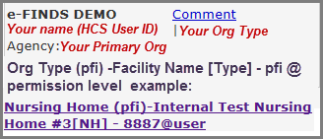
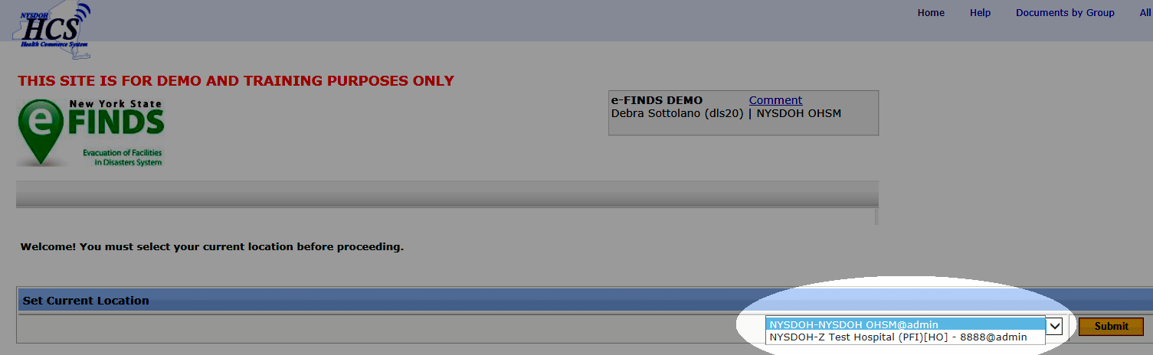
ADMINISTRATIVE EXERCISES
Log into HCS: https://commerce.health.state.ny.us
Open: Evacuation of Facilities in Disasters System Demo from your “My Applications” list on the HCS homepage
Select: the appropriate Current location
(facility for which you are currently registering
patients) and Role from drop down list if you
are affiliated with more than one facility, or have more than one role at a given facility
Click SUBMIT
Notes:
Let’s go out to eFINDS DEMO application on the Health Commerce System, and walk through some practice scenarios. For demonstration purposes, we will act as both an evacuating and receiving facility.
If you have more than one eFINDS role assigned (data reporter and reporting administrator) select @admin (not @user) from the drop-down when you select your current location.
***Demonstration Begins - Please refer to participant handouts if dual presentation (slides and web demo) is not available***

Slide 31
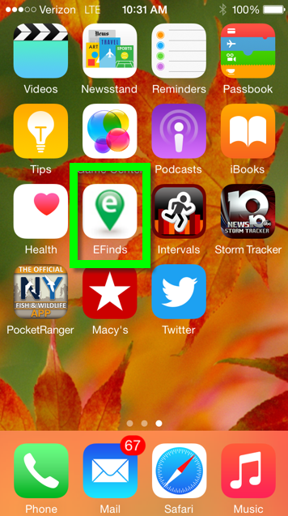
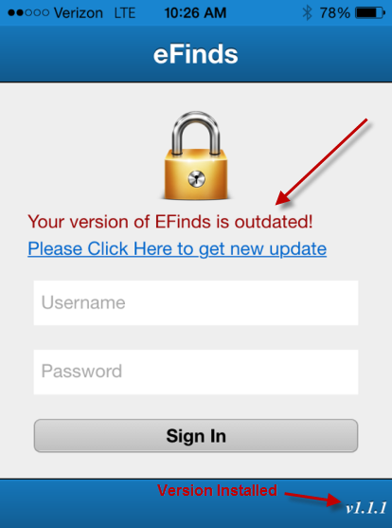
A-1: Mobile Application (Optional)
Log on to the HCS from your MOBILE device (https://commerce.health.state.ny.us)
Click +Show My Applications > Click e-FINDS (Demo)
Select your location
Click Submit
Click Mobile Download from the menu bar
Select Android or iOS
Confirm Install
Wait for application to install on mobile device; progress may not displayed on screen
NOTE: If you are not using the most current version, the app will display a message and you will need to uninstall and then reinstall
Notes:
Both the eFINDS Data Reporter and the eFINDS Reporting Administrator have the option of using the mobile application in lieu of a scanner
Mobile is available by logging into the HCS from your mobile device.
If you are not using the most current version, the app will display a message and you will need to uninstall and then reinstall.
See eFINDS QRC – Mobile for details.

Slide 32
A-2: Generate a Paper Log (PDF)
e-FINDS Administrator Role Only
1. Click Manage Barcodes > Generate Barcodes Spreadsheet.
2. Verify your current location
Enter Start and End barcode numbers, e.g., 4—13 for ten
patient/residents to be relocated OR leave blank for all assigned
barcodes
Select the PDF option
5. Click Generate
6. Print the PDF.
Notes:
Your current location is the facility you are entering data for. If you have access to multiple facilities then make sure you are entering data for correct location.
eFINDS also allows you to download and print a paper log that can be used to track patients if you don’t have power or internet. You get one copy of the paper log with your kit from NYSDOH, which can be useful just to see what your barcode numbers are. If lost or misplaced you can create additional copies of the paper log.
Follow Steps 1-6
Please note the differences between the PDF and Excel options:
PDF FILES:
- cannot be electronically updated or uploaded, but could be data can be hand written and sent with transport
contains a scannable barcode.
provides a list of ALL barcodes allotted to your facility but notes which barcodes have been used. (without inputting patient data)
EXCEL FILES:
Can be electronically updated and uploaded to eFINDS system
Does not contain scannable barcodes
Defaults to the first available/unused barcode in your sequence

Slide 33
A-3: Create Operation
e-FINDS Administrator Role Only
Click Admin from the menu bar
Click Manage Operations
Review the list of existing operations to avoid creating a duplicate
If needed add a new Operation
Enter Operation Name and Description
Naming Convention: Date (mm/dd/yyyy), type of event/emergency, (e.g. flood),
and hospital (facility) name
Select Active Status from drop down list
Enter Begin and End Date if other than current date
Click Add Operation
Verify Saved operation
Please Note: Operation names must be unique
Check list of existing operations first
NOTE: Email confirmation is sent to all NYSDOH eFINDS Application Administrators: “eFINDS Operation has been added”.
Notes:
An operation is the reason for the evacuation. It simply refers to the event, incident or drill. Please keep in mind that multiple operations can happen concurrently or simultaneously, so be sure to make the correct operation selection. The determined eFINDS operation can be added to the application by an eFINDS Reporting Administrator OR your state or state agency eFINDS administrator.
Important Reminder! Inform the participants that in the event of a large scale emergency involving multiple facilities the NYSDOH will create the Operation and inform all facilities, using the HCS Integrated Alerting and Notification System (IHANS) which Operation will be used for that emergency. A facility will only create an Operation when it is an emergency involving only their facility
Please Note: Operation names must be unique. Check list of existing operations first, and use naming convention for training operation.
The Naming Convention for a Training Operation is:
The date of the Operation in the following format: mm/dd/yyyy (In other words, one operation per training session)
Following the date give a brief description of the nature of the emergency, e.g., “facility flooding”, “extended power loss”, etc.
Hospital name should be facility (facilities) involved e.g. “all nursing homes in county X”. If just one facility then use facility name.
When an regional operation is created, an IHANS Alert will be sent to let facilities know which operation to select. Updating operation name for multiple p/r can be accomplished using the Multi P/R Update and Update Type “Change Operation”

Slide 34
A-4: Create Temporary Location
e-FINDS Administrator Role Only
1. Click Admin > Manage Locations
Enter Location Name (e.g. St Anthony’s), Description (e.g. Church), town or city (e.g. Albany) Note: this will display in Operation drop down list when registering a P/R
Enter Description, Address, City, State, Zip, Phone and County
Click
Verify your temporary training location has been saved.
Please Note: New TMP location names must be unique
Check list of existing TMP locations first
Notes:
A temporary location (ie: stopover point used before a patient/resident can arrive at final destination) can be added to the eFINDS application by an eFINDS Reporting Administrator OR your state or state agency eFINDS administrator.
NOTE: If your evacuation plan includes the use of a stop-over point, these TMP locations can be pre-identified/created in the eFINDS application so they are available to you before an event/exercise/etc.
For Facility Based Training: This location is specific to your training session, i.e., one receiving location per training. This will allow participants to play both the sending and the receiving facility roles.
Follow Steps 1-5
Please Note: Operation names must be unique. Check list of existing operations first. Adding the training date or trainer’s userID can make location unique if necessary.
Search for location prior to entering a new one by sorting column heading by name, address, description, etc. Be sure to view all pages.

Slide 35
Register Scenario
Your facility begins preparing for evacuation by placing wristbands on 7 patients/residents and registers patient/resident in eFINDS Demo using the newly created operation and the newly created temporary location (TMP) as the intended receiving destination

Slide 36
R-1: Register Single P/R with Scanner
Sending Facility
1. Scan a barcode OR click Register Patient/Resident > With Scanner and scan barcode.
2. Confirm message: Barcode is located. You can register a new Patient/Resident with it.
3. If time allows, enter first name, last name, date of birth (mm/dd/yyyy), gender, etc.
4. Verify or Select the Evacuation Operation (required field input).
5. Verify the patient/resident current location is correct.
6. Select the Intended Destination Organization type (Home, TMP, HO, NH, ACF).
7. Select the Intended Destination (ie: temporary location or partner facility).
8. Enter the Bulk Group; such as bus no. or transportation description.
9. Click Register. If the required fields are not complete, you will receive an error message OR
Click Override to bypass the error..
10. Confirm message: Patient/Resident info is updated.
At the very minimum, the evacuating facilities will only need to place the barcoded wristbands on their patient/residents and send them to a safe location. The receiving locations can scan wristbands, and update the location information when they arrive.
Register 1 patient/resident using this process
Notes:
Our first evacuation exercise is to register a single patient into eFINDS. At this point in the scenario there is sufficient lead time to place wristbands on the patients and scan them into eFINDS for registration. Again if you do not have wrist bands with your today, work from your paper log.
Steps 1-10
REMEMBER: At the very minimum, the evacuating facilities will only need place the barcoded wristbands on their patient/residents and send them to a safe location. The receiving locations can scan wristbands, and update the location information when they arrive.
However, if the evacuation facility is able to scan a patient, the minimum field input must be the EVACUATION OPERATION (select the operation you created for the training session)
You can OVER-RIDE name, birthdate, gender, etc….but can not override evacuation operation.
Note: when sending patients home or to a shelter there is no way to verify “arrival” through eFINDS. One best practice suggestion is to develop ground rules or policy that once the patient/resident physically leaves the facility a note is added to the “bulk group” section of the patient/resident file. The change will be reflected in the updated time stamp of the patient/resident file

Slide 37

R-2: Register Single P/R without Scanner
Sending Facility
1. Click Register Patient/Resident > With Scanner > Type the barcode number into the field.
2. Confirm message: Barcode is located. You can register a new Patient/Resident with it.
3. If time allows, enter first name, last name, date of birth (mm/dd/yyyy), gender, etc.
4. Verify or Select the Evacuation Operation (required field input).
5. Verify the patient/resident current location is correct.
6. Select the Intended Destination Organization type (Home, TMP, HO, NH, ACF).
7. Select the Intended Destination (ie: temporary location or partner facility).
8. Enter the Bulk Group; such as bus no. or transportation description.
9. Click Register. If the required fields are not complete, you will receive an error message OR
Click Override to bypass the error.
10. Confirm message: Patient/Resident info is updated..
Register 1 patient/resident using this process
Notes:
As facility registers evacuees there are not enough scanners so patients/residents are registered by typing the wristband number rather than scanning the barcode
Steps 1-10
REMEMBER: At the very minimum, the evacuating facilities will only need place the barcoded wristbands on their patient/residents and send them to a safe location. The receiving locations can scan wristbands, and update the location information when they arrive.
However, if the evacuation facility is able to scan a patient, the minimum field input must be the EVACUATION OPERATION (select the operation you created for the training session)
You can OVER-RIDE name, birthdate, gender, etc….but can not override evacuation operation.
Note: when sending patients home or to a shelter there is no way to verify “arrival” through eFINDS. One best practice suggestion is to develop ground rules or policy that once the patient/resident physically leaves the facility a note is added to the “bulk group” section of the patient/resident file. The change will be reflected in the updated time stamp of the patient/resident file

Slide 38
R-3: Register Single P/R without Wristband/Barcode
Evacuating Facility
1. click Register Patient/Resident > Without Scanner
2. Verify Location Org Type/Facility Type
3. Verify Facility Name
4. Click
5. Locate and click on barcode number link
6. Enter known patient/resident information (name, DOB, gender)
7. Select the Evacuation Operation (required field input)
8. Select the Intended Destination Organization type (Home, TMP, HO, NH, ACF)
7. Select the Intended Destination (ie: temporary location or partner facility).
9. Enter the Bulk Group; such as bus no. or transportation description.
10. Click Register. If the required fields are not complete, you will receive an error message OR
Click Override to bypass the error.
11. Confirm message: Patient/Resident info is updated.
Register 1 patient/resident using this process
Notes:
Description of Scenario:
Wristbands are not available to be scanned and eFINDS Data Reporter does not know which barcodes have already been used and which are available
eFINDS Data Reporter will register one, or any number of patients/residents , without having wristbands or barcode log to scan using the “Register Patient/Resident without Scanner” function

Slide 39
R-4: Register Multiple Patients/Residents
Using On-Screen Table
Sending Facility: Register Multiples
e-FINDS Administrator Role Only
1. Click Register Patient/Resident > Multi Patient/Resident Input.
2. Select Evacuation Operation and Verify Current Location.
3. Select Intended Destination.
4. Enter the number of barcodes to be assigned.
5. Click (Table).
6. Enter known information, such as first name, last name, date of birth (mm/dd/yyyy), and gender.
7. Click .
8. Verify message: Successfully saved {correct # being evacuated} Patient/Resident
9. Click the barcode to view or update the patient or resident information.
Register 2 patients/residents using this process
Notes:
This feature works best for registering P/R with a known intended location. Unlike FINDS spreadsheet upload it does not allow you to indicate intended destination.
If you are running short on time you have the option to register multiple patients without the need to scan wristbands or barcodes log. This is especially useful for a group of patients going to the SAME destination and perhaps on the SAME transportation vehicle. The eFINDS administrator has the option of registering patients en masse through the web interface.
NOTE: system defaults to the FIRST available unused barcode in your sequence. Before you enter patient information on the web-interface, verify that the barcode listed matches up with the barcode number on your patients/residents wristband. If you want a list of all available barcodes (if you do not see your barcode in the list) enter the total number of barcodes you have available in the “barcodes to be assigned” field (step 4) and search through the list.

Slide 40
R-5a: Generate Fillable Spreadsheet for Upload
Sending Facility
e-FINDS Administrator Role Only
1. Click Manage Barcodes > Generate Barcodes Spreadsheet.
2. Verify (or Select) the current location.
3. Enter the Number of Barcodes (optional).
4. Select EXCEL option button.
5. Click Generate.
6. Save the Excel spreadsheet to your network or desktop location.
DO NOT Change File Name
The Excel file can be updated with patient/resident information and uploaded to e-FINDS.
See upload instructions on next slide.
Notes:
Description of Scenario:
Your facility is in an evacuation zone and you want to be ready to register all of your patients/residents for evacuation with one file upload
For this exercise we will learn how to download, populate/maintain and upload the “Fillable Spreadsheet.” Only the eFINDS administrator can generate (download) the spreadsheet. Anyone can fill-in the spreadsheet offline. You may consider using this if you have a stable/static population and want to maintain the spreadsheet off line to be ready if and when an evacuation is called for. This process also allows clerical, non-commerce users to enter the patient data electronically (offline) – for later upload into the eFINDS system.
A facility can prepare and maintain this spreadsheet incrementally when not in the midst of an emergency
The First step is for the eFINDS admin to generate the spreadsheet
Steps 1-6
NOTE: The spreadsheet can be opened in Microsoft Excel or Open Office and can be transmitted electronically around your facility. Do not change the file name however as the filename designates the spreadsheet as a valid, uploadable file. If you change the file name the file upload will fail.

Slide 41
R-5b: Update/Maintain Spreadsheet
Sending Facility
1. Locate/Open the spreadsheet from your desktop.
(nys_eFINDS file name with facility id, date and time)
2. Enable editing.
3. Register 2 patients/residents by entering data onto spreadsheet.
4. Click Save.
DO NOT Change File Name
Notes:
Now you are the user who received the Excel file
Steps 1-4
NOTE: system defaults to the FIRST available unused barcode in your sequence. If you use this process you need to ensure that the wristbands placed on the patients match the barcode numbers on the spreadsheet!!

Slide 42
R-5c: Upload Spreadsheet
Sending Facility
1. Select or verify location.
2. Click Register Patient/Resident > Patient Resident File Upload.
3. Select Evacuation Operation and verify current location.
4. Click Browse button.
Locate Excel file with saved patient/resident information.
(nys_eFINDS file name with facility id, date and time)
6. Click Open to add file.
7. Click Upload button.
8. Verify Patient/Resident Info is updated, and Edit information, if needed.
9. Click Save All Patients/Residents.
Notes:
The next step is to upload the fillable spreadsheet to eFINDS. While it takes an administrator to create the file any eFINDS user – administrator or data reporter – can upload the file.
Return to eFINDS
Follow STEPS 1-9
**Make sure to click SAVE ALL PATIENTS/RESIDENTS!!
NOTE: If the Excel file has no patient or resident information, then the file cannot be uploaded
NOTE: This process does not allow you to select the intended destination – so you will need to use the multi-patient update to set the intended destination.
Important Reminder: Do NOT change the name of the file generated. Do NOT upload file unless you are planning to evacuate. This file may be stored on your local
or network and updated on a regular basis. If there is no information associated with a given barcode on the Excel spreadsheet then that barcode will remain available

Slide 43
R-5d: Update Multiple Patients/Residents
Spreadsheet with Intended Location
Sending Facility
1. Click Update Patient/Resident > Multi Patient/Resident Update.
2. Verify your location.
3. Select the Action Type: Releasing Patient/Resident From this Location.
4. Select the Intended Destination Org. Type(TMP) Temporary.
5. Select Intended Destination.
6. Enter the Bulk Group, for example transport via bus.
7. Click . .
8. Select All OR select Update for each patient/resident.
9. Click Release Selected Patient/Residents.
10. Verify Successfully updated {#} Patient/Resident.
UPDATE the 2 PATIENTS/RESIDENT
Notes:
In order to set the intended destination for the residents/patients that you uploaded, you will utilize the UPDATE function on eFINDS.
When you choose “release patient from this location” you can select the destination.
NOTE: the default MIGHT be “select all”….make sure to un-check that button.
Follow steps 1-10 to set the Intended destination
If a sending facility wants to see all of the patients that have not yet been received in (location updated) by the receiving facility then select Update Type “Release patient/resident from this location” and click. In the report display focus on the Patient/Resident Location column. This will display all of the people that have not been “checked in” by the receiving facility. It will also display any individuals that went home to be with their families. The reason for this is because the family cannot check individual into their home-they are not a facility in the eFINDS system. Select all records or individual records and click .

Slide 44
U1: Updating Single P/R with Scanner
Receiving Facility
Scenario You are located at the Temporary Location (TMP) previously created by eFINDS Reporting Administrator
Click Update Patient/Resident > With Scanner.
Scan barcode and click Submit, if necessary.
Confirm message: Patient/Resident is found. You can update the information.
Enter or confirm information, including Evacuation Operation and Patient/Resident location (TMP).
Click Update or Override.
Confirm message: Patient/Resident info is updated.
RECEIVE/UPDATE 1 PATIENT/RESIDENT USING THIS PROCESS
Notes:
Switching gears - now you are the receiving facility. A patient has just arrived from an evacuating facility. All patients/residents have barcoded wristbands, and need to be checked in. remember if you have the scanner you can use it – it will be faster, but you can always type the numbers in as well.
Steps 1-5
And that’s it/ Receiving a patient in eFINDS is nothing more than updating the current location to your facility.

Slide 45
U2: Update Single P/R without Scanner
Receiving Facility
Scenario: Patients/Residents begin arriving at this temporary location.
Click Update Patient/Resident > Without Scanner.
Enter search criteria, such as last name, into Keyword search box.
Click
Identify the correct record to be updated.
Click on Barcode link.
Select facility in Patient/Resident Location list.
Enter other info if needed.
Click
Verify Patient/Resident information is updated.
RECEIVE/UPDATE 1 PATIENT/RESIDENT USING THIS PROCESS
Notes:
Description of Scenario:
A transportation vehicle just arrived and the patients/residents needs to be checked in at receiving facility (temporary location)
You have the name of the person and DOB to search for their record and update their location
NOTE: This search feature will only work if the patient/resident was intended to come to your facility, otherwise you will need to scan or type the barcode into Quick Search
Steps 1-9
And that’s it/ Receiving a patient in eFINDS is nothing more than updating the current location to your facility.

Slide 46

U3: Update Group of Patients/Residents
Receiving Facility
Scenario: You have scanner to scan wristbands to check-in and update patient/resident location.
1. Click Update Patient/Resident > Multi Patient/Resident Update.
2. Verify your location (TMP).
3. Select Action Type: Checking in Patients/Residents into this location.
4. Click Load All Patient/Resident.
5. Click Select All OR Update for each patient or resident being received.
6. Click Check in Selected Patient/Resident.
7. Confirm Message: Successfully updated {correct #} of Patient/Resident..
RECEIVE/CHECK-IN 5 PATIENTS/RESIDENTS USING THIS PROCESS
Notes:
Description of Scenario:
A transportation vehicle just arrived with multiple patients/residents who need to be checked in at the temporary location
Follow steps 1-7
NOTE: This procedure can be used to view any/all “registered patients” intended to come to your facility. Make sure you only “check in” patients that have actually arrived.
If a receiving facility wants to see all of the patients that are intended to come to their facility they will select the Update Type “Checking in Patient/Resident into this location and click. In the report that displays look in the Intended Dest column. This shows all of the patients/residents with their facility as the intended location that have not been received in or location updated yet. Select all records or individual records and click.

Slide 47
Repatriation Scenario
The emergency event is over and the evacuated facility has been inspected and approved to repatriate their patients/residents
NOTE: another facility can be identified as the longer term location if the evacuated facility cannot reopen (mainly applies to nursing homes and adult care facilities)
Receiving facility (TMP) will update the intended location (originating facility or other) in the eFINDS record of each patient/resident from this operation.
Notes:
Successfully update patient/resident location to which they are repatriating or being sent for longer term care

Slide 48
Z1: Receiving Facility Repatriates
Receiving Facility Should Change Intended Destination to Original Sending Facility Name
With scanner, or
Without scanner, or
Multi Patient/Resident Update (Release)
Update/Release 7 patients/residents using this process
Notes:
If patients/residents cannot return to original facility, then it is up to the Sending Facility’s (Evacuated Facility) management to ensure the new permanent location is set up, and the receiving facility will use this location as the new intended location.
The eFINDS function selected to update patient/resident location is determined by facility (pick the best option to send the evacuate back to their original location or a new permanent location)

Slide 49
Z2: Sending Facility Repatriates
Original Sending Facility Should Update Record by Changing Current Location to Their Facility Name
With scanner, or
Without scanner, or
Multi Patient/Resident Update (Check-In)
Receive/Check-In 7 patients/residents
using this process
Notes:
If patients/residents cannot return to original facility its management should ensure the new permanent location for all their evacuees is updated by their new facility in the final eFINDS record for that event
Evacuated facility receives patients/residents and updates their location
Update their patient/resident location when patient/resident arrives at their facility of origin or other facility if the origin facility is not capable of reopening at all
The feature selected to update patient/resident location is determined by facility

Slide 50
The sending facility has sent evacuees to the receiving facility and would like to determine if the patients/residents have been checked in using the eFINDS Patient Locator function.
Search/Reports
Scenario One

Slide 51
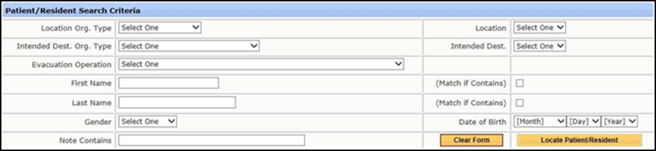
S1:View Patients/Residents by
Sending Location
Click Locate Patient/Resident from the menu bar
Enter at least two search criteria
Click Locate Patient/Resident
Notes:
If a person has never been to your facility, you will NOT be able to search for them.

Slide 52
An individual with a wristband just arrived at the tmp location but was not destined for this location using the eFINDS
Quick Search function.
Search/Reports
Scenario Two

Slide 53
S2: Quick Search
See Quick Search text box (located top right).
Type in search criteria, such as name, barcode, content from the notes section, etc.
Click if needed
Locate record and click the Barcode (Serial ID) link.
Verify: Patient/Resident is found. You can update the information.
View, Add, or change the necessary information.
Click Update Patient/Resident.
If a person has never been to your facility,
you will NOT be able to search for them.
Notes:
You can use the Quick Search find and Update information. You can search by LAST name or by barcode. You would search by name if you were looking for the current location of a patient or resident you evacuated or if your receive someone and the person is not wearing a wristband, or otherwise has a visible barcode. You can also search by notes, all of which can be found in the detail section
Note that there is some privacy built in and if a person was never at your facility, or intended to come to your facility, you will not be able to find them in eFINDs through Quick Search or Locate Patient functions. However, as long as you have the wristband (to scan or manually enter barcode) you can update a patient/resident record in tracking system
Updating a record would be used to add more information or change info. such as correct spelling, DOB, location, notes, etc.
Steps 1-7
Note: the Patient/Resident Tracking History has been updated

Slide 54
The sending facility wants to locate all male patient/residents that were evacuated during this operation using the eFINDS
Patient Locator function.
Search/Reports
Scenario Three

Slide 55
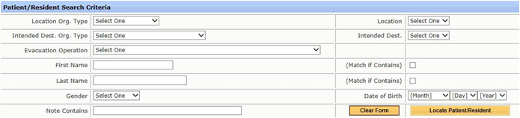
S3: Locate Patient
Click Locate Patient/Resident from the menu bar
Enter at least two search criteria
Click Locate Patient/Resident:
If a person has never been to your facility, you will NOT
be able to search for them.
Notes:
Successfully search for patients/resident using the Locate Patient feature in eFINDS
You must enter at least 2 search criteria….possibly more if the data base is too large (error message)
No reporting feature is available at this time to export the results

Slide 56
Dashboard
Click Dashboard from the menu bar
Select Evacuate Operation
Select Region, Organization Type and County if available.
Select Group by Evacuees (County, Gender or Age)
Click Display Report
Notes:
Note: Reports are available for facilities in your jurisdiction. Jurisdictions are your facility(s), or facilities in your county, region, or agency, such as NYS OASAS, OCFS, OMH, OPWDD, OTDA or DOH. Your role assignment for eFINDS determines what you have the ability to view.
Currently, the Dashboard is designed to provide information for DOH management, LHD management, DOH regional offices and healthcare networks. Additional reports are being built that will be accessible to the facilities and useful during an event to track their evacuees. This scenario is simply to give trainees an awareness of Dashboard functionality, access rules and upcoming types of reports they will be able to access. Trainee feedback and suggestions for reports they anticipate needing will be very useful to gather during this scenario.
Three dashboard reports to support any Evacuation Operation:
1. Evacuees by County 2. Evacuees by Gender and 3. Evacuees by Age.
The data for these reports are grouped by number of Patients/Residents that have been: Evacuated, Received, Shelter-in-Place and Repatriated for any Region, County, and Organization Type.
· By default, the reports are set to display the data as a Bar Chart.
Users can change the report setting to show the aggregated count for the number of Patients/Residents that have been: Evacuated, Received, Shelter-in-Place and Repatriated as a table.
User can filter the data to meet their local need.
Depending on the role assigned, you may not need to select a Region or a County. The system will do that for you. However, if you are in a Regional Role, you may want to select one or all the counties.
If you are a facility user, the system will display the message “Option Not available” for the Region and County.

Slide 57
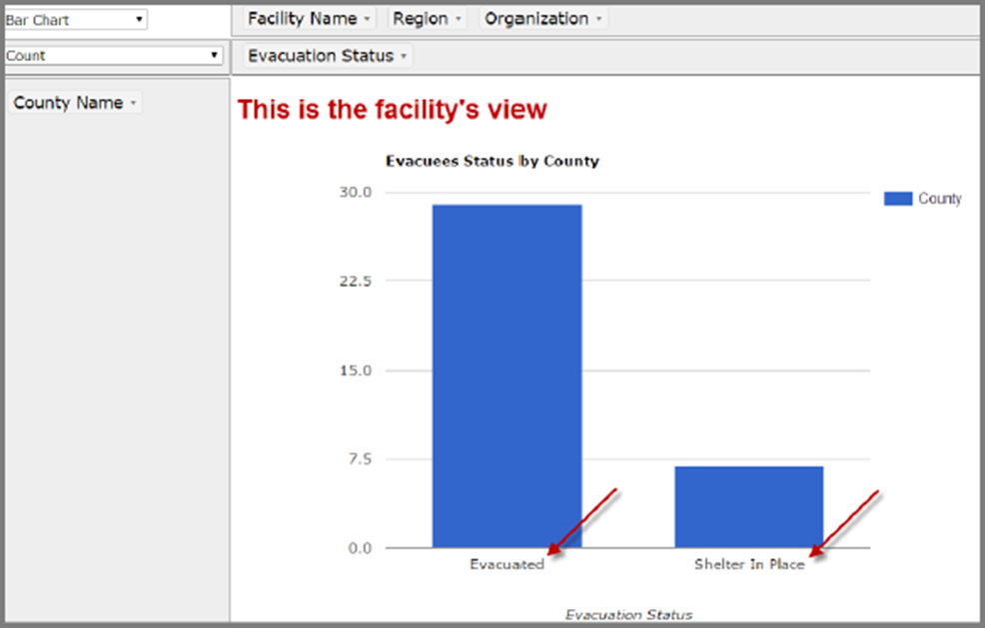
Dashboard
Notes:
This is a dashboard image from a facility’s perspective, based on their one eFINDS role assignment. They only see Evacuated and SiP. This display may change in the future.

Slide 58
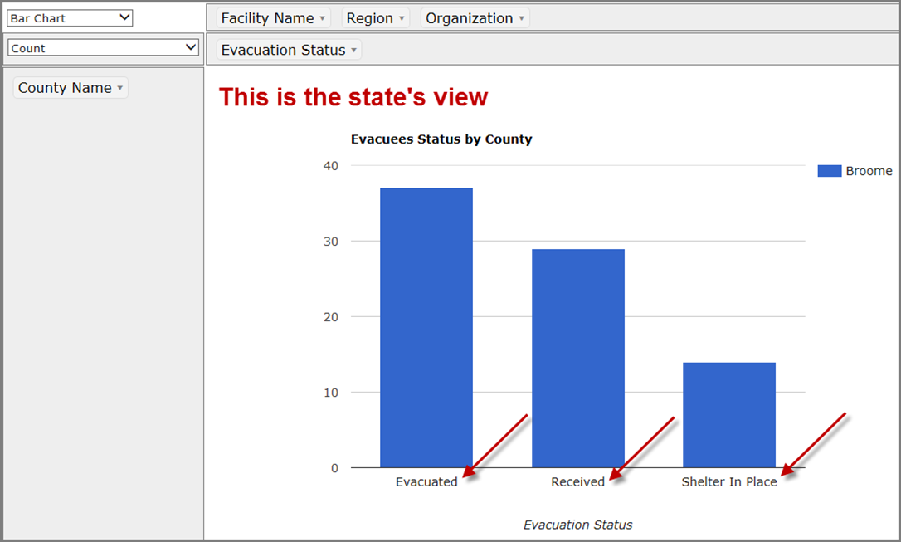
Dashboard
Notes:
From the State Level you can drag the facility name over to customize what you see.
Then you can hover over a bar and reveal the facility name and totals.

Slide 59
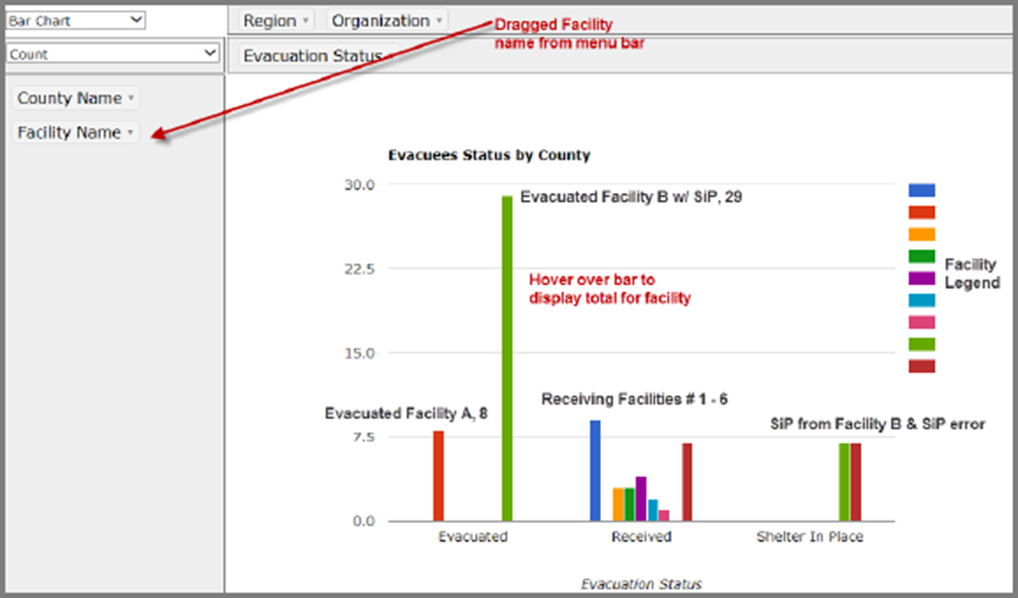
Dashboard
Notes:
From the State Level you can drag the facility name over to customize what you see. Then you can hover over a bar and reveal the facility name and totals.
The next slide shows more detail when you change Bar Chart to Table View

Slide 60
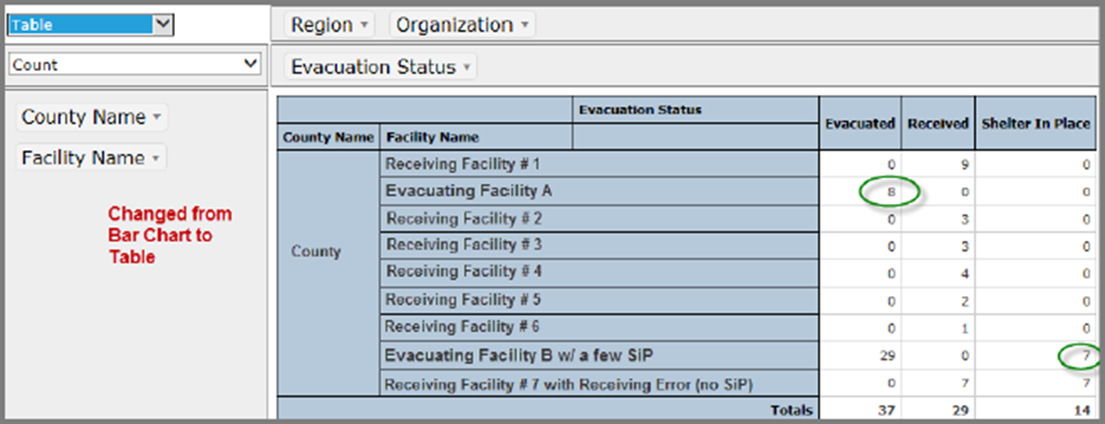
Dashboard
Notes:
Then you can customize further by changing the display type from Bar Chart to Table and view more details. From this display, it looks like patients are still in transit.
See errors in Facility #7, this facility received 7 patients/residents and then changed their status to Shelter in Place.

Slide 61
A-5: HOUSEKEEPING Inactivate TMP & Training Operation
OPERATIONS
1. Click Admin > Manage Operations
Locate/Select Operation
Change Status to Inactive
Click Save Operation
TMP LOCATIONS
1. Click Admin > Manage Locations
Locate/Select TMP Locations
Change Status to Inactive
Click Save Location
Notes:
At the conclusion of a drill/exercise/training please consider inactivating your operation and/or temporary location. This will help clean-up the drop-down list when individuals search for TMPs and Operations. If the location and/or operation is needed again, you can always re-activate it.
You can only inactivate operations/locations that YOU created. You can filter through operations by clicking on “created by” and search for your name alphebetically.

Slide 62
Frequently Asked Questions

Slide 63
FREQUENTLY ASKED QUESTIONS
Q: What if a patient/resident refuses to wear a wristband?
NYSDOH A: Create a person record in eFINDS with associated barcode number. Make sure that a barcode number is written on that persons paper record that is transported with them. Send bracelet along with person paper record.
Q: What if one of my patients/residents is pediatric or just too slim for the bracelet?
NYSDOH A: Carefully wrap the wristband to a size that fits the pt/resident; allow the excess to hang off, but be careful not to cover the barcode number underneath the barcode; if the number is readable, it can be manually entered; if barcode itself must be covered, then assure barcode number is written in accompanying patient record. If an infant just include the barcode number and bracelet as part of the record accompanying the infant so that the receiving facility can enter the barcode and record the receipt of infant. Also can try putting bracelet on the infant’s ankle.
Q: What if some of my patients/residents are sheltering in place?
NYSDOH A: Apply one of your facility wrist bands to that resident as you would for those evacuating to another facility and do not remove for duration of the event. Enter individual’s info in e-FINDS and click to check the “SiP” checkbox.
Notes:
Module 4

Slide 64
FREQUENTLY ASKED QUESTIONS
Q: Can other locations be entered into the system?
NYSDOH A: Yes. Incident specific temporary locations (such as shelters or other locations) can be loaded into eFINDS by NYSDOH or by an eFINDS Reporting Administrator at the facility.
Q: What if I need to send an evacuee to a facility or location that is not available in the “dropdown” destination choices in e-FINDS?
NYSDOH A: Ensure that a “Temporary Location” has been created by your facility’s eFINDS Reporting Administrator, as described above and select that location under the “TMP” location type.
Q: What if one of my residents is going to a family member’s home for the duration of the evacuation?
NYSDOH A: Apply one of your facility wrist bands to that resident as you would for those evacuating to another facility and instruct the family to keep the wristband on until the resident returns to their original facility or is admitted to a new facility. Identify the resident as “Home” in the “Intended Destination” field.
Notes:
Module 4

Slide 65
FREQUENTLY ASKED QUESTIONS
Q: If I receive a call from a family member searching for a loved one and I am not able to access e-FINDS to provide their location, who should family members contact to get the information?
NYSDOH A: The NYSDOH will provide the number for a call center as it had done following Super Storm Sandy that will assist with this type of phone call.
Q: Does a declaration of emergency need to be in effect for eFINDS to be utilized?
NYSDOH A: No, there does not need to be a declaration of emergency in order for eFINDS to be utilized. eFINDS can be and in the past has been used for very localized emergencies at a facility that did not involve a state declaration of emergency.
Q: If a facility is doing an internal evacuation (horizontal or vertical) but staying within the same facility building, do they need to use eFINDS? If yes, how would that work since they are not being accepted into a different facility?
NYSDOH A: No – eFINDS is not required for an internal facility evacuation (horizontal
or vertical within the same building facility.
Notes:
Module 4

Slide 66
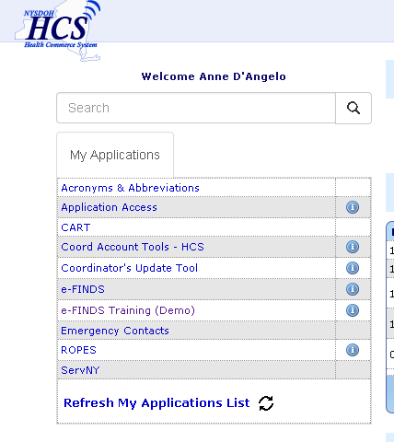
NYSDOH RESOURCES
Self-Guided Walkthrough:
https://apps.health.ny.gov/pub/ctrldocs/e-finds.html
Support Documents on HCS
https://commerce.health.state.ny.us
Implementation Procedure and Job Action Sheet Templates
Application Use Training Guides
Recorded webinar – step by step on eFINDS functions
eFINDS process flow diagram
Scanner specs and pricing
Power point presentations
eFINDS quick reference cards
Current eFINDS training webinar schedules
Notes:
Module 4

Slide 67
NYSDOH RESOURCES
training
request additional barcode numbers be provisioned to facilities conducting training and exercises
exercise support
non-training wristbands (if expended in real event or if there has been an increase in certified bed count, facility name)
send an e-mail to efinds@health.state.ny.us and copy the appropriate NYSDOH RO Representative
Refer to NYSDOH Non-Emergency eFINDS Request Process for further details/instructions

Slide 68
NYSDOH RESOURCES
TECHNICAL
Example Issues:
I cannot find or open eFINDS.
I do not see my facility listed in eFINDS.
Valerie Shuba
DOH ITS
518-473-1809
valerie.shuba@health.ny.gov
Gregory Sweet
DOH ITS
518-473-1809
Gregory.sweet@health.ny.gov
I cannot log into the HCS.
  Contact CAMU help desk: 1-866-529-1890
PROGRAMMATIC
Example Issues:
Implementation Questions
Regulatory or policy issues/concerns
Debra Sottolano
Office of Primary Care & Health Systems Management,
518.485.9914
debra.sottolano@health.ny.gov
Shannon Ethier
Office of Health Emergency Preparedness
518.474.2893
Shannon.ethier@health.ny.gov
Notes:
The Health Commerce System trainers are the team responsible for providing technical assistance with eFINDS, so if you find that you are having a technical issue with eFINDS or the Health Commerce System in general you should contact the Health Commerce System Trainers at the number or email listed on the screen.
Contact the CAMU help desk For password and account questions.
Contact hinweb@health.state.ny.us if you are experiencing technical problems with the site.
For non-technical issues that lean more towards implementation, operations and regulatory concerns, please address those to the Office of Primary Care&Health a Systems Management, Director of Preparedness
Programmatic Questions about eFINDS Implementation/requirements Contacts
As of 3/3/14 – NYSDOH implementation guide has not been released

Slide 69
Vendor Resources
Contact for Purchase of Additional Scanners
To receive the discounted price at the time of purchase,
indicate the scanner is being purchased for the “eFINDS Project”
Charlie Waldman | L-Tron Corporation
P (585) 383-0050 ext. 111 | F (585) 383-0701
596 Fishers Station Dr., Victor, NY 14564

Slide 70

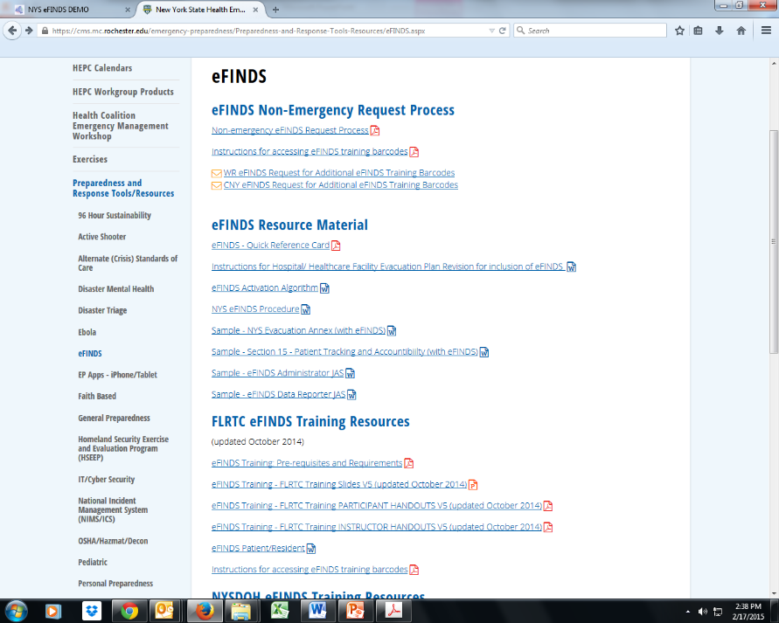
RTC RESOURCES
WRHEPC.URMC.EDU
  preparedness and response tools/resources
  eFINDS
Finger Lakes Regional Training Center
Anne D’Angelo
Phone: (585) 758-7640
anne_dangelo@urmc.rochester.edu
AMC Regional Training Center
Chris Smith
Phone: (518) 262-1070
SmithC12@mail.amc.edu
MARO Regional Training Center
Connie Kraft
Phone: (631) 444-9074
Connie.Cincotta-Kraft@stonybrookmedicine.edu
Notes:
Documents that can be used to incorporate eFINDS into your Evacuation and/ or Disaster Plan can be found:
WRHEPC.URMC.edu
http://www.urmc.rochester.edu/emergency-preparedness/Preparedness-and-Response-Tools-Resources/eFINDS.aspx

Slide 71
QUESTIONS
FEEDBACK
EXPECTATIONS
NEXT STEPS
EVALUATION
CERTIFICATE

