Slide 1

Emergency Operations Activation Levels
Southern Tier Coalition Work Group

Slide 2
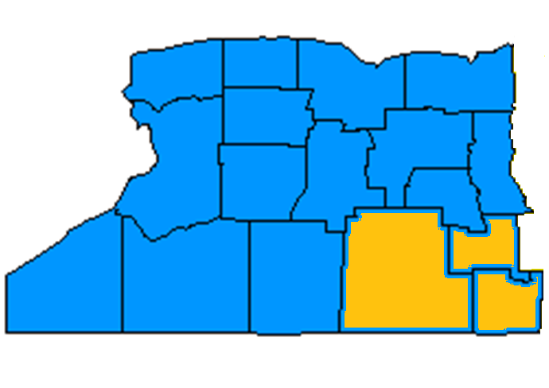

Finger Lakes – Southern Tier
H
H
H
H
H
H

Slide 3
Problem Statement
Develop a plain language Emergency Operations Plan activation level matrix to enhance the common operating picture among healthcare and emergency management agencies.

Slide 4
Background
Hospitals throughout Region use varying means to describe activation levels
  Numbered Levels
  Color Codes
  Plain language descriptors
Plain Language and Common Terminology will help to create a Common Operating Picture for Mutual Aid and Coordinating Agencies

Slide 5
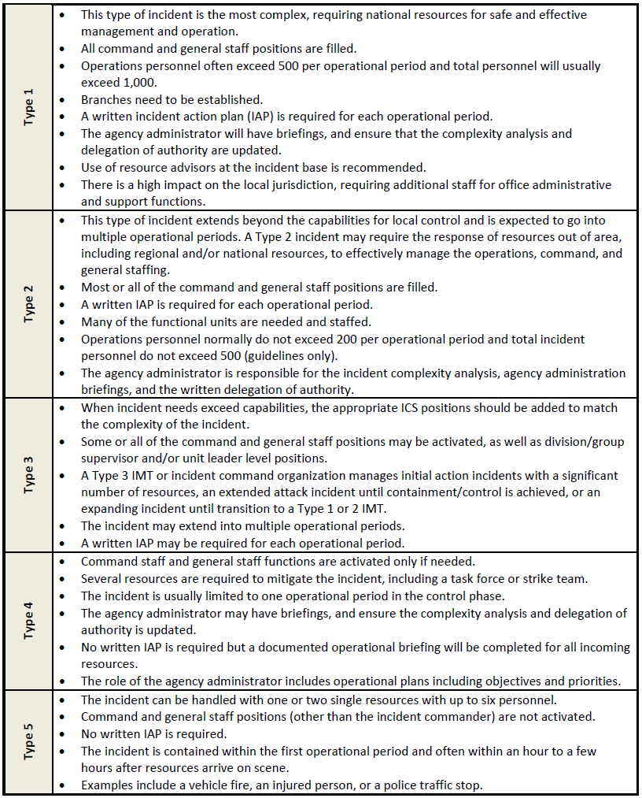
NIMS Incident Types

Slide 6
IS-775: EOC Management & Operations

Slide 7
Steuben County - Hospital Based
Emergency Response Activation Levels
Level 5-Continuous Monitoring: Continuous Monitoring: Routine monitoring of daily situations by Steuben County Emergency Services and local agencies, this could include; International, National, State or Local issues. Hospitals should use pre-existing means to monitor daily activities and maintain a posture of readiness.
Level 4 – Limited Activation: Activation select Hospital staff to more closely monitor a developing situation or an incident with the potential for limited impact. This condition can also be defined as partial mobilization. An additional phase of Limited activation is Advance Readiness.
Level 3 – Partial Activation: Activation by one or more appropriate departments to respond to discipline-specific events; or to more closely monitor a developing situation or an incident with potential impact; or potential for impending strike.
Level 2 – Full Activation: Activation of the Hospitals Internal or External disaster plan to respond to an emergency or disaster situation that may have a broad and potentially devastating impact on the local community or hospital facility.
Level 1 – Full Activation with State and National Response Framework (NRF) Coordination: A event warranting this level of activation will most likely result in a Presidential Disaster Declaration of “Major Disaster” or “Emergency” and significant local, state and federal government involvement.

Slide 8
Empire CEMP Template
Level 1: Alert/Notification Information received indicating a situation or event that will have an actual or potential unusual impact on facility operations.
Level 2:Minor Impact An actual situation or event that is having a minor unusual impact on facility operations.
Level 3: Moderate Impact An actual situation or event that is having a moderate unusual impact on facility operations.
Level 4: Major Impact An actual situation or event that is having a major unusual impact on facility operations.

Slide 9
Recommended Activation Levels
Normal Operations: Normal activities; No alteration to routine operations
Monitoring and Assessment: Monitoring a specific threat, unusual event or situation: HCC likely not activated
Partial Activation: Coordinate response to minor incident, or prepare for major event; Tailored HCC activation; Limited to one Operational Period
Full-Scale Activation: Coordinate response to major incident; Plan for response, demobilization & recovery; Full HCC & hospital activation: Extends to multiple Operational Periods

Slide 10
Activation Level | Definition/ Parameters |  | Authority to Activate | Anticipated HICS Activation | Notifications
Monitoring & Assessment | Typically a monitoring and assessment phase where a specific threat, unusual event, or situation, is actively monitored by the hospital |  | Incident Commander Nursing Supervisor Administrator on Call | Incident Commander | Administrator on Call Switchboard Other departments/ units/managers as conditions warrant Local government/ public safety/ public health / EOC (if services, support, or information needed)
 | Emergency Department and Clinical Factors
 | Patients from single event | XX actual patients or expected patients
 | ED waiting time | Greater than or expected to be X hours
 | Logistical Factors
 | HCC | Unlikely to be open
 | Facilities | Physical plant or utility real or expected disruption that is limited, contained, and/or has a minor impact on operations (e.g., a partial system failure; failure of a non-mission-critical system)
 | Staff | XX % of staff not available or not expected for duty
 | Supplies/Materiel | Actual or projected supply shortage of non-critical items, or <XX hours supply remaining of critical items
 | Internal occupancy | Real or expected need for horizontal evacuation of patients/visitors/staff
Casualty Care Group Activation/ Response | An immediate or imminent situation arising in the Emergency Department meets EOP activation criteria. Examples: Unexpected arrival of multiple or contaminated casualties Incident notification received in the ED from a public safety source indicating the impending arrival (within 15 minutes) of multiple patients from an incident Outbreak of a disturbance, fire, or unusual situation in the ED |  | ED Charge Nurse (Casualty Care Group Supervisor) | Casualty Care Group Supervisor Triage Unit Leader Immediate Treatment Leader Delayed Treatment Leader Minor Treatment Leader | Incident Commander –designee: Administrator on Call (Business Hours) Assistant Director of Nursing (all other times)

Slide 11
Activation Level | Definition/ Parameters |  | Authority to Activate | Anticipated HICS Activation | Notifications
Partial Activation | Typically limited hospital activation |  | Incident Commander, in consultation with AOC | Incident Commander Operations Section Chief Logistics Section Chief Planning Section Chief Finance/ Administration Section Chief Command Staff Liaison Officer Safety Officer Public Information Officer Medical / Technical Specialists as needed Branches / divisions / groups / units / individual resources as needed | Administrator on Call Emergency Department Director & Charge Nurse Emergency Preparedness Coordinator Environmental Services Supervisor Facilities Engineering Supervisor Health System EOC Nursing Administration Safety Officer Switchboard Other departments/ units/managers as conditions warrant Local government/ public safety/ public health / EOC (if services, support, or information needed)
 | Emergency Department and Clinical Factors
 | Patients from single event | >XX actual patients
 | ED waiting time | >X hours
 | Increase in ED patient census | >XXX % above normal over X hours
 | Increase in in-patient census (surge) | >XX% patients admitted above staffed bed count
 | Logistical Factors
 | HCC | Open
 | Facilities | Physical plant or utility disruption affecting a mission-critical area or system; or general operations
 | Staff | >XX% of staff not available for duty
 | Supplies/ Materiel | Actual or projected supply shortage of critical items, or 2XXhours supply remaining of critical items
 | Internal occupancy | Need for vertical evacuation of patients/visitors/staff from one floor of a building
 | Event duration | Event lasting greater than X hours

Slide 12
Activation Level | Definition/ Parameters |  | Authority to Activate | Anticipated HICS Activation | Notifications
Full Activation | An actual incident with a major unusual impact on hospital operations. |  | Incident Commander, in consultation with AOC | Incident Commander Operations Section Chief Logistics Section Chief Planning Section Chief Finance/ Administration Section Chief Command Staff Liaison Officer Safety Officer Public Information Officer Medical / Technical Specialists as needed Branches / divisions / groups / units / individual resources as needed | Administrator on Call Emergency Department Director & Charge Nurse Emergency Preparedness Coordinator Environmental Services Supervisor Facilities Engineering Supervisor Health System EOC Nursing Administration Safety Officer Switchboard Other departments/ units/managers as conditions warrant Local government/ public safety/ public health / EOC (if services, support, or information needed)
 | Emergency Department and Clinical Factors
 | Patients from single event | >XX actual patients
 | ED waiting time | Greater than XX hours
 | Increase in ED patient census | Greater than XXX% above normal over X hours
 | Increase in in-patient census (surge) | xx patients admitted above licensed bed count
 | Logistical Factors
 | HCC | Open
 | Facilities | Physical plant or utility disruption affecting a major or mission-critical area or system; or general operations
 | Staff | XX% of staff not available for duty
 | Supplies/ Materiel | Actual or projected supply shortage of critical items, or XX hours supply remaining of critical items
 | Internal occupancy | Need for vertical evacuation of patients/visitors/staff from one floor of a building
 | Event duration | Event lasting greater than X hours

Slide 13
Recommendation
That WREPC healthcare agencies consider the adoption of the plain language Emergency Operations Plan Activation matrix.

