Slide 1
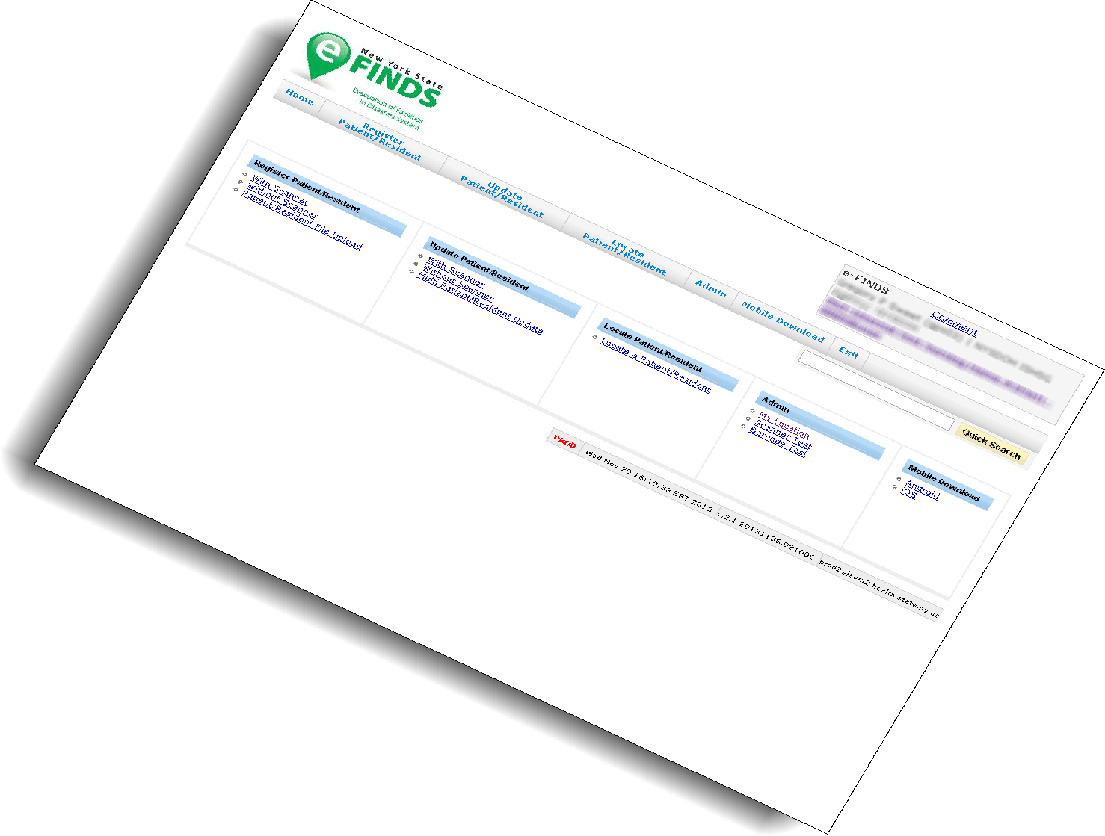
Finger Lakes Region Training

Slide 2
Agenda
e-FINDS INTRODUCTION
HANDS-ON EXERCISES
Administrative
A-1: Download Patient/Resident Tracking Sheet (PDF barcode sheet/paper log)
A-2: Create an Operation for a training, exercise, event
Evacuate
E-1: Evacuate a single patient or resident
E-2: Register multiple patients or residents through the web page (admins only)
E-3a-c: Create a fillable spreadsheet (admins only), fill it in and upload
E-4: Update/Release a batch of patients or residents from the evac. Facility
Receive
R-1: Receive a single patient or resident
R-2: Check in (Receive) a batch of patients or residents at the receiving facility
Search
S-1: eFINDS patients by original location
S-2: eFINDS patients at current location
S-3: Identified incoming eFINDS patients
S-4: Patient Location/Quick Search Functions
TEST/SCENARIOS (Optional)
Notes:
This is what we hope to accomplish during today’s session:
BRIEF Overview of eFINDS (more indepth review was covered during the NYSDOH Webinar roll-out) followed by several hands-on training exercises

Slide 3
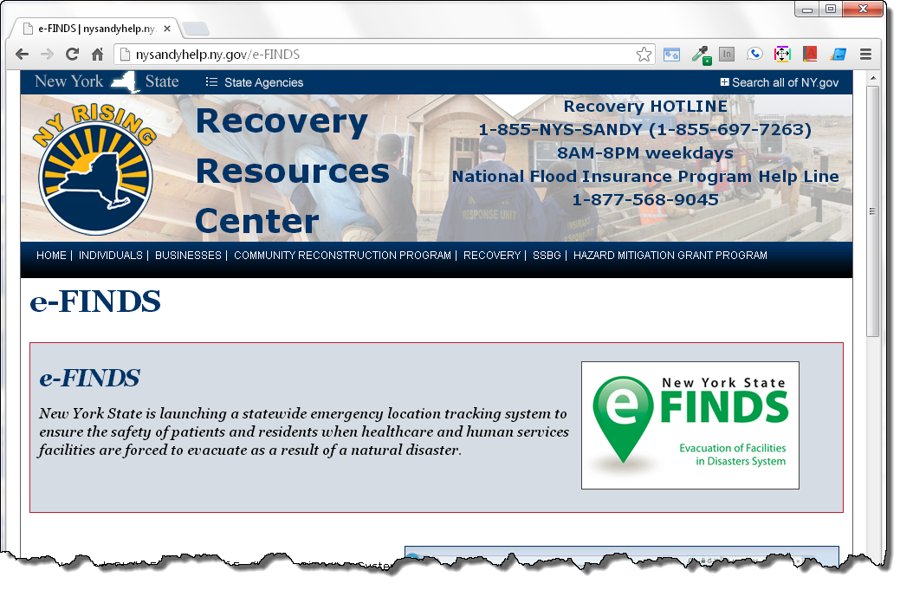
e-FINDS
Notes:
What is e-FINDS?
Secure, real time & easy to use common platform for sharing patient and resident location information - Used for incidents, events or practice exercises when facilities need to relocate their patients or residents
The system captures minimal amounts of data, can accommodate multiple updates and allow facilities to track their patient’s and resident’s movement to other facilities, including temporary shelters. More importantly, where ever the patient/resident resides, the system has hard coded the original location, that is, the location they will return to.
** The application is time saving, especially for the evacuating facilities. At the very minimum, the evacuating facilities will only need place the barcoded wristbands on their patient/residents and send them to a safe location. The receiving locations can scan wristbands, and update the location information when they arrive.
eFINDS merely tracks patients and in no way is meant to be an electronic medical record.

Slide 4
Other/Existing Patient Tracking Forms? (Internal, MAP)
eFINDS does not replace other tracking forms and procedures for tracking within the facility
Patient/ Resident wristband used for identification
Patient/ Resident “Evacuation Tag”
“Go Pouch”
Internal tracking (Unit to staging area to portal?)
HICS Tracking Log
Notes:
eFINDs is used in conjunction with internal methods to track and document the patient and associated equipment, such as the Patient Evacuation Tag, and hospital identification wrist band.The patient’s wrist identification band verifies initial identity.
A GO Pouch with chart and clinical information may be used/ affixed to the patient. Basic clinical information such as medications and treatments may also be entered into the eFINDS patient record.

Slide 5
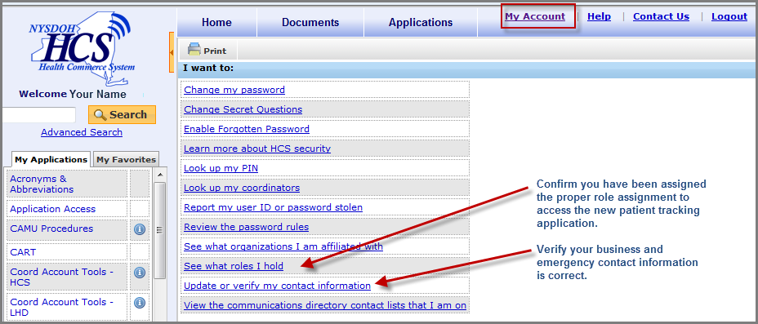
Your HCS Person Record
Notes:
Because e-FINDS is a role based application, once you are added to an e-FINDS role, the application will appear in your My Applications list in the left side panel.
e-FINDS can also be access from the main list of applications.
To verify your role assignment, go to the My Account link and click See what roles I hold. If you are not in an e-FINDS and would like to be, then click on the Look up my coordinators. They are the ones who will add you to the role.
FRIENDLY REMINDER: To ensure that you receive timely communications from your county health department and/or the state, please make sure your business and emergency contact information is correct and updated. To do so, click on the Update or verify my contact information.

Slide 6
e-FINDS Roles
Data Reporter | Reporting Administrator
Register patient/resident Update patient/resident Information Upload patient/resident file | Same as data reporter Generate the paper log file Generate patient/resident barcodes spreadsheet Register multiple patients/residents without pre-printed barcode wristbands via the website Create an Operation
Notes:
eFINDS is a commerce based-application and relies on Communications Directory role assignments to access the system. There are two roles for healthcare facility employees that provide access (facility permission assignments)
1. The e-FINDS Data Reporter can register patients/residents in the system with or without a scanner, one at a time or multiples by using the e-FINDS spreadsheet provided by the e-FINDS Admin. They can also update with or without a scanner, one at a time or more than one.
2. The e-FINDS Reporting Administrator role can accomplish more tasks such as: generate a PDF of used and unused barcodes, generate a spreadsheet that can be populated with patient/resident information and uploaded by the e-FINDS Data Reporter. The Admin also has the ability to register multiple patient/residents, at a time, without scanning the barcodes.
**Because the Admin can do everything that a data reporter can, you only need to be added to the admin role; both roles are not needed. Also, a facility can have more than one person assigned to either role.

Slide 7
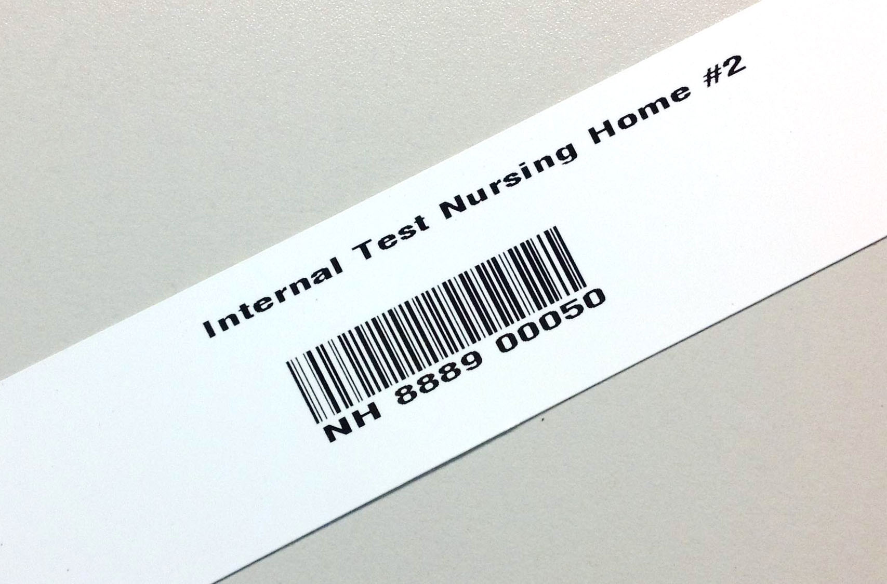
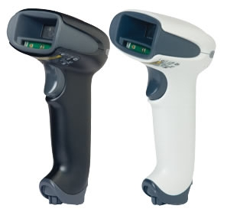
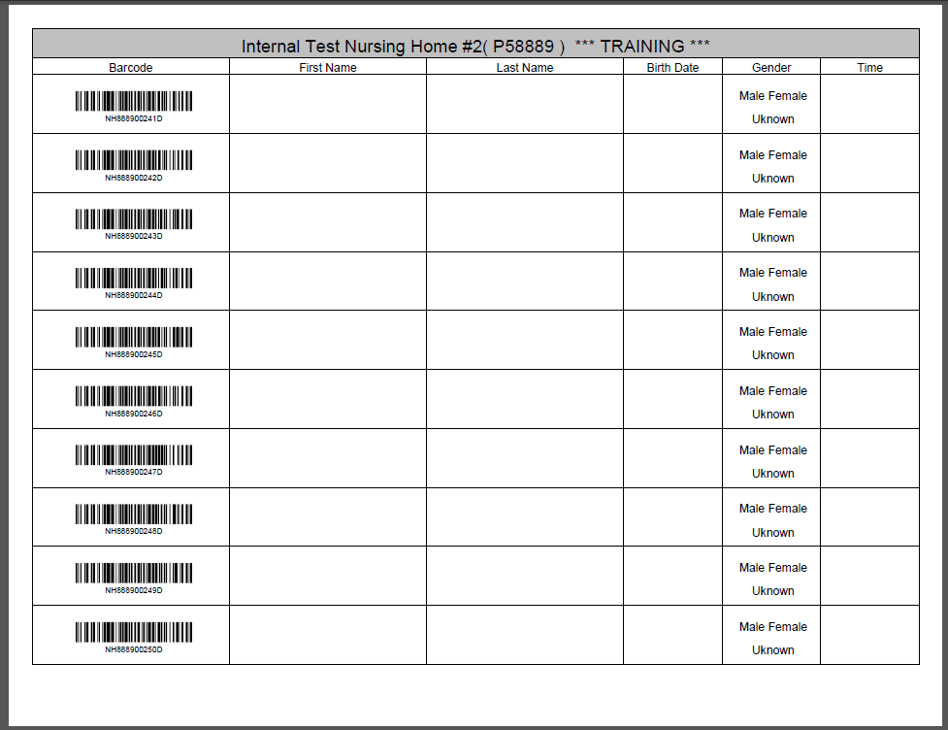
e-FINDS Supplies and Equipment (supplied by NYSDOH)
Notes:
Each facility received a number of wristbands, based on the licensed bed, and the corresponding log sheets.
The barcodes provided will have a special sequence number used solely for your facility to allow for better patient and resident relocation management. Each wristband will contain the facility name, a scannable barcode, and the barcode number. If needed, you can even write on them.
The barcodes on the wristband have a prefix that corresponds to the type of facility (HO, NH, ACF) followed by your agency’s unique identifier code, followed by a changing number sequence
Facilities also be received a small set of training bands (16). You will clearly know that they are for training, because they are marked for training in two places, and the barcode number ends in a D for demo. Training wristbands can only be used in the e-FINDS Demo application and the production bands are only recognized in the production e-FINDS. The bands cannot be used in the wrong application by mistake.
If additional training barcodes are needed, please email a request to the Health Commerce System Trainers noted at the beginning of the presentation and they will add more to the system/application.
Each facility also received one bar code scanner select to work with the e-FINDS application. The budget only provides for one scanner per facility.
Other hospital scanners do work with the eFINDS program but because they are not “programmed” use of non-DOH scanners may require a manual “enter” with the keyboard
Finally, each facility received a copy of their facility paper log – which contains facility name, a space for a patient/resident’s first name, last name, date of birth and gender. These logs can be used if a facility has no power or not internet.

Slide 8
e-FINDS Supplies and Equipment (supplied by facility)
Additional Handheld Scanner(s)
Computer (laptop, WOW) with internet/ Health Commerce System access
eFINDS Quick Reference Card
Evacuation Annex (eFINDS Policy and Procedures)
Where is stuff located in your facility?
What is the access procedure? Who, when?
Notes:
Facilitator/ trainer should review the procedures and locations where the equipment can be accessed. Is it a 24/7 process, or differences day and off shifts.

Slide 9
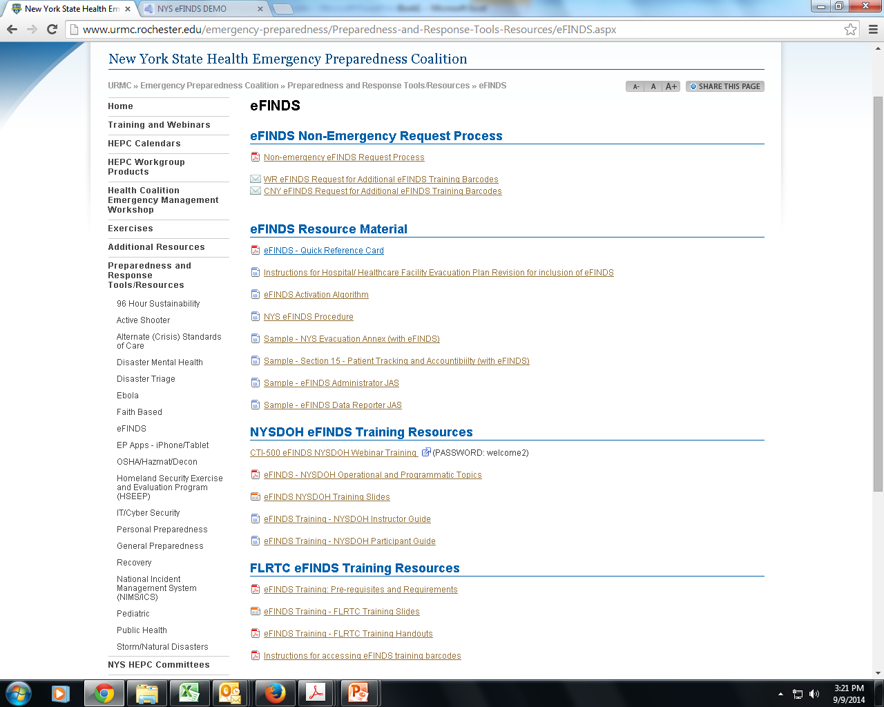
eFINDS Planning/Resource Documents
WRHEPC.URMC.EDU
preparedness and response tools/resources
eFINDS
Notes:
Documents that can be used to incorporate eFINDS into your Evacuation and/ or Disaster Plan can be found:
WRHEPC.URMC.edu
http://www.urmc.rochester.edu/emergency-preparedness/Preparedness-and-Response-Tools-Resources/eFINDS.aspx

Slide 10
Considerations for Implementation
Full Evacuation
Partial Evacuation
Emergent (immediate) Evacuation
Urgent Evacuation
Planned Evacuation
**as designated by the Evacuation Plan and the Incident Commander at the time of the incident**
REMEMBER
At the very minimum, the evacuating facility will only need to place the barcoded wristbands on their patient/residents and send them to a safe location
Notes:
Emergent Evacuation
Imminent circumstances making immediate evacuation essential (e.g., an uncontrolled fire, physical plant, security, or environmental emergency). Any delay in evacuation is potentially life-threatening.
Urgent Evacuation
Impending circumstances that potentially render the environment of care unsafe or inhospitable, or that may adversely impact the provision of patient care or ancillary services, where evacuation must commence within four hours in order to maintain a suitable environment to allow a unit/department to fulfill its mission (e.g., a physical plant, environmental, or mission-critical system problem that is not correctable within a short time frame).
Planned Evacuation
Circumstances are anticipated that require relocation of patient care or ancillary service activities within not less than 48 hours, or where ample time exists to inform patients and staff, plan activities, mobilize resources, and control the relocation without extraordinary measures (e.g., a planned alteration in physical plant, environmental, or staffing conditions). This type of evacuation normally will be anticipated several hours to days in advance.
Keep in mind, eFINDS:
Allows communication on patient locations between facilities.
Patient/ resident data can be entered, and their location updated and tracked using and-held scanners, mobile applications, or paper tracking.
** The application is time saving, especially for the evacuating facilities. At the very minimum, the evacuating facilities will only need place the barcoded wristbands on their patient/residents and send them to a safe location. The receiving locations can scan wristbands, and update the location information when they arrive.

Slide 11
Log into HCS Open Evacuation of Facilities in Disasters System Demo Select your current location from drop down list click SUBMIT pair up with another facility You will be evacuating and receiving 7 patients/residents
TRAINING EXERCISES
Notes:
Let’s go out to eFINDS DEMO application on the Health Commerce System, and walk through some practice scenarios. For demonstration purposes, we will act as both an evacuating and receiving facility during concurrent events. The training scenarios are outlined in the participant guide, so please follow along.
***Demonstration Begins - Please refer to the Participant Guide for Scenarios***

Slide 12
Training Exercise (A-1)
Generate a Paper Log PDF
e-FINDS Administrator Role Only
1. Click Manage Barcodes > Generate Barcodes Spreadsheet.
2. Select or verify the current location.
Enter Start and End barcode numbers, e.g., 4—13 for ten
patient/residents to be relocated.
Select the PDF if you want a scannable barcode log OR select
EXCEL for the upload patient/resident option.
5. Click Generate.
6. Print the PDF OR save the Excel spreadsheet to your computer.
Notes:
eFINDS also allows you to download and print a paper log that can be used to track patients if you don’t have power or internet. You get one copy of the paper log with your kit from NYSDOH, which can be useful just to see what your barcode numbers are. If lost or misplaced you can create additional copies of the paper log.
Follow Steps 1-6
Please note the differences between the PDF and Excel options:
PDF FILES:
- cannot be electronically updated or uploaded, but could be data can be hand written and sent with transport
contains a scannable barcode.
provides a list of ALL barcodes allotted to your facility but notes which barcodes have been used. (without inputting patient data)
EXCEL FILES:
Can be electronically updated and uploaded to eFINDS system
Does not contain scannable barcodes
Defaults to the first available/unused barcode in your sequence

Slide 13
Training Exercise (A-2)
Create an Operation
e-FINDS Administrator Role Only
1. Click Admin > Manage Operations.
2. Enter Operation Name, Description, Dates
3. Click Add Operation.
Please Note: Operation names must be unique
Check list of existing operations first
Notes:
An operation is the reason for the evacuation. It simply refers to the event, incident or drill. Please keep in mind that multiple operations can happen concurrently or simultaneously, so be sure to make the correct operation selection. The determined eFINDS operation can be added to the application by an eFINDS Reporting Administrator OR your state or state agency eFINDS administrator.
Reporting Administrators have the ability to create an operation for a training, exercise or event.
Follow Steps 1-3
Please Note: Operation names must be unique. Check list of existing operations first.

Slide 14
Training Exercise (E-1)
Evacuating Facility - Register Single Patient/Resident
1. Scan a barcode OR click Register Patient/Resident > With Scanner
OR type the barcode number into the field
2. Confirm message: Barcode is located. You can register a new Patient/Resident with it.
3. If time allows, enter first name, last name, date of birth (mm/dd/yyyy), gender, etc.
4. Verify the Evacuation Operation (required field input)
5. Verify the patient/resident current location is correct.
6. Select the Intended Destination Organization type (HO, NH, ACF)
7. Select the Intended Destination (this is your partner’s organization).
8. Enter the Bulk Group; such as bus no. or transportation description.
9. Click Register. If the required fields are not complete, you will receive an error message.
Click Override to bypass the error.
10. Confirm message: Patient/Resident info is updated.
REGISTER 2 PATIENTS/RESIDENTS USING THIS PROCESS
At the very minimum, the evacuating facilities will only need to place the barcoded wristbands on their patient/residents and send them to a safe location. The receiving locations can scan wristbands, and update the location information when they arrive.
Notes:
Our first exercise is to register a single patient into eFINDS. In this case, we will assume that we have sufficient lead time to place wristbands on the patients and scan them into eFINDS for registration. Again if you do not have wrist bands with your today, work from your paper log.
Steps 1-10
REMEMBER: At the very minimum, the evacuating facilities will only need place the barcoded wristbands on their patient/residents and send them to a safe location. The receiving locations can scan wristbands, and update the location information when they arrive.
However, if the evacuation facility is able to scan a patient, the minimum field input must be the EVACUATION OPERATION (ie: training demo or FLurricane 2014)

Slide 15
Training Exercise (E-2)
Evacuating Facility: Register Multiple
e-FINDS Administrator Role Only
1. Click Register Patient/Resident > Multi Patient/Resident Input.
2. Verify/Change Evacuation Operation and Current Location.
3. Select Intended Destination.
4. Enter the number of barcodes to be assigned.
5. Click Generate Fillable Spreadsheet.
6. Enter known information, such as first name, last name, date of birth (mm/dd/yyyy),
and gender.
7. Click Save all Patient/Resident.
8. Verify message: Successfully saved {correct # being evacuated} Patient/Resident
and click barcode to view or update the patient or resident information.
REGISTER 3 PATIENTS/RESIDENTS USING THIS PROCESS
Notes:
If you are running short on time you have the option to register multiple patients. This is especially useful for a group of patients going to the SAME destination and perhaps on the SAME transportation vehicle. The eFINDS administrator has the option of registering patients en masse through the web interface.
Please use 3 of your paper patients and follow steps 1-8
NOTE: system defaults to the FIRST available unused barcode in your sequence. Before you enter patient information on the web-interface, verify that the barcode listed matches up with the barcode number on your patients/residents wristband

Slide 16
Training Exercise (E-3a)
Evacuating Facility: Generate a Fillable Spreadsheet for Upload
e-FINDS Administrator Role Only
1. Click Manage Barcodes > Generate Barcodes Spreadsheet.
2. Select or verify the current location.
3. Enter Start and End barcode numbers, e.g., 4—13 for ten patient/residents
to be relocated OR leave it blank for a list of all available barcodes
4. select EXCEL for the upload patient/resident option.
(note: select the PDF if you want a scannable barcode log)
5. Click Generate.
6. Save the Excel spreadsheet to your computer (DON’T Change file name)
Note: PDF files cannot be uploaded, but could be sent with transport.
The Excel file can be updated with patient/resident information and uploaded to e-FINDS. See upload instructions on next slide.
Notes:
For this exercise we will learn how to download, fill-in and upload the “Fillable Spreadsheet.” Only the eFINDS administrator can generate (download) the spreadsheet. Anyone can fill-in the spreadsheet offline. You may consider using this if you have a stable/static population and want to maintain the spreadsheet off line to be ready if and when an evacuation is called for. This process also allows clerical, non-commerce users to enter the patient data electronically (offline) – for later upload into the eFINDS system.
The First step is for the eFINDS admin to generate the spreadsheet
Steps 1-6
NOTE: The spreadsheet can be opened in Microsoft Excel or Open Office and can be transmitted electronically around your facility. Do not change the file name however as the filename designates the spreadsheet as a valid, uploadable file. If you change the file name the file upload will fail.

Slide 17
Training Exercise (E-3b)
Evacuating Facility: Update the Fillable Spreadsheet for Upload
1. Open the spreadsheet from your desktop
2. Enable editing
3. Register 2 patients by entering data onto spreadsheet.
4. Click Save
Notes:
Now you are the user who received the Excel file
Steps 1-4
NOTE: system defaults to the FIRST available unused barcode in your sequence. If you use this process you need to ensure that the wristbands placed on the patients match the barcode numbers on the spreadsheet!!

Slide 18
Training Exercise (E-3c)
Evacuating Facility: Upload the Fillable Spreadsheet
1. Select or verify location
2. Click Register Patient/Resident from the main menu bar
3. Select Patient/Resident File upload
4. Verify Evacuation Operation and current location
5. Click Open File button
6. Locate Excel file with saved patient/resident information (nys_eFINDS file
name with facility id, date and time) Note: PDF files cannot be upload
7. Click Open to add file
8. Click Upload button
9. Verify Patient/Resident Info is updated below
10. Edit information if needed
11. Click Save All Patients/Residents
Notes:
The next step is to upload the fillable spreadsheet to eFINDS. While it takes an administrator to create the file any eFINDS user – administrator or data reporter – can upload the file.
Return to eFINDS
Follow STEPS 1-11
NOTE: If the Excel file has no patient or resident information, then the file cannot be uploaded
NOTE: This process does not allow you to select the intended destination – so you will need to use the multi-patient update to set the intended destination.

Slide 19
Training Exercise (E-4)
Evacuating Facility: Updates Multiple Patient/Resident
e-FINDS Administrator Role Only
1. Click Update Patient/Resident > Multi Patient/Resident Update.
2. Verify your location.
3. Select the Action Type: Releasing Patient/Resident From this Location
4. Select the Intended Destination.
5. Enter the Bulk Group, for example transport via bus.
6. Click Load All Patient/Resident.
7. Select All OR select Update for each patient/resident.
8. Click Release Selected Patient/Residents.
9. Verify Successfully updated {#} Patient/Resident.
UPDATE the 2 PATIENTS/RESIDENTS
Notes:
In order to set the intended destination for the residents/patients that you uploaded, you will utilize the UPDATE function on eFINDS. When you choose “release patient from this location” you can select the destination.
NOTE: the default MIGHT be “select all”….make sure to un-check that button.
Follow steps 1-9 to set the Intended destination

Slide 20
Prepare to Evacuate/Receive
Exchange 7 patients/residents with your partner facility
Notes:
Write the barcode on your paper patient OR staple/stick the wristband on the paper patient

Slide 21
Training Exercise (R-1)
Receiving Facility: Update Single Patient/Resident
1. Click Update Patient/Resident > With Scanner
2. Scan barcode and click Submit, if necessary.
3. Enter or confirm information, including Evacuation Operation and the current
patient/resident location.
Click Update or Override.
Confirm message: Patient/Resident info is updated
RECEIVE/UPDATE 2 PATIENTS/RESIDENTS USING THIS PROCESS
Notes:
Switching gears - now you are the receiving facility. A patient has just arrived from an evacuating facility. All patients/residents have barcoded wristbands, and need to be checked in. remember if you have the scanner you can use it – it will be faster, but you can always type the numbers in as well.
Steps 1-5
And that’s it/ Receiving a patient in eFINDS is nothing more than updating the current location to your facility.

Slide 22
Training Exercise (R-2)
Receiving Facility: Receive a Group of Patients
e-FINDS Administrator Role Only
1. Click Update Patient/Resident > Multi Patient/Resident Update.
2. Verify your location.
3. Select Checking in Patients/Residents into this location.
4. Verify the patient or resident is correct.
5. Click Select All OR Update for each patient or resident being received.
6. Click Check in Selected Patient/Resident.
Confirm Message: Successfully updated {correct #} of Patient/Resident.
RECEIVE/CHECK-IN 5 PATIENTS/RESIDENTS USING THIS PROCESS
Notes:
Switch gears – you are not the receiving facility again and you need to receive the group of patients that just arrived from your partner facility.
Follow steps 1-7
NOTE: This procedure can be used to view any/all “registered patients” intended to come to your facility. Make sure you only “check in” patients that have actually arrived.

Slide 23
Training Exercise (R-3)
Update File OR Redirect to Another Facility/Home/Shelter
1. Click Update Patient/Resident > With Scanner
2. Scan a barcode and click Submit, if necessary.
3. Change the patient or resident’s intended destination.
4. Click Register, Update, or Override.
5. Confirm message: Patient/Resident info is updated.
.
Notes:
Patient records may be updated as many times as needed. For example, an intended destination needs to be changed for a patient/resident already registered in the system.
Note: when sending patients home or to a shelter there is no way to verify “arrival” through eFINDS. One best practice suggestion is to develop ground rules or policy that once the patient/resident physically leaves the facility a note is added to the “bulk group” section of the patient/resident file. The change will be reflected in the updated time stamp of the patient/resident file
Follow steps 1-5 to update a patient from the previous exercise

Slide 24
Training Exercise (S-1)
View All Patients by Original Location
1. Click Update Patient/Resident > Without Scanner
Verify Correct Location
Click Search barcode by Original Location
list contains all “ORIGINAL” patients from any evacuation operation your facility was involved in and their current location

Slide 25
Training Exercise (S-2)
View All Patients at YOUR Location
1. Click Multi Patient/Resident Updates
Verify Correct Location
Select Releasing Patient/Resident from this location
Click Load All Patients/Residents
Provides a list of all eFINDS registered patients/residents currently within your facility – either registered by your facility for evacuation (not yet received by accepting facility) or accepted into your facility by an evacuating facility
Notes:
NOTE: the patients will still remain on this list even if they have been released. They come off the list once the patient has been received by an accepting facility.

Slide 26
Training Exercise (S-3)
View Incoming Patients
1. Click Update Patient/Resident > Multi Patient/Resident Update.
Verify your location.
Select Checking in Patients/Residents into this location.
Click Load All Patients/Residents
Do not check-in patients/residents until they actually arrive to your facility!
Notes:
Contains a list of any eFINDS registered patients intended to come to your facility. In other words, an evacuating facility selected your facility as the intended destination.

Slide 27
Training Exercise (S-4)
Quick Search
1. Click Home on the e-FINDS menu bar.
2. Scan a barcode, enter a barcode number, OR enter first or last name in
Quick Search (located top right).
If necessary click Quick Search.
3. Locate the correct patient/resident record.
4. If you search by name, Click the Barcode (Serial ID) link.
5. Verify: Patient/Resident is found. You can update the information.
6. View, Add, or change the necessary information.
7. Click Update Patient/Resident.
If a person has never been to your facility,
you will NOT be able to search for them.
Notes:
You can use the Quick Search find and Update information. You can search by LAST name or by barcode. You would search by name if you were looking for the current location of a patient or resident you evacuated or if your receive someone and the person is not wearing a wristband, or otherwise has a visible barcode.
Note that there is some privacy built in and if a person was never at your facility, or intended to come to your facility, you will not be able to find them in eFINDS.
Updating a record would be used to add more information or change info. such as correct spelling, DOB, location, notes, etc.
Lets find the person who needs to be updated.
Steps 1-7
Note: the Patient/Resident Tracking History has been updated

Slide 28
eFINDS Planning/Resource Documents
WRHEPC.URMC.EDU
preparedness and response tools/resources
eFINDS
Notes:
Documents that can be used to incorporate eFINDS into your Evacuation and/ or Disaster Plan can be found:
WRHEPC.URMC.edu
http://www.urmc.rochester.edu/emergency-preparedness/Preparedness-and-Response-Tools-Resources/eFINDS.aspx

Slide 29
Non-emergency eFINDS Requests
training
additional barcodes for training
exercise support
additional barcode creation for exercise
non-training wristbands (if change in certified bed count)
send an e-mail to efinds@health.state.ny.us and copy the appropriate NYSDOH RO Representative
Refer to NYSDOH Non-Emergency eFINDS Request Process for further details/instructions

Slide 30
Technical Questions
I cannot log into the HCS.
I cannot find or open eFINDS.
I do not see my facility listed in eFINDS.
Contact CAMU help desk: 1-866-529-1890
Contact the Health Commerce System Trainers
Usually available Monday—Friday 8:30 a.m. to 4:30 p.m.
518-473-1809 option 2
hcsoutreach@health.state.ny.us
Mac-Arthur Louis: mxl22@health.state.ny.us
Notes:
The Health Commerce System trainers are the team responsible for providing technical assistance with eFINDS, so if you find that you are having a technical issue with eFINDS or the Health Commerce System in general you should contact the Health Commerce System Trainers at the number or email listed on the screen.
Commerce Trainers
518-473-1809
hcsoutreach@health.state.ny.us
Contact the CAMU help desk For password and account questions.
Contact hinweb@health.state.ny.us if you are experiencing technical problems with the site.
Account Issue
CAMU 1-866-529-1890

Slide 31
Regulatory/Implementation Questions
For Non-Technical Issues
examples:
Implementation Questions
Regulatory or policy issues/concerns
Contact the
OHSM Liaison to Public Health Emergency Preparedness
Debra L. Sottolano, PhD, MBA
Division of Standards and Surveillance
NYS Department of Health
518-402-1004
dls20@health.state.ny.us
Notes:
For non-technical issues that lean more towards implementation, operations and regulatory concerns, please address those to the NYSDOH Office of Health Systems Management Liaison to Public Health Emergency Preparedness, Dr. Debra Sottolano
As of 3/3/14 – NYSDOH implementation guide has not been released

Slide 32
THE TEST

Slide 33
REVIEW – True or False
If I have technical questions about eFINDS I will contact The Health Commerce System Trainers.
True
eFINDS includes a complete medical history for each person tracked in the system.
False
Extended lead times are required for eFINDS because it significantly increases the amount of time required for an evacuation.
False
I can verify my role assignments and contact information using the HCS My Account features.
True
eFINDS Data Reporter and eFINDS Reporting Administrator are the only two healthcare facility roles that can access eFINDS.
True

Slide 34
REVIEW – True or False
The eFINDS Reporting Administrator can assign others to the eFINDS Data Reporter role.
False
HCS Coordinators have access to eFINDS.
False
Each eFINDS users at my facility will receive a barcode scanner form NYSDOH.
False
The number of wristbands I receive will be equal to the number of beds my facility is licensed to operate.
True
Training wristbands are distinctive in that the word training is printed on the band, and the barcode number ends with the letter ‘D’.
True

Slide 35
REVIEW – True or False
An official NYSDOH barcode scanner is required to use eFINDS.
False
Official NYSDOH pre-printed wristbands are required to use eFINDS.
False
The eFINDS Data Reporter can register multiple patient/resident without barcoded wristbands or a barcode sheet.
False
The operation is the official name given to the reason to evacuate.
True
The operation is the minimum amount of data required to register a patient or resident.
True

Slide 36
REVIEW – True or False
Quick Search allows me to find anyone who has been registered into eFINDS.
False
You must manually enter the Intended Destination on line after uploading a fillable spreadsheet.
True
I can change the name of the fillable spreadsheet to meet my needs.
False
Only the eFINDS Reporting Administrator can create the fillable spreadsheet.
True
Any eFINDS user can upload the fillable spreadsheet.
True

Slide 37
SCENARIOS

Slide 38
Scenario #1 Emergent (Immediate) Evacuation
Scenario: A helicopter has crashed at your campus near an area adjacent to gas and medical lines
Facilities staff, engineering, and the Fire Department feel there is a threat of significant explosion warranting an immediate whole-building evacuation from an exit point at the furthest point from the crash.
Notes:
[These scenarios can be adapted to your facility type and specific hazards. This should represent a scenario where the hospital must immediately vacate all or part of the building due to a life-threatening issue.]

Slide 39
Emergent Patient Tracking Procedure
Scenario #1 Emergent (Immediate) Evacuation
Incident Command & the Disaster Plan is activated, and the Evacuation Code is announced.
IC determines that patients will immediately be evacuated to a stop-over point at ___, where further notifications and tracking procedures will be initiated.
Notes:
Discuss what paper forms are used to document/ track patients.

Slide 40
Scenario #1 Emergent (Immediate) Evacuation
Discussion:
What forms of patient identification will be used?
Will patients be logged out as they leave?
What is your stopover point, and how would eFINDs be implemented there?

Slide 41
Scenario #2 Urgent/ Planned Evacuation
Scenario: The facility’s basement where key departments are located is experiencing substantial flooding and sewer system back-up due to a heavy rain volume and a water main break which has also disrupted the water supply.
Facilities in consult with the FD, locality, and OEM feel that the extent of damage and time required to repair the water outage would justify a full-building patient evacuation over the next 4 hours. Grid power is intact, but may be shut down at some point.
Notes:
Personalize to your agency’s vulnerabilities and likelihoods

Slide 42
Scenario #2 Urgent/ Planned Evacuation
Incident Command determines/ announces Full Building Evacuation, activates a Patient Tracking Unit Leader (PTUL).
Notifies County EM, NYSDOH (and all)
IC decides eFINDs online HCS application will be used, and communicates to the PTUL to activate eFINDs roles and equipment:
Creates Operation
eFINDS patient wristbands, barcode list.
Scanner
Computer for HCS/ eFINDS access & patient data entry

Slide 43
Scenario #2 Urgent/ Planned Evacuation
PTU-L decides where/ how eFINDS will be implemented
Wristbands applied on Units or at staging areas?
Patient scanning and data entry location?
Patient data entry in real time at Unit/ Staging/Evacuation Portal, or
Entered to a spreadsheet by a Data Enterer and uploaded?
Patient destination entered at Evacuation Portal?
PTU-L notifies eFINDs Administrator and Data Reporter roles to access equipment, and bring to designated locations.
PTU-L notifies Units about the procedures.

Slide 44
Scenario #2 Urgent/ Planned Evacuation
Distributes (or ensures are distributed) barcoded wristbands
Ensures staff apply the wristbands.
With no power or no internet access: Enters Resident information on the Paper Bar Codes Log corresponding to their wristband barcode number
With power & internet access: Enters Resident information into the electronic system
With or without a scanner
One patient/resident at a time, or multiples

Slide 45
Patient Data Entry Process #1
Scenario #2 Urgent/ Planned Evacuation
Wristbands applied to all patients on the Unit
Units have entered each patient’s information on the Log next to their wristband ID number
Logs are sent to eFINDS Administrator and Data Reporter roles who enter patient data into eFINDs on Commerce
Patients are sent down to Evacuation Portals
eFINDs roles check each patient’s wristband and e-FINDS info, & update destination

Slide 46
Patient Data Entry Process #2
Scenario #2 Urgent/ Planned Evacuation
Incident Command decides to enter patients into eFINDS on the Nursing Units.
Unit staff apply a wristband to each patient on the Unit [even those to be discharged].
An eFINDS Data Reporter/Administrator brings the scanner and computer-on-wheels with HCS access to the Unit.
One staff scans the wristband barcode while the Data Enterer enters patient’s data to the eFINDS screen
The patient’s destination is checked and updated as needed by an eFINDS role when they get to the Evacuation Portals.

Slide 47
Patient Data Entry Process #3
Scenario #2 Urgent/ Planned Evacuation
Incident Commander decides to enter patients to eFINDS at the Evacuation Portal
A wristband is applied to the patient on the Unit or when they arrive at the evacuation portal
The scanner and computer-on-wheels with HCS access is positioned in the portal area
One staff scans the barcode while an eFINDS role enters patient data (as time allows) to the eFINDS screen.

