Slide 1
WNY Training Needs Survey
THE RESULTS
Presented by: The Finger Lakes Regional Training Center
September 05, 2014
WNY ALL-PARTNERS SUBREGION MEETING
Erie County Fire Training Facility – Cheektowaga, NY

Slide 2
29
Total Responses
Survey Opened: July 31, 2014
Survey Closed: August 14, 2014
Complete Responses: 29

Slide 3
Q1: Where in the Western Region is your agency located?
Answered: 29 Skipped: 0

Slide 4
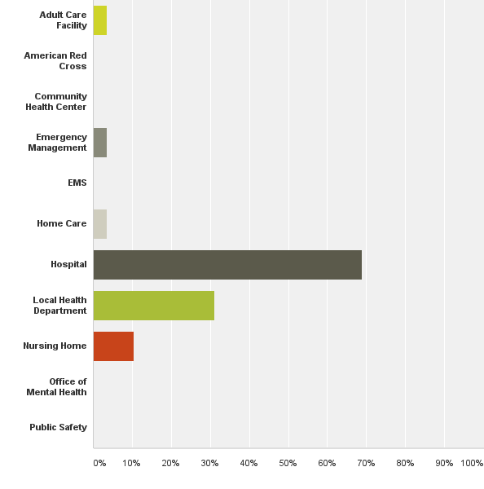
Q2: What is your agency type? (Please select all that apply)
Answered: 29 Skipped: 0
Urgent Care Center

Slide 5
Q3: Please prioritize the following "MAINTENANCE" emergency preparedness courses based upon the need for your agency.

Slide 6
HOSPITAL Priority "Maintenance" Emergency Preparedness Courses

Slide 7
Q4: Please prioritize the following emergency preparedness courses based upon the need for your agency.
MGT-319 Mass Prophylaxis Preparedness and Training

Slide 8
HOSPITAL Priority Emergency Preparedness Courses

Slide 9
Q5: Support for Train-the-Trainer initiatives?

Slide 10
Q6. What non-traditional training formats will best serve your facility for the listed courses. Webinar = live online Independent Study = an archived webinar OR a pre-taped self-paced online course

Slide 11
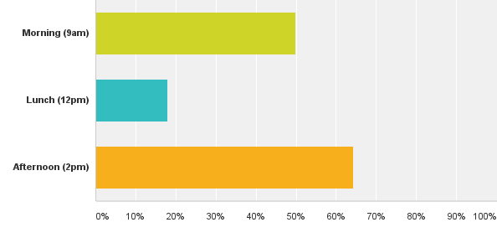
Q7: What is the best time to schedule webinar based courses?
Answered: 28 Skipped: 1

Slide 12
Q9: Would you be willing and able to host NYSDOH and/or RTC sponsored training at your facility?
Answered: 28 Skipped: 1

Slide 13
Open Ended Questions
“n/a”

Slide 14
Questions/Comments/Discussion?
Finger Lakes Regional Training Center
Anne D’Angelo (Program Director) - anne_dangelo@urmc.rochester.edu
Eileen Spezio (Administrative Assistant) - eileen_spezio@urmc.rochester.edu
Kathee Tyo (Lead Instructor) – kathee_tyo@urmc.rochester.edu
(585) 758-7640
Mondays, Tuesdays, Thursdays
wrhepc.urmc.edu
please subscribe to the FLRTC-HPP listserv
send an email to: listserv@lists.rochester.edu
In the email BODY write: Subscribe FLRTC-HPP firstname lastname
Note: subject line can be blank
substitute firstname lastname with your first and last name

