Slide 1
Continuity of Operations Planning
COOP Overview for Leadership
Notes:
NOTE: It would be helpful to have a copy of the plan available at the time of the presentation. Point out sections of the plan as you cover them in the presentation.

Slide 2
Agenda
Continuity of Operations Planning Basics
Authority, Purpose, Key Components, Terms, & Phases
COOP Elements
Essential Functions, Positions, Resources & Communications
Plan Approval & Maintenance
Leadership Approval, Plan Storage, Training & Exercises

Slide 3

COOP Overview
Getting the basics

Slide 4

What is COOP?
“’Continuity of Operations,’ or ‘COOP,’ means an effort within individual executive departments & agencies to ensure that Primary Mission-Essential Functions continue to be performed during a wide range of emergencies, including localized acts of nature, accidents, & technological or attack-related emergencies”
National Security Presidential Directive NSPD-51/Homeland Security Presidential Directive HSPD-20

Slide 5


Authority
National Security Presidential Directive NSPD-51/ Homeland Security Presidential Directive HSPD-20:
“It is the policy of the United States to maintain a comprehensive and effective continuity capability composed of Continuity of Operations and Continuity of Government programs in order to ensure the preservation of our form of government under the Constitution and the continuing performance of National Essential Functions under all conditions.”
Utah Governor’s Office Directive:
“Critical to the State of Utah’s commitment to ‘Be Ready’ for emergencies and disasters is the development of a Continuity of Operations Plan (COOP) for all state agencies. These plans help us to identify essential functions and how we will maintain those functions in the event of a disaster.”
“All State Departments and Agencies shall prepare a Continuity of Operations Plan and share this plan...” ~Chief of Staff Derek Miller

Slide 6
Purpose & Objectives
Maintain essential governmental operations
Ensure succession of leadership
Communicate with employees & public
Protect vital assets & resources
Achieve timely recovery
Ability to implement anytime, anywhere
Notes:
ASK QUESTIONS – WHY DO YOU THINK COOP PLANNING WOULD BE IMPORTANT? HOW MIGHT THIS AFFECT US AT OUR AGENCY?

Slide 7
Key Components
COOP Plans answer the following questions in a catastrophic event or other emergency situation:
What critical things do we need to do?
Who will do them?
How will they be done? What equipment/resources?
Where will we be doing these things?
When (how quickly) will we need to resume them?
Also:
Who’s in charge? What if he/she can’t?
How will we return to normal, or what if we can’t?

Slide 8
Terms & Definitions
Questions
COOP Terms
What?
Who?
How?
Where?
When?
Who’s in charge?
Return to normal?
Essential Functions (Mission-Critical)
Essential Positions; Functional Roles & Responsibilities; Incident Command
Vital Records & Critical Applications; Communications Resources; Logistics Support & Resource Requirements
Alternate Operating Facility; Recovery Location
Function Priority; COOP Phases; Recovery Time Objective (RTO)
Lines (Orders) of Succession; Delegations of Authority
Reconstitution; Devolution
Notes:
State that we are familiar with these questions, but we may not yet be familiar with the COOP terminology. Explain that common COOP terms just refer to these basic questions we would all need to know in an emergency situation.

Slide 9

COOP Phases
Phase 1: Emergency Response
Initial emergency management activation
Phase 2: Event Assessment
Assess workstations, facilities, impact/outage length
Phase 3: Notification & Implementation
Implement emergency policies & communication protocols, evacuate
Phase 4: Continuity of Operations Preparations
Arrange for transfer activities, personnel, records, equipment
Phase 5: Continuity of Operations
Execution of essential operations at alternate facility
Phase 6: Public Information
Partner & media information
Phase 7: Reconstitution; Final Report Activity
Normal operations resume; After Action Report created
Notes:
In Phase 2, determine if COOP needs to be implemented, based on how severe damage is, etc. If so, proceed to Phase 3 and declare emergency.

Slide 10
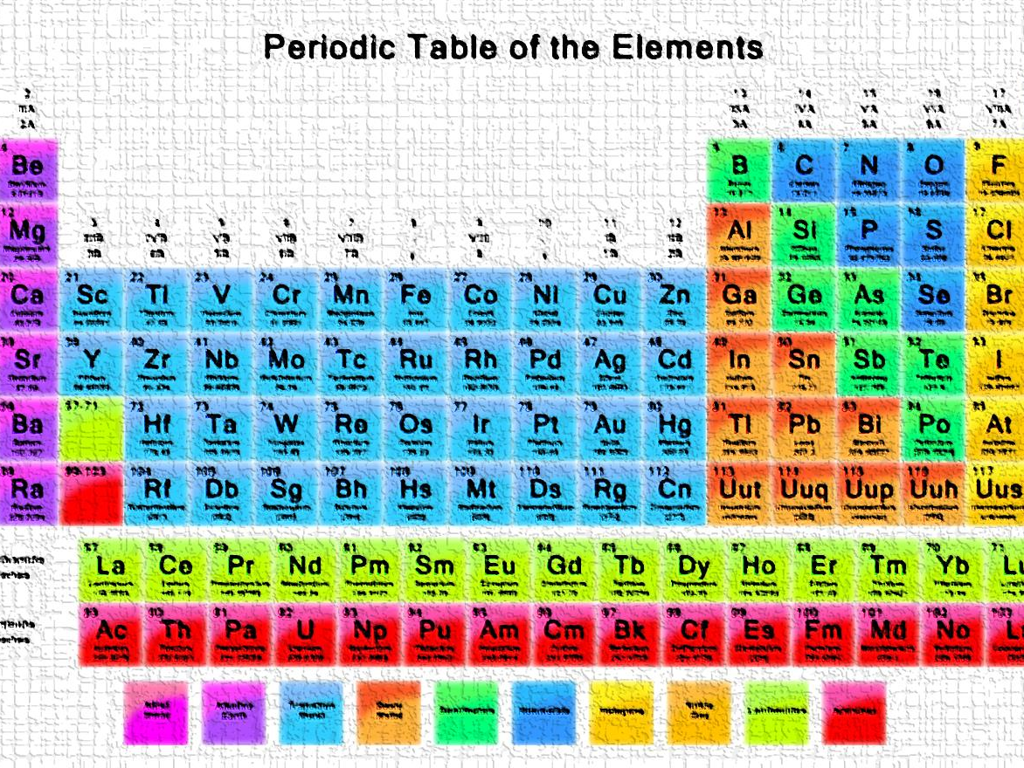
COOP Elements
In more detail

Slide 11

Essential Functions
Identified services & functions that must be continued
Prioritized according to how quickly they need to be resumed:
Priority 1 – within 12 hours
Priority 2 – within 72 hours
Priority 3 – within 7 days
Priority 4 – as possible
Notes:
Everything else in plan stems from this (personnel, resources required, etc). We’re mostly concerned with the top 3 priorities.

Slide 12

Essential Positions
Positions (not names) that are necessary for carrying out the identified essential services/functions
Each position requires a primary individual and 2 alternates
Primary & backups need to be aware of, and trained on, their emergency role(s)

Slide 13

Vital Resources
Documents, records, software, applications and equipment necessary to carry out essential functions
Examples:
Emergency plans, Job Action Sheets, Lines of Succession
Legal/financial, payroll, contracts, personnel files
Microsoft Office, email, databases
Computers, phones, internet
Notes:
Lines of Succession are formalized in documents as “Orders of Succession” and “Delegations of Authority”

Slide 14

Communication
COOP Plan lists all emergency contact information
Emergency calling tree
Who calls who
Contact information for every employee
(Describe other communication methods, if applicable)
Notes:
Describe the way employees would be notified in an emergency

Slide 15
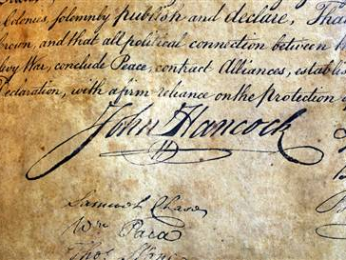
Approval & Maintenance
Assistance needed by leadership

Slide 16

Leadership Approval
Review & approval of COOP Plans by leadership is required at least annually
Review for updates in the following areas:
Essential functions & prioritization
Reorganizations, staff changes
Contact information changes

Slide 17
Plan Storage & Maintenance
(Describe how COOP Plans will be stored & shared. One example is given here)
All COOP Plans will be stored on Google Drive
Securely shared
Accessible anywhere, anytime
Those with leadership / emergency roles will be given shared access
The COOP Representative (your name) will update plans on this drive annually in January, and will share updated plan with State Division of Emergency Management

Slide 18

Training & Exercises
Help prepare for the REAL thing
Leadership encouraged to participate:
Incident Command System (ICS) Training
3 courses: ICS 100, ICS 200 & NIMS 700
“Shakeout” Exercise each April
Help identify & make plan improvements

Slide 19

Thanks!
(Your name and contact info)

