Slide 1


Train the Trainer 3.0
Finger Lakes Regional Training Center

Slide 2
Updates to eFINDS
Key items:
Enable additional “statuses” and full cycle of person movement
Streamlining menus and vocabulary, standardization of naming conventions
Revision of behind the scenes data model
Create useful and printable reports
Printable labels.

Slide 3

AGENDA
eFINDS INTRODUCTION
Planning Considerations & Implementation
Tailor Your Facility Training Session
HANDS-ON EXERCISES
  Administrative
  Evacuating/Sending Facility: Register, Evacuate, SIP, Repatriate
  Receiving Facility: Receive, Initiate Repatriation, Will Not Repatriate
  Search/Reports
Frequently Asked Questions
Teach Back (TtT ONLY)
Notes:
This is what we hope to accomplish during today’s session:
BRIEF Overview of eFINDS (more in-depth review was covered during the NYSDOH Webinar roll-out) followed by several hands-on training exercises
Hands-on Exercises are divided into 4 sections – Admin, Evacuate, Receive, Search. This will allow sites the ability to focus on a particular aspect of eFINDS when doing training (perhaps JIT) at their facility.
The “OPTIONAL” component is a True/False test to help summarize important aspects covered in the training.
WNY workgroup developed some scenarios to help EP committees discuss various ways they might consider implementing eFINDS in their facility based on an emergent, urgent or planned evacuation.

Slide 4
Introduction to eFINDS

Slide 5
In 2012 - Hurricane Sandy forced the following number of Healthcare Facility Evacuations
    56 Facilities evacuated in NYC, Nassau, Westchester and Suffolk Counties
    7,820 HCF Patients/Residents evacuated from NYC, LI and Lower Hudson Valley
Notes:
Module 2.
Your are building a case for why eFINDS was needed and developed:
NH patients particularly sent out without meds, complete patient records.
Not sent to original expected areas or even traditional facilities; on the fly creation of shelter sites, including hotels must be something system can handle.
ACFs – 2550 evacuated
NHs – 3683 from NHs
Hospitals -- 1587
Regarding their evacuated patients/residents, facilities
Often didn’t know their location, condition; unable to provide ongoing guidance to receiving facility
Had difficulty in repatriating or discharge to other facilities
Families did not know where loved ones were located; some still searching weeks after the storm
Residents sent without basic health records; medication information
Much of this data had to be manually tracked and verified by phone calls to facilities for several months after the storm.

Slide 6
Evacuated Patients/Residents
Providers:
    Often didn’t know their location, condition;
    unable to provide ongoing guidance to receiving facility – many sent without basic health records; medication information
    Had difficulty in repatriating all their people or discharging to other facilities
    Families did not know where loved ones were located; some still searching weeks after the storm
Notes:
This slide is regarding the patients evacuated during Sandy and justifies the need for a patient tracking system. Much of this data had to be manually tracked and verified by phone calls to facilities for several months after the storm.

Slide 7
Patient Tracking Imperative
NO formal mechanism for tracking evacuees
statewide was available at that time

Slide 8
eFINDS is …
… a statewide, person tracking system,
… mandated by Governor Andrew Cuomo following Hurricane Sandy, for use by healthcare and human services facilities,
… helps ensure the safety of persons (patients, residents and staff) during a forced evacuation of their location, due to emergency conditions that jeopardizes their life-safety.
eFINDS:
… provides ongoing awareness of the current location of each evacuated person, across all movement,
… captures essential care needs information for the person, and
… captures key contact information for their loved ones and
care givers.

Slide 9
System Requirements
Key Data Requirements – System must:
    Track current location of all evacuees
    Track non-traditional/temp locations like hotels/shelters
    Provide summary stats/status of all individuals evacuated
    Enable quick recognition of missing individuals
    Minimize data collected to only essential fields
    Enable capture of basic medical and additional care requirements
Key Functional Requirements
    Must be quick, easy to use; user friendly
    Must protect sensitive data from those not authorized
    Enable data tracking even if HCFs have lost power
    Exchange data with other response systems (HEC)
Notes:
This slide lists the critical data and functional elements that the system had to provide.

Slide 10
CMS Final Emergency Preparedness Rule
During 2016, the Centers for Medicare and Medicaid Services (CMS) approved a final rule describing emergency preparedness requirements for 17 different types of health care providers.
The rule’s key provisions will be enforceable as of November 2017.
Your participation in this eFINDS training may help your facility demonstrate its compliance with aspects of the rule related to tracking the movement and location of your facility’s patients, residents and staff during an emergency.
Accordingly, at the conclusion of the training, you will receive a certificate documenting your attendance and participation in the training.

Slide 11
NYS Regulations & HIPAA
eFINDS use by all NYS Hospitals, Nursing Homes and Adult Care Facilities (ACF)
is Required for all Evacuations
Health facility electronic data exchange with NYSDOH Health Commerce System (HCS):
  Title 10: Section 400.10 9 -- Nursing Homes and Hospitals
  Title 18: Section 487.12/488.12 -- ACFs
Active HCS Accounts; Up to date, HCS Communications Directory role assignment and business AND emergency contact information
HIPAA Privacy/disclosure of data during emergencies:
Providers/health plans covered by the HIPAA Privacy Rule may share patient information if to provide treatment, inform families; and if in imminent danger situations
Notes:
This slide identifies the regulations that require facilities to use eFINDS.

Slide 12
  Current eFINDS Deployment
  “O” Agencies and their facilities
      OASAS – Clinics
      OMH – Psychiatric Centers and Licensed Housing
      OPWDD – Residential Homes & Developmental Centers
      OCFS – Juvenile Facilities
      OTDA – Supportive Housing
Notes:
This slide lists the big picture for role out and includes all the “O” agencies that are currently using eFINDS.

Slide 13

Current eFINDS Deployment (cont’d)
DOH Facilities
  Hospitals, nursing homes, adult care facilities
  NYCDOHMH and upstate Local Health Departments
  NYSDOH Regional Offices

Slide 14
Planning Considerations

Slide 15
Why Plan?? Lessons Learned from 28 Actual Events
Flooding, winter storms, facility relocation -- Issues seen in practice:
  Didn’t know how to use system; no protocol in place
  Didn’t know where supplies are stored or lost them
  Too few people in eFINDS roles; none onsite at time of emergency
  Removed wristbands from evacuee; couldn’t register
  Misused “real” versus “training” applications and/or wristbands
  Didn’t understand concept of “operation,” i.e. where to record data for event
  Confusion when the receiving facility must also register the person
  Didn’t realize need to repatriate returning persons by the sending facility
  Didn’t understand concept of “shelter in place”
  Didn’t know how to find/track their persons in the system

Slide 16

Planning Considerations - Activating eFINDS Large-scale event that affects multiple facilities
NYSDOH will create the operation and notify HCFs that they must use eFINDS
The HCS, Integrated Health Alerting and Notification System (IHANS) is used to send the notification:
Therefore, your facility’s business hours and emergency/after hours contact information in the HCS Communications Directory
must be up to date !!!

Slide 17
Planning Considerations - Activating eFINDS
Individual Facility Event
Facility staff assigned to the eFINDS Administrator Role, can create an Operation themselves if they need to use eFINDS;
  inform any receiving facilities of the Operation Name to use in eFINDS when receiving evacuees at their location
Facility staff should also always contact their NYSDOH Regional Office Program Representatives to inform them of the emergency and gain assistance as needed

Slide 18
PLANNING CONSIDERATIONS
Each facility needs an eFINDS policy/procedure that
  Addresses different circumstances/scenarios
  Is incorporated into evacuation protocols
  is customized to their facility
Ensure patient/resident/family education/guidance on the evacuation process is outlined/ready:
  Importance of wristband; reassurance of how it will help to keep them safe; how they, and their belongings will easily be tracked wherever they move; Emphasize security of the system regarding their personal information
Drill Various scenarios and test policy/protocols
  Include in annual evacuation drill
  Work with neighbor/sister facilities
  Act in both sending and receiving roles
Notes:
During evacuation should not be the first time staff use the system.
These are some suggestions and best practices to use in creating a facility policy/procedure
Trainer should give examples for how their facility has addressed (or needs to address) each bullet
Trainer should gather feedback for those basic planning principles that have not been addressed.

Slide 19
PLANNING CONSIDERATIONS
Are you going to enter any key medical information into the notes fields in eFINDS?
Are you going to scan your facility wristband into the notes field to capture your facility’s barcode ID# in the eFINDS application?
    May or may not be your MR# - now is the time to find out
Have you prepared stickers using eFINDS label printing function or handwrite unique barcodes on a sticker to apply to the person’s charts/other personal items?
Have you identified staff in charge of monitoring movement of patient’s/resident’s through receipt by receiving facility using eFINDS tracking search and dashboard functions?
Notes:
Module 4

Slide 20
PLANNING CONSIDERATIONS
Have you considered the flow of persons through your facility in your eFINDS implementation plan? Do you have intermediate evacuation points? Where/will you set up eFINDS stations?
  Depends on size of building; egress and staging points; amount of pre-evacuation movement?
  Are you going to scan/update in eFINDS again as they leave your building (for a final time/date stamp)?
What equipment/documents are you sending with your patient/resident?
  Medical records (which parts)? Information sheet/transfer packet, Medical evaluation, medications/medications list
  Personal medical equipment
    Have you tagged these items with the same unique
    eFINDS identifiers (barcode #s)?

Slide 21
Don’t get hung up by the electronic process!!
If all else fails….
  Just wristband your evacuees and get them out the door…
  Hand write first name and the barcode number on a sticker and apply to person’s medical record
Notes:
Module 4

Slide 22
PLANNING CONSIDERATIONS
Repatriation
  Don’t put the scanner away!
  Don’t forget to repatriate your patients/residents when they return to your facility by updating their final destination back to their home facility OR
  If patients/residents cannot return to original facility its management should ensure the new permanent location for all their evacuees is updated by their new facility in the final eFINDS record for that event
Notes:
Repatriation can mean the return to the home (originating) facility or admission to another permanent location following the evacuation

Slide 23
Planning Considerations
DRILLS and EXERCISEs - validating your plan!
Incorporate eFINDS into your CMS required drills to create
a functional or full scale exercise.
Just in Time or pre-exercise training with staff
Movement of mannequins, actors, “paper persons”
Quick reference card at each drill station
Benchmark to strive for: ~30 seconds to register each person
practice using paper logs as primary or backup registration/validation
Unannounced eFINDS drills: shown to increase user proficiency;
almost no coaching to users needed
Notes:
Examples of how some facilities have planned and prepared for the implementation of eFINDS
Examples of best practices
Just in time training should focus on the functions that the facility needs to perform during that emergency, e.g., if they are an evacuating facility, JIT should only train the staff on only those methods of registering their patient/residents that they will use during the circumstances they are under. Example: Facility has lost power, and can only use the printed bar code sheets to register their patients/residents.

Slide 24
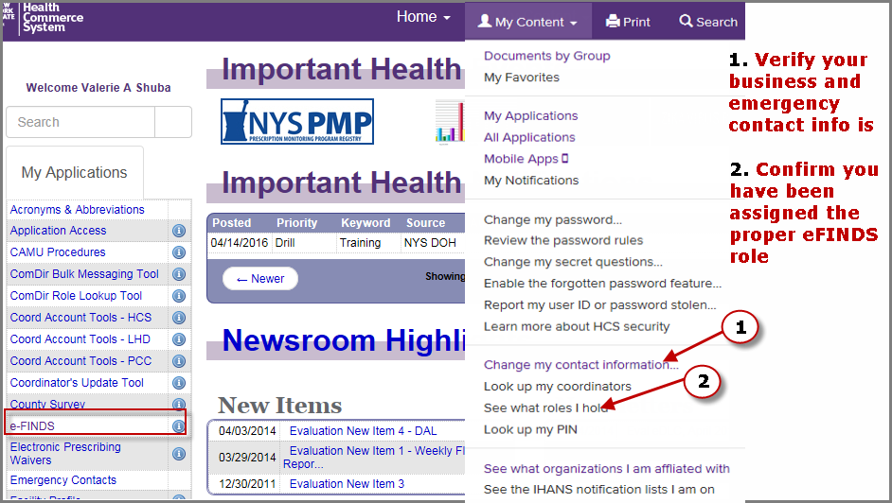
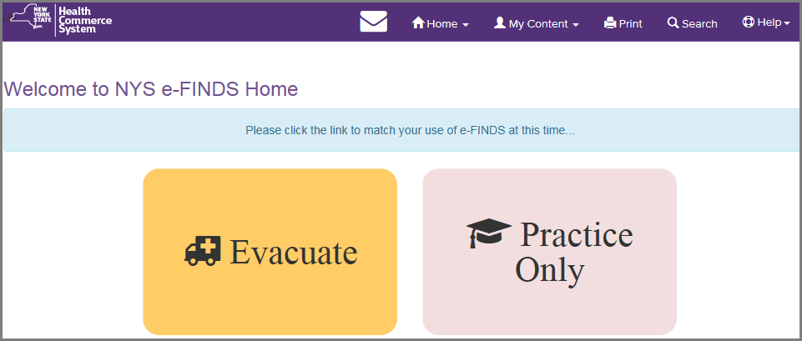
Planning Considerations
Notes:
Because e-FINDS is a role based application, once you are added to an e-FINDS role, the application will appear in your My Applications list in the left side panel.
e-FINDS can also be access from the main list of applications.
To verify your role assignment, go to the My Account link and click See what roles I hold. If you are not in an e-FINDS and would like to be, then click on the Look up my coordinators. They are the ones who will add you to the role.
FRIENDLY REMINDER: To ensure that you receive timely communications from your county health department and/or the state, please make sure your business and emergency contact information is correct and updated. To do so, click on the Update or verify my contact information.

Slide 25
Planning Considerations eFINDS Roles
eFINDS Data Reporter (@user) | eFINDS Reporting Administrator (@admin)
Register patient/resident with or without a scanner one patient/resident at a time, or upload spreadsheet provided by eFINDS Reporting Admin Update patient/resident Information with or without a scanner one patient/resident at a time or multiples | Same as data reporter (user) plus: Generate patient/resident barcode PDF log or spreadsheet Register multiple patients/residents without pre-printed barcode wristbands to scan Create, activate and inactivate an Evacuation Operation Create, activate and inactivate Temporary Locations
Notes:
eFINDS is a commerce based-application and relies on Communications Directory role assignments to access the system. There are two roles for healthcare facility employees that provide access (facility permission assignments)
1. The e-FINDS Data Reporter can register patients/residents in the system with or without a scanner, one at a time or multiples by using the e-FINDS spreadsheet provided by the e-FINDS Admin. They can also update with or without a scanner, one at a time or more than one.
2. The e-FINDS Reporting Administrator role can accomplish more tasks such as: generate a PDF of used and unused barcodes, generate a spreadsheet that can be populated with patient/resident information and uploaded by the e-FINDS Data Reporter. The Admin also has the ability to register multiple patient/residents, at a time, without scanning the barcodes.
**Because the Admin can do everything that a data reporter can, you only need to be added to the admin role; both roles are not needed. Also, a facility can have more than one person assigned to either role.

Slide 26
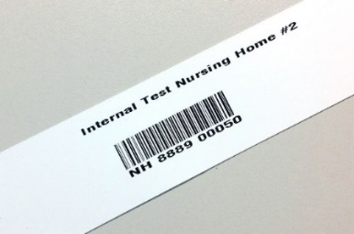
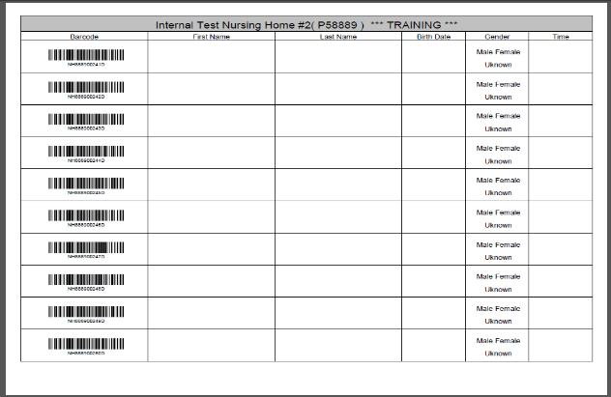
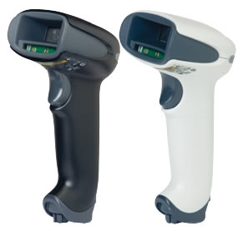
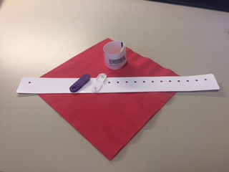
eFINDS Supplies/Equipment –
Users on every shift must know where supplies are stored and have access to them…
Originally distributed,
currently used,
sticker-type wristbands
Newer style, clip wristbands,
expected to be used
going forward
Manual barcode
assignment log
Scanners: white for use at facilities where more stringent disinfectants are used
Notes:
KNOW where these supplies are kept!!!! Each facility received a number of wristbands, based on the licensed bed, and the corresponding log sheets.
The barcodes provided will have a special sequence number used solely for your facility to allow for better patient and resident relocation management. Each wristband will contain the facility name, a scannable barcode, and the barcode number. If needed, you can even write on them. The barcodes on the wristband have a prefix that corresponds to the type of facility (HO, NH, ACF) followed by your agency’s unique identifier code, followed by a changing number sequence
Facilities also received a small set of training bands (16). You will clearly know that they are for training, because they are marked for training in two places, and the barcode number ends in a D for demo. Training wristbands can only be used in the e-FINDS Demo application and the production bands are only recognized in the production e-FINDS. The bands cannot be used in the wrong application by mistake.
NOTE: barcodes are one time use. If a facility has used demo barcodes in a training (demo) it may be necessary to request additional barcodes be added to the facility e-cache. NYSDOH will not issue additional barcode wristbands unless a specific request is made.
Each facility also received one bar code scanner select to work with the e-FINDS application. The budget only provides for one scanner per facility.
Information regarding the purchase of replacement scanners at a discounted price is listed on the “Vendor resources” slide at the end of the presentation.
Other hospital scanners do work with the eFINDS program but because they are not “programmed” use of non-DOH scanners may require a manual “enter” with the keyboard ..
Finally, each facility received a copy of their facility paper log (PDF) – which contains facility name, a space for a patient/resident’s first name, last name, date of birth and gender. These logs can be used if a facility has no power or not internet.

Slide 27

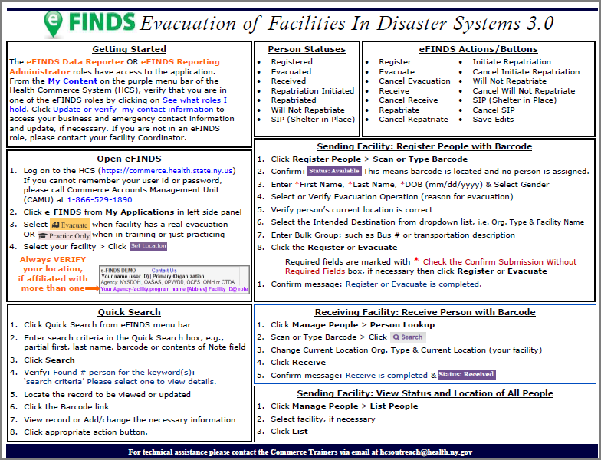
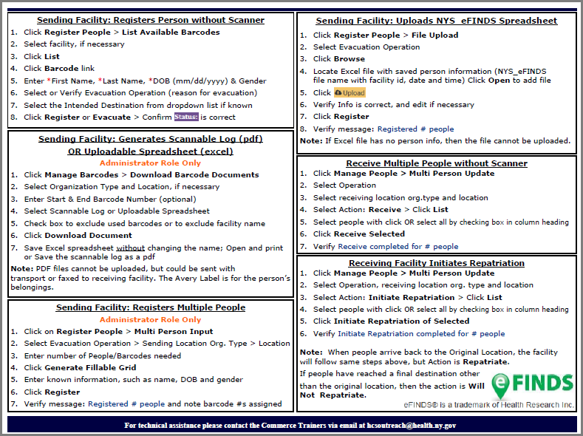
eFINDS Quick Reference Cards
Notes:
Click on the eFINDS or eFINDS Training (Demo) info icon (blue circle with I in it) also known as the application profile button.
Find other quick reference material in the profile.

Slide 28
Facility Supplies/Procedures
(facility provided)
  Additional Handheld Scanner(s)
  Mobile Application (March 2017)
  Computer (laptop/WOWs) with internet Health Commerce System access
  Evacuation Annex (eFINDS Policy and Procedures)
  Enhanced Patient/ Resident wristband used for identification
  “Go Pouch”
  Internal tracking (Unit to staging area to portal?)
    HICS Tracking Log
    Patient/Resident “Evacuation Tag”
Where are supplies located in your facility?
What is the access procedure? Who, when?
Notes:
Facilitator/ trainer should review the procedures and locations where the equipment can be accessed. Is it a 24/7 process, or differences day and off shifts.
eFINDS merely tracks patients and in no way is meant to be an electronic medical record.
eFINDS should be used in conjunction with internal methods to track and document the patient and associated equipment, such as the Patient Evacuation Tag, and hospital identification wrist band. The patient’s wrist identification band verifies initial identity.
A GO Pouch with chart and clinical information may be used/ affixed to the patient. Basic clinical information such as medications and treatments may also be entered into the eFINDS patient record.

Slide 29

Tailor Your Facility Training
Planning Considerations & Implementation

Slide 30
Tailor Your Facility Training
Tips for Facility Trainers:
Review your facility’s evacuation plan
Work with your facility leadership to plan logistics of using eFINDS/which eFINDS functions are most congruent with the facility’s plan
Cover the points described on the Facility eFINDS Planning Considerations Checklist during your discussion with your facility’s leadership.
Notes:
Review Facility eFINDS Planning Considerations Checklist

Slide 31
Tailor Your Training:
Tips for Facility Trainers cont’d:
Review the facility’s general eFINDS evacuation plan/strategy/process with your trainees
Add information to the Facility Trainer template slides that describes your facility’s plan

Slide 32
Tailor Your Facility Training:
eFINDS provides several basic tracking functions:
Registering a person for evacuation
Actually Evacuating a person
Sheltering a person in place, if allowed for a given event
Receiving an evacuated person and updating their eFINDS record to reflect their new location
Initiating Repatriation of a person to their home facility or to a new permanent location
Repatriating a person back to your facility
Searching for an individual person or groups of people based on specific characteristics of those individuals as search
“filters”

Slide 33
Tailor Your Facility Training (cont’d)
eFINDS also has several options for how to perform each of the tracking functions (e.g., several ways to register a person for evacuation).
The following exercises will help you understand how to use all of the options and determine which options best match your facility’s evacuation plan, physical layout, and nature of your clients
Each facility trainer can then streamline and simplify their training to focus on only those options
Notes:
Once you clearly understand the eFINDS options that your facility’s staff will need to use during an evacuation to perform the basic registration and receiving functions, remove the slides from the presentation that cover other options to perform the basic functions, so you can focus only on those options you will use.

Slide 34
All eFINDS functions are usable by all facility types under all circumstances;
However, to assist you in designing your facility’s eFINDS plan, refer to the eFINDS Function Recommendations Tables (distributed separately) for suggestions regarding the circumstances and facility characteristics for which each function is especially well suited
Notes:
In the previous version, we only had two actions: Register and Update
In the new version, the action updates the person’s status, AND whatever action they select can be undone or cancelled.
Why this is so important, it because if a person is registered and not evacuated AND you have not issued any wristbands then NYSDOH can cancel registration and you can use the barcodes for another potential full or partial evacuation. Just send an email to eFINDS.

Slide 35
Hands-On Exercises

Slide 36
eFINDS Person Statuses:
  Registered
  Evacuated
  Received
  Repatriation Initiated
  Repatriated
  Will Not Repatriate
  SIP (Shelter in Place)
Notes:
The most significant enhancement to eFINDS 3.0 are the person statuses.
What we had before was in the eFINDS System, Original Location and Current Location.
These are the statuses we have now. They define the state of the person during an event and when the event is over.

Slide 37
eFINDS Actions/Buttons
Register
Evacuate
Cancel Evacuation
Receive
Cancel Receive
Repatriate
Cancel Repatriate
Initiate Repatriation
Cancel Initiate Repatriation
Will Not Repatriate
Cancel Will Not Repatriate
SIP (Shelter in Place)
Cancel SIP
Save Edits
Notes:
In the previous version, we only had two actions: Register and Update
In the new version, the action updates the person’s status, AND whatever action they select can be undone or cancelled.
One reason why this is important and helpful, is if a person is registered and not evacuated AND you have not issued any wristbands then NYSDOH can cancel registration and you can use the barcodes for another potential full or partial evacuation. Just send an email to eFINDS@health.ny.gov.

Slide 38
Hands-On Training Modules
Administrative
A-1: Install eFINDS Mobile Application (optional)
A-2: Download Barcode Assignment: Scannable Log (PDF log)
A-3: Create an Operation for a training, exercise, event
A-4: Create a Temporary (TMP) Location for a training, exercise, event
A-5: Housekeeping (FINAL STEP in Training/Exercise)
Register People
R-1: Register a single person with Scanner
R-2: Register a single person without Scanner
R-3: Download Barcode Document: Uploadable Spreadsheet (Admins Only) & then upload file
R-4: Register multiple people using Multi Person Input (admins only)
R-5: Register a person using List Available Barcodes
Update Status, Person Record or Intended Location
U-1: Change Status to Evacuated
U-2: Change Status to SIP
U-3: Indicate Person is Deceased
U-4: Change Status to Received
U-5: Change Status to Initiated Repatriation
U-6: Change Status to Repatriated
U-7: Change Intended Location
Search/Reports
S-1: View Reports > Facility Report
S-2: List People
S-3: Quick Search
S-4: Locate People
Notes:
We will complete the following exercises during the Hands-on portion of this training:
Facility trainers should edit this slide to only list those exercises they will use in their training, based on their facility’s plan and choice
of the eFINDS functions it will use.
Remove Or Hide Exercise Slides For Those eFINDS functions
their facility WILL NOT use.
The Administrative “Housekeeping” Exercise will be the last Hands-On component we will do today

Slide 39


Exercise 1: A-1: Mobile Application (Optional)
Log on to the HCS from your MOBILE device (https://commerce.health.state.ny.us)
Tap +Show My Applications > Click e-FINDS
Tab either Evacuate or Practice Only
Select your location Note: All of the locations you currently have access to will also be available on Mobile
Tap Submit
Click Mobile Download from the menu bar
Select Android or iOS
Confirm Install
Wait for application to install on mobile device; progress is displayed on the main screen.
NOTE: If you are not using the most current version, the app will reject the attempt to login. you will need to uninstall the old app and then download the new app.
Notes:
eFINDS Mobile version 4.0 was released in mid March 2017. If you were in an eFINDS role, then you received a notification via email that the new version was ready.
To update to the latest version, FIRST uninstall eFINDS, and then download/reinstall the new updated version.
How to trust Enterprise apps on iPhone or iPad
Launch Settings from your Home Screen.
Tap on General.
Tap on Device Management.
Tap the name of the distributor under the Enterprise App section, “New York State Department of Health”.
Tap to trust.
Tap to confirm.
How to trust Enterprise apps on an Android device:
Launch Settings from your Home Screen.
Tap on Security (under Personal section).
On the Security window, tap to check the checkbox representing Unknown sources under the DEVICE ADMINISTRATION section.
View warning in window and tap OK.
The new Sign In screen allows users to save their user ID. This is a time saver feature because you will only need to enter your password the next time you need to use the Mobile application.
Any eFINDS role assignment, including eFINDS Reporting Admin, eFINDS Data Reporter, or eFINDS Reader has permission to install the eFINDS mobile application.
Mobile is available by logging into the HCS from your mobile device.
See eFINDS Mobile quick reference card for details.
Note: if you select Mobile Download from your pc, you will see instructions on how to register, evacuate, receive, etc.

Slide 40
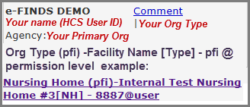
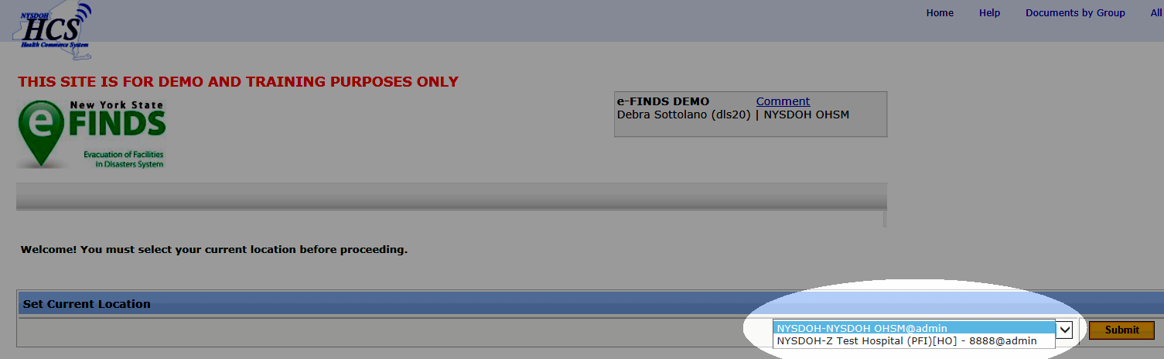
ADMINISTRATIVE EXERCISES
Log into HCS: https://commerce.health.state.ny.us
Open: Evacuation of Facilities in Disasters System Demo from your “My Applications” list on the HCS homepage
Select: the appropriate Current location
(facility for which you are currently registering
patients) and Role from drop down list if you
are affiliated with more than one facility, or have more than one role at a given facility
Click SUBMIT
Notes:
Let’s go out to eFINDS DEMO application on the Health Commerce System, and walk through some practice scenarios. For demonstration purposes, we will act as both an evacuating and receiving facility.
If you have more than one eFINDS role assigned (data reporter and reporting administrator) select @admin (not @user) from the drop-down when you select your current location.
***Demonstration Begins - Please refer to participant handouts if dual presentation (slides and web demo) is not available***

Slide 41
SCENARIO
Exercise 2: Download the Barcode Assignment: Scannable Log (PDF) (A-2 Hands-On Exercises)
  Knowing where your eFINDS Supplies are is crucial.
  Having one or more copies of the Scannable PDF log will be extremely helpful if there is a power or internet outage or if an urgent evacuation is needed and there is no time for registration of people into eFINDS.
  You need to use of eFINDS to track your evacuees. Download and print the Scannable Log (PDF).
Notes:
Know where the facility eFINDS supplies are kept, that is, not in a locked storage closet, but a safe place where your staff can access them whenever needed.
Remember that if you only have time to get the wristband on the people, and get them to a safe location, registration can occur later. With a wristband, we can always determine the facility that a person originated from. This could be very important especially during a large scale event with people ending up in temporary shelters.
Note: PDF files cannot be uploaded, but could be sent with transport or faxed to receiving facility. The Avery Label is the barcode number that corresponds to the person’s wristband and can be applied to the person’s belongings.

Slide 42
A-2: Generate a Scannable Log (PDF)
e-FINDS Administrator Role Only
1. Click Manage Barcodes > Download Barcode Documents
2. Verify your current location
Enter Start and End barcode numbers, e.g., 4—13 for ten
patient/residents to be relocated OR leave blank for all assigned
barcodes
Select the Barcode Assignment: Scannable Log (PDF) option
Click Download Document
Check Exclude used barcodes from List? If desired.
7. Print the PDF.
Notes:
New in 3.0: You also have the ability to exclude used barcodes from your download or not print your facility name on the PDF log or Avery Label.
This feature was developed with OASAS Programs (drug treatment) and OHM clinics in mind specifically, not necessarily for DOH facilities.
Your current location is the facility you are entering data for. If you have access to multiple facilities then make sure you are entering data for correct location.
eFINDS also allows you to download and print a paper log that can be used to track people if you don’t have power or internet. You get one copy of the paper log with your kit from NYSDOH, which can be useful just to see what your barcode numbers are. If lost or misplaced you can create additional copies of the paper log.
Follow Steps 1-7
Please note the differences between the PDF and Excel options:
PDF FILES:
- cannot be electronically updated or uploaded, but could be data can be hand written and sent with transport
contains a scannable barcode.
provides a list of ALL barcodes allotted to your facility but notes which barcodes have been used. (without inputting patient data)
EXCEL FILES:
Can be electronically updated and uploaded to eFINDS system
Does not contain scannable barcodes
Defaults to the first available/unused barcode in your sequence

Slide 43
SCENARIO
Exercise 3: Add Operation (A-3)
  You are a 20 bed facility, and there is a planned power outage and the backup generator cannot support all of the equipment.
  Your facility is at maximum capacity; a full facility evacuation is needed.
  You have made sending arrangements with other facilities and these arrangements can accommodate but 90% of your people (18 people). The remaining 10% (two) people who cannot be transferred to the other facilities will be sent to a local high school until power is restored.
  An evacuation operation needs to be created.
Notes:
See eFINDS_QuickReferenceCard_Operation_3.0
If you have attendees from the same facility, then consider give each training participant a different reason for evacuating or make each session operation unique by adding the creator of the operation’s user ID, e.g., in the location field include facility name and user ID.
Emphasize step 3 and step 7’s note that you may need to click Add Operation 2X. Check for the Verify message in blue at the top of the page that Operation was created.
The operation name is built as the answers are selected or typed in the Manage Operations page. Each Operation should be unique and specific to the facility.

Slide 44
A-3: Create Operation
e-FINDS Administrator Role Only
Click Admin from the menu bar
Click Manage Operations
ALWAYS search Name list first to be sure you are not creating a duplicate operation
Select Begin Date > Event Type
If you select Blizzard, Hurricane, Ice Storm or Snow Storm, then enter the Storm Name.
If you select Other, then enter Other Description.
Enter location, e.g., your facility, town/city/village
Verify Active Status
Click
Note: You may need to click Add Operation twice
8. Verify Operation YYYY-MM-DD EVENT TYPE LOCATION was created.
NOTE: Email confirmation is sent to all NYSDOH eFINDS Application Administrators: “eFINDS Operation has been added”.
Notes:
There is a quick card for this. See e-FINDS_QuickReferenceCard_Operation_3.0
An operation is the reason for the evacuation. It simply refers to the event, incident or drill. Please keep in mind that multiple operations can happen concurrently or simultaneously, so be sure to make the correct operation selection. The determined eFINDS operation can be added to the application by an eFINDS Reporting Administrator OR your state or state agency eFINDS administrator.
Important Reminder! Inform the participants that in the event of a large scale emergency involving multiple facilities the NYS will create the Operation.
A facility will only create an Operation when it is an emergency involving only their facility.
Please Note: Operation names must be unique. Check list of existing operations first.
Operations created in eFINDS Training Demo do NOT appear in the eFINDS PROD evacuation list or visa versa.
You will now get an email asking you to review an operation that has been active for more than 90 day. You can either make it active or check the box to Extend it for another 30 days.
If you have attendees from the same facility, then consider give each training participant a different reason for evacuating or make each session operation unique by adding the creator of the operation’s user ID, e.g., in the location field include facility name and user ID.
Emphasize step 3 and step 7’s note that you may need to click Add Operation 2X. Check for the Verify message in blue at the top of the page that Operation was created.

Slide 45
SCENARIO
Exercise 4: Add Temporary Location (A-4)
  Due to the operation in scenario 1 (Facility Power Outage), you now need to create the Temporary Location for the High School <or other TMP Location> across the street.
  Eighteen (18) of the 20 people at your facility will be evacuated to NYS hospitals. These facilities are already in eFINDS and can be selected from the Intended Destination Org. Type (Hospital) and the Intended Destination dropdown list. The Temporary Location cannot be selected until it is created.
Notes:
This function has not changed in eFINDS 3.0.
See eFINDS_QuickReferenceCard_TempLocation.
All TMP Locations need to be unique, so collaboration may be needed if you have a training session with attendees from the same facility. For this scenario, the name of the location is not important.
Emphasize the naming convention in step 4.

Slide 46
A-4: Create Temporary Location
e-FINDS Administrator Role Only
1. Click Admin > Manage Locations
Enter Location Name (e.g. Public School# 304), Description (e.g. HS), town or city (e.g. Albany) Note: this will display in Operation drop down list when registering a person
Enter Description, Address, City, State, Zip, Phone and County
Click
Verify your temporary training location has been saved.
Please Note: New TMP location names must be unique
Check list of existing TMP locations first
Notes:
A temporary location (i.e.: stopover point used before a patient/resident can arrive at final destination) can be added to the eFINDS application by an eFINDS Reporting Administrator OR your state or state agency eFINDS administrator.
NOTE: If your evacuation plan includes the use of a stop-over point, these TMP locations can be pre-identified/created in the eFINDS application so they are available to you before an event/exercise/etc.
For Facility Based Training: This location is specific to your training session, i.e., one receiving location per training. This will allow participants to play both the sending and the receiving facility roles.
Follow Steps 1-5 Create your own temp. location, so that it is unique to your facility. In my example HS = high school.
Operation names must be unique. Check list of existing operations first. Adding the training date or trainer’s user ID can make location unique if necessary.
Search for location prior to entering a new one by sorting column heading by name, address, description, etc. Be sure to view all pages.
See e-FINDS_QuickReferenceCard_TempLocation_3.0

Slide 47
Scenario
Exercise 5: Register A Single Person With Scanner (R-1)
Your facility is ready to send two people to the temporary location just created, along with two employees/staff members.
Facility Staff at the Temporary Location have eFINDS Data Reporter roles to update the evacuees’ status when they arrive.
Wristbands have been place on the patient’s wrists, and they are currently waiting for transportation.
Scan one wristband and then type in the second barcode number in eFINDS to register two people total.
Notes:
Two Methods for registering or evacuating a person: With scanner and without a scanner (i.e., Scan or Type Barcode).

Slide 48
R-1: Register Single Person with Scanner
Click Register People > Scan a barcode from the Scannable Log or wristband
Confirm: Status Available This means barcode is located and no person is registered to it.
Enter *First Name, *Last Name, *DOB (mm/dd/yyyy) & Select Gender
Select Employee ID (Emp #) from MR/Emp # Type drop down list
Enter an employees name
Select or Verify Evacuation Operation (reason for evacuation in exercise 2)
Verify person’s current location is correct
Select the Intended Destination from dropdown list, i.e. Temp Location from exercise 3
Enter Evacuee Group Description; such as Bus #, transportation description or facility unit (optional)
Click the Register
Confirm message: Register is completed and Status: Registered
At the very minimum, the evacuating facilities will only need to place the barcoded wristbands on their patient/residents and send them to a safe location. The receiving locations can scan wristbands, and update the location information when they arrive.
Register 1 person using this process
Notes:
Our first evacuation exercise is to register a single patient into eFINDS. At this point in the scenario there is sufficient lead time to place wristbands on the patients and scan them into eFINDS for registration. Again if you do not have wrist bands with your today, work from your paper log.
REMEMBER: At the very minimum, the evacuating facilities will only need place the barcoded wristbands on their people and send them to a safe location. The receiving locations can scan wristbands, and update the location information when they arrive.
However, if the evacuation facility is able to scan a patient, the minimum field input must be the EVACUATION OPERATION (select the operation you created for the training session). When registering the second person, leave out the DOB and demonstrate the * Check the Confirm Submission Without Required Fields box
Bulk Group has been changed to Evacuee Group Description. HOVER over question mark and view help text for this description:

Slide 49
Scenario
Exercise 6: Register A Single Person Without Scanner (R-2)
You now need to register a person but do not have a barcode scanner available. You also do not have date of birth or gender information for this person.
Notes:
Two Methods for registering or evacuating a person: With scanner and without a scanner (i.e., Scan or Type Barcode).

Slide 50
R-2: Register Single Person with Scanner
Click Register People > and type a barcode from the Scannable Log (pdf)
Confirm: Status Available
Enter *First Name and *Last Name only
Select or Verify Evacuation Operation (reason for evacuation in exercise 2)
Verify person’s current location is correct
Select the Intended Destination from dropdown list, i.e. Temp Location from exercise 3
Click the Register and view message in red flashing text
Check box: Required fields are marked with * Check the Confirm Submission Without Required Fields
Click Register
Confirm message: Register is completed
Notes:
This exercise registers the second person without scanner and with minimal amounts of patient info.
This exercise registers the second person with minimal patient info.
Verify barcode number was entered correctly and patient tracking has not been overwritten.
When registering this person, and skipping the DOB and gender, demonstrate the missing info/Confirm Submission without required field’s message and how it affects the action buttons available.

Slide 51
Scenario
Exercise 7: Updating Single Person with barcode #
Some time has passed since you registered the person in the last exercise. In that time, you have obtained the person’s date of birth and gender. You need to re-open the person’s eFINDS™ record and insert this information.

Slide 52
Edit Record
Click Manage People > Person Lookup
Scan or Type Barcode, and click Search
Select record with missing DOB & Gender
Enter the DOB and gender.
Click Save Edits.
Confirm message: Edit is complete
Notes:
This is the person you just registered.
All fields may be edited at any time without changing the status

Slide 53
Scenario
Exercise 8: Shelter in Place (SIP) (R-1, U-2)
You now have a third person to register into eFINDS™. This person is on a ventilator powered by a generator. It is determined that this individual cannot be moved. An eFINDS™ wristband is on the person’s wrist but you are unsure if the person has been registered. In this exercise, you will register this person into eFINDS™ and set the person’s status to Shelter in Place.
Notes:
Facility Shelter-In-Place Consideration
For the purpose of NYSDOH evacuation planning and incident management, SIP policy and process (2016) the potential to SIP is defined as: The ability of a NYSDOH regulated health care facilities (HCF)(hospitals, nursing homes, ACF, etc.) to retain for at least 96 hours a small number of residents that are too critical to be moved or where moving them may have a negative health outcome, while the remainder of the facility is evacuated, in accordance with a mandatory evacuation order by a local chief elected official that includes an option to SIP.
HCFs and agencies should appreciate that as defined, SIP represents an unusual incident related action which permits the HCF to remain in an active hazard zone. This action can place the facility’s patients/residents and staff at considerable risk. As such SIP does not represent business as usual and should be differentiated from defending in place or “hunkering down” during a storm. SIP must also be differentiated from staying put simply because a HCF ran out of time to conduct necessary evacuation procedures during the appropriate pre storm period.
NYSDOH reviews all materials in the Profile Application, and any other information deemed appropriate, and may conduct outreach to health care as part of the review to determine a facility’s pre-storm season potential eligibility to SIP during the current Atlantic Hurricane Season. If authorized, the SIP option would be in place for those patients/residents, as described above and in the Profile Application, that facility leadership judge to be at greater risk if transferred/transported then if they SIP. Phase specific details are outlined below.
SIP is contingent on the Chief Elected Official of a jurisdiction issuing a Mandatory Evacuation order that includes a HCF SIP option to remain in a defined evacuation zone, is incident specific and requires explicit consent of NYSDOH.

Slide 54
R-1 Register Single P/R with Scanner
U-2: Change Status to SIP
Click Register People > Scan or Type a barcode
Confirm: Status Available
Enter *First Name, *Last Name, *DOB (mm/dd/yyyy) & Select Gender
Enter reason for SIP in the Note section
Select or Verify Evacuation Operation (reason for evacuation in scenario 2)
Verify person’s current location is correct
Select the Intended Destination from dropdown list, i.e. same as current location
Click SIP
Confirm message: SIP is completed.
Notes:
If the Status is not available, then you may be overwriting someone’s tracking record.
Be sure to scroll down to the tracking history to show the person was registered and status changed to SIP simultaneously.
ALWAYS confirm action at top of eFINDS page. (usually in blue text)

Slide 55
Scenario
Exercise 9: Deceased Person (U-3, S1)
The person on the ventilator expired, and had a status of Sheltered In Place.
You need to mark the person’s record to indicate they are deceased.
Notes:
This person has expired while at the original/sending facility.

Slide 56
U-3: Indicate Person is Deceased
Click Manage People > Person Lookup
Scan or Type Barcode of person from scenario 5 (SIP) above
Click Search
Verify the correct person displays
Click Cancel SIP
Verify Status Registered and Cancel SIP is completed
Check the Deceased box and Enter the date and time of death in Note field
Click Save Edits and verify Edit is completed
View More Info from Tracking History to see the notes.
Notes:
If a person dies before being evacuated, then be sure that their status is Registered and the check box for deceased is checked.
If a person who was evacuated to a receiving facility dies, then check the deceased box and change their status to Will Not Repatriate.
Caution: Cancel Action will undo what was previously entered into the Note field, therefore cancel action such as SIP before updating notes.
View Tracking History after step 6 to demonstrate the Show Detailed History check box. By default the cancelled actions do not display in the Tracking History until box is checked.
The cancelled action appears in the history with a line through the action that was cancelled. Ultimately, every action can be cancelled.
Also hover over the corresponding question mark to reveal the help text.
Then expand the More Info caret to reveal the contents of the Note Section.

Slide 57
S-1: View Reports > Facility Report
Click Reports > Facility Report
Verify Location and Operation
Click Generate Report
View report and Deceased field = true.
Notes:
This report can be exported.
This is the only report that displays the deceased check box being checked (true) or not checked (false).

Slide 58
Scenario
Exercise 10: Change Status to Evacuated (U-1)
It is time for the people registered in exercises 5 and 6 to be moved from your facility to the temporary location. In this exercise, you will re-open their records and set their status to evacuated.
Notes:
Facility staff are traveling with the two evacuees.

Slide 59
U-1: Change Status to Evacuated
Click Manage People > Person Lookup
Scan Barcode > Click Search
Verify person is correct
Click Evacuated
Confirm message: Receive is completed & Status: Evacuated
Repeat steps 1 – 5 for second person, but in Step 2 Type in barcode number.
Notes:
Confirm status is received for both people.

Slide 60
Scenario
Exercise 11: Change Status to Received (U-4)
It is time for the people registered in exercises 5 and 6 to be moved from your facility to the temporary location. In this exercise, you will re-open their records and set their status to evacuated.
Notes:
Facility staff are traveling with the two evacuees. Assume you are now at the Tmp Location.

Slide 61
U-4: Change Status to Received
Click Manage People > Person Lookup
Scan Barcode > Click Search
Change Current Location Org. Type (TMP) & Current Location to the Temporary Location
Click Received
Confirm message: Receive is completed & Status: Received
Repeat steps 1 – 5 for second person, but in Step 2 Type in barcode number.
Notes:
Assume that you are also at the Temp Location for this scenario.

Slide 62
Scenario
Exercise 12: Change Status to Initiated Repatriation Using the Multi Person Update (U-5)
Power has been restored to your facility. People can be returned.
The two evacuees are being sent back to the original facility.

Slide 63
U-5: Change Status to Initiated Repatriation
Click Manage People > Multi Person Update
Select Operation, Original location org. type and location
Select Action: Initiate Repatriation
Click List
Select people with check/click OR select all by checking box in column heading
Click Initiate Repatriation of Selected
Verify Initiate Repatriation completed for two people.
Notes:
Confirm status is Repatriated for both people.
Initiate Repatriation is only available if Intended Location equals Original Location.

Slide 64
Scenario
Exercise 13: Change Status to Repatriation Using the Multi Person Update (U-6)
The people you registered in exercises 5 and 6 have returned to their original facility. You will need to indicated that they have arrived by changing their status to Repatriated.

Slide 65
U-6: Change Status to Repatriated
Click Manage People > Multi Person Update
Select Operation, Original location org. type and location
Select Action Repatriate
Click List
Select people with check/click OR select all by checking box in column heading
Click Repatriation of Selected
Verify Repatriation completed for two people.
Notes:
Confirm status is Repatriated for both people.
Status of Repatriated will only be available if the Original Facility equals the current location.

Slide 66
Scenario
Exercise 14: Review Facility Report (S1)
People have been repatriated, and you would like to confirm that all statuses and current locations are up to date and correct.
Notes:
This report can be exported to excel or pdf, but report requires an operation.
If you want to view people for multiple operations, then use the List People.

Slide 67
S-1: View Reports > Facility Report
Click Reports > Facility Report
Verify Location and Operation
Click Generate Report
Verify two people have been Repatriated and current location is original location.
Notes:
Confirm status is Repatriated for both people and location is correct.

Slide 68
Scenario
Exercise 15: Evacuating Facility Prepares For An Evacuation By Downloading The Barcode Assignment: Uploadable Spreadsheet (R-3a, R-3b)
A Hurricane is making its way east, therefore your facility is preparing to have a full facility evacuation. The exact path of the hurricane is still not determined as it is still a five days out.
If full facility is evacuation is warranted, the facility would like to utilize the eFINDS Spreadsheet. For demonstration purposes, we will only input info for two people using this method.
The Operation had been created by NYS call <current date> HURRICANE TEST NYS
Notes:
Create an operation that you can use for all of your trainings. Change “Test” for location to something that differentiates your trainings from others.

Slide 69
R-3a Download Barcode Document:
Uploadable Spreadsheet (eFINDS Reporting Admins Only)
Click Manage Barcodes > Download Barcode Documents
Enter Start & End Barcode Number (optional)
Select Barcode Assignment: Uploadable Spreadsheet (excel)
Click Download Document
Click Save and Open NYS_eFINDS_<facility ID Date Time>_Training
Populate First Name, Last Name, DOB and Gender
Save file
Print file (optional, but recommended).
Register 2 patient/resident using this process
Notes:
New in version 3.0, the can be renamed and stored on your networks for multiple staff to update and access as needed.
eFINDS downloads can be saved to network using any file name. You no longer need to keep the name from the eFINDS system.

Slide 70
R-3b Upload the updated eFINDS Spreadsheet
(Excel file)
Click Register People > File Upload
Select Operation <current date> HURRICANE TEST NYS
Click recycle icon, if operation does not display
Locate Excel file with saved person information (NYS_eFINDS file name with facility id, date and time or other file name)
Click Open to add file
Click Upload
Verify Info is correct, and edit if necessary
Click Register
Verify message: Registered 2 people.
Notes:
Note: If Excel file has no person info, then the file cannot be uploaded. OR if barcode does not have a person affiliated with a barcode, then barcode will remain available.
Remember: The role of eFINDS Data Reporter cannot download the spreadsheet, but they can maintain it on their network and upload it when the operation is created or made active.

Slide 71
Scenario
Exercise 16: Evacuating Facility Updates Intended Destination Using Multi Person Update and Evacuates the People (U-1, U-7)
The file uploaded in exercise 16 will assign the people to the selected operation, and update the status to Registered, but they will still need to be assigned to an Intended Destination and be evacuated.
For practice purposes, please send your people to the Temp. Location created in scenario 3.
Two people are ready to be evacuated.

Slide 72
U-7: Change Status to Evacuated
U-7: Change Intended Location
Click Manage People > Multi Person Update
Select Operation, Original location org. type and location
Select Action: Evacuate
Click List
Select people with check/click OR select all by checking box in column heading
Select Intended Destination Org Type & Intended Destination
Click Evacuate Selected
Verify Evacuation completed for two people.
Notes:
Confirm status is evacuated for both people.

Slide 73
Scenario
Exercise 17: Review List People Report
(S-2)
Upon evacuation of multiple people, you want to view all of the people in eFINDS, their status, and current location.

Slide 74
S-2: List People
Click Manage People > List People
Select facility, if necessary
Click List
Notes:
This report cannot be exported.
Note: The report display people from multiple operations.

Slide 75
Scenario
Exercise 18: Register A Person Using List Available Barcodes (R-5)
Transportation is ready to leave.
Another person arrives to the Evacuation Station without a wristband.
This person is going to the TMP Location, and will need insulin at a specific time.
Notes:
Demonstrates how the evacuating facility can register/evacuate people without having wristbands to scan.

Slide 76
R-4: Register A Person Using The
List Available Barcodes (R-5)
Click Register People > List Available Barcodes
Select facility, if necessary
Click List
Click Barcode link
Enter *First Name, *Last Name, *DOB (mm/dd/yyyy) & Gender
Add in the Note section that the person needs insulin at a specific time
Select or Verify Evacuation Operation
Select the Temp Location as Intended Destination
Click Evacuate
Verify Status: Evacuated.
Notes:
Remember: Available barcodes have a status of Available, so be sure to note the wristband assigned. Also, be sure to select the proper action button (evacuate) according to the person’s status.

Slide 77
Scenario
Exercise 19: Quick Search (S-3)
Some time has passed, and you are concerned about the evacuated person who needed insulin at a specific time.
You want to know if they have been received in at the TMP Location.
You have forgotten the person’s name and barcode #.
Notes:
Only two characters are needed to do a quick search. Search for content in the Medical Info, Note section as well all info entered on the right side of the patient info area.

Slide 78
S-2: Quick Search
Click Quick Search from eFINDS menu bar
Enter search criteria in the Quick Search box, e.g., insulin other or contents of Note field
Click Search
Verify: Found # person for the keyword(s): ‘search criteria’ Please select one to view details
Locate the record to be viewed or updated
Click the Barcode link (optional)
View record
Notes:
Demonstrates the Quick Search feature to find a person with minimal search criteria, such as content in the Note field.
It also demonstrates how a person’s record can be updated when record is located.
Upon completing step 8, view the person’s tracking history to view content of Note field.

Slide 79
Scenario
Exercise 20: Register A Person Using The Multi Person Input (R-4)
The Director of Nursing hands you a medical record, and asks you to register this person into eFINDS.
Currently, the Intended Location has not been determined.
There are no wristbands to scan.
Notes:
This function would generally used for registering multiple people when you do not have wristbands or barcodes to scan.
For demonstration purposes, you will only register one person using this method.
This method registers the person, but the intended destination is not chosen at this time.

Slide 80
R-4: Register A Person Using The Multi Person Input
Click on Register People > Multi Person Input
Select Evacuation Operation > Sending Location Org. Type > Location
Enter number of People/Barcodes needed
Click Generate Fillable Grid
Enter known information, such as name, DOB and gender
Click Register
Verify message: Registered # people and note barcode #s assigned
Note barcode # assigned to person.
Notes:
There is no export function for this features, so suggest that the page is printed.
Be aware if you have multiple attendees from the same facility, they will need to coordinate who registers a person using a specific barcode.
Suggest that then request multiple bar codes needed, and then each participant select on unique one from the list.
If this feature is used by multiple eFINDS Reporting Admins at the same time, the person info will be overwritten and accurate reporting will not be available.

Slide 81
Scenario
Exercise 21: As A Receiving Facility, Determine How Many People Are Intended To Come To Your Facility (S-4)
You are located at the Temporary Location.
You are waiting for people to arrive and would like to see how many people have been registered and have your Temp. Location in their Intended Location field. In other words, you want to know how many people to expect.
Notes:
Utilizes the Locate People function of eFINDS.

Slide 82
S-4: Locate People
Click Locate People from eFINDS menu bar
Enter the Intended Destination Org. Type as TMP Temporary > and select Temp. Location from scenario 3
Select Operation “HURRICANE TEST NYS”
Click Search
View search results, including current location, intended location and status.

Slide 83
Scenario
Exercise 22: Update Current Location And Status To Received (U-4)
Transportation has just arrived and evacuees are coming in.
You are handed a PDF Scannable Log, but you do not have a scanner.
The log include names, DOB and gender.
The staff person who traveled with the evacuees has arrived also.
You count the people and it matches the number on the log.
Notes:
Utilizes the Locate People function of eFINDS.
If you are affiliated with one facility, then you will only see results for the people who originated from your facility. People being evacuated to the temp location from other facilities will not display.

Slide 84
U-7: Change Status to Received
Click Manage People > Multi Person Update
Select Operation, Current location org. type (TMP Location) and location
Select Action Receive
Click List
Select people with check/click OR select all by checking box in column heading
Click Receive Selected
Verify Receive completed for # people.
Notes:
Now that all evacuee are received, when the operation is over change status to Initiate Repatriation.
When the evacuees arrive back to the original facility, change their status to Repatriated using whatever method or eFINDS function desired.

Slide 85
Scenario
Exercise 23: Inactive Operation And Temporary Location (A-5)
Power was restored, and all of the evacuees have been repatriated.
You need to inactive both the operation and temporary location.
Notes:
Utilizes the Locate People function of eFINDS.

Slide 86
A-5: HOUSEKEEPING Inactivate TMP & Training Operation
OPERATIONS
1. Click Admin > Manage Operations
Locate/Select Operation
Change Status to Inactive
Click Save Operation
TMP LOCATIONS
1. Click Admin > Manage Locations
Locate/Select TMP Locations
Change Status to Inactive
Click Save Location
Notes:
At the conclusion of a drill/exercise/training please consider inactivating your operation and/or temporary location. This will help clean-up the drop-down list when individuals search for TMPs and Operations. If the location and/or operation is needed again, you can always re-activate it.
You can only inactivate operations/locations that YOU created. You can filter through operations by clicking on “created by” and search for your name alphabetically.

Slide 87
Frequently Asked Questions

Slide 88
FREQUENTLY ASKED QUESTIONS
Q: What if a patient/resident refuses to wear a wristband?
NYSDOH A: Create a person record in eFINDS with associated barcode number. Make sure that a barcode number is written on that persons paper record that is transported with them. Send bracelet along with person paper record.
Q: What if one of my patients/residents is pediatric or just too slim for the bracelet?
NYSDOH A: Carefully wrap the wristband to a size that fits the pt/resident; allow the excess to hang off, but be careful not to cover the barcode number underneath the barcode; if the number is readable, it can be manually entered; if barcode itself must be covered, then assure barcode number is written in accompanying patient record. If an infant just include the barcode number and bracelet as part of the record accompanying the infant so that the receiving facility can enter the barcode and record the receipt of infant. Also can try putting bracelet on the infant’s ankle.
Q: What if some of my patients/residents are sheltering in place?
NYSDOH A: Apply one of your facility wrist bands to that resident as you would for those evacuating to another facility and do not remove for duration of the event. Enter individual’s info in e-FINDS and click to check the “SiP” checkbox.
Notes:
Module 4

Slide 89
FREQUENTLY ASKED QUESTIONS
Q: Can other locations be entered into the system?
NYSDOH A: Yes. Incident specific temporary locations (such as shelters or other locations) can be loaded into eFINDS by NYSDOH or by an eFINDS Reporting Administrator at the facility.
Q: What if I need to send an evacuee to a facility or location that is not available in the “dropdown” destination choices in e-FINDS?
NYSDOH A: Ensure that a “Temporary Location” has been created by your facility’s eFINDS Reporting Administrator, as described above and select that location under the “TMP” location type.
Q: What if one of my residents is going to a family member’s home for the duration of the evacuation?
NYSDOH A: Apply one of your facility wrist bands to that resident as you would for those evacuating to another facility and instruct the family to keep the wristband on until the resident returns to their original facility or is admitted to a new facility. Identify the resident as “Home” in the “Intended Destination” field.
Notes:
Module 4

Slide 90
FREQUENTLY ASKED QUESTIONS
Q: If I receive a call from a family member searching for a loved one and I am not able to access e-FINDS to provide their location, who should family members contact to get the information?
NYSDOH A: The NYSDOH will provide the number for a call center as it had done following Super Storm Sandy that will assist with this type of phone call.
Q: Does a declaration of emergency need to be in effect for eFINDS to be utilized?
NYSDOH A: No, there does not need to be a declaration of emergency in order for eFINDS to be utilized. eFINDS can be and in the past has been used for very localized emergencies at a facility that did not involve a state declaration of emergency.
Q: If a facility is doing an internal evacuation (horizontal or vertical) but staying within the same facility building, do they need to use eFINDS? If yes, how would that work since they are not being accepted into a different facility?
NYSDOH A: No – eFINDS is not required for an internal facility evacuation (horizontal
or vertical within the same building facility.
Notes:
Module 4

Slide 91
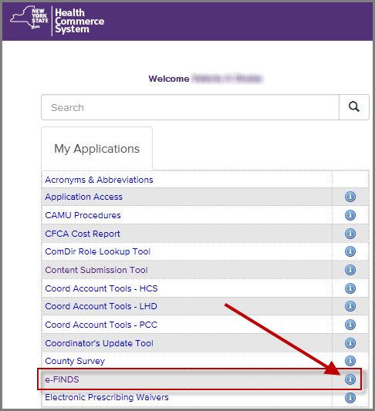
NYSDOH RESOURCES
Self-Guided Walkthrough:
https://apps.health.ny.gov/pub/ctrldocs/e-finds.html
Support Documents on HCS
https://commerce.health.state.ny.us
Implementation Procedure and Job Action Sheet Templates
Application Use Training Guides
eFINDS process flow diagram
Scanner specs and pricing
Power point presentations
eFINDS quick reference cards
Current eFINDS training webinar schedules
Notes:
Module 4

Slide 92
NYSDOH RESOURCES
training
request additional barcode numbers be provisioned to facilities conducting training and exercises
exercise support
non-training wristbands (if expended in real event or if there has been an increase in certified bed count, facility name)
send an e-mail to efinds@health.state.ny.us and copy the appropriate NYSDOH RO Representative
Refer to NYSDOH Non-Emergency eFINDS Request Process for further details/instructions

Slide 93
NYSDOH RESOURCES
TECHNICAL
Example Issues:
I cannot find or open eFINDS.
I do not see my facility listed in eFINDS.
Valerie Shuba
DOH ITS
518-473-1809
valerie.shuba@health.ny.gov
Gregory Sweet
DOH ITS
518-473-1809
Gregory.sweet@health.ny.gov
I cannot log into the HCS.
  Contact CAMU help desk: 1-866-529-1890
PROGRAMMATIC
Example Issues:
Implementation Questions
Regulatory or policy issues/concerns
Debra Sottolano
Office of Primary Care & Health Systems Management,
518.485.9914
debra.sottolano@health.ny.gov
Shannon Ethier
Office of Health Emergency Preparedness
518.474.2893
Shannon.ethier@health.ny.gov
Notes:
The Health Commerce System trainers are the team responsible for providing technical assistance with eFINDS, so if you find that you are having a technical issue with eFINDS or the Health Commerce System in general you should contact the Health Commerce System Trainers at the number or email listed on the screen.
Contact the CAMU help desk For password and account questions.
Contact hinweb@health.state.ny.us if you are experiencing technical problems with the site.
For non-technical issues that lean more towards implementation, operations and regulatory concerns, please address those to the Office of Primary Care&Health a Systems Management, Director of Preparedness
Programmatic Questions about eFINDS Implementation/requirements Contacts
As of 3/3/14 – NYSDOH implementation guide has not been released

Slide 94
Vendor Resources
Contact for Purchase of Additional Scanners
To receive the discounted price at the time of purchase,
indicate the scanner is being purchased for the “eFINDS Project”
Charlie Waldman | L-Tron Corporation
P (585) 383-0050 ext. 111 | F (585) 383-0701
596 Fishers Station Dr., Victor, NY 14564

Slide 95

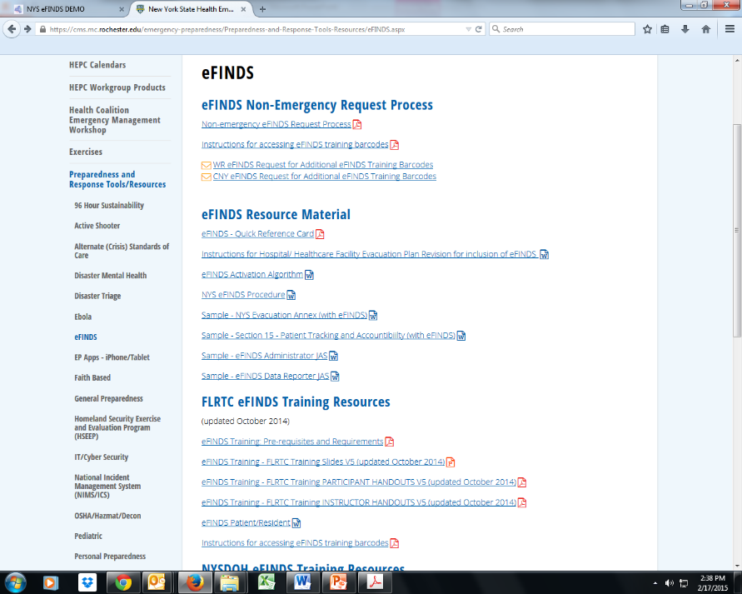
RTC RESOURCES
WRHEPC.URMC.EDU
  preparedness and response tools/resources
  eFINDS
Finger Lakes Regional Training Center
Anne D’Angelo
Phone: (585) 758-7640
anne_dangelo@urmc.rochester.edu
AMC Regional Training Center
Chris Smith
Phone: (518) 262-1070
SmithC12@mail.amc.edu
MARO Regional Training Center
Connie Kraft
Phone: (631) 444-9074
Connie.Cincotta-Kraft@stonybrookmedicine.edu
Notes:
Documents that can be used to incorporate eFINDS into your Evacuation and/ or Disaster Plan can be found:
WRHEPC.URMC.edu
http://www.urmc.rochester.edu/emergency-preparedness/Preparedness-and-Response-Tools-Resources/eFINDS.aspx

Slide 96
Teach Back

Slide 97
QUESTIONS
TEACH BACK
FEEDBACK
EXPECTATIONS
NEXT STEPS
EVALUATION
CERTIFICATE

