Slide 1
Hazmat Training for the First Receiver (OSHA)
Finger Lakes Regional Training Center
University of Rochester Medical Center
Rochester, NY

Slide 2
Instructor
Allan Chrysler, CHEP, MEP
  Allan@trexplanning.com
  315-272-9352

Slide 3
Acknowledgements
USAMRICD, USAMRIID
John G. Benitez, MD, MPH (Vanderbilt)
Ruth A. Lawrence Poison & Drug Information Center (URMC)
Center for Disaster and Emergency Preparedness (URMC)
Gail Quinlan, RN, MS (URMC)
Robert Passalugo, CIH, Darlene Ace, CIH
(U of R)
Kathee Tyo, MS, RN (URMC)

Slide 4
General Principles of Decon
Training Requirements
Recognition and Response
Chemical Identification

Slide 5
Awareness Level Training
WHO: Everyone
WHAT:
  How to know if someone…
  How to keep safe
  How to alert

Slide 6
Operations Level Training
WHO: Decon Team Members
WHAT:
  Didactic and Practical
    Recognition of chemicals
    PPE
    Recognition of symptoms
    Clean up
When:
  Must be completed annually along with a respiratory questionnaire

Slide 7
Decontamination
Who: Anyone that is contaminated
  Victims
  Responders
What: Anything that is necessary for your hospital to function
  Equipment
  Structures

Slide 8
Decontamination
Where
  Uphill, Upwind when possible
  Designated external sites
When: Anytime you suspect contamination
  Victim complains of pain, odor, etc.
  Victims near release site
  Visible material

Slide 9
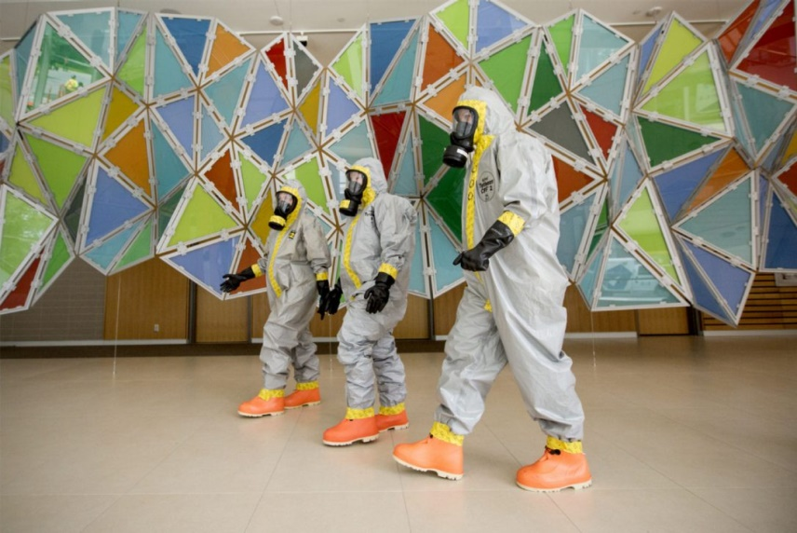
Decontamination
Why: Prevent worsening of problem
  Remove toxic agent
  Prevent staff/facility contamination

Slide 10
Recognition & Response

Slide 11
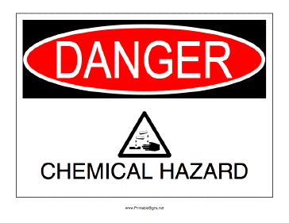

Hazardous Substance
Is any substance to which exposure may result in adverse effects on the health or safety of employees. (OSHA)
Includes:
  Substances defined by CERCLA
  Biological agents with disease causing potential
  US DOT substance listed as hazardous
  Substances classified as hazardous waste

Slide 12
Chemical Hazards
69% occur at fixed sites (ATSDR,2007-2008)
91% involve one substance(ATSDR2007-2008)
Most are liquid (40%) or vapors (41%)
  Corrosives
  Pesticides
  Gases
  Paints and dyes
  Volatile organic hydrocarbons
  Other inorganic chemicals
  http://www.atsdr.cdc.gov/HS/HSEES/annual2008.html#substances

Slide 13
Contamination Event
VERY common
Patients go to CLOSEST* hospital – Self Extricate!
Risk to hospital
  Contamination of staff and facilities
  Need emergency plan
  Need decontamination facility and team

Slide 14
Emergency Response Plan
Train everyone to AWARENESS level
  All ED staff
  Valet
  Security
  Information Staff
Decon Team Policies, Procedures & Guidelines
Notification Procedure – After hours & Weekends
ASSUME all are contaminated

Slide 15
Notification System
Notifies all in ED/Hospital
  HICS / HCC Staff
  Decon members
  Support staff – Security, Engineering
  Specific responsibilities - JAS
Activates Decon team
Access Control/Lockdown

Slide 16
Activation/Response
Decon Team members and support staff
  Prepares the decon room / area ready
  Gets partially dressed, except respirator
  Finalizes PPE and decontaminates victim(s)

Slide 17
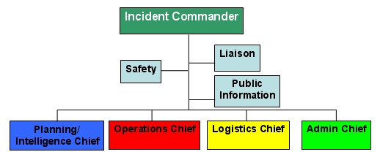
Incident Command System
ICS should be followed at ALL levels
Hospital
  Departmental
    Specific team (ie, Decontamination)
At each level, designated person to communicate with.

Slide 18
ICS – Decon Team
Command
Safety Officer (Asst. Safety Officer-Decon)
Operations (Haz-Mat Branch Director, Victim Decon Unit Leader)
Logistics (Decon team suit/equipment support)

Slide 19
Agent Identification

Slide 20
Labels/warnings…
CAS numbers
(Chemical Abstract Service #)
Shipping manifesto/label
Container label
DOT placards
Name of product on container

Slide 21

Initial ID/precautions
Emergency Response Guidebook
Quick guide
  General ID
  Occasional specific ID
  General guidance for class of chemical

Slide 22
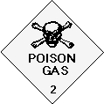
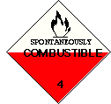
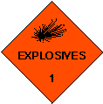

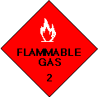
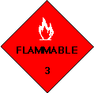
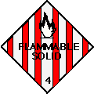

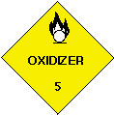
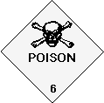
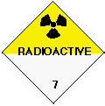
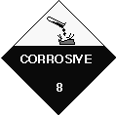


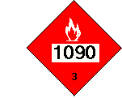

Placards and Labels

Slide 23
Other patient’s warning…
I was doing…
It smelled like…
It is used for…
You HAVE TO USE A RESPIRATOR to…
It tasted like…
There’s a <color> warning/placard on it…
Use Safety Data Sheets (SDS)
Shipping information – if available

Slide 24
Poison Center will…
ID chemical
  Based on placard information you find
  Based on signs and symptoms displayed
Healthcare information
  Signs and symptoms to watch out for
  Treatments that may be needed
1-800-222-1222

Slide 25
WHY???
Types of PPE
Types of hazards to providers
Type of Decon
  Dry- removal of clothing
  Wet- removal of clothing and shower

Slide 26
CBRNE
Define
  WMD
  NBC
  CBRNE
Nuclear Devices
Biological Weapons
Chemical Weapons
POISON
Notes:
FOCUS - NBC DELTA
The focus of the Domestic Preparedness Training Program is on the response to an incident involving NBC agents. These agents are significant as they were designed and optimized specifically to kill or injure, and as a result will affect the response procedures normally employed at hazardous material incidents. We will discuss the impact of NBC and potential changes to response procedures. This is the NBC Delta (or difference) in emergency response.
Additionally, because many of these agents were invented for military use, the terminology associated with them is military in nature, and thus different from that normally encountered with respect to hazardous materials. Your mission, to train responders to bring order from confusion and defeat the terrorist by minimizing the effects of these weapons, will rely heavily on an understanding of these differences.

Slide 27
NBC/CBRNE Agent Sources
Home production
Laboratory / commercial production
Industrial facilities
Military sources
Medical / university research facilities
Notes:
NBC AGENT SOURCES
a. A likely source of chemical and biological agents is the home laboratory. This can mean low concentration, impure, inexpensive materials or fairly potent agents, depending on the processes used to produce and purify them. In some cases, the process is as simple as an improperly preserved canned good (botulinum toxin) or very complex (nerve gas).
b. Many terrorists rely on a legitimate laboratory to produce the agent, and simply attempt to either buy it or steal it.
c. Stealing NBC agents or precursors from industries that use poisonous chemicals in bulk may be easier for terrorists than making these agents themselves. Frequently, industries ship or store the chemicals in relatively accessible areas.
d. Terrorists are less likely to obtain NBC agents from military authorities, although foreign military equipment can be obtained. With the breakup of the Soviet Union, there are many establishments involved in NBC looking for a new market among the unscrupulous.
e. Medical and university research facilities are possible sources for small quantities of hard to obtain chemical or biological materials, and these are often poorly protected from theft. The Ohio man who obtained bubonic plague bacteria bought it from a biological research supplier.

Slide 28
The Fallacies
It can’t happen to us
NBC agents are so deadly the victims will all die anyway
There is nothing we can do
Many of the following terrorist examples can happen more commonly right in our own communities.
Notes:
THE FALLACIES
There are three common perceptions about NBC agents that we can now debunk:
a. It can’t happen to us: Yes, it can happen to you. It already has in many states and in foreign nations. If, in 1994, we had been asked to list the 10 cities most likely to be attacked by a terrorist, how many of us would have included Oklahoma City?
b. NBC agents are so deadly, the victims will all die anyway: NBC agents are not a doomsday machine. The vast majority of people within the area affected by an NBC event are not going to be seriously injured. Many won’t show any symptoms at all. This does not lessen the severity of the injuries for those unlucky enough to become casualties; however, most of the survivors should eventually recover with proper medical treatment. In spite of the magnitude of the Tokyo subway attack, only 12 people died.
c. There is nothing we can do: Yes, there is something you can do; you can begin preparing your HAZMAT team to identify and mitigate the NBC material hazard. Once these skills are mastered your hospital can build on this capability to treat victims of a mass casualty incident. Dealing with NBC agents as a part of the terrorist attack will certainly make that job harder, but not impossible. The key is to train, prepare plans, and then exercise the training and plans.

Slide 29
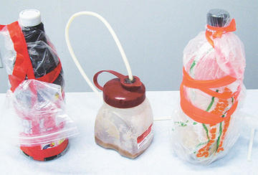
Chemical Agents
Notes:
CHEMICAL AGENTS
March 20, 1995, 7:46 a.m. Eleven devices containing the chemical agent Sarin were placed in five subway cars of the Tokyo metropolitan system. Over 5,500 people were victims of the agent, 12 died. This incident raised serious concern about the ability of any emergency response system to react to terrorist use of supertoxic chemicals.
During the next hour, this module will provide detailed information about the chemical agents that a potential terrorist would find most attractive to use. As we discuss these agents, keep a few things in mind:
a. The response to an incident caused by a terrorist employing a chemical agent is in many ways similar to an “everyday” HAZMAT response, but with the addition of some very significant considerations:
(1) The materials considered chemical agents vary from those used during WWI, which are hazardous materials used in industry today (such as chlorine, hydrogen cyanide, and phosgene), to nerve agents which are 200-600 times more toxic than chlorine.
(2) There is a an elevated potential for casualties.
(3) It is a crime scene. This is a deliberate act, not an accident.
b. All of these add to the complexity of the incident, and make it less forgiving.
c. We will be using military terms frequently during our discussion because they are the terms used with many of the detection instruments (most of which are military in origin). Additionally, many of the supporting federal response teams also use these terms.

Slide 30
Chemical Agents
General Information
Pulmonary Agents
“Blood” Agents
Blister Agents
Nerve Agents

Slide 31
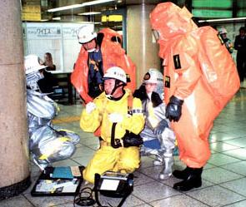
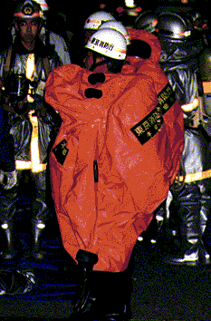
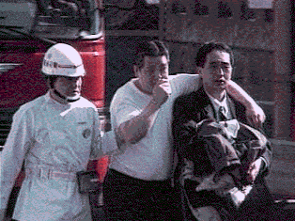
Tokyo Sarin Attack
Numbers seeking medical care:
  5,510 total at 278 health-care facilities
    Mild: 984
    Moderate: 37
    Severe: 17
    Deaths: 12
    Status unknown: >300
No secondary contamination of
health-care workers,
but 2 vapor-exposed physicians

Slide 32
Real Life
Most will not wait for EMS to arrive
Most will go to hospitals without decontamination
About 80 % of victims arrive without decontamination

Slide 33
Characteristics and Behavior
Generally liquid (when containerized)
Normally disseminated as aerosol or gas
Present both a respiratory and skin contact hazard
May be detectable by the senses (especially smell)
Influenced by weather conditions
Notes:
CHARACTERISTICS AND BEHAVIOR
The chemical agents discussed in this module will have characteristics and behaviors which are understandable and predictable. The better we understand these properties, the better equipped we will be to mitigate their effects.
Chemical agents:
a. Are generally liquids when containerized; some boil at very low temperatures and are almost immediately released as vapors (gases).
b. Are normally disseminated as an aerosol or gas, since entry through the respiratory route is the most effective.
c. When disseminated as a liquid, many chemical agents present a hazard both through the respiratory tract and by contact with the skin. This applies especially to the blister and nerve agents.
d. May have an identifiable odor and/or physical characteristics. However, the exact odor and physical characteristics are dependent on the purity of the agent.
e. Are influenced by weather conditions such as temperature, wind speed and direction, humidity, precipitation, and air stability.

Slide 34
Characteristics and Behavior
Irritant/Corrosive vs. Drug-Like Effects
Physical States
  Vapor/Gases act quickly
  Liquids act slower
  Solids
Normally disseminated as aerosol or gas

Slide 35
Characteristics and Behavior
Present both a respiratory and skin contact hazard
May be detected by the senses (especially smell)
All forms of chemicals may cause contamination
Personnel must wear protective equipment during decontamination and immediate patient care

Slide 36
Chemical Agent Clues
Rapid onset of symptoms
Similar signs and symptoms
Absence of traumatic injury
Emergency responders may be affected
Animal or insect die-off
Report of cloud or vapor release

Slide 37
Routes of Entry
Inhalation - vapor or aerosol
Skin (percutaneous) - liquid or vapor
(vapor if prolonged contact with skin)
Ingestion - liquid or solid
Injection - intravenous or intramuscular

Slide 38
Volatility
Tendency of a liquid agent to form vapor
Volatility proportional to vapor pressure
Affected especially by:
  Temperature
  Wind
  Method of delivery

Slide 39
Persistence
Tendency of a liquid agent to remain on terrain, other surfaces, material, clothing, skin
Affected especially by
  Temperature
  Surface material
Persistence is inversely proportional to volatility

Slide 40
Examples
Non-persistent agents (less than 24 hours)
tabun, sarin, soman, cyanide, phosgene
Persistent agents (greater than 24 hours)
mustard, VX

Slide 41
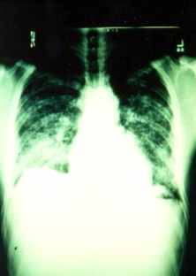
CHOKING (PULMONARY) AGENTS
Disrupts pulmonary function
  Non cardiogenic pulmonary edema
  ARDS (Adult Respiratory Distress Syndrome)
Treatment: Supportive
Notes:
Chlorine and Phosgene are the classic examples of Lung Damaging (Pulmonary) chemical warfare agents. Both are gases at standard temperature and pressure, but in munitions or storage containers, are compressed liquids.
They cause an alveolar-capillary membrane leakage resulting in non-cardiac pulmonary edema. This is analogous to the Adult Respiratory Distress Syndrome (ARDS) seen in intensive care units every day.
The clinical situation with pulmonary agents is greatly worsened if patients continue to work or exert themselves in the latent period immediately following the insult. Even if the exposed person looks pretty good and has no objective evidence of lung damage, he or she must not be allowed to walk or otherwise exert him or herself.
Therapy is supportive, with use of O2 (oxygen) mechanical ventilation, positive end expiratory pressure (PEEP), IV fluids and antibiotics as needed. Recovery may require prolonged hospitalization.
Diuretics are a relative contraindication since shock is frequently a complication of this non-cardiac pulmonary edema.

Slide 42
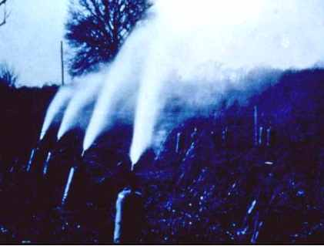
CHLORINE CYLINDERS
Ypres, Belgium, April 1915
Notes:
The Germans launched that first chemical agent attack--using chlorine gas-- on the battlefield of Ypres, Belgium in April 1915. After they placed the chlorine canisters, they had to wait three weeks for the prevailing winds so they were blowing from East to West. When correct wind conditions came, the Germans simply turned the valves on 6,000 chlorine tanks.

Slide 43

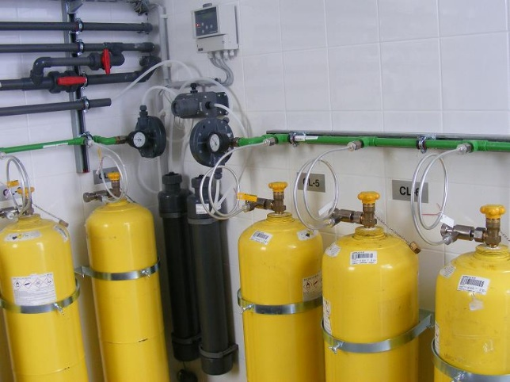
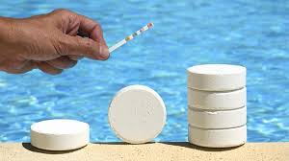
CHLORINE - Civilian Uses
Chlorinated lime (bleaching powder)
Water purification
Disinfection
Synthesis of other compounds
  synthetic rubber
  plastics
  chlorinated hydrocarbons
Notes:
We are all familiar with many of the uses of chlorine and we recognize its irritating effects on skin and mucous membranes from our contact with chlorine as a disinfectant and water purifying agent. Chlorine is also used extensively in the chemical industry as a precursor or building block compound for the chlorinated- hydrocarbon plastics we use everyday.

Slide 44
CHOKING (PULMONARY) AGENTS
Phosgene
Chlorine
Odor: Newly cut hay
Symptoms: Coughing, choking, vomiting
Odor: Swimming pool
Symptoms: Coughing, choking, vomiting

Slide 45
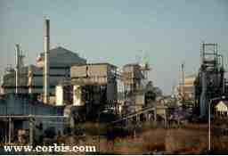
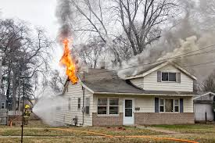
PHOSGENE - Uses/Sources
Chemical industry
  foam plastics (isocyanates)
  herbicides, pesticides
  dyes
Burning of:
  plastics
  carbon tetrachloride
  methylene chloride (paint stripper)
  degreasers
Notes:
Phosgene is used extensively in the chemical industry as a precursor for chlorinated hydrocarbons like those found in plastics, herbicides and dyes. The facility in the photo is the Union Carbide plant in Bhopal, India. This plant was producing these types of compounds when, in 1984, a single release of methylisocyanate and phosgene killed thousands. Its sister facility in Chemical, West Virginia produces these same compounds.
When chlorinated hydrocarbon compounds like paint strippers and degreasers are burned, phosgene is one of the products of combustion. Because many tons of phosgene and related chemicals are used, stored and transported in this country daily, soldiers are probably at greater risk for exposure from peacetime release or fires, than from exposure by enemy action in war.

Slide 46
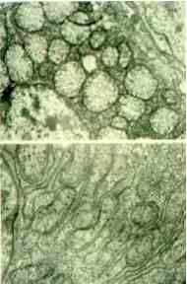
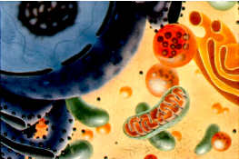
“BLOOD” AGENTS (CYANIDE)
Hydrogen Cyanide (AC)
Cyanogen Chloride (CK)
Notes:
The next category of chemical warfare agent is “Blood” agent represented entirely by Cyanide. The two warfare representatives are Hydrogen Cyanide (AC) and Cyanogen Chloride (CK).
The military term “blood agent” is actually a misnomer in that blood only transports cyanide to the mitochondria in the cell, where it interferes with the cytochrome oxidase system. The cyanides are thus better thought of as “cell” agents.

Slide 47
Blood Agents
Cyanide Gas
Odor: Bitter almonds/musty
Symptom Onset: Rapid
Symptoms: Normal skin color, gasping for air, shock, seizure

Slide 48
CYANIDE (BLOOD AGENTS)
Hydrogen Cyanide (AC), Cyanogen Chloride (CK)
Gas at STP, lighter than air
Mechanism: blocks cell utilization of oxygen
Old treatment: amyl/sodium nitrite and sodium thiosulfate
New treatment: hydroxocobalamin
Notes:
Both forms, Hydrogen Cyanide and Cyanogen Chloride, are gases at standard temperature and pressure. Hydrogen Cyanide is slightly lighter than air.
Cyanide works rapidly to block cellular utilization of oxygen to form energy, ATP, in the mitochondria. Cyanide asphyxiates the victim at the cellular level but does not deplete the blood of oxygen. Therefore, the cyanide poisoned person can appear pink because the venous blood is oxygenated.
Therapy requires the formation of methemoglobin. Methemoglobin pulls the cyanide out of the mitochondria, thereby allowing the cytochrome oxidases to resume ATP production. Sodium thiosulfate is given next to augment the systemic clearance of cyanide. Oxygen support helps. Both antidotes are included in the Cyanide Antidote kit for cyanide toxicity. Even severely symptomatic patients can be expected to recover fully if treated before circulatory collapse.

Slide 49
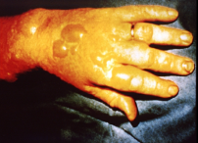
BLISTER AGENTS (VESICANTS)
Sulfur Mustard (H,HD)
Nitrogen Mustard (HN1, HN2, HN3)
Lewisite = chlorovinyldichloroarsine (L)
Mustard / Lewisite mixtures (HL,HT,TL)
Phosgene oxime (CX)
Notes:
These are the major agents classified as Vesicants because they burn and blister the skin.
Sulfur Mustard (H, HD) is the major vesicant because of its ease of manufacture, effectiveness, and the existing stockpiles. Twice as toxic as cyanide, but with injuries evolving over hours and days, mustard’s time to death can be several weeks. Time for recovery can be weeks or months.
Nitrogen Mustard (HN) was our first chemotherapeutic agent from the 1930s and is still used today occasionally for the skin lymphoma, mycosis fungoides.
Lewisite (L) was invented during WWI by a U.S. Captain (Lewis), probably looking for a better treatment for syphilis. It contains arsenic, a known carcinogen.
Mustard/Lewisite (HL) mixtures are made to lower the freezing point of sulfur mustard to around 10⁰ F.
Phosgene oxime (CX) is a very corrosive substance stockpiled by the former USSR.

Slide 50
VESICANTS: SULFUR MUSTARD
Sulfur Mustard, Nitrogen Mustard
Oily liquid, heavier than air and water, persistent
Garlic Odor
Mechanism: alkylating agent, DNA and proteins most sensitive targets
Symptom onset delayed
Symptom: Tearing, eye irritation, cough, blisters, and runny nose
Treatment: Treat similarly to burn patients
Notes:
Sulfur Mustard is an oily liquid heavier than water, and its vapor is heavier than air. Because it is an oily substance which easily stays in the atmosphere longer than 24 hours, it is classified as a persistent agent and is primarily a liquid hazard. However, at warm temperatures or with aerosolization, it does become a vapor hazard.
HD is an alkylating agent that rearranges carbon-carbon bonds in sensitive targets, such as the DNA of rapidly dividing cells, cell membranes, and other cellular proteins. It causes severe burns of the eyes, skin and pulmonary system. It also cause immune suppression at larger doses with the circulating lymphocytes being depressed within 24 hours or less.
Therapy is entirely supportive with a severe casualty requiring all the capabilities of a modern intensive care burn unit. Death is usually due to secondary pneumonia.

Slide 51
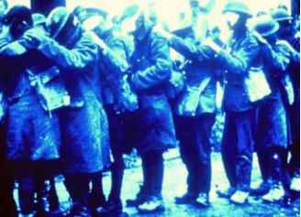
BLIND LEADING THE BLIND
Convalescence 2wks-6months
Notes:
This is a famous photo from WWI showing soldiers with the Mustard eye injury. Their convalescence ranged from two weeks to six months. Most did not die. One percent had permanent damage, and 0.1% would qualify as legally blind today.

Slide 52
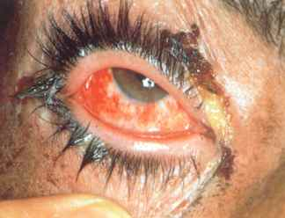
MUSTARD: EYE
Notes:
This is a photo of a moderately severe conjunctivitis. Note the ointment on the eyelids to prevent them from sticking together. This allows the pus to drain and prevents the formation of an eye abscess. Judicious use of topical antibiotics with steroids is probably indicated and has been shown to work in research. However, care must be given when using steroids and, when possible, is best prescribed by an Ophthalmologist. This WWI casualty required an average of two months to heal.

Slide 53
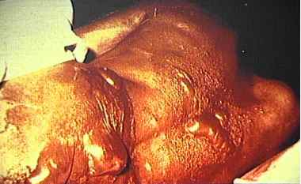
VESICANT EFFECTS
Iran/Iraq War: 90-95% burns, pulmonary injury, bone
marrow suppression, sepsis, and eventually died.
Notes:
This unfortunate Iranian casualty had 90-95% body burns, pulmonary injury, bone marrow suppression, and sepsis. He died.

Slide 54
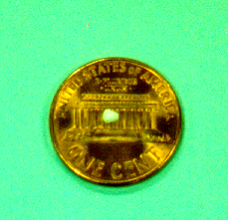
NERVE AGENTS
(ANTICHOLINESTERASES)
Tabun (GA)
Sarin (GB)
Soman (GD)
GF
VX
Represents three lethal doses of VX
Notes:
These are the five major Nerve Agents: Tabun, Sarin, Soman, GF, and VX. They are listed in order of their invention. The G stands for Germany. VX was invented in Great Britain and developed by Great Britain and the United States. The Russians have Russian V agent, which is very similar to VX. Sarin is the most volatile and is similar to water in its consistency. VX is oily and very persistent, easily hanging around for up to a month in the atmosphere. VX is also the most toxic on a mg basis, but responds well to therapy because it essentially doesn’t permanently bind to the enzyme, acetylcholinesterase. Soman is the most difficult nerve agent to treat medically because it binds irreversibly to acetylcholinesterase in two minutes.
The liquid drop on the penny represents about three lethal doses of VX.
The other photo on this slide is a computer generated model of acetylcholinesterase.

Slide 55
NERVE AGENTS
Sarin (GB), VX (persistent)
All liquids initially at STP
Mechanism: inhibits acetylcholinesterase, causes massive cholinergic crisis
More common - Organophosphate Poisoning
Treatment: atropine, oxime, diazepam
Notes:
All nerve agents are liquid at standard temperature and pressure.
Nerve agents work by blocking the enzyme acetylcholinesterase.
This results in a massive cholinergic crisis. Pupils become pinpoint, glands greatly over secrete, muscles, (both smooth and striated) contract and spasm causing fasciculation's, spasm and eventually flaccid paralysis. In the gastrointestinal tract vomiting and diarrhea are usual. Bronchospasm, spasm of the diaphragm and central nervous system (CNS) respiratory effects cause marked difficulty breathing. Larger exposures cause potentially life-threatening seizures. All of this leads to pulmonary death through several mechanisms without medical intervention.
Atropine, the first line of therapy, blocks the effects of acetylcholine at muscarinic receptors. It makes breathing easier and decreases secretions.
2-PAM chloride (Oxime) breaks the agent-enzyme bond to restore the normal activity of the enzyme.
Pyridostigmine is taken prophylactically to allow for rescue of soman casualties.
Diazepam is a good anti-seizure medication.

Slide 56
Nerve Agents
Odor
Properties
Tabun, Sarin: None or fruity
Soman: None
VX: None/Sulfur
Volatile
Volatile
Persistent

Slide 57
Signs and Symptoms of NA Exposure
D iarrhea
U rination
M iosis
B radycardia
B ronchospasm
B rhochorrhea
E mesis
L acrimation
S alivation
and:
Seizures
Coma
Death

Slide 58
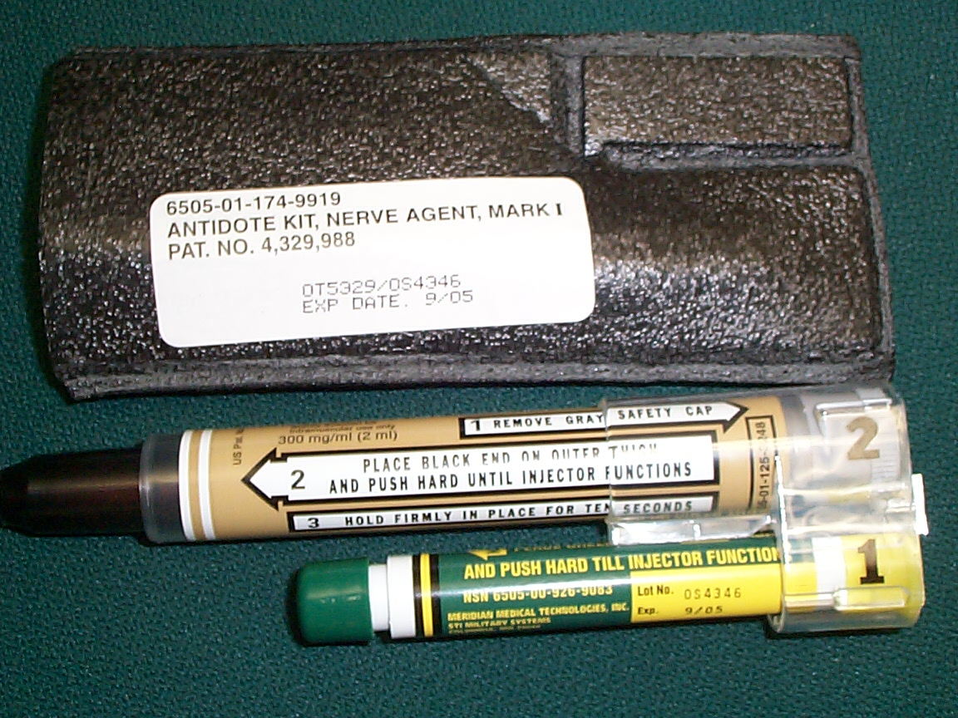
MARK I Kit

Slide 59
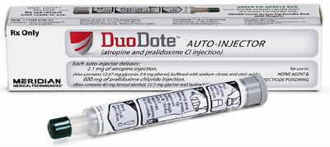
DuoDote

Slide 60
Auto-Injectors
Finish decontamination after administration
Observe for further symptoms
If needed repeat with another kit
Children
  Will need size appropriate dosing
  No auto-injectors at this time

Slide 61
Follow-up Care
Notify HazMat Branch Director or Victim Decon Unit Leader
Receiving team and rest of ED should be ready with:
  IV
  Atropine
  Pralidoxime
  Benzodiazepine
  Airway

Slide 62
Other Use
IF YOU OR ANY DECON TEAM MEMBER BECOMES SYMPTOMATIC:
  Notify HazMat Branch Director or Victim Decon Unit Leader
  Use Auto-Injector kit
  Assist member to decon
  Assist member out of decon for further care

Slide 63
COMPARATIVE TOXICITY OF AGENTS
6000
5000
4000
Ct₅₀
(mg-min/m³)
3000
2000
1000
0
CL
CG
AC
H
GB
VX
AGENT
(L)
(L)
(L)
(L)
(L)
(L)
Notes:
We are returning to this comparative toxicity chart for the last time. You can easily see how little GB and VX are required to cause death. Remember, a liquid drop the size of a pinhead represents a lethal dose of VX.
The pattern throughout history has been the development of more effective and deadly agents. On the modern battlefield, our two greatest threat agents are nerve followed by mustard.

Slide 64

Break

Slide 65
Biological Agents
Notes:
BIOLOGICAL AGENTS
The time was April, 1979 - the place, Sverdlovsk, USSR. Sverdlovsk (now Ekaterinburg) was located about two and one-half miles from a Soviet military facility. On this particular day, the wind was blowing such that Sverdlovsk was downwind from the military facility when an accidental release of biological material occurred. It was probably just another day in the lives of the people of Sverdlovsk, or so they thought.
A few days later, some of the townspeople started developing fevers, chills, and other symptoms; some were complaining about chest pains. As time passed, more individuals started displaying these same symptoms and some of the earlier victims died.
What happened? Attending medical personnel diagnosed this occurrence as an outbreak of anthrax. The initial news releases coming from the Soviets said the anthrax outbreak was the result of ingesting contaminated meat purchased on the black market.
Eventually 77 cases of anthrax were reported, with 66 deaths resulting. The autopsies listed anthrax as the cause of death.
In 1992, President Boris Yeltsin admitted that the nearby military installation had been part of an offensive biological weapons program and that an epidemic had been caused by a non-intentional release of one to two kilograms of anthrax spores during the process of uploading artillery shells.
This is a classic example of what a biological agent can do.

Slide 66
Biological Agents
General Information
Bacterial Agents
Viral Agents
Toxin Agents

Slide 67
Biological Agent Characteristics
Produce delayed effects
Do not penetrate unbroken skin
Non-specific symptoms
Undetectable by senses
Difficult to detect in the field
Do not evaporate
Long incubation period
Notes:
BIOLOGICAL AGENT CHARACTERISTICS
As we look at biological agents, you will see some similarities to hazardous chemicals, but you will also note some significant differences.
Biological agents:
a. Produce delayed effects. From a responder's point of view, the biggest difference is time. Unlike chemical agents, most of which have an immediate effect, biological agents have a delayed effect ranging from several hours to days, and in some cases weeks. This is due to the incubation period between the time a person is infected and the time symptoms develop.
b. Do not penetrate unbroken skin. Unlike some of the chemical agents (nerve and blister agents), biological agents cannot penetrate healthy unbroken skin. Some toxins affect the skin (e.g., poison ivy, mycotoxins). To cause disease, most biological agents must be inhaled or ingested. Our skin provides a good barrier to most agents, in contrast to some chemical agents which can cause toxic reactions and symptoms if placed on the skin.
c. Do not evaporate. Unlike chemical agents, biological agents do not evaporate. A container of biological material would be dependent on environmental factors to release particles into the atmosphere.
d. By weight are generally more toxic than chemical agents. For example, ricin, one of the biological toxins, is two to three times more toxic than VX, the most toxic nerve agent. Botulinum, another toxin, is 5,000 to 10,000 times more toxic than VX.

Slide 68
Biological Agent Characteristics (continued)
Most effectively disseminated as aerosols
Range of effects
Obtained from nature
Multiple routes of entry
Destroyed by environment
Some are contagious
Notes:
BIOLOGICAL AGENT CHARACTERISTICS (continued)
a. Disseminated as aerosols. Like the chemical agents, the terrorist will attempt to disseminate biological agents as aerosols in order to get them into the respiratory system. Biological agents will be disseminated as either liquid or solid aerosols.
b. Have a range of effects. Biological agents have a variety of effects depending on the organism and how it affects us, the dose we receive, and the route of entry. These effects range from skin irritation to death.
c. Are obtained from nature. Each of the biological agents has a natural host. In some instances, with little training or equipment, a small amount of culture or material can be "grown" into larger quantities which are then placed in a dissemination device.
d. Multiple routes of entry. Biological agents can enter the body through inhalation or ingestion, through a wound or break in the skin, or through other body openings or orifices. In a terrorist use, inhalation would be the most likely targeted route of entry, followed by ingestion.
e. Destroyed by the environment. Many biological agents are living organisms and adverse temperature and humidity will affect them. The ultraviolet rays in sunlight will kill most of them within hours (an exception is anthrax, which can survive for extended periods in the environment). Because of this, the use of biological agents is more likely at night or in enclosed areas.

Slide 69
Classes of Biological Agents
Biological Warfare Agents
Bacteria
Viruses
Toxins
Notes:
CLASSES OF BIOLOGICAL AGENTS
Biological agents considered for warfare fall into three primary classes:
a. Bacteria. Bacteria are self-sufficient, living organisms.
b. Viruses. Viruses are living organisms, but they need a “host” organism in order to survive.
c. Toxins. Toxins are poisons produced by bacteria, viruses, plants, and animals. Botulinum is a good example of a toxin. Poison ivy is caused by a plant toxin.

Slide 70
Agents Considered for BW
Bacteria and Rickettsiae
Anthrax spores, Tularemia, Plague, Brucella,
Q Fever
Viruses:
Smallpox,VEE, Hemorrhagic fevers
Toxins:
Botulinum toxin, SEB, Ricin, Saxitoxin

Slide 71
Acquisition of Etiological Agents
Multiple culture collections
Universities
Commercial biological supply houses,
e.g. Iraq
Foreign laboratories
Field samples or clinical specimens,
e.g. Ricin

Slide 72
Biological Agents
Most toxic per weight
Production technology is easily accessible
Inhalation threat – 1 to 5 micron aerosol
Undetected until numerous casualties
Incapacitating to lethal effects
Notes:
2. Biological agents. These can be considerably more lethal than chemical agents. Because they are obtained from nature, they are far more accessible to the terrorist and relatively easy to produce. They are primarily an inhalation threat and are usually dispersed in their aerosolized form in the 1 to 5 micron size. They have effects that usually go undetected for days, until large numbers of the population begin to present with similar patterns of symptoms. They vary from incapacitating to lethal and fall into three categories:

Slide 73
BW General Properties
Not volatile, must be dispersed as an aerosol
Silent, odorless, tasteless
Relatively inexpensive to produce
Simple delivery technology
  Point source - aerosol generator
  Line source - moving aerosol generator:
  auto, airplane, etc

Slide 74
BW - General Properties 2
Inhalation is the most significant route of transmission for BW
Aerosol - 1 to 5 microns ideal size
Other routes of entry: oral, dermal abrasion, or intentional percutaneous
Notes:
II. CHARACTERISTICS OF BIOLOGICAL WEAPONS
A. General Properties
Despite differences between the various types of biological agents, these agents, bacteria, viruses, and toxins share some common characteristics. The primary route of infection or “portal of entry” is by inhalation (pulmonary). Since BWs are nonvolatile (do not evaporate), they must be dispersed in aerosols as 1 to 5 micron size particles (1/30,000 of the diameter of a hair follicle) which may remain suspended in the air for hours (depending on weather conditions). If inhaled, the particles will deposit deep into the terminal air sacs of the lungs, causing disease.

Slide 75
Biological Detection
Mainly of clinical diagnosis
Lab confirmation may be delayed
Unusually bad cases
Syndromic Surveillance - HCS
Beware of multiple healthy people with similar complaints

Slide 76
Impact of a BW Release
Extensive and prolonged need for medical services
Increased need for PPE
Possibility of a quarantine
Handling remains/mortuary facilities
Multiple jurisdictional challenges
Responding to a “hoax” can be expensive
Notes:
Outside of a few professional groups and some military personnel, there is a very poor understanding of BWs. Bacteria and viruses are often perceived by the public to be invisible agents that have the ability to attack at will and spread from person to person and against which there are no means of self-protection. In the event of a real or threatened BW attack, many unaffected people will attribute various nonspecific symptoms to toxins or infectious agents. When a BW agent is suspected and a call for assistance is made, the emergency response will cross jurisdictions and may include fire personnel, emergency medical service (EMS), law enforcement, specially trained response teams [Metropolitan Medical Strike Teams (MMSTs), Chemical/Biological Incident Response Force (CBIRF)], federal agencies, public health departments, and various experts in biological warfare.
The public reaction to BW was manifested recently in Washington, D.C. (April 1997) when a package containing a Petri dish labeled with “anthrachs,” an apparent misspelling of the deadly bacterial disease, anthrax, and “yersinia” was sent to the international headquarters of B’nai Brith. After being discovered and reported, 108 employees inside the building were “quarantined” for 8 hours, traffic to the area was diverted for miles, and two B’nai Brith employees and 12 firefighters were decontaminated in the streets with a chlorine solution as a precaution (Associated Press 4/25/97).
It may be appropriate to institute a quarantine if the agent is known to be contagious.

Slide 77
Physical Protection (PPE)
Only foolproof means of protection
Present equipment is effective
Problem is knowing when to put protective mask on
No universal protection for civilian populations
Limited education programs for civilian populations

Slide 78
Possible Epidemic Syndromes in BW
Influenza syndrome
Pulmonary syndrome
Jaundice syndrome
Encephalitis syndrome
Rash syndrome or cutaneous lesions
Unexplained death or paralysis
Septicemia/toxic shock
Notes:
After a characteristic incubation period following aerosol exposure, most BW agents present as an initial influenza syndrome with fever, chills, malaise, headache, and myalgia. Some BW agents rapidly develop into a pulmonary syndrome with dyspnea, cyanosis, chest pain, and radiological abnormalities. Liver involvement is indicated by rising liver enzymes, with or without jaundice. Encephalitis may occur with some select viral agents, typified by photophobia, confusion, nuchal rigidity. Maculopapular, vesicular pustular, or ulcerative skin lesions with or without bleeding abnormalities may occur with some agents. Unexplained death or flaccid paralysis may be indicative of the use of biological toxins.

Slide 79
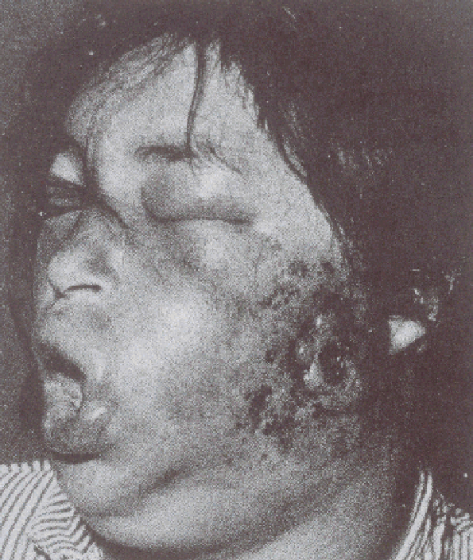
Cutaneous Anthrax
Notes:
Following a major attack, it is possible that cutaneous anthrax cases might appear in conjunction with inhalational cases.
The slide shows cutaneous anthrax of face with a black eschar formation and gross malignant edema.
Skin lesions appear 1 to 5 days after spores are introduced into skin abrasions. 1 to 2 cm vesicles with regional edema and lymphadenitis. Most patients with small lesions maybe afebrile. The lesions develop into a painless necrotic ulcer with a black eschar base. The ulcer may spontaneously heal within 2 to 3 weeks, however, 20 percent of the cases may develop septicemia and death.

Slide 80
Anthrax - Prevention
No documented cases of person-to-person transmission of inhalational anthrax has ever occurred
Cutaneous transmissions are possible
Universal precautions required
Notes:
d. Prevention. No cases of person-to-person transmission of inhalational anthrax have ever been reported. However, cutaneous transmissions have occurred. Universal precautions should be maintained for the duration of illness for cutaneous and inhalation anthrax.
28

Slide 81
Plague - Pathogenesis
Humans develop disease from either the bite of an infected flea or by inhaling the organism
  Bubonic - infection of a lymph node
  (usually lower legs)
  Pneumonic - infection of the lungs
  Septicemia - generalized infection from bacteria escaping from the lymph node: toxic shock
  Orophangeal infections are rare, but reported
Notes:
b. Pathogenesis. The plague is spread to humans from either the bite of an infected flea or by inhaling the organism. Infection occurs in three forms: bubonic, which involves lymph nodes closest to the bite of infected fleas; pneumonic, which is an infection of the lungs; and septicemia, which is a generalized infection in the blood from the bacteria escaping through the lymph nodes or lungs. (In 2.5 percent of the cases plague septicemia may develop directly without a clinically apparent lymphadenitis.)
34

Slide 82
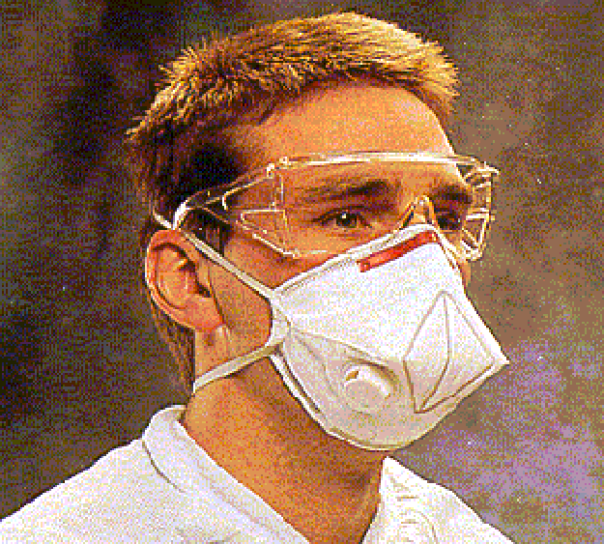
Pneumonic Plague
Prevention
Secondary transmission is possible
Standard, contact, and aerosol precautions for at least 48 hrs until sputum cultures are negative or pneumonic plague is excluded
Notes:
Pneumonic plague may be highly communicable under appropriate climate conditions. For patients with confirmed pneumonic plague, respiratory droplet isolation with precautions against airborne spread is required until sputum cultures are negative.
Accidental exposures to health care workers are managed by giving post-exposure tetracycline or doxycycline therapy for a minimum of 7 days.
Vaccine is ineffective against aerosol exposures and is only effective against bubonic plague.
43

Slide 83
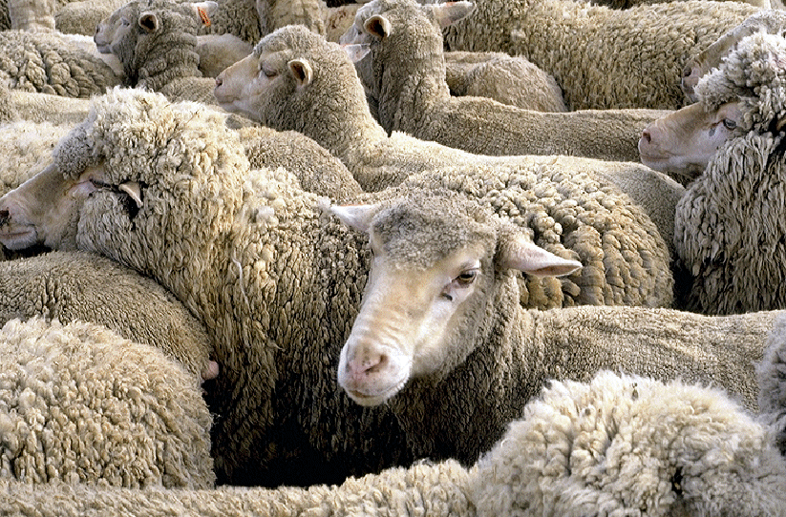
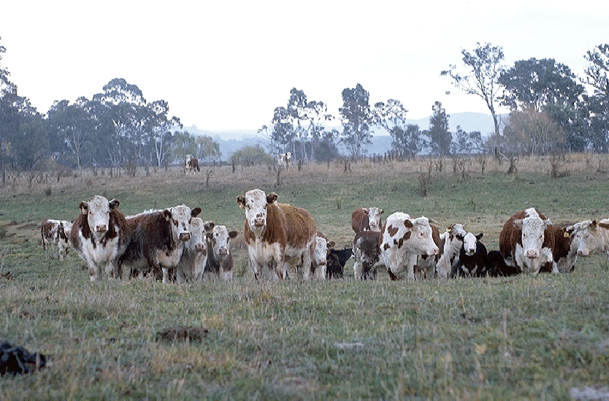
Q Fever - Pathogenesis
Causes disease in animals (sheep, cattle, goats)
Humans acquire disease by inhaling aerosols contaminated with the organism.
Notes:
b. Pathogenesis. First described in Australia (“Query” fever). Q fever typically causes infection in animals (sheep, cattle, and goats), but humans can acquire the disease by inhaling aerosols contaminated with the organism. Lung macrophages engulf the organism and the rickettsia multiply inside the cell until the macrophage undergoes lysis and free organisms are liberated into the local tissue and blood stream.
The Q fever agent is extremely infective by aerosol with only a low inoculating dose required to establish infection.
59

Slide 84
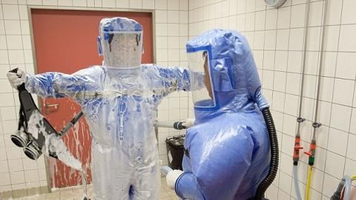
Viruses as Biological Agents
Smallpox
Venezuelan Equine Encephalitis (VEE)
Viral Hemorrhagic Fevers
Non-Agents we see:
  Eastern Equine Encephalitis (EEE)
  West Nile Virus
  Lyme Disease
  Ebola (EVD)
Notes:
IV. VIRUSES AS BIOLOGICAL AGENTS
64

Slide 85
Smallpox - Clinical Course
7-17 day incubation period followed by myalgias, fever, rigors, vomiting, HA, and backache
May have mental status changes
Discrete rash with pustules develops over face and extremities and spreads to trunk
Infectious until all scabs healed over
All contacts quarantined for at least 17 days

Slide 86
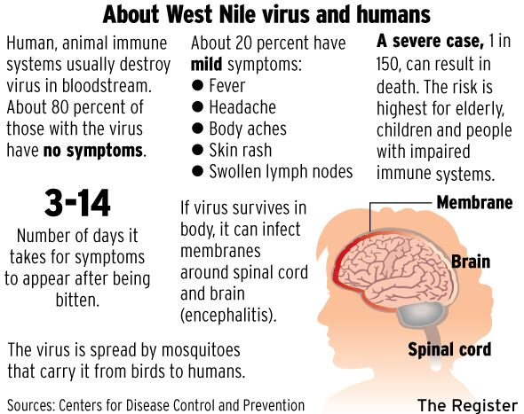
West Nile Virus

Slide 87
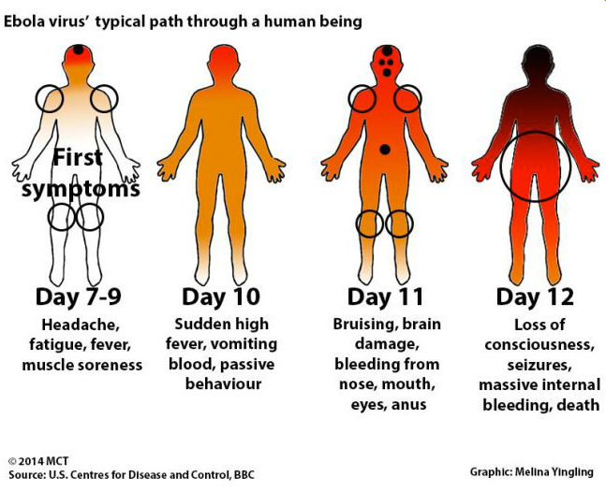
Ebola

Slide 88
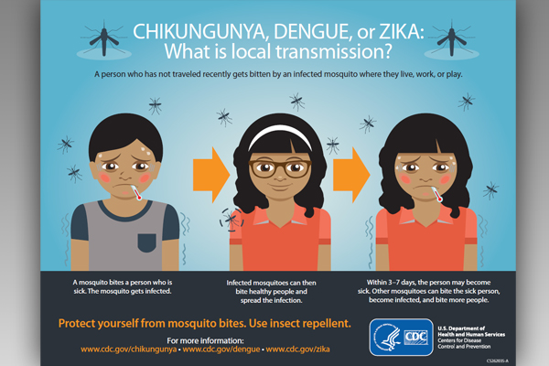
Other Viruses

Slide 89
Terrorist Use of Infectious BW Agents
Provisional diagnosis needs to be made quickly
High index of suspicion that BW agents have been used
No time to wait on laboratory results to establish a definitive diagnosis
The time course of the epidemic may aid in diagnosis
Notes:
Many scenarios involving the use of BW agents suggest an attack by aerosol dissemination. Consequently, disease onset in a community would be rapid, and treatment would need to be implemented quickly to have any effect on mortality or to ensure effective prophylaxis by implementing PPE, antibiotic therapy, or vaccinations if available.
Emergency care physicians need to have a high index of suspicion, be aware of the clinical picture afforded by the most common BW agents, and the most effective clinical intervention.
93

Slide 90
Toxins as Biological Agents
Think of them as chemicals!
  Botulinum
  Ricin
  Staphylococcal Enterotoxin B
Notes:
V. TOXINS AS BIOLOGICAL WEAPONS
95

Slide 91
Toxins General Characteristics
Poisons produced by living organisms that cause effects in humans, animals or plants
More toxic per weight than chemical agents
Not volatile and minimal absorption in intact skin
Not prone to person-to-person transmission
Sudden onset of symptoms, prostration or death
Effects: interfere with nerve conduction; interact with immune system; inhibit protein synthesis
THINK OF IT AS A CHEMICAL!!!!!
Notes:
A. General Characteristics
Biological toxins are nonliving, poisonous chemical compounds that are produced by living organisms (animals, plants, and microorganisms). These agents are up to 1,000 times more lethal than standard chemical agents, but unlike chemicals, are not typically volatile or able to cause illness through skin absorption. As a result, toxins are not prone to
person-to-person transmission and are not very persistent when released. The toxicity of these agents varies by the route of entry (inhalation vs. ingestion vs. injection).
96

Slide 92
Botulism Poisoning - Epidemiology
Most outbreaks of foodborne botulism result from eating improperly preserved home-canned foods, with vegetables canned in oil being the most common source.
145 cases/year in the United States
  15% foodborne
  65% infantile botulism
  20% wound
Toxin can be harvested and delivered as aerosol
No person to person transmission
Notes:
In 1994, CDC reported 34 cases of food borne botulism in the U.S. Most outbreaks result from eating improperly preserved home-canned foods, with vegetables (asparagus, green beans, and peppers) being the most common source. In this case, the closed lid on the pot created the anaerobic environment necessary to allow spores of Clostridium botulinum to germinate and produce the toxin. (MMWR Vol. 44, No. 11. 3/24/95)
100

Slide 93
Ricin - Pathogenesis
Potent cytotoxin - a by-product of castor oil production: 5% of mash after oil removed
Over a million tons of castor beans are processed yearly into castor oil
200 times more toxic by weight than VX
Blocks protein synthesis within the cell and
thus tissue death
Causes airway necrosis and edema when inhaled
Notes:
a. Pathogenesis. Ricin is a potent cytotoxin that is derived from castor beans and is a
by-product in castor oil production. When compared to the chemical warfare agent VX, ricin is over 200 times more toxic by weight. This agent works by blocking protein synthesis within the cell and causes necrosis of the airway when inhaled. Over a million tons of castor beans are processed yearly into castor oil (5 percent of the mash is ricin).
108

Slide 94
Ricin - Pathogenesis
Toxic by multiple routes of exposure
Can be dispersed as an aerosol
Effective by inhalation, ingestion, injection
Notes:
Ricin is a very stable compound and is extremely toxic by multiple routes of exposure.
Ricin can be dispersed as an aerosol and can produce signs and symptoms within 8 hours of exposure. Ricin is also effective orally and by injection. Some believe ricin is a likely agent for assassinations.
109

Slide 95
Ricin - Signs & Symptoms
Fever, chest tightness, cough, SOB, nausea, and joint pain 4 to 8 hours after inhalation
Airway necrosis and edema leads to death
in 36 to 72 hours
Ingestion causes N,V, severe diarrhea, GI hemorrhage, and necrosis of the liver, spleen, and kidneys - shock and death within 3 days
Injection causes necrosis of muscles and lymph nodes with multiple organ failure leading to death
Notes:
b. Signs and symptoms. After inhalation, victims would begin to experience fever, chest tightness, cough, shortness of breath, nausea, and joint pain within 4 to 8 hours of exposure. Ricin appears to cause necrosis of the lower airway epithelium and severe pulmonary edema following aerosol challenge in experimental animals. Death may occur in 36 to 72 hours. If ricin is ingested, victims often develop rapid onset of nausea, vomiting, severe diarrhea, and gastrointestinal hemorrhage with necrosis of the liver, spleen, and kidneys. Shock typically ensues with death occurring in 3 days. By injection, ricin causes marked death of muscles and LNs near the site of injection along with multiple organ failure leading to death.
111

Slide 96
Ricin - Diagnosis & Treatment
DIAGNOSIS
  Difficult
  Routine labs are nonspecific
TREATMENT
  Supportive - oxygenation and hydration
  No antitoxin or vaccine available
  Not contagious
Notes:
c. Diagnosis and treatment. Diagnosis is often difficult since most routine laboratory findings are nonspecific. ELISA testing of blood or immunohistochemical techniques may be used to confirm ricin intoxication. Clinically, ricin inhalation will appear to be very similar to other inhaled corrosives such as phosgene.
Treatment is supportive, ensuring adequate oxygenation and hydration. Gastric lavage and activated charcoal is probably indicated following accidental ingestion. No antitoxin or vaccine is currently available. If death has not occurred within 3 to 5 days, the patient usually recovers.
112

Slide 97
Staphylococcal Enterotoxin B (SEB)
Pathogenesis
Fever producing exotoxin secreted by Staphylococcus aureus - has endotoxin effects
Common cause of food poisoning in improperly handled foods
Symptoms vary by route of exposure
Causes proliferation of T-cells and massive production of various interleukins and cytokines, which mediate the toxic effects
Notes:
3. Staphylococcal Enterotoxin B.
a. Pathogenesis. Staphylococcal Enterotoxin B (SEB) is a fever producing exotoxin (secreted from the organism) produced by the bacteria, Staphylococcus aureus. This toxin commonly causes food poisoning in improperly handled foods that have an overgrowth of the staph organism and then are ingested. SEB symptoms will vary with the route of exposure (inhaled versus ingested). Inhalation of SEB does not occur naturally and the only experience is with animal models. The toxin over stimulates certain components of the immune system, which causes a large proliferation of T-cell lymphocytes and stimulates the production and secretion of various cytokines (such as tumor necrosis factor, interferon, and interleukins). These events are thought to mediate many of the toxic effects seen with SEB and a related staphylococcal toxin mediated disease called Toxic Shock Syndrome.
113

Slide 98
SEB - Signs & Symptoms
3 to 12 hours after inhalation
  Sudden onset of high fever, HA, chills, myalgias, and nonproductive cough
  Severe SOB and chest pain with larger doses
  Chest x-ray usually nonspecific - ARDS in severe cases
Ingestion - Nausea, vomiting and diarrhea develops, which may be severe
Notes:
b. Signs and symptoms. After inhalation, symptoms would be expected to develop within
3 to 12 hours and include sudden onset of fever (103º to 104º F), headache, chills, generalized myalgias, and a non-productive cough. Severe shortness of breath and chest pain will develop with larger doses. Nausea, vomiting, and diarrhea develop if the agent is swallowed and can be severe. Chest examination is usually unremarkable as is the chest x-ray, but in severe cases, pulmonary edema (ARDS) may develop.
116

Slide 99
Defense Against BA –
Self-Protection
Treat every patient with respiratory complaints, a rash or open wounds as an “Infectious Source”
Normal standard universal precautions for most biological agents
HEPA filter mask upgrade for Pneumonic Plague/Smallpox/VHF
Special protective garments are not necessary
Precaution upgrades in areas of the hospital where aerosols could be generated: Lab centrifuges, autopsy facilities
Notes:
B. Self-Protection
The best safeguard to prevent the spread of a biological agent is self-protection. The first responder and medical caregiver must treat every patient with respiratory complaints (fever, cough, and shortness of breath) and open wounds as a possible infectious source. All health care providers should wear eye protection follow standard blood and wound precautions when treating these patients. Special protective garments are not required since clothing or disposable gowns provide reasonable protection against skin absorption. (29 CFR 1910. 1030)
121

Slide 100
Defense Against BA - Triage
Initial triage of all biological casualties is Immediate
Highest priority will be allocating existing resources
  Isolation rooms away from other patients
  Mechanical ventilators
  Personal protective equipment for staff
  Medications
Notes:
VII. TRIAGE
Triage typically will not be implemented soon after a BW attack because of the lack of warning and the insidious nature of the illness. When symptoms do begin to develop, patients will continue to present sporadically to health care facilities, unless a large epidemic occurs. When the pattern of patient complaints is confirmed to be secondary to a BW attack and this information is made public, hospitals will become overwhelmed by infected patients and by individuals worried that they may have been exposed to the agent. Triage will now be necessary to properly allocate existing resources, including isolation rooms, ventilators, PPE, and medications. The triage method used will vary according to local jurisdictions and their standard operating procedures (SOPs).
123

Slide 101
Key Points
Medical Approach to BA Attack
Mandatory universal precautions with all infectious patients prevents spread of infection by containing all bodily fluids and utilizing barrier-protection nursing procedures
Decontamination as appropriate (toxins)
Initiate therapy for what is treatable, but do not delay for infectious identification
Notes:
VIII. KEY POINTS
The only means of limiting the continual spread of any infectious agent is by
self-protection, following universal wound and blood precautions, and decontaminating patients as necessary. Therapy should be initiated for what is treatable, including the use of broad-spectrum antibiotics, such as ciprofloxacin.
Support and confirmation is available from the specialized laboratories at the USAMRIID and CDC. If a BW attack is suspected or confirmed, hospital personnel should work to obtain information on the identification of the agent and its particular transmission and infectious properties, along with the BW immediate health consequences and specific management protocols. Law enforcement officials and the local FBI also should be notified.
124

Slide 102
Radiological Materials
Notes:
RADIOLOGICAL MATERIALS
Of the three types of threats (chemical, biological, or radiological) a nuclear weapon explosion is considered the least likely for a terrorist to be able to use; however, the potential exists for it to happen and even more potential exists for the use of radiological materials.

Slide 103
Terms and Definitions
Ionizing Radiation
Protection
Contamination vs. Exposed
Notes:
TERMS AND DEFINITIONS
Ionizing Radiation: In its simplest definition, ionizing radiation can be defined as either electromagnetic or particulate emissions of energy from the disintegration of the nucleus of an atom. This energy, when impacting on or passing through material, including us, can cause some form of reaction.
Radioactive material: This is simply any material which is giving off some form of ionizing radiation.
Rem: A unit of measurement, relating to biological effects, is the rem (Roentgen Equivalent Man). The term millirem is used frequently, and is equivalent to 1/1000th of a rem.
Contamination: Radioactive particles inappropriately located on or transferred to an object.
Exposure: Subjected to the effects of ionizing radiation. The amount of exposure absorbed is referred to as the dose. The amount of exposure, or dose, is usually expressed in units of rem or milli-rem (mrem).

Slide 104
Ionizing Radiation
++
n
Alpha particles
Beta particles
Gamma rays
Neutrons
n
n
Notes:
IONIZING RADIATION
Now we need to examine the different types of ionizing radiation. The reason for this examination is that each type of radiation has different properties. Detection of the types of radiation varies as well as shielding needs and PPE.
For our purposes, this ionizing radiation can be classified as:
alpha particles
beta particles
gamma rays
neutrons

Slide 105
Radiation Exposures
Average Annual Exposure 360 mrem per year
Chest x-ray 10 to 30 mrem
Flight 0.5 mrem every hour
Smoking 1.5 packs per day 16,000 mrem per year
Mild radiation sickness* 200,000 mrem
Lethal Dose* 450,000 mrem
* single acute exposure
Chronic
Acute
DOE maximum annual occupational limit = 5,000 mrem
DOE maximum emergency dose = 10,000 mrem (for saving property)
Maximum emergency dose (for saving life) = 25,000 mrem
Notes:
RADIATION EXPOSURES
This chart reflects naturally occurring radiation doses (and doses received during normal activities) to provide a point of reference and for comparison. The threshold for any real consequences begins around 200,000 mrem (200 rem). Mild radiation sickness (i.e., nausea, vomiting, diarrhea, etc.) may onset after receiving a whole body dose of approximately 200 rem, in a short amount of time (generally less than 24 hours). The lethal dose, known as the LD_{50/60} is a single, acute, whole body exposure of around 450,000 mrem (450 rem). The LD_{50/60} is defined as: 50 percent of everyone present at an incident that received 450,000 mrem, without any medical treatment, will die within 60 days.
The average annual radiation exposure has been calculated as:
Naturally occurring 295 mrem
Medical 52 mrem
Consumer products 10 mrem
Other 3 mrem
Total 360 mrem

Slide 106
Health Risks
Risks depend on:
  Amount
  Rate
Categorized as:
  Acute
  Chronic
Notes:
HEALTH RISKS
Risk depends upon several factors:
a. The dose (total amount of radiation received). The larger the dose received, the greater the health risk becomes.
b. The dose rate (the length of time over which the dose is received). Dose rate exposures are categorized as follows:
(1) Acute - a large dose occurring over a short period of time. Acute exposures normally pose a high health risk with symptoms occurring within hours or days. Symptoms of acute radiation exposure are burns of the skin, vomiting, and diarrhea.
(2) Chronic - small doses occurring over a long period of time. Chronic exposures normally pose a smaller health risk with symptoms (tumors, etc.) delayed for years.
c. As previously discussed, alpha and beta emitters generally pose only internal exposure hazards; however, gamma radiation poses an external hazard for a distance of hundreds of feet. There are medical treatments available that can help reduce the internal exposure effects.

Slide 107
Exposure Protection
Time
Distance
Shielding
Alpha
Beta
Gamma
paper
lead
Notes:
PROTECTION
The radiation exposure received will depend on the type and strength of the radiation source. This exposure can be mitigated by the effective use of:
a. Time
b. Distance
c. Shielding

Slide 108
Contaminated vs. Exposed
Contaminated victims pose a risk to others
If you are contaminated, you are also exposed
Exposed victims are not necessarily contaminated
Geiger counter to determine if victims are contaminated

Slide 109
Contaminated vs. Exposed
Easiest way to remember the difference:
If you have been near the site of a “Dirty Bomb”…you are assumed to be Contaminated.
If you have ever had an X-Ray, hiked the High Peaks or taken a commercial plane ride…you have been Exposed.

Slide 110
Decontamination Team
Roles
Chemical ID
PPE
Equipment
Patient Flow

Slide 111
Decon Team Roles
HICS 2014
HazMat Branch Director
Detection And Monitoring Unit Leader
Spill Response Unit Leader
Victim Decontamination Unit Leader
Facility/Equipment Decontamination Unit Leader
http://www.emsa.ca.gov/disaster_medical_services_division_hospital_incident_command_system

Slide 112
Decon Team Members
Pre-entry assessment
Inspect equipment
Don PPE
Decontaminate as needed
Provide BLS
Clean self/room
Doff PPE
Post-entry assessment
Shower
Debrief

Slide 113
Donning / Doffing Assistance
Utilize appropriate PPE (splash protection)
Prepare PPE
Assist donning/doffing PPE
Monitor team
Assist moving cleaned patients
Assist in PPE removal and exit of Decon team

Slide 114
Key Questions Prior to Decon
Water compatibility of substance
  Most OK
Dry vs Wet Decon
Level of PPE required
Signs and symptoms of acute exposure
Cleanup and disposal requirements

Slide 115

Personal Protective Equipment

Slide 116
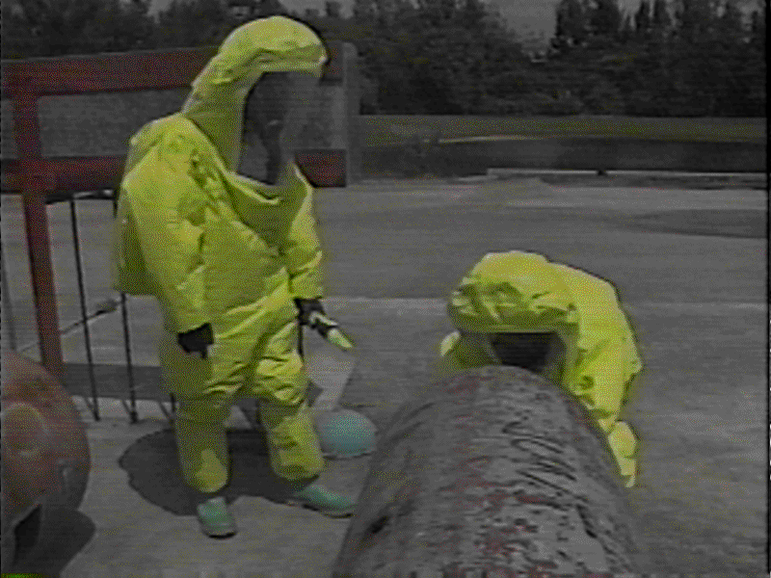
Level A
Required when the
highest potential
for exposure to
hazards exists and
the highest level
of skin, respiratory,
and eye protection
is called for
VAPOR PROTECTION

Slide 117
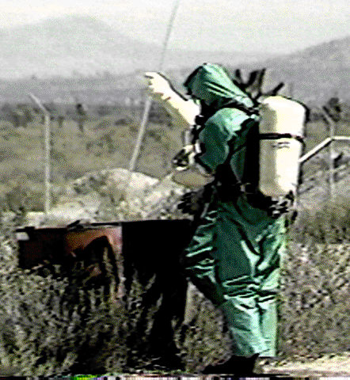
Level B
Required when the
highest level of
respiratory
protection but a
lesser level of skin
protection is needed
Can be encapsulating
or non-encapsulating
LIQUID SPLASH PROTECTION

Slide 118
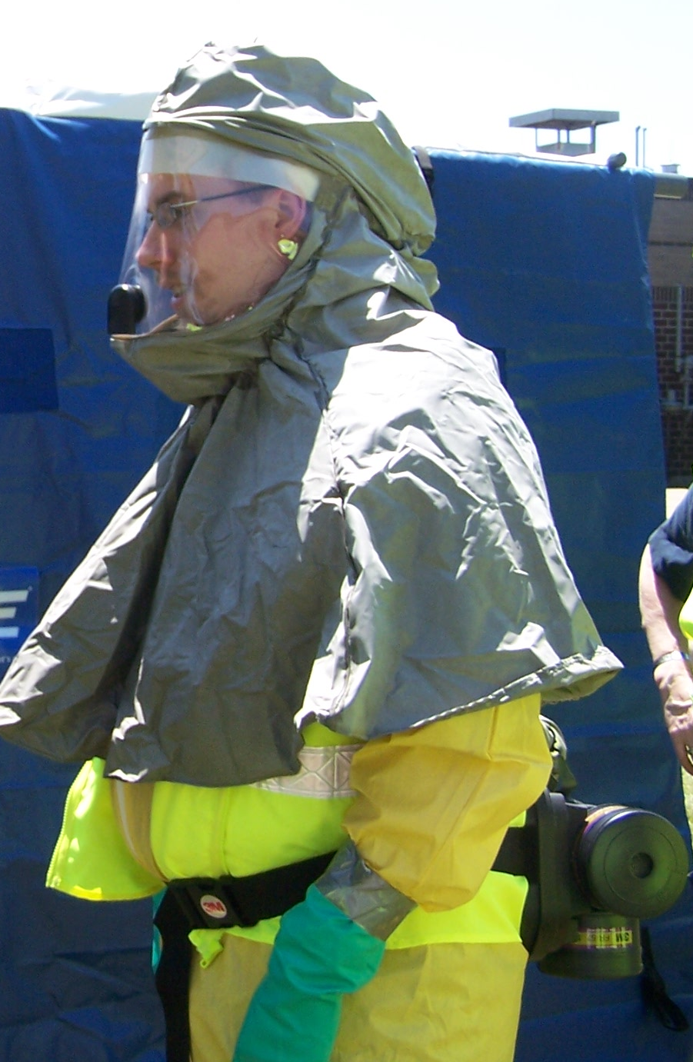
Level C
Required under
circumstances that
call for lesser levels
of respiratory and
skin protection
Can be used with
SCBA’s or APR’s
First Receivers Ensemble
DUST & SOLIDS PROTECTION

Slide 119
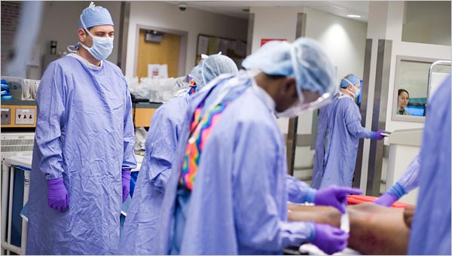

Level D
Appropriate
when minimal
skin protection
and no respiratory
protection is required.
Every day uniform!
SUPPORT PROTECTION

Slide 120
Levels of Protection
Greater Hazard
Level
A
Level
C
Level
D
Level
B
Higher Burden
Notes:
LEVELS OF PROTECTION
This graphic depicts the various OSHA protection levels from A, the highest level of protection, to D, the lowest level of protection.
Due to encumbrances resulting from wear of the equipment, the higher the level of protection, the more difficult it is to function. Thus there must always be a risk/benefit analysis, made with consideration of regulations and policy, when selecting the equipment to be worn.
Level A Protection
a. Level A includes a totally encapsulated chemical resistant suit, with SCBA or supplied air with escape mask.
b. It provides maximum respiratory and skin protection.
c. It is used when there is a high level of liquid splash potential, a toxic respiration and skin vapor hazard, or where the chemical agent is unidentified.

Slide 121
Equipment Needs
Emergency Equipment / anti-dotes in Cold / Cool Zone just outside of the Decon area.
Rescue team should be available in same level PPE or immediately available.
Continuity of Decon Operations
Maintain personnel protection!
Batteries, Cartridges, Soap, Collection Containers (clothes & water) &…
Back-up or Relief Staff

Slide 122
Radios
IF USED:
Must go on UNDER PPE
Make sure all on ONE channel
Test before putting on, after dressed
Have backup procedures for communication should radios fail!
Hand signals, Megaphones or PA Systems

Slide 123

Cautions
Risks to person conducting Decon.
PPE survey & exam
Personnel: vital signs before & after!
Risks:
  Heat
  Chemical
  Equipment malfunction
  Slips, trips & falls

Slide 124
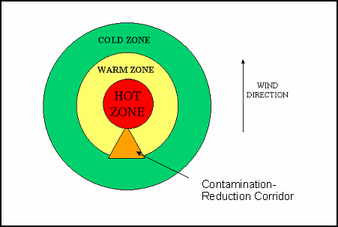
Patient Flow
“Hot” zone:
  Undress
  Collect contaminated clothing
“Warm” zone: under shower, on stretcher
  Shower or wash
“Cold” or Cool zone: by door to hallway
  Pass to clean stretcher, etc.
  Assistants to help

Slide 125
Patient Flow
Enter decon
Shower/hose
(decontaminating)
Undress
(contaminated)
Dry/re-dress
Exit to hospital

Slide 126
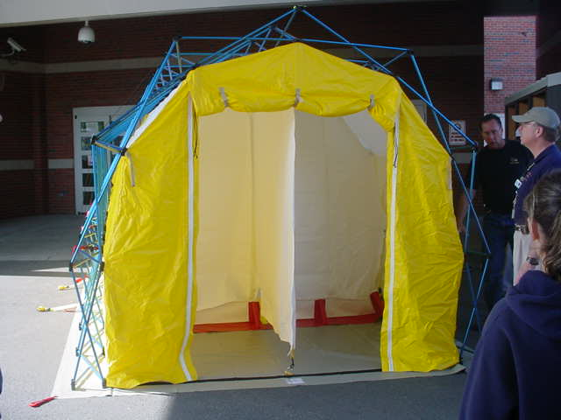
Tent (if applicable)
Additional training in setting up
Know your facilities policy!

Slide 127
Conclusion
Keep yourself safe!
Keep institution safe!
Only in this manner can we take care of patients.
What is appropriate PPE?
What is our appropriate response?

Slide 128
REVIEW
1. People exposed to certain biological agents (viruses or bacteria) may not become ill until many days later.
True
2. Following any chemical, biological, or radiation incident, all victims will be decontaminated before arriving at medical care facilities.
False
3. Standard latex medical gloves provide adequate
protection for disposing of waste contaminated by a
chemical.
False

Slide 129
REVIEW
4. A Department of Transportation (DOT) placard on the
back/side of a tanker trunk will not provide any
information that could identify the chemical being
transported.
False
5. Chemical, biological, and radiation attacks are crimes, and victims' clothing should be saved because it may be used as evidence.
True

Slide 130
REVIEW
6. Level D personal protective equipment (PPE) provides
the highest level of protection and is appropriate for
highly dangerous chemicals.
False
7. The main effects of all the following chemical agents
occur within seconds to a few minutes except one:
a. Sarin (nerve agent)
b. Cyanide (blood or tissue agent)
c. Chlorine (choking agent)
d. Sulfur mustard (blister agent)
e. Mace (tearing agent)
d. Sulfur mustard (blister agent)

Slide 131
REVIEW
8. You hear through other employees that a patient that you cared
for yesterday has now been diagnosed as having pneumonic plague.
The patient had a fever and a cough when you cared for her. What
actions should you take?
a. No action is necessary since pneumonic plague can not be spread
person- to-person.
b. Ensure that you get vaccinated with the plague vaccine at once so
that you do not become ill.
c. Notify employer so you can begin a course of antibiotics at once so
that you do not become ill.
d. Notify your family that you must be quarantined until it becomes
known if you will develop plague.
e. None of the above
c. Notify employer so you can begin a course of antibiotics at once so you
you do not become ill.

Slide 132
REVIEW
9. Atropine should be administered as soon as possible to victims suffering from which class of chemical agents?
a. Vomiting agents
b. Nerve agents
c. Blood agents
d. Blister agents
e. Choking agents
b. Nerve Agents

Slide 133
QUESTIONS?

Slide 134
Instructor Information
Now what do I do??
What do I need to document?
Can you help me???

Slide 135
Now what do I do??
Needs assessment
Recruit Team Members
Schedule a Class
Ask SME’s / Other Instructors to HELP
Gather Materials
  Handouts
  Gear
  DECON Area

Slide 136
What do I need to document?
Attendance Sheets
Practice
Donning & Doffing
DECON Line
Updates – Yearly OSHA
Regular Updates
REAL EVENTS
Exercises

Slide 137
Can you help me???
Visit Our Website at:
WRHEPC.URMC.EDU
-Select Preparedness & Response Tools / Resources
-Select OSHA/Hazmat/Decon
http://www.emsa.ca.gov/hospital_incident_command_system_job_action_sheets_2014_Operations

Slide 138

Thank You!
Finger Lakes Regional Training Center
Anne D’Angelo: anne_dangelo@urmc.rochester.edu
Eileen Spezio: eileen_spezio@urmc.rochester.edu
585-758-7640
Visit Our Website at:
WRHEPC.URMC.EDU
-Select Preparedness & Response Tools/Resources
-Select OSHA/Hazmat/Decon

