Slide 1
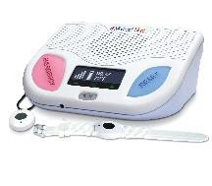
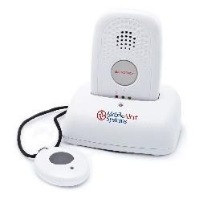
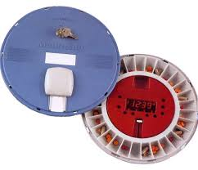
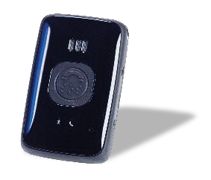
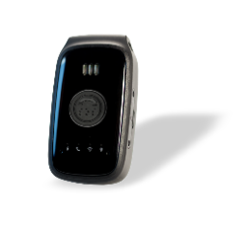
Contact: Lori Shamp, 585-274-4186 Lori_Shamp@URMC.Rochester.edu
 | Cellular Two Way PERS** | GPS/Mobile PERS | Fall Detection | Med Ready | Belle Mobile PERS | Belle+ Mobile/GPS PERS
Overview | Two-way interactive emergency monitoring No landline required- operates on AT&T’s 3G network, Plug & play installation LCD display with time/date, temperature and cell strength | Two-way interactive voice emergency monitoring When Help Button is pressed, customer’s latest position coordinates are sent to our Reponses Center Easy to setup and operate No cell or landline phone required | Automatically sends a signal for help when a fall is detected Compatible with cellular and mobile PERS devices | MedReady’s functions and capabilities provide the best value in the medication dispensing marketplace Check compliance history, change dispensing times, and update all device setting via the www.medready.net website | Mobile Two-Way Voice Communication Easily call for help at home or away from home; anywhere in the US where there is AT&T or Verizon 3G coverage All in one unit - no additional pendants required | Mobile Two-Way Voice Communication GPS and WiFi location technologies can help locate the person with fall detection option built-in Operates on AT&T’s 3G network All in one unit - no additional pendants required
Features | 24/7 emergency monitoring service Waterproof wrist and necklace pendant options No cellular contract required Compatible with fall detector pendant 30 hour battery backup Help pendants have a battery life of 2-5 years | 24/7 emergency monitoring service Waterproof wrist or pendant options Mobile wireless device w/GPS works virtually anywhere Compatible with fall detector pendant Up to 24 hour battery life- rechargeable | Wearable as a pendant Waterproof design for use in the shower | The cellular dispenser has the capability to communication compliance events via cell towers. No phone line or internet connection is necessary at the dispenser location Holds up to seven days of four times a day dosing | No cellular contract required Designed for use in the shower Up to 28 day rechargeable battery life | No cellular contract required Designed for use in the shower Up to 5 day rechargeable battery life
Price | $35.00 per month $40.00 1 x installation fee | $50.00 per month $40.00 1 x installation fee | $15.00 per month In addition to any of the 2 devices | $65.00 per month No installation fee | $50.00 per month $40.00 1 x installation fee | $65.00 per month $40.00 1 x installation fee
**Second household member is free!**

Slide 2
Bringing you and your loved ones Safety, Independence and Peace of Mind
Live your life your way with UR Medicine Home Care’s Personal Emergency Response Service
Help is just a button press away
You are protected 24 hours a day, seven days a week wherever you are
Once you press your button you are rapidly connected to a highly trained and caring response center specialist
The response center specialist will send out the appropriate help
The easy to use service is affordable and there is no long term commitment, service is month to month.
Service Options - see other side
Cellular Unit – no cell phone nor cellular contract required, works in and around your home
Fall Detection Button - Provides an added level of protection when a fall is detected and you are unable to press the button
Mobile Units – be protected anywhere you go**. No cell phone nor cellular contract required!
**Mobile Units do require cellular reception (just like your cell phone)

