Slide 2
Part 1
What is causing an outbreak of encephalitis?

Slide 3
Part 1: What is causing an outbreak of encephalitis?
1. How did the work of environmental health investigators help the doctors understand what might be causing the encephalitis outbreak?

Slide 4
Part 1: What is causing an outbreak of encephalitis?
2. What is the name of the virus that is causing Patient 1’s encephalitis? Support your answer with evidence from the antibody tests.
3. Explain how this virus spread to affect the additional patients.

Slide 5
Part 2
Is there a link between bird deaths and the encephalitis outbreak?

Slide 6
Part 2: Is there a link between bird deaths and the
encephalitis outbreak?
4. Why did the veterinarians conduct genetic tests on viruses from the brains of the dead birds?

Slide 7
Part 2: Is there a link between bird deaths and the
encephalitis outbreak?
5. The genetic information for the viruses that cause encephalitis is coded in a sequence of nucleotide bases (A, U, C, G) in RNA molecules. The sequence of letters below represents part of an RNA molecule from the virus that killed one of the birds.
AGUAGUGUUU GUGAGGAUUA ACAACAAUUA
Solve the Known RNA Sequences for Four Viruses Carried by Mosquitoes puzzle. Then compare the sequence of letters in the box above with the sequences of letters on the Known RNA Sequences for Four Viruses Carried by Mosquitoes sheet.
Which type of virus most likely caused the bird encephalitis?
Support your answer with evidence from the genetic information.

Slide 8
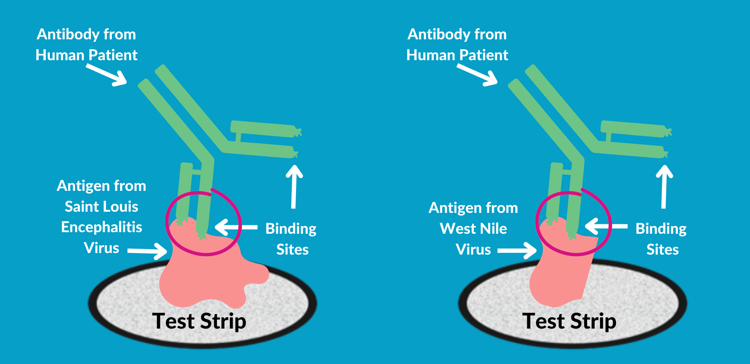
Part 2: Is there a link between bird deaths and the
encephalitis outbreak?
Antibodies have specific binding sites and will only attach to parts of antigens that fit into their binding site. Use the diagram below to answer Question 6 on the next page.

Slide 9
Part 2: Is there a link between bird deaths and the
encephalitis outbreak?
6. Use the information in the diagram on the previous slide to explain why the antibodies in Patient 1’s blood plasma could attach to antigens from BOTH the Saint Louis Encephalitis virus and the West Nile virus.

Slide 10
Part 2: Is there a link between bird deaths and the
encephalitis outbreak?
7. To determine whether Saint Louis Encephalitis virus or West Nile virus was causing the human encephalitis outbreak, scientists from the Health Department did genetic tests on the viruses that cause human encephalitis. The genetic information below represents part of an RNA molecule from a virus that caused the outbreak of human encephalitis.
GUGAGGAUUA ACAACAAUUA ACACAGUGCG
Compare this genetic information (sequence of letters) with the Known RNA Sequences for Four Viruses Carried by Mosquitoes.
Which type of virus caused the human encephalitis outbreak?
Support your answer with evidence from the genetic information.

Slide 11
Part 2: Is there a link between bird deaths and the
encephalitis outbreak?
8. Explain how the work done by veterinarians was important in protecting human health.

Slide 12
Part 3
How is the West Nile virus transmitted and spread?

Slide 13
Part 3: How is the West Nile virus transmitted and spread?
Base your answer to question 9 on the Virus Transmission illustration and text.
9. The transmission of West Nile virus is shown in the illustration above. Based on this illustration, put an “X” in front of the statements below that are correct.
_____ Birds can become infected with West Nile virus when they are bitten by mosquitoes.
_____ Humans and horses can become infected with West Nile virus when they are bitten by mosquitoes.
____ Mosquitoes can become infected with West Nile virus when they bite birds.
_____ Birds can transmit West Nile virus to other birds.
_____ Birds can transmit West Nile virus to humans.
_____ Mosquitoes can become infected with West Nile virus when they bite humans or horses.
_____ West Nile virus can be transmitted by human to human contact.

Slide 14
Part 3: How is the West Nile virus transmitted and spread?
Base your answer to question 10 on the Virus Transmission illustration and text.
10. Before 1999, the West Nile virus had never been found in the United States. It had only been found in Europe, the Middle East, and Africa. What two organisms most likely carried West Nile virus to the United States from Europe, the Middle East, or Africa?

Slide 15
Part 3: How is the West Nile virus transmitted and spread?
Base your answers to questions 11 and 12 on the Virus Spread illustration and text.
11. Explain how West Nile virus could spread so rapidly throughout the continental United States.
12. Predict where in the continental United States you would expect to find West Nile virus in 2019.

Slide 16
Part 3: How is the West Nile virus transmitted and spread?
Base your answers to questions 13 and 14 on the Climate Change and West Nile Virus illustration and text.
13. How would an increase in bird populations affect the number of mosquitoes that carry the West Nile virus?
14. How would an increase in mosquito populations affect the number of birds infected with West Nile virus?

Slide 17
Part 3: How is the West Nile virus transmitted and spread?
15. How would an increase in mosquito populations affect the number of humans infected with West Nile virus?
16. What environmental factors might lead to increased bird populations in an area?
17. What environmental factors might lead to increased mosquito populations in an area?

Slide 18
Part 3: How is the West Nile virus transmitted and spread?
Climate change is a change in the average conditions — such as temperature and precipitation — in a region over a long period of time. NASA scientists have observed that the Earth’s surface is warming and the distribution of precipitation is changing.
Modified from: https://climatekids.nasa.gov/climate-change-meaning/
18. Scientists claim that climate change is likely to cause an increase in the number of people infected with West Nile virus. Cite two pieces of evidence from the illustration and text on the previous page to support this claim.

Slide 19
Part 4
Should insecticides be sprayed to prevent the spread of West Nile virus?

Slide 20
Part 4: Should insecticides be sprayed to prevent the spread of West Nile virus?
19. Read the news article online (and on the next page) about a State Health Department’s plan to spray insecticides to control the spread of West Nile virus. As you read use these three editing tools to:
Underline information that someone could use to convince people that insecticides should be sprayed
Circle or Highlight information that someone could use to convince people that insecticides should not be sprayed.
These three editing tools are at the top of the next four slides. Drag them over the text based on the directions above to underline, circle and highlight text:
No it should not be sprayed!
Ban Mosquito Spraying!
Yes it should
be sprayed!
Spraying Saves Lives!

Slide 21
Part 4: Should insecticides be sprayed to prevent the spread of West Nile virus?
Drag the editing tools to underline, circle and highlight text below.
News Article: West Nile Virus Has Killed 3 in the State
An outbreak of encephalitis caused by West Nile virus has occurred in 13 counties. There have been 9 confirmed human cases of West Nile disease and 3 of these cases resulted in death. There have also been 27 cases among animals, including horses, deer, and dogs.
According to the state’s public health veterinarian, “Aerial spraying is a tool we should use to protect human and animal health.” The state plans to spray an organic insecticide to control populations of mosquitoes in 13 counties. Planes flying at 300 feet will spray an organic insecticide over 720,000 acres, at an estimated cost of between $1.5 million and $1.8 million. The insecticide is toxic to insects and it is commonly used to control mosquitoes, fleas, flies, moths, ants and many other insect pests. Scientific tests have shown that the insecticide will not pose a health risk to humans, pets, or farm animals. Aerial spraying is not expected to affect surface water or drinking water.
Modified from https://www.northjersey.com/story/news/nation/2019/09/27/eastern-equine-encephalitis-michigan-aerial-insecticides/3793737002/

Slide 22
Part 4: Should insecticides be sprayed to prevent the spread of West Nile virus?
Drag the editing tools to underline, circle and highlight text below.
News Article: West Nile Virus Has Killed 3 in the State
Some community members are concerned about exposure to the insecticide spray. State officials suggest that people with asthma or chemical sensitivities remain indoors, close windows and doors, shut off fans and air conditioners, and wash any garden produce before eating it.
An ecologist with the State Department of Natural Resources is concerned about the effects of the insecticide on the environment. The insecticide being used is a “broad spectrum insecticide that has the potential to affect any insect it comes in contact with, including beneficial species (bees and other pollinators) and threatened species (butterflies and moths).”
Many beekeepers and farmers are worried that the spraying of insecticides will contaminate crops and kill bees that pollinate crops. However, one beekeeper stated, “While the death of bees will affect my source of income, I really don’t want to see one of my friends become sick with this virus.”
Modified from https://www.northjersey.com/story/news/nation/2019/09/27/eastern-equine-encephalitis-michigan-aerial-insecticides/3793737002/

Slide 23
Part 4: Should insecticides be sprayed to prevent the spread of West Nile virus?
Drag the editing tools to underline, circle and highlight text below.
News Article: West Nile Virus Has Killed 3 in the State
Even with the planned spraying, state health officials say the risk for contracting West Nile disease from mosquitoes in affected areas will continue until after the season’s first “hard frost.” State health officials encourage residents in the affected counties to:
Empty water from mosquito-breeding sites around the home such as buckets, unused pools, old tires, clogged gutters, or similar places with standing water where mosquitoes may lay eggs.
Avoid being outdoors from dusk to dawn when mosquitoes that carry the West Nile virus are most active.
Wear long-sleeved shirts and pants.
Apply insect repellents that contain the active ingredient DEET, or another U.S. Environmental Protection Agency-approved product to exposed skin or clothing.
Maintain window and door screening to help keep mosquitoes outside.
More information about mosquito control is available at https://www.cdc.gov/westnile/vectorcontrol/integrated_mosquito_management.html
Modified from https://www.northjersey.com/story/news/nation/2019/09/27/eastern-equine-encephalitis-michigan-aerial-insecticides/3793737002/

Slide 24
Part 4: Should insecticides be sprayed to prevent the spread of West Nile virus?
20. Based on the information in the article, list the two most important things someone might say to convince people that insecticides should be sprayed to kill mosquitoes and prevent West Nile disease.
21. Based on the information in the article, list the two most important things someone might say to convince people that insecticides should not be sprayed to kill mosquitoes and prevent West Nile disease.

Slide 25
Part 4: Should insecticides be sprayed to prevent the spread of West Nile virus?
22. Is the article biased - prejudiced in favor of spraying or against spraying? Support your answer.
23. The article does not include all of the information that might be needed to make an informed decision about the planned insecticide spraying. List at least two kinds of additional information that might help people to make an informed decision about whether to spray, or not spray, to control mosquito populations.

Slide 26
Part 4: Should insecticides be sprayed to prevent the spread of West Nile virus?
24. A trade-off is a compromise where people give up one thing in order to get something else that they want. The State Health Department insists that spraying is the best way to reduce the spread of the West Nile virus. Concerned citizens are against spraying because they are concerned that spraying will harm humans, animals, and the environment. Suggest a possible tradeoff (compromise) that both groups could accept. Be prepared to explain your tradeoff to the class.

Slide 27
Part 4: Should insecticides be sprayed to prevent the spread of West Nile virus?
25. Do you support the spraying of insecticides to kill mosquitoes and prevent the spread of West Nile virus? Explain why or why not.

Slide 28
Part 5
One Health and the West Nile virus

Slide 29
Part 5: One Health and the West Nile virus
A university is suggesting that the local government take a One Health approach to solving complex local problems, such as West Nile virus. A One Health approach uses the idea that complex problems often involve the health of people, animals, and the environment. Therefore, solutions to One Health problems must be designed to protect the health of people, animals, and the environment.
26. Use the information in the text box above to explain what must be involved in a complex problem for it to be considered a One Health problem.

Slide 30
Part 5: One Health and the West Nile virus
To support adoption of a One Health approach, the university officials want to create a series of One Health digital slides to share with community members. Your team has been hired to create the first slide for this presentation. They want you to use West Nile virus as an example of a One Health problem. The slide you produce should answer the question, “Why are West Nile viruses a One Health problem?”
Community members often get most of their information from this first slide – they tend to lose interest once in-depth discussion of the issue begins. Therefore, that first slide needs to give information in a way that people will remember. Using examples and pictures will help people understand and remember what the One Health approach involves.
27. Use the information in the text box and what you learned about West Nile virus to develop your digital slide. The Online Resources, Digital Slide Resource Page, and templates on the next set of slides may help you organize your digital slide. You can use either template that is given or create your own design.

Slide 32
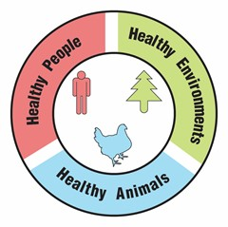
Part 5: One Health and the West Nile virus
TEMPLATE 1
Why are West Nile viruses a One Health problem?
1-2 sentences that answer the question | Picture with brief caption
Picture with brief caption | Picture with brief caption

Slide 33
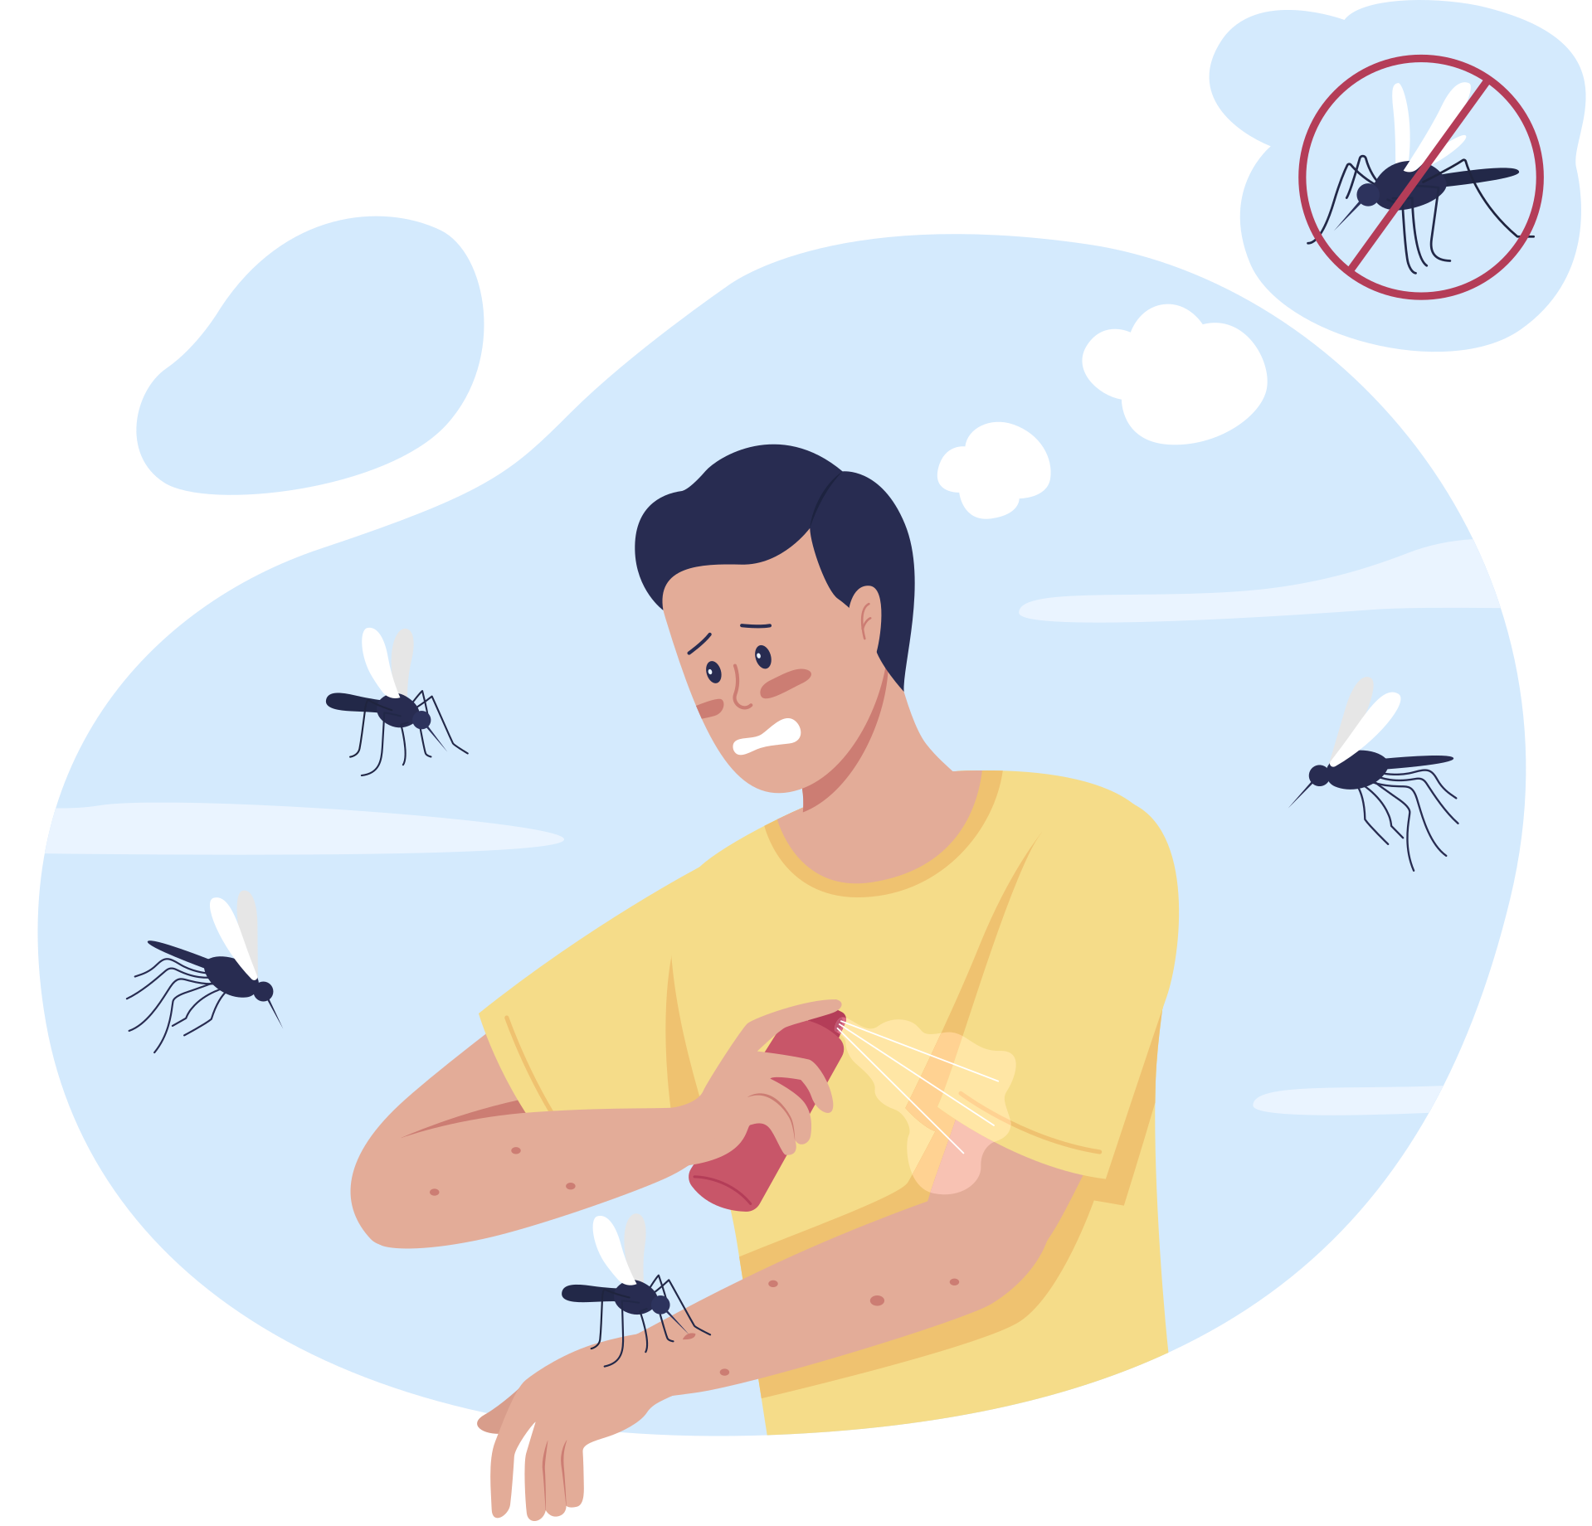
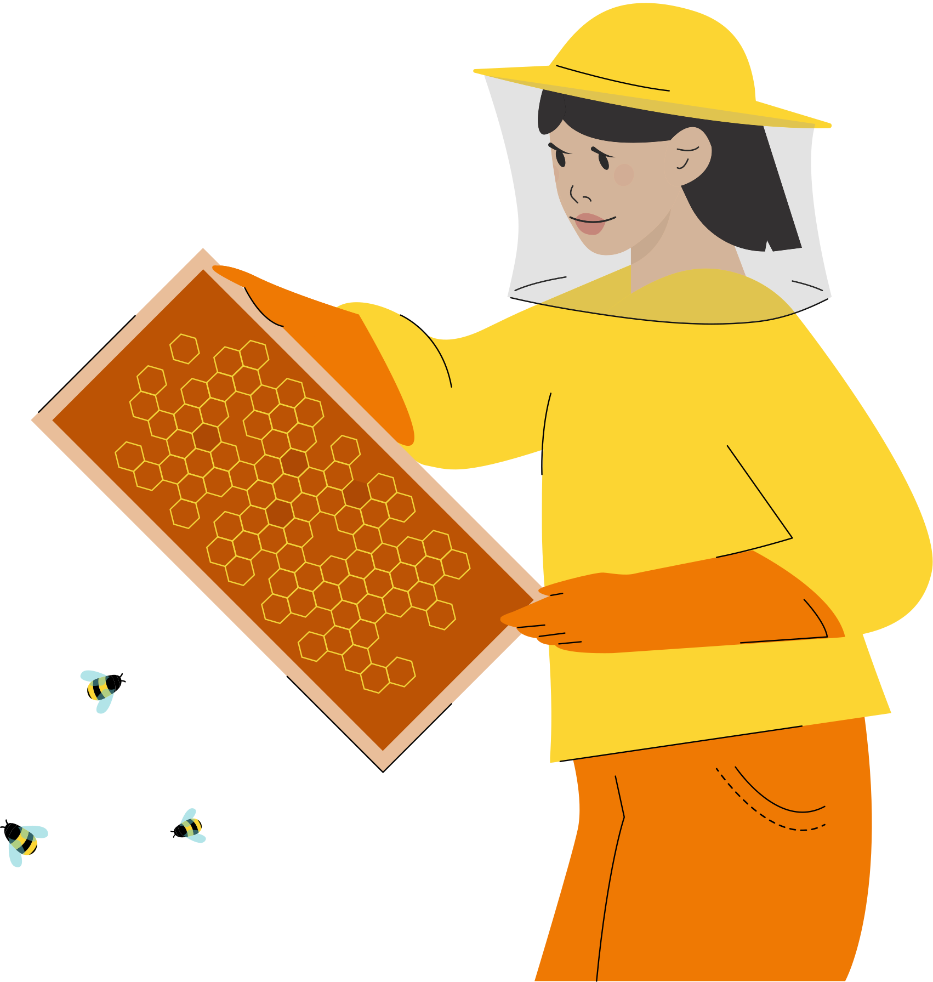
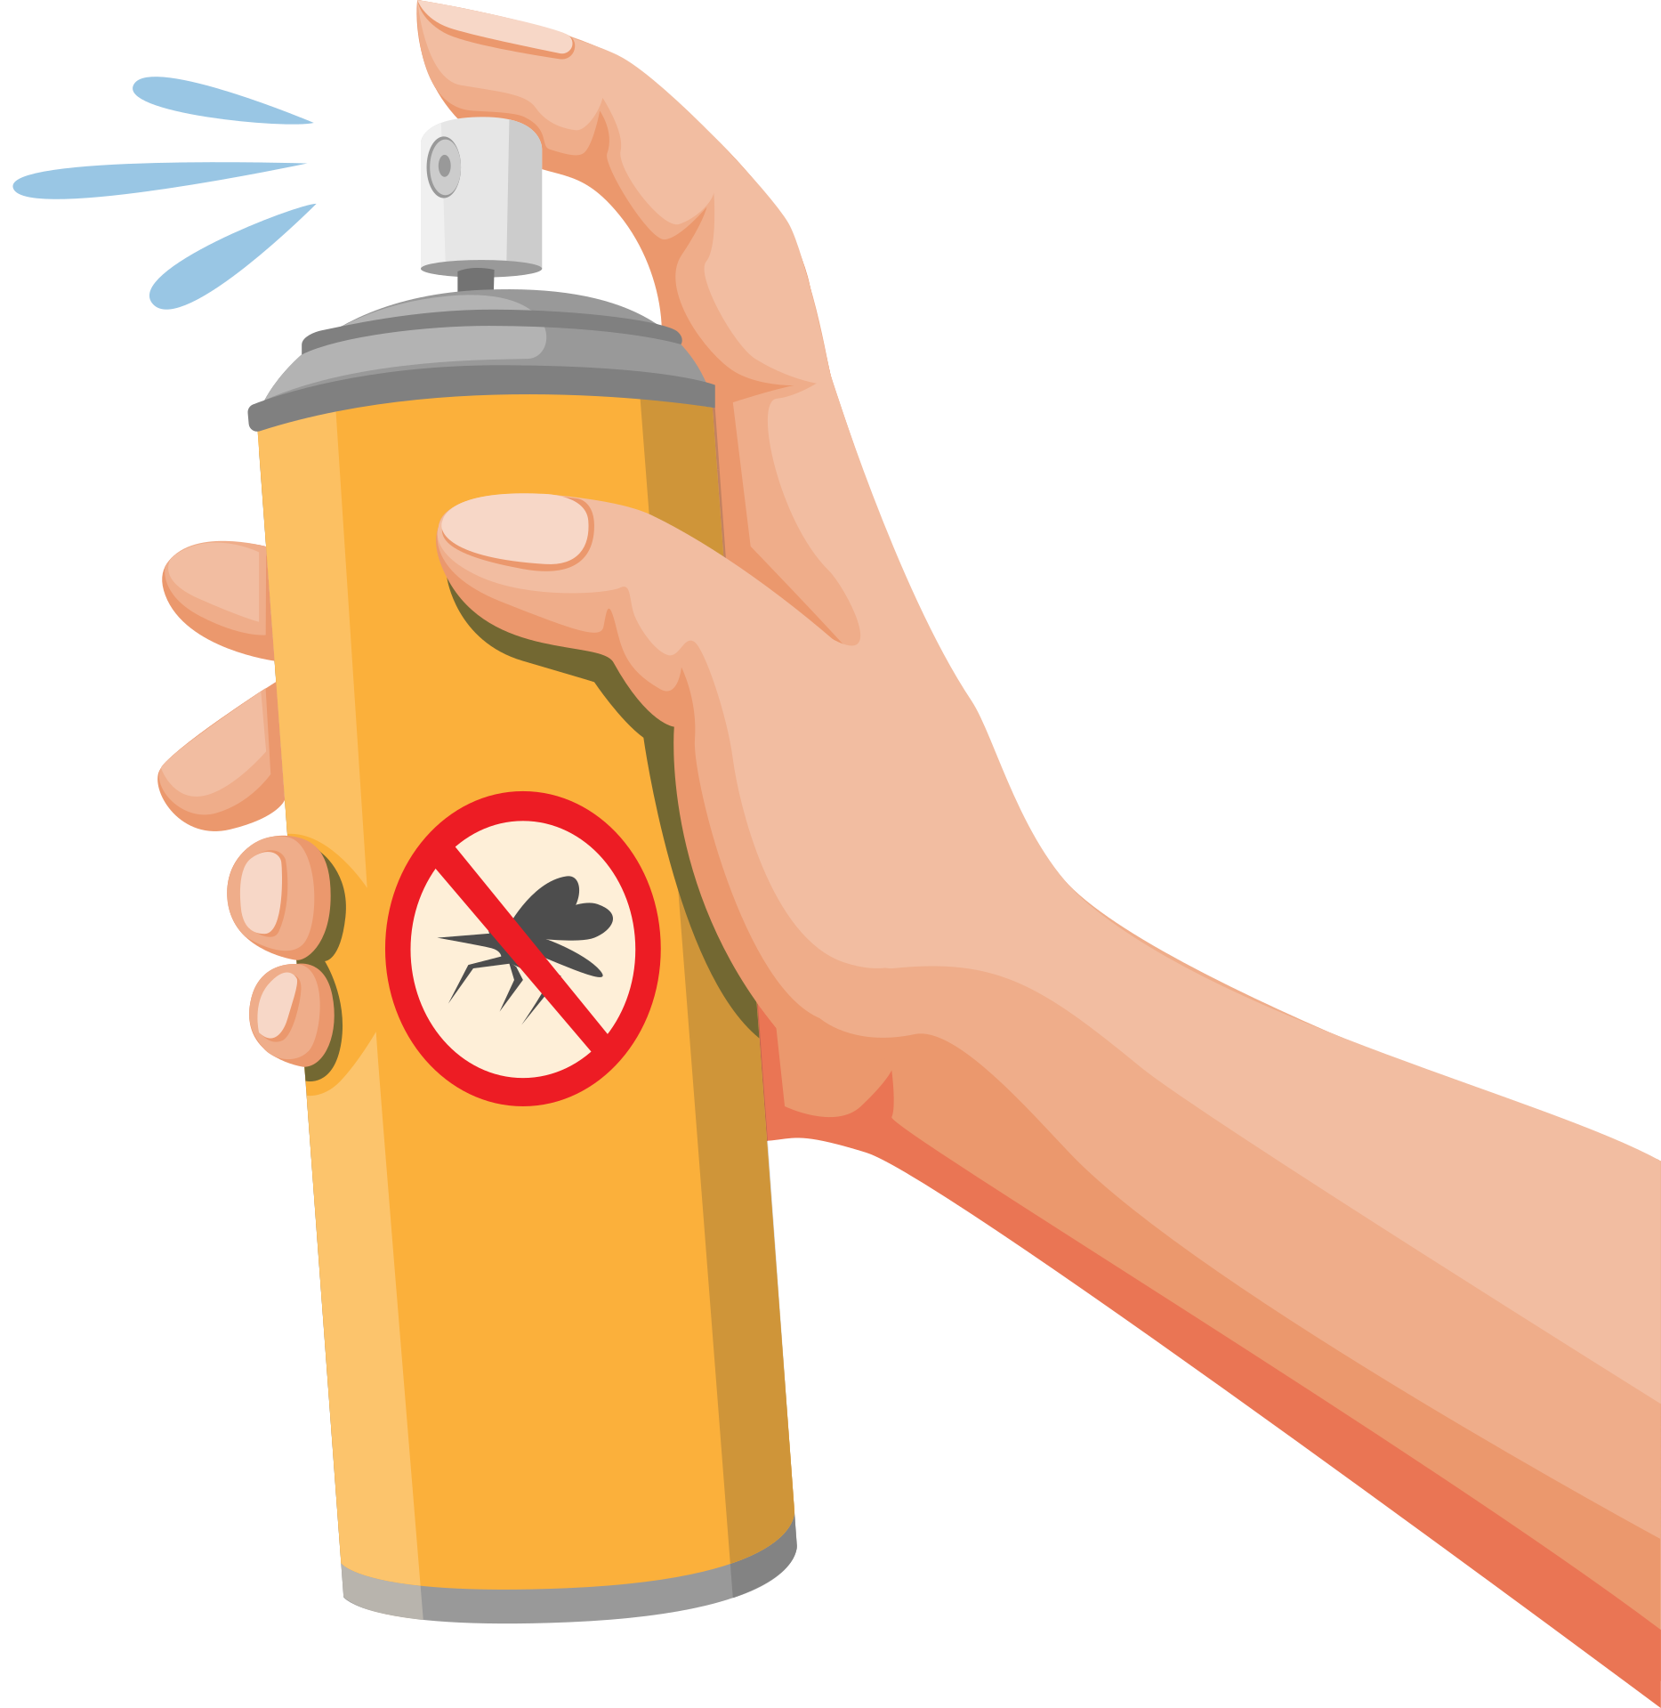
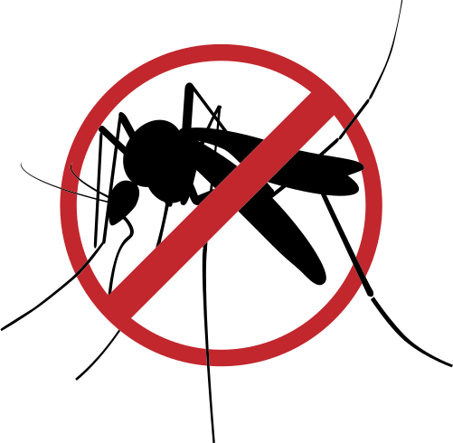
Digital Slide Resource Page
Use the these images on the next slide or use these images to personalize your Digital Slide design.

Slide 34
TEMPLATE 2
Why are West Nile viruses a One Health problem?
Type 1 sentence that answers the question here
Delete text or Type additional sentences that answer the question here
Delete text or Type additional sentences that answer the question here
Picture 1. Make a title for your figure and type here.
Insert
Picture 1
Here
Type a brief caption for the picture here
Picture 1. Make a title for your figure and type here.
Insert
Picture 1
Here
Type a brief caption for the picture here
Picture 1. Make a title for your figure and type here.
Insert
Picture 1
Here
Type a brief caption for the picture here
Digital Slide created by: Type your name here

Slide 35
Create your own...

Slide 36
Mysterious Case of Brain Illness
Digital Lab Student Evaluation Form.
CLICK HERE
To complete and submit your feedback
Notes:
Now that you have finished, discuss your responses to Part 5 with your teacher(s), classmates, and others who may be learning about One Health concepts. Perhaps others have thought of similar ideas to the ones you shared. Alternatively, you could learn new things that you had not thought of before. Continue learning and enjoying investigating your responses more using the resources from this field trip.
Also if you want to help provide input on the next Virtual Field Trip, return to the virtual field trip website (use the CLICK HERE on the slide) and complete the survey questions . We value your feedback.

Slide 37
Extension Activity
1. Identify your own One Health Problem: Brainstorm ideas using the table below. Be sure to include issue(s) related to humans, animals, and the environment.
One Health Problem
Environment | Animals | People

Slide 38
Extension Activity
2. Identify your own One Health Solutions: Brainstorm ideas for actions that could be taken to “solve” parts of problem that you describe. Be sure to include actions that would improve the health of humans, animals, and the environment.
One Health Solution
Environment | Animals | People

Slide 39
Extension Activity
3. Which One Health solution would be easiest for you to implement? Explain why you chose that solution.
4. Which One Health solution would be easiest for local communities to implement? Explain why you chose that solution.
5. Which One Health solution would have the greatest impact on solving the One Health problem? Explain why you chose that solution.

Slide 40
Additional Notes

Slide 41
Additional Notes

Slide 42
Additional Notes

Slide 43
Additional Notes

