Slide 1


Reproductive Healthcare Systems through the Eyes of Black Women
Sydnie Turner, University of Rochester School of Medicine and Dentistry

Slide 2


Pre-Slavery
Zambia, Africa
Pregnant women are cared for by birth attendants also known as Mbusas.
During the antenatal period mbusas would massage the mother's abdomen. If the baby is discovered to be in the breech position, an external version is performed (1).
During labor the mother is supported by 2-3 other women.
After delivery, the mother stays indoors to be taken care of by the mbusas or other women in the community. This time varied anywhere between 8 to 40 days. During this time, the mother's abdomen is wrapped and massaged. During recovery, mother's are assisted with basic necessities such as bathing and cooking (2).

Slide 3



Reproduction in Bondage
Female slave bodies were used to breed more black bodies into slavery. After 1808, when Congress forbade the importation of slaves to the United States, reproduction by black slave women was necessary to
sustain a slave owners' wealth.
Rape was used as a means to assert power over female slaves. Rape was also used for economic gain in efforts to birth more children into slavery. It is estimated that 58% of all enslaved women, aged 15-30 years, were sexually assaulted by their slave owners and other white men. By 1860 10% of the slave population were classified as "mulatto" (3).

Slide 4






Slavery 1619-1865
Mississippi, US
A former slave, Lizzie Williams, recounts the beating of a pregnant slave woman on a Mississippi cotton plantation :
"[The white folks] would dig a hole in de ground just big 'nuff fo' her stomach, make her lie face down an whip her on de back to keep from hurtin' the child" (3)
Slave owners' perception of the Black fetus as a means for potential economic gain parallels current U.S. policies that seek to protect the fetus while disregarding the humanity of the pregnant woman.

Slide 5






---------· -
Reproductive Health Care Facilitated by Slave Owners
Slaveholders' interest in slave women of child bearing age was matched by physicians who would assist in the labor process. In unprecedented ways, doctors tried to manage the health of enslaved women from puberty through the reproductive years, attempting to foster pregnancy, cure infertility, and resolve gynecological problems.
White southern doctors used their access to enslaved women to enhance their own reputations and their profession as a whole by experimenting on slave women's bodies to produce medical and surgical advances. These experiments were performed without the consent of the women, but instead the consent of the slave owner. (4)
",perfor'med many reproductive
ies to treat various childbirth illnesses ican American women. Many of these rformed without anesthesia as Black yped as lessable to feels pain. Non·
Post-Slavery: Jim Cro,
��
WWl.ci'''.l.f''JA�

Slide 6

Slide 6
Notably James Marion Sims, also known as the "Father of Modern Gynecology", performed many reproductive experimental surgeries to treat various childbirth illnesses among enslaved African American women. Many of these experiments were performed without anesthesia as Black women were stereotyped as less able to feels pain. Non-consensual gynecological and reproductive surgeries, such as Caesarean sections were performed and perfected on black women so that the procedures could be used on other women in the future.

Slide 7
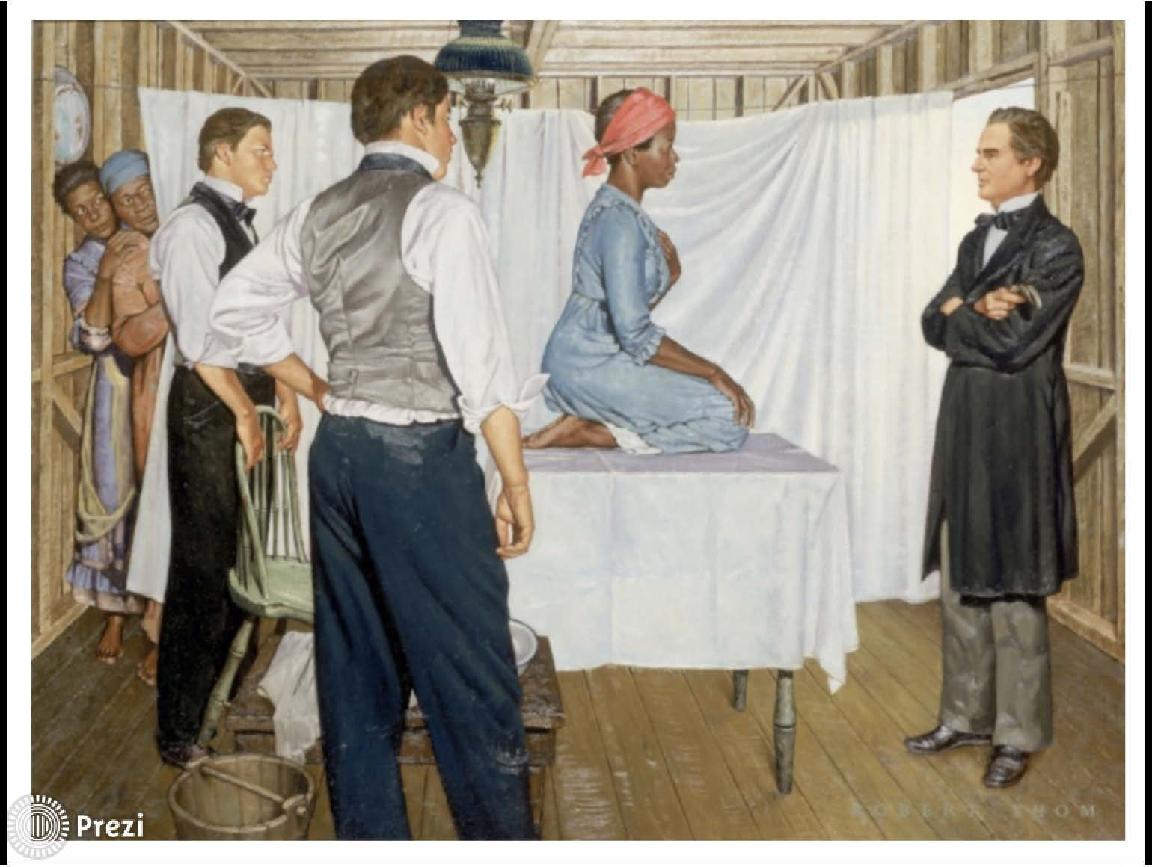
Slave with doctor

Slide 8




Post-Slavery: Jim Crow Era to the Civil Rights Movement (1865-1975)
of the slave owner. (4)
Sterilization and Eugenics
Eugenics programs were based in scientific racism. The thought was that criminality, mental illness and disability are hereditary and more common amongst those who are non-white. African American women would undergo sterilizations without full knowledge that these procedures were not reversible. Thirty states supported formal eugenic programs that enforced compulsory sterilization of women, children, and men considered disabled, mentally ill, and non-white from the early 1900s to the 1970s.
Federal funding supported coerced sterilization. As a result, some African American women were threatened with denial of medical care or termination of welfare benefits if they did not undergo sterilization.(5)

Slide 9
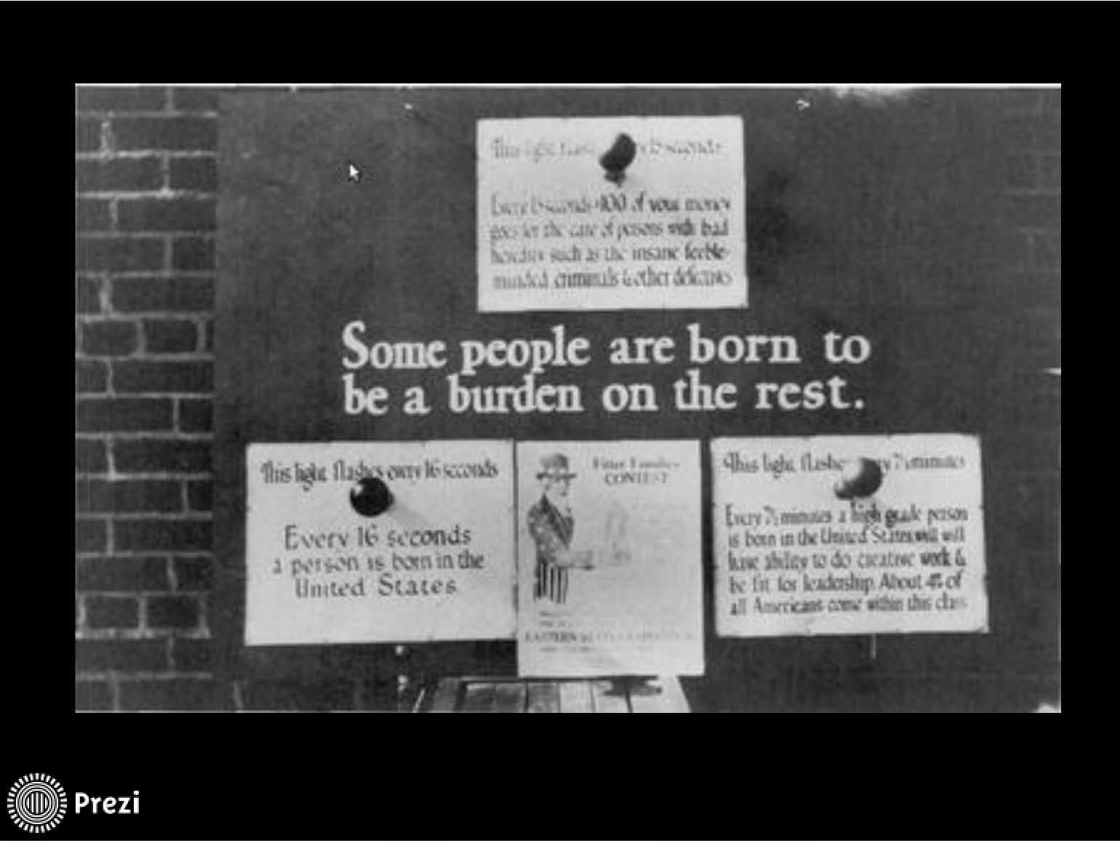
Billboard with signs

Slide 10


Post-Slavery: Jim Crow Era to the Civil Rights Movement - (1865-1975)
Effects of Tuskegee Syphilis Study on Women
In 1932, the U.S. Public Health Service recruited poor and uneducated African American men in Alabama to determine the effect of untreated syphilis. Although treatment became available, the men were misled, denied treatment, and not informed of the study findings until 1972. Study subjects experienced syphilis-related morbidity and mortality. This morbidity and mortality did not stop at the men. As a result of these experiments, their wives acquired syphilis and some of their children suffered complications from congenital syphilis. (6)

Slide 11
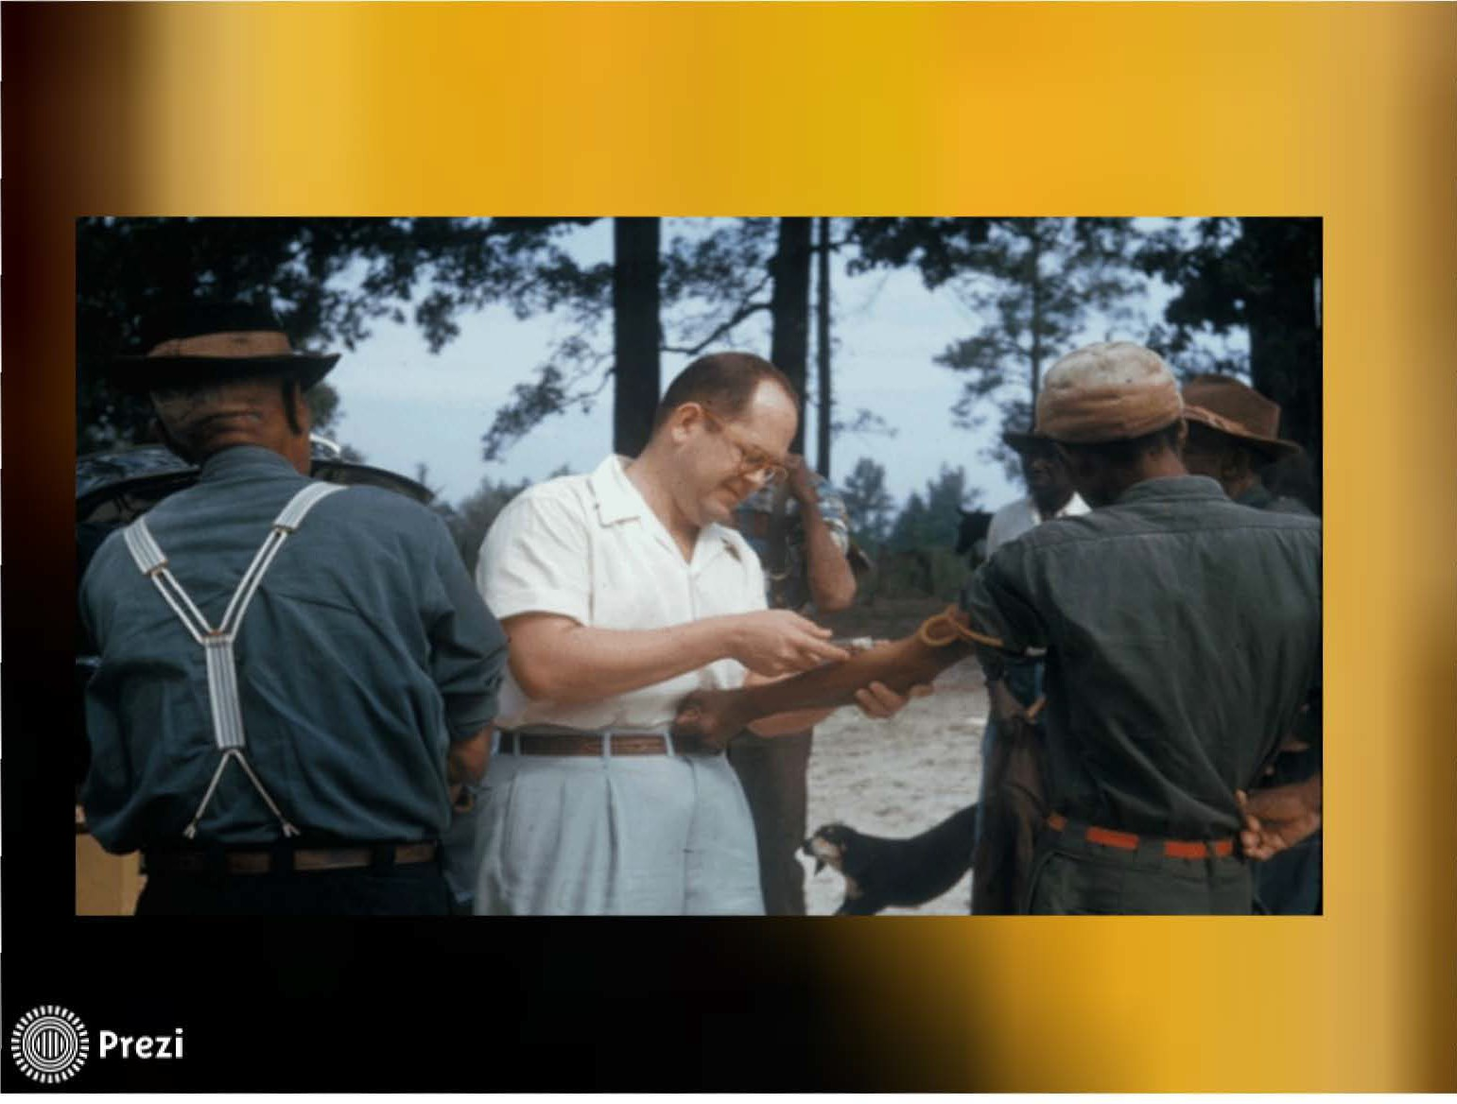
Doctor drawing blood from woman

Slide 12

Post-Civil Rights to today (1975-2019)
Family Planning
African American women report experiences of racial discrimination when seeking family planning services, and are more likely than white women to be advised to restrict childbearing.
Black women of low SES are more likely than white women of low SES to be recommended by their healthcare provider for intrauterine contraception (IUD).
Most private insurance providers cover reproductive health services and abortion care, but Black women are 55% more likely to be uninsured than their white counterparts. Even if a woman relies on Medicaid for health care, most states ban the use of government funds for abortions. (7)

Slide 13




Post Civil Rights to Today (1975-2019)
Perinatal Care African American women have a three to four times higher risk of pregnancy-related death at every age interval compared with
women of other races.
It has also been found that black women were more likely than other women to have longer hospital stays and three times more likely to suffer from surgical complications after interventions such as Caesarean sections(3).
In 2013, CDC reported that the preterm rate for black inf ants was 60% higher than for white infants (17.1% and 10.8% respectively)

Slide 14

MISTRUST
Medical experimentation and inadequate healthcare have fostered the complex relationship African American women have with healthcare systems. These experiences have laid a foundation of mistrust.

Slide 15




Future
There are multiple levels on which reproductive health for black women must be addressed. They include the individual-level, the interpersonal-level, the community-level, and importantly the system-level.
Addressing how history affected Black women on each of these levels might facilitate long-term, sustainable
improvements in reproductive health for this patient
population.

Slide 16




FUTURE
Culturally competent care and research
Public health researchers should be familiar with the histories and lived experience of their African American patients to appropriately design collaborative prevention efforts that acknowledge racism and its health-related impacts among African American women.
It is important to adopt culturally and linguistically appropriate curricula for rising clinicians, such as medical students, and for clinicians who are already practicing. Curricula should consider how this country's history continues to impact reproductive health and the overall well-being of African American women.

Slide 17
Future
Research
African American women should be involved in the design, implementation, and evaluation of all aspects of the research geared towards improving reproductive health for black women. To ensure this, the best approach is modeled by community-based participatory research.
Representation in Healthcare systems
Representation is key.
Therefore, addressing the shortage of African American healthcare professionals and supporting quality education/training that do not ignore history's impact on healthcare as we know it are two key features of advancement.

Slide 18

Reproductive Healthcare Systems through the Eyes of Black Women
Sydnie Turner, University of Rochester School of Medicine and Dentistry

Slide 19
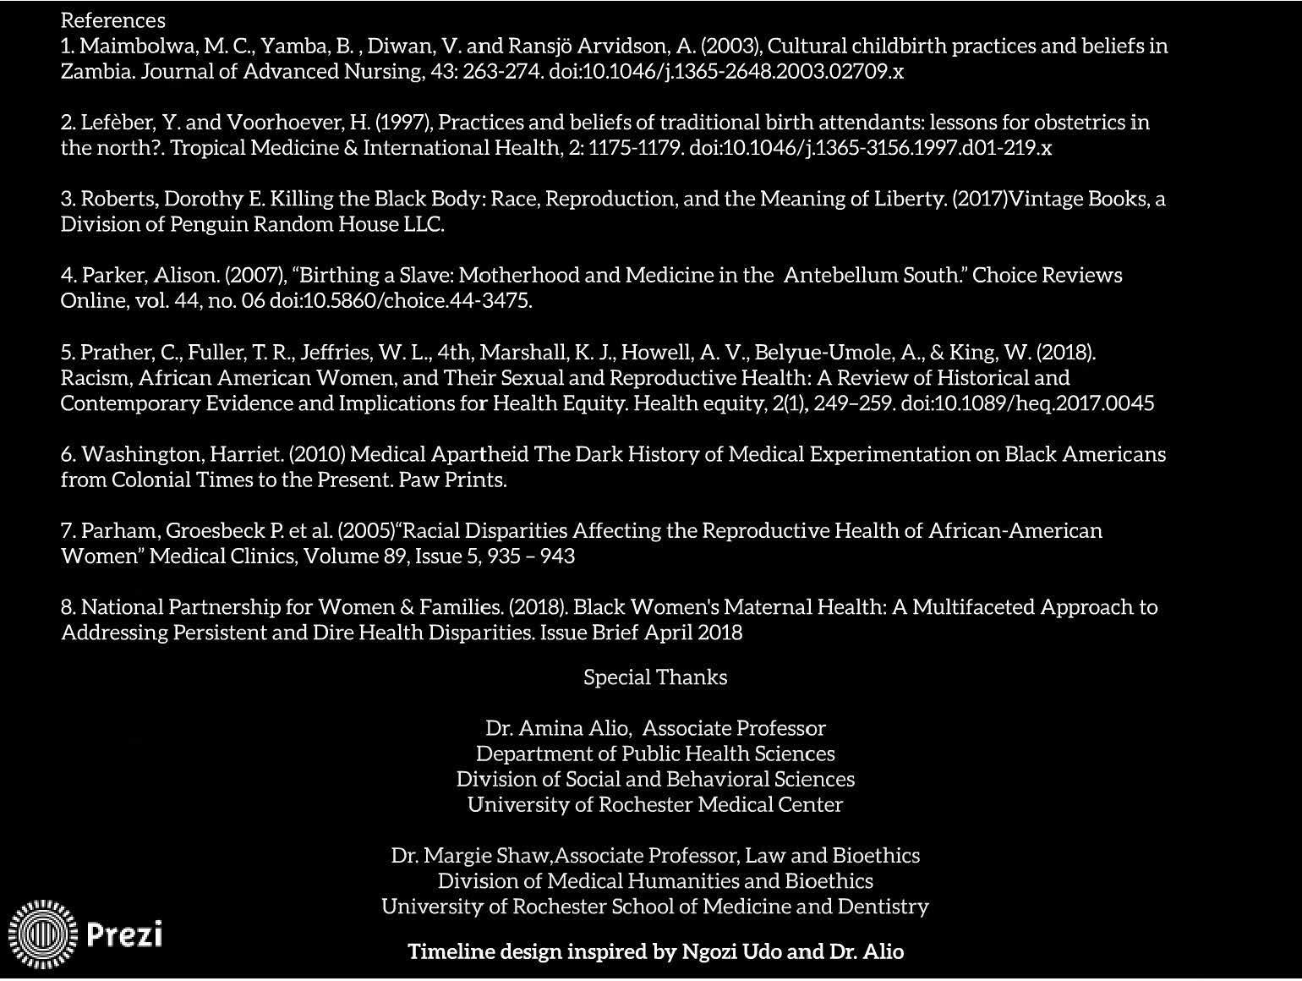
References

