Slide 1




Understanding Treatment Tolerability in Older Patients with
Advanced Cancer
Supriya Mohile, MD, MS
Philip and Marilyn Wehrheim Professor
Co-Director, Cancer Prevention and Control Program, Wilmot Cancer Institute
Director, Geriatric Oncology Research Program
Editor-in-Chief, Journal of Geriatric Oncology
Co-Lead, Cancer and Aging Research Group

Slide 2
Key Considerations
Demographic imperative and gaps in knowledge in geriatric oncology
Using geriatric assessment to improve treatment tolerability in older patients with advanced cancer
Expanding our framework for tolerability
Efforts to improve the evidence base for older adults with cancer

Slide 3
Projected Rise in Cancer Incidence
from 2010 to 2030
67% in patients 65+
Cancer Incidence (million)
11% in patients <65
Year
Smith et al. J Clin Oncol, 2009

Slide 4
Under-representation of Older Adults on
FDA Registration Trials (ASCO 2017)
10-yr perspective
  - 2005-2015
105 FDA registration trials
224,766 patients
Disparity is Greatest for
Patients Age ≥ 75
Singh et al. ASCO Annual Meeting, 2017
Notes:
Disparity in Greatest for Patients Age ≥ 75

Slide 5
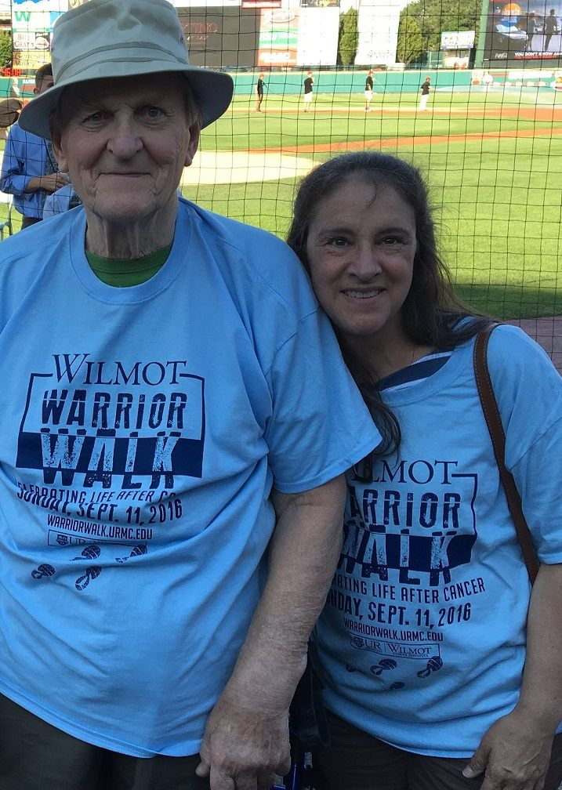
Common Concerns for Older Patients
Needs assistance with daily activities
Multiple comorbid medical conditions
Mild cognitive impairment
Limited social support
Lives alone
Transportation issues
Polypharmacy
Frailty
Likely Did Not Participate in
Registration & Cooperative Group Studies
Notes:
5

Slide 6
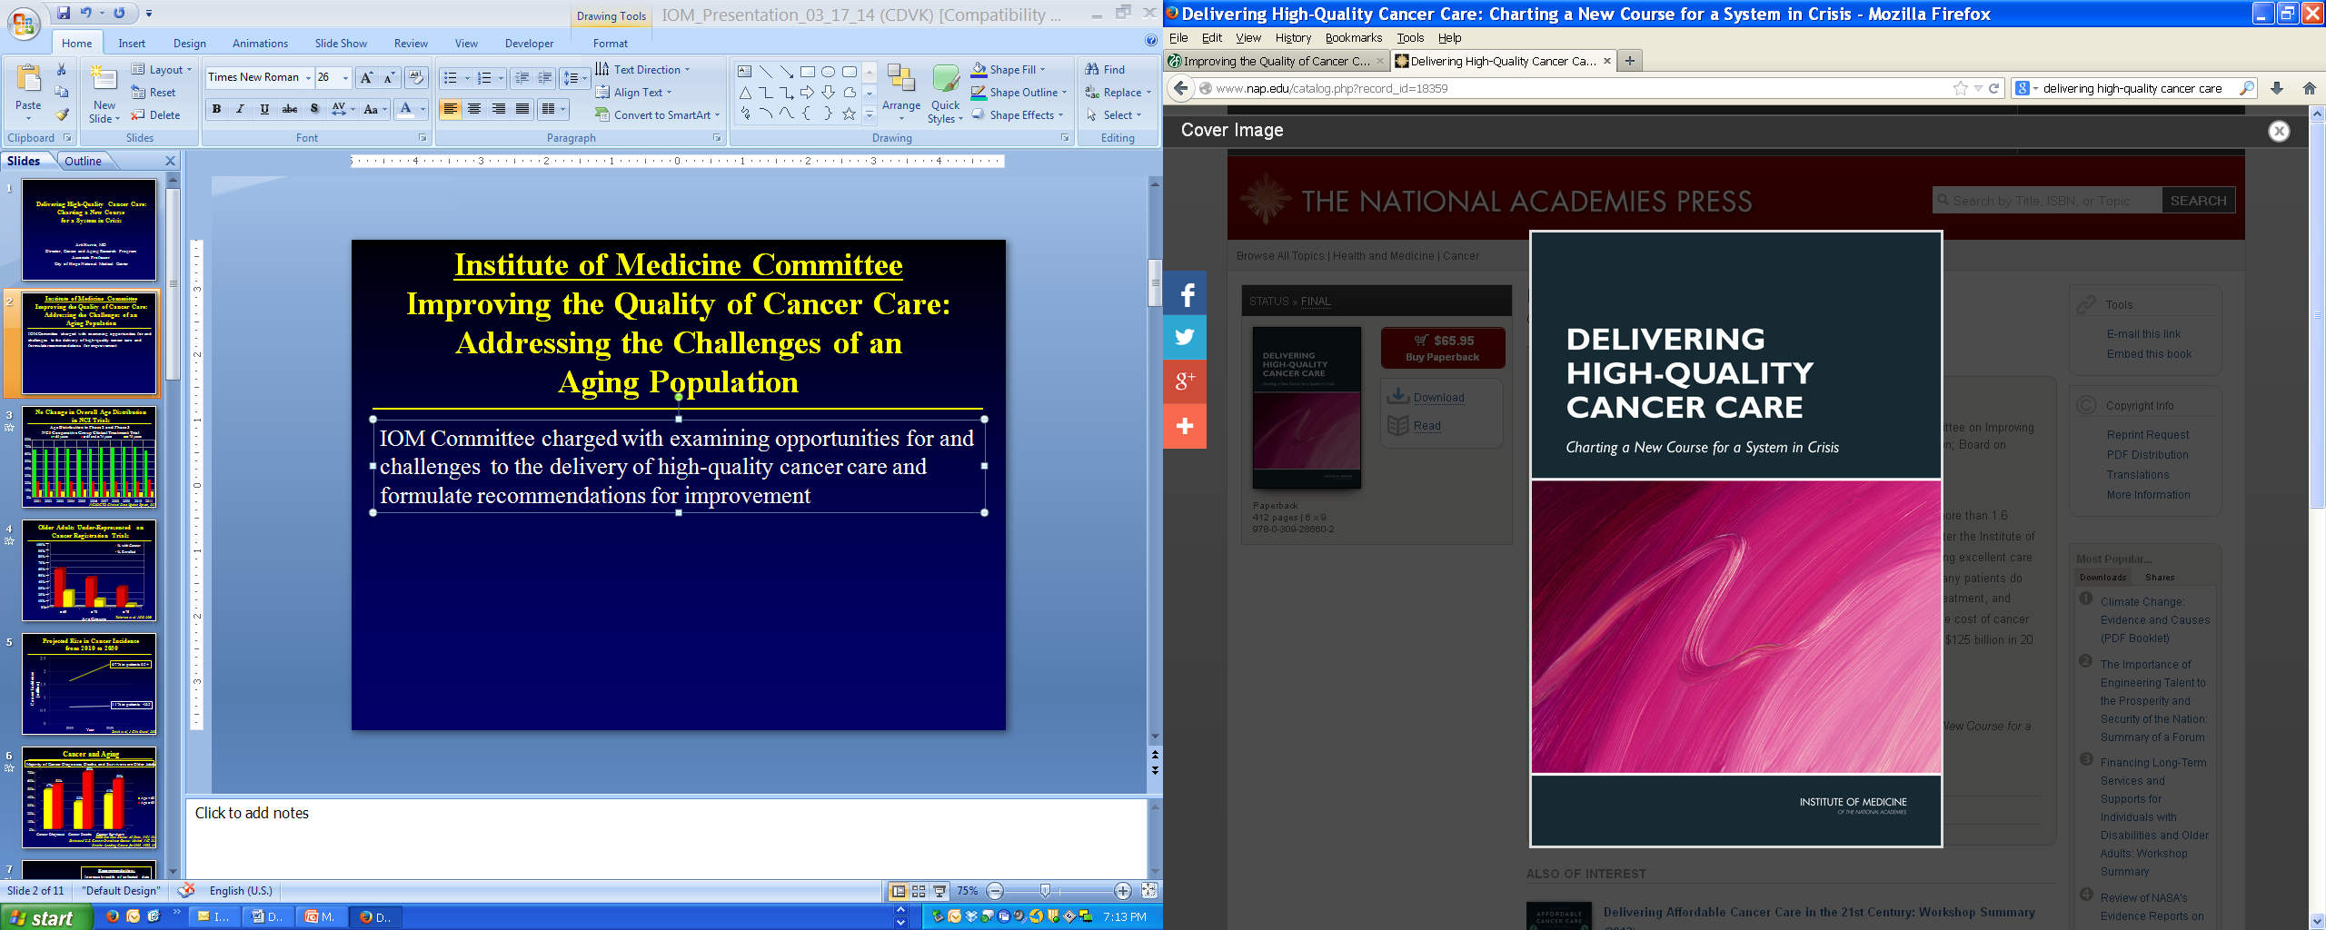
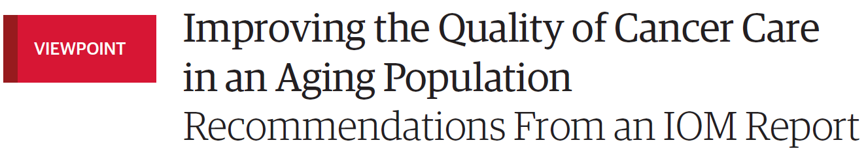
2013 Institute of Medicine Report
Delivering High-Quality Cancer Care:
Charting a New Course for a System in Crisis
Editors: Levit, Balough, Nass, and Ganz
Recommendations:
There is a critical need for research in older adults
with cancer
Potential Solutions:
Increase FDA’s authority to incentivize & require
research on older adults
Considerations regarding:
  Research design & infrastructure
  Recruitment of older adults
  Reporting of results
Hurria et al. JAMA 2013
IOM, 2013
Notes:
IOM Report Title: “Delivering High-Quality Cancer Care: Charting a New Course for a System in Crisis”
“This report is the result of the thoughtful deliberations of our study committee…”

Slide 7

Geriatric Assessment
Geriatric assessment (GA) is an approach to the evaluation of the older patient, leading to the early identification and treatment of areas of vulnerability.
The GA evaluates the following domains:
  Functional status
  Objective physical performance
  Comorbid medical conditions
  Cognition
  Nutritional status
  Psychological status
  Social support
Each domain is an independent predictor of morbidity and mortality in older patients with cancer
Mohile, Dale, Hurria and Panel. ASCO Guidelines in Geriatric Oncology. JCO, 2018

Slide 8
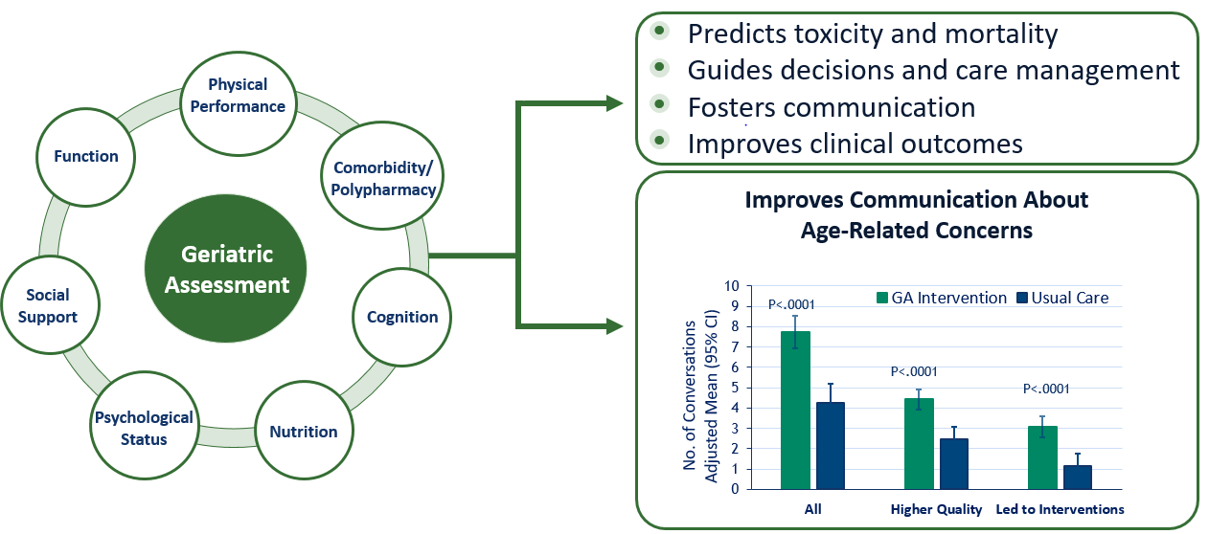
Geriatric Assessment Guides Clinical Care
Mohile et al. JCO, 2018; Mohile et al. JAMA Onc, 2019

Slide 9
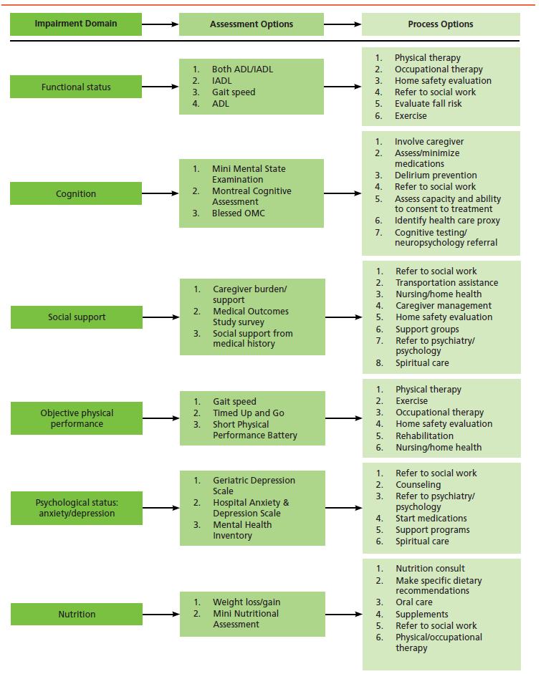
Mohile et al. JNCCN, 2015

Slide 10
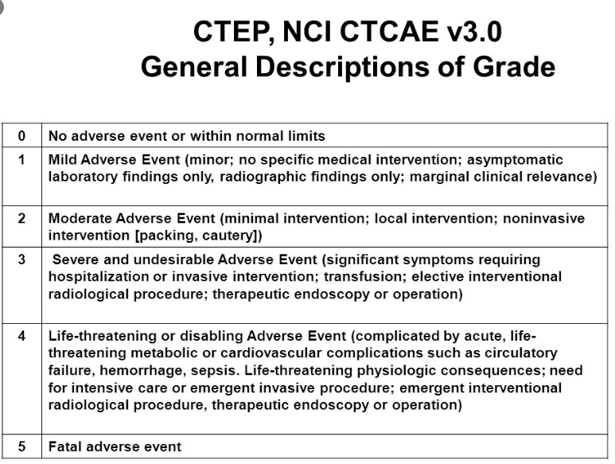
Goal of our R01-funded NCORP Study
URCC 13059; GAP 70+
  Primary Aim:
    To evaluate if providing a GA summary with recommendations for management to oncologists reduces grade 3-5 toxicity (CTCAE) in patients aged 70+ starting a new regimen with chemotherapy and/or other agents which cause toxicity for advanced cancer
  Secondary Aims:
    Survival at 6 months
    Treatment decisions
    Functional and Physical Performance
Mohile et al. ASCO, 2020; Lancet 2021

Slide 11
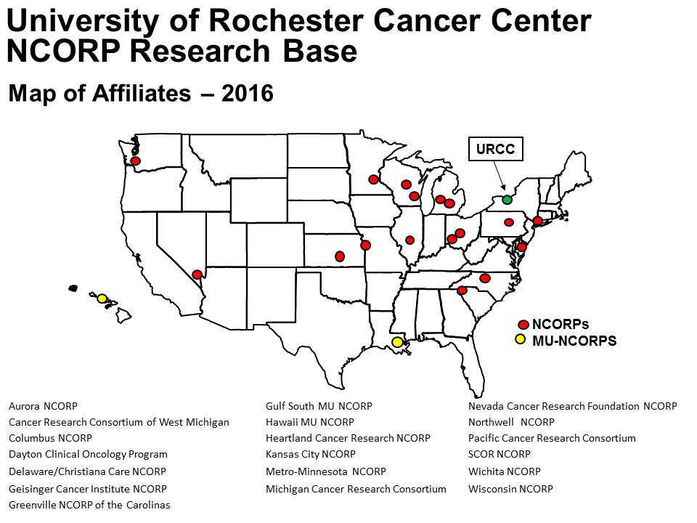

University of Rochester NCORP
Research Base

Slide 12
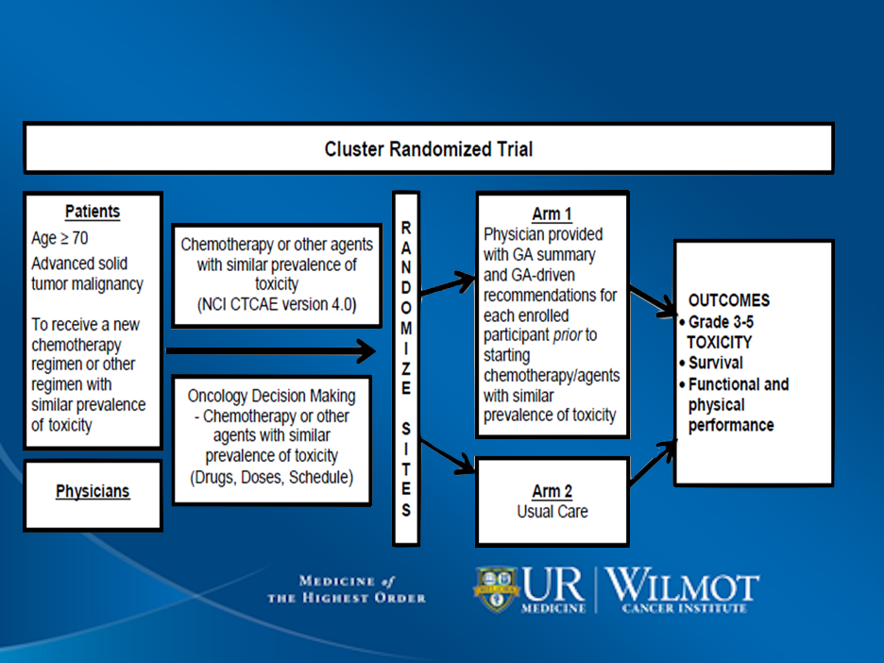
URCC 13059 Schema

Slide 13
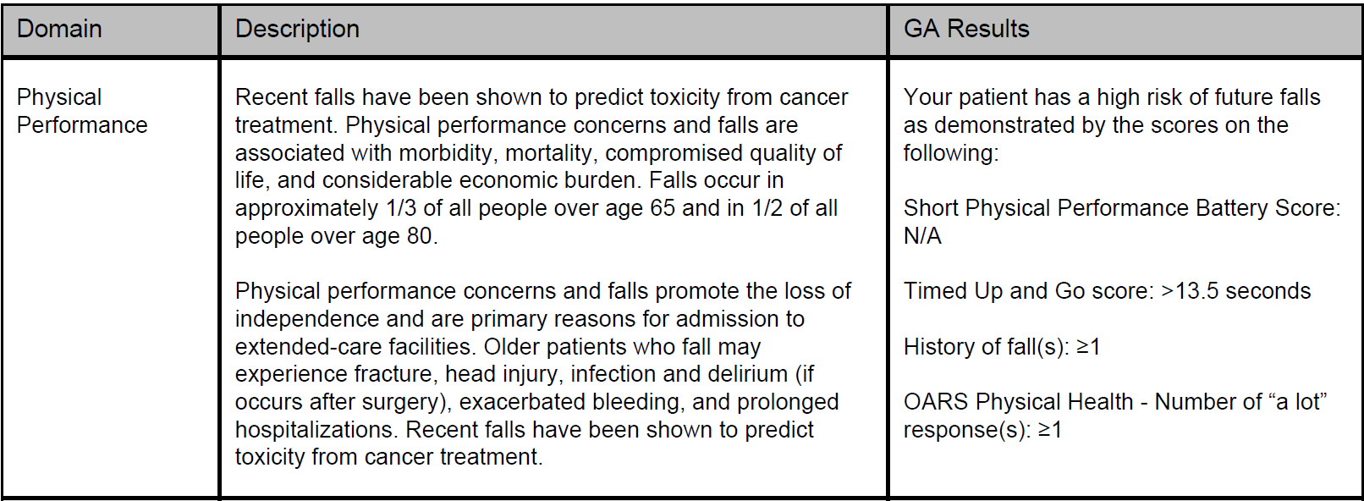
Geriatric Assessment Summary

Slide 14
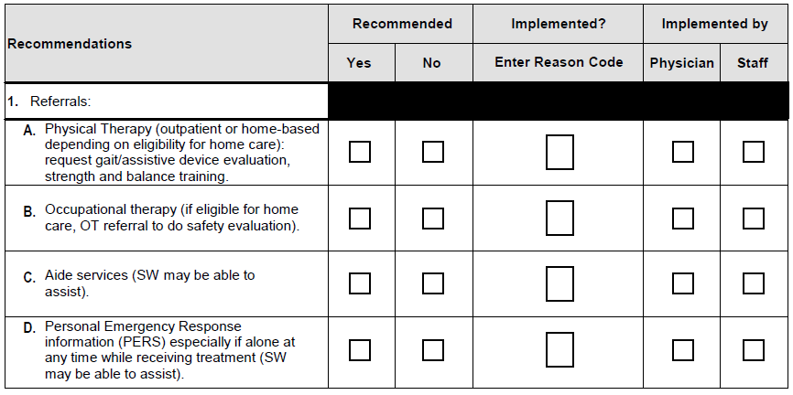
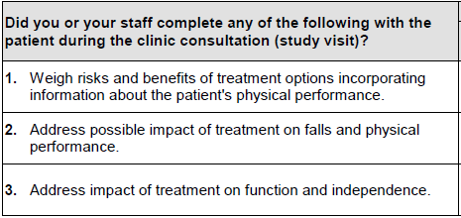
Geriatric Assessment-Guided Recommendations for Management

Slide 15
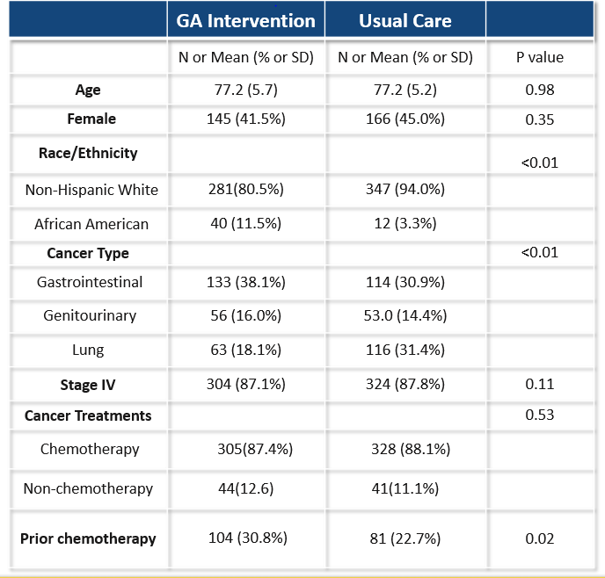
Patient Eligibility and Characteristics
Age ≥70 years
Diagnosis of advanced solid tumor or lymphoma
Have ≥1 GA Domain Impairment (other than polypharmacy)
Starting a new chemotherapy regimen or another regimen with high risk of toxicity
Have decision-making capacity, or, if not, oncologist has obtained consent from health-care proxy
Mohile et al. ASCO, 2020

Slide 16
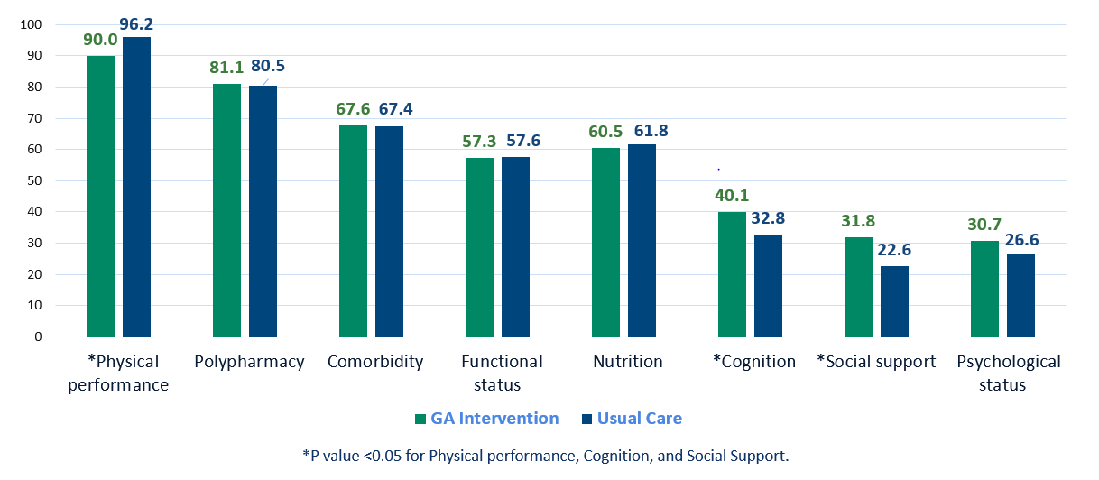
GA Domains for Arm (n=718)

Slide 17
Prevalence of Adverse Outcomes (n=718)
Adverse Outcome | Prevalence
Grade 3-5 toxicity within 3 months | 60.9%
Dose modification within 3 months | 50.0%
Discontinuation of treatment within 3 months | 17.7%
Entered into Hospice within 3 months | 15.9%
Death (due to all causes) within 6 months | 26.5%

Slide 18
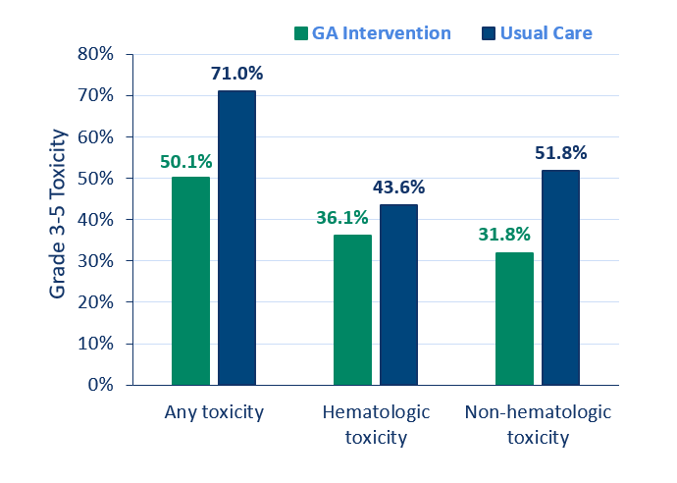
Any Grade 3-5 CTCAE Toxicity in 3 Months
Any Grade 3-5 Toxicity
Adjusted Risk Ratio: 0.74
95% CI: (0.63-0.87), P < 0.01
Clustering effect: P = 0.15
Any Grade 3-5 Hematologic Toxicity
Adjusted Risk Ratio: 0.85
95%CI: (0.69-1.05), P = 0.13
Clustering effect: P = 0.30
Any Grade 3-5 Non-hematologic Toxicity
Adjusted Risk Ratio: 0.73
95% CI: (0.53-0.996), P = 0.047
Clustering effect: P < 0.01
Mohile et al. ASCO, 2020; Lancet 2021

Slide 19
Conclusions from URCC 13059
A GA summary with management recommendations provided to the oncologist prior to the start of a new treatment regimen
  reduces clinician-rated grade 3-5 toxicity over 3 months
  without significantly lowering survival at 6 months
This large cluster randomized study is the first show to that a GA intervention for patients aged 70+ with advanced cancer and >1 GA domain impairment improves clinical outcomes
Mechanism?

Slide 20
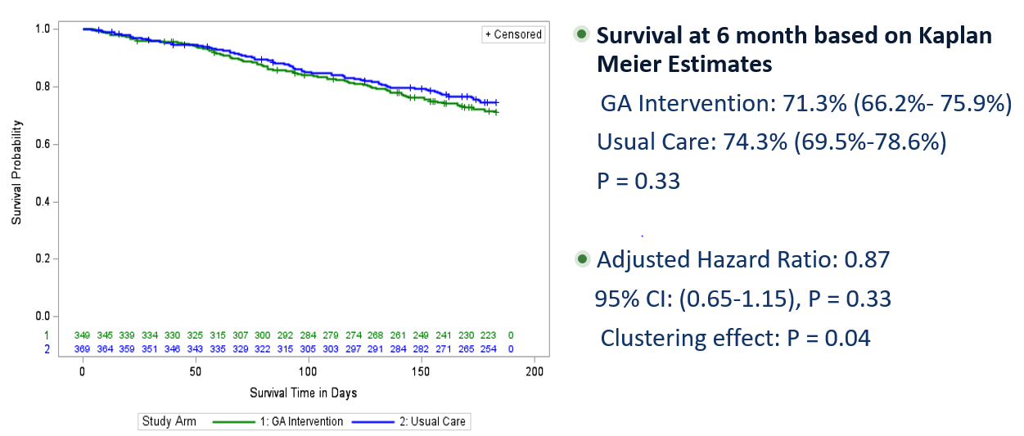
Survival
Mohile et al. ASCO, 2020; Lancet 2021

Slide 21
Relative Dose Intensity (RDI)
Definition: The amount of drug(s) administered per unit time expressed as a percentage of the planned dose or standard regimen¹⁻³
Clinical tolerability measures such as dose reductions and dose delays can lead to reduced RDI
Previous data have shown an association between reduced RDI and worse outcomes in terms of disease-free survival and overall survival ⁴⁻⁵
Very little is known about RDI in older patients with advanced cancer
¹ Hryniuk, et al: J Clin Oncol. 1984; 2(11): 1281-88
² Hryniuk, et al: Semin Oncol. 1987;14(1): 65-74
³ Lyman GH: J Natl Compr Canc Netw. 2009;7(1): 99-108
⁴ Wildiers, et al: Crit Review Oncol Hematol. 2011; 77(3): 221-40
⁵ Denduluri et al: Clinical breast Cancer. 2018; 18 (5): 380-386

Slide 22
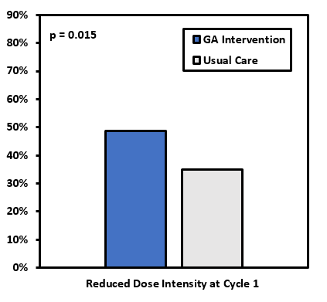
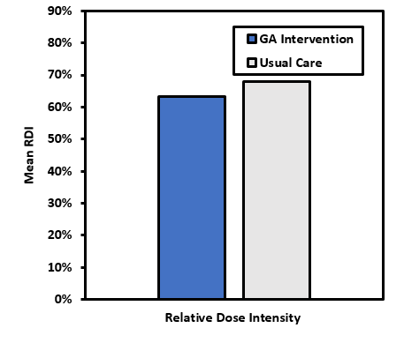
Treatment Intensity
Mohile et al. ASCO, 2020; Lancet 2021

Slide 23
GA Intervention Improves Falls over 3 months
All Events: 103/627=16.4% GA Arm: 35/298=11.7% Control Arm: 68/329=20.7% | Risk Ratio | 95% CI | P-value | P-value for cluster effect. Do results differ by site?
Unadjusted | 0.58 | (0.40-0.84) | 0.004 | N/A
Clustered Standard error | 0.58 | (0.45 - 0.75) | P<0.001 | N/A
Bootstrap Standard error | 0.58 | (0.40 - 0.84) | 0.004 | N/A

Slide 24
Analyzing and Interpreting Clinician and Patient Adverse Event Data to Better Understand Tolerability (U01)
Beau Biden Cancer Moonshot Initiative
The purpose is to stimulate the development of methods for better understanding tolerability by analyzing the clinical trials adverse event data through:
  Common Terminology Criteria for Adverse Events (CTCAE)
  Patient-Reported Outcomes version of the CTCAE (PRO-CTCAE™)
  other clinically relevant data
    e.g., co-morbidities, concurrent medications, other patient-reported outcomes (PROs)

Slide 25
Tolerability
“The tolerability of a medical product is the degree to which symptomatic and non-symptom­atic adverse events associated with the product’s administration affect the ability or desire of the patient to adhere to the dose or intensity of therapy. A complete understanding of tolera­bility should include direct measurement from the patient on how they are feeling and func­tioning while on treatment.” Friends of Cancer Research
Context:
  Treatment is from community-based oncologists with patients receiving “standard of care” for diagnosis
  Older adults with advanced incurable cancer

Slide 26
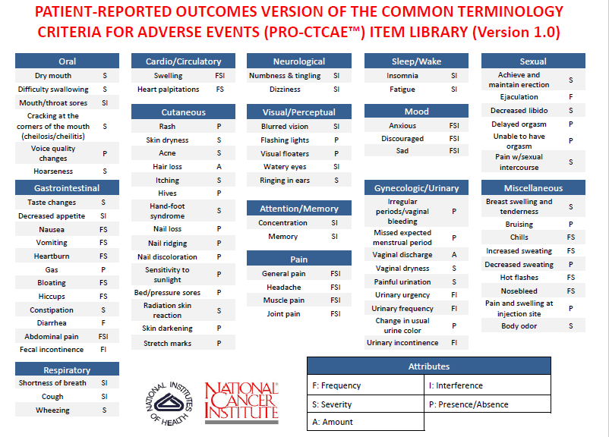
PRO-CTCAE: Patient-Reported Outcome version of the Common Terminology Criteria for Adverse Events
Complementary to clinician rated toxicities measured by CTCAE.
Developed to evaluate symptomatic toxicity in cancer clinical trials as reported by patients.
Capture patient experience during cancer treatment.
https://healthcaredelivery.cancer.gov/pro-ctcae/
Basch et al. JNCI, 2014; Dueck et al. JAMA Onc, 2015

Slide 27
Measures: PRO-CTCAE items
GAP 70+ Study
27 PRO-CTCAE library items:
frequency 8/27
severity 24/27
interference 16/27
PRO-CTCAE data were collected at baseline, 4-6 weeks, 3 months, 6 months
Set of Core Symptoms*
Fatigue^{G}
Insomnia^{G}
Pain^{G}
Anorexia (appetite loss) ^{G}
Dyspnea^{G}
Cognitive problems^{G}
Nausea^{G}
Sensory Neuropathy^{G}
Constipation^{G}
Diarrhea^{G}
Anxiety (includes worry)
Depression (includes sadness)
*The National Cancer Institute's Symptom Management and Health-Related Quality of Life Steering Committee (Reeve) J Natl Cancer Inst 106, 2014. ^{G}in GAP 70+ dataset

Slide 28
Proposed Operational Model of Tolerability
Tolerability
Aim 4
Clinical Tolerability Metrics
Dose Modification ( Dose Delays, Changes, Relative Dose Intensity)
Treatment discontinuation
Hospitalizations
Mortality
Patient Reported Outcome Endpoints
Functional Decline ( ADLs, IADLs, SPPB)
Quality of Life ( FACT-G)
Satisfaction with treatment
(Satisfaction, Decision Regret)
Aim 2
Aim 3
CTCAE
PRO-CTCAE
Aim 1
GA characteristics(including comorbidity), demographics (including race/ethnicity), cancer types, and treatment types.

Slide 29
Leadership Structure and Responsibilities
Principal Investigator
Luke Peppone, PhD
Lead, Clinical Trial Team
Goals of team: To facilitate the translation of U01 consortium findings into endpoints and interventions for trials and to ensure results are generalizable.
Eva Culakova, PhD, MS
Lead, Biostatistics & Data Science Team
Goals of team: To utilize classical and novel statistical and data science methods to analyze and interpret data from GAP (URCC 13059) to understand how PRO_CTCAE informs tolerability of cancer treatment in older adults with age-related conditions.
Marie Flannery, PhD, RN
Lead, Patient Reported Outcome Measurement Team
Goals of team: To provide directions on measurement issues including how patient reported outcomes (i.e., PRO_CTCAE, GA, endpoints) should be incorporated into analyses
Team Members
Gary Morrow, MS, PhD
Michelle Janelsins, PhD
(Cognition, Cancer Control Trials)
Charles Kamen, PhD
(Health Disparities)
Team Members
Erika Ramsdale, MD
(Geriatric Oncology, Informatics)
Martin Zand, MD, PhD
(Data Science)
Team Members
Beverly Canin
(Patient Stakeholder)
William Dale, MD, PhD
(Decision-making, Satisfaction)
Paul Duberstein, PhD
Ben Chapman, PhD, MPH, MS
(PRO methodology, IRT)

Slide 30
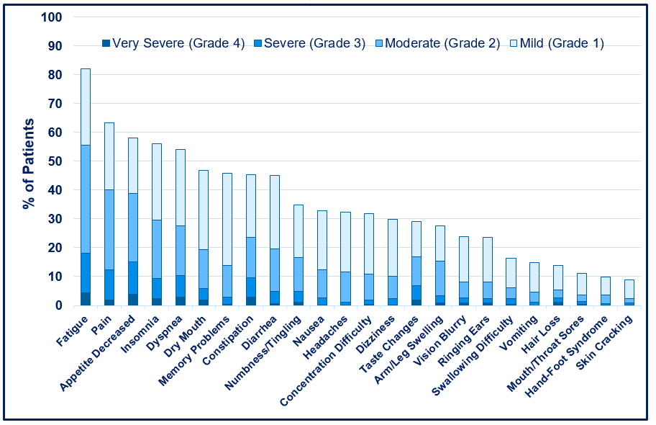
Severity of Symptoms at Baseline
Flannery et al. Submitted.

Slide 31
PRO-CTCAE: Baseline Symptom Prevalence vs. Cumulative Prevalence

Slide 32
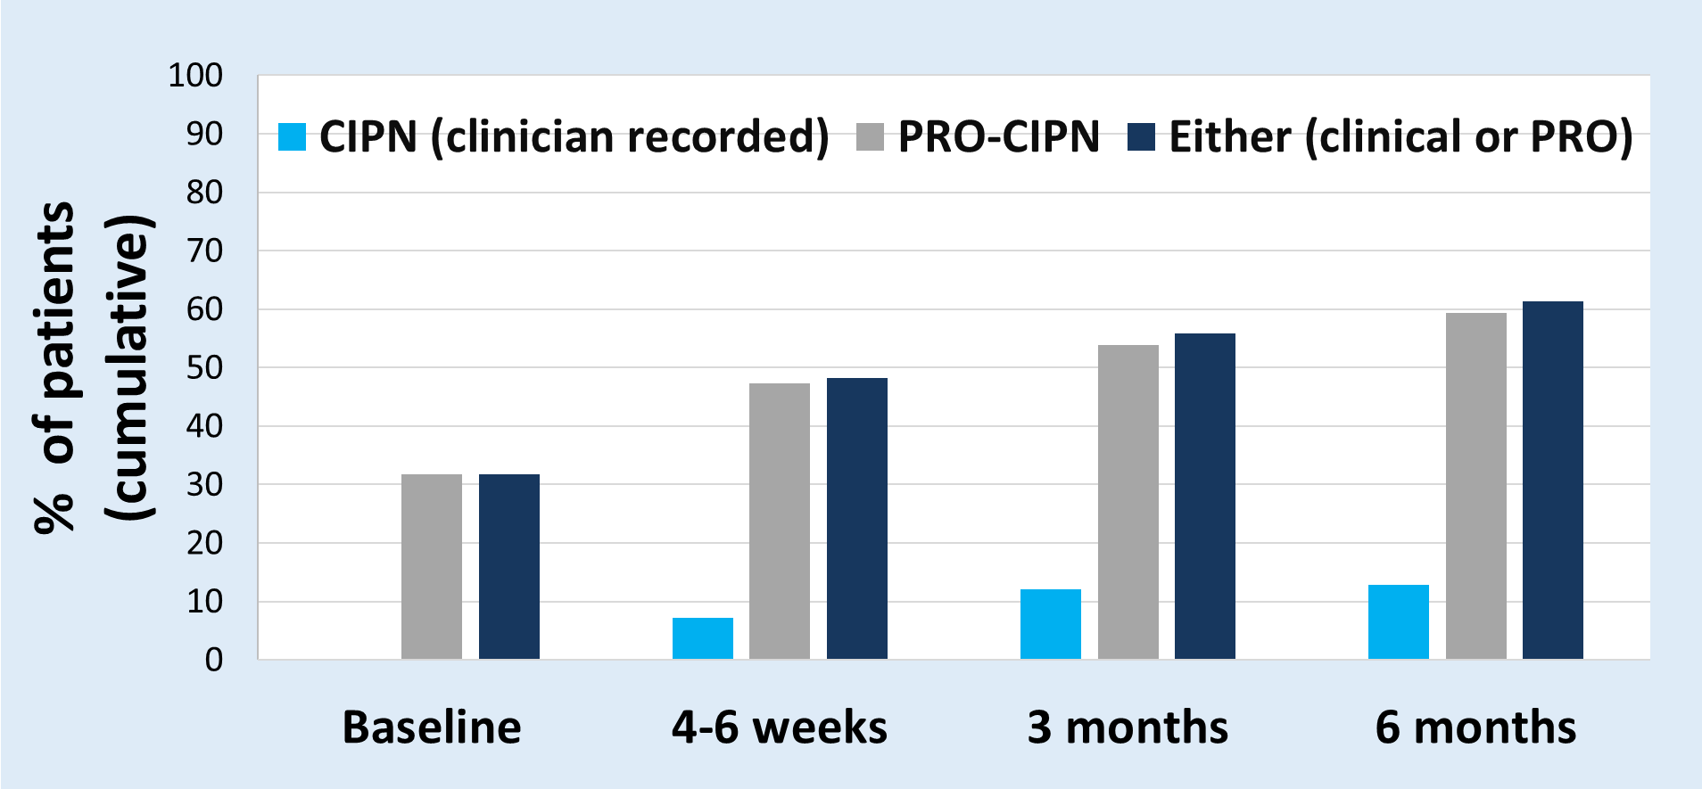
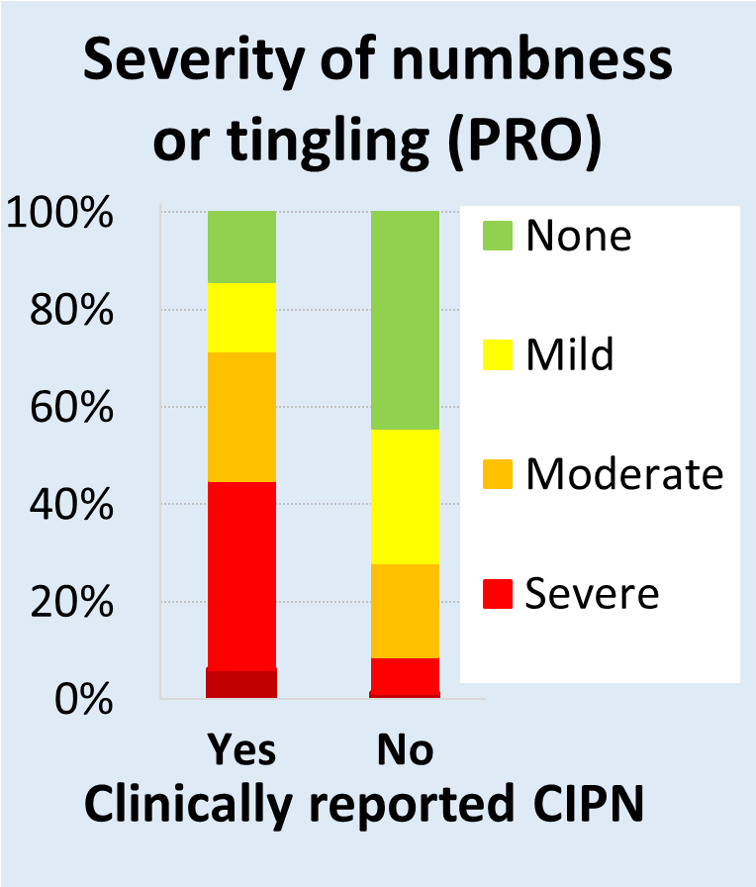

Trajectory of Numbness/Tingling (PRO-CTCAE)
Versus Neuropathy (CR-CTCAE)
Culakova et al. SIOG, 2019

Slide 33
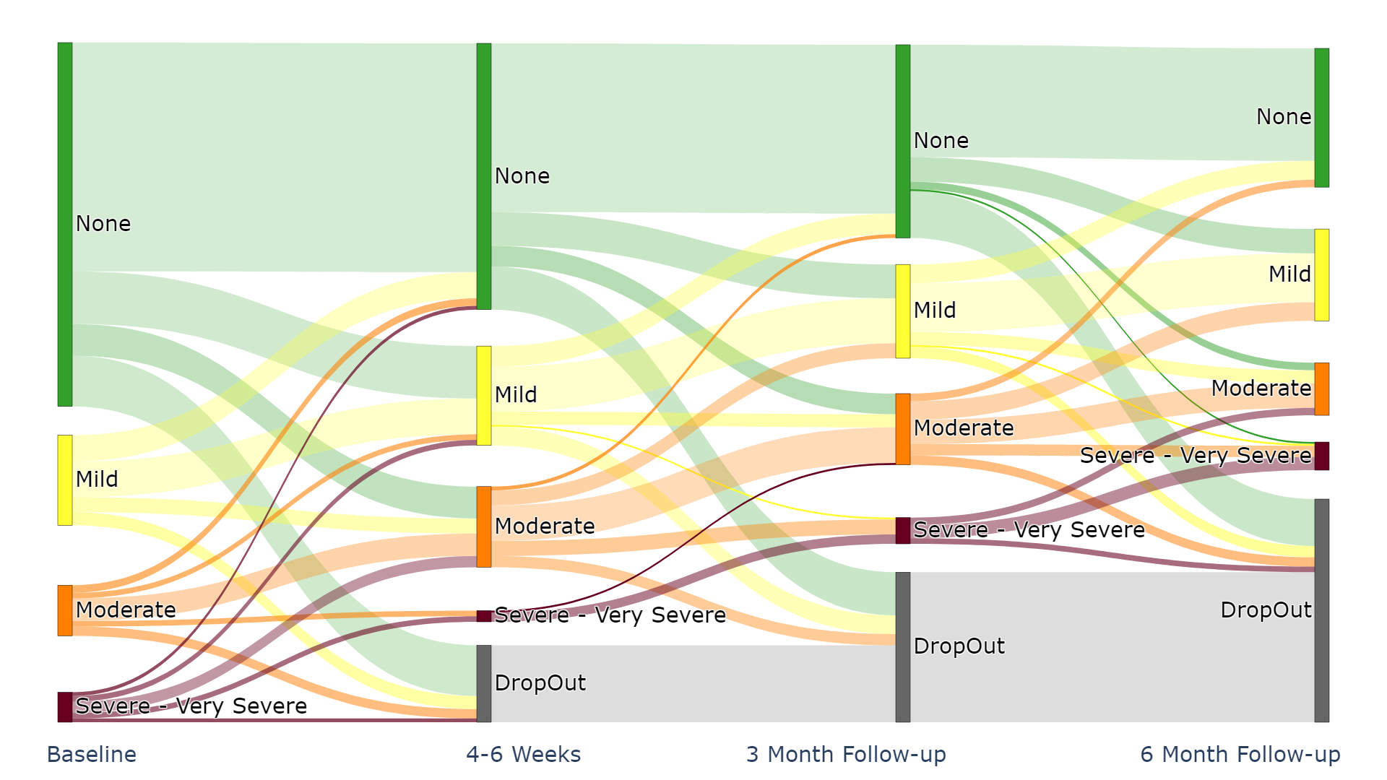
PRO-CTCAE: Severity of numbness or tingling in hands or feet at its worst over time
* Thickness of each pad (line) represents number of patients
Work by Flannery, Culakova and team; presented to U01 consortium

Slide 34
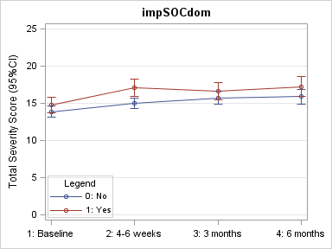
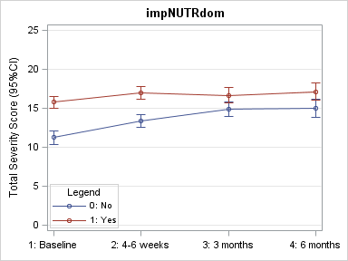
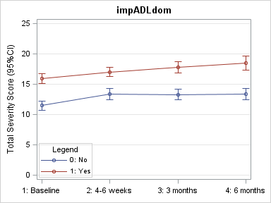
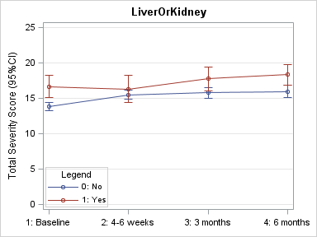
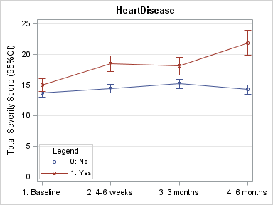
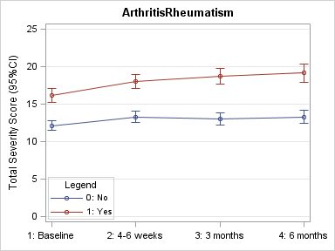
Association of GA and Comorbidities with
Total PRO-CTCAE Severity Score
GA Domain Impairments
Impaired Social Domain
Impaired Nutrition
Impaired Function
Total Severity (mean, SE)
Total Severity (mean, SE)
Total Severity (mean, SE)
Liver or Kidney Disease
Heart Disease
Arthritis or Rheumatism
Total Severity (mean, SE)
Total Severity (mean, SE)
Total Severity (mean, SE)
Comorbidities
Work by Culakova and team; presented to U01 consortium

Slide 35
Clustering based on baseline PRO-CTCAE severity in relation to trajectory of function
Clustering by Baseline Severity
Patients
1
2
3
4
PRO-CTCAE Severity
@baseline
Work by Culakova and team; presented to U01 consortium

Slide 36
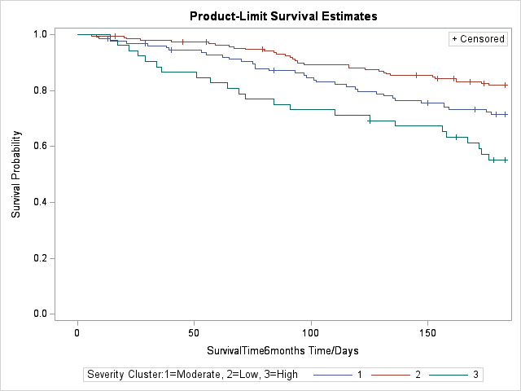
Longitudinal Outcomes by Symptom Clusters
Survival in 6m by cluster
P=0.004, 0.054, <0.001, respectively
Xu et al. ASCO Qual Care, 2020.

Slide 37
Learning from each other: U01 Tolerability Consortium
How can we operationalize PRO-CTCAE in analyses?
  PIs: Basch/Dueck
  Basch E, Rogak LJ, Dueck AC: Methods for Implementing and Reporting Patient-reported Outcome (PRO) Measures of Symptomatic Adverse Events in Cancer Clinical Trials. Clin Ther, 2016.
  Thanarajasingam G et al. Longitudinal adverse event assessment in oncology clinical trials: the Toxicity over Time (ToxT) analysis of Alliance trials NCCTG N9741 and 979254. Lancet Oncol, 2016.
How can advanced statistical methods help us to evaluate toxicities/adverse events?
  PIs: Rogatko/Ganz
  Gresham et al., Evaluating Treatment Tolerability in Cancer Treatment Trials using the Toxicity Index. JNCI, 2020.
How are toxicities/adverse events related to other PROs to help us understand the patient experience?
  PIs: Gray/Wagner
  Wagner LI, Zhao F, Goss PE, et al. Patient-reported predictors of early treatment
discontinuation…. Breast Cancer Res Treat, 2018.

Slide 38
Results: Grade ≥ 2 Symptomatic Toxicities
Moderate, Severe, Very Severe
Adjusted Risk Ratio=0.91
95% CI: (0.83-1.00)
P=0.05
Adjusted Risk Ratio=0.88
95% CI: (0.81-0.95)
P<0.01
All 24 symptoms
11 core symptoms
*Basch E, Rogak LJ, Dueck AC: Methods for Implementing and Reporting Patient-reported Outcome (PRO) Measures of Symptomatic Adverse Events in Cancer Clinical Trials. Clin Ther 38:821-30, 2016.
**Reeve B, Mitchell S, Dueck AC: Recommended patient-reported core set of symptoms to measure in adult cancer treatment trials. J Natl Cancer Inst 106, 2014.
Culakova et al. ASCO Qual Care, 2020.

Slide 39
Definitions and Background
Established Scales designed to capture unmeasured PRO constructs
Decision Regret
“Distress or remorse after a [health care] decision."
(Brehaut, 2003)
Satisfaction with Cancer Therapy
“Satisfaction is a psychological process which involves comparison of perceived performance of a treatment relative to expectations…… discontinuation or future use depends on this.” (Abetz, 2005)
GP5
“I am bothered by side effects of treatment.”(FACT-G)

Slide 40
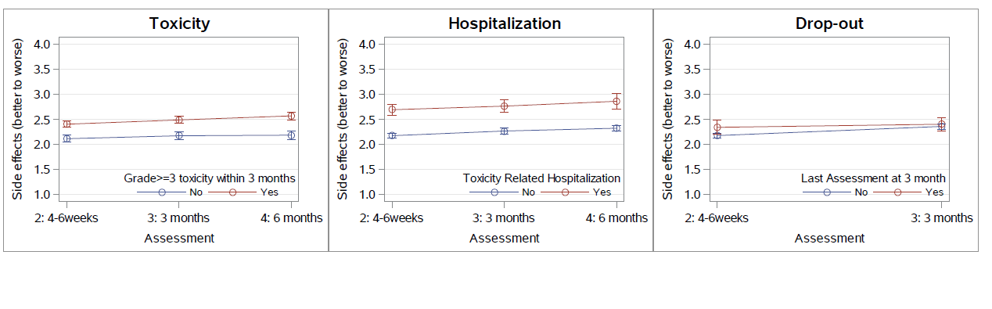
Were the Side Effects of Cancer Therapy as You Expected (from much better to much worse)?
P<0.01
P<0.01
P=0.77

Slide 41
Satisfaction With Cancer Therapy
P=0.01
P<0.01
P=0.05

Slide 42
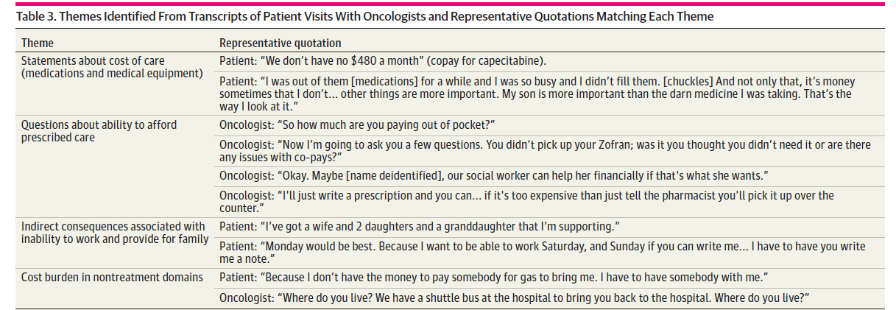
Social Determinants of Health:
Financial Toxicity in Older Patients with Advanced Cancer
Arastu, Patel, et al. JAMA Network Open, 2020

Slide 43
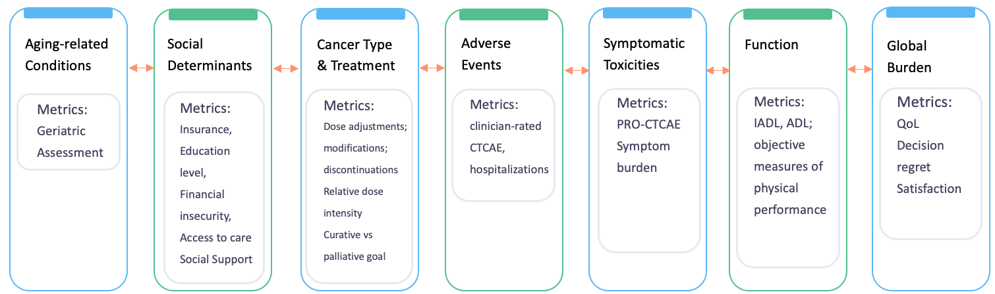
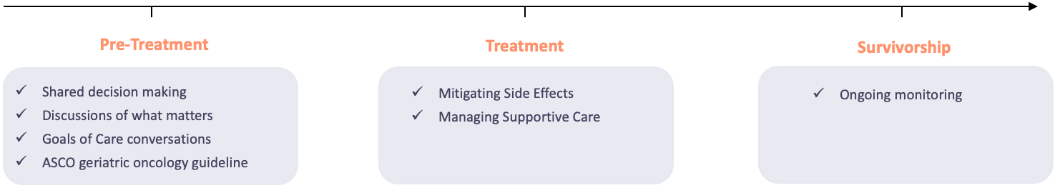
Understanding Treatment Tolerability In Older Patients with Advanced Cancer
Flannery et al. Submitted.

Slide 44
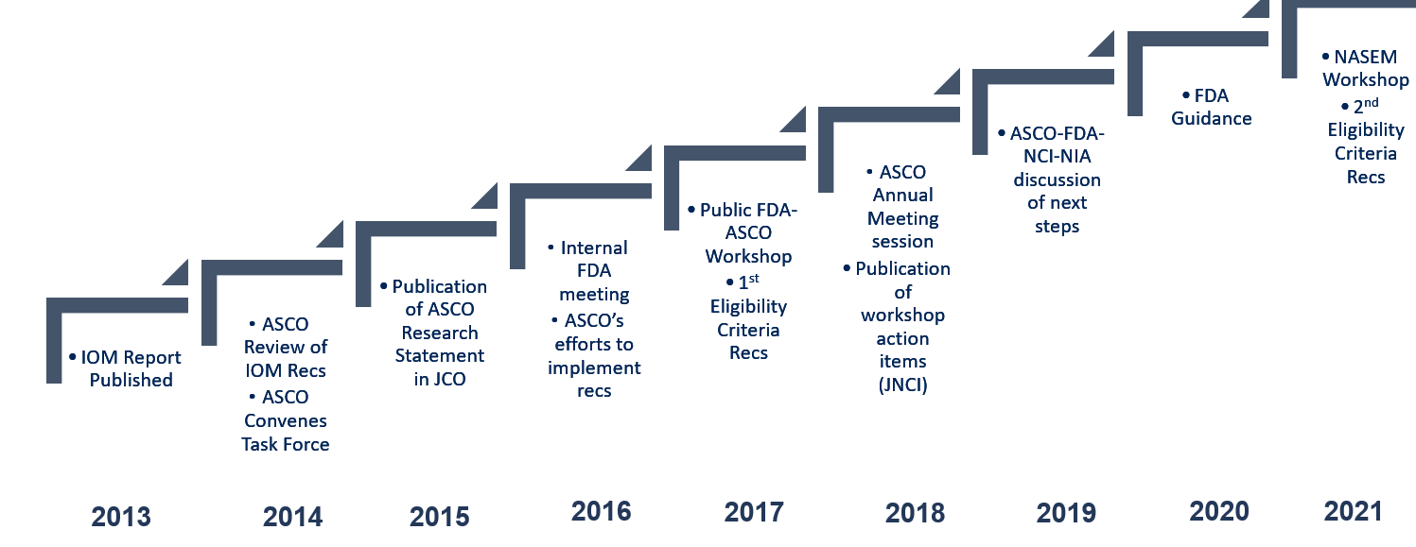
Improving Evidence-base of Older Patients with Cancer
NASEM 2021 presented by Dr. Heidi Klepin

Slide 45
Cancer and Aging Research Group
NIA R33; MPIs: Drs. William Dale, Supriya Mohile, Heidi Klepin
Build the support network:
Bring together mentors
Bring together peers
Present, discuss, and develop research ideas
Collaborate
Goals:
Mentor junior geriatric oncology investigators and promote academic productivity
Design intervention studies
Improve accrual of older adults to clinical trials
Slide c/o Arti Hurria and team Hurria, JCO; 2008

Slide 46

Restructuring cancer clinical trials so that the translational power of personalized oncologic medicine is inclusive of older and frail adults with cancer
Design trials specific to older adults
Modify trial design to collect more data on older adults
Leverage population cohort studies
Establish post-marketing surveillance studies
Embed biological or functional age evaluation in trials
Conduct concurrent differential dosing trials
Measure relevant endpoint
Broaden (further) eligibility criteria
Advance regulatory and policy efforts
Evaluate and address site/stakeholder-specific barriers
Engage referring providers in the clinical trial process
Design pragmatic clinical trials
Leverage real-world data
Multi-System Problems Need Multi-System Solutions
by Multi-Stakeholder Partnership
Sedrak et al, CA A Cancer Journal for Clinicians 2020

Slide 47
Engaging Older Adults in Cancer Clinical Trials Conducted in the NCI Clinical Trials Network: Challenges and Opportunities
A Cancer MoonshotSM Workshop
Diane St. Germain
Supriya Mohile
September 14, 2020

Slide 48

“Historically, research left out people who were older and more experienced, which doesn’t make much sense. We’re changing that. Older people have much to teach us.”
— Arti Hurria, MD, FASCO

Slide 49


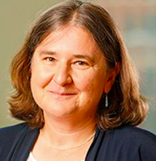








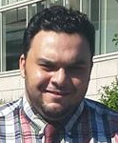

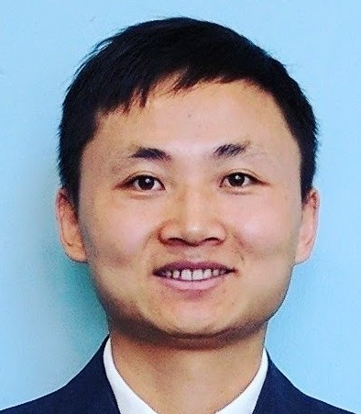


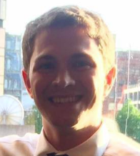





Wilmot Cancer Institute
Geriatric Oncology Research Group
@Rochgerionc

